Slide 1
Telehealth, Telemedicine & Virtual Health
Bob Marshall, Program Director
DoD/MAMC Clinical Informatics Fellowship

Slide 2
Learning Objectives
Define Telehealth and Telemedicine
Explain the difference between the two
Review the benefits of Telemedicine/Telehealth
Review the types of services provided as well as the delivery methods
Review the shortcomings of Telemedicine/Telehealth
Discuss the barriers to Telemedicine/Telehealth

Slide 3
Definition of Telehealth
While there’s no common definition of telehealth (and its many synonyms), the term itself can evoke a limited view of what telehealth does.
What was, until recently, referred to as telemedicine now encompasses a much broader array of services and technologies – AI, virtual reality and behavioral economics are a few examples that come to mind – that are transforming the way health and care are delivered.

Slide 4
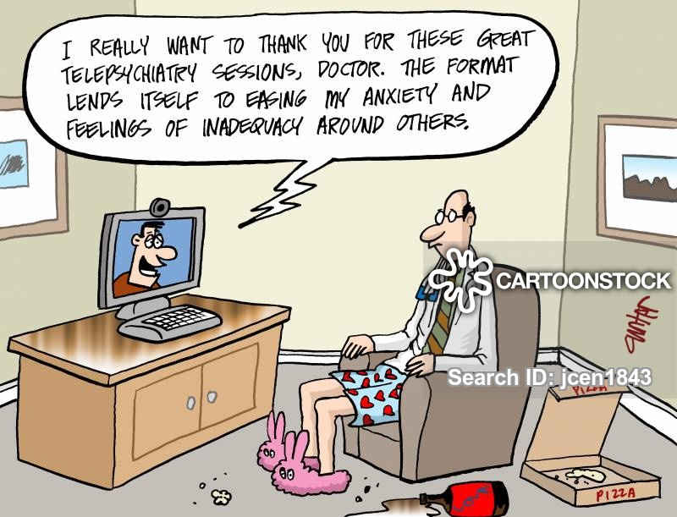
Definition of Telemedicine
It is simply defined as the remote delivery of healthcare services

Slide 5
What are the differences between Telemedicine and Telehealth? 1 of 3
The World Health Organization defines Telemedicine as “healing from a distance”
It is the use of telecommunications technology and information technologies to provide remote clinical services to patients.
Physicians use telemedicine for the transmission of digital imaging, video consultations, and remote medical diagnosis.
Today, individuals no longer have to schedule an in-person visit with a physician to receive treatment.
The use of secure video and audio connections makes it possible for specialists to treat patients who reside in locations with limited access to care.

Slide 6
What are the differences between Telemedicine and Telehealth? 2 of 3
HealthIT.gov defines Telehealth as “the utilization of electronic information and telecommunications technologies to support and promote long-distance clinical health care, patient and professional health education, public health and health administration.”
While this deﬁnition sounds a lot like telemedicine, there is one distinct diﬀerence.
Unlike telemedicine, telehealth also covers non-clinical events like administrative meetings, continuing medical education (CME), and physician training.
Telehealth is not a speciﬁc service, but a collection of methods to improve patient care and education delivery.

Slide 7
What are the differences between Telemedicine and Telehealth? 3 of 3
In general, one can think of telehealth as all-encompassing, as telemedicine and telecare fall under its umbrella.
The terms telemedicine and telehealth bring with them plenty of debate among individuals in the healthcare ﬁeld.
One reason for this debate is due to the varying deﬁnitions pertaining to the terms themselves.
Some experts consider telemedicine to be physician focused and telehealth to include all health professionals in general.
As technology in the medical ﬁeld continues to advance, the two terms will likely become more distinguishable.

Slide 8
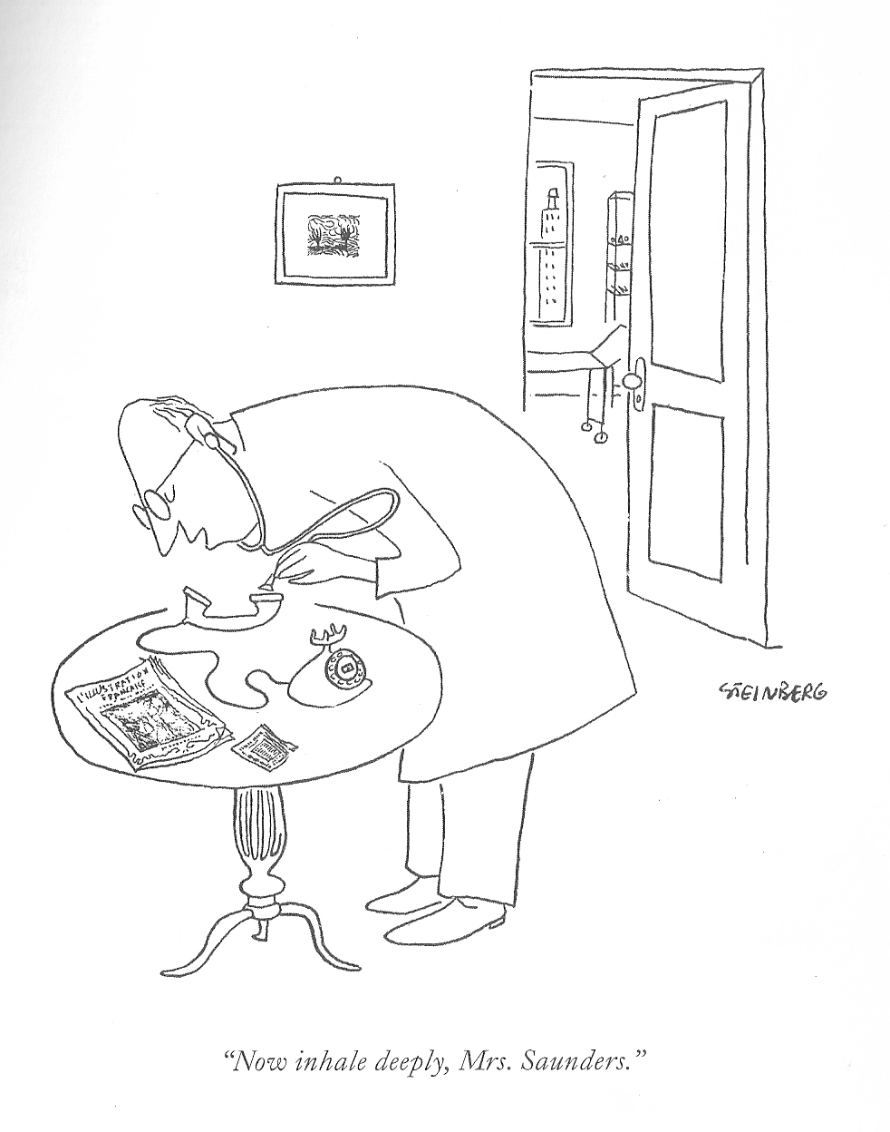
Benefits of Telehealth
Improved Access
Cost Efficiencies
Improved Quality
Consumer Demand

Slide 9
Improved Access
Since its inception, telehealth has been used to bring healthcare services to consumers in distant locations.
Telehealth not only improves consumer access; it extends the geographic reach and expertise of physicians and health facilities.
Given provider shortages around the world, telehealth has a unique and appealing value proposition.
It can provide millions of people in both rural and urban areas access to safe, effective and appropriate care when and where they need it.

Slide 10
Cost Efficiencies
Reducing or containing the cost of healthcare is one of the strongest motivators to fund and adopt virtual care technologies.
Telehealth reduces the cost of healthcare and increases efficiency with better management of chronic diseases, shared health professional staffing, reduced travel times, and fewer or shorter hospital stays

Slide 11
Improved Quality
Studies have consistently shown that the quality of healthcare services delivered via telehealth are as good as those given in traditional in-person consultations.
In some specialties, particularly in mental health and ICU care, telehealth delivers a superior product, with greater outcomes and consumer satisfaction

Slide 12
Consumer Demand
The greatest impact of telehealth is on the consumer, their family and their community.
Using telehealth technologies reduces travel time and related stresses for the consumer.
Over the past 15 years, multiple studies have documented consumer satisfaction and support for telehealth services.
Such services offer consumers the access to providers that might not be available otherwise, as well as medical services without the need to travel long distances.

Slide 13
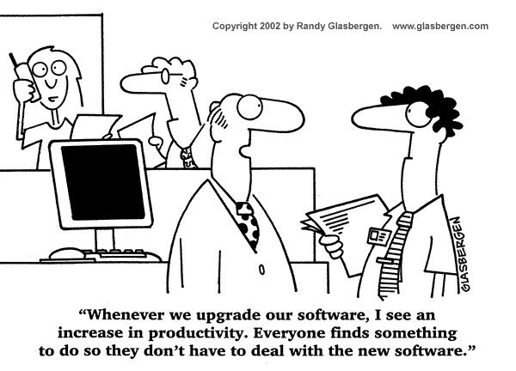
Services Provided by Telehealth
Sometimes tele is best understood in terms of the services provided and the mechanisms used to provide those services
Live videoconferencing (synchronous)
Store and forward (asynchronous)
Remote patient monitoring (RPM)
Mobile health (mHealth)

Slide 14
Live videoconferencing (synchronous)
The delivery of a live, interactive consultation between:
  Primary care and patients
  Specialist health services and patients
  Primary care and specialist consultants
This may involve a primary care or allied health professional providing a consultation with a patient, or a specialist assisting the primary care physician in rendering a diagnosis.
Communication methods include both phone consultations and video conferences.
Physicians can assess a patient’s medical history, perform psychiatric evaluations, and more using interactive medicine

Slide 15
Store and Forward (Asynchronous)
The use of store and forward transmission of diagnostic images, vital signs and/or video clips along with patient data for later review that enables a primary care or allied health professional providing a consultation the ability to render a diagnosis
Very common for image-based specialty consultants like Dermatology, ENT, Ophthalmology, Orthopedics, etc.
Systems can transmit information across vast distances and diﬀerent systems (sometimes) so one physician can know what another has already done.
This leads to less duplicate testing and fewer instances of poor medication management.
Could also be used for field use from Role 1/2 settings to Role 3 or ships to shore-based facilities

Slide 16
Remote Patient/Health Monitoring (RPM/RHM)
Likely a favorite among patients aging in place, telemedicine permits providers to monitor their patients in their own homes.
Using patient portals, a physician can gather and share information with their patient.
Including home telehealth, uses devices to remotely collect and send data to a home health agency or a remote diagnostic testing facility (RDTF) for interpretation.
Such applications might include a specific vital sign, such as blood glucose or heart ECG or a variety of indicators for homebound consumers.
Such services can be used to supplement the use of visiting nurses
In addition, medical devices can send vital signs and more to providers so they can adjust care as needed.

Slide 17
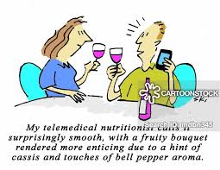
Mobile Health (mHealth)
Consumer medical and health information includes the use of the internet and wireless devices for consumers to obtain specialized health information and online discussion groups to provide peer-to-peer support

Slide 18
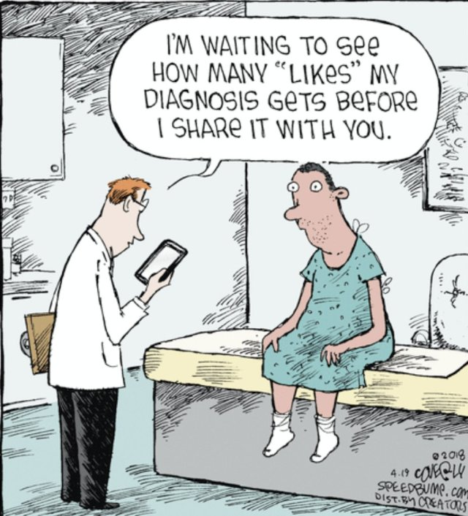
Delivery Mechanisms
Networked programs
Point-to-point connections
Monitoring center links
Web-based e-health consumer service sites

Slide 19
Networked Programs
Link tertiary care hospitals and clinics with outlying clinics and community health centers in rural or suburban areas.
The links may use dedicated high-speed lines or the Internet for telecommunication links between sites.
The American Telemedicine Association (ATA) estimates the number of existing telehealth networks in the United States at roughly 200 providing connectivity to over 3,000 sites

Slide 20
Point-to-Point Connections
Private high-speed networks that are used by hospitals and clinics that deliver services directly or outsource specialty services to independent medical service providers.
Such outsourced services include radiology, stroke assessment, mental health, and intensive care services.

Slide 21
Monitoring Centers and Links
Used for cardiac, pulmonary or fetal monitoring, home care and related services that provide care to patients in the home.
Often normal landline or wireless connections are used to communicate directly between the patient and the center although some systems use the Internet.

Slide 22
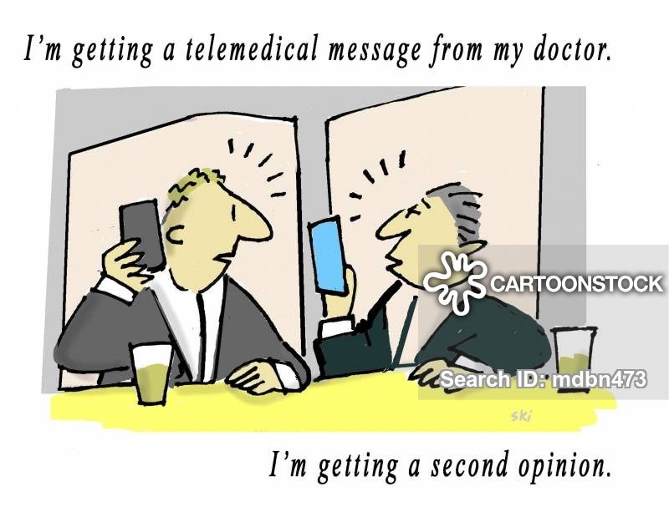
Web-based e-Health Consumer Service Sites
Provide direct consumer outreach and services over the Internet.
Under telehealth, these include those sites that provide direct consumer care

Slide 23
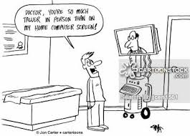
Application of Telemedicine
Chronic Disease Management
Medication Management
Sharing Medical Information
Emergency Room/Department (ER/ED) Diversion
2nd Opinion
Disaster Relief
Paramedic/Ambulatory

Slide 24
Chronic Disease Management
With high-tech medical devices, physicians can now monitor their patients health over long distances.
Touchscreen technology allows providers to access heart rate, blood pressure, glucose levels and more through the transmission of data from one device to another
Seventy-five percent (75%) of the United States healthcare spending is dedicated to treating heart disease, cancer, and diabetes.
As a result, there are now telemedicine solutions that can keep physicians abreast from hospital to home.
In addition, the patient, their family members, and other healthcare professionals can collaborate in the patient care process.

Slide 25
Medication Management
Those in the healthcare industry recognize that medication management is a big deal, especially among seniors.
Older adults are more likely to forget to take their medications, which is where telemedicine comes in.
Providers and other healthcare professionals can use telemedicine technology to monitor when and if their patients took their medicine.
As a result, this leads to fewer hospital readmissions and enhances medication adherence.

Slide 26
Sharing Medical Information
Store and forward, allowing providers to share information over a distance, has been a game changer.
Today, primary care physicians can connect with specialists who are in another location than them.
Healthcare information like diagnostic images, blood analysis, and more can be shared for appropriate patient assessment in real time

Slide 27
ER/ED Diversion
Without a doubt, the emergency room is one of the most expensive, overcrowded, and stressful environments in healthcare.
With telemedicine, overcrowded emergency rooms can be reduced by having patients see a remote physician using video chat ﬁrst.
The remote physician can determine if that individual should seek care in an emergency department, which increases ED eﬃciency

Slide 28
Second Opinion
Today, there are telemedicine solutions that allow patients to seek a second opinion from the comforts of their home.
Sending another physician copies of your medical images and more can easily be done by uploading the content to their secure website.
This is very convenient for those who need a specialist but do not have the resources to drive thousands of miles away or wait a long time.

Slide 29
Disaster Relief
When a disaster occurs, the local healthcare resources are immediately pulled in to provide both emergent and non-emergent care.
This usually results in a shortage as the demand for services is much higher than what can be supplied.
With telemedicine, physicians in other locations can help by conducting video visits.
In fact, when Hurricane Harvey occurred in 2017, healthcare professionals provided emergency and behavioral health video visits.
This allowed practitioners to focus on high demand, complex cases in-person versus low level cases that can managed remotely.

Slide 30
Paramedic/Ambulatory
It’s not uncommon for an emergency department to shut down after reaching capacity.
This leads to ambulances taking patients to hospitals that are farther away and this ultimately aﬀects their outcome.
By using telemedicine, paramedics can use technology to see the capacity of an emergency room in real-time instead of heading to the hospital and then being diverted later.
Also, when emergency rooms begin using video consultations to triage their patients, it gets the non-emergent cases out sooner.
This leads to less ambulance diversion and better patient outcomes.

Slide 31
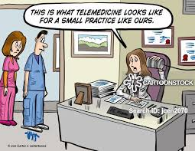
Disadvantages of Telemedicine
Unclear policies
Fewer face-to-face consultations
Technology is expensive

Slide 32
Unclear Policies
Because technology is growing at such a fast pace, it’s been diﬃcult for policymakers to keep up with the industry.
There is great uncertainty regarding matters like reimbursement policies, privacy protection, and healthcare laws.
In addition, telemedicine laws are diﬀerent in every state.
There are currently 29 states with telemedicine parity laws, which require private payers to reimburse in the same way they would for an in-person visit.
As additional states adopt parity laws, private payers may institute more guidelines and restrictions for telemedicine services.
Although it’s a step in the right direction, there is still uncertainty regarding reimbursement rates, billing procedures, and more.

Slide 33
Fewer F2F Consultations
Some physicians and patients are ﬁnding it diﬃcult to adapt to telemedicine, especially older adults.
Physicians are very concerned about patient mismanagement.
While advances in medicine have made it more eﬃcient to use technology, there are times when system outages occur.
There is also the potential for error as technology cannot always capture what the human touch can.

Slide 34
Technology is Expensive
Healthcare systems that adopt telemedicine solutions can attest that it requires a lot of time and money.
Implementing a new system requires training and sometimes staﬀ members ﬁnd it diﬃcult to welcome this change.
Practice managers, nurses, physicians, and more have to learn how to utilize the system so that practices can see the beneﬁts.
Although telemedicine is expensive in the beginning, healthcare systems should see a positive return on investment over time due to more patients and less staﬀ.
There are significant cost differences between dedicated “Telemedicine carts” and simple desktop-/laptop-based Telemedicine.

Slide 35
How Common is Telehealth?
According to a 2018 JAMA study, annual telemedicine visits have increased at an average annual compound growth rate of 52% from 2005 to 2014.
The AHA states that 76% of U.S. hospitals connect with patients and consulting practitioners using video and other technology, and a study performed by NGBH revealed that virtually all (96%) of the nation’s large employers will provide medical coverage for telehealth in 2019.
COVID-19 effects on policy/legislation, licensing and reimbursement surrounding telehealth

Slide 36
Is Telehealth Safe?
Data from a 2018 survey of healthcare providers by Deloitte found that telehealth can improve patient experience, an important factor in quality care.
In fact, nine out of ten physicians (90%) see the benefits of virtual care, especially regarding patient experience – access to care, patient satisfaction, and improved communication with the care team being the main benefits

Slide 37
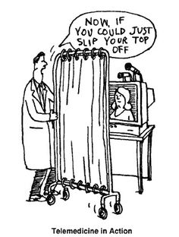
Barriers to Telemedicine
Provider Reimbursement
Physician Licensing
Security Concerns

Slide 38
Provider Reimbursement
If private payers, Medicaid, and Medicare choose not to reimburse organizations for telemedicine, then the fee falls on the hospitals.
Some hospitals can receive grants, but there are only so many that can go around.
In addition, some states do not have parity laws.
That means physicians may not receive the same reimbursement that they would for onsite services.
This issue alone makes implementing telemedicine unattractive for providers and they, in turn, forego it.

Slide 39
Physician Licensing
Although telemedicine itself permits physicians to treat patients nationwide, there are restrictions on who can provide services across state lines.
States with large rural areas with limited access to care could greatly beneﬁt from this, but varying state regulations make the process challenging.
Physicians who do want to practice medicine across states may have to obtain a full medical license in all states.
Not only is the process time consuming, but it is also expensive for physicians to do.
This process alone makes what would be a convenient option, a very inconvenient one.

Slide 40
Security Concerns
Providers and patients alike have concerns with telemedicine due to the mass amount of sensitive information in the healthcare world.
Because of telemedicine, physicians are able to communicate with their patients via video chat, text message, and phone call, but not all communication mediums are safe.
To be fully HIPAA-compliant, all data must be fully encrypted, have secure peer-to-peer network connections and have no storage of video.
Telemedicine providers should also be comfortable signing a business associate agreement, which asserts that they will take responsibility in keeping patient information safe.

Slide 41
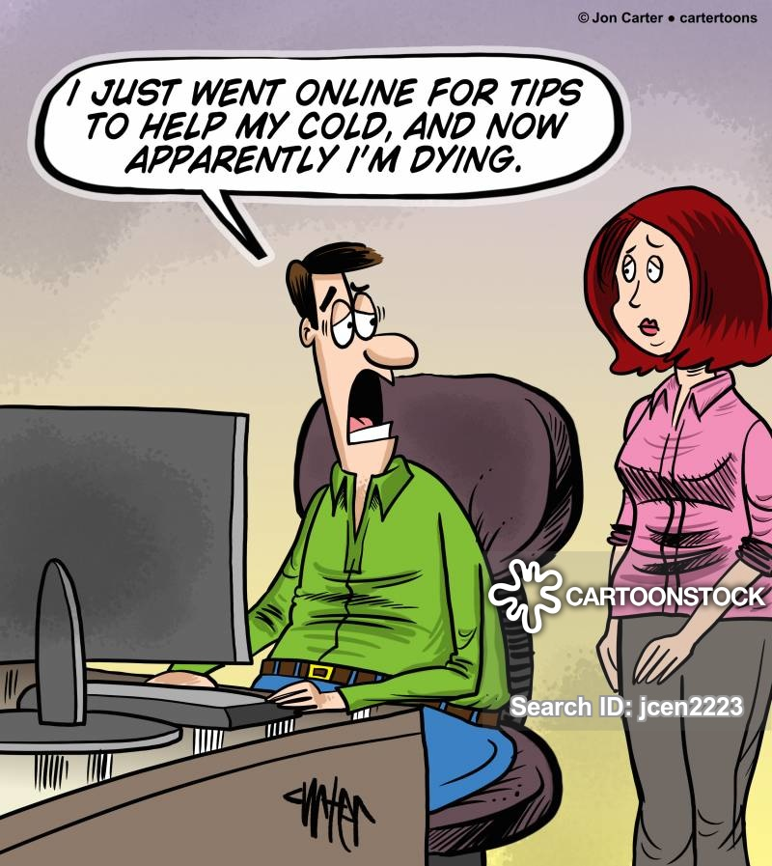
Questions/Discussion

