Slide 1
Clinical Informatics Regulatory Landscape
Bob Marshall
Program Director
DoD/MAMC Clinical Informatics Fellowship

Slide 2
Learning Objectives
Discuss Medical Ethics and how they apply to Clinical Informatics
Review HIPAA and the associated rules
Discuss the PPACA and HITECH
Review the interaction of The Joint Commission, PQRS, MIPS and MACRA with Clinical Informatics

Slide 3
Ethics in Clinical Informatics
As with other specialties, clinical informatics poses its own questions with regards to ethics.
The large amounts of private health data that clinicians and IT staff analyze may result in new correlations or causation that may affect the patient's decision on treatment and may even impact their longevity.
AMIA has produced a list of professional ethics do's and don'ts for clinical informaticists.

Slide 4
AMIA Code of Professional and Ethical Conduct
The code of conduct offers the following guidelines to informaticists regarding patient information:
  Do facilitate their legal rights to their health information
  Do safeguard their healthcare information consistent with legal and industry standards
  Do act in a courteous, timely, respectful and professional manner
  Do alert colleagues to potential issues and bugs in their systems that may affect patients
  Do lead by example by practicing and promoting ethical and professional behavior
  Do follow ethical legal mandates when you feel that something is "off"

Slide 5
AMIA Code of Professional and Ethical Conduct
Code of Conduct continued:
  Do engage in ethical and legal research that moves clinical informatics forward
  Do encourage the growth of informatics for research, teaching, professional development, encouragement and other appropriate methods
  Do Not disclose data in inappropriate or illegal ways
  Do Not mislead patients regarding the use of their healthcare information

Slide 6
Conflict of Interest
Individuals who make decisions and conduct affairs on behalf of professional groups may be required to disclose any potential conflicts of interest that may affect their ability to make unbiased decisions.
The Council of Medical Specialty Societies (CMSS) has developed its own voluntary code societies to guide their interactions with companies.
By opting to follow this code, medical specialty societies are expected to maintain objectivity and minimize perceived and actual conflicts of interest.
To accomplish this, guidelines and principles for interaction are outlined to cover the following topics: independence, transparency, charitable contributions, corporate sponsorships, society meetings, research grants, clinical practice guidelines, journals and advertising and licensing.

Slide 7
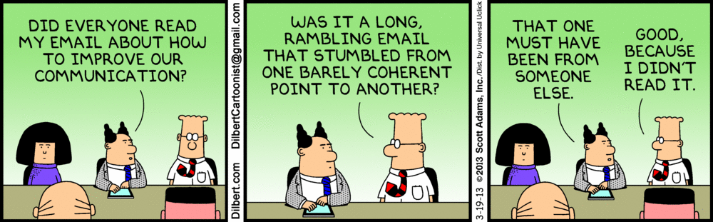
Rules and Regulations

Slide 8
HIPAA
The Health Insurance Portability and Accountability Act of 1996, also known as the Kennedy-Kassebaum Act, protects health insurance coverage for personnel and their families when they lose or change jobs as well as governance electronic transactions in healthcare.
HIPAA compliance is a necessary but costly and time-consuming requirement for healthcare providers and organizations.

Slide 9
HIPAA Privacy & Security Rules
The HIPAA Privacy Rule outlines how and when PHI may be disclosed and to whom, whereas the HIPAA Security Rule covers how Electronic Personal Health Information (EPHI) should be secured using administrative, technical and physical safeguards.
Each category of safeguards has their own adoption requirements and addressable specifications.

Slide 10
HIPAA & PHI
According to HIPAA, all "individually identifiable health information held or transmitted by a covered entity or its business associate, in any form or media, whether electronic, paper or oral" is protected by the privacy rule.
Individually identifiable health information is defined as information, including demographic, that relate to:
  The individual's past, present or future physical or mental health or condition
  The provision of healthcare to the individual
  Past, present or future payment for the provision of healthcare to the individual
  And that identifies the individual for which there is a reasonable basis to believe it can be used to identify the individual

Slide 11
Covered Entities 1 of 2
PHI may be used and disclosed by covered entities as the privacy rule allows, and if the individual (or legal representative) authorizes its use or disclosure in writing.
Within HIPAA, 2 primary groups mentioned below include covered entities and business associates.
A covered entity must comply with HIPAA regulations to protect the privacy and security of health information provide certain rights to individual's health information.
A business associate is a separate person or organization a covered entity uses to help with his healthcare activities and functions.
Contractual obligations between a covered entity and a business associate must be formalized in a business associate agreement.

Slide 12
Covered Entities 2 of 2
A covered entity is a:
  Healthcare Provider: physicians, nurses, psychologists, dentists, chiropractors, nursing homes, pharmacies and any other entity that transmits any electronic information in connection with a transaction for which the HHS has adopted standards.
  Health Plan: health insurance companies, HMOs, health plans, public healthcare
  Healthcare Clearinghouse: entities that take nonstandard health information and process it into a standard format or vice versa

Slide 13
HIPAA and Clinical Informatics
The ONC has defined a Health Information Organization as "an organization that oversees and governs the exchange of health related information among organizations according to nationally recognized standards."
HHS states that the principles of the HIPAA privacy rule that apply to HIO's are:
  Correction
  Openness and transparency
  Individual choice
  Collection, use and disclosure limitations
  Safeguards
  Accountability

Slide 14
Privacy Rule and PHR’s
The Privacy Rule supports the use of individual PHR's as ways that patients can access and control their health information.
Covered entities offering a PHR must safeguard information as required by the Privacy Rule.
The covered entity may also hire a business associate to administer and manage the PHR and must determine how information will be safeguarded in the business associate agreement.
The Privacy Rule does not apply to personal health records not offered by the covered entities.
Therefore, dated within these PHR's are not protected or governed by the Privacy Rule.

Slide 15
Breach Notification Rules
Complementary to the privacy rule and security rule is the breach notification rule.
Under the Breach Notification Rule, covered entities and their business associates are required to notify those individuals who are affected by the breach, the HHS Sec. and the media, if the case involves more than 500 individuals.
If the risk has been assessed as low, using the following evaluation points, then the impermissible use or disclosure of PHI is not presumed to be a breach:
  The nature and extent of the protected health information involved, including the types of identifiers and the likelihood of re-identification;
  The unauthorized person who use the protected health information or to whom the disclosure was made;
  Whether the protected health information was actually acquired or viewed; and
  The extent to which the risk to the protected health information has been mitigated.

Slide 16
PPACA
The Patient Protection and Affordable Care Act is a federal statute aimed to increase the affordability, accessibility and quality of health insurance.
Many healthcare organizations are facing decreased reimbursements, increase financial strain and other issues since the act has been passed, though it may still be too early to understand the long-term ramifications.

Slide 17
PPACA and Patient Protection
PP ACA also includes the following provisions:
  Requires individuals to carry health insurance through a private or employee sponsored plan or pay a penalty (Struck down?)
  Prohibits insurers to downline coverage to those with pre-existing conditions
  Enacts health insurance exchanges for enrollment and plans
  Provides federal subsidies to eligible persons to purchase insurance through an exchange
  Requires minimum standards for health insurance policies
  Expands eligibility for Medicaid and restructures Medicare reimbursements from fee-for-service the bundled payments
  Requires businesses that meet certain employee benchmarks to offer affordable insurance and provide minimum value coverage (Struck down?)

Slide 18
Open Payments Program
This program, better known as The Physician Payments Sunshine Act, requires manufacturers of drugs, medical devices and biologicals report payments and gifts given to physicians in teaching hospitals.
The Centers for Medicare and Medicaid Services (CMS) then reports this data to the public.
The intent is to ensure greater transparency in the physician/manufacturer relationship.

Slide 19
HITECH
The Healthcare Information Technology for Economic and Clinical Health Act is a part of the American Recovery and Reinvestment Act of 2009.
It is aimed at promoting the adoption and meaningful use of health information technology.
Meaningful Use requirements aimed to improve patient care through increased adoption of electronic health records.
As a part of the HITECH Act, healthcare organizations must show that they are using their electronic health records in an "meaningful way" defined by objectives.
There are incentives for compliance with "meaningful use", as well as penalties for noncompliance.

Slide 20
The Joint Commission
The Joint Commission on Accreditation of Healthcare Organizations, now referred to simply as The Joint Commission, is an accrediting organization whose mission is to "… Continuously improve healthcare for the public, in collaboration with other stakeholders, by evaluating healthcare organizations and inspiring them to excel in providing safe and effective care of the highest quality and value."
In order to meet licensure requirements for Medicaid reimbursement, healthcare organizations must be certified by the joint commission or another recognized accreditation organization.
There are some requirements, such as RC.01.01.01 (requiring hospitals to maintain accurate records) that are addressed by having an EHR that needs meaningful use criteria.

Slide 21
PQRS
The Physician Quality Reporting System allows physicians to report on various quality measures to quantify the quality of care and how often they are meeting quality measures.
Eligible providers who meet PQRS requirements are eligible for an incentive "equal to .05% of their total estimated Medicare part B PFS allowed charges for covered professional services furnished during the same reporting period."
Eligible providers can report their quality metrics are the following means:
  Medicare part B claims
  Qualified PQRS registry
  Directly within a certified EHR using CEHRT
  CEHRT via data submission vendor
  Qualified Clinical Data Registry (QCDR)
CEHRT – Certified EHR Technology

Slide 22
MIPS
The merit-based incident payment system is a modified fee-for-service model or physicians are paid based on quality, Advancing Care Information (ACI), improvement activities and cost.
MIPS aligns:
  PQRS
  Meaningful Use
  Value-based Modifier
And adds:
  Improvement Activities

Slide 23
MACRA
The Medicare Access and CHIP Reauthorization Act was created with the intent to establish new ways to pay physicians caring for Medicare beneficiaries while reducing the complexity of the administrative process.
It consolidated PQRS, meaningful use and the value-based payment modifiers while adding an improvement activities component.
The first full year of implementation was 2019.
MACRA's payment system is referred to as the Quality Payment Program (QPP)

Slide 24
Quality Payment Program (QPP)
The Q PP aims to accomplish the following:
  Support care improvement by focusing on better outcomes for patients, decreased provider burden and preservation of independent clinical practice
  Promote adoption of Alternative Payment Models that align incentives across healthcare stakeholders
  Advance existing efforts of delivery system reform, including ensuring a smooth transition to a new system that promotes high quality, efficient care through unification of CMS legacy programs
  The 2 payments models under the QPP include the Merit-Based Incentive Payment System (MIPS) and Alternative Payment Model (APM)

Slide 25
Advanced APM
Under MACRA, providers may elect the advanced APM option.
To be considered as an advanced APM:
  Participants must use certified EHR technology (CEHRT);
  The model offered must provide for payment for covered professional services based on quality measures comparable to those in the quality performance category under MIPS; and
  The payment arrangement must require participants to either bear more than nominal financial risk; or be a Medicaid Medical Home Model that meets criteria comparable to medical home models expanded under this section 1115A(c) of MACRA

Slide 26
FDASIA
The Food And Drug Administration Safety and Innovation Act gives the FDA the authority to:
  Collect user fees from industry
  Promote innovation to faster patient access to products
  Increase stakeholder involvement in FDA processes
  Enhance the safety of the drug supply chain
The law was passed in 2012.
Its full impact on clinical informatics is yet to be determined, and a draft FDA proposal for approval of medical applications and software is now available.

Slide 27
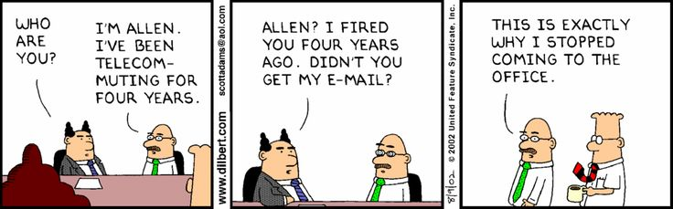
CDS Regulations

Slide 28
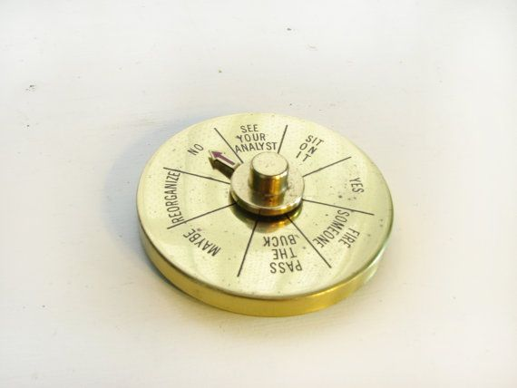
Regulation of CDS 1 of 2
The Food and Drug Administration (FDA) has long regulated software that meets the definition of a device in section 201(h) of the Federal Food, Drug, and Cosmetic Act (FD&C Act)
In the Food and Drug Administration Safety and Innovation Act (FDASIA) Health IT Report of 2014, CDS is described as a variety of tools including, but not limited to: computerized alerts and reminders for providers and patients; clinical guidelines; condition-specific order sets; focused patient data reports and summaries; documentation templates; diagnostic support; and contextually relevant reference information
Section 3060(a) of the 21 Century Cures Act (“Cures Act”) amended the Federal Food, Drug, and Cosmetic Act (“FD&C Act”) to add section 520(o), to exclude certain CDS software functions from the definition of a device.

Slide 29
Regulation of CDS 2 of 2
Software functions that meet all the following four criteria are not considered medical devices:
  not intended to acquire, process, or analyze a medical image or signal from an in vitro diagnostic device or a pattern or signal from a signal acquisition system (ex. ECG machine);
  intended for the purpose of displaying, analyzing, or printing medical information about a patient or other medical information (such as peer-reviewed clinical studies and clinical practice guidelines);
  intended for the purpose of supporting or providing recommendations to a health care professional about prevention, diagnosis, or treatment of a disease or condition; and
  intended for the purpose of enabling a health care professional to independently review the basis for recommendations presented by said software (ex. InfoButtons)

Slide 30
IMDRF Software as a Medical Device
International Medical Device Regulators Forum (“IMDRF”) Software as a Medical Device: Possible Framework for Risk Categorization and Corresponding Considerations (“IMDRF Framework”) evaluates software as a medical device (“SaMD”) using two categories to establish a risk-based classification:
  assessment of the significance of the information provided by the SaMD to a health care decision
  assessment of the state of the health care situation or condition as critical, serious or non-serious

Slide 31
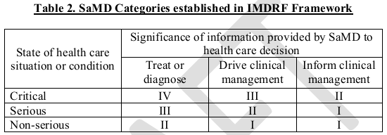

Slide 32
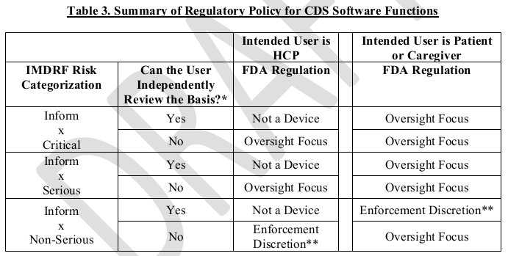

Slide 33
Other Pertinent Regulations
The use of CDS to help achieve quality and safety improvements is explicit or implicit in many of the Federal meaningful use objectives for electronic health record (EHR) systems established under Title XIII of the American Recovery and Reinvestment Act of 2009 (ARRA), also known as the Health Information Technology for Economic and Clinical Health (HITECH) Act.
This focus is reinforced in provisions of the 2010 Patient Protection and Affordable Care Act (ACA)
The 21st Century “Cures Act,”† enacted in 2016, formalized the FDA’s risk-based approach by redefining the statutory term “device” to exclude low-risk clinical decision support technologies

Slide 34

Discussion/Questions

