Slide 1
Introduction to EHR and Data Standards
Bob Marshall, MD, MPH, MISM, FAAFP, FAMIA Program Director, DoD/MAMC Clinical Informatics Fellowship

Slide 2
Learning Objectives
Provide background and definition of data standards
Discuss standardizing health care data
Review the health data interchange standards
In-depth review of the user interface and standards
Discuss patient data linkage
Review the WHO-recognized health data standards

Slide 3
Background
Data standards are the principal informatics component necessary for information flow through the national health information infrastructure
With common standards, clinical and patient safety systems can share an integrated information infrastructure.
This allows data to be collected and reused for multiple purposes, to include more efficiently and effectively meeting data collection and reporting requirements
Common data standards also support effective assimilation of new knowledge into decision support tools

Slide 4
A Definition of Data Standards
In the context of health care, the term data standards encompasses:
methods, protocols, terminologies, and specifications…
for the collection, exchange, storage, and retrieval of information associated with…
health care applications, including medical records, medications, radiological images, payment and reimbursement, medical devices and monitoring systems, and administrative processes

Slide 5
Standardizing health care data involves the following:
Definition of data elements—determination of the data content to be collected and exchanged
Data interchange formats—standard formats for electronically encoding the data elements (including sequencing and error handling)
Interchange standards can also include document architectures for structuring data elements as they are exchanged and information models that define the relationships among data elements in a message
Terminologies—the medical terms and concepts used to describe, classify, and code the data elements and data expression languages and syntax that describe the relationships among the terms/concepts.
Knowledge Representation—standard methods for electronically representing medical literature, clinical guidelines, and the like for decision support

Slide 6
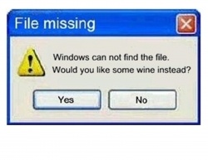
Data Interchange Standards

Slide 7
Standards are needed for message format, document architecture, clinical templates, user interface, and patient data linkage
Message format standards facilitate interoperability through the use of common encoding specifications, information models for defining relationships between data elements, document architectures, and clinical templates for structuring data as they are exchanged

Slide 8
Consolidated Health Informatics (CHI) initiative
all federal health care services agencies adopt…
the primary clinical messaging format standards (i.e., the Health Level Seven [HL7] Version 2.x [V2.x] series for clinical data messaging,
Digital Imaging and Communications in Medicine [DICOM] for medical images,
National Council for Prescription Drug Programs [NCPDP] Script for retail pharmacy messaging,

Slide 9
Institute of Electrical and Electronics Engineers [IEEE] standards for medical devices, and
Logical Observation Identifiers, Names and Codes [LOINC] for reporting of laboratory results

Slide 10
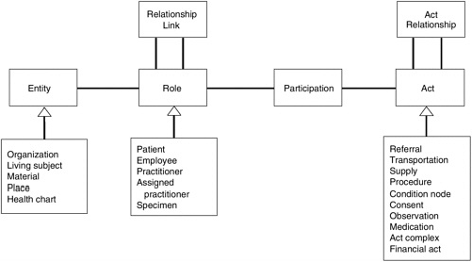
HL7 Reference Information Model (RIM)

Slide 11
Document Architecture
A method for representing electronically clinical data such as discharge summaries or progress notes and patient safety reports requires a standardized document architecture
The architecture should be designed as a markup standard so that clinical documents can be revised as needed or appended to existing documents
It should also be able to accommodate the desire for rich narrative text that makes up a significant portion of patient safety information from voluntary and mandatory reports

Slide 12
One example is the HL7 Clinical Document Architecture (CDA), a defined, complete information object that can include text, images, sounds, and other multimedia content
The CDA provides a hierarchical set of specifications for the structure of clinical documents and derives its semantic content from the RIM

Slide 13
User Interface 1 of 6
The medical device industry is well versed in developing user interfaces that make devices safer, more effective, and easier to use by employing a voluntary standard for human factors design established by the Association for the Advancement of Medical Instrumentation (AAMI) and approved by the American National Standards Institute (ANSI)
This standard—the ANSI/AAMI HE74 Human Factors Design Process for Medical Devices—establishes tools and techniques to support the analysis, design, testing, and evaluation of both simple and complex systems; these tools and techniques have been applied for many years in the engineering of consumer products, military applications, aviation equipment, and nuclear power systems

Slide 14
User Interface 2 of 6
Consideration of the HE74 standard may provide insight into the processes employed for designing and developing user-friendly clinical information systems
Although entry into the cycle can begin at any step, involving users at the early stages of development is critical.
Once user needs and the concept for the device (system) have been well defined, it becomes possible to address the design criteria/requirements that specify the operating conditions, user characteristics, functions, and potential hazards of the device/system

Slide 15
User Interface 3 of 6
Hardware and software designers craft the necessary technical requirements and specifications
Next, structured evaluation of the resulting device/system can ensure that the design is technically sound (i.e., verification) and that it also meets the user’s needs and intended uses (i.e., validation)
The last step—implementation and deployment—is related to the manufacturing, marketing, sales, and regulatory aspects of the device/system, including post-market surveillance and vigilance reporting that provide critical data on design strengths and shortcomings

Slide 16
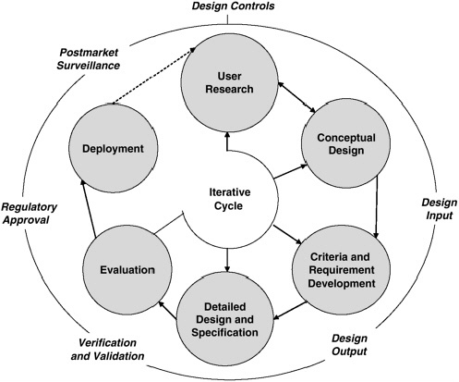
Human factors engineering process governing
the HE74 standard

Slide 17
User Interface 4 of 6
HL7 has taken an approach to data integration at the visual level by way of the user interface.
These applications and standards facilitate the integration of multiple independent applications from many different systems through interface standards
An example of this is the ANSI certified HL-7 context manager standard (See image)
With the context manager, an organization can give providers a single sign-on capability so they do not have to log on for each separate clinical application program

Slide 18
User Interface 5 of 6
The context manager standard establishes the primary architecture, a core set of data definitions, rules for application user interfaces, security specifications and translation of the architecture for interoperability with applications in a way that is technology neutral.
The context manager also provides a single patient selection that, similar to a single clinician sign-on, allows all patient data in multiple applications to be readily available for use as needed by the clinician

Slide 19
User Interface 6 of 6
Context management gives users the experience of using a single system, when in fact they are accessing multiple applications simultaneously
Along with identifying users in patients, the context manager can identify concepts for unifying the availability of clinical data across applications

Slide 20
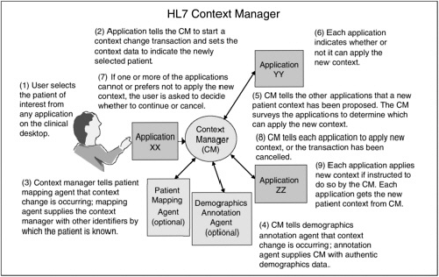

Slide 21
Patient Data Linkage
While not a traditional data standard, being able to link a patient's healthcare data from one departmental location or site to another, and unambiguously is important for maintaining the integrity of patient data and delivering safe care
The administrative simplification provisions of HIPAA originally mandated the implementation of a unique health identifier for individuals
However, Congress withheld funding of the implementation pending adequate federal privacy protection

Slide 22
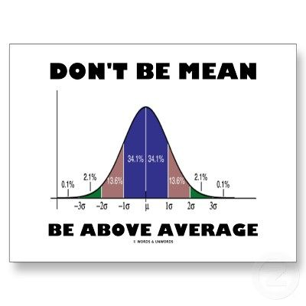
Health Data Standards

Slide 23
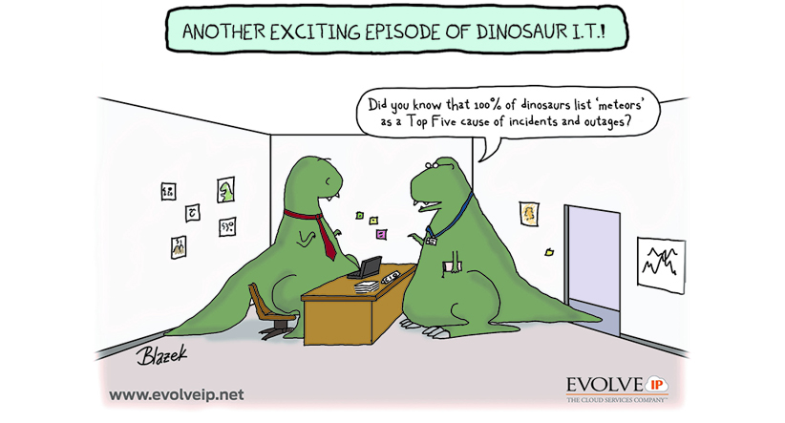
International Classification of Diseases (ICD)
International standard diagnostic classification for all general epidemiological, many health management purposes and clinical use

Slide 24
LONIC – Logical Observation Identifiers Names and Codes
A universal code system for identifying laboratory and clinical observations
LOINC has standardized terms for all kinds of observations and measurements that enable exchange and aggregation of electronic health data from many independent systems
The LOINC database contains the usual categories of chemistry, hematology, serology, microbiology, toxicology; as well as categories for drugs and the cell counts, antibiotic susceptibilities, and more

Slide 25
HL7 – Health Level Seven
HL7 is an international community to provide a framework for the exchange, integration, sharing and retrieval of electronic healthcare information
HL7 is a coordinated message-based connection between two systems that allows information to be exchanged reliably between application programs
Common standards include HL7 for administrative data such as patient demographics

Slide 26
SNOMED – Systematized Nomenclature of Medicine
Designed as a comprehensive nomenclature of clinical medicine for the purpose of accurately storing and/or retrieving records of clinical care in human and veterinary medicine
It provides the core general terminology for the electronic health record (EHR) and contains active concepts with unique meanings and formal logic-based definitions organized into hierarchies
It offers a standard-based foundation for different functions e.g. collection of a variety of clinical information, linked to clinical knowledge bases, information retrieval, data aggregation, analyses, exchange, etc.

Slide 27
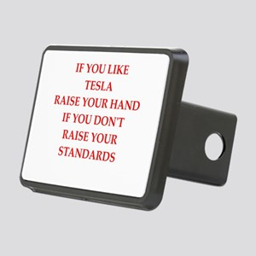
SNOMED - Cont
It contributes to the improvement of patient care by underpinning the development of systems that accurately record health care encounters and to deliver decision support

Slide 28
SDMX – Statistical Data and Metadata eXchange
SDMX provides standard formats for data and metadata, together with content guidelines and an IT architecture for exchange of data and metadata
SDMX-HD (Health Domain) is a WHO implementation of the SDMX standard to allow medical facilities to share and exchange medical indicators and metadata between medical organizations

Slide 29
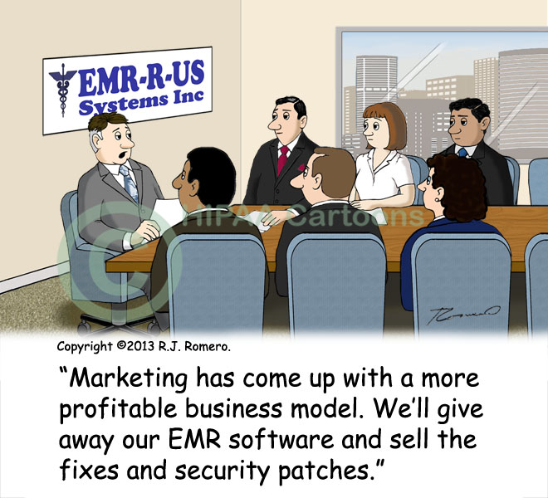

Slide 30
Useful References
Hammond WE. The making and adoption of health data standards. Health Affairs. September/October 2005. Vol. 24(5):1205-1213. DOI 10.1377/hlthaff.24.5.1205.
Mandel JC, Kreda DA, Mandl KD, Kohane IS, Ramoni RB. SMART on FHIR: a standards-based, interoperable apps platform for electronic health records. J Am Med Inform Assoc 2016;23:899–908. doi:10.1093/jamia/ocv189.
Meehan RA, et al. Increasing EHR system usability through Standards: Conformance criteria in the HL7 EHR-system functional model. J Biomed Inform 2016;63:169-173.

