Slide 1
VDI and DaaS – Say What?!?...and More
Bob Marshall, MD MPH MISM FAAFP
Program Director, DoD Clinical Informatics Fellowship

Slide 2
Objectives
Define both VDI and DaaS
Review the pros and cons of each
Explain the similarities and differences
Review how to select the best solution and who should and should not get a virtualized solution
Go over relative costs of each option
Discuss virtual machines versus containerization
Review the three types of virtualization directly affecting end users: application; desktop/VDI; and user

Slide 3
Definitions
VDI (Virtual Desktop Infrastructure) – is when virtual desktops are served via on-site technology solutions. A hardware stack is maintained by IT admins and usually located on-site.
DaaS (Desktop as a Service) – an approach that allows IT to outsource its virtual desktops to an outside service provider. Basically, it is VDI as a cloud application.

Slide 4
VDI Pros
Offers on-site control over hardware, software and data
Is an ideal solution for highly sensitive computing environments
Greater degree of control allows more customization of the delivered desktops
Having the data on-site resolves any data ownership issues
VDI is a more mature and established capability, making software licensing also more mature

Slide 5
VDI Cons
On-site IT administrators are completely responsible for VDI management
Any hardware upgrades must be performed in-house
The initial and ongoing hardware resource investments can be quite significant, potentially reducing agility
Careful monitoring of the infrastructure is required to mitigate threats and avoid data breaches
While more mature than for DaaS, software licensing is still quite complex and expensive

Slide 6
DaaS Pros
No need for on-site technology infrastructure
IT admins have no need to implementing and maintaining a hardware stack
Allows IT resources to be reallocated for managing virtual desktops, clients and applications
Outsourcing provides greater flexibility, mobility and general ease-of-experience for both users and administrators
In many cases, DaaS allows user access to their desktops from BYOD or inexpensive enterprise devices

Slide 7
Daas cons
Trust in the 3rd party cloud provider is key
Careful consideration for data storage and ownership – must be clear
Reliable connectivity is a must – any outage affects a large number of users
Software licensing can be quite problematic and expensive.
Microsoft offers no service provider license agreements.

Slide 8
Vdi vs. daas
VDI | DaaS
Technology
On-premises; enterprise purchases desktop virtualization software, equipment and trains IT staff | Hosted service with a subscription model; vendor provides server and software
Cost
Substantial up-front costs, including software, servers and staff training | Can be high for current level of service, but costs should drop once DaaS is more widely adopted
Use Cases
Organizations that wish to centralize operating system management and possibly save money by decreasing IT-related costs | Temporary or seasonal workers, contractors, small organizations with straightforward setups and a variety of cloud apps, and environments with many BYOD users

Slide 9
VDI vs. Daas – cont.
Strengths
Enterprise has complete control of user experience Solid, proven technology with many reputable vendors Security is completely controlled by the enterprise Greater desktop customization | Quick implementation, especially with cookie cutter installations No infrastructure required other than network and an Internet connection Security is handled by the DaaS provider
Market Share / Who's Using It
1 to 5 percent; large enterprises who can afford the upfront costs and have the staff to deal with VDI’s complexity | Less than 1 percent – small and medium-sized businesses. Larger enterprises are becoming increasingly interested in DaaS as a possible replacement for VDI

Slide 10
Vdi vs. daas – last one
Weaknesses
Cost of implementation can be prohibitive Complexity causes many enterprises to back off Must plan for high-capacity events (such as everyone logging in at 8:30 a.m.) or risk degraded performance Because data is stored on centralized servers, users may experience latency when connecting remotely | Not all applications are supported or are compatible with DaaS operating system (usually Windows Server 2008 or 2012) User experience may be suboptimal due to latency Provider outage will bring desktops down Redundant Internet connection required

Slide 11
Who needs VDI or Daas?
Not everyone needs or benefits from virtualized desktops, regardless of methodology
When considering VDI or DaaS, the first question to ask is…what end users can benefit from it?
People who move from room to room (outpatient clinic) can benefit from VDI or DaaS
People who never move about, and who do not have special computing needs can also benefit
For anyone who cannot wait for virtual sessions to appear (mostly fast-paced locations) will not like or benefit from VDI or DaaS
People who want and use BYOD will benefit from VDI or DaaS

Slide 12
DaaS vs. VDI costs
Scaling for DaaS is incremental in both directions
DaaS costs are fairly predictable – this is just the subscription portion
VPN and Internet bandwidth costs are fairly predictable (more so with DaaS than for VDI)
DaaS pilots are easy to run
VDI requires strategic planning for the data center
Upfront costs include all hardware, software and IT support personnel costs
Incremental scaling is only doable until you run out of VM’s or licenses…then you have to add a bunch more

Slide 13
How do you choose?
VDI is a more mature environment in terms of software licensing
VDI can give end users a better desktop environment (customization), but it requires significant IT worker skill to do so
Connectivity issues are much less a factor with VDI than with DaaS
Data ownership is easier with VDI than with DaaS (a legal issue that can be overcome)
DaaS cost savings are only about 15-25% versus a similar VDI deployment

Slide 14
More Virtualization/Virtual Containers

Slide 15
Virtualization is a collection of software technologies that enable software applications to run on virtual hardware (virtualization via virtual machines and hypervisor) or virtualoperating systems (virtualization via containers).
A container is a virtual runtime environment that runs on top of a single operating system (OS) kernel and emulates an operating system rather than the underlying hardware.
A container engine is a managed environment for deploying containerized applications. The container engine allocates cores and memory to containers, enforces spatial isolation and security, and provides scalability by enabling the addition of containers.
A hybrid container architecture is an architecture combining virtualization by both virtual machines and containers, i.e., the container engine and associated containers execute on top of a virtual machine. Also known as hybrid containerization.

Slide 16
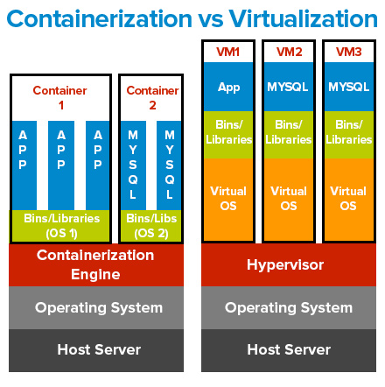

Slide 17
Current Trends
Containers are becoming more widely used because they provide many of the isolation benefits of VMs without as much time and space overhead.
Although containers are typically hosted on some version of Linux, they are also now hosted on other operating systems, such as Windows and Solaris.

Slide 18
Advantages of Container Virtualization
Hardware costs. Virtualization via containers decreases hardware costs by enabling consolidation (i.e., the allocation of multiple applications to the same hardware improves hardware utilization)
Reliability and robustness. The modularity and isolation provided by VMs improve reliability, robustness, and operational availability by localizing the impact of defects to a single VM and enabling software failover and recovery
Scalability. A single container engine can efficiently manage large numbers of containers, enabling additional containers to be created as needed

Slide 19
Advantages of Container Virtualization
Spatial isolation. Containers support lightweight spatial isolation by providing each container with its own resources (e.g., core processing unit, memory, and network access) and container-specific namespaces.
Storage. Compared with virtual machines, containers are lightweight with regard to storage size. The applications within containers share both binaries and libraries.
Performance. Compared with virtual machines, containers increase performance (throughput) because they do not emulate the underlying hardware. Not so with hybrid.
Real-time applications. Containers provide more consistent timing than virtual machines, although this advantage is lost when using hybrid virtualization.

Slide 20
Advantages of Container Virtualization
Continuous integration. Containers support Agile and continuous development processes by enabling the integration of increments of container-hosted functionality.
Portability. Containers support portability from development to production environments, especially for cloud-based applications.
Safety. Safety is improved by localizing the impact of faults and failures to individual containers.
Security. The modular architecture provided by the containers increases the complexity and difficulty of attacks. Spatial isolation largely limits impact of malware to a single container.

Slide 21
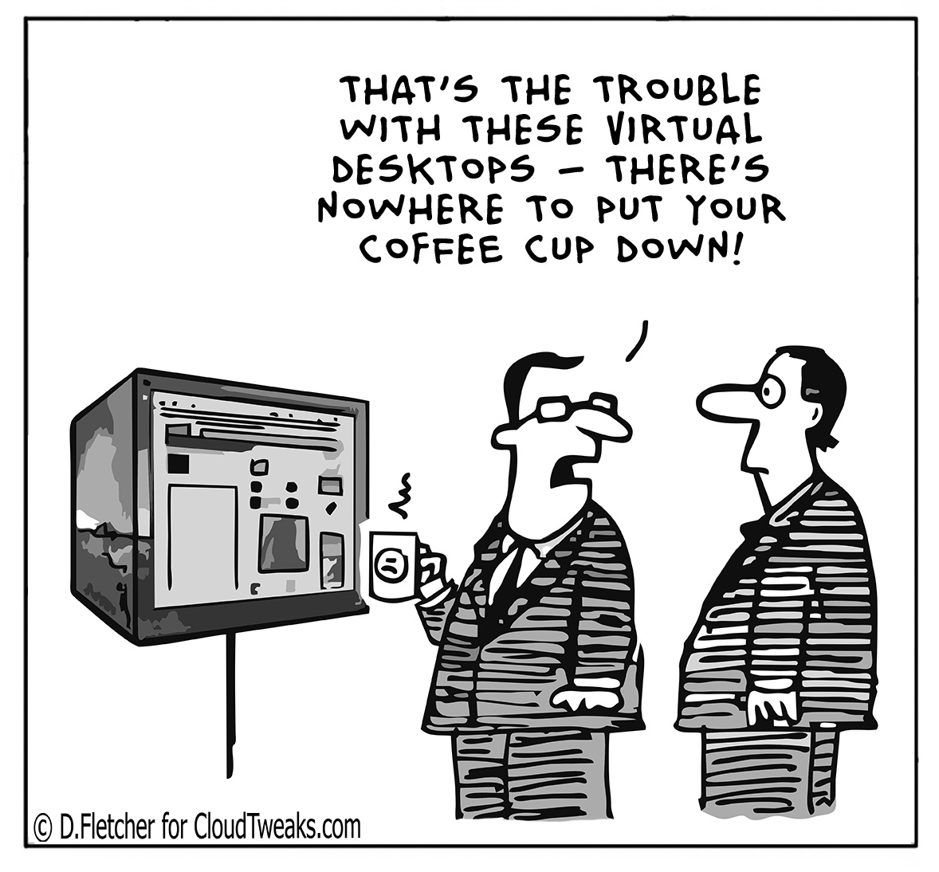
It is not all wonderful

Slide 22
Disadvantages of Container Virtualization
Shared Resources. Applications within containers share many resources including (1) container-specific resources including the container, container engine, and OS kernel, (2) virtualization by VM resources including the virtual machine, the hypervisor, and the host operating system if using a type-2 hypervisor, and (3) multicore processing resources
Such shared resources imply (1) single points of failure exist, (2) two applications running in the samecontainer can interfere with each other, and (3) software running in onecontainer can impact software running in anothercontainer

Slide 23
disadvantages of Container Virtualization
Interference Analysis. Shared resources imply interference. Virtualization via containers increases the difficulty of the analysis of temporal interference (e.g., meeting timing deadlines) and tends to make the resulting timing estimates overly conservative.
Interference analysis becomes more complex as the number of containers increases and virtualization via containers is combined with virtualization via VMs and multicore processing.
Container Sprawl. Excessive containerization is relatively common and increases the amount of time and effort spent on container management.

Slide 24
disadvantages of Container Virtualization
Safety. Although containers provide significant support for isolation, the use of containers does not guarantee isolation. Temporal interference may cause delays that cause hard, real-time deadlines to be missed. Spatial interference can cause memory clashes.
Security. Containers are not by default secure and require significant work to make them secure.
One must to ensure that (1) no data is stored inside containers, (2) container processes are forced to write to container-specific file systems, (3) the container's network namespace is connected to a specific, private intranet, and (4) the privileges of container services are minimized

Slide 25
Clarifying Types of Virtualization
Application versus Desktop versus User

Slide 26
User Virtualization
User virtualization refers to the independent management of all aspects of the user on the desktop environment.
User virtualization decouples a user's profile, settings and data from the operating system and stores this information into a centralized data share either in the data center or cloud.
User virtualization solutions provide consistent and seamless working environments across a range of application delivery mechanisms.
Although user virtualization is most closely associated with desktop virtualization, in fact, this technology can be used to manage user profiles on physical desktops as well.

Slide 27
Virtual Desktops and User Virtualization
For virtualized desktop environments, user virtualization represents a fundamental change in the way the corporate desktop is constructed, delivered and managed.
The user’s personality is decoupled from the operating system and applications, managed independently and applied into a desktop as needed without scripting, group policies or use of user profiles – regardless of how the desktop is being delivered (physical, virtual, cloud, etc.)
User Virtualization Providers: AppSense; Ivanti; Citrix UPM; VMware UEM; ProfileUnity; Microsoft UE-V

Slide 28
User Virtualization Features
Persistent personas in non-persistent virtual desktop environments
Policy and profile updates based on changes in environment
Rights management
Integration with Microsoft Active Directory
Allow users of non-persistent desktops to install applications without affecting the base machine image
Ability to connect and disconnect network printers
Ability to lockdown desktop limiting access to storage, application installs, etc.

Slide 29
Desktop Virtualization 1 of 2
Desktop virtualization is the concept of separating the logical desktop from the physical machine.
One form of desktop virtualization, virtual desktop infrastructure (VDI), can be thought of as a more advanced form of hardware virtualization.
Rather than interacting with a host computer directly via a keyboard, mouse, and monitor, the user interacts with the host computer using another desktop computer or a mobile device by means of a network connection.
In addition, the host computer in this scenario becomes a server computer capable of hosting multiple virtual machines at the same time for multiple users

Slide 30
Desktop Virtualization 2 of 2
Desktop virtualization simplifies software versioning and patch management, where the new image is simply updated on the server, and the desktop gets the updated version when it reboots.
It also enables centralized control over what applications the user is allowed to have access to on the workstation.
Moving virtualized desktops into the cloud creates hosted virtual desktops (HVDs), in which the desktop images are centrally managed and maintained by a specialist hosting firm.
Benefits include scalability and the reduction of capital expenditure, which is replaced by a monthly operational cost.

Slide 31
Application Virtualization
Application virtualization is often confused with application-server virtualization.
What it means is that applications operate on computers as if they reside naturally on the hard drive, but instead are running on a server.
The ability to use RAM and CPU to run the programs while storing them centrally on a server, like through Microsoft Terminal Services and cloud-based software, improves how software security updates are pushed, and how software is rolled out.

Slide 32

Questions?

