Slide 1
Talent Management

Slide 2
Talent Management History
Used strategically during WWII to manage workforce
Connection between human resource (HR) development and organizational effectiveness since 1970s
Coined in 1997 by McKinsey & Company
Understanding grew during the 2000s as a subset of HR
Shift from HR focused to Management/Leadership focused

Slide 3
Military Talent Management
What is the military doing for “Talent management”

Slide 4
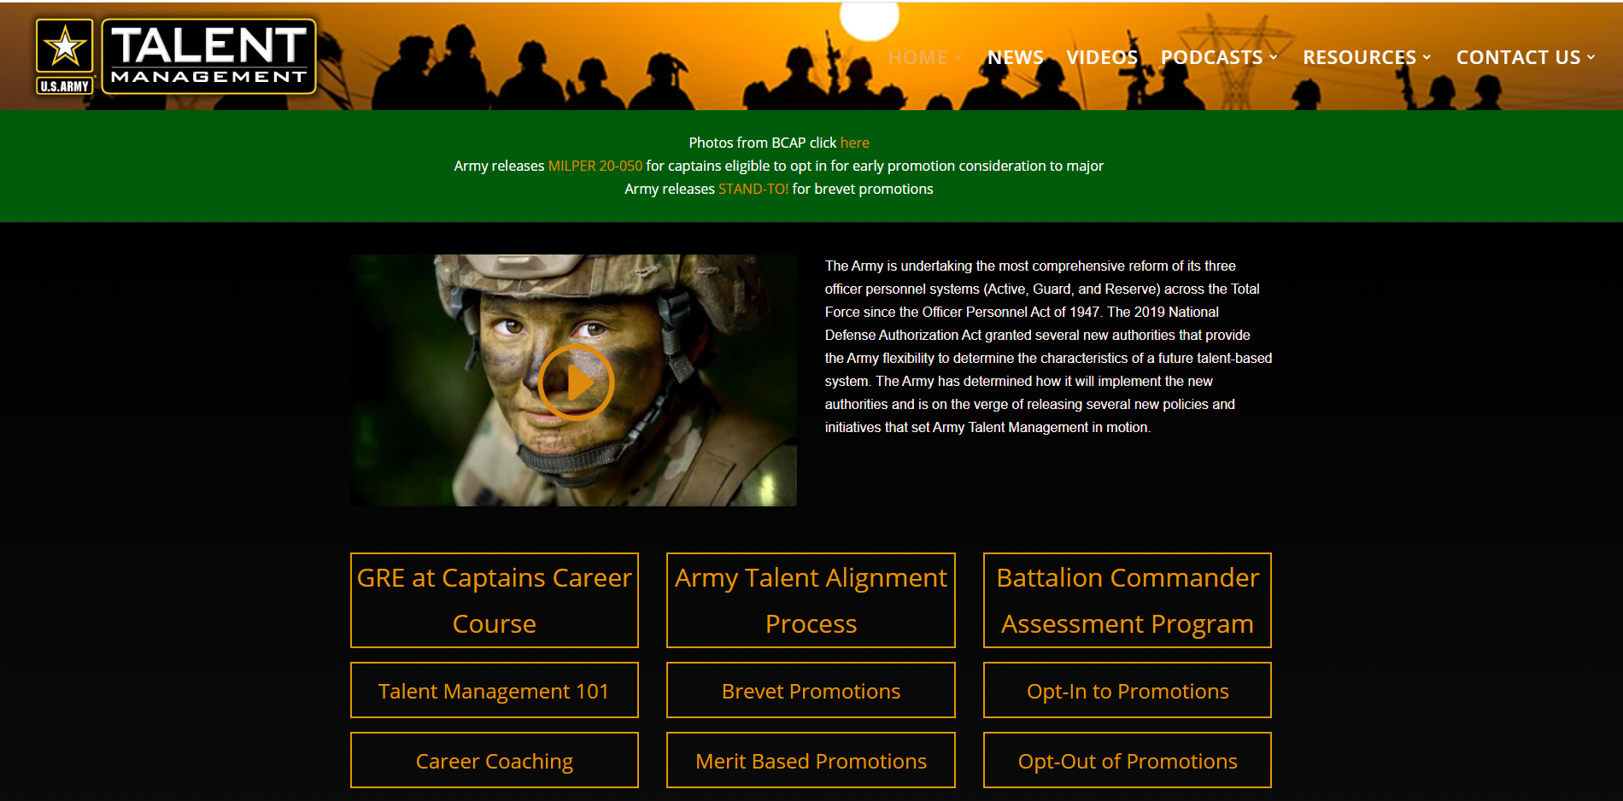

Slide 5
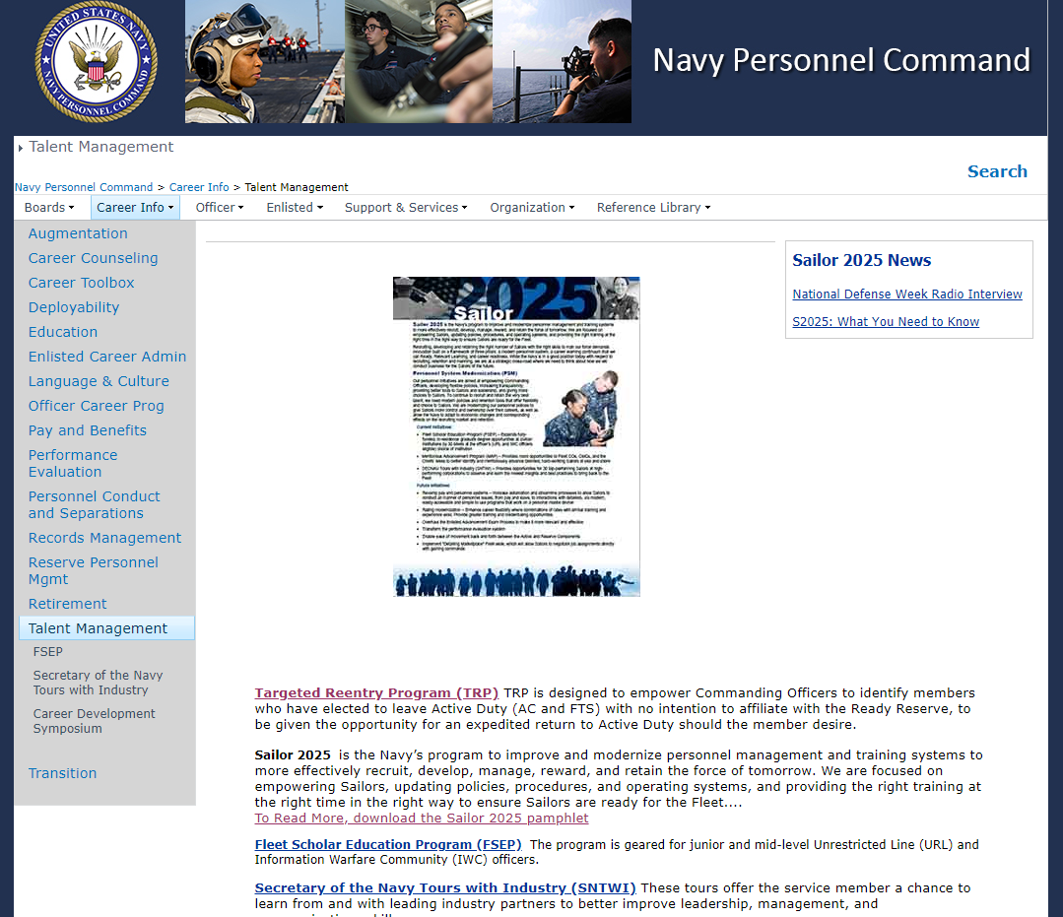

Slide 7
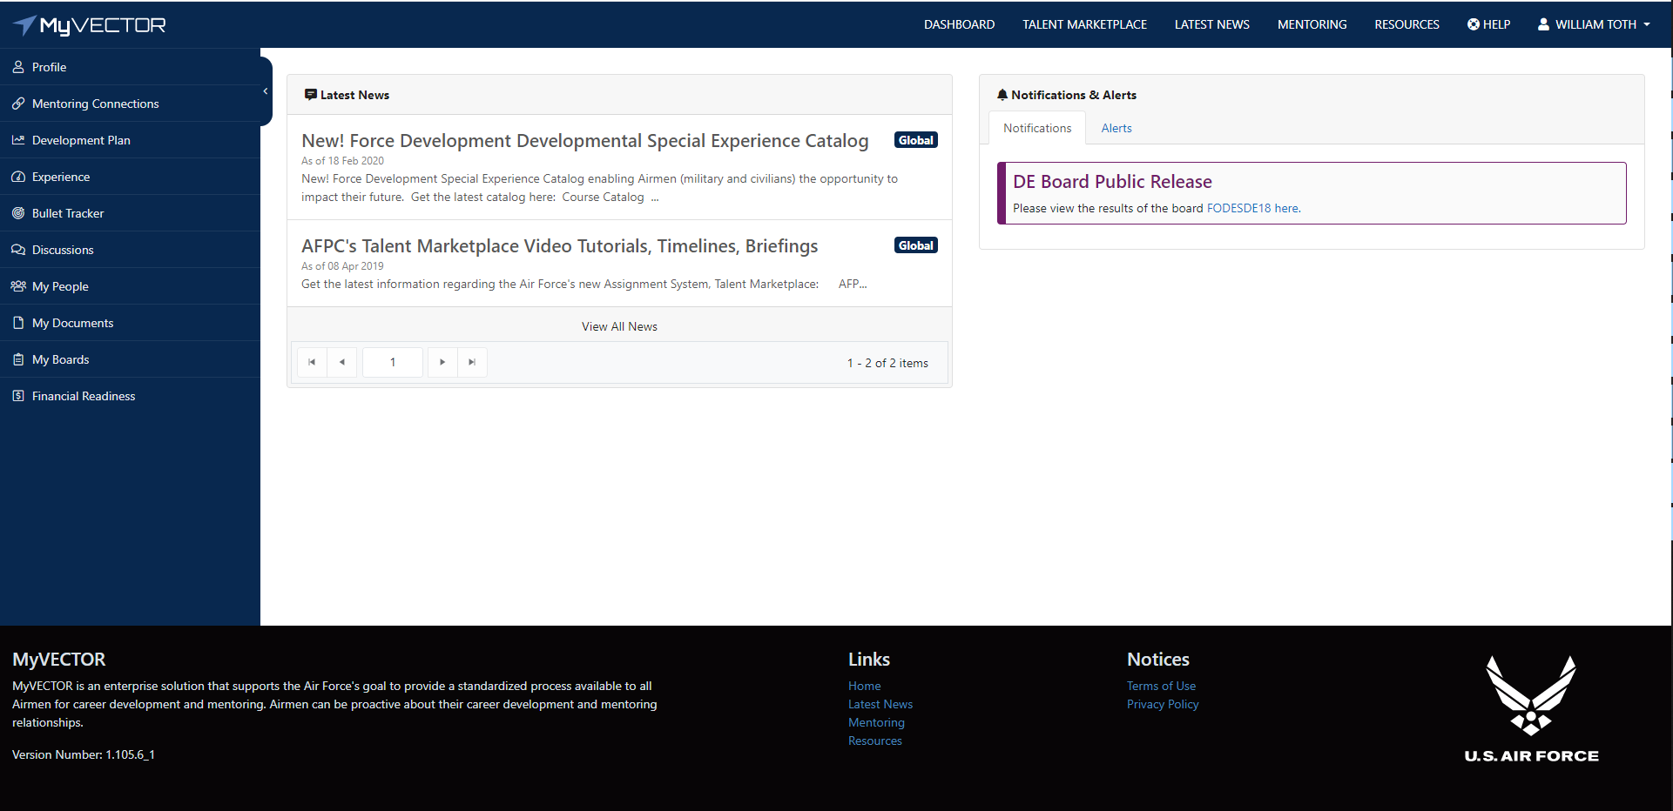

Slide 8
Talent Management
What is talent management
Why is talent management important
How do you do talent management
What does talent management mean to me

Slide 9
What is Talent Management
Strategic deployment of HR resources to help reach business goals, specifically by hiring, developing and retaining the best employees
What is the business is trying to accomplish -> how your people plan aligns with accomplishing those results
Relies on identifying mission critical process
  quantity and quality of people in place
  current and future business priorities
Employee’s “life cycle”
  managing the experience of employees from end to end
  Similar to manage the patient experience
NOT simply an HR function
  Plays an advisory and support role in the company
  They help the leaders run the company

Slide 10
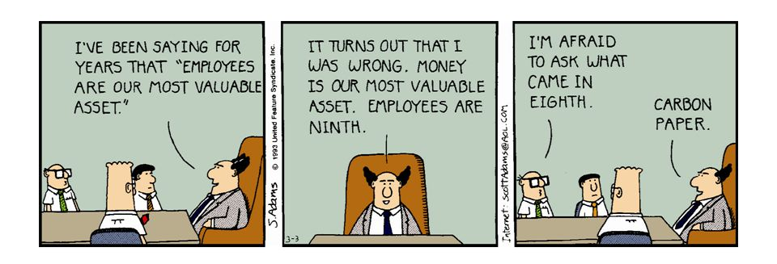
Why is Talent Management Important
Limited high-quality candidates -> “war for talent”
Hiring can be a long, expensive process that may not yield results
Ensures that the right people with the right “talents” are in the right position at the right time
People are your largest asset and what will make you successful. If you’re not leveraging your people properly, if you don’t have a people strategy that aligns with your business strategy, you’re leaving your business results up to chance

Slide 11
Why is Talent Management Important
Companies that excel at managing talent post earnings that are 15 percent higher than peers
84% of top global companies align talent with strategy, compared to just 53% of other organizations
Market is changing
  In 1982, 62 percent of an average company’s value was attributed to its physical assets (including equipment and facilities) and only 38 percent to intangible assets (patents, intellectual property, brand, and, most of all, people).
  By 2003, these percentages nearly flip-flopped, with 80 percent of value attributable to intangible assets and 20 percent to tangible assets.
Talent consistently uncovers benefits in these critical economic areas: revenue, customer satisfaction, quality, productivity, cost, cycle time, and market capitalization.

Slide 12
Why is Talent Management Important
It takes on average 43 days to fill positions
Employees holding onto jobs for an average of just 4.6 years
40% lower employee turnover and 38% higher employee engagement in companies which implemented strategic talent management process
Employees today are:
  Increasingly interested in having challenging and meaningful work.
  More loyal to their profession than to the organization.
  Less accommodating of traditional structures and authority.
  More concerned about work-life balance.
  Prepared to take ownership of their careers and development.

Slide 13
Who does talent management
EVERYONE!
It is the responsibility of the leadership to provide the initiative, time, resources (and strategy)
Traditionally headed by the HR department
Managers now play a (the) key role in talent management
The employee also plays a role (which is why selection is a big deal)
Increasingly workforce analytics to provide data for fact-based decisions

Slide 14
Talent Management Strategies
Starts with considering your business strategy
  Evaluating your organization’s current workforce
  Identify employees with leadership potential
  Identifying gaps that need to be filled with new hires
Consider employees as investments
Remember that opportunity to grow and develop their professional and personal skills is a major motivator for why employees take and stay at a job
Connect with HR
  understanding of the long-term business strategy
  start preparing now for the hires the company will need in the future.
Focus not just on the talent strategy itself, but the elements required for successful execution.

Slide 15
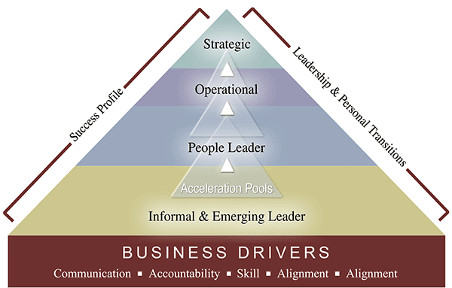
Talent management strategies

Slide 16
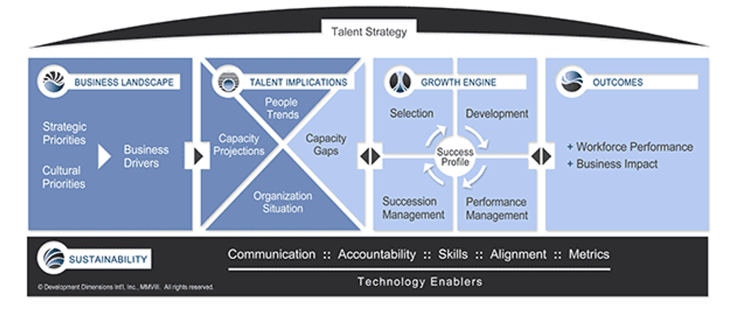
Talent management strategies

Slide 17
Organizational Strategy
Attract
Onboarding
Branding
Recruitment
Negotiation
Selection
Cultural
integration
Expectations
Personal Needs
Identify
Assess
Talent Review
Knowledge
Skills
Abilities
Performance
management
Leadership Assessment
Engagement
Business Plan
Transition
Retain
Develop
Succession Planning
Position Analysis
Rewards/Benefits
Org. effectiveness
Retention Analysis
Development planning
Coaching and Mentoring
Executive development
Training/education

Slide 18
Organizational Strategy
Attract
Onboarding
Branding
Recruitment
Negotiation
Selection
Cultural
integration
Expectations
Personal Needs
Identify
Assess
Talent Review
Knowledge
Skills
Abilities
Performance
management
Leadership Assessment
Engagement
Business Plan
Transition
Retain
Develop
Succession Planning
Position Analysis
Rewards/Benefits
Org. effectiveness
Retention Analysis
Development planning
Coaching and Mentoring
Executive development
Training/education

Slide 19
Organizational Strategy
Attract
Onboarding
Branding
Recruitment
Negotiation
Selection
Cultural
integration
Expectations
Personal Needs
Identify
Assess
Talent Review
Knowledge
Skills
Abilities
Performance
management
Leadership Assessment
Engagement
Business Plan
Transition
Retain
Develop
Succession Planning
Position Analysis
Rewards/Benefits
Org. effectiveness
Retention Analysis
Development planning
Coaching and Mentoring
Executive development
Training/education

Slide 20
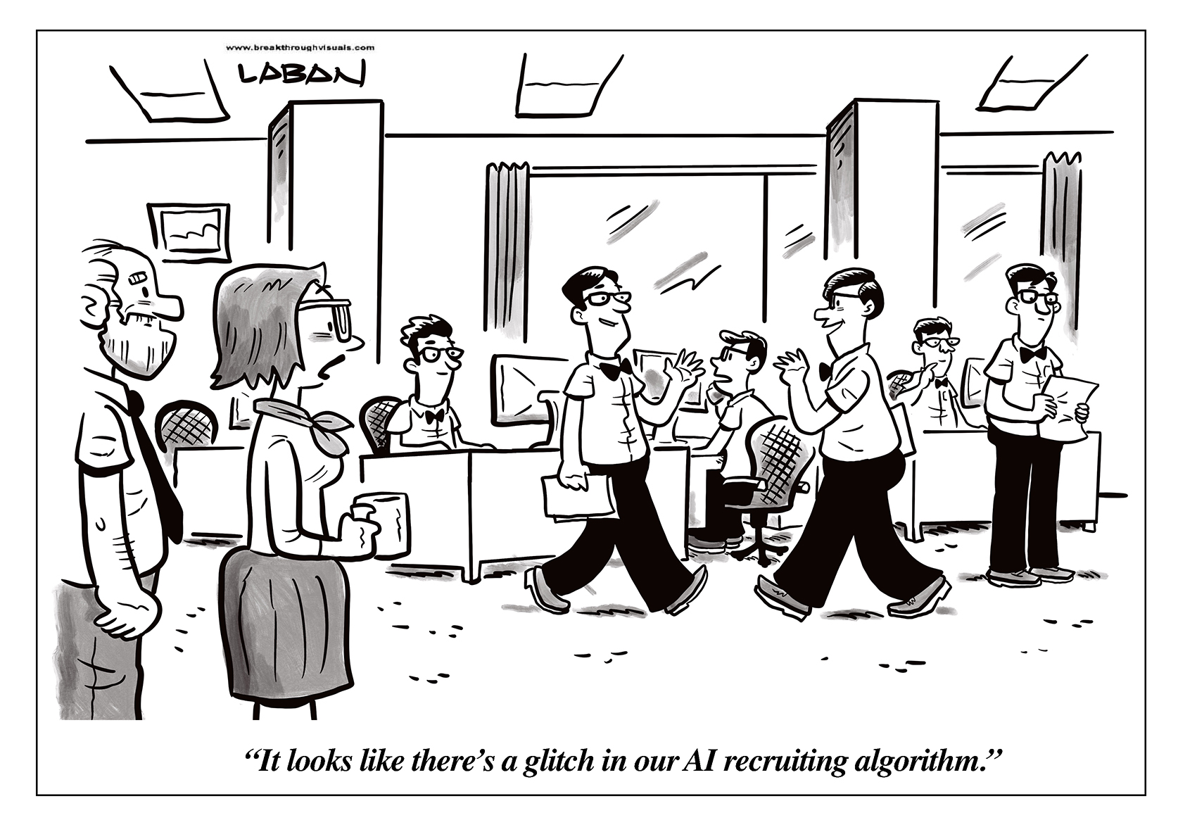
Identify

Slide 21
Identify
They need to strategize manpower requirements, compensation, and “talent”
Identification of the key gaps between the talent in place and the talent required
“Talent” is subjective, so must Identify more concrete needs
Identify Knowledge, Skills, Abilities (Behaviors, Education, Experience)
Align with the future state
Develop clear job descriptions using an employee talent tool
Competency architecture with a competency dictionary (same language)
Move from reactive to proactive hiring process
Avoids mismatched costs

Slide 22
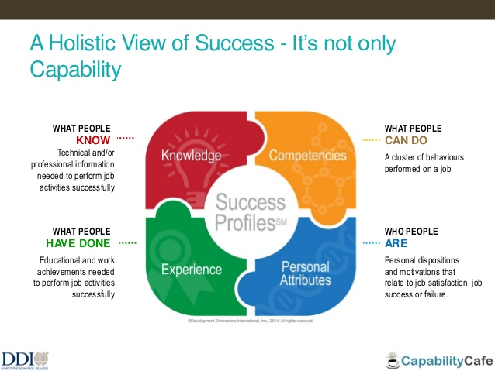

Slide 23
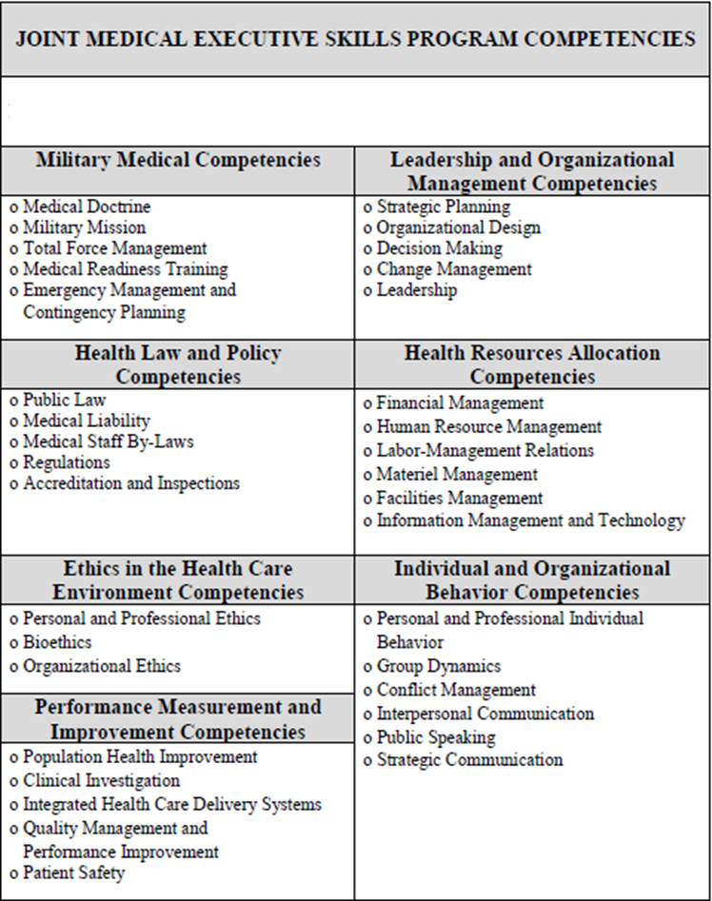
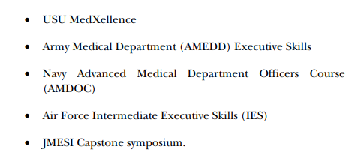

Slide 24
Organizational Strategy
Attract
Onboarding
Branding
Recruitment
Negotiation
Selection
Cultural
integration
Expectations
Personal Needs
Identify
Assess
Talent Review
Knowledge
Skills
Abilities
Performance
management
Leadership Assessment
Engagement
Business Plan
Transition
Retain
Develop
Succession Planning
Position Analysis
Rewards/Benefits
Org. effectiveness
Retention Analysis
Development planning
Coaching and Mentoring
Executive development
Training/education

Slide 25
Attract – Branding and Recruitment
Potentially the most instrumental phase of talent management
Difficulty recruiting requires improving the brand of the organization
Targeting - Where and how to advertise
Current employees are likely your #1 recruiting tool

Slide 26
Attract – Interview and Selection
Prepare in advance
Consider what information you hope to gain from the interview process
  Standarized questions allow for better comparisons
  How to handle potential issues
  How they meet the KSA/Experience needs
Get to know your candidates' strengths, weaknesses, and abilities to contribute what you need.
Use potential employee testing and assignments where they make sense for the position that you are filling.
https://hiring.monster.com/employer-resources/recruiting-strategies/interviewing-candidates/interview-hiring-guide/
Offer your selected candidate the job and negotiate the terms and conditions of employment including salary, benefits, paid time off, and other organizational perks

Slide 27
Organizational Strategy
Attract
Onboarding
Branding
Recruitment
Negotiation
Selection
Cultural
integration
Expectations
Personal Needs
Identify
Assess
Talent Review
Knowledge
Skills
Abilities
Performance
management
Leadership Assessment
Engagement
Business Plan
Transition
Retain
Develop
Succession Planning
Position Analysis
Rewards/Benefits
Org. effectiveness
Retention Analysis
Development planning
Coaching and Mentoring
Executive development
Training/education

Slide 28
Onboarding
An instrumental but oft overlooked step in the talent life-cycle
Selection requires recognizing the KSAs and cultural “fit”
Consider hiring for attitude and training for skills
Provide effective new employee orientation
Assign a mentor (provide for mentoring?)
Integrate your new employee into the organization and its culture
Cultural match of the organization are most likely to motivate people to work better

Slide 29
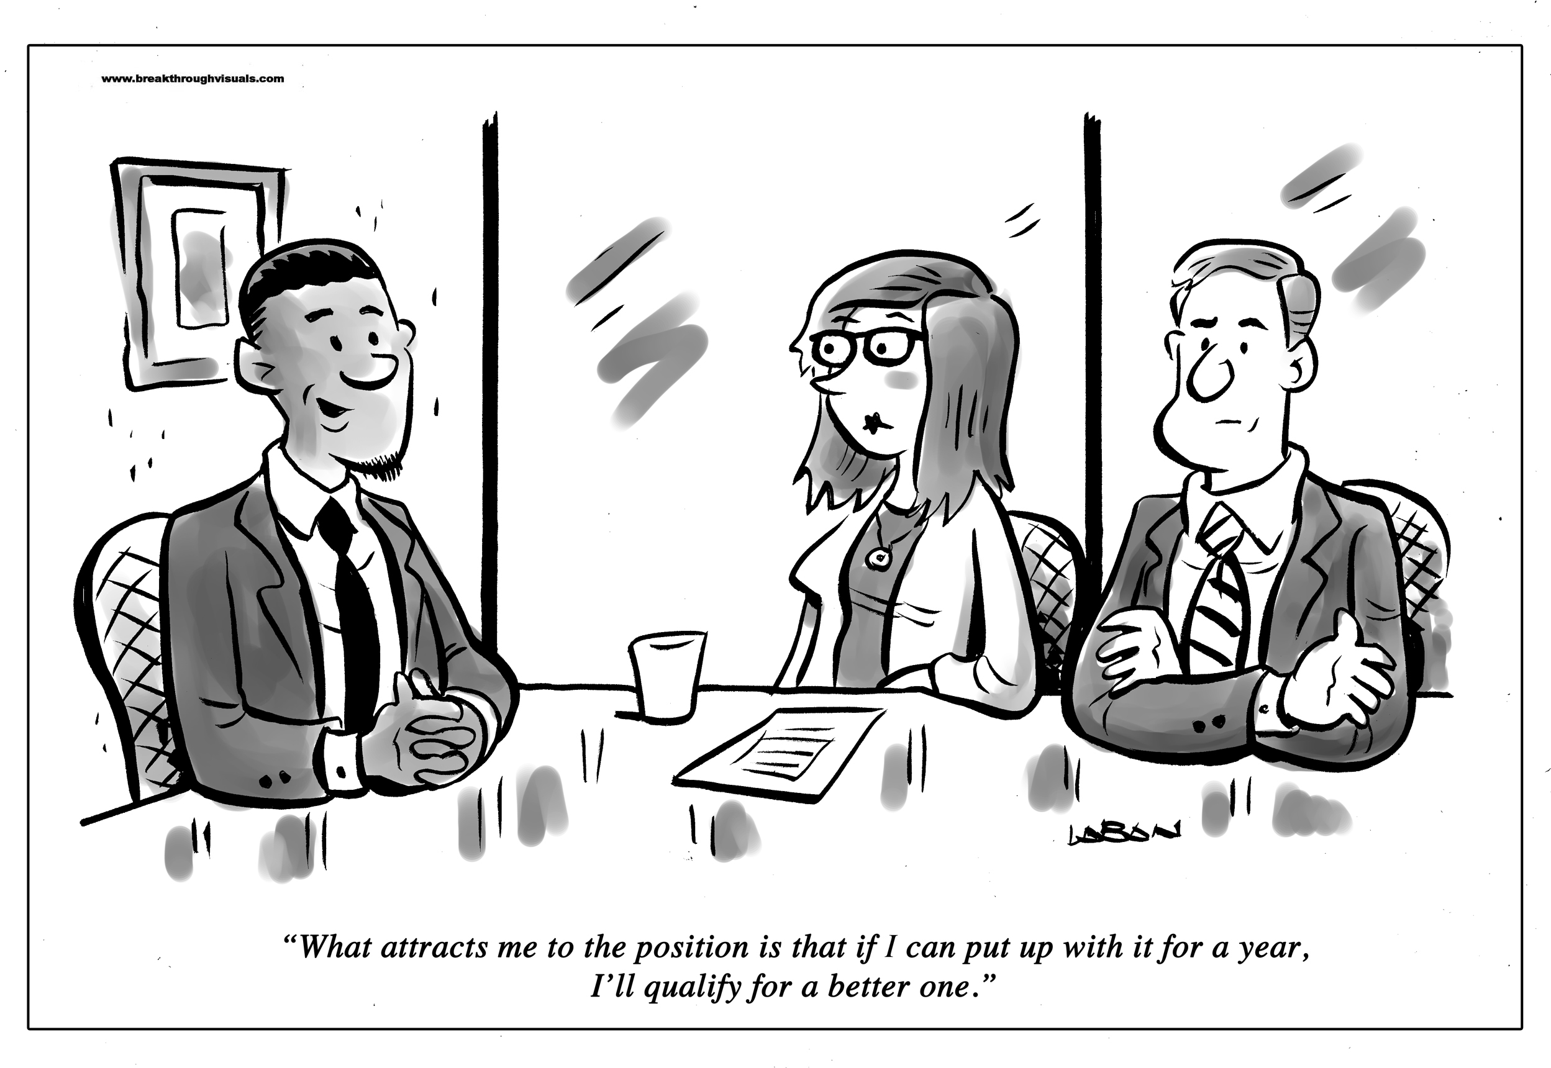
Onboarding

Slide 30
Organizational Strategy
Attract
Onboarding
Branding
Recruitment
Negotiation
Selection
Cultural
integration
Expectations
Personal Needs
Identify
Assess
Talent Review
Knowledge
Skills
Abilities
Performance
management
Leadership Assessment
Engagement
Business Plan
Transition
Retain
Develop
Succession Planning
Position Analysis
Rewards/Benefits
Org. effectiveness
Retention Analysis
Development planning
Coaching and Mentoring
Executive development
Training/education

Slide 31
Assess
Opportunity for Measure and Accountability
  Employee
  Management
  Organization
Also assess engagement
  engaged employees perform 22 percent better
  lesser rates of absenteeism
  greater customer satisfactions
Utilize employee surveys
Understand employee needs
Assess advancement/leadership potential against future organizational need

Slide 32
Assess - Performance Management
Process of creating a work environment that enables maximal performance
  Performance management is not an annual appraisal meeting
  Not a form nor a measuring tool
Develop clear job descriptions using an employee recruitment plan
Use business strategies to inform KSAs to develop a talent map (or roadmap)
  Informs how you assess your talent
  Uniform and standard across the organization
Requirements and accomplishment-based performance standards, outcomes, and measures
Conduct quarterly (minimum) performance development planning discussions.

Slide 33
Organizational Strategy
Attract
Onboarding
Branding
Recruitment
Negotiation
Selection
Cultural
integration
Expectations
Personal Needs
Identify
Assess
Talent Review
Knowledge
Skills
Abilities
Performance
management
Leadership Assessment
Engagement
Business Plan
Transition
Retain
Develop
Succession Planning
Position Analysis
Rewards/Benefits
Org. effectiveness
Retention Analysis
Development planning
Coaching and Mentoring
Executive development
Training/education

Slide 34
Develop
Managing talent needs for the future that the organization has envisioned
Employees need to be equipped with the right tools to maximize their own potential
Talent management involves strategically planning career paths that make sense for every employee
Develop training to reinforce the KSAs to match the organizational needs
Create a career map with the employee
  They have ownership and input
  Realistic
  Outlines necessary tools to make it a reality
  Improves retention scores
Employees work better they know where they are headed and what the next stop is for their careers

Slide 35
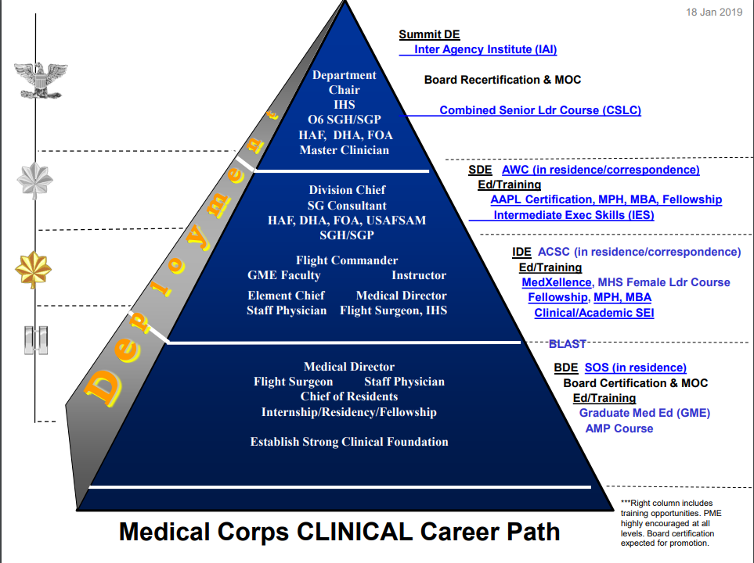
Develop

Slide 36
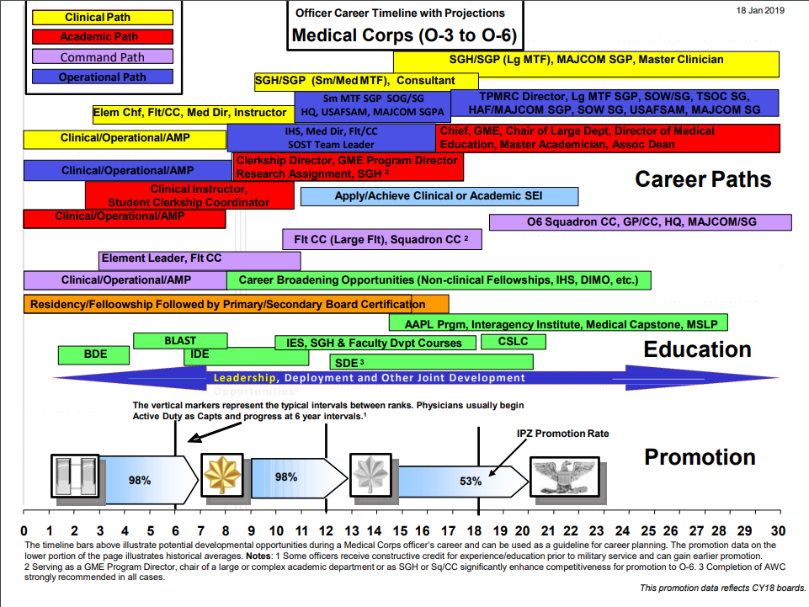
Develop

Slide 37
Develop
Train managers on motivation techniques and performance evaluation methods to better engage employees
High-value employee training programs
Feedback
Coaching
Mentoring

Slide 38
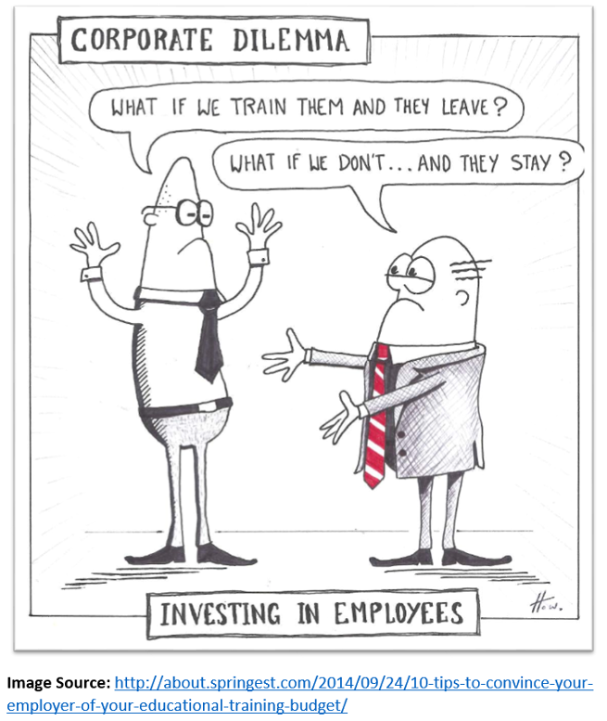
Develop

Slide 39
Develop - feedback
Encourage early
Experts desire negative feedback (constructive)
  Must be specific, task-focused
Most effective when immediate, but keep examples
Make it a habit (monthly/quarterly)
Goal is not to reprimand but drive improvement
Prepare – know the areas of KSAs that need attention
  Choose 1-2 issues (3 at most)
Publicly Praise, Confidentially Criticize
Pre-determine the follow up (both time and expectations)
Don’t forget the power of the word “AND”
Finish on a high note

Slide 40
Develop
Coaching | Mentoring
Direct Supervisor | Not Supervisor (generally)
Position Oriented | Career (or whole-person) Oriented
Short-term | Long-term
Quick, Measurable Results | Broad Goals and Objectives
Performance Based | Development Based
Knowledge/Skills/Behaviors | Growth/Abilities
“How To” | Guidance

Slide 41
Retain
Rewards and recognition are part of a strategy to motivate, engage and manage employees better
Design effective compensation and recognition systems that reward people for their ongoing contributions
  Beyond financial rewards and bonus packages (absence is de-motivating, but not motivating for long)
  employees want things that motivate them that are relevant to them as individuals
Opportunities for Growth, Creativity, and Autonomy
Provide promotional/career development opportunities including lateral moves, transfers, and job shadowing for staff

Slide 42
Transition
Promotion, Termination, Transfer
Succession Planning vs Replacement Planning
  Replacement provides a body to a position
  Succession provides a plan to get people the tools they need
A planned approach to transitions
  “Growing their own leaders” vs risky outside hires
  proactive succession processes starting at the lower leadership levels
Assist with exit interviews to understand WHY valued employees leave the organization
Avoids mismatched costs by developing the required KSAs

Slide 43
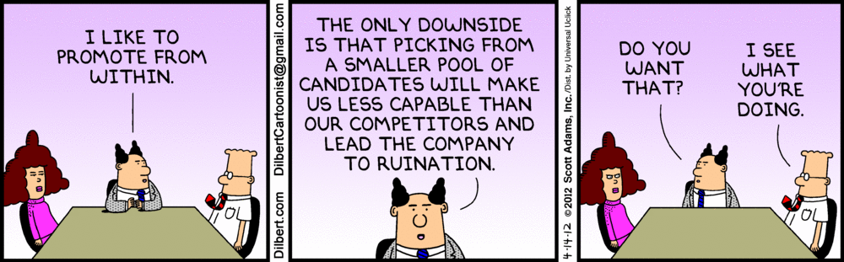
Transition

Slide 44
Role of the CMIO
Overall strategy the responsibility of leadership (including CMIO)
HR can provide support including standardization
Phases primarily in the hands of the employee's manager
  Requires prioritizing training managers
  Need to understand their impact on retention and organizational success
Must develop the KSAs for the ongoing evaluation

Slide 45
Final Thoughts on Talent
“If you have only one dollar to spend on either improving the way you develop people or improving your selection and hiring process, pick the latter.”
  Not everything can be developed
  Training people to improve their judgment, learning agility, adaptability may be impossible
  Lack of motivation for a specific role or a poor fit between employees’ values and those of the organization leads to poor performance
  Hiring for the right skills is more efficient than developing those skills
Impediments to effective integrated talent management efforts include conflicting priorities, limited resources, non-supportive corporate cultures, incompatible organizational processes, and senior leaders who undervalue integrated talent management.

Slide 46
Final thoughts (roi)
Resources for employee development are limited
The best returns are to focus on promising individuals
Focus on two major categories:
  high-potential leaders
  individuals who create value for the organizations
potential, performance, and readiness.
  This is not unlike an athlete. good performance at one level of competition is no promise that the athlete can keep up at the next level Taking a leader from potential to readiness is an equally long process. It takes, on average, 10 years for a high-potential leader to advance into a senior position and along the way, that individual needs mentoring, stretch assignments, personalized development plans, and development activities to build key skills. In short, it’s a lot of work.

