Slide 1
System Needs Analysis & System Evaluation
Bob Marshall, MD MPH MISM FAAFP
Faculty, DoD Clinical Informatics Fellowship

Slide 2
Learning Objectives
Overview of needs assessment
Granular look at needs assessment
CIS testing overview and individual steps
Overview of CIS evaluation
Steps in CIS evaluation, and performing an evaluation project

Slide 3


Slide 4
Assessing need 1 of 2
Important to assess need prior to purchase or implementation of clinical information system
The first step is to answer the “need” versus “want” question
Particular questions to ask during the needs assessment include the following:
Why do we need this system?
How will it improve the care we deliver to our patients?
What is the impact on patient safety?
Will it require changes to the clinician’s current workflow?

Slide 5
Assessing need 2 of 2
Particular questions to ask continued:
Does it have the potential to save money?
What is the estimated cost, both initially and ongoing? Does it have the potential to save time or streamline a workflow process?
What is the risk to the organization if we do not implement this particular CIS?
How can those risks be mitigated?
Does this system support the strategic plan?

Slide 6
More granular Needs assessment
The assessing needs slides are aimed at the systemic level; there is also the requirement for assessing needs at lower levels, all the way to the individual user
On the individual end-user level, you still have the needs versus wants discussion
However, at this level, it also gets into usability and functionality in terms of individual patient care
This is where the need for customization and standardization occurs

Slide 7


Slide 8
CIS testing
CIS testing is part of the evaluation process in both the implementation and maintenance phases.
It requires planning and attention to detail
The goals of testing are to evaluate if the given system is built according to its specifications and design and to reduce the risk of critical problems when turned over to the end user
This is especially critical in systems like electronic health records that could result in patient harm if there are performance problems

Slide 9
Types of CIS testing
Unit testing
Functional testing
Integration testing
Performance testing
User acceptance testing
Production validation testing
Regression testing

Slide 10
Unit testing
This is performed well in item or system component is being developed and before it’s turned over to a testing team
It is performed by the builder or developer
This testing is low-level and includes testing of foundational configuration
This includes testing such things as spelling, font, color and location of content

Slide 11
Function testing
This typically requires the assessment of data flow to other systems
Most clinical information systems must integrate with other systems, hence the need to test the functioning of an interface engine using defined standards
An example would be lab order entry and lab results retrieval between the CIS and a lab system
Other types of function testing:
Printing and testing of various reports
End-user security privileges and access
Function of integrated medical devices

Slide 12
Integration testing
Essentially includes functional testing of the entire process from multiple care providers perspectives
An example would be the process from multiple end-users perspectives for ordering and giving a blood transfusion
For such a scenario, testing becomes quite complex as the testing team simulates various roles in the process: position, lab technician, nurse and blood bank technician

Slide 13
Performance testing
Entails creating scenarios that test the system when a high volume of users are accessing and using the system at the same time
Generally, the tester create scripts which get executed by performance testing program
Monitoring software should also be in place at this time to help validate the system memory, processor allocation and response time
This is a very highly technical approach, but it can be performed on a smaller scale by groups of people performing tasks simultaneously, and then monitoring response times

Slide 14
User acceptance testing
This is where the end-users are brought into a testing center, put them in a developmental practice environment and have them test new functionality
Care providers provide feedback on screen layout, field names, dataflow between screens and overall workflow support
This is one of the most important phases, and probably the least conducted
Omit this phase, and the project manager should plan on performing we work and hearing frustrations from end-users after go live

Slide 15
Production validation testing
Once new functionality (or a new EHR) is promoted into the live, production environment, it should be given one final test
While a development or test environment that mimics production can work very well when creating new functionality it will never be exactly the same as a live database
For this very reason, the developer/builder should validate one last time to ensure that what they built is working as designed

Slide 16
Regression testing
New features and functions will be continuously added to enhance a clinical information system to support clinical care
As such, the complex CIS is in a constant and dynamic state of change
Regression testing attempts to assess the systems basic and core functions whenever significant changes are made
Regression testing typically includes the testing of:
Order entry
Clinical documentation
Orders to other systems via HL7 messaging
Preview of key reports
Alerts, such as drug allergy and drug-drug interactions
Patient admission, discharge and transferring functions

Slide 17
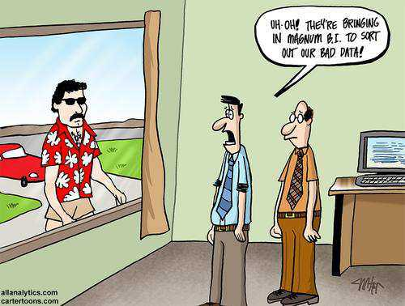

Slide 18
Evaluating outcomes of CIS use 1 of 2
Both HIMSS and AHRQ have independently developed five-step processes for looking at health system evaluations
In the 2015 book, Sengstack provided eight steps to walk informatics specialists through an outcome evaluation project:
Identify the area of focus for the evaluation
Determine the problem under study and the evaluation question
Review the associated literature
Identify the appropriate data to be collected

Slide 19
Evaluating outcomes of CIS use 2 of 2
Steps of an outcome evaluation project (continued):
Determine the type of study
Determine the data collection method and sample size/date range
Collect and display the data
Document and disseminate results

Slide 20
Identify the area of focus
Prioritize a list of potential topics to evaluate
Generate initial ideas with the organization’s key stakeholders
Ensure the work supports the organization’s mission and goals
Brainstorming is a good technique for developing ideas
Use voting in a nominal group technique to make decisions regarding where to start

Slide 21
Determine the evaluation question
Determine the question that will lay the foundation for the entire valuation
A clear, focused question helps the team determine what data will need to be collected and how it ultimately should be reported
A couple of examples:
To patients who enter their blood glucose readings into their patient portal have better control over their diabetes in patients who do not use a patient portal
Has duplicate ordering of chemistry labs been reduced since duplicate order checking functionality was implemented

Slide 22
Review the associated literature
Conduct a literature review
There may be others who have studied this question in the past, and evidence may already be published that answers the question
Searches should be conducted in peer-reviewed journals by searching the available databases such as PubMed, meta-search engines and things like the Cochrane Reviews

Slide 23
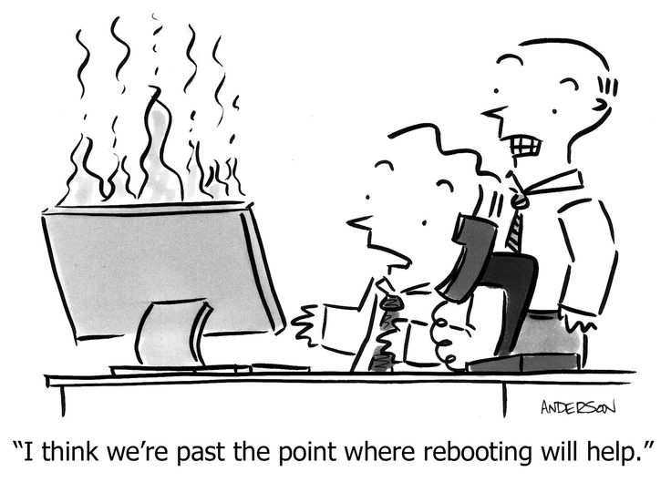

Slide 24
Identify the appropriate data to be collected
Determine the specific data elements to be collected
Breakdown evaluation project into it subcomponents
Determine what pieces of data are necessary to collect to look at all of those subcomponents
By doing so, you should be able to identify even the more obscure pieces of data to capture
Don’t forget about ratios and other things that require population numbers and demographics that aren’t necessarily thought of.

Slide 25
Determine the type of study
Randomized control trials are difficult to conduct in the area of health IT
The majority of health IT outcomes evaluations are descriptive studies or comparative studies over time (i.e., pre-post studies)
Keeping it simple, clear and straightforward is key
This helps to ensure that the evaluation can be conducted, and
Information gleaned from the assessment can easily be disseminated to an audience for action
It is helpful to consult a statistician to determine what information is needed to perform desired statistics

Slide 26
Determine data collection method and sample size/date range
The exact method to be used to attain data is clarified
Ensure key stakeholder consensus on both the type of data and the collection method data can be obtained to answer an outcome question in a number of ways:
Data from the EHR or another database
Manual chart review
Workflow studies with end-users
Surveys
Focus groups

Slide 27
Collect and display data
Once the data has been collected over the agreed-upon timeframe, it will need to be presented and displayed in a format comprehensible to multiple audiences
Data can be displayed in graphs, charts and/or tables
Data representing outcome evaluation results must contain all the information necessary for interpretation
Have someone view the data who is not a technical whiz kid to ensure interpretability

Slide 28
Document and disseminate results
Once you are done you want to write up your evaluation and potentially submit it for publication
Without comprehensive documentation of the study, the chance that any practice improvements will occur becomes unlikely
Because of the paucity of well conducted evaluation studies on electronic health records and other components of health IT, there is a great need for solid evidence to move the discipline of health IT along to actually achieve the promise of lower costs, greater efficiency, improved patient outcomes and greater patient safety

Slide 29
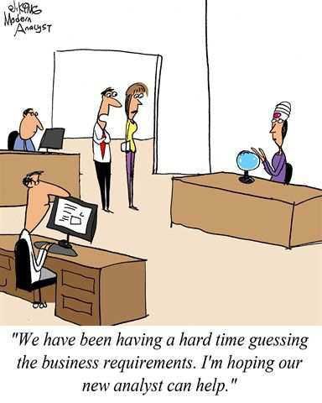
questions

