Slide 1
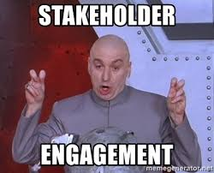
Stakeholder Engagement
Bob Marshall, MD, MPH, MISM, FAAFP, FAMIA
Program Director, DoD/MAMC Clinical Informatics Fellowship

Slide 2
Learning Objectives
Define Stakeholders
Provide some models of stakeholder engagement
Identify the parts of a stakeholder engagement plan
Discuss how to design a stakeholder engagement plan
Discuss how to improve stakeholder engagement

Slide 3
Stakeholder Engagement Definition
Stakeholder engagement is the process by which an organization involves people who may be affected by the decisions it makes or can influence the implementation of its decisions
They may support or oppose the decisions, be influential in the organization or within the community in which it operates, hold relevant official positions or be affected in the long term
An underlying principle of stakeholder engagement is that stakeholders have the chance to influence the decision-making process
This differentiates stakeholder engagement from communications processes that seek to issue a message or influence groups to agree with a decision that is already made

Slide 4
Identifying Stakeholders
There are numerous models and methods for identifying stakeholders.
One recommended approach (Deloitte) focuses on two dimensions;
  the stakeholder’s influence on the organization and
  the stakeholder’s dependence on the organization
These two dimensions are plotted using a simple rating scale, resulting in the grouping of stakeholders in 4 quadrants as set out in the following slide…which is simply a 2x2 table

Slide 5
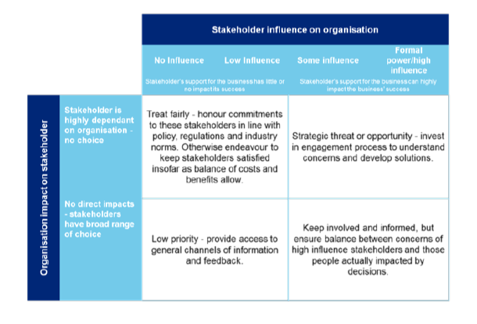

Slide 6
Key Focus Areas
The key focus area should be top right quadrant (high influence and high dependence)
This does not mean that other stakeholders are not important, but engagement with these stakeholder groups will be targeted at different levels and forms
This needs to be a robust process, using objective criteria, to confirm whether the important stakeholders of the organization have, indeed, been identified and prioritized

Slide 7
Deloitte’s Approach
Develop an engagement plan, including frequency, method and channel
Facilitate the stakeholder engagement process
Identify the legitimate concerns and interest of key stakeholders
Design a process for dealing with conflicts between stakeholder concerns
Define a mechanism to feed stakeholder concerns into strategic planning to ensure alignment
Provide feedback to stakeholder groups
Generate reports, including input for Integrated Report

Slide 8
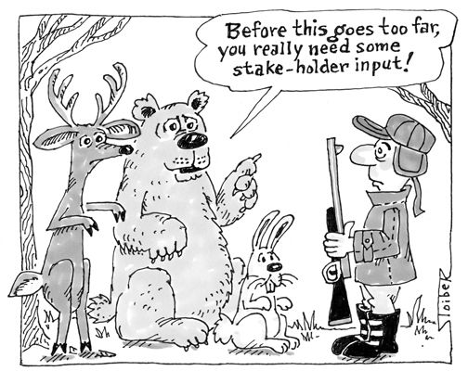
Another Model/Approach

Slide 9
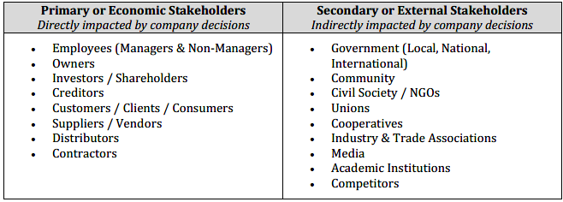
What are Stakeholders?
Generally refers to any individual or group that, either positively or negatively, impacts or is impacted by the decisions and actions of an organization.
They are often categorized into two groups based on whether the impact is direct or indirect.
Examples include, but not limited to:

Slide 10
Benefits of Engaging with Stakeholders
Building Trust: Sincere efforts at engagement can improve relations between a company and its stakeholders
  This can diffuse existing tensions and make it easier to solve potential problems down the road
Risk Management: Working with stakeholders can lead to a more stable operating environment and reveal critical information that is important for company decision-making
Brand Enhancement: By engaging with stakeholders a company can improve its visibility and reputation
  Customers, investors, and other economic stakeholders may also view this engagement as a differentiating factor in the market

Slide 11
Benefits of Engaging with Stakeholders
Improved Productivity: Better internal engagement can identify areas in which the company can become more efficient.
  Additionally, employees that have a greater voice in the workplace tend to have higher morale.
Strategic Opportunities: Engaging with stakeholders can help a company to identify new business opportunities and market segments.
Partnerships: By collaborating with stakeholders, companies can pool resources to achieve a common goal.
Increased Investment: Greater transparency and stakeholder engagement can be an attractive draw for capital, particularly from impact investors

Slide 12
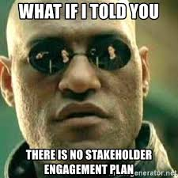
Parts of a Stakeholder Engagement Plan

Slide 13
Stakeholder list
The first step in any stakeholder engagement plan is to list the stakeholders.
But it’s important to be thorough because it’s easy to underestimate the ability of a minor stakeholder to trip up the project when they’re not being communicated with adequately.
According to the PMBOK, this list is called a Stakeholder Register, and it is created as part of the Identify Stakeholders process.

Slide 14
Project Phase
Many stakeholders will be involved in only a certain phase of the project

Slide 15
Contact Name(s)
It’s important to be in contact with the correct people.
Large organizations or government (regulatory) stakeholders have many layers of bureaucracy which can result in project delays when the primary decision maker is not being communicated with directly

Slide 16
Areas of Influence
This is where the stakeholder’s “stake” is defined.
How do their interests overlap with the project?
What are their business goals and how does your project interfere with them?
Why is this stakeholder interested in your project?
There can be no meaningful stakeholder engagement without understanding each other’s viewpoints

Slide 17
Power
Each stakeholder has a unique ability to stop and/or change the project.
What is that ability?
Where does it derive from, and how can it be controlled?
Sometimes the stakeholder’s power over the project can be removed, but this comes at a cost, both monetary and in stakeholder satisfaction (they could become very unhappy and influence other stakeholders).

Slide 18
Engagement Approach
The strategy for engaging the stakeholder must be outlined in detail.
The types and frequency of communication, for example weekly emails, monthly phone calls, or weekly face to face meetings.
The content of those communications, for example a weekly update that contains project progress, design information, and open house plans

Slide 19
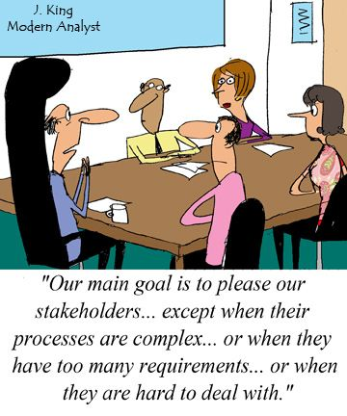
Designing an Engagement Plan

Slide 20
Identify Stakeholders and Key Issues
  Profile stakeholders to understand their interests, knowledge, and capacity to engage
  Categorize or map stakeholders based on the characteristics and issues that are most important to the company or project
  Prioritize the issues and stakeholders that are most important to the business
  Identify who are the legitimate and accountable representatives of each stakeholder

Slide 21
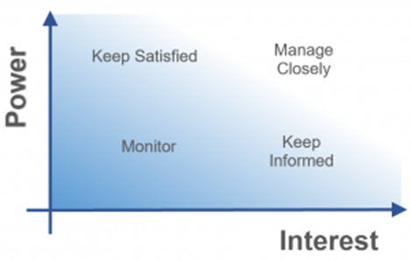
Develop a Power/Interest Grid

Slide 22
Power/Interest Grid
This is the primary stakeholder analysis tool.
It contains the power of the stakeholder on the y-axis, which is the ability of the stakeholder to stop and/or change the project, and the interest level of the stakeholder on the x-axis, which is the amount of overlap the stakeholder’s interests have with the project.
This defines the stakeholder’s “stake” in the project

Slide 23
Define Power
Although the stakeholder’s location on the chart is important, a verbal analysis of the power of the stakeholder is imperative to get a sense of how much influence the stakeholder has.
For example, a government regulatory agency usually has extremely high power to stop the project – they can withhold their approval and stop the project immediately.
The success of the project is heavily dependent on keeping them informed on an ongoing basis

Slide 24
Define Interest
Once again, the location of the stakeholder on the chart is expanded and analyzed to determine what their interest in the project really is.
The stakeholder’s business interests are analyzed and prioritized.
Their needs and wants are described to a point where the stakeholder is well understood by the project management team

Slide 25
Establish Objectives and Process
Decide on the scope of the process, timeline, and level of engagement.
Set strategic goals and agree upon expectations.
Determine what methods are best suited to achieve these objectives and how to measure outcomes.
Identify whether there are any regulatory or financial requirements for disclosure or engagement.
Assign ownership for the process and outline responsibilities for carrying out the different components of the plan
Determine the resources available for engagement and any training needed in order for all stakeholders to engage effectively
Establish a method for documenting progress and outcomes

Slide 26
Implement Plan
Managers make sure that the process moves forward as planned, gather data, and coordinate with any third parties that are involved.
Embed commitment to engagement across all levels of company corporate and operating areas.
Communicate progress to all stakeholders on a frequent and transparent basis.
Enact written grievance mechanisms to allow stakeholders a chance to provide feedback during the process

Slide 27
Review and Report
Keep track of how outcomes correspond with original objectives
Empowering stakeholders in this process gives them more ownership and can strengthen the relationship
Use findings and feedback to revise the plan as needed and capture key learnings that can be applied in future stakeholder engagement initiatives
Provide regular and transparent information to stakeholders about the results of the engagement

Slide 28
Principles for Successful Engagement
Engage with stakeholders early and often
Make it easy for stakeholders to understand
Take a long-term approach to engagement
Remain thoughtful and sincere
Mutually define expectations
Tailor engagement to the context
Sensitivity to stakeholder dynamics
Recognize challenges

Slide 29
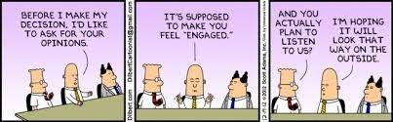
Improving Stakeholder Engagement

Slide 30
Show the Stakeholders You Care
Stakeholders understand that someone wants to win them over, and that the organization probably has a plan to do just that
A little bit of empathy costs nothing, but accomplishes great strides in addressing project opposition

Slide 31
Emphasize the Human Aspect
Private sector projects are undertaken by organizations that hope to enhance their bottom line, to increase their profits.
Government and NGO projects also have goals that sometimes overlap with stakeholders with conflicting interests.
Even private sector projects have a societal benefit – the employment of the project staff, that is, the project is a crucial piece in the generation of prosperity to society.
In other words, there are people on both sides.
Project stakeholders should be consulted in a way that communicates the benefits to society rather than purely increasing investor profits

Slide 32
Give Stakeholders a Voice
More than anything else, people want to be heard.
It’s amazing what type of transformation takes place when a stakeholder is allowed to voice their concerns and realizes that it’s being heard.
Most stakeholders are well attuned to the possibility that they will be listened to and ignored.
The transformation occurs when they truly believe that the project management team has considered their concerns and tried very hard to implement them.
And this belief is not accomplished by the development and rigid implementation of a plan.

Slide 33
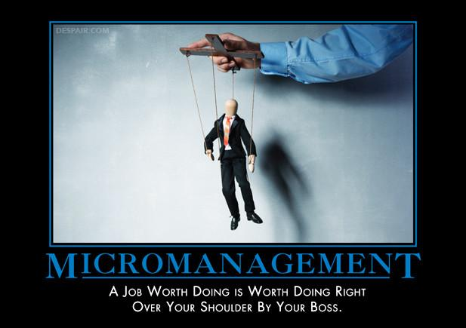
Questions/Further Discussion

