Slide 1

Software System Integration
Victor Lin
Dod clinical informatics fellowship

Slide 2
Learning objectives
Explain the concept of system integration, particularly as it relates to IT.
Introduce software system integration as a subset of the system integration concept.
Discuss the process of software system integration, and how it relates to the software development life cycle.
Discuss the process of software integration testing.

Slide 3

System integration

Slide 4
System Integration
In engineering, system integration is the process of bringing a system’s components or sub-systems into a coherent whole, and ensuring that they all function well together.
In information technology, it is the act of bringing together disparate computing hardware and software applications, to create a functioning system.

Slide 5
Software system integration
One of the practice areas of software engineering.
Various components of a software system must work well with others, and the software must integrate well with other software applications.
According to the Software Engineering Institute at Carnegie Mellon, software system integration is the “practice of combining individually tested software components into an integrated whole.”

Slide 6
Software system integration
Software
System/product
Subsystem 1
Component
A
Component
B
Subsystem 2
Component
C

Slide 7
Benefits of software system integration
Integration of existing subsystems or software packages to deduce need to acquire new off-the-shelf software.
Adds value and capabilities to existing system.
Reduces need to manually enter data into different systems.
Software components can be built by different individuals independently at different times and in different locales.
Can increase productivity.

Slide 8
Challenges in software system integration
Can be a long and complicated process.
Components come from different vendors.
Requires close attention to details.
Often requires system integrator (group of professionals or company) to facilitate the integration.

Slide 9
Software integration process
Components/subsystems of the software are built/programmed separately.
The components are integrated after they are built and tested.
Software system integration occurs towards the end of the SDLC between component development and integration testing.

Slide 10
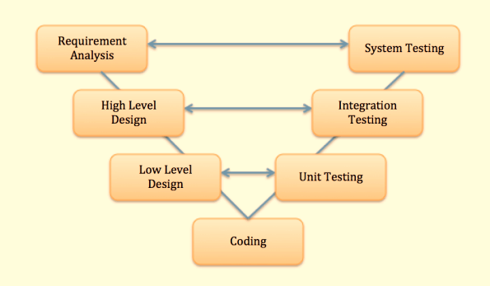
Software integration in SDLC

Slide 11
Interface between components
Software components must be programmed properly interface with each other for the system to integrate, and to ensure seamless data flow.
In programmer’s lingo, the interface between the components constitutes the assumptions that that the programmer for one component can safely make about another component (Parnas definition).
Defines how each component connects to and works with the others.
With careful interface definition and documentation, the integration can proceed much more smoothly.

Slide 12
“big bang” approach
Components are individually built.
Components are individually tested.
The components are integrated together.
Integration testing occurs to ensure all the components work well together.
Components are revised as needed based on the integration testing.

Slide 13
Continuous integration approach
In contrast to the “big bang” approach, the continuous integration approach is much less risky.
Integration testing occurs continuously and individually, rather than at the end with the entire system.
As the components are being designed and built, they are integrated into multiple subsystems.
Integration testing occurs with each subsystem.
Further components are built onto these subsystems.

Slide 14
Software integration testing
Level of software testing where the individual subsystems/components are combined and tested as a whole.
Goal: To expose flaws in the interactions and interfaces between the integrated subsystems/components.
Integration testing may occur when two or more components are built and ready.

Slide 15
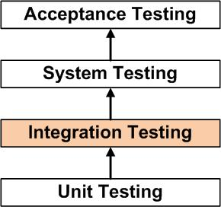
Software integration testion

Slide 16
Integration testing tasks
Planning for testing
  Prepare
  Review
  Rework
  Baseline
Preparing scripts and test cases for testing
  Prepare, Review, Rework, Baseline
Conducting the integration test
From: http://softwaretestingfundamentals.com/integration-testing/

Slide 17
Integration testing approaches
Big Bang: When all or most of the components are combined together and tested all at once.
Top Down: Top level units are tested first, and subsequently the units below are tested step by step.
Bottom Up: Bottom level units are tested first, followed by the units above.
Sandwich/Hybrid: Combination of top down and bottom up approaches.

Slide 18

Questions?

