Slide 1
Adaptive IT Governance

Slide 2

"IF EVERYTHING SEEMS UNDER CONTROL, YOU'RE NOT GOING FAST ENOUGH."
Mario Andretti
Notes:
Placeholder for text (substitute your own text; delete when not used)

Slide 3
Key Issues
Where do traditional approaches to IT governance break down?
What is adaptive IT governance, and how are enterprises benefiting from it?
What are leaders doing to implement adaptive IT governance?
Notes:
We'll cover the following key issues as this story unfolds: do traditional approaches to governance break
Where do traditional approaches to governance break down?
How do strategy and governance complement each other?
What is the focus of a governance reset for digital business?
Where do traditional approaches to IT governance break down?
1. IT governance, undervalued and underestimated
a. Digital trends (IoT, autonomy)
b. Regulatory pressure
c. Agility
2. IT governance, intent and purpose
a. Define governance
3. IT governance breakdown
a. Existing slide from EDG
4. IT governance and culture
a. Hook into why values are important to recognize
Placeholder for text (substitute your own text; delete when not used)

Slide 4
Key Issues
Where do traditional approaches to IT governance break down?
What is adaptive IT governance, and how are enterprises benefiting from it?
What are leaders doing to implement adaptive IT governance?

Slide 5
GOVERNANCE
UNDERESTIMATED
UNDERVALUED

Slide 6

IT Governance — Undervalued and Underestimated
38% of CIOs reported that senior business leaders' lack of understanding and/or involvement in critical IT decisions are often or always obstacles to strategically leveraging IT.
62% of CIOs reported that nonprioritized competing projects and programs are often or always obstacles to strategically leveraging IT.
Only 48% of CIOs reported that business executives are mostly or completely satisfied with IT's contribution to the enterprise.
Source: Gartner ITScore

Slide 7
Governance Breakdown
No Mandate
No Strategic Focus
Governance lacks strategic focus — Only tactical and operational considerations are made, leading to challenged strategy execution.
No business value — Governance decisions are not business value or outcome based.
No priority setting — There is an inability to set the right priorities (strategy versus operations) against limited resources or regulatory constraints.
Designed by IT for IT — Governance is a critical capability of the business to balance risk and business outcomes.
Culture Clash
No Business Value
Governance Breakdowns
IT Management
No Priority Setting
Focused on Control
Designed by IT for IT

Slide 8
Governance Breakdown
No Mandate
No Strategic Focus
Focused on control — A control-based focus alone is not able to deliver on strategy and business outcomes. Control does not scale.
IT management — There is no clear separation between what is governance and what is a management responsibility. This dilutes accountabilities.
Culture clash — Governance cannot reach its potential due to culturally based believes and behaviors.
No mandate — The governance capability has no mandate to make decisions and follow through on commitments.
Culture Clash
No Business Value
Governance Breakdowns
IT Management
No Priority Setting
Focused on Control
Designed by IT for IT

Slide 9
Key Issues
Where do traditional approaches to IT governance break down?
What is adaptive IT governance, and how are enterprises benefiting from it?
What are leaders doing to implement adaptive IT governance?
Notes:
What is adaptive IT governance, and how are enterprises benefiting from it?
1. Adapt your governance or lose relevancy
2. Adaptive governance: Swiss army knife versus hammer
3. Adaptive governance styles
a. Control
b. Outcome
c. Agility
d. Autonomous
4. Adaptive governance mechanisms
5. Configuring your adaptive governance
a. Example bimodal
b. Example business model
6. Benefits of adaptive governance
Placeholder for text (substitute your own text; delete when not used)

Slide 10

A traditional one-size-fits-all, command-and-control-based IT governance capability has neither the scope nor the agility to meet the needs of digital business.

Slide 11

IT Governance — Intent and Purpose
"Old school" governance focused on compliance and minimizing risk — one-size-fits-all situations.
"New school" governance is focused on strategy execution and risk balancing — the right approach is context dependent.
One coherent strategy and one coherent governance model focused on strategy execution.
Notes:
Why do cars have brakes? So you can go faster without ending up in a ditch. With the appropriate "brakes and guardrails," the enterprise can pursue its strategic ambitions full throttle.
Old-school governance emphasized compliance and minimizing risk almost exclusively, which can only take you so far in executing on digital strategy — or any strategy, for that matter.
The new principle of governance is to focus on strategy execution and risk balancing. This also means that governance is context-dependent. The way we govern the protection of launch codes is different than the way we govern new product development and prototyping.
Although there will be many facets to our strategy and governance, the goal is to strive for one coherent business strategy and one coherent but adaptive governance model that best suits execution of strategy in the context it is being delivered.

Slide 12

Adaptive IT Governance
"Adaptive governance is the organizational capability that determines the governance styles and mechanisms that will deliver required business outcomes in a given context."
Notes:
The days of a one-size-fits-all approach to IT governance are numbered. Digital business innovation and real-time ecosystems demand governance that is more like a Swiss army knife than a hammer.

Slide 13
Adaptive IT Governance Requires Adopting New Practices
Autonomous
Control-Based Style
Making decisions according to rules, policies, standards, directives and compliance requirements from regulators dominates this command-and-control style of governance. It remains a foundation of, and anchor for, governance of the enterprise.
Outcome-Based Style
Achieving business outcomes while balancing risk, return and performance on investments within the enterprise guardrails.
Agility
Outcomes
Control

Slide 14
Adaptive IT Governance Requires Adopting New Practices
Autonomous
Agility-Based Style
Empowering roles and teams with the authority to make distributed and/or mandated decisions that create value for the business; relying more on people’s competencies, principles, attitudes and ways of working, rather than authority and/or rules.
Autonomous-Based Style
Driving value and managing risk from decisions made in real time by people and things.
Agility
Outcomes
Control

Slide 15
Adaptive IT Governance Requires Adopting New Practices
Autonomous
Add agility- and autonomous-based governance styles:
Digital innovation/Mode 2 requires agility-based governance.
Full-on IoT requires autonomous-based governance.
Clarify the right governance style that is fit for purpose:
Distinguish between back-office and front-office IT functions.
Agility
Outcomes
Control

Slide 16



Adaptive IT Governance Requires Adopting New Practices
Autonomous
"If you get out of the way, people can do amazing things."
Rajeev Chandrasekharan, CIO, Verizon Business Markets
Agility
"We measure everything on the basis of the end business results, so this is viewed as a business, as opposed to an IT initiative."
Outcomes
Harsha Bellur, CIO, James Avery Craftsman
Control
"IT leadership is leading the way as to how IT can evaluate/inform sales processes, logistics, etc. When I talk of IT leadership, I think of the enterprise."
Dr. P. Ribbers, Professor Emeritus TIAS Business School

Slide 17
Adaptive Governance Mechanisms
Role
Product Owner
Team
BRM
Sponsor
Rule
Process
Values
Values
Business Case
Value Statement
Backlog
Prototyping
Structure
Values
Values
ARB
PPM
Risk
Council(s)
Principles
Architecture
Risk
Compliance

Slide 18
Configure Your Own IT Governance Style
Business Strategy — Business Expectations
Control- Based Governance Style
Outcome- Based Governance Style
Agility- Based Governance Style
Autonomy- Based Governance Style
Example: Adaptive Governance Manufacturing
Ecosystem
Innovation
Strategy
Value Delivery
Compliance
Risk Mgt.
Adaptive Governance Mechanisms
Notes:
Placeholder for text (substitute your own text; delete when not used)

Slide 19
Key Issues
Where do traditional approaches to IT governance break down?
What is adaptive IT governance, and how are enterprises benefiting from it?
What are leaders doing to implement adaptive IT governance?
Notes:
What leadership actions are required to launch and sustain it?
1. Understand impact and outcomes.
2. Build your target model.
3. Develop your action plan.
4. Prepare leadership for adaptive governance.
5. Evaluate adaptive governance.
Placeholder for text (substitute your own text; delete when not used)

Slide 20

Context Determines How to Apply Adaptive IT Governance
Technology role in the business
The pace of digital business
The enterprise operating model
IT capability and maturity
Culture, values and believes
Notes:
Race conditions, car setup, crew capability, etc. all lead to a race strategy that requires anticipating scenarios, associated key decisions and making adjustments all along the way.

Slide 21
Implementing Governance — Clarify Desired Business Outcomes
Business Context
Business Outcomes
Target Model
IT Role
Digital Pace
Operating Model
IT Capability
Action Plan
Governance Styles
Governance Mechanisms
Leadership
Governance Blueprint
Scenarios
Implementation
Vision
Plan
Engage
Notes:
What leadership actions are required to launch and sustain it?
1. Understand impact and outcomes.
2. Build your target model.
3. Develop your action plan.
4. Prepare leadership for adaptive governance.
5. Evaluate adaptive governance.

Slide 22
Build Your Target IT Governance Model
Autonomous
4
Agility
3
Conventional Business
Digital Business
Outcomes
2
Head Office
1
2
3
4
Control
1
Back Office
Front Office
Innovation
1
2
2
3
3
Infrastructure and Operations
Platforms and Ecosystem
1
4

Slide 23
Adaptive Governance Applied — Bimodal
Both Must Win …
… but Who Wins When?
Control
Agility
Industrializing bimodal in order to deliver a digital transformation demands agility.
Something has to change!
Notes:
Governance has always been a delicate balancing act between control and agility. As organizations grow or become more conservative, then tend to swing toward greater control, often almost forgetting agility. Agility materializes despite the governance, rather than because of it. However, in a digital world, where uncertainties are high (uncertainties that may related to the business case, use case, features/functions, UC, CX, technology, suppliers, partners, channels, etc.), the importance of agility is amplified. So, it becomes even more important than it may previously have been. Many organizations try and address this primarily bottom up, by doing agile AD. That’s a great capability, and teaches the organization many very useful lean principles. But it is nowhere near enough for a strategic transformation such as digital. There must be a dynamic and continual assessment and reassessment of priorities as the organization moves forward. The sustained difference between Mode 1 and Mode 2 is the exploratory nature, the associated behaviors of exploring and potentially experimenting, and very importantly the governance of Mode 1 versus Mode 2. The processes may be one, but the criteria used to assess them will be very different.

Slide 24
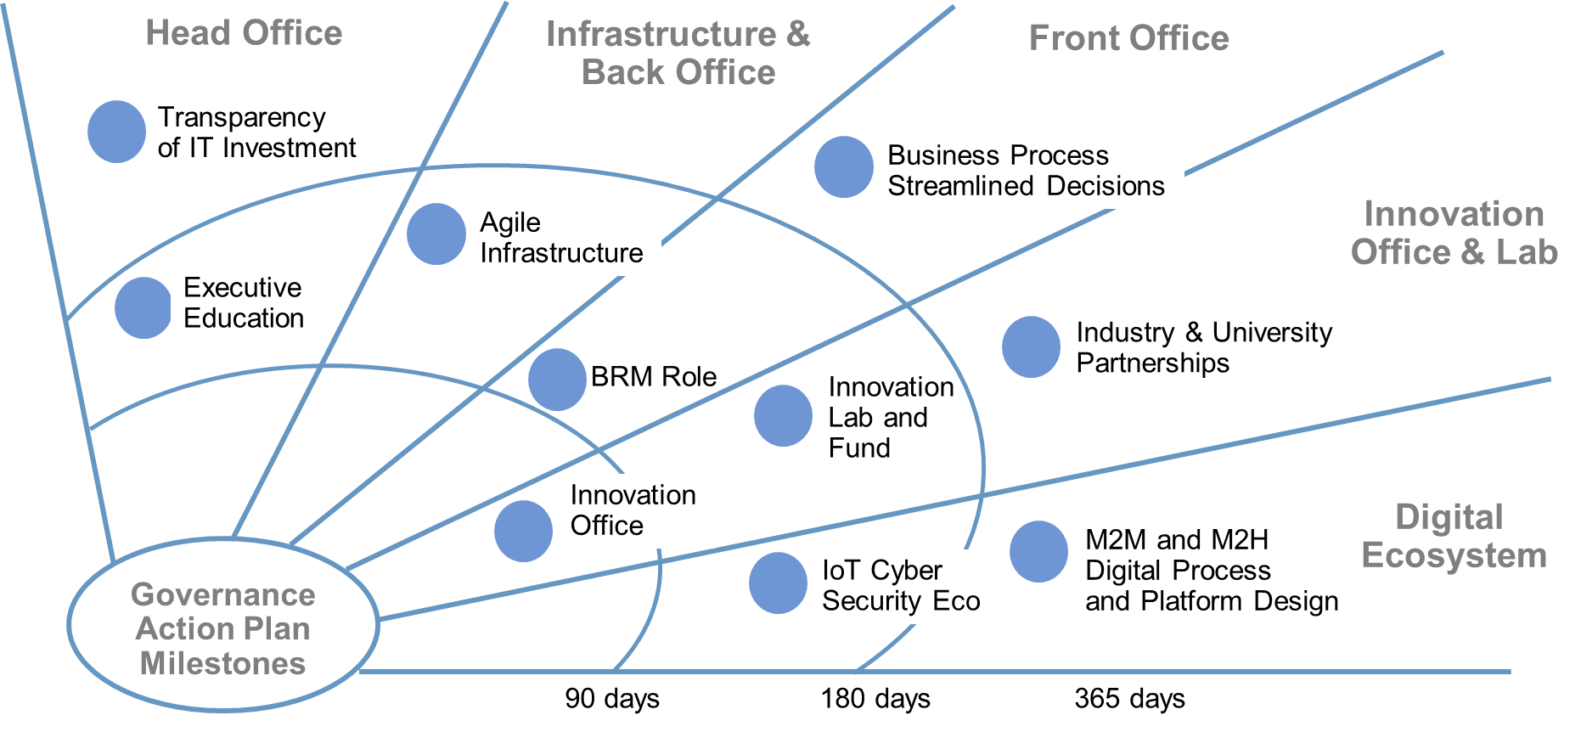
Develop Your Action Plan
Sample Plan

Slide 25

Prepare Leaders to Drive Governance Change
Vision — Why change is required and what are we changing to?
Planning — Provide a framework that measures success in terms of business outcomes, capabilities and expectations.
Engagement — Involve stakeholders at all levels.
Notes:
Three leadership actions will be most important:
Gaining business sponsorship is critical! Without it you are nowhere.
Organize for adaptive IT governance.
Promote leadership behaviors fit for your target operating model.

Slide 26
Evaluate Results of Governance Change — Continue to Mature and Adapt
Monitor key business outcomes, capabilities and leading indicators.
Monitor improvement in enterprise IT maturity → ITScore.
Monitor progress in address key "blocking issues."
Make necessary changes to Investment portfolio, IT operating model, supporting culture and incentives.
Evaluate enterprise governance structures, styles and mechanisms for continuous improvement.
Adaptive IT Governance
Conventional IT Governance
Lack of IT Governance

Slide 27
GOVERNANCE
VALUE DELIVERED
FULLY UTILIZED

Slide 28
Recommendations
Adopt adaptive IT governance principles using the right governance style fit for purpose.
Expand your repertoire to include agile and autonomous styles.
Fuse IT governance of all digital domains into a coherent yet adaptive model.
Enable and empower distributed decision-making authority.
Enlist stakeholder champions in resetting IT governance for the digital age.

Slide 29
Gartner Recommended Reading
Building the Digital Platform: The 2016 CIO Agenda Dave Aron, Graham P. Waller, Lee Weldon (G00292133)
The 90% Club: Winning the Game Before the Team Takes the Field Richard Hunter, Tina Nunno, Robert Towry (G00264096)
Practical Governance Tina Nunno, Cathleen E. Blanton, Heather Colella (G00209451)
CIOs Must Implement a Risk-Based Approach to Improve Business Outcomes Paul E. Proctor (G00316908)
Top Strategic Predictions for 2017 and Beyond: Surviving the Storm Winds Digital Disruption Daryl C. Plummer, Martin Reynolds, Charles S. Golvin (G00315910)

