Slide 1

Quality Measures and BI
Bob Marshall, MD MPH MISM FAAFP Program Director, DoD Clinical Informatics Fellowship

Slide 2
Learning Objective
Review the IOM Quality Measures
Review the larger set of quality metrics from AHRQ
Discuss how EHR/Health Care Business Intelligence/Analytics fits with the Quality Measures

Slide 3
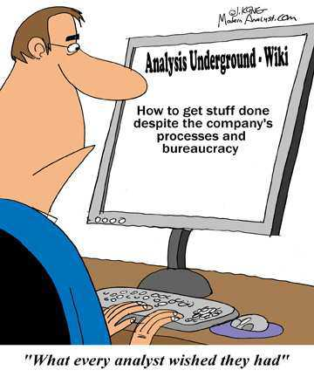

Slide 4
Overview of IOM Quality Metrics
In the report, "Toward Quality Measures for Population Health and the Leading Health Indicators," the IOM committee made six recommendations for HHS
"All partners in the multisector health system […] should adopt as their explicit purpose to continually improve health outcomes of the entire population and the conditions in which people can be healthy."
HHS and population health improvement partners should choose set of measures to assess quality of the health system.
HHS and other stakeholders should use set of criteria for choosing population health improvement quality measures.
HHS should take systematic approach to development of health system quality measures, and HHS should create or name nongovernmental entity to endorse quality measures.
HHS should develop and implement data collection, analysis and dissemination of quality measures.
HHS and stakeholders should integrate health system quality measures into all health reform activities

Slide 5
Six Domains of Health Care Quality
Safety – avoiding harm to patients from care
Effectiveness – providing services based on scientific knowledge – avoiding underuse and misuse
Patient-centered – providing care that is respectful of/responsive to patient preferences, needs and values
Timely – reducing waits and sometimes harmful delays for both patient and healthcare team
Efficient – avoiding waste, including waste of equipment, supplies, idea and energy (and time)
Equitable – providing care that does not vary in quality because of personal characteristics (gender, ethnicity, geographic location and socioeconomic status

Slide 6
Types of Quality Measures
Measures used to assess and compare the quality of health care organizations are classified as either a structure, process, or outcome measure.
Known as the Donabedian model
Structural Measures
Health care provider’s capacity, systems, and processes to provide high-quality care
Process Measures
indicate what a provider does to maintain or improve health, either for healthy people or for those diagnosed with a health care condition
Outcome Measures
Reflect the impact of the health care service or intervention on the health status of patients
Notes:
Outcome measures may seem to represent the “gold standard” in measuring quality, but an outcome is the result of numerous factors, many beyond providers’ control. Risk-adjustment methods—mathematical models that correct for differing characteristics within a population, such as patient health status—can help account for these factors

Slide 7
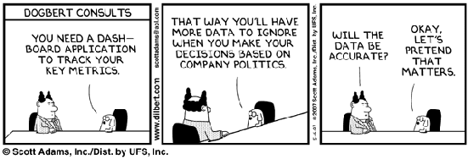

Slide 8
Selecting the Right Measures to Report
Need to consider two issues:
Whether the measures are "good"
Whether the measures are appropriate for your audience
The easiest way to determine whether a measure is good is to confirm that it has been endorsed by the National Quality Forum (NQF)
Whether or not measures are NQF-endorsed, assess the extent to which the measures have attributes that make them appropriate for reporting purposes
Standardization – at the national level
Comparability – external validity/generalizable
Availability – data available for majority of reporters
Timeliness – up to date and available in time to report
Relevance – address the concerns of the audience

Slide 9
Selecting the Right Measures to Report
Assess for yourself, cont.
Validity – adequately test to ensure consistency and accuracy
Experience – measures reflect actual performance and not CIS shortcomings
Evaluability – results can be evaluated as either better or worse than other results
Distinguishable – reveal significant differences among health care organizations
Credibility – either audited or do not require an audit
Are the measures appropriate for the audience?
Does the measure support your goal (ex. Improved decision-making; improved accountability)?
Do consumers view the measure as important?
Is the measure relevant to your intended audience?

Slide 10
Data Sources
Helpful to know what kinds of data you will need to produce the scores for the measure before you decide which quality measures to report
Data sources include all of the following – each has advantages and disadvantages
Administrative data
Patient medical records
Patient surveys
Individual patient comments
Standardized clinical data

Slide 11


Slide 12
Quality Measures Mgmt Information System
Comprehensive, Web-based, electronic tool to support the Measures Management System.
Repository of all the quality measures used by CMS and the electronic tool to track development and maintenance of those measures
Measures Management System (MMS) - set of processes and decision criteria used by CMS to oversee development, implementation, and maintenance of healthcare quality measures
QMIS serves as authoritative repository of information on quality measures used by CMS, including their technical specifications, justification, and history

Slide 13
Hospital Measurement Sets
A number of valid and reliable hospital measurement sets as the basis for collecting data and preparing comparative information for your audience.
The five measure sets listed here have been endorsed by the National Quality Forum(NQF):
AHRQ Quality Indicators.
National Hospital Quality Measures.
CAHPS Hospital Survey - Consumer Assessment of Healthcare Providers and Systems (CAHPS) Hospital Survey (aka HCAHPS).
ORYX (developed by TJC).
The Leapfrog Group’s Measures

Slide 14
Provider/Physician Measurement Sets
As with the major hospital measurement sets, the measure sets listed here have been endorsed, in whole or in part, by the National Quality Forum (NQF)
Physician Consortium for Performance Improvement (PCPI)
National initiative to implement evidence-based clinical performance metrics and used by CMS in the P4P initiative
Healthcare Effectiveness Data and Information Set (HEDIS)
Widely used set of performance measures in the managed care industry
30 standardized measures - most often use a subset
CAHPS - Consumer Assessment of Healthcare Providers and Systems
Promoting Healthy Development Survey (PHDS)
administered to parents or guardians of children 3-48 months old to assess whether the children are receiving nationally recommended preventive and developmental services

Slide 15
AHRQ’s Core Metrics – aka Vital Signs

Slide 16
How Vital Signs Came Into Being
Thousands of measures in use today to assess health/health care in the United States.
Although many measures provide useful information, their sheer number, as well as their lack of focus, consistency, and organization, limits overall effectiveness in improving health system performance
Institute of Medicine (IOM) convened a committee to identify core measures for health and health care.
In Vital Signs: Core Metrics for Health and Health Care Progress, the committee uses a four-domain framework—healthy people, care quality, lower cost, and engaged people—to propose a streamlined set of 15 standardized measures, with recommendations for their application at every level and across sectors.
Ultimately, the committee concludes that this streamlined set of measures could provide consistent benchmarks for health progress across the nation and improve system performance in the highest-priority areas.

Slide 17
Core Measures Set
Life expectancy
Well-being
Overweight and obesity
Addictive behavior
Unintended pregnancy
Healthy communities
Preventive services
Care access
Patient safety
Evidence-based care
Care match with patient goals
Personal spending burden
Population spending burden
Individual engagement
Community engagement

Slide 19
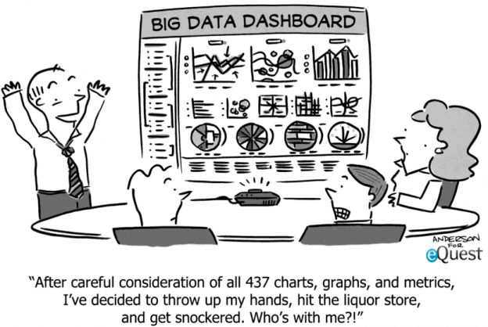

Slide 20
BI/Clinical Analytics and Quality Measures
Every quality metric can be either derived directly from the EHR or some other accessible data source
Except for encounter note content, all available data is discrete
Once the required reporting metrics are identified, a system/practice can use one of the numerous large or small clinical analytics tools to both extract and develop reports
The reports can then be analyzed internally for QI efforts and then automatically reports to the regulatory agencies/payers
If used regularly to identify deficiencies and drive QI efforts, the analytics tools can help both systems and physicians to provide better quality care and make more money
If the regulatory agencies/payers have selected appropriate measures, the outcome of the combined efforts should be improved health/QoL for patients and reduced overall healthcare costs

Slide 21
BI/Clinical Analytics and Quality Measures – the Policy Component
The issue is not whether or not the data is available or that some type or report can be generated
The issue is whether or not the formatting and content of the reporting format can be matched by the reporting/analytics tools
What needs to happen is that the NQF, CMS or ONCHIT need to develop reporting standards so that all quality measures can be reported in a standardized format
That would allow both EHR vendors and BI/Analytics vendors to make the process much easier for the practices and hospitals that are required to report these metrics – the so-called “push button report”

Slide 22
BI/Clinical Analytics and Healthcare Reform
Healthcare reform has led to countless initiatives designed to improve both the cost and quality of care delivery.
For the first time in the history of U.S. healthcare, health systems need to measure and report on the care they’re delivering.
They must also understand the financial ramifications of individual care decisions
Health systems and providers need to use clinical analytics to analyze their data to help them achieve success with the following three healthcare initiatives
Value-based purchasing
Accountable care organization/accountable care networks
Value-based insurance design (VBID)

Slide 23

Questions

