Slide 1

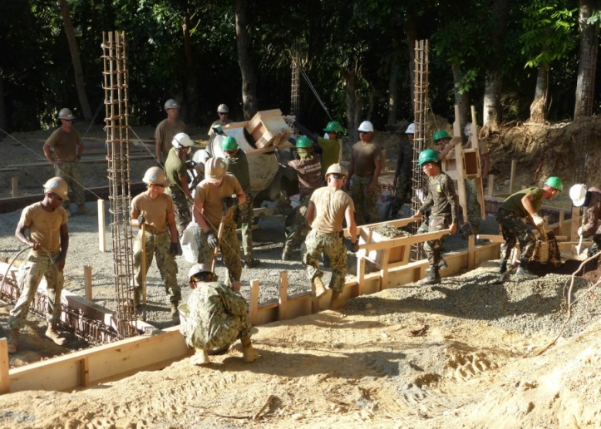

Project Management: A Primer
DoD/MAMC Clinical Informatics Fellowship

Slide 2
Learning Objectives
Define what a project is – the basics
Define project, program, and portfolio management
Describe the scope and practice of project management, with emphasis on health care
Describe the training and qualifications required of project managers
Describe some notable examples of project management successes and failures

Slide 3
What is a project?
“A temporary endeavor undertaken to create a unique product, service, or result”
Projects exist in virtually all areas of life, span across numerous diverse enterprises, and can of varying scope, size, and duration
A project has purpose, constraints, resources, customers/sponsors, and risks
Examples:
  Building an aircraft carrier
  Implementing a new electronic health record system (e.g. MHS GENESIS) at NH Bremerton
  Improving the workflow in the Family Medicine Clinic at MAMC
  Selecting and purchasing a home (residence)

Slide 4
Project Management Defined
“The application of knowledge, skills, tools and techniques to project activities to meet the project requirements.”
Achieve goals and manage stakeholder expectations
Facilitate the process
Defined time period
Involves trade-offs!
In contrast, routine/standard business operations are repetitive and permanent/semi-permanent functional activities

Slide 5
Program and Portfolio Management
Program Management
  Management of a group of related projects in a coordinated fashion to obtain benefits not available from managing the projects individually.
  Ex: MHS GENESIS at the enterprise level
  Functions at the“Operational” level
Portfolio Management
  Management of related programs and projects as a portfolio of investments that contributes to the organization/enterprise’s overall success
  Ex: DoD’s EHR modernization effort
  Functions at the “Strategic” level

Slide 6
Program and Portfolio Management
Portfolio
Program 1
Project 1
Project 2
Program 2
Project 3

Slide 7
Stakeholders in Project Management
Individuals sponsoring the project or affected by the project
Customers, patients, clients
End users
Rank and file staff
Leadership (C-suite)
Clinicians
Opponents/competitors

Slide 8
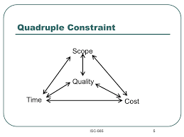
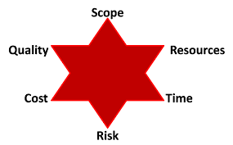
Constraints in Project Management
Traditional Triple constraints:
  Scope, Cost, Time
Quadruple constraints:
  Scope, Cost, Time, Quality
Six-Pointed Star:
  Scope, Cost, Time, Quality, Risk, Resources

Slide 9
Four “P’s” of Project Management
Plan: planning, forecasting
Processes: predetermined and structured processes
People: stakeholders, team members
Power: lines of authority, decision making

Slide 10
Process Groups in Project Management
A process is a series of actions directed towards a result
Does not necessarily move in a linear fashion from one process to the next
Five “Process Groups” which, when applied in a consistent structured manner, optimizes the chance of success:
  Initiating
  Planning
  Executing
  Monitoring and controlling
  Closing

Slide 11
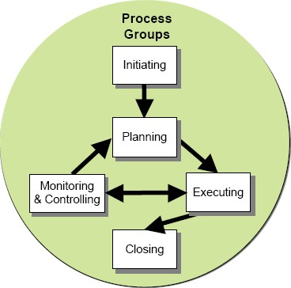
Process Groups in Project Management

Slide 12
Knowledge Areas in Project Management
Key competencies that project managers must develop
  Related to process groups
  10 Areas:
    Integration
    Scope
    Time
    Cost
    Quality
    Human Resources
    Communications
    Risk
    Procurement
    Stakeholder management

Slide 13
Tools and Techniques in Project Management
PM software
Scope statements
Work breakdown structures (WBS)
Requirement analyses
Lessons-learned reports
Status and progress reports]
Well-planned kick-off meetings
Gantt charts
Change requests

Slide 14
Success in Project Management
The project met scope, time and cost goals
The project satisfied the customer/sponsor
The results of the project met its main business objectives
Healthcare projects often involve patient safety and quality of care, so the 3rd measurement might be the most important
Success criteria can be used to derive a set of performance indicators needed to track progress

Slide 15
Change Management and Project Management
Change management must be an integral part of project management!
Behavioral change management methodology
  Analyze organizational risks and cultural readiness for change
  Engage the staff and mitigate the resistance to change
  Delivery, preparing stakeholders for the impact of change
Align change management activities with:
  Process groups
  Knowledge areas

Slide 16
Considerations in healthcare projects
Patient safety and outcomes are crucial
Government and regulatory influences
Complex financing, difficult to estimate revenues and value (ROI)
Metrics are different (also affects ROI calculations)
Complex, multi-disciplinary projects
Collaboration (with other entities) needed

Slide 17
Team Members in Project Management
Project manager
Designer/idea generator
Clinicians
Administrators
IT staff
Patient advocates or representatives
Quality officer
Legal staff
Business/accounting professionals

Slide 18
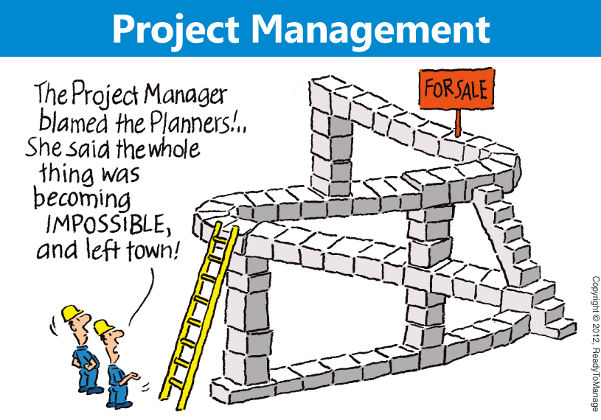

Slide 19
Qualifications for Project Managers
Project Management Institute (PMI) provides certification as Project Management Professional (PMP) after several years of experience and exam
Leadership skills
Communication skills
“Soft” people skills
Code of ethics

Slide 20

Project Management Success:
Metrolink rail station built in 3 days after 1994 earthquake

Slide 21

Project Management Failure:
Space Shuttle Challenger Disaster

Slide 22
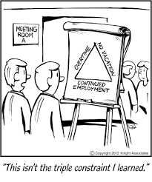
Questions?

