Slide 1
Project Management – Part 2
DoD/MAMC Clinical Informatics Fellowship

Slide 2
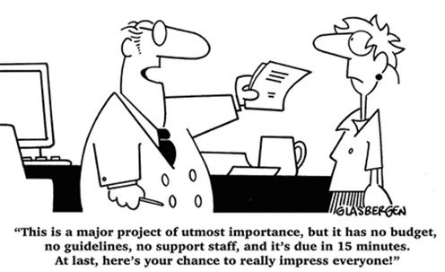
Learning Objectives
Review the four phases of project management
Discuss the various types of project managers
Discuss the important roles in project management
Discuss how to prioritize projects

Slide 3
Four Phases of Project Management
Planning: How to map out a project
Build-up: How to get the project going
Implementation: How to execute the project
Closeout: How to handle end matters

Slide 4
Planning Phase
Planning is about defining fundamentals: what problem needs solving, who will be involved and what will be done
Steps include the following:
Determine the real problem to solve
Identify the stakeholders
Define project objectives
Determine scope, resources and major tasks
Prepare for trade-offs due to time, cost and quality drivers

Slide 5
Buildup phase
Assemble your team
Plan assignments
Create the schedule
Hold a kickoff meeting
Develop a budget

Slide 6
Implementation
Monitoring control process and budget
Report progress
Hold weekly team meetings
Manage problems

Slide 7
Closeout
Evaluate project performance
Close the project
Debrief the team

Slide 8
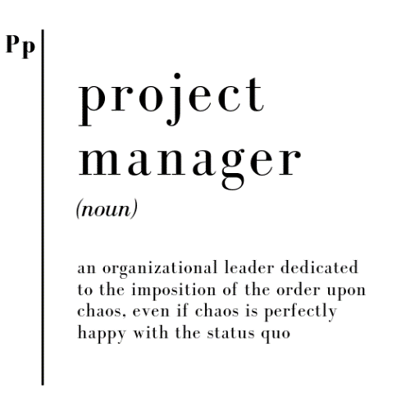
Project Manager Types

Slide 9
Four Types of Project Managers
Generally, organizational growth opportunities fall into 4 different categories
As a result, you need four specific types of project managers to pursue them
The employee types and the growth opportunities they are best at pursuing can be positioned along 2 dimensions:
1. Growth opportunities in line with existing organizational strategy
2. Can a reliable business case be made?
These 2 questions now create a 2 x 2 matrix that distinguishes the 4 different types of project leaders

Slide 10
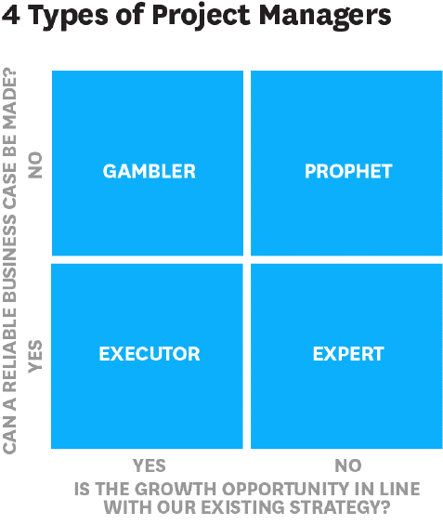

Slide 11
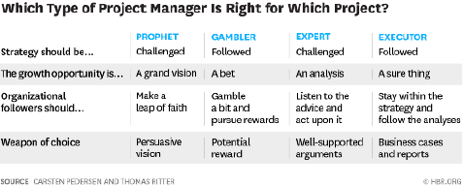

Slide 12
The Prophet
The prophet seeks to gain organizational followers for a grand vision of a growth opportunity that is strategically different from the status quo
This is often without trustworthy quantitative evidence, and consequently relies on organizational members taking a leap of faith in support of the vision
Obviously, running such projects is risky
A prophet is needed to challenge the existing strategy and to pursue overlooked growth opportunities

Slide 13
The Gambler
The gambler seeks to gain organizational followers for a big bet on a growth opportunity that is consistent with the current strategy but without trustworthy quantitative evidence
Gamblers play by the rules of the game as they pursue growth opportunities within existing strategy; however, they cannot predict the likelihood of success
The gambler seeks to engage other organizational members who also like bets, which is an uncertain pathway
While gamblers can be risky, they are necessary as they can update the existing strategy by pursuing analytically overlooked growth opportunities

Slide 14
Experts
Experts advocate for a change in action in favor of a growth opportunity that is inconsistent with the current strategy but is supported by solid, trustworthy quantitative evidence
Experts rely on organizational members listening carefully to their advice
Although the growth opportunities advocated by experts are well supported and should be feasible, the main challenge is to make organizational members aware of the need for strategic change and the urgent need to act in this regard
The expert is needed to challenge the existing strategy by pursuing well-supported growth opportunities that lie outside current strategy

Slide 15
Executor
The executor advocates for a sure thing growth opportunity that is consistent with the current strategy and is backed by trustworthy qualitative evidence
There is no risk, no uncertainty and no challenge... just a need for execution
Executors rely on organizational members to follow their rigorous analysis of a strategically embraced project
The executor cannot provide insights into the more radical and unknown business opportunities
They are limited in the number of growth opportunities that they can support and visualize; the so-called, low hanging fruit

Slide 16
Interactions Between the 4 Types 1 of 2
Conflict tends to loom among the different types
What typically happens is that the logic of one of the types becomes dominant throughout the organization
Once a single logic pervades the organization at the expense of the others, key employees of a different type may leave the organization and take their ideas with them
Relying on a single type of logic can lead to organizational inertia, which is dangerous in dynamic and evolving markets/situations

Slide 17
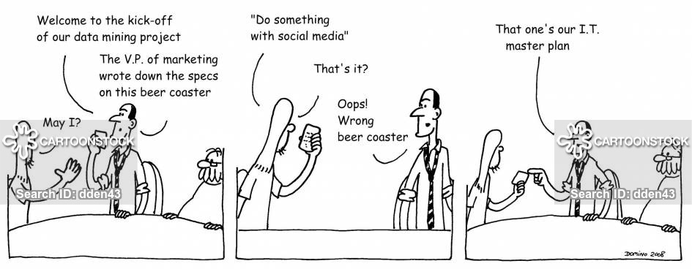
Interactions Between the 4 Types 2 of 2
It is critical to ensure there is enough room for all of the logics within the organization, ideally by introducing boundary spanning individuals who can navigate among the logics
It is quite beneficial if top management adopts a "bridging" role to allow for coexistence and diversity

Slide 18
Project Manager Types: The Bottom Line
The diversity of project manager styles offers a competitive advantage in terms of business development.
All four types are necessary pieces of your organizational constellation, even though the optimal dose of each may differ
It is crucial that executives:
Make sure each type exists within the organization
Make room for each type to work in their own manner
Make sense of their respective ideas by following their respective logics
Make time for matching projects and project managers correctly

Slide 19
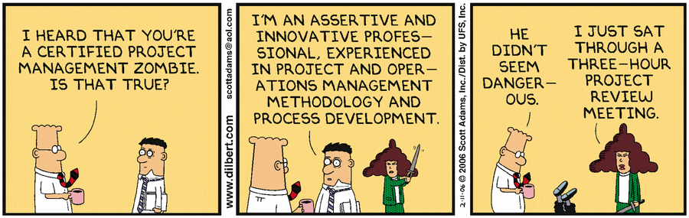
Five critical roles in project management

Slide 20
Sponsor
The sponsor champions the project at the highest level in the company and gets rid of organizational obstructions
He or she should have the clout to communicate effectively with the chief executive and key stakeholders
The sponsor should be able to provide necessary resources and approve or reject outcomes
It's also important that the sponsor have "skin in the game", which simply means accountability for the project's performance

Slide 21
Project Manager
The project manager identifies the central problem to solve and determines, using input from the sponsor and stakeholders, how to tackle it
This includes delineating with the projects objectives and scope will be in which activities will deliver the desired results
The PM then plans and schedules tasks, oversees day-to-day execution and monitors progress
In the end, the PM evaluates performance, brings the project to a close and captures the lessons learned
The project manager receives his or her authority from the sponsor

Slide 22
Project Manager Tasks
Provide a framework for the project's activities
Identify needed resources
Negotiate with higher authority
Recruit effective participants
Set milestones
Coordinates activities
Keep the vision clear and the work on track
Make sure everyone on the team contributes and benefits
Mediate conflicts
Make sure project goals are delivered on time and on budget

Slide 23
Team Leader
Large projects may include a formal team leader, who reports directly to the project manager
In smaller projects, the project manager usually wears both hats
To be effective and obtain the benefits of team-based work, the team leader must adopt the following important roles:
Initiator
Model
Negotiator
Listener
Coach
Working member

Slide 24
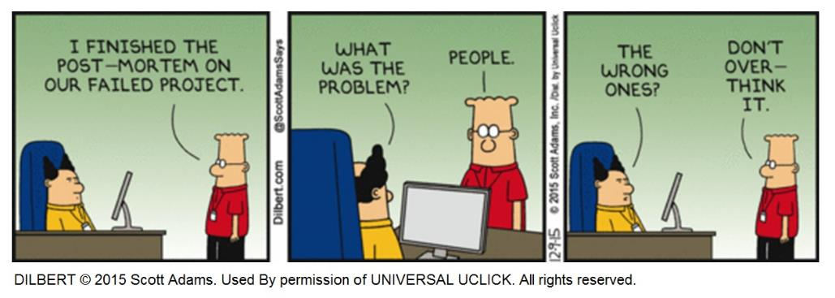
Team Members
The heart of any project, and the true engine of its work, is its membership
That's why bringing together the right people is so very important

Slide 25
Criteria for Membership
Although the skills needed to accomplish the work should govern team selection, one is unlikely to get all the know-how one needs or desires without providing some training
Areas of proficiency to consider:
Technical skills in a specific discipline
Good problem-solving skills
Interpersonal skills
Organizational skills

Slide 26
Membership Changes
You may have to add new members and possibly bid good-bye to others over time, as tasks and needs change
A note of caution: Team members gradually develop effective patterns for working together, making decisions and communicating
Cohesion is undermined when too many people join or exit the team

Slide 27
Contributions and Benefits
Free riders - team members who obtain the benefits of membership without doing their share - cannot be tolerated
However, not every member has to put in the same amount of time
Just as each member must contribute to the team’s work, each should receive clear benefits
Otherwise, individuals will not participate at a high level - at least not for long
The benefits they derive from their regular jobs will absorb their attention and make your project a secondary priority

Slide 28
Alignments 1 of 2
The goals of the project team and those of its individual members must align with organizational objectives
For that reason, everyone’s efforts should be coordinated through the company’s rewards system
This kind of reinforcement begins at the top, with the sponsor
Since the sponsor is accountable for the team’s success, some part of his/her compensation should be linked to the team’s performance

Slide 29
Alignments 1 of 2
Moving down the line, the project manager and team members should likewise see their compensation affected by team outcomes
Such alignment gets everyone moving in the same direction

Slide 30
Project Steering Committee 1 of 2
Some projects have a steering committee, which consists of the sponsor and all key stakeholders (or at least representatives from all stakeholder groups)
The committee’s role is to approve the charter, secure resources, and adjudicate all requests to change key project elements, such as deliverables, the schedule, and the budget
A steering committee is a good idea when different partnering organizations, units, or individuals have a strong stake in the project
Because it represents these various interests, it is well positioned to sort out complicated inter-organizational or interdepartmental project problems

Slide 31
Project Steering Committee 2 of 2
It can also be helpful if you anticipate many change requests
The downside to having a steering committee?
The PSC needs to have a clear purpose and set of goals/outcomes to provide that oversight
It involves another level of oversight, and its meetings take up the time of some of the company’s most expensive employees
It has to be staffed and supported adequately to accomplish its mission
So don’t have a committee if you don’t need one, but make it primed for success if you do (the right resources)

Slide 32

Prioritizing Projects

Slide 33
Why to Prioritize Projects
Every organization needs what a recognized expert in PM calls a “hierarchy of purpose”
Without one, it is almost impossible to prioritize effectively
Prioritization at a strategic and operational level is often the difference between success and failure
Prioritizing increases the success rates of strategic projects, increases the alignment and focus of senior management teams around strategic goals, clears all doubts for the operational teams when faced with decisions and, most important, builds an execution mindset and culture

Slide 34
Leadership Activities for Project Prioritization
Organizations that start prioritizing can experience significant reductions in costs as less-vital activities are cut and duplicated efforts are consolidated
The most successful executives tend to be more risk taking and have a laser-like focus on a small number of priorities
These executives know what matters today and tomorrow
At the extreme, this might mean simply having a single priority
The more focus, the better

Slide 35
The Hierarchy of Purpose 1 of 2
Purpose. What is the purpose of the organization and how is that purpose best pursued? What is the strategic vision supporting this purpose?
Priorities. Given the stated purpose and vision, what matters most to the organization now and in the future? What are its priorities now and over the next two to five years?
Projects. Based on the answers to the first two points, which projects are the most strategic and should be resourced to the hilt? Which projects align with the purpose, vision, and priorities, and which should be stopped or scrapped?

Slide 36
The Hierarchy of Purpose 1 of 2
People. Now that there is clarity around the strategic priorities and the projects that matter most, who are the best people to execute on those projects?
Performance. Traditionally, project performance indicators are tied to inputs (e.g., scope, cost, and time). They are much easier to track than outputs (such as benefits, impact, and goals). However, it’s the outputs that really matter. What are the precise outcome-related targets that will measure real performance and value creation?
Reduce your attention on inputs and focus on important, strategically-aligned outcomes instead

Slide 37
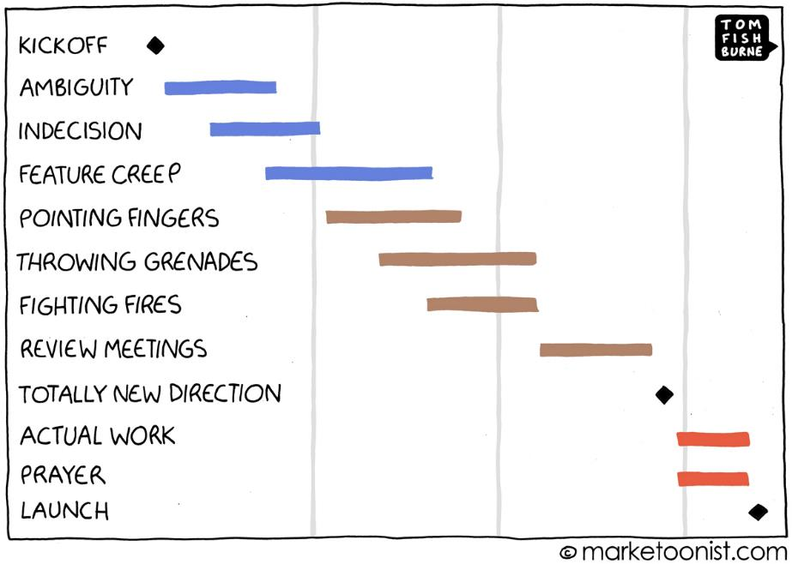
Questions??????

