Slide 1
Programming in Health IT – Part 2
Bob Marshall, MD MPH MISM FAAFP DoD/MAMC Clinical Informatics Fellowship

Slide 2
Education Objectives
Provide overview of FHIR
Discuss FHIR’s structure and why it is better
Introduce FHIR Resources
Provide overview of SMART
Review SMART on FHIR and its uses
Review and discuss CDS Hooks and how it works

Slide 3
FHIR Overview
Fast Healthcare Interoperability Resources (FHIR, pronounced "fire") is a standard describing data formats and elements (known as "resources") and an application programming interface (API) for exchanging electronic health record
FHIR can be used as a stand-alone data exchange standard, but can and will also be used in partnership with existing widely used standards
FHIR aims to simplify implementation without sacrificing information integrity
It leverages existing logical and theoretical models to provide a consistent, easy to implement, and rigorous mechanism for exchanging data between healthcare applications

Slide 4
More about FHIR
FHIR is easier to implement than the older HL7 taxonomies (versions 2.x and 3.x) because it uses a modern web-based suite of API technology:
HTTP-based RESTful protocol, HTML and Cascading Style Sheets for user interface integration
A choice of JSON or XML for data representation
Atom for results
FHIR provides an alternative to document-centric approaches by directly exposing discrete data elements as services
For example, basic elements of healthcare like patients, admissions, diagnostic reports and medications can each be retrieved and manipulated via their own resource URLs

Slide 5
RESTful and FHIR
The design of FHIR is based on RESTful web services, in contrast to the majority of IHE profiles, which are based on SOAP web services
With RESTful web services, the basic HTTP operations are incorporated including Create, Read, Update and Delete
Representational state transfer (REST) or RESTful web services are a way of providing interoperability between computer systems on the Internet
REST-compliant Web services allow requesting systems to access and manipulate textual representations of Web resources using a uniform and predefined set of stateless operations

Slide 6
Why FHIR is Better 1 of 2
FHIR offers many improvements over existing standards:
A strong focus on implementation – fast and easy to implement (multiple developers have had simple interfaces working in a single day)
Multiple implementation libraries, many examples available to kick-start development
Specification is free for use with no restrictions
Interoperability out-of-the-box– base resources can be used as is, but can also be adapted for local requirements
Evolutionary development path from HL7 Version 2 and CDA – standards can co-exist and leverage each other

Slide 7
Why FHIR is Better 2 of 2
Strong foundation in Web standards– XML, JSON, HTTP, OAuth, etc.
Support for RESTful architectures, seamless exchange of information using messages or documents, and service based architectures
Concise and easily understood specifications
A human-readable serialization format for ease of use by developers
Solid ontology-based analysis with a rigorous formal mapping for correctness

Slide 8
FHIR Goals
Facilitate interoperation between legacy health care systems
To make it easy to provide health care information to health care providers and individuals on a wide variety of devices from computers to tablets to cell phones
Allow third-party application developers to provide medical applications which can be easily integrated into existing systems

Slide 9
Components
The basic building block in FHIR is a Resource
All exchangeable content is defined as a resource
Resources all share the following set of characteristics:
A common way to define and represent them, building them from data types that define common reusable patterns of elements
A common set of metadata
A human readable part

Slide 10
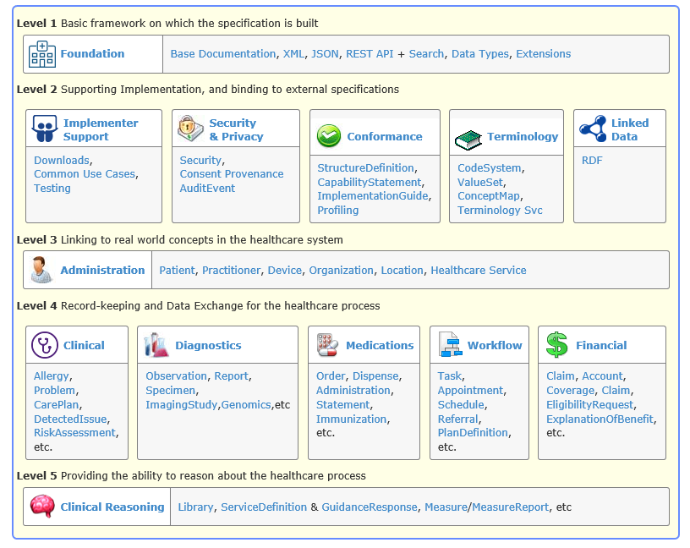

Slide 11
Approach 1 of 2
The philosophy behind FHIR is to build a base set of resources that, either by themselves or when combined, satisfy the majority of common use cases
FHIR resources aim to define the information contents and structure for the core information set that is shared by most implementations
There is a built-in extension mechanism to cover the remaining content as needed
With FHIR, specific use cases are usually implemented by combining resources together through the use of resource references

Slide 12
Approach 2 of 2
Although a single resource might be useful by itself for a given use case, it is more common that resources will be combined and tailored to meet use case specific requirements
Two special kinds of resources are used to describe how resources are defined and used:
Capability Statement - describes the interfaces that an implementation exposes for exchange of data
Structure Definition - provide additional rules that serve to constrain the optionality, cardinality, terminology bindings, data types and extensions defined in the resources used by the implementation

Slide 13
The Specification 1 of 3
Broadly, the FHIR specification is broken up into a set of modules:
Foundation: The basic definitional and exchange infrastructure on which the rest of the specification is built
Implementer Support: Services to help implementers make use of the specification
Security & Privacy: Documentation and services to create and maintain security, integrity and privacy
Conformance: How to test conformance to the specification, and define implementation guides
Terminology: Use and support of terminologies and related artifacts

Slide 14
The Specification 2 of 3
Linked Data: How to use RDF, and how ontologies are used when defining the FHIR content
Administration: Basic resources for tracking patients, practitioners, organizations, devices, substances, etc
Clinical: Core clinical content such as problems, allergies, and the care process (care plans, referrals) + more
Medications: Medication management and immunization tracking
Diagnostics: Observations, Diagnostic reports and requests + related content
Workflow: Managing the process of care, and technical artifacts to do with obligation management

Slide 15
The Specification 3 of 3
Financial: Billing and Claiming support
Clinical Reasoning: Clinical Decision Support and Quality Measures

Slide 16
What does it mean for CI?
Because FHIR is implemented on top of HL7 and the HTTPS (HTTP Secure) protocol, messages can be parsed by wire data analytics platforms for real-time data gathering
In this concept, healthcare organizations would be able to gather real-time data from specified segments in FHIR messages as those messages pass over the network
That data can be streamed to a data store where it can be correlated with other informatics data
Potential use cases include epidemic tracking, prescription drug fraud, adverse drug interaction warnings, and emergency room wait times

Slide 17
SMART/SMART on FHIR

Slide 18
SMART
The SMART project, Substitutable Medical Apps & Reusable Technology, was borne from an essay published in New England Journal of Medicine in 2009
The project is under the ONC's Strategic Health IT Advanced Research Projects. In 2010, the SMART project received a four-year, $15 million grant from the ONC to conduct its research
The key focus of SMART is to develop a SMART platform architecture to achieve two major goals:
Develop a user interface to allow substitutability for medical apps based on shared basic components and
Create a set of services to enable efficient data capture, storage, retrieval and analytics.

Slide 19
SMARTer
The overarching mission of SMART is to "create an ecosystem of substitutable apps that can run on any EHR system
Substitutability is defined as the capability to seamlessly replace one app with another of similar functionality without requiring any re-engineering or technical expertise
The SMART platform is composed of open standards, open source tools for developers building apps and a publicly accessible app gallery

Slide 20
Open Standards
The SMART project defines a health data layer that builds on the FHIR API and resource definitions
SMART standards outline a robust authorization model for apps based on the OAuth standard, providing a key component that enables innovation while keeping patients and providers in control of their data.
Through the SMART Genomics and SMART CDS Hooks efforts, the SMART project is taking the lead on defining the next generation of FHIR based standards for the clinical use of genomic data and the integration of clinical decision support into provider workflows

Slide 21
Tools and Infrastructure
To make it easy for developers, the SMART Health IT project created, maintains and supports a set of open source libraries that simplify and streamline the use of the SMART standards in real world apps
Currently, libraries are available for HTML5/Javascript, iOS and Python
The SMART App Gallery is not restricted to a single EHR platform or technology and hosts commercial and open source apps
Integration with SMART infrastructure enables developers to offer app trials without needing to run their own SMART server, and provides app users the ability to safely try out apps with a single click

Slide 22
Scopes and Launch Context
SMART on FHIR’s authorization scheme uses OAuth scopes to communicate (and negotiate) access requirements
In general, these scopes are used for three kinds of data:
Clinical data
Contextual data
Identity data

Slide 23
Scope | Grants
patient/*.read | Permission to read any resource for the current patient (see notes on wildcard scopes below)
user/*.* | Permission to read and write all resources that the current user can access (see notes on wildcard scopes below)
openid profile | Permission to retrieve information about the current logged-in user
launch | Permission to obtain launch context when app is launched from an EHR
launch/patient | When launching outside the EHR, ask for a patient to be selected at launch time
offline_access | Request a refresh_token that can be used to obtain a new access token to replace an expired one, even after the end-user no long is online after the access token rexpires
online_access | Request a refresh_token that can be used to obtain a new access token to replace an expired one, and that will be usable for as long as the end-user remains online.

Slide 24
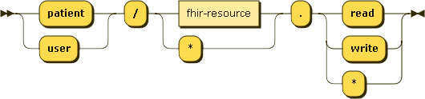
Clinical Scope Syntax
Expressed in EBNF notation, the clinical scope syntax is:
clinical-scope ::= ( 'patient' | 'user' ) '/' ( fhir-resource | '*' ) '.' ( 'read' | 'write' | '*' )

Slide 25
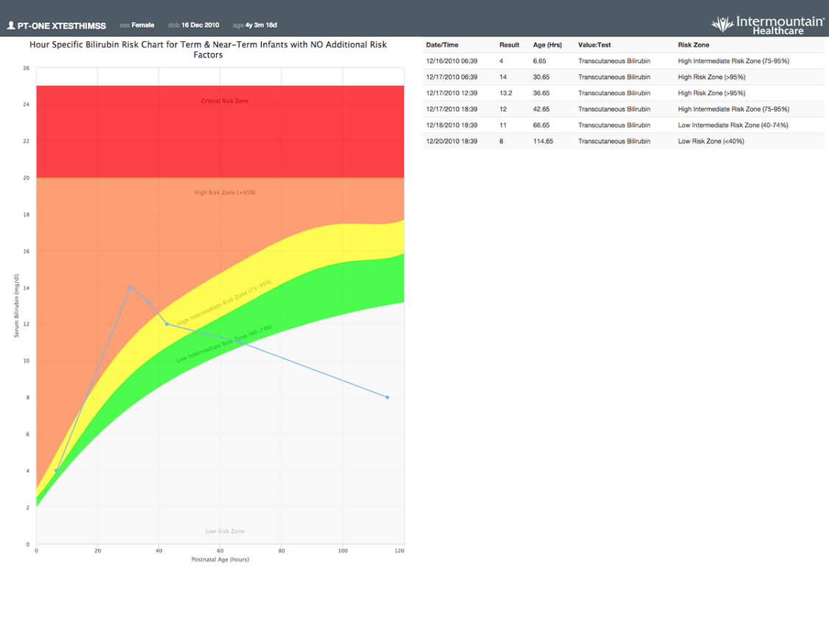
Neonatal Bilirubin

Slide 26
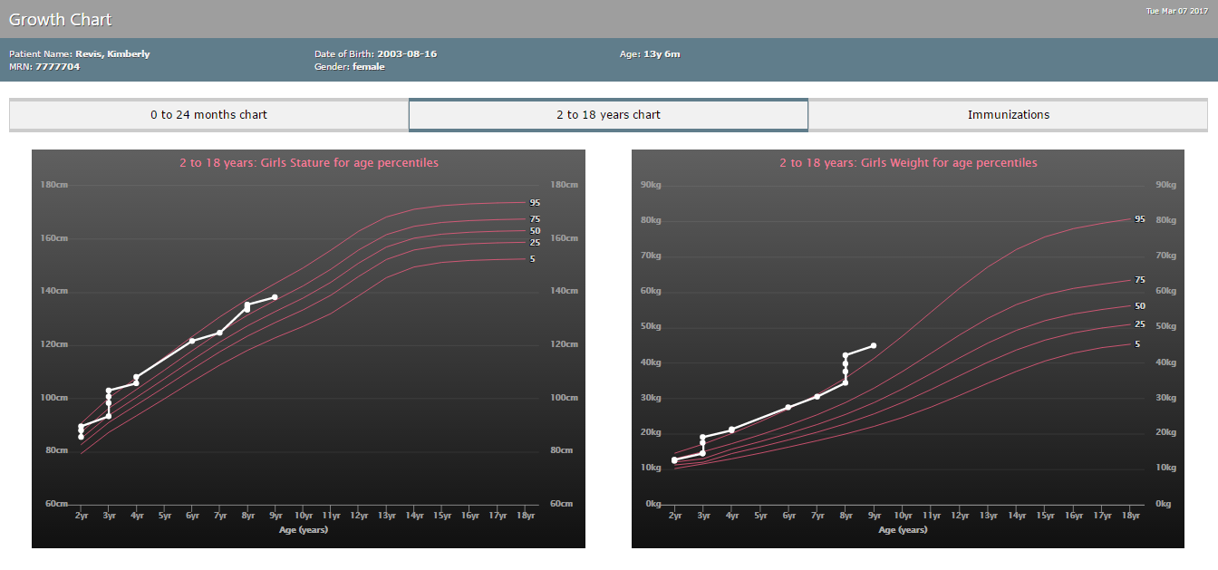
Growth Chart App

Slide 27
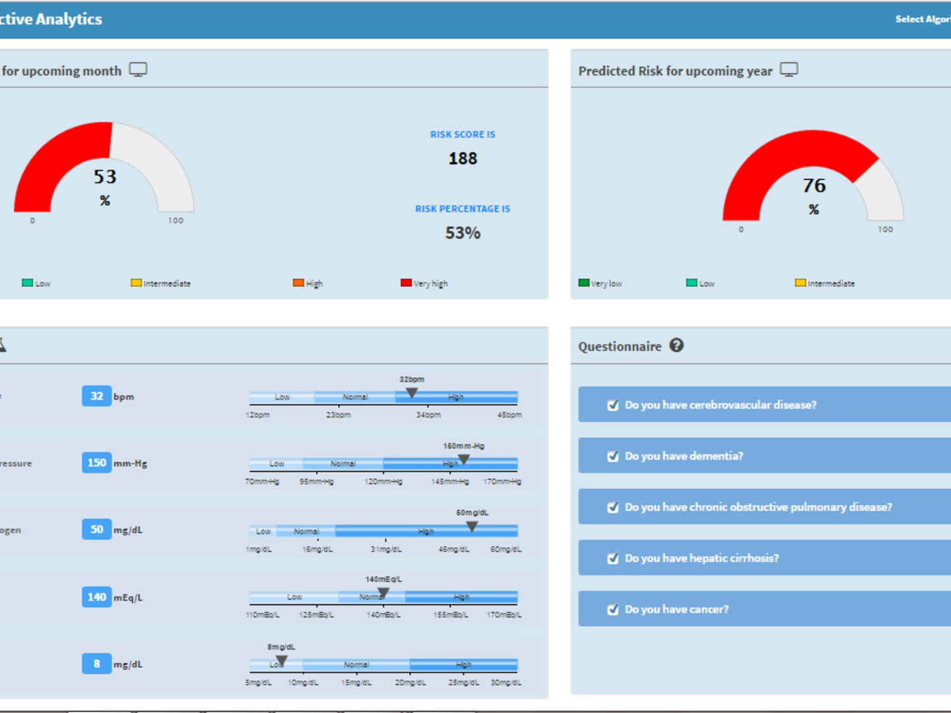
CHF Predictive App

Slide 28
CDS Hooks

Slide 29
CDS Hooks
CDS Hooks is a technology from SMART on FHIR that allows third-party CDS systems to register with an EHR using a "hook" pattern
This specification describes a “hook”-based pattern for invoking decision support from within a clinician’s EHR workflow
The API supports:
Synchronous, workflow-triggered CDS calls returning information and suggestions
Launching a user-facing SMART app when CDS requires deeper interaction
Long-running, non-modal CDS sessions that observe EHR activity in progress

Slide 30
How CDS Hooks Works
User activity inside the EHR triggers CDS hooks in real-time.
For example:
patient-view when opening a new patient record
medication-prescribe on authoring a new prescription
order-review on viewing pending orders for approval
When a triggering activity occurs, the EHR notifies each CDS service registered for the activity
These services must then provide near-real-time feedback about the triggering event

Slide 32
CDS Cards 1 of 2
Each CDS service can return any number of cards in response to the hook
Cards convey some combination of text (information card), alternative suggestions (suggestion card), and links to apps or reference materials (app link card)
A user sees these cards — one or more of each type — embedded in the EHR, and can interact with them as follows:
information card: provides text for the user to read

Slide 33
CDS Cards 2 of 2
suggestion card: provides a specific suggestion for which the EHR renders a button that the user can click to accept.
Clicking automatically populates the suggested change into the EHR’s UI
app link card: provides a link to a SMART app where the user can supply details, step through a flowchart, or do anything else required to help reach an informed decision
When the user has finished, flow returns to the EHR. At that point, the EHR re-triggers the initial CDS hook
The re-triggering may result in different cards, and may also include decisions

Slide 34
CDS Decisions
In addition to cards, a CDS service may also return decisions — but only after a user has interacted with the service via an app link card
Returning a decision allows the CDS service to communicate the user’s choices to the EHR without displaying an additional card
For example, a user might launch a hypertension management app, and upon returning to the EHR’s prescription page she expects her new blood pressure prescription to “just be there”
By returning a decision instead of a card, the CDS service achieves this expected behavior

Slide 35
Check it out
You can try CDS Hooks in the test harness at http://demo.cds-hooks.org
In computer programming, the term hooking covers a range of techniques used to alter or augment the behavior of an operating system, applications, or other software components by intercepting function calls, messages or events passed between software components
Code that handles such intercepted function calls, events or messages is called a hook

Slide 36
CDS Hooks and Cybersecurity
Because CDS Hooks requires a call-out to a library of CDS resources, it requires opening a port, and we know who does not like that
If there is not a way to minimize opening that port so it meets cyber requirements, then CDS Hooks is DOA for the MHS
The CDS Pre-fetch query/proxy
A generic proxy that takes the URL of an underlying service, and exposes a gateway in front of it
This service exposes the CDS API calls and forwards them to the underlying service
In cases that preFetch data are expected, but not present, the proxy will assemble the required preFetchData

Slide 37
CDS Hooks and Docker
This proxy service can be deployed with Docker. By default, the Dockerfile exposes port 3000.
Creating the Docker container can be done by:
$ docker build -t <your-name>/cds-hooks-prefetch-proxy . Successfully built <container-id>
$ docker run -p 3000:3000 -d <your-name>/cds-hooks-prefetch-proxy npm start

Slide 38

Questions

Slide 39
Backup Slides

Slide 40
OAuth
OAuth is an open standard for authorization, commonly used as a way for Internet users to authorize websites or applications to access their information on other websites but without giving them the passwords
OAuth provides to clients a "secure delegated access" to server resources on behalf of a resource owner
It specifies a process for resource owners to authorize third-party access to their server resources without sharing their credentials
Designed specifically to work with Hypertext Transfer Protocol (HTTP), OAuth essentially allows access tokens to be issued to third-party clients by an authorization server, with the approval of the resource owner
The third party then uses the access token to access the protected resources hosted by the resource server

Slide 41
RESTful 1 of 2
Representational state transfer (REST) or RESTful Web services are one way of providing interoperability between computer systems on the Internet.
REST-compliant Web services allow requesting systems to access and manipulate textual representations of Web resources using a uniform and predefined set of stateless operations.
Other forms of Web service exist, which expose their own arbitrary sets of operations such as WSDL and SOAP

Slide 42
RESTful 2 of 2
Using HTTP, as is most common, the kind of operations available include those predefined by the HTTP verbs GET, POST, PUT, DELETE and so on.
By making use of a stateless protocol and standard operations, REST systems aim for fast performance, reliability, and the ability to grow, by re-using components that can be managed and updated without affecting the system as a whole, even while it is running.

Slide 43
JSON
JSON (JavaScript Object Notation) is an open-standard format that uses human-readable text to transmit data objects consisting of attribute–value pairs
It is the most common data format used for asynchronous browser/server communication, largely replacing XML, and is used by AJAX
JSON is a language-independent data format
It was derived from JavaScript, but as of 2017 many programming languages include code to generate and parse JSON-format data

Slide 44
Docker 1 of 2
The Docker engine includes tools for automating the creation of container images
The Docker components that drive this automation are the Dockerfile, and the docker build command
Dockerfile – a text file containing the instructions needed to create a new container image
Docker build - the Docker engine command that consumes a Dockerfile, and triggers the image creation process

Slide 45
Docker 2 of 2
Dockerfile instructions provide the Docker Engine with the steps needed to create a container image
These instructions are performed in order, and one-by-one

Slide 46
Sample Dockerfile
# Sample Dockerfile
# Indicates that the windowsservercore image will be used as the base image. FROM microsoft/windowsservercore
# Metadata indicating an image maintainer. MAINTAINER jshelton@contoso.com
# Uses dism.exe to install the IIS role. RUN dism.exe /online /enable-feature /all /featurename:iis-webserver /NoRestart
# Creates an HTML file and adds content to this file. RUN echo "Hello World - Dockerfile" > c:\inetpub\wwwroot\index.html
# Sets a command or process that will run each time a container is run from the new image. CMD [ "cmd" ]

