Slide 1
Leadership Vision for 2019:
Program and Portfolio Management Leader

Slide 2
Implementing Digital Platforms Is a Team Effort
CIO
Sourcing and
Vendor Management
Business
Infrastructure and
Operations
Program and Portfolio Management
Enterprise
Architecture and Technology Innovation
Data and Analytics
Security
and Risk
Applications
Notes:
"Leadership Vision for 2019: Program and Portfolio Management Leader" is a critical tool to ensure corporate and personal success. It highlights major trends affecting the program and portfolio management role and related challenges, and provides practical advice and best practices to overcome these challenges and successfully deliver the expected business outcomes.
This presentation is part of a series of seven scenarios, covering the whole set of Gartner IT Leaders, namely:
"Leadership Vision for 2018: Program and Portfolio Management Leader"
"Leadership Vision for 2018: Application Leader"
"Leadership Vision for 2018: Data and Analytics Leader"
"Leadership Vision for 2018: Enterprise Architecture and Technology Innovation Leader"
"Leadership Vision for 2018: IT Infrastructure and Operations Leaders"
"Leadership Vision for 2018: Security and Risk Leaders"
"Leadership Vision for 2018: Sourcing and Vendor Management Leader"

Slide 3
Key Challenges for PPM Leaders and PMOs
"How do we remain relevant
as a PMO in the face
of digitalization?"
"How do we support
and work with emergent workstreams?"
"How do we reconcile
value delivery as new workstreams emerge?"
"How do we establish ourselves as a partner
with the business?"
Notes:
The PPM function is unique in the enterprise. It has the most diverse set of contacts, because it serves clients from across the company. In many cases, however, this collective knowledge is not exploited. Prolonged, day-to-day focus on the work at hand can cause PPM leaders to miss opportunities for the PMO to increase its value contribution to the enterprise.
While the PMO's main task of bringing projects in on time and on budget is essential, spotting opportunities for cross-enterprise leverage or identifying synergies is equally valuable from an enterprise perspective. It is, therefore, advisable for PPM leaders to designate periodic reviews specifically targeted at evaluating the balance between the PMO's roles and skills versus the company's overall needs. This should include asking stakeholders what future needs the PMO ought to plan for over the next, say, two years. Some basic roles to be evaluated should include senior project leader, project coordinator, project support analyst, program manager, portfolio manager, center-of-excellence or resource manager, methods guru, and trainer or coach.
Digital business is altering what PMOs need to do to be successful and provide value to the business. Program and portfolio management leaders must reinvent processes, embrace new approaches and enhance skill sets to continue to be effective. Our data indicates that PMO leaders are late in embracing digital business. They tend to be resistant to newly emerging concepts and constructs, and this behavior can often be seen as a barrier to progress.
PMOs must change themselves to be effective change enablers in today's environment. They must adapt rapidly to enable organizations to keep pace with the constant changes brought by digital business. They must manage their stakeholders' expectations, identify their unmet needs and factor those unmet needs into their planning.
For more on this, see "How IT PMOs Can Remain Relevant in the Age of Digitalization" (G00332169).

Slide 4
Key Issues
What are the future trends and challenges affecting the program and portfolio management (PPM) leader?
How do leading organizations deliver the highest value using PPM to drive innovation?
What leadership skills and competencies are needed for the PPM leader in the digital age?
What actions and next (best) practices should a PPM leader and team implement?
Notes:
PPM leaders can leverage these PowerPoint slides to understand and act on:
What are the future trends and challenges affecting the PPM leader?
How do leading organizations deliver the highest value using PPM to drive innovation?
What leadership skills and competencies are needed for the PPM leader in the digital age?
What actions and practices should a PPM leader and team look to implement next?
PPM leaders who are Gartner clients can leverage such research material, or part of it, to raise the quality of their own teams, better influence the other IT leaders, and communicate the value of the PPM organization to the higher ranks of the organization and other stakeholders.

Slide 5

Why Have a PMO and Other PPM Functions?
The benefits of PPM using advanced
practices include:
Optimizing a complex set of portfolios across products, projects, programs, streams and teams
Ensuring you have ongoing transparency to key information that allows you to make better decisions faster and enhance organizational agility
Ensuring that there is consensus on value and priority for all activities
Building capability to execute strategy and complex programs reliably
Notes:
Five years ago, we suggested that organizations create a strategic enterprise program management office, and we estimate that a significant number of organizations have (about 30%). The problem is that what we envisioned when we made the recommendation was something very different from the majority of enterprise program management offices (EPMOs) in existence today. In hindsight, the reason behind this is obvious. Program and portfolio management (PPM) has become a high-process discipline, and strategy realization is, almost by definition, the anti-routine process approach. Strategy realization in the digital age is all about delivering the capability of creating different and better repeatedly.
Roles would be the program, portfolio and product manager with executive management.
See "The Need to Execute Digital Strategy Will Drive the Transformation of the EPMO" (G00274517).

Slide 6
Gartner Predicts: Change Is Here Now for PPM
... By 2021
50% of large organizations will have integrated disparate business and IT PMOs into EPMO hubs to enable digital transformation.
IT PMOs that fail to shift focus toward speed of delivery will be relegated to legacy maintenance oversight or disbanded.
Traditional project management discipline will be largely supplanted by modern, dynamic methods for the bulk of digital and IT projects.
Notes:
"True Project Managers Will Adapt to New Roles in Bimodal IT" (G00314225)

Slide 7
Gartner Predicts: Strategy Needs Humans, Maybe Projects Don't
... By 2030
Enterprises that commit dedicated organizational resources to ensuring that strategy is successfully executed are 80% more likely to be industry leaders.
Some 80% of the "work" that represents the bulk of today's project management discipline, practices and activities will be eliminated by partnerships between humans, smart machines and AI.
The multitude of PMOs existing in organizations will have to amalgamate into
one function concerned with change, strategy, product evolution and
organizational governance.
Notes:
The digital transformation will reshape how we run projects and challenge the value impact of PMOs. New systems that begin to fulfill some of the earliest visions for what information technologies might accomplish — doing what we thought only people could do and machines could not — are now emerging, but in 2030 will be a pervasive reality. Data collection, analysis and reporting comprise a large proportion of managing projects and programs. Based on current trends, we hypothesize that 80% of the "work" of today's PM discipline will be eliminated as AI takes on traditional PM functions such as data collection, tracking and reporting.
For more, see "Digitalization's Impact on PPM Practices and the PMO by 2030" (G00325444).

Slide 8
PPM Innovation Is Possible and Necessary ㄧ Move Early With Innovations That Make Sense
Project Collaboration
and Management
Integrated IT Portfolio Analysis
PPM for New Product Development
Enterprise Agile Frameworks
Agile Project Management
Business Transformation Office
Business Agile
Adaptive Program Management
Adaptive Enterprise
Application Portfolio Management
Cloud-Based IT PPM Services
Strategy Realization Office
Hybrid Application Project Management
Kanban for Programs
Project Management Certification
PPM for Professional Services
IT Project and Portfolio Management
Applications
Project Capability Centers
Earned Value Management
IT PMO
Reporting EPMO
Traditional IT Project Management
Human-Centered Design
Organizational Change
Resource Management
Project Management Bots
As of July 2017
Peak of
Inflated Expectations
Trough of Disillusionment
Plateau of Productivity
Innovation Trigger
Slope of Enlightenment
time
Years to mainstream adoption:
obsolete
before plateau
less than 2 years
2 to 5 years
5 to 10 years
more than 10 years
From "Hype Cycle for Project and Portfolio Management, 2017."
Notes:
Hype Cycles and Priority Matrices offer a snapshot of the relative market promotion and perceived value of computing innovations. They highlight overhyped areas, estimate when technologies and trends will reach maturity, and provide actionable advice to help organizations decide when to adopt.
The Hype Cycle for Project and Portfolio Management provides insight into the disciplines, technologies and methodologies that help PPM leaders be more successful. The cluster of technologies crammed into the Peak of Inflated Expectations in 2017's Project and Portfolio Management Hype Cycle differs starkly from previous years. This group has moved quickly along the Hype Cycle, in comparison with their 2016 positions This suggests a lot of unfettered hype around new ways of doing things that will put pressure on traditional ways and practitioners. PPM leaders must take note, be aware, and respond quickly and cogently. Also noteworthy is that five of the eight disciplines at the peak are expected to reach maturity in less than five years, indicating a fast path toward market maturity.
For more, see "Hype Cycle for Project and Portfolio Management, 2017" (G00314744).

Slide 9
PPM Leaders Do Not Regularly Collaborate With the "Team" Associated With Digital Transformation, Despite Other Leaders Seeing It as Important — Don't Let Someone Else Fill This Vacuum
Regularly Collaborate (Among All Disciplines)
Should Collaborate (Among All Disciplines)
"Applications" includes development, integration, CRM, ERP, supply chain management and portals, content, and collaboration.
Q13A: Which roles or functional areas do you regularly collaborate with?
Q16: Which are the role(s) or functional area(s) that you should collaborate with, other than that which you regularly collaborate with?
Base: n = 274
Notes:
The need for cross-functional collaboration has risen (increased from 41% to 78%), relative to 2013. Collaboration enables more DevOps-like solutions to emerge by bringing diversity of thought to emerging problems. PPM was the second most-cited role where greater collaboration was desired by others, second only to business process improvement. This presents an issue or opportunity for PPM, as several roles expressed a desire for greater collaboration with PPM. The specific roles desiring greater collaboration were:
Business process improvement (BPI)
IT financial management (FM) and IT asset management (AM)
IT executive leadership, because they are the ones most wanting to collaborate
Simply stated, PPM leaders are at a precipice. They must change their processes, streamlining them to embrace risk, speed and change. Doing this is not a one-person show. It will require the help of others. The survey showed that PPM regularly collaborated with application and operations leaders, and this should continue. The survey also showed that BPI, FM, AM and IT executive leadership desired greater collaboration with PPM:
BPI desired greater collaboration, which made sense; it makes sense to improve processes while changing them.
IT FM and IT AM desired greater collaboration, which was saddening, as PPM should be collaborating heavily with those versed in IT FM.
IT executive leadership desired greater collaboration with PPM, which was maddening. It suggests, at least on the surface, that PPM appears insular.
In short, PPM leaders must reach out to these IT leaders to streamline processes, making them faster, more efficient and more collaborative.
From September to October 2016, we surveyed 274 people in organizations ranging in annual revenue from less than $250 million to $10 billion or more, and representing 13 industry segments. We selected a three-year time horizon for many questions, asking respondents to rate certain attributes now and three years ago when digital business began taking off. For more information on the survey, see "Survey Analysis: PPM Leadership in the Era of Digital Business Requires Speed, Change and Collaboration" (G00337798).

Slide 10
Key Issues
What are the future trends and challenges affecting the program and portfolio management (PPM) leader?
How do leading organizations deliver the highest value using PPM to drive innovation?
What leadership skills and competencies are needed for the PPM leader in the digital age?
What actions and next (best) practices should a PPM leader and team implement?
Notes:
PPM leaders can leverage these PowerPoint slides to understand and act on:
What are the future trends and challenges affecting the PPM leader?
How do leading organizations deliver the highest value using PPM to drive innovation?
What leadership skills and competencies are needed for the PPM leader in the digital age?
What actions and practices should a PPM leader and team look to implement next?
PPM leaders who are Gartner clients can leverage such research material, or part of it, to raise the quality of their own teams, better influence the other IT leaders, and communicate the value of the PPM organization to the higher ranks of the organization and other stakeholders.

Slide 11
PPM ITScore Maturity Model — Level 2 Can Be Zombies, Level 3 Is OK for Now, Level 4 Needed for Digital Futures
Level 1
Reactive
Level 2
Emerging Discipline
Level 3
Initial Integration
Level 4
Effective Integration
Level 5
Effective Innovation
Increasing Emphasis
Centers of competency improve workload management
Change operations provide a constant stream of
miniprojects
Specialized PPM leader roles formalized
All internal
processes are
centered on the
management
of critical
projects
The portfolio is modeled and appropriately optimized, factoring
in risk
Project processes are standardized
Cross-functional groups are easily formed, and collaboration is the norm
PMO(s)
established
Rapid strategy execution is the focus of enterprise programs
Projects have budgetary estimates
Multiple methods exist and are used by all PMs
Programs increasingly managed
in-house
Benefit realization is being tracked
Change management and communications are core capabilities of the EPMO
Projects are aligned with strategy
Projects and programs are prioritized
Career paths
defined
No formal
management tools
Notes:
The Gartner ITScore maturity model is designed to help organizations understand the best practices around using the concepts of project management, as well as PPM, to handle delivering strategic value. The underlying principles for this model assume that organizations progress through a maturity curve, and that each level of organizational maturity directly affects the level of investment and types of PPM approaches that organizations chose to adopt.
At Level 1, most investment decisions are easy, because there are only money and people to do the "we must do" types of projects. At Level 2, most IT organizations are struggling with the need to be perceived as capable of reliable execution that is often characterized as "consistent application of a single PPM method." PPM leaders often respond by trying to ensure that everyone follows a single set of rules — a focus that keeps organizations firmly locked at Level 2.
At Level 3, organizations are at the stage of initial integration. This means that they've found a balance among the competing demands of people, practices, value, technology and relationships (the five dimensions of our model). Although nothing is perfect, it's good enough to keep everyone somewhat happy. Mature Level 3 organizations practice reasonable resource management (which includes being adequately staffed with talented and capable project managers), and they match their project demand to their resource capacity before they start a project. At Level 3, organizations understand the difference between a project and a program. Therefore, they staff and manage a program when the scale, risk and complexity of the work justify it. At Level 3, a good portfolio process ensures that the right projects and programs are approved, with the benefits that a project must provide being articulated at the beginning of the business case, not desperately searched for at the conclusion of the project.
Level 4 is focused on taking the good practices developed at Level 3 and making them available across the enterprise. This level is called "effective integration," because it assumes that there is no "one size fits all" process. Also at Level 4, the investment portfolio for major change initiatives is consolidated at the enterprise level.
For more, see:
"How to Avoid the 'Seven Deadly Sins' of a Level 2 PMO" (G00314156)
"How to Detect and Cure a Zombie PMO" (G00340899)

Slide 12
According to Gartner Research, PMOs Need to "Shift Emphasis" for the Digital Era
Increasing Emphasis
Govern and
Deliver Projects
Orchestrate Delivery
and Team Workflows
Develop and Enable
Digital Talent
Support Digital
Transformation
Project execution
Process compliance resource management
Project status reporting
Manage product launch to market
Facilitate cross-portfolio prioritization
Manage organizational change
Lead enterprise digital programs
Facilitate operating model shifts
(e.g., to product lines)
Steward enterprise-level capital allocation
Align product roadmaps with strategic goals
Continuously improve product line performance
Notes:
Today, change is transforming the speed of delivery and recognizable business outcomes. While some project management offices, program management offices or portfolio management offices (PMOs) have transformed to enable success, most have not. PMOs must enable alignment between often-evolving strategy and performance. PMOs must reposition themselves as adaptable enablers of change. PMOs must learn to adopt agile practices. In the digital era, PMOs must move from risk-averse administrative functions, toward enterprise digital leadership. PMO leaders must re-evaluate and likely adjust their staff competencies, disciplines, metrics and tools to enable enterprise transformation in the digital era. PMOs failing to adapt face being pigeonholed into cost management or obsolescence.
As the center of excellence in project management, the PMO is uniquely positioned and vital to facilitating, supporting and leading change. Projects and programs are inherently about change. Although the magnitude of change might differ from one project to another, projects always bring about change in an organization.
To support and lead successful change, PMOs need to adopt the five best practices detailed in "Five Best Practices PMOs Can Use to Effectively Support Organizational Change" (G00301948).
Although all five practices might not come into play in a given project, PMOs can introduce a few of these elements, even for in-flight projects. This will help with success and satisfaction all throughout the process and lead to maximizing the value of the outcomes.
For more, see:
"Predicts 2018: PPM Leaders Must Keep Pace With Digital Business" (G00325893)
"Evolving Portfolio and Resource Management Primer for 2018" (G00342202)

Slide 13
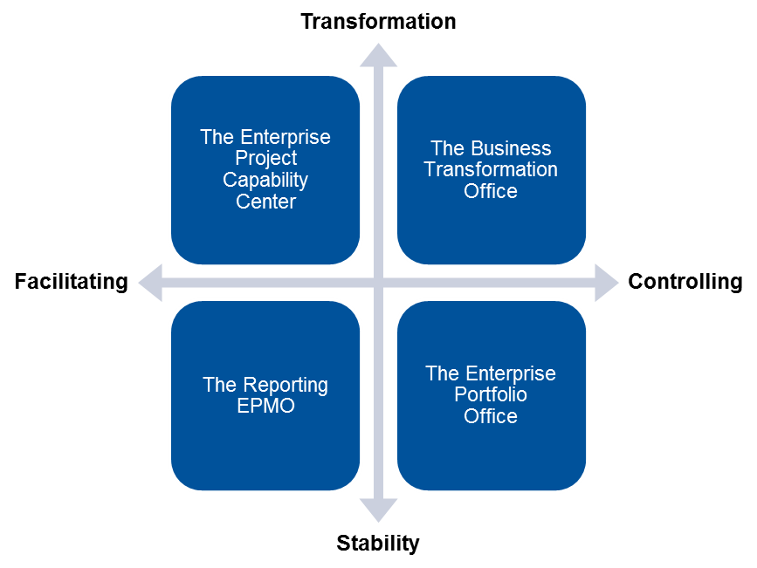
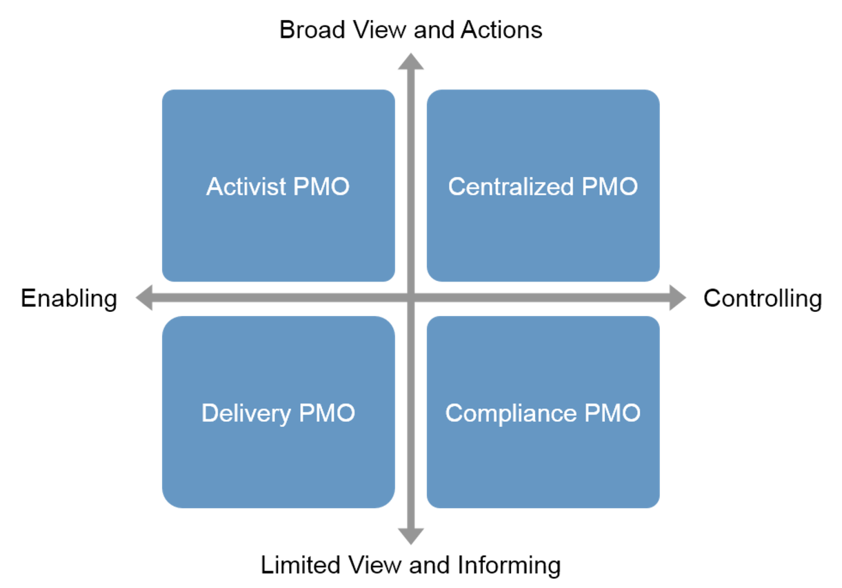
Evolving and Repositioning: PMOs Can Only Persist by Enabling Enterprise Strategy, Program and Change
The Digital Enterprise
The Digital Divide
EPMO
Strategy
Realization Office
Projects
Orchestrate
Advise
Products
PMO
Strategy Realization
Enable
PMO
Strategize
Team
SRO
Stream
The Industrial
Enterprise
Program
Program
Notes:
Digital business requires program and portfolio management leaders to make strategy execution a primary focus. The enterprise program/portfolio management office, or EPMO, is gaining traction in large organizations as responsive and effective execution capability in the face of changing conditions.
As digital business impacts organizations, strategy execution and value delivery are key factors in the success of all styles of EPMO. Value delivery is not focused on just delivery and execution. Only 50% of EPMOs have any responsibility for project delivery. Even then, it is often for only a small fraction of the portfolio — usually large or strategic projects or programs. Consequently, EPMOs must use influence rather than authority to ensure successful project delivery.
Looking at the PMI’s Pulse of the Profession survey of more than 3,200 PM practitioners, globally, 71% state their organization has a project management office (PMO), of which approximately 37% to 38% align to a departmental, regional or enterprise strategy.
The role of the EPMO is to be a bridge between business units to ensure that the enterprise can optimize. Less than 42% of the organizations surveyed by PMI have an EPMO. There is a gap between EPMO/business transformation and the digital enterprise. The evolution is not linear at this point — maturing what exists will not work anymore. The digital enterprise is adaptive and requires another change — the strategy realization office (SRO).
There is still too much on project success, standardization and project management. There were 70% of respondents that stated overwhelmingly that these are the roles the focus on, with less emphasis on portfolio, resource, benefits and transition to the business. On time, on budget and in scope are not going to be sufficient in the digital business. There are many high-level maturity organizations from the late technology boom in the 1990s to 2000s that are no longer with us (e.g., telephony and retail).
For more, see:
"The Need to Execute Digital Strategy Will Drive the Transformation of the EPMO" (G00274517)
"Use the Four Styles of the EPMO to Evolve From Visibility to Transformation" (G00340622)
"How IT PMOs Can Remain Relevant in the Age of Digitalization" (G00332169)

Slide 14
The Ps — Definitions Vary by Organization, but Coexistence Is a Must as All Forms of Building Capabilities and Executing Change Will Be Called Into Play
The Ps — Definitions Vary by Organization
Product
(and/or)
Project
(and/or)
Work and Other Efforts
Portfolios
Programs
Hardware/ Infrastructure
Application
Application
Application
Hardware/Infrastructure
Hardware/Infrastructure
Services
Projects
Services
Services
Managed Work
Projects
Projects
Notes:
Digital business represents a new era of IT, where the role and objectives of IT morph into two different, although somewhat overlapping, directions. While traditional IT activities, like internal infrastructure management and application development, will still be required (although with increasingly fewer people and lower budgets), technology innovation will increasingly be a requirement for driving and scaling a digital business. This will often require significant changes to the business and economic (e.g., investment and funding) model. In turn, these shifts require changes in strategy, culture, organization and capabilities that extend beyond the IT organization to encompass business and operational functions, and especially product management. Product managers are no longer limited to consumer product firms or technology companies. They now play an increasingly crucial role in driving digital business success by orchestrating all relevant stakeholders to manage a continually evolving digital strategy (see "Product Managers Are Key to Digital Business Success" G00313019).
The shift to a product-centric organization should be made in areas where there is a need to drive innovation and collaboration. A product-centric organization must make trade-off decisions that are in the best long-term interest of a product/service, as opposed to satisfying the needs of the loudest customer.
A project-centric organization means that people typically shift from one project to another, placing a premium on tactical success and their technical skills. In contrast, product centricity places a premium on full-stack skills. Core elements of product management disciplines include technology-infused innovation, business fundamentals and metrics, continuous (digital) customer engagement, and understanding market delivery and competition.
Resources that contribute to a product will intensely work toward product release or launch objectives.
For more, see "Moving From Project to Products Requires a Product Manager" (G00289817).

Slide 15
Build a Business Agile Mindset to Enable Enterprise Agility, Including, but Not Exclusive to IT
Business Agile Mindset
6
Situational-Specific Strategies
1
Continuous Flow of Value
5
Shared Responsibility
for Results
2
Frequent Customer Interaction
Business
Agile
Mindset
4
Creativity and
Innovation
3
Iterative and Adaptive
Notes:
Harvard Business Review, "By taking people out of their functional silos and putting them in self-managed and customer-focused multidisciplinary teams, the agile approach is not only accelerating profitable growth but also helping to create a new generation of skilled general managers."
Gartner surveys indicate that agile practices continued to grow at more than 60% year over year. Increasingly, IT organizations across multiple industries are proving the benefits of using agile (see Note 1). Such benefits include the ability to manage changing priorities, increased team productivity, improved project visibility and faster delivery time to market. Why, then, is the rest of the enterprise slow to adopt agile? People naturally resist change. No blueprint exists for adopting agile for outside of IT projects, so there is much work to be done to determine the best way to use agile for other types of deliverables.
We are not suggesting that all PMO leaders start doing Scrum or even development. However, they can adopt tools from the agile toolbox that can make their teams more effective at identifying and prioritizing business needs, and collaborating with cross-functional teams. These projects may or may not include IT deliverables. PMO leaders are well-positioned to influence the enterprise to adopt agile practices in the business.
For more, see:
"PMOs Can Deliver Faster Results With Business Agile" (G00340499)

Slide 16
Key Issues
What are the future trends and challenges affecting the program and portfolio management (PPM) leader?
How do leading organizations deliver the highest value using PPM to drive innovation?
What leadership skills and competencies are needed for the PPM leader in the digital age?
What actions and next (best) practices should a PPM leader and team implement?
Notes:
PPM leaders can leverage these PowerPoint slides to understand and act on:
What are the future trends and challenges affecting the PPM leader?
How do leading organizations deliver the highest value using PPM to drive innovation?
What leadership skills and competencies are needed for the PPM leader in the digital age?
What actions and practices should a PPM leader and team look to implement next?
PPM leaders who are Gartner clients can leverage such research material, or part of it, to raise the quality of their own teams, better influence the other IT leaders, and communicate the value of the PPM organization to the higher ranks of the organization and other stakeholders.

Slide 17
To Be a Great PMO Leader, You Must Hone 5 Specific Soft Skills to Facilitate Success and Execution Through the Work of Others
Gartner's Model of Critical Soft Skills for Effective PMO Leadership
Develop Your Empathy
Communicate in Ways That
Create Change
Be a Symbol
of Change
Establish Yourself as a Servant Leader
Become an Expert at Persuasion
and Influence
Notes:
Skills in PPM methodologies, process and technology are important. However, a great PMO leader must hone specific soft skills to facilitate success in project management and project execution through the work of others.
Success for the project management office (PMO) leader depends on the contribution and participation of many people in the organization. Dealing with other human beings requires a different set of skills than those that project, program and portfolio management (PPM) practitioners and IT leaders may use to solve, for example, a system problem. Building support for an initiative, idea or concept depends on the soft skills around socialization, discussion and synthesis. Soft skills are defined as those attributes that enable an individual to interact effectively and harmoniously with others, and are complementary to the learned occupational and professional skills.
Soft skills aren't simple skills. Some PMO leaders may find that they possess an intrinsic understanding, while others have to constantly work on reminding, improving and assessing these skills. However, soft skills cannot be ignored. A lack of soft skills can be, and has been, a career killer for many in leadership positions. They are as integral as technical skills to the PMO leader's career and success, and in some cases, more integral, especially if the PMO leader is driving organizational change.
For more, see:
"Critical Soft Skills for Effective PMO Leadership" (G00352662)
"The PMO Leader's First 100 Days" (G00342206)
"Adapt the Science of Influence to Develop Your Art of Persuasion" (G00319407)

Slide 18
Choose Behaviors Today That Move You Toward an Activist PMO Approach
Passive PMO
Activist PMO
Offers scheduled training sessions
Lacks and avoids measurable objectives
Requests project updates
Waits for approved projects to
assign project managers
Relies on a library of templates from
standards, textbooks
Shies away from conflict, politics
Goes by mantra of "standards and consistency"
Ensures plentiful reporting, and is scant on ideas or help
Sets up projects with project managers, and does on-the-job training
Establishes self-improvement metrics,
shared goals
Probes for risk, asks tough questions
Promotes PMO as the source of best
project managers
Customizes good project artifacts and shares
Works organizational politics up, down
and across
Goes by mantra of "a foolish consistency is the hobgoblin of small minds"
Makes data-driven recommendations for go or no-go and kill or fix decisions
Notes:
An effective PMO actively goes beyond collating reports, emailing available training schedules, passively requesting updates and the like. It "goes the extra mile" — for example, where reports indicate problems such as delays to future projects from stalled progress on present projects, it can perform analysis to recommend remedies and trade-offs.
Therefore, as they mature, PMOs go beyond a narrow approach — for example, from passive process checking — to build a repertoire of capabilities. Activist PMOs work to share strategic vision up and down the PPM value chain and help make the connections. They broaden their focus beyond reliable project delivery, often beginning by offering portfolio analysis and recommendations. This slide identifies eight major characteristics.
For more details on this research, see:
"Activist PMOs and the Struggle for Lean PPM" (G00332772)

Slide 19
Competencies for the Future: Project Manager
Digital transformation will
drive a fundamental shift in what the business values and requires in the project
management space
Innovation
Agile/Adaptive
Product Mgmt.
Leverage Automation
Notes:
A tsunami of change is engulfing every aspect of the PPM disciplines. Project managers, like their counterparts in other PPM areas, will need to make fundamental changes to survive and thrive in the years to come.
Those who manage or facilitate projects in the future will require very different skills and capabilities from those seen as being useful today. Today's project managers must look to reinvent themselves, focusing on those locations within the enterprise that are engaged in digital transformation and road testing what does and does not work in a new and fast-changing environment.
Enterprises that employ project management (and managers), and industry organizations like the Project Management Institute (PMI) and AXELOS, have historically advocated for one-size-fits-all, reusable, best-practice frameworks for projects. In the past, enterprises that are self-assessed as Level 2 (emerging discipline) and lower Level 3 (initial integration) in overall PPM maturity have benefited from this approach. However, during the next five years or so, it will shift from a benefit to a liability as enterprises undergo digital transformation, and especially as they embrace the Internet of Things (IoT). All of these changes will drive a fundamental shift in what the business values in the project management space, shifting from a focus on software delivery to a focus on overall change management.
Gartner recommends project managers to:
- Master bimodal IT practices for managing both waterfall and agile efforts; together, with the ability to plan and manage effective change to optimize business value realized.
- Add continuous improvement skills to their resume, ensuring that they will be in high demand in a shrinking world of full-time IT project management.
- Work with the business side to add basic project management skills to line manager capabilities, fulfilling the goal of managing projects closer to the consumer.
For more, see:
"Where Your PPM Career Won't Be in 2020: Project Managers Must Reinvent Themselves for the Digital Future" (G00292419)
"Digitalization's Impact on PPM Practices and the PMO by 2030" (G00325444)

Slide 20
Competencies for the Future: Program Manager
Program Management –
inside the program — will be least impacted by digital transformation. Surrounding "ecosystem" changes will
drive new behaviors and strategic change
Complex Assembly
Architecture
Strategic Change
Dispersed Teams
Notes:
Program managers will find that they must emphasize integration much more strongly than delivery. From the viewpoint of platforms and available components, much of delivery — in the digital future — will be about finding things to snap together, rather than code development. In the future, program planning must do a much better job of including roles, activities, and results for enterprise and technology architecture experts across the entire life cycle.
Program life cycles must be changed to accommodate iterative trade-off discussions. Many past program technology decisions were simple: "We already use the xx platform; so the new functionality will execute there." As programs become more about fitting and connecting parts, the discovery process inside the program will be structured to periodically reraise preliminary technology choices in light of new or changed hard numbers. At each iteration, current trade-off alternatives will be weighed, inside known parameters and best (or least bad) choices made (or remade) and tested as the program moves forward. Some components or combinations will be changed or discarded as more knowledge is gained. This will add both duration and work effort to some life cycle segments.
Gartner recommends program managers:
- Do a better job of integrating enterprise and technology architecture roles and activities across the entire program life cycle.
- Expect extra time and work effort, which are required in multiple phases for iterative component and technology trade-off discussions and modeling of alternatives.
- Recognize that integration activities require a shifting cast of internal/external experts and enterprise readiness to make them available on demand.
- Make onboarding of program staff, management, and executives a formal workstream.
For more, see:
"Where Your PPM Career Won't Be in 2020: Program Managers Will Focus More on Integration Than on Delivery" (G00292420)

Slide 21
Competencies for the Future: Portfolio Manager
Strategy "disconnects" and increased change velocity will all distort portfolio data reported to leadership. Constant scenario building, hypothesis testing and iteration will be necessary.
IT + Business Understanding
Focus on Outcomes
Utilizing Enhanced Automation
Integrated Analysis
Notes:
Portfolio managers in 2020 will find themselves as the human half of a partnership with a smart assistant, which assumes, of course, substantial innovative thinking and investment by those current (and future) vendors in this marketplace. Gartner has seen at least one example of a current vendor and toolset that is moving in this direction.
Use cases and business-IT strategy/investment rules will trigger action-and-response requirements — likely with very short service times. These will, in turn, make strategy, planning, product and financial investment alternative modeling essential. Portfolio managers — and their smart (as well as human) assistants — will be asked to determine where leadership action is needed, identify what kinds of leadership action (and range of choices) are needed, provide specific recommendations as to what actions to take and define likely impacts of those actions.
Gartner recommends portfolio managers:
- Move beyond today's project lists into modeling IT and major business investments, future forecasts and impacts inside the broader strategic ecosystem.
- Take up an educational role for your organizational leaders to fully understand the value and results-oriented fit of their discipline.
- Demolish barriers separating yourself from the broader IT and business governance functions if they are to add real value.
- Press your current tool vendors and explore new options to get tools that will support a much-changed discipline.
For more, see "Where Your PPM Career Won't Be in 2020: Portfolio Management Will Be Driven to Provide Real and Accurate Analysis" (G00292421).

Slide 22
Key Issues
What are the future trends and challenges affecting the program and portfolio management (PPM) leader?
How do leading organizations deliver the highest value using PPM to drive innovation?
What leadership skills and competencies are needed for the PPM leader in the digital age?
What actions and next (best) practices should a PPM leader and team implement next?
Notes:
PPM leaders can leverage these PowerPoint slides to understand and act on:
What are the future trends and challenges affecting the PPM leader?
How do leading organizations deliver the highest value using PPM to drive innovation?
What leadership skills and competencies are needed for the PPM leader in the digital age?
What actions and practices should a PPM leader and team look to implement next?
PPM leaders who are Gartner clients can leverage such research material, or part of it, to raise the quality of their own teams, better influence the other IT leaders, and communicate the value of the PPM organization to the higher ranks of the organization and other stakeholders.

Slide 23
Next Action Steps
Today's Enterprise PPM Leader — Prepare to Jump the Divide:
Introduce adaptive program management for delivery
Perfect your portfolio analytical skills
Establish communication across silos and functions
Build long-term change enablement into
your programs
Tomorrow's Strategy Realization Leader — On the Other Side of the Divide:
Use adaptive approaches for delivery
Create a culture of continuous scanning for change
Put people at the forefront of your considerations
Remember that teams supply the creativity
and innovation
Do more with less structure
SRO
The Digital Enterprise
EPMO
The Digital Divide
PMO
The Industrial
Enterprise
Notes:
Moving toward collaborative digital technology leadership means breaking down the barriers between the IT organization and other technology enablers of the enterprise. Digital technologies are everyone's business, and digital decisions need to be embedded everywhere.
Robust and flexible governance frameworks and processes are required to manage digital business transformation. With so many new technology stakeholders, deciding who gets a seat at the table as digital projects are approved and implemented becomes critically important. Bad decisions will set the stage for uncoordinated initiatives with resource duplication, limited data integration, expanding technical debt, security weaknesses and inadequate role assignments. Good decisions lead to a unified and connected approach to achieve digital business transformation, where disparate parties collaborate effectively based on mutual trust and respect, and where resources are applied in an inclusive manner.
For more, see:
"The Need to Execute Digital Strategy Will Drive the Transformation of the EPMO" (G00274517)
"Use Adaptive Portfolio Investment Management to Execute Strategy" (G00324669)
"Harness the Strategy Realization Office to Fight Organizational Change Fatigue" (G00340543)

Slide 24
Gartner Recommended Research
"Hype Cycle for Project and Portfolio Management, 2017"
Mbula Schoen
"Moving From Project to Products Requires a Product Manager"
Bill Swanton, Stefan Van Der Zijden, Donna Fitzgerald
"Predicts 2017: PPM Leaders"
Matt Light, Donna Fitzgerald, Robert A. Handler
"2017 CEO Survey: CIOs Must Scale Up Digital Business"
Mark Raskino
"Digitalization's Impact on PPM Practices and the PMO by 2030"
Mbula Schoen
"Toolkit: How to Design Relevant and Effective Metrics That Drive Better
Business Outcomes"
Samantha Searle

