Slide 1
Portfolio Management
Bob Marshall, MD MPH MISM FAAFP
Faculty, DoD Clinical Informatics Fellowship

Slide 2
Learning Objectives
Review definitions
Compare financial and IT portfolio management
Overview and background of IT portfolio mgmt.
IT portfolio in context
Review each of the three types of IT portfolio management
IT portfolio management and strategic planning
Advanced IT portfolio mgmt and future reports

Slide 3
Definitions
IT portfolio management is the application of systematic management to the investments, projects and activities of enterprise Information Technology (IT) departments.
Application Portfolio Management is using lessons from financial portfolio management to justify and measure the financial benefits of each application in comparison to the costs of the application's maintenance and operations.

Slide 4
What is the value?
According to Forrester Research, the typical IT organization expends 78% of its human and capital resources maintaining an ever growing inventory of applications and supporting infrastructure.
With a large majority of expenses going to manage the existing IT applications, the practice of Application Portfolio Management attempts to reign in these costs by identifying (and eliminating when possible) duplication and redundancy.
The same issues apply for the IT project and IT infrastructure portfolios (discussed shortly).

Slide 5


Slide 6
Comparing IT and Financial PM
Financial portfolio assets typically have consistent measurement information (enabling accurate and objective comparisons)
Achieving such universality of measurement takes considerable effort in the IT industry
IT investments are not liquid, like stocks and bonds, and are measured using both financial and non-financial yardsticks (for example, a balanced scorecard approach); a purely financial view is not sufficient
Assets in an IT portfolio have a functional relationship to the organization, such as an inventory management system for logistics or a human resources system for tracking employees’ time

Slide 7
Financial versus Portfolio Mgmt
Every project is expected to be on time and on budget.
Every project is expected to deliver on expected returns.
IT investments are considered discretely.
Return on investment potential may be considered for an individual investment, but the impact on the portfolio as a whole is often ignored.
Investment allocation across segments is not targeted in advance, but is rather an outcome of project funding.
Resource utilization and optimization, rather than outcome, may drive decisions.
Perhaps most importantly, all investment classes are evaluated with the same set of criteria

Slide 8
IT Portfolio Mgmt - Overview
IT portfolio management is distinct from IT financial management in that it has an explicitly directive, strategic goal in determining what to continue investing in versus what to divest from
IT portfolio management is accomplished through the creation of three portfolios:
Application portfolio
Infrastructure portfolio
Project portfolio - addresses the issues with spending on development of innovative capabilities in terms of potential ROI, reducing investment overlaps in situations where reorganization or acquisition occurs, or complying with legal or regulatory mandates.

Slide 9
Benefits of IT Portfolio Mgmt
Agility of portfolio management is its biggest advantage over other investment approaches and methods.
Other benefits include central oversight of budget, risk management, strategic alignment of IT investments, demand and investment management along with standardization of investment procedure, rules and plans.

Slide 10
IT Portfolio Mgmt in Context
IT portfolio management is the superset of the various portfolio management subspecialties required to develop, execute, and allocate the IT resources of the organization.
Together, these subspecialties provide the information needed for ongoing management and optimization, providing information up and down the reporting structure and creating the feedback loops required for optimal performance
Within this context, IT portfolio management sits between the strategic planning functions and the project arbitration, project management, and project optimization processes

Slide 11
Interrelating IT Processes

Slide 12
IT Mgmt Processes Overlay Operational Processes

Slide 13
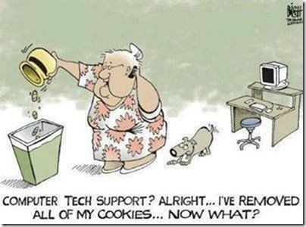

Slide 14
Project Portfolio Management
Projects that are under consideration or currently underway are the domain of project portfolio management (PPM).
By using techniques like categorization, financial, inventory, and risk and benefits analysis combined with tools, organizations can prioritize which projects best fit their goals
Key goals of PPM include:
Elimination of redundancy
Better resource allocation
Common repository for business value metrics
Notes:
The initiatives managed by the PPM organization/people become the engine of value growth, the way that the organization rebalances the IT investment portfolio, and the way that the IT reacts to changes in business focus or market dynamics

Slide 15
Application Portfolio Management
Application portfolio management provides a way to create business-oriented metrics around existing applications by linking existing applications and components with concurrent costs to manage and maintain current business processes, business value, and business metrics.
Application portfolio management allows the following:
Maintenance and renewal decisions are made with sound business backing
Proper disaster recovery and business continuity planning can occur
Better outsourcing agreements can be developed – benefiting all partners

Slide 16
IT Asset and Infrastructure Mgmt
IT asset management (ITAM) inventories network-attached hardware and installed licensed software and links them to underlying contracts, depreciation schedules, and maintenance agreements.
Potential benefits of ITAM include:
License compliance
Better maintenance and replacement requirements
Improved utilization of IT assets/infrastructure
IT infrastructure Investment decisions must be made based not solely on cost and cost savings possibilities but also as a component that can reduce IT risk, increase business flexibility, or enable business value through better execution of new application development and rollout

Slide 17
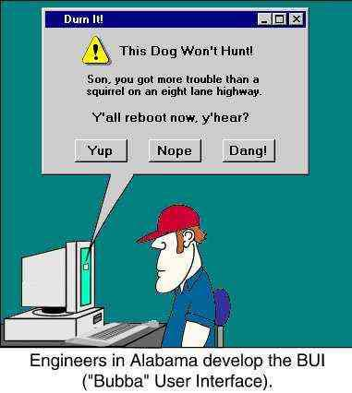

Slide 18
IT Portfolio Mgmt & Strategic Planning
An organization strategic plan lays out the basic goals and direction for that organization over a coming period of time.
To implement that plan, individual goals are apportioned to various departments in the organization.
These departments, in turn, define strategies and tactics to let them meet their part of the whole.
The IT organization receives its marching orders from two fronts:
General business management
Departmental business management

Slide 19
Linking the IT Portfolio to the Strategic Plan & Investments
Once the strategic plan is developed and spending priorities established, potential investment options are analyzed to ensure that they contribute to one or more of the goals.
With this basic analysis completed, the portfolio manager can then:
Allocate spending by goal
Validate the relevancy of the strategic plan
Develop trial portfolios based on resource limitations
Communicate IT plans in business terms
Manage the portfolio as a portfolio
Expand the coverage

Slide 20
Advanced Mgmt & Future Reports
Once the concepts of IT portfolio management are embraced, the process of evaluating and communicating the components and goals of the portfolio can be layered in.
Future reports will cover such topics as:
Visualizing the IT portfolio – classifying and categorizing IT investments
Metrics and measurements for the IT portfolio
Risk & return – and their relationship to the IT portfolio
The role of architecture in maintaining the IT portfolio

Slide 21


