Slide 1
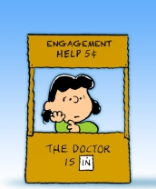
Patient Engagement
Bob Marshall, Program Director

Slide 2
Learning Objectives
Define Patient Engagement
Discuss Benefits and Challenges
Review the 5 Elements of Successful Patient Engagement
Discuss Patient Portals and How to Use Them Effectively
Review the 4 Myths of Patient Engagement

Slide 3
Some Definitions
“Patient activation”
  Patient’s knowledge, skills, ability, and willingness to manage his or her own health and care
“Patient engagement”
  Broader concept that combines patient activation with interventions designed to increase activation and promote positive patient behavior, such as obtaining preventive care or exercising regularly
Why bother
  Increasing evidence that patients more actively involved in their health care experience better health outcomes and incur lower costs
  Patient engagement is an essential strategy to achieve the quadruple aim

Slide 4
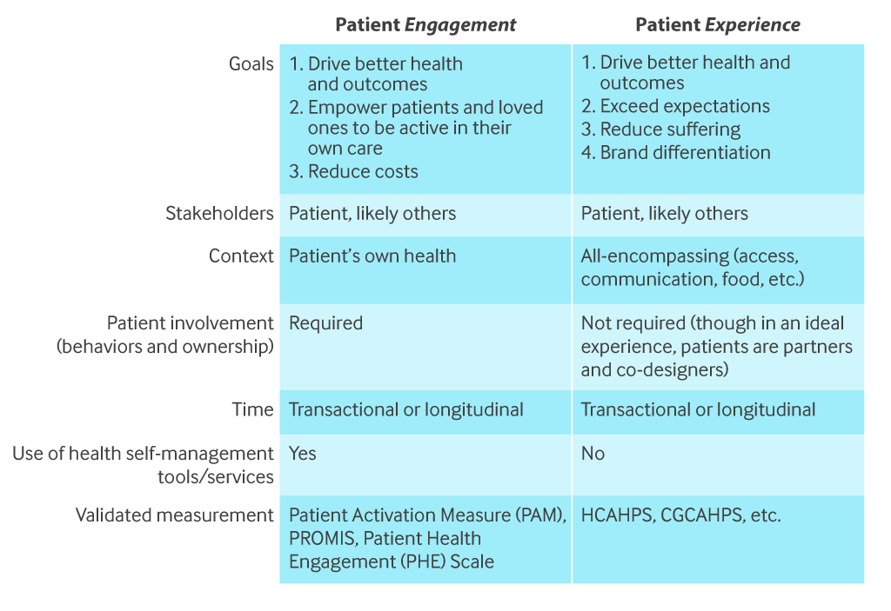

Slide 5
Another Perspective
Patient engagement refers to:
  The knowledge, skills, ability, and willingness of patients to manage their own and family members’ health and care;
  The culture of the health care organization that prioritizes and supports patient engagement; and
  The active collaboration between patients and providers to design, manage and achieve positive health outcomes.

Slide 6
Benefits of Patient Engagement
Reduced costs
Increased communication
Increased patient satisfaction
Population health
Increased efficiency and effectiveness (i.e., improved outcomes)

Slide 7
Challenges to Patient Engagement
There are obstacles such as:
  Difficulty shifting behaviors
  Different communication preferences
  Lack of health information exchanges
  Technology ease of use
  Operational and implementation challenges
  Workforce reluctance
  Cybersecurity obstacles to implementation and patient access

Slide 8
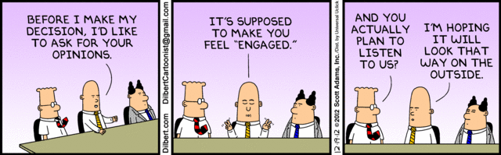

Slide 9
Five Elements of Successful Patient Engagement
Define your organization’s vision for patient engagement
Create a culture of engagement
Employ the right technology and services
Empower patients to become collaborators in their care
Chart progress and be ready to change and adapt

Slide 10
Defining the organization vision
First, understand where you are and where you want to be in terms of patient engagement
Discuss what patient and family engagement means to your senior leadership, board, staff, patients and their families
With these discussions, you can work with the definition of engagement presented here or generate your own custom definition
Create an “end state” vision of what your practice will look like when you have a strong patient engagement strategy in place
Next, develop goals and expected outcomes based on your patient engagement vision
Keep in mind that to fully engage patients and families, health care practices must plan for change at multiple levels

Slide 11
Create a culture of engagement 1 of 2
Getting practice-wide support is critical for successful patient engagement
Rely on policies and procedures when moving forward with patient engagement
Be prepared with—and communicate often—the benefits of patient engagement for patients, staff and providers
Make clear that staff are valued and critical to successful patient engagement
Explain why patient engagement is important to the organization
Make a clear, enforceable policy around completing tasks, but also add some fun to the process with rewards and recognition
Ease concerns that patient messaging requires more clinical time—in fact, secure messaging actually reduces clinical time compared to phone calls

Slide 12
Create a culture of engagement 2 of 2
Make sure providers understand the benefits of patient engagement for themselves, for patients, and for the organization
Address concerns about older patient adoption of new technology.
  Research consistently shows that patients aged 65 and over use the Internet regularly and are comfortable using patient portals to access medical records online
Consider provider competition for portal adoption rates

Slide 13
Employ the right technology and services
Patient portals can enhance patient-provider communication and enable patients to check test results, refill prescriptions, review their medical record, and view education materials
Patient portals can streamline administrative tasks such as registration, scheduling appointments, and patient reminders
Technology and patient communication services can help satisfy patients who demand convenient, 24/7 access to their health information
Educate patients on appropriate use of the portal and the importance of safeguarding their log-in credentials as well as where they store any information they download or print

Slide 14
Empower patients to become collaborators in their own health care 1 of 2
Having patients use your portal is an important component of patient engagement
Some ideas to engage patients with the portal include:
  Make the benefits of using the portal clear, and provide incentives for patients to use it
  Ask providers to talk with patients about how the portal can improve their experience
  If necessary, walk patients through logging onto the portal, and show them how to do tasks they do regularly

Slide 15
Empower patients to become collaborators in their own health care 2 of 2
Ideas to engage patients with the patient portal include (part 2):
  When someone calls to do a task that they could do on the portal, walk them through it using the patient portal and encourage them to try it next time
  Try to understand and address any hesitancy or concerns with using the portal
  Rely on the patient portal for as much of your communication to patients as you can
    The more you use it, the more they will too
  Accept that some patients will not use the portal.
    Make sure it is consistently an option so they have opportunities to change their mind

Slide 16
Chart progress; be ready to change and adapt
Use the organizational patient engagement vision to set achievable targets and ways to measure progress
Depending on the stated vision, the organization may want to track metrics such as patients’ understanding of how a given intervention is going to help with health goals, how patients are using technology to progress towards health goals, and any changes in confidence in managing their own health
At minimum, consider monitoring how many patients have signed up to use the patient portal, how many emails have been collected, or how often patients connect

Slide 17
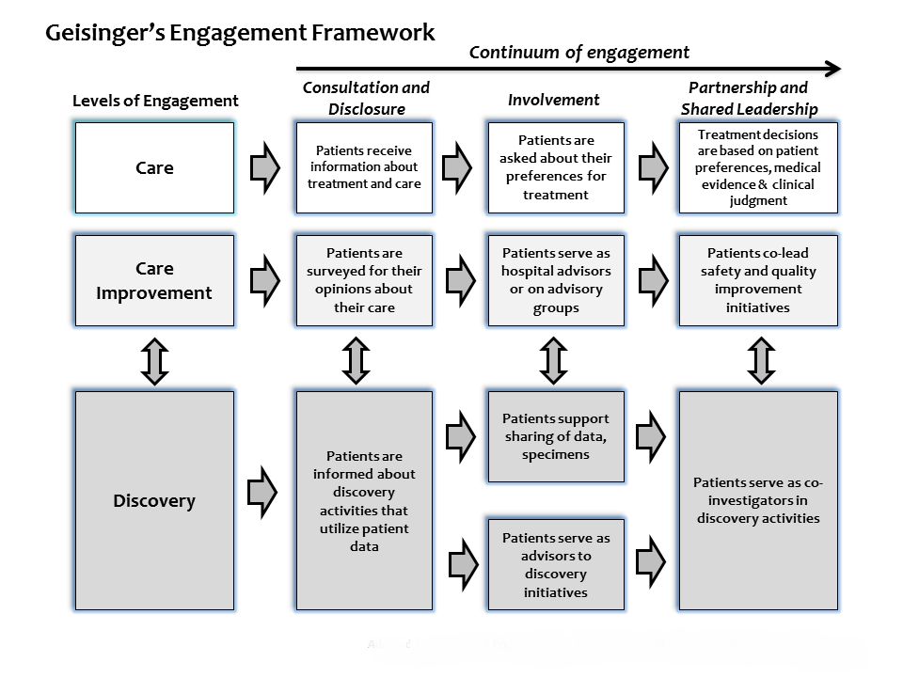

Slide 18
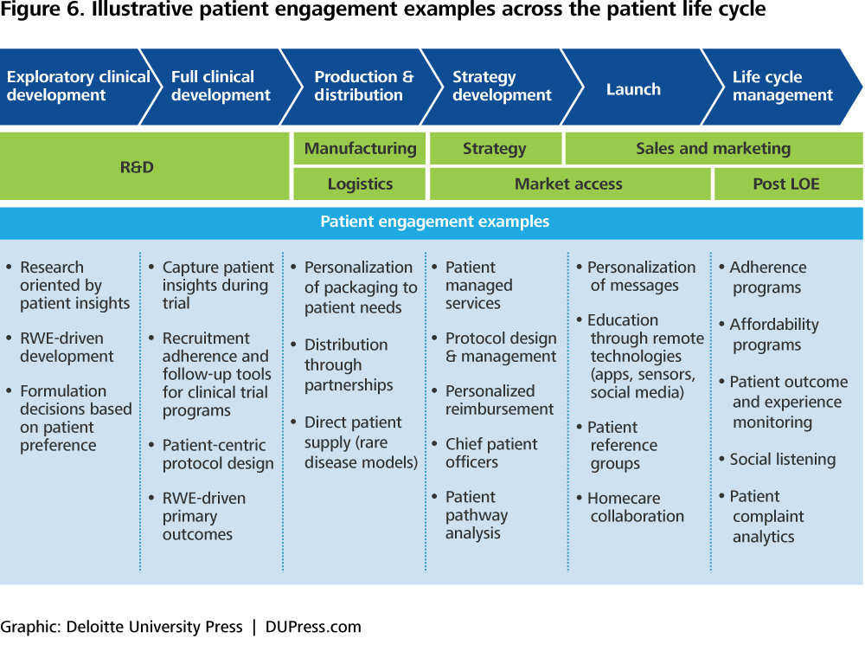

Slide 19
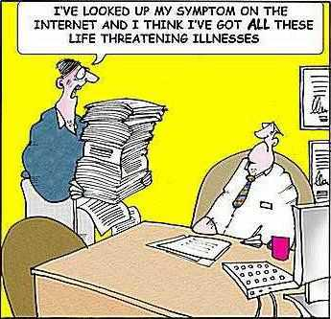

Slide 20
Statistics from Google and Pew Research Center
4.7 billion: daily Google searches
1 in 20 Google searches is for health-related information
80 percent of Internet users seek online health information
77 percent of patients used a search prior to booking an appointment
66 percent of Internet users look online for information about a specific disease or medical problem
44 percent of Internet users look online for information about doctors or other health professionals

Slide 21
Myths of Patient Engagement 1 of 4
Myth #1 – Patient engagement doesn’t have to be a top priority now
  Patient engagement is a goal of several major initiatives, both in the DoD and in the civilian sector
  There are incentives for doing this well, and there can be penalties for not doing so
  Accountable care, value-based care, PCMH and population health are all based on patient engagement for success
  Given that patients can have the ability to choose where they receive their care, engaging them and offering tools for convenience and access is a way to attract and keep them

Slide 22
Myths of Patient Engagement 2 of 4
Myth #2 – Older patients will not use an online patient portal
  67% of Americans 65 and older say that accessing their medical information online is very or somewhat important.
  83% of U.S. seniors think that they should have full access to their electronic health records, but only 28% actually do.
  In an AMA study, patients over 65 adopted portals at a rate greater than patients aged 18-35.
  Between 2000 and 2012, Internet use tripled for those 65 and older, and it doubled among those 50 to 64 years old

Slide 23
Myths of Patient Engagement 3 of 4
Myth #3 – Sharing medical information with patients will add to provider workload
  Providers report increased efficiency and appreciate being able to respond to patients at their convenience
  Evaluation studies find that telephone volume decreases when secure messaging is introduced
  Studies also find that the communication content of patient messages tends to be appropriate, addressing non-urgent care issues
  Portal features have been found to provide cost savings by decreasing indirect and direct labor costs, such as mailing costs for lab results, online billing questions versus telephone, online appointment scheduling, and online appointment reminders

Slide 24
Myths of Patient Engagement 4 of 4
Myth #4 – Lower income patients won’t be able to use online patient information
  In a study looking at lower income persons’ access and use of Internet connectivity:
    60% of lower income patients in the study reported using email regularly,
    54% said they obtained general research information from the Internet, and
    78% expressed interest in electronic communications with health care services
  What this translates to in the DoD is that your lower enlisted ranks and the poorer retirees can have access to the Internet and do want the same things as anyone else using the healthcare system

Slide 25
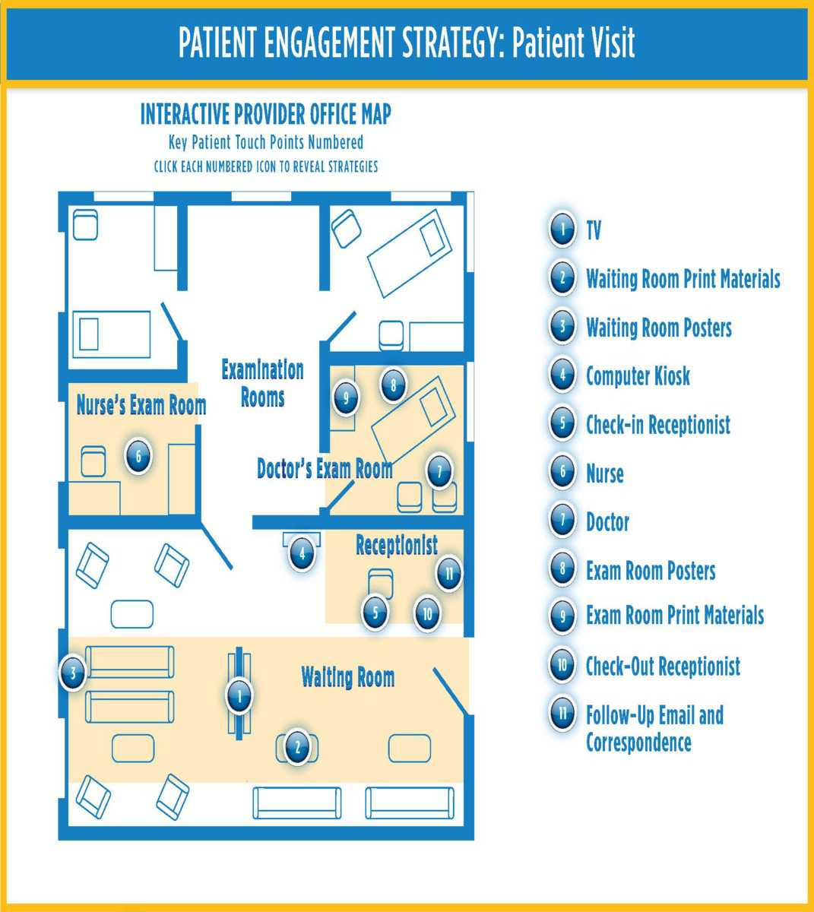

Slide 26
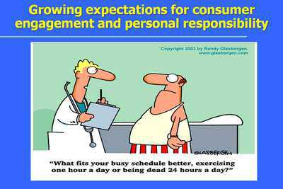
Questions

