Slide 1
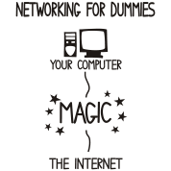
Network and Internet Security
Bob Marshall, MD MPH MISM FAAFP
DoD Clinical Informatics Fellowship

Slide 2
Learning Objectives
Review network security topics
Review Wi-Fi network security
Review Internet security topics

Slide 3
Network Security
Network security consists of the policies and practices implemented to monitor and prevent unauthorized access, misuse, modiﬁcation or denial of a computer network and network-accessible resources.
Network security involves the authorization of access to data in a network, which is controlled by the network administrator.

Slide 4
Network Security Factors
Network security starts with authenticating, commonly with a username and a password
Since this requires just one detail authenticating the user name (the password), this is termed one-/single-factor authentication
With two-factor authentication, something the user 'has’ is also used (e.g., security token or 'dongle', ATM card, mobile phone)
With three-factor authentication, something the user 'is’ is also used (e.g., a ﬁngerprint, retinal scan, face scan, voice-print…aka biometric)

Slide 5
Network Protection Devices
Once authenticated, a ﬁrewall enforces access policies such as what services are allowed to be accessed by the network users as well as what external services/users are allowed to access the network
Though eﬀective to prevent unauthorized access, firewalls may fail to stop potentially harmful content such as network transmitted computer worms or Trojans
Anti-virus software or an intrusion prevention system (IPS) help detect and inhibit the action of such malware
An anomaly-based intrusion detection system may also monitor the network like Wireshark traﬃc and may be logged for audit purposes and for later high-level analysis
Newer systems, combining unsupervised machine learning with full network traﬃc analysis, can detect active network attackers from malicious insiders or targeted external attackers that have compromised a user machine or account
Wireshark is a free and open source packet analyzer

Slide 6
Honeypots
Honeypots are essentially decoy network-accessible resources that are deployed in a network as surveillance and early-warning tools.
Honeypots are not normally accessed for legitimate purposes
Techniques used by the attackers that attempt to compromise these decoy resources are studied during and after an attack to keep an eye on new exploitation techniques
A honeypot encourages attackers to spend their time and energy on the decoy server while distracting their attention from the data on the real server

Slide 7
PKI – Public Key Infrastructure
A public key infrastructure (PKI) is a system for the creation, storage, and distribution of digital certificates which are used to verify that a particular public key belongs to a certain entity
The purpose of a PKI is to facilitate the secure electronic transfer of information for a range of network activities such as e-commerce, internet banking and confidential email
The PKI creates digital certificates which map public keys to entities, securely stores these certificates in a central repository and revokes them if needed

Slide 8
Components of a PKI
A certificate authority (CA) that stores, issues and signs the digital certificates
A registration authority which verifies the identity of entities requesting their digital certificates to be stored at the CA
A central directory—i.e., a secure location in which to store and index keys
A certificate management system managing things like the access to stored certificates or the delivery of the certificates to be issued.
A certificate policy

Slide 9
Network Attacks
Networks are subject to attacks from malicious sources
Attacks can be divided into two categories:
“Passive” when a network intruder intercepts data traveling through the network, and
“Active” in which an intruder initiates commands to disrupt the network’s normal operation or to conduct reconnaissance and lateral movement to ﬁnd and gain access to assets available via the network

Slide 10
Active Types of Network Attacks
Denial-of-service attack
DNS spooﬁng
Man in the middle
ARP poisoning
VLAN hopping
Smurf attack
Buﬀer overﬂow
Heap overﬂow
Format string attack
SQL injection
Phishing
Cross-site scripting
CSRF
Cyber-attack

Slide 11
Phishing
Phishing is the attempt to acquire sensitive information such as usernames, passwords, and credit card details directly from users
Phishing is typically carried out by email spoofing or instant messaging, and it often directs users to enter details at a fake website whose look and feel are almost identical to the legitimate one
Preying on a victim’s trust, phishing can be classified as a form of social engineering
A variant, called spear-phishing, targets specific individuals based on their role or access to obtain sensitive information or access to the network using the target’s credentials

Slide 12
Denial-of-Service Attack
Denial of service attacks (DoS) are designed to make a network resource unavailable to its intended users
Attackers can deny service to individual victims, or they may overload the capabilities of a machine or network and block all users at once
While a network attack from a single IP address can be blocked by adding a new firewall rule, many forms of Distributed denial of service (DDoS) attacks are possible, where the attack comes from a large number of points – and defending is much more difficult.
Such attacks can originate from the zombie computers of a botnet, but a range of other techniques are possible including reflection and amplification attacks, where innocent systems are fooled into sending traffic to the victim.

Slide 13
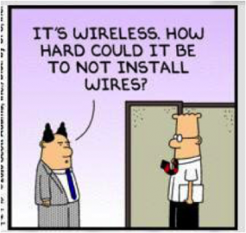
Wireless Security

Slide 14
Wi-Fi Network Security Intro
Security is especially important on Wi-Fi wireless networks.
Hackers can easily intercept wireless network traffic over open air connections and extract information like passwords and credit card numbers.
Several Wi-Fi network security technologies have been developed to combat hackers, although some of these technologies can be defeated relatively easily
Issues can arise in a supposedly non-wireless organization when a wireless laptop is plugged into the corporate network.
A hacker could access remotely and gather information from the wired network through laptops and/or other devices, or even break in through a wireless card–equipped laptop (that was plugged into the Ethernet) and gain access to the wired network.

Slide 15
Network Data Encryption
Network security protocols usually use encryption technology
Encryption scrambles data sent over network connections to hide information from humans while still allowing computers to properly decipher the messages
Many forms of encryption technology exist in the industry
Some examples of wireless encryption:
EAP-versions include LEAP, PEAP and other EAP’s
EAP – Extensible Authentication Protocol

Slide 16
Network Authentication
Authentication technology for computer networks verifies the identity of devices and people
Network operating systems like Microsoft Windows, Unix, Linux and Apple OS-X include built-in authentication support based on user names and passwords
Network routers also authenticate administrators by requiring them to enter separate login credentials

Slide 17
Common Wi-Fi Security Standards - WEP
WEP stands for Wired Equivalent Privacy
It is the original wireless security standard for Wi-Fi and is still commonly used on home computer networks
Some devices support multiple versions of WEP security
WEP-64-bit key (sometimes called WEP-40)
WEP 128-bit key (sometimes called WEP-104)
WEP 256-bit key
WEP should not be used except as a last resort, as it provides very limited security protection

Slide 18
WPA Security
WPA stands for Wi-Fi Protected Access and was developed to replace WEP.
Wi-Fi devices typically support multiple variations of WPA technology.
Traditional WPA, also known as WPA-Personal and sometimes also called WPA-PSK (for pre-shared key), is designed for home networking while another version, WPA-Enterprise, is designed for corporate networks
WPA2 is an improved version of Wi-Fi Protected Access supported by all newer Wi-Fi equipment
Like WPA, WPA2 also exists in Personal/PSK and Enterprise forms

Slide 19
More WPA
The WPA profile also provides optional support for the AES-CCMP algorithm that is the preferred algorithm in 802.11i and WPA2
WPA Enterprise provides RADIUS based authentication using 802.1x
WPA Personal is secure when used with ‘good’ passphrases or a full 64-character hexadecimal key
TKIP, WIDS and EAP may be added alongside WPA to increase security
TKIP – Temporal Key Integrity Protocol
EAP – Extensible Authentication Protocol

Slide 20
802.1X
802.1X provides network authentication to both Wi-Fi and other types of networks
It tends to be used by larger businesses as this technology requires additional expertise to set up and maintain
802.1X works with both Wi-Fi and other types of networks.
In a Wi-Fi configuration, administrators normally configure 802.1X authentication to work together with WPA/WPA2-Enterprise encryption
802.1X is also known as RADIUS

Slide 21
WIPS and WIDS
Wireless Intrusion Prevention Systems (WIPS) or Wireless Intrusion Detection Systems (WIDS) are commonly used to enforce wireless security policies
WIPS is typically implemented as an overlay to an existing Wireless LAN infrastructure, although it may be deployed standalone to enforce no-wireless policies within an organization.
WIPS is considered so important to wireless security that in July 2009, the Payment Card Industry Security Standards Council published wireless guidelines for PCI DSS recommending the use of WIPS to automate wireless scanning and protection for large organizations

Slide 22

Internet Security

Slide 23
Overview
The Internet represents an insecure channel for exchanging information leading to a high risk of intrusion or fraud, such as phishing
Diﬀerent methods have been used to protect the transfer of data, including encryption and from the-ground-up engineering
A computer user can be tricked or forced into downloading software onto a computer that is of malicious intent
Such software comes in many forms, such as viruses, Trojan horses, spyware, and worms

Slide 24
Malware 1 of 2
Malware is any software used to disrupt computer operation, gather sensitive information, or gain access to private computer systems
Malware is deﬁned by its malicious intent, acting against the requirements of the computer user, and does not include software that causes unintentional harm due to some deﬁciency
A botnet is a network of zombie computers that have been taken over by a robot or bot that performs large-scale malicious acts for the creator of the botnet.
Computer Viruses are programs that can replicate their structures or eﬀects by infecting other ﬁles or structures on a computer.
The common use of a virus is to take over a computer to steal data.
Computer worms are programs that can replicate themselves throughout a computer network, performing malicious tasks throughout.

Slide 25
Malware 2 of 2
Ransomware is a type of malware which restricts access to the computer system that it infects, and demands a ransom paid to the creator(s) of the malware in order for the restriction to be removed
Scareware is scam software with malicious payloads, usually of limited or no beneﬁt, that are sold to consumers via certain unethical marketing practices
The selling approach uses social engineering to cause shock, anxiety, or the perception of a threat, generally directed at an unsuspecting user
Spyware refers to programs that surreptitiously monitor activity on a computer system and report that information to others without the user’s consent
A Trojan horse is a general term for malicious software that pretends to be harmless, so that a user willingly allows it to be downloaded onto the computer

Slide 26
Denial-of-Service
A denial-of-service attack (DoS attack) or distributed denial-of-service attack (DDoS attack) is an attempt to make a computer resource unavailable to its intended users
Although the means to carry out, motives for, and targets of a DoS attack may vary, it generally consists of the concerted eﬀorts to prevent an Internet site or service from functioning eﬃciently or at all, temporarily or indeﬁnitely
DDoS attacks are still quite common, although Ransomware has become the attack of choice for Health IT systems

Slide 27
Security Remedies
TCP/IP protocols may be secured with cryptographic methods and security protocols.
These protocols include:
Secure Sockets Layer (SSL), succeeded by Transport Layer Security (TLS) for web traﬃc,
Pretty Good Privacy (PGP) for email, and
IPsec for the network layer security

Slide 28
Internet Protocol Security (IPSec)
IPsec is designed to protect TCP/IP communication in a secure manner
It is a set of security extensions developed by the Internet Task Force (IETF)
It provides security and authentication at the IP layer by transforming data using encryption
Two main types of transformation that form the basis of IPsec: the Authentication Header (AH) and ESP
These two protocols provide data integrity, data origin authentication, and anti-replay service
These protocols can be used alone or in combination to provide the desired set of security services for the Internet Protocol (IP) layer

Slide 29
IPSec Components
The basic components of the IPsec security architecture are described in terms of the following functionalities:
Security protocols for AH and ESP
Security association for policy management and traﬃc processing
Manual and automatic key management for the Internet key exchange (IKE)
Algorithms for authentication and encryption
Encapsulating Security Payload (ESP) provides origin authenticity, integrity and confidentiality protection of packets

Slide 30
E-mail Security
Pretty Good Privacy provides conﬁdentiality by encrypting messages to be transmitted or data ﬁles to be stored using an encryption algorithm such as Triple DES or CAST-128.
Email messages can be protected by using cryptography in various ways, such as the following:
Signing an email message to ensure its integrity and conﬁrm the identity of its sender.
Encrypting the body of an email message to ensure its conﬁdentiality.
Encrypting the communications between mail servers to protect the conﬁdentiality of both message body and message header

Slide 31
VPN for E-Mail
A VPN can encrypt entire messages, including email header information such as senders, recipients, and subjects
In some cases, organizations may need to protect header information
However, a VPN solution alone cannot provide a message signing mechanism, nor can it provide protection for email messages along the entire route from sender to recipient

Slide 32
MIME and MAC for E-Mail
MIME (Multipurpose Internet Mail Extensions) transforms non-ASCII data at the sender’s site to Network Virtual Terminal (NVT) ASCII data and delivers it to client’s Simple Mail Transfer Protocol (SMTP) to be sent through the Internet
The server SMTP at the receiver’s side receives the NVT ASCII data and delivers it to MIME to be transformed back to the original non-ASCII data
A Message authentication code (MAC) is a cryptography method that uses a secret key to encrypt a message
This method outputs a MAC value that can be decrypted by the receiver, using the same secret key used by the sender
The Message Authentication Code protects both a message’s data integrity as well as its authenticity

Slide 33
Intro to Firewalls
A computer ﬁrewall controls access between networks
It generally consists of gateways and ﬁlters which vary from one ﬁrewall to another
Firewalls also screen network traﬃc and are able to block traﬃc that is dangerous
Firewalls act as the intermediate server between SMTP and Hypertext Transfer Protocol (HTTP) connections

Slide 34
More on Firewalls
Firewalls impose restrictions on incoming and outgoing Network packets to and from private networks
Incoming or outgoing traﬃc must pass through the ﬁrewall; only authorized traﬃc is allowed to pass through it
Firewalls create checkpoints between an internal private network and the public Internet, also known as choke points, based on IP source and TCP port number
They can also serve as the platform for IPsec
Using tunnel mode capability, ﬁrewall can be used to implement VPNs
Firewalls can also limit network exposure by hiding the internal network system and information from the public Internet

Slide 35
Packet Filter Firewalls
These are ﬁrst generation ﬁrewalls that processes network traﬃc on a packet-by-packet basis
Its main job is to ﬁlter traﬃc from a remote IP host, so a router is needed to connect the internal network to the Internet
The router is known as a screening router, which screens packets leaving and entering the network

Slide 36
Stateful Packet Inspection Firewalls
In a stateful ﬁrewall the circuit-level gateway is a proxy server that operates at the network level of an Open Systems Interconnection (OSI) model and statically deﬁnes what traﬃc will be allowed
Circuit proxies will forward Network packets (formatted unit of data ) containing a given port number, if the port is permitted by the algorithm
The main advantage of a proxy server is its ability to provide Network Address Translation (NAT), which can hide the user’s IP address from the Internet, eﬀectively protecting all internal information from the Internet

Slide 37
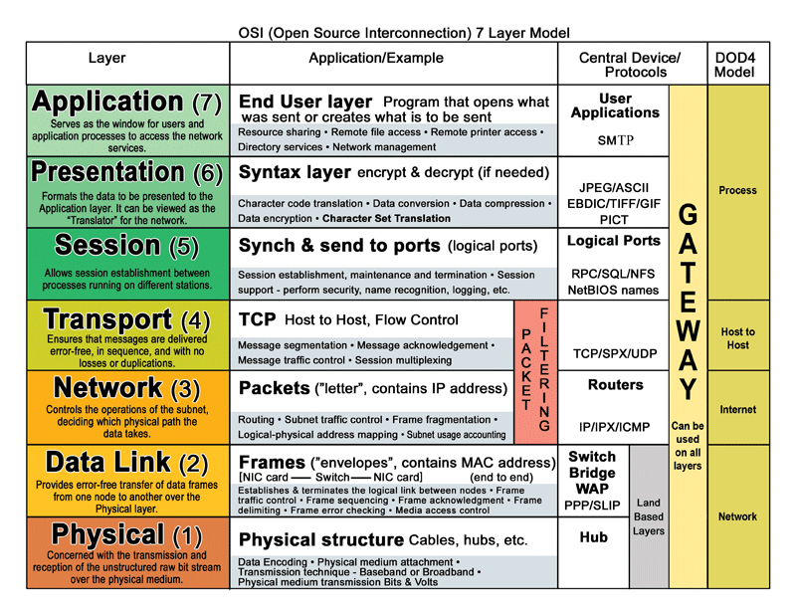

Slide 38
Application Level Gateway Firewall
An application-level ﬁrewall is a third generation ﬁrewall where a proxy server operates at the very top of the OSI model, the IP suite application level
A network packet is forwarded only if a connection is established using a known protocol
Application-level gateways are notable for analyzing entire messages rather than individual packets of data when the data are being sent or received

Slide 39

Questions

