Slide 1
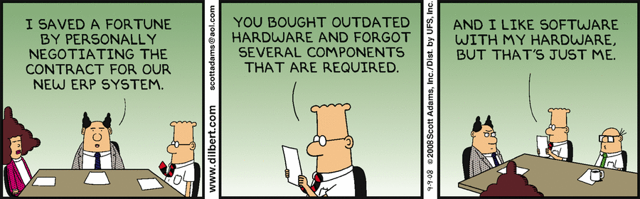
Fundamentals of Negotiation
Bob Marshall, MD, MPH, MISM
DoD/MAMC Clinical Informatics Fellowship

Slide 2
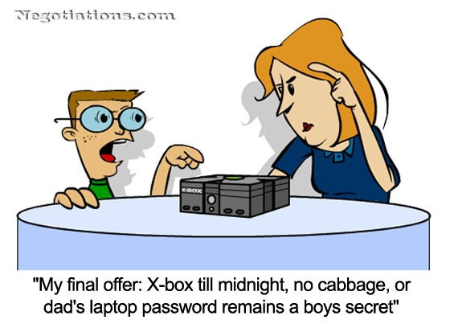
Objectives
Understand goals of negotiation
Recognize negotiator roles and reasons for behavior
Improve preparatory skills
Understand the negotiation process

Slide 3
Why Negotiate?
Gain greater understanding of the other side’s motives, objectives, and constraints
Allow the other side to learn some of your motives, objectives, constraints
Seek common ground (Win/Win)
Build relationships

Slide 4
When to Negotiate?
Win/Win outcome is desirable to both parties
You occupy a defensible position
Both parties have options

Slide 5
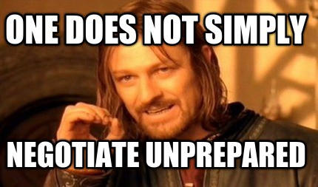
When to NOT Negotiate:
You are in competition with the other party.
One or both sides enter with false intentions
  (both sides must want win/win).
Can’t possibly win
You or other party lack authority

Slide 6
To Summarize (so far)
Both sides must want and be willing to pursue win/win.
Don’t negotiate w/ someone who’s intent is to defeat you (& vice versa)
  “Don’t wrestle with a pig…you both get dirty and the pig likes it!”

Slide 7
Negotiator Roles
Equal parties
Employer/Employee
Superior/Subordinate
Agent/Beneficiary (or other recipient)
Seller/Customer
  Where does Doctor/Patient fit in?

Slide 8
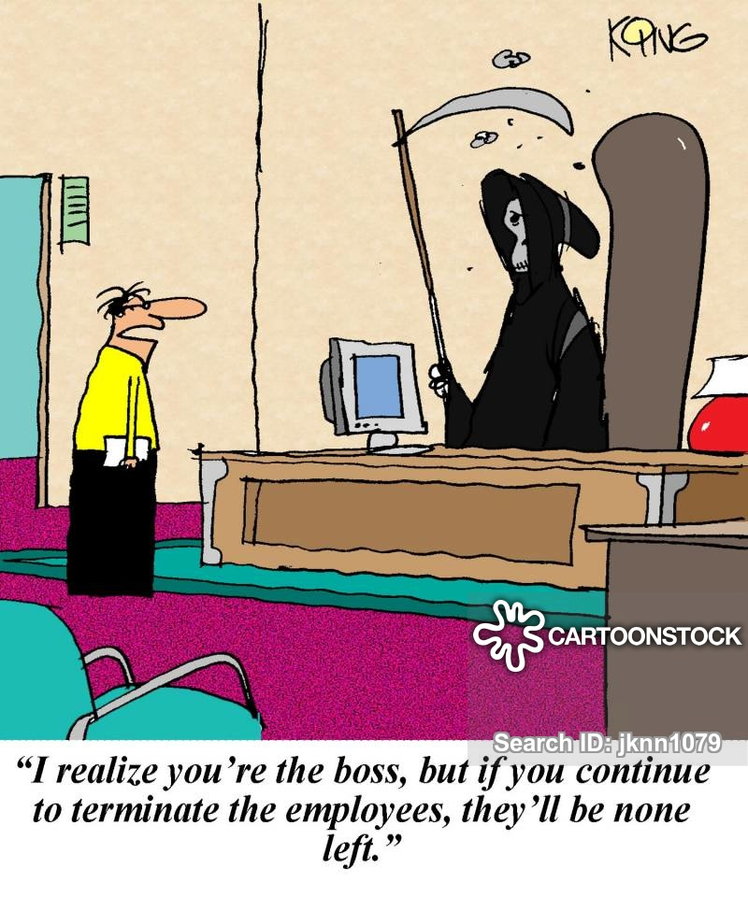
Negotiator Roles
Your role determines:
  What latitude you have
  What behavior is expected of you
  Behavior you expect from the other party
  Constraints

Slide 9
Preparing to Negotiate
Determine roles
Examine your position
  Strengths, weaknesses, BATNA
  Limits, and ranges of options
Consider the other party’s needs
  How would you proceed in their role?
Identify and prioritize key issues

Slide 10



Preparing to Negotiate
Set goals and strategies
Work through emotions beforehand
  “It’s nothing personal…just business”
      Vito Corleone, “The Godfather”

Slide 11
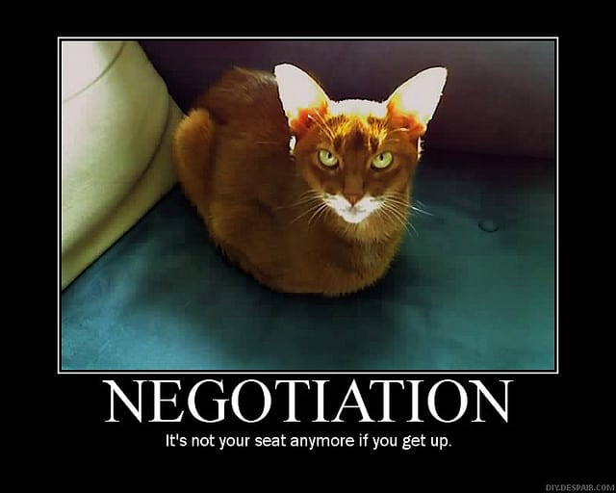
The Negotiation Process
Finding Common Ground
  Active listening is critical.
Exploring Differences
  Ask “Why?”
Tactics
  Disclosures
  Opening Offers & Counteroffers

Slide 12
The Negotiation Process
Tactics vary w/negotiation position
  How much do you disclose?
  First offer: aim high? middle ground?
  Counteroffers
  Principled negotiation
  Time out’s

Slide 13
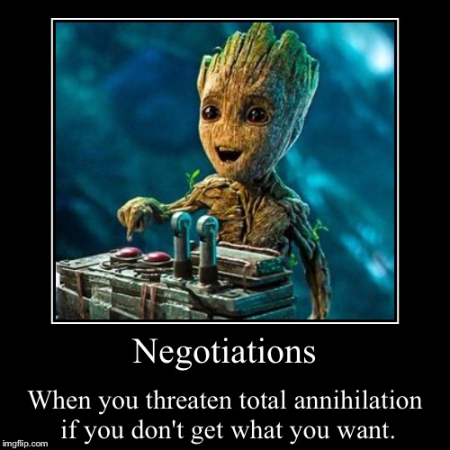
The Negotiation Process
Recognize and Use Milestones
  Track achievement of both parties’ critical objectives
  Compare “scorecard” when tackling the toughest issues

Slide 14
The Negotiation Process
How do you know when you’re done?
  Success - Both sides:
    Achieve critical objectives
    Are “happy” (satisfied)
  Failure
    Irreconcilable differences
    Capitulation of one side

Slide 15
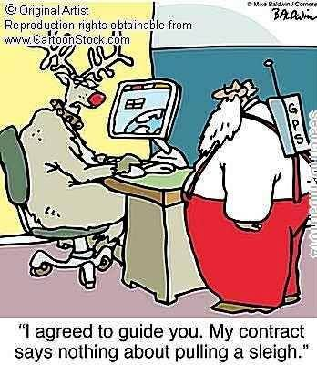
The Negotiation Process
When finished:
  Summarize and document
  Thank the other party for their efforts
  Leave the door open for further negotiation

Slide 16
Caveats
The negotiating table is NOT a smorgasbord!
  Don’t go back for “seconds”.
Greed is risky.
Don’t play games.
  Demonstrate respect
  Avoid surprises

Slide 17
Caveats
Beware “winning the battle and losing the war”
Don’t make offers you can’t keep.
  Retracting an offer will often destroy the spirit of negotiation.
  Lying or misrepresentation may be grounds to invalidate the agreement.

Slide 18
Summary
Highly disparate parties can achieve win/win solutions.
Parties must be prepared, serious, sincere, and committed.
Keys to success are preparation, effective two-way communication, and principled negotiation.

Slide 19
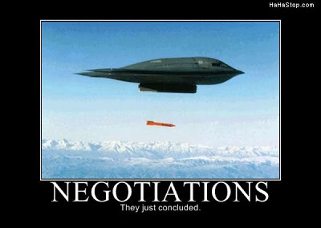
Summary
The reasons negotiations fail include:
  poor preparation
  wrong intentions
  greed
  indecision
  emotion

