Slide 1
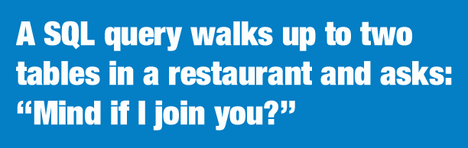
More Database 101
Bob Marshall, MD MPH MISM FAAFP
Program Director, DoD/MAMC Clinical Informatics Fellowship

Slide 2
What Are We Talking About?
Some more basics of databases
Review the different types of databases
Review simple SQL Query designs

Slide 3
Some more basics
A database is a large quantity of indexed digital information
It can be searched, referenced, compared, changed or otherwise manipulated with optimal speed and minimal processing expense
A database is built and maintained by using a database programming language
The most common database language is SQL, but there are multiple "flavors" of SQL, depending on the type of database being used
Each flavor of SQL has differences in the SQL syntax and are designed to be used with a specific type of database

Slide 4
Another Way to Put It
Schema - A database contains one or more schemes, which are basically collections of one or more tables of data.
Table - Each table contains multiple columns, which function similar to columns in a spreadsheet. A table can have as few as two columns or as many as one hundred or more columns, depending on the data type(s) being stored in the table.
Column - Each column contains one of several types of data or values, dates, numeric or integer values, and alphanumeric values (also known as varchar).
Row - Data in a table is listed in rows, which are similar to data rows in a spreadsheet. Often there are hundreds or thousands of data rows in a table

Slide 5
What is a Database Management System
Also called a DBMS, it is a single or set of computer programs that are responsible for creating, editing, deleting and generally maintaining a database or collection of data records
The type of database management system is determined by the database model
A database model is the manner in which the data collection is stored, managed and administered

Slide 6
Types of Database Management Systems
Relational Database Management Systems (RDBMS)
Flat File Based DBMS
Hierarchical DBMS
Network DBMS
Object-oriented DBMS
NoSQL Database
Graph Database

Slide 7
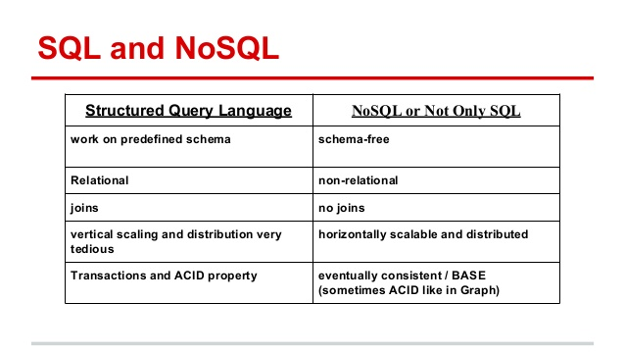

Slide 8
Relational DBMS
The most widely used database management systems today and are relatively easy to use.
Relational database management systems are named so because of the characteristic of normalizing the data which is usually stored in tables.
The relational model relies on normalizing data within rows and columns in tables.
The data can be related to other data in the same table or other tables which have to be correctly managed by joining one or more tables.

Slide 9
Relational DBMS cont
Relational models may be somewhat less efficient than other models
Data in this type of model is stored in fixed predefined structures and are usually manipulated using Structured Query Language (SQL)
Relational database management systems include Oracle, Ms SQLServer, IBM DB2, MySQL, SQLite and PostgreSQL among others

Slide 10
Flat File DBMS
Flat File based database management systems, also called “Flat Models,” are probably the simplest of them all
These come in human readable text formats as well as in binary formats
These are ideal for stand alone applications, holding software configuration and native format storage models
Flat files in a formatted row and column model rely on assumptions that every item in a particular model consists of the same data
One common example of this type of database is the CSV (Comma Separated Values) and another is a spreadsheet such as Ms Excel

Slide 11
Hierarchical DBMS
Hierarchical database management systems operate on the parent-child tree-like model
These normally have a 1:N relationship and are good for storing data with items describing attributes, features and so on
These could store a book with information on chapters and verses or financial data
They can also be used to store a database of songs, recipes, models of phones and anything that can be stored in a nested format

Slide 12
Hierarchical DBMS
Hierarchical database management systems are not quite efficient for various, complex real world operations; however, they are fast and reliable for certain data types…financial data, discrete medical data
One such example of a Hierarchical database management system is an XML document
Another is MUMPS

Slide 13
Network DBMS
This DBMS uses a data model similar to Hierarchical database management systems
The major difference here is that the tree structure in the Network models can have a many parent to many child relational model.
The Network model structure is based on records and sets and most of these databases use SQL for manipulation of their data.
Network database management systems tend to be very flexible but are now rarely used

Slide 14
Network DBMS
They were quite common in the1960s and 1970s
Searching for an item in this model requires the program to traverse the entire data set, which is quite cumbersome
These have mostly been replaced by Relational database management systems in today’s environment

Slide 15
Object-Oriented DBMS
Object-oriented database management systems borrow from the model of the Object-oriented programming paradigm
In this database model, the Object and its data or attributes are seen as one and accessed through pointers rather than stored in relational table models
Object-oriented database models consist of diverse structures and are quite extensible

Slide 16
Object-Oriented DBMS cont
This data model was designed to work closely with programs built with Object-oriented programming languages, thereby almost making the data and the program operate as one
With this model, applications can treat the data as native code
There is little commercial implementation of this database model as it is still developing
Examples of Object-oriented database management systems include IBM DB4o and DTS/S1 from Obsidian Dynamics

Slide 17
NoSQL Database
NoSQL is often known as “Not Only SQL”
When people realized that unstructured text carry tons of information which they are unable to mine using RDBMS, they started exploring ways to store such datasets
Anything which is not RDBMS today is loosely known as NoSQL
After social networks gained importance in the market, such databases became common in the industry

Slide 18
The Facebook Example
Someone posts something on Facebook
The user, user’s friends, who liked and Author of comments all are FB users.
Now if we try to store the entire data in RDBMS, for executing a single query which can be just a response of opening home page, we need to join multiple tables with trillions of row together to find a combined table and then run algorithms to find the most relevant information for the user.

Slide 19
The Facebook Example cont
This does not look to be a seconds job for sure
Hence we need to move from tabular understanding of data to a more flow (graph) based data structure
This is what drove the development of NoSQL structures

Slide 20
Graph Database 1 of 4
Designed for working with highly interconnected data, a graph database might be described as more “relational” than a relational database.
Graph databases shine when the goal is to capture complex relationships in vast webs of information
The term “graph” comes from the use of the word in mathematics.
There it’s used to describe a collection of nodes (or vertices), each containing information (properties), and with labeled relationships (or edges) between the nodes

Slide 21
Graph Database 2 of 4
Graph databases work by storing the relationships along with the data.
Because related nodes are physically linked in the database, accessing those relationships is as immediate as accessing the data itself.
In other words, instead of calculating the relationship as relational databases must do, graph databases simply read the relationship from storage.

Slide 22
Graph Database 3 of 4
Satisfying queries is a simple matter of walking, or “traversing,” the graph
Like other NoSQL databases, a graph database is schema-less.
Thus, in terms of performance and flexibility, graph databases hew closer to document databases or key-value stores than they do relational or table-oriented databases

Slide 23
Graph Database 4 of 4
Graph databases work best when the data you’re working with is highly connected and should be represented by how it links or refers to other data, typically by way of many-to-many relationships.
You will often find graph databases behind recommendation engines, content and asset management systems, identity and access management systems, and regulatory compliance and risk management solutions

Slide 24
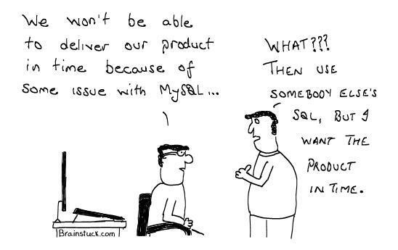
Basic SQL Queries

Slide 25
Parts of an SQL Query
SELECT
FROM
WHERE
AND
ORDER BY/GROUP BY
LIMIT

Slide 26
Who are the people who have red hair in Massachusetts and were born in 2003 organized in alphabetical order?
SELECT
first_name,
last_name
FROM
people_massachusetts
WHERE
hair_color = "red"
AND
birth_date BETWEEN '2003-01-01' AND '2003-12-31'
ORDER BY
last_name
LIMIT
100
;

Slide 27
Some Advanced Tips
The Asterisk: *
  When you add an asterisk to one of your SQL queries, it tells the query that you want to include all the columns of data in your results.
LAST 30 DAYS
COUNT
  Comes in handy so you don't have to manually add up the number of people who have different hair colors or export that information to Excel

Slide 28
JOINs
A JOIN clause is used to combine rows from two or more tables, based on a related column between them
A self JOIN is a regular join, but the table is joined with itself

Slide 29
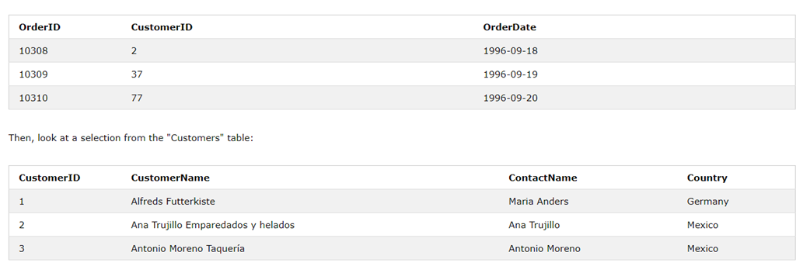
JOIN These Two Tables (INNER JOIN)

Slide 30
Building the Query
The "CustomerID" column in the "Orders" table refers to the "CustomerID" in the "Customers" table.
The relationship between the two tables above is the "CustomerID" column.
Then, we can create the following SQL statement (that contains an INNER JOIN), that selects records that have matching values in both tables

Slide 31
Here is the Query Structure
SELECT Orders.OrderID, Customers.CustomerName, Orders.OrderDate
FROM Orders
INNER JOIN Customers ON Orders.CustomerID=Customers.CustomerID;

Slide 32
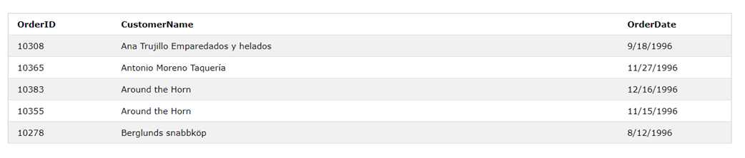
Resulting Data Table

Slide 33
Types of SQL JOINs
Here are the different types of the JOINs in SQL:
  (INNER) JOIN: Returns records that have matching values in both tables
  LEFT (OUTER) JOIN: Return all records from the left table, and the matched records from the right table
  RIGHT (OUTER) JOIN: Return all records from the right table, and the matched records from the left table
  FULL (OUTER) JOIN: Return all records when there is a match in either left or right table

Slide 34
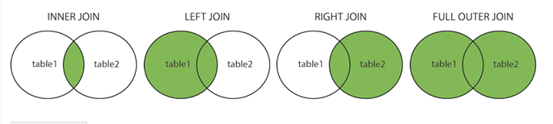
Images of Results for JOINs

Slide 35
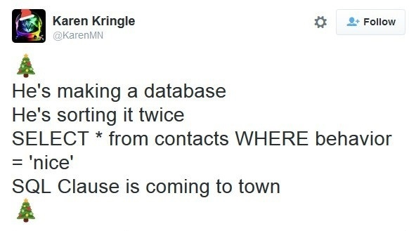
Questions

