Slide 1
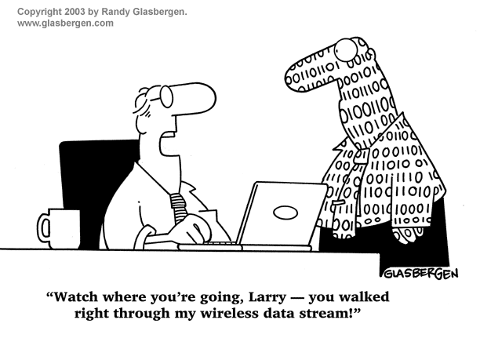
Mobile Security
Bob Marshall, MD MPH MISM FAAFP
DoD Clinical Informatics Fellowship

Slide 2
Introduction/Overview 1 of 2
More and more users and businesses use smartphones to communicate, but also to plan and organize their users’ work and also private life
Within companies, these technologies are causing profound changes in the organization of information systems and therefore they have become the source of new risks
Indeed, smartphones collect and compile an increasing amount of sensitive information to which access must be controlled to protect the privacy of the user and the intellectual property of the company

Slide 3
Introduction/Overview 2 of 2
All smartphones, as computers, are preferred targets of attacks
These attacks exploit weaknesses inherent in smartphones that can come from the communication mode—like Short Message Service (SMS, aka text messaging), Multimedia Messaging Service (MMS), wiﬁ, Bluetooth and GSM, the de facto global standard for mobile communications
There are also exploits that target software vulnerabilities in the browser or operating system
Of course, the weakest link is the lack of knowledge users often have

Slide 4
Threats
A smartphone user is exposed to various threats when they use their phone
In just the last two quarters of 2012, the number of unique mobile threats grew by 261%, according to ABI Research
These threats can disrupt the operation of the smartphone, and transmit or modify user data
Since some apps could themselves be malware, their functionality and activities should be limited (I.e., restricting the apps from accessing location information via GPS, blocking access to the user’s address book, preventing the transmission of data on the network, sending SMS messages that are billed to the user, etc.)

Slide 5
Data/Availability as Targets
Data: Smartphones are devices for data management, and may contain sensitive data like credit card numbers, authentication information, private information, activity logs (calendar, call logs)
Availability: attacking a smartphone can limit access to it and deprive the owner of its use

Slide 6
Identity as a Target
Smartphones are highly customizable, so the device or its contents can easily be associated with a speciﬁc person
For example, every mobile device can transmit information related to the owner of the mobile phone contract, and an attacker may want to steal the identity of the owner of a smartphone to commit other oﬀenses

Slide 7
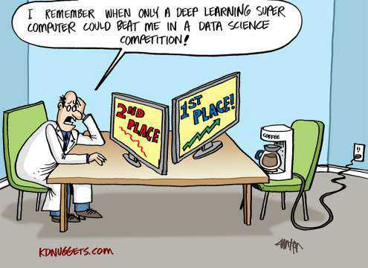
Types of Attacks

Slide 8
Attacks based on SMS/MMS
Some attacks derive from ﬂaws in the management of SMS and MMS
Some mobile phone models have problems in managing binary SMS messages.
It is possible, by sending an ill-formed block, to cause the phone to restart, leading to denial of service attacks
A study on the safety of the SMS infrastructure revealed that SMS messages sent from the Internet can be used to perform a distributed denial of service (DDoS) attack against the mobile telecommunications infrastructure of a big city
The attack exploits the delays in the delivery of messages to overload the network

Slide 9
Attacks based on MMS
Another potential attack could begin with a phone that sends an MMS to other phones, with an attachment
This attachment is infected with a virus
Upon receipt of the MMS, the user can choose to open the attachment
If it is opened, the phone is infected, and the virus sends an MMS with an infected attachment to all the contacts in the address book

Slide 10
Attacks based On GSM 1 of 2
The GSM network encryption algorithms belong to the family of algorithms called A5
Due to the policy of security through obscurity it has not been possible to openly test the robustness of these algorithms
Even in case mobile phones are able to use 3G or 4G which have much stronger encryption than 2G GSM, the base station can downgrade the radio communication to 2G GSM and specify A5/0 (no encryption)
This is the basis for eavesdropping attacks on mobile radio networks using a fake base station commonly called an IMSI catcher

Slide 11
Attacks based On GSM 2 of 2
In addition, tracing of mobile terminals is diﬃcult since each time the mobile terminal is accessing or being accessed by the network, a new temporary identity (TMSI) is allocated to the mobile terminal
The TSMI is used as identity of the mobile terminal the next time it accesses the network
The TMSI is sent to the mobile terminal in encrypted messages
Once the encryption algorithm of GSM is broken, the attacker can intercept all unencrypted communications made by the victim’s smartphone

Slide 12
Bluetooth-Based Attacks
Security issues related to Bluetooth on mobile devices have been studied and have shown numerous problems on diﬀerent phones
One easy to exploit vulnerability: unregistered services do not require authentication, and vulnerable applications have a virtual serial port used to control the phone
An attacker only needed to connect to the port to take full control of the device
Another example: a phone must be within reach and Bluetooth in discovery mode. The attacker sends a ﬁle via Bluetooth
If the recipient accepts, a virus is transmitted

Slide 13
Other Potential Exploits
Web browser exploits
Operating system exploits
Wi-Fi exploits

Slide 14
Hardware Deficiency Attacks
Electromagnetic Waveforms
In 2015, researchers at the French government agency…Agence nationale de la sécurité des systèmes d'information (ANSSI) demonstrated the capability to trigger the voice interface of certain smartphones remotely by using “speciﬁc electromagnetic waveforms”
The exploit took advantage of antenna properties of headphone wires while plugged into the audio-output jacks of the vulnerable smartphones and eﬀectively spoofed audio input to inject commands via the audio interface

Slide 15
Hardware Deficiency Attacks
Juice Jacking
A physical or hardware vulnerability speciﬁc to mobile platforms
Utilizing the dual purpose of the USB charge port, many devices have been susceptible to having data ex-ﬁltrated from, or malware installed on to a mobile device by utilizing malicious charging kiosks set up in public places, or hidden in normal charge adapters

Slide 16
Password Cracking
In 2010, researcher from the University of Pennsylvania investigated the possibility of cracking a device’s password through a smudge attack (literally imaging the ﬁnger smudges on the screen to discern the user’s password)
The researchers were able to discern the device password up to 68% of the time under certain conditions
Outsiders may perform over-the-shoulder on victims, such as watching speciﬁc keystrokes or pattern gestures, to unlock device password or passcode

Slide 17
Malware Attacks
As smartphones are a permanent point of access to the internet (mostly on), they can be compromised as easily as computers with malware
Malware are far less numerous and important to smartphones as they are to computers
Typically an attack on a smartphone made by malware takes place in 3 phases: the infection of a host, the accomplishment of its goal, and the spread of the malware to other systems
Malware often use the resources offered by the infected smartphones
It will use the output devices such as Bluetooth or infrared, but it may also use the address book or email address of the person to infect the user’s acquaintances
The malware exploits the trust that is given to data sent by an acquaintance

Slide 18
Malware portability
There is a multitude of malware, which is partly due to the variety of operating systems on smartphones
Attackers can choose to make their malware target multiple platforms, and malware can be found which attacks an OS but is able to spread to diﬀerent systems
Malware can use runtime environments like Java virtual machine or the .NET Framework
They can also use other libraries present in many operating systems
Other malware carry several executable ﬁles in order to run in multiple environments and they utilize these during the propagation process
In practice, this type of malware requires a connection between the two operating systems to use as an attack vector
Memory cards can be used for this purpose, or synchronization software can be used to propagate the virus

Slide 19
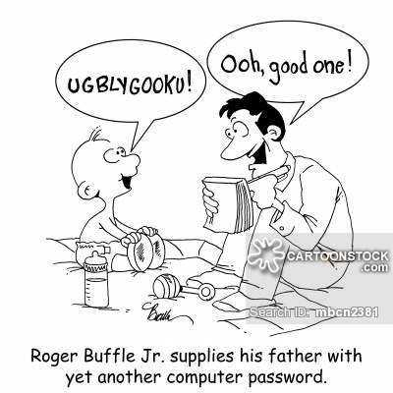
Countermeasures

Slide 20
OS Security
A central paradigm in mobile operating systems is the idea of a sandbox
Since smartphones are designed to accommodate many applications, they must have mechanisms to ensure these applications are safe for the phone itself, for other applications and data on the system, and for the user
If a malicious program reaches a mobile device, the vulnerable area presented by the system must be as small as possible.
Sandboxing extends this idea to compartmentalize diﬀerent processes, preventing them from interacting and damaging each other.
Based on the history of operating systems, sandboxing has different implementations.
iOS focuses on limiting access to its public API for applications from the App Store by default
Android bases its sandboxing on its legacy of Linux and TrustedBSD

Slide 21
Rootkit Detectors
The intrusion of a rootkit in the system is a great danger in the same way as on a computer
With this type of malicious program, the result could be a partial or complete bypass of the device security, and the acquisition of administrator rights by the attacker
If this happens, then nothing prevents the attacker from studying or disabling the safety features that were circumvented, deploying the applications they want, or disseminating a method of intrusion by a rootkit to a wider audience
The Chain of trust in iOS relies on the signature of the diﬀerent applications required to start the operating system, and a certiﬁcate signed by Apple
In the event that the signature checks are inconclusive, the device detects this and stops the boot-up

Slide 22
Process Isolation
Android uses mechanisms of user process isolation inherited from Linux
Each application has a user associated with it, and a tuple (UID, GID)
This approach serves as a sandbox: while applications can be malicious, they can not get out of the sandbox reserved for them by their identiﬁers, and thus cannot interfere with the proper functioning of the system
For example, since it is impossible for a process to end the process of another user, an application can thus not stop the execution of another

Slide 23
File Permissions
From the legacy of Linux, there are ﬁle system permissions mechanisms
They help with sandboxing: a process can not edit any ﬁles it wants
It is therefore not possible to freely corrupt ﬁles necessary for the operation of another application or system
In the Android OS, there is also the method of locking memory permissions
It is not possible to change the permissions of ﬁles installed on the SD card from the phone, and consequently it is impossible to install applications

Slide 24
Memory Protection
Memory protection prevents privilege escalation
If a process managed to reach the area allocated to other processes, it could write in the memory of a process with rights superior to their own, with root as the worst case scenario, and perform actions which are beyond its permissions on the system

Slide 25
Runtime Environment Controls
Software is often developed in high-level languages, which can control what is being done by a running program
For example, Java Virtual Machines continuously monitor the actions of the execution threads they manage, monitor and assign resources, and prevent malicious actions
Buﬀer overﬂows can be prevented by these controls

Slide 26
Security Software
Anti-virus and Firewall
Visual Notifications
In order to make the user aware of any abnormal actions, such as a call they did not initiate, one can link some functions to a visual notiﬁcation that is impossible to circumvent
Turing test
The Turing test is used to distinguish between a human and a virtual user, and it often comes as a captcha
Biometric identification
In a system with strong biometric security, only the primary user can access the smartphone

Slide 27
Resource Monitoring
When an application passes the various security barriers, it can take the actions for which it was designed.
When such actions are triggered, the activity of a malicious application can be sometimes detected if one monitors the various resources used on the phone
What can be monitored:
Battery
Memory Usage
Network Traffic
Services

Slide 28
Network Surveillance
Network traﬃc exchanged by phones can be monitored
One can place safeguards in network routing points in order to detect abnormal behavior
A mobile device’s use of network protocols is much more constrained than that of a computer, and expected network data streams can be predicted (e.g. the protocol for sending an SMS), which permits detection of anomalies in mobile networks:
Spam Filters
Encryption of stored or transmitted information
Telecom network monitoring

Slide 29
Next Generation Security 1 of 2
Rich operating system:
In this category will fall traditional Mobile OS like Android, iOS, Symbian OS or Windows Phone
Secure Operating System (Secure OS):
A secure kernel which will run in parallel with a fully featured Rich OS, on the same processor core
The trusted infrastructure could include interfaces like the display or keypad to regions of PCI-E address space and memories

Slide 30
Next Generation Security 2 of 2
Trusted Execution Environment (TEE)
Made up of hardware and software
It helps in the control of access rights and houses sensitive applications, which need to be isolated from the Rich OS
It eﬀectively acts as a ﬁrewall between the “normal world” and “secure world”
Secure Element (SE)
The SE consists of tamper resistant hardware and associated software
It can provide high levels of security and work in tandem with the TEE

Slide 31
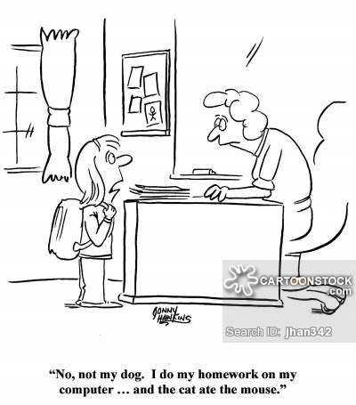
Questions?

