Slide 1
Management and Process Control
Bob Marshall, MD, MPH, MISM, FAAFP, FAMIA
Program Director, DoD Clinical Informatics Fellowship

Slide 2
Objectives
Scientific Management – as a management and process improvement tool/methodology
Discuss two other previously uncovered methods of Process Improvement:
  Failure Effects Mode Analysis
  Statistical Process Control

Slide 3
Scientific Management
Frederick Winslow Taylor published “The Principles of Scientific Management” in 1909
Proposed that productivity would increase by optimizing and simplifying jobs
Advanced the idea that workers and managers needed to work together (cooperate) to be successful and efficient
Believed that all workers were motivated by money; promoted idea of, “a fair day’s pay for a fair day’s work”
  This also meant that people who worked harder and were more efficient deserved higher pay than those who accomplished less
Started the idea of “time and motion” studies to identify best practice

Slide 4
Principles of Scientific Management
Replace working by “rule of thumb,” or simple habit and common sense, and instead use the scientific method to study work and determine the most efficient way to perform specific tasks
Rather than simply assign workers to just any job, match workers to their jobs based on capability and motivation, and train them to work at maximum efficiency
Monitor worker performance, and provide instructions and supervision to ensure that they are using the most efficient way of working
Allocate the work between managers and workers so that the managers spend their time planning and training, allowing the workers to perform their tasks efficiently

Slide 5
Critiques of Scientific Management Theory
SMT promotes the idea of “one right way” to do things
  Leads to rigid, rules-driven organizations that have adaptability issues
SMT breaks down tasks into tiny steps and focuses on how each person can perform his/her set of steps better/best
SMT separates manual from mental work, focusing mostly on the mechanics vice the “people side” of work
  Does not address the ideas of motivation and workplace satisfaction as key elements to an efficient, productive organization
SMT views labor as a commodity and leads to “deskilling” of jobs, making it easy to offshore the jobs

Slide 6
Failure Mode and Effects Analysis (FMEA)

Slide 7
Overview of FMEA
A structured way to identify and address potential problems or failures, and their resulting effects on the system or process before an adverse event occurs
Different than root cause analysis (RCA), which is a structured way to analyze and address problems after they have already occurred
FMEA involves identifying and eliminating/correcting process failures in order to prevent the undesirable from occurring

Slide 8
When to use FMEA
When a process, product or service is being designed or redesigned.
  For new processes, can identify potential bottlenecks or unintended consequences prior to implementation
When an existing process, product or service is being applied in a new way.
Before developing control plans for a new or modified process.
When improvement goals are planned for an existing process, product or service.
When analyzing failures of an existing process, product or service.
Periodically throughout the life of the process, product or service

Slide 9
Quick overview of FMEA steps

Slide 10
Basic FMEA Terminology
Failure mode - Specific manner or way by which a failure occurs
Failure cause and/or mechanism - Defects and requirements, design, process, quality control, handling or part application which the underlying cause or sequence of causes that initiate a process failure mode
Failure effect - Immediate consequences for failure on operation, function or functionality
Risk Priority Number (RPN) - Severity (of the event) * Probability (of the event occurring) * Detection (probability that the event would not be detected before the user was aware of it)

Slide 11
Major benefits of FMEA
Provides documented method for selecting a design with high probability of successful operation and safety
Documented, uniformed method of assessing potential failure mechanisms, failure modes and their impact on system operation
Early identification of single failure points (SFPS) and system interface problems, which may be critical to mission success and/or safety
Effective method for evaluating the effect of proposed changes to the design and or operational procedures on mission success and safety
Basis for in-flight troubleshooting procedures and for locating performance monitoring and fault detection devices
Criteria for early planning of tests

Slide 12
Limitations of FMEA
In the healthcare context, FMEA and other risk assessment methods have been found to have limited validity when used in isolation
  Challenges around scoping and organizational boundaries appear to be major factors in this lack of validity
If used as a top-down tool, FMEA may only identify major failure modes in a system
When used as a bottom-up tool, FMEA can augment or complement fault tree analysis and identify many more causes and failure modes resulting in top-level symptoms
  However, it is not able to discover complex failure modes involving multiple failures within a subsystem
Multiplication of severity, occurrence and detection rankings may result and rank reversals, where a less serious failure mode receives a higher RPN than a more serious failure mode

Slide 13
Statistical Process Control

Slide 14
Overview of Statistical Process Control
A method of quality control which uses statistical methods
Pioneered by Walter A. Shewart at Bell Laboratories
Applied in order to monitor and control a process
Monitoring and controlling the process ensures that it operates at its full potential
At full potential, the process can make as much conforming product as possible with the minimum of waste
Can be applied to any process where the “conforming product” (product meeting defined specifications) output can be measured
Key tools used in SPC include:
  Control charts; focus on continuous improvement; and design of experiments

Slide 15
Key Characteristics and Advantages
SPC must be practiced in two phases:
  Initial establishment of the process
  Regular production use of the process
    A decision on the period to be examined must be determined
SPC emphasizes early detection and prevention of problems vice correcting problems once they have occurred
In addition to reducing waste, SPC can lead to reduced production times and reduced likelihood the product will need to be reworked

Slide 16
Limitations of SPC
SPC is applied to reduce/eliminate process waste
This eliminates the need for the usual process step of post-manufacture inspection
The success of SPC relies both on the skill with which it is applied, and also on how suitable/amenable a given process is to the application of SPC
It is sometimes difficult to judge when the application of SPC is appropriate
If applied to a process that is not suitable for/amenable to SPC, the outcomes will not be achieved

Slide 17
Control Charts
Arguably, the most successful SPC tool is the control chart (developed by Shewart)
The control chart helps record data, allowing early identification of “unusual” events (out of alignment with the “typical” process)
Control charts help to distinguish between two types of process variation:
  Common cause variation – intrinsic to the process and always present
  Special cause variation – stems from external sources, indicating the process is out of statistical control
Various tests can help determine when an out-of-control event has occurred
However, more tests increase the risk of false positives/alarms

Slide 18
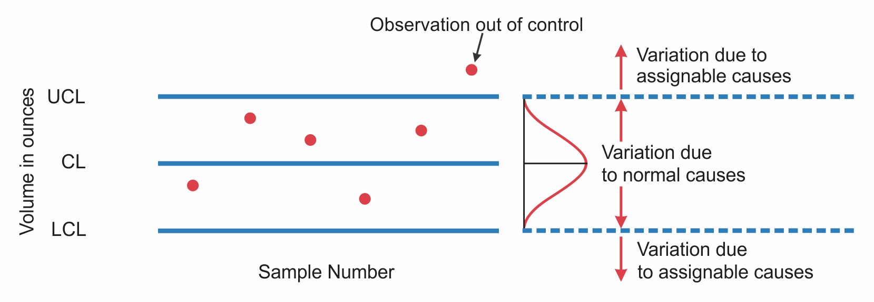
Control Chart with a normal distribution

Slide 19
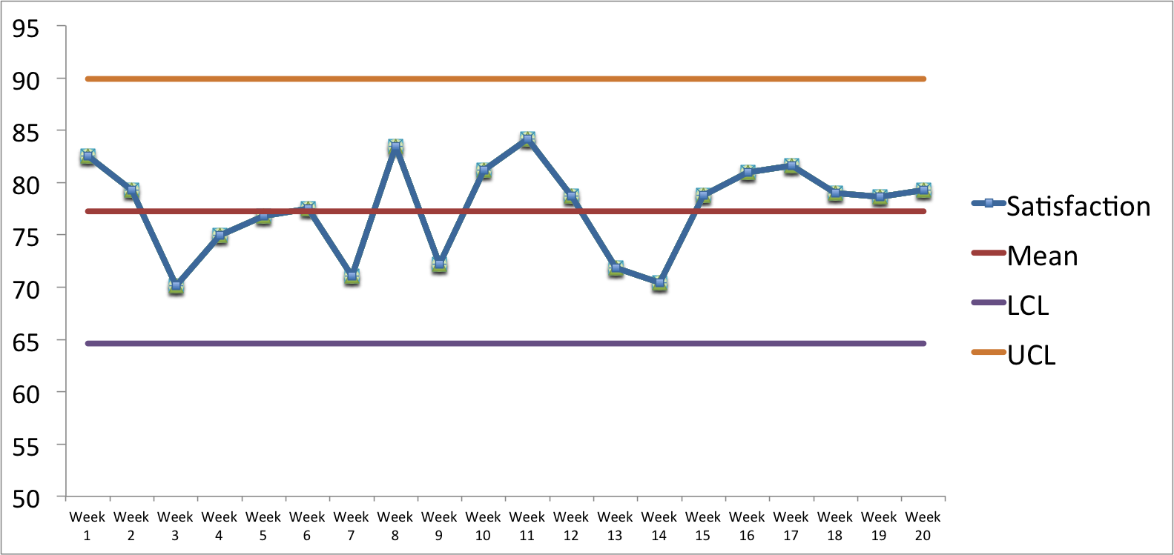

Slide 20
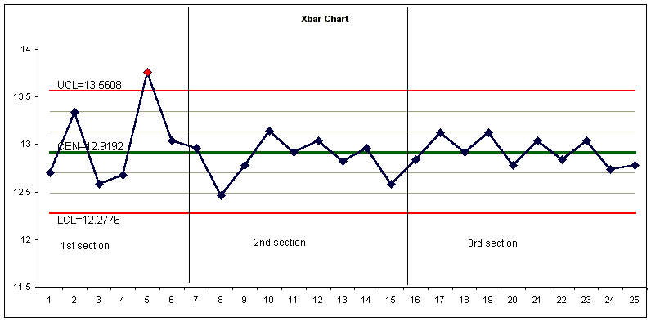

Slide 21
Newer but Related Process Monitoring Tools
Cumulative Sum (CUSUM) Charts: the ordinate of each plotted point represents the algebraic sum of the previous ordinate and the most recent deviations from the target
Exponentially Weighted Moving Average (EWMA) Charts: each point represents the weighted average of current and all previous subgroup values
  Gives more weight to recent process history and decreasing weights for older data
Engineering Process Control (EPC) tools: regularly change process inputs to improve performance

Slide 22
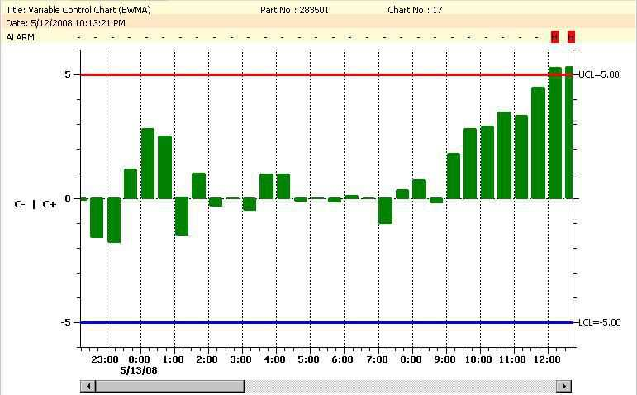

Slide 23
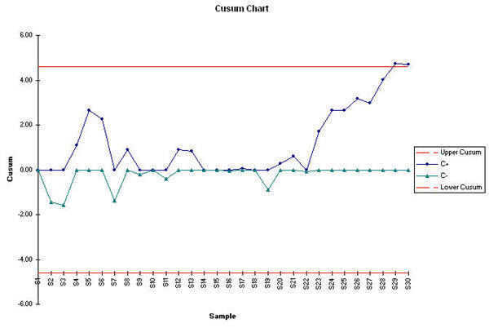

Slide 25


