Slide 1

Learning Needs Assessment
Bob Marshall, MD MPH MISM FAAFP
Program Director, DoD/MAMC Clinical Informatics Fellowship

Slide 2
Learning Objectives
Provide overview and definitions
Discuss the benefits/value of performing LNA’s
Review the different methods for performing LNA’s
Review the “Readiness to Learn” process
Discuss doing your own LNA
Summarize the key points

Slide 3
Overview
Assessing learner needs is a crucial step in the development of effective education and training programs
Evidence indicates that programs that are based on well conducted needs assessments lead to changes in learner behavior
It has often been the responsibility of learners to self-assess, identify, and participate in programs to remain competent
Research has concluded that learners have limited ability to accurately self-assess their own needs

Slide 4
What is an Learning Needs Assessment
An educational needs assessment can be defined as the gap between what is known and what should be known
Without grounded methods and an assessment of practice and performance gaps, educational offerings are unlikely to be effective
Needs assessments need to go beyond what is already known about clinical practice and current disease trends and add a snapshot of what is happening now

Slide 5
Additional Information
Educational needs assessments are used to direct and shape educational initiatives, and are a major component of the framework for effective continuing education
What would happen if you tried to conduct education without first understanding the needs of the population?
You risk the possibility that you are conducting education in an area that is well understood by the audience
You would not have any indication on the effectiveness of your program

Slide 6
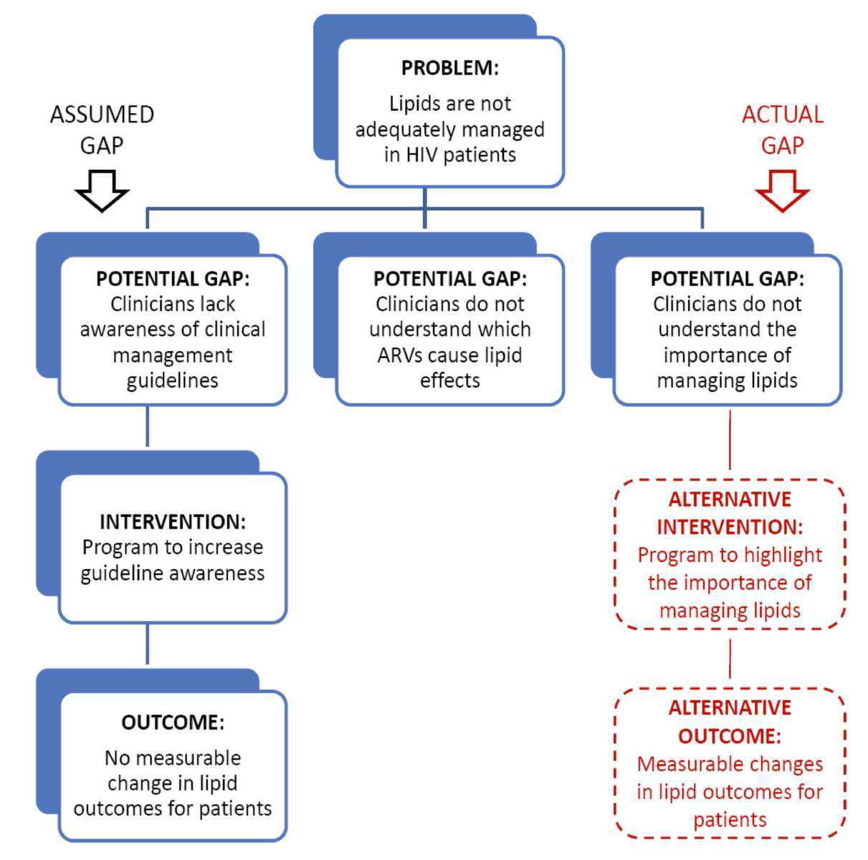

Slide 7
Benefits of an LNA
When adequate educational needs assessments of the target audience are conducted and education is linked to practice, education is more likely to:
Engage the audience
Meet the expectations of that audience
Increase or reinforce knowledge
Promote and reinforce best practices and evidence-based behaviors
Improve patient health

Slide 8
What is the value of conducting a learning needs assessment?
Primary use is to identify and prioritize information for the purpose of:
setting goals and objectives,
planning instruction, and
evaluating learning
What are other values?

Slide 9
What is the value of conducting a learning needs assessment?
Ensure that optimal learning can occur with least amount of learner stress and anxiety
Prevent needless repetition of known material
Save time and energy on the part of the learner and teacher
Increase motivation to learn

Slide 10
Steps in assessment of learning needs*
Identify the learner(s)
Choose the right setting
Collect data about the learner(s)
Collect data from the learner(s)
Prioritize needs
Determine availability of educational resources
Assess organizational/curricular mission and goals
Consider time management issues
*Bastable, et. al., pp. 107-110

Slide 11
Subjective vs. Objective Data
Learners are inaccurate in self-assessing their educational needs
Subjective assessments, such as questionnaires and self-reflection activities, may not be as useful for obtaining rigorous data
Objective, comprehensive assessments are necessary for demonstrating true need, as these are built upon validated criteria
Assessments such as case vignettes, standardized knowledge and skill assessment, peer reviews, and objective practice observation may be helpful to eliminate self-assessment bias

Slide 12

LNA Methods

Slide 13
Methods for assessing learning needs
Informal conversations
Structured interviews
Focus groups
Self-administered questionnaires
Tests
Observations
Documentations

Slide 14
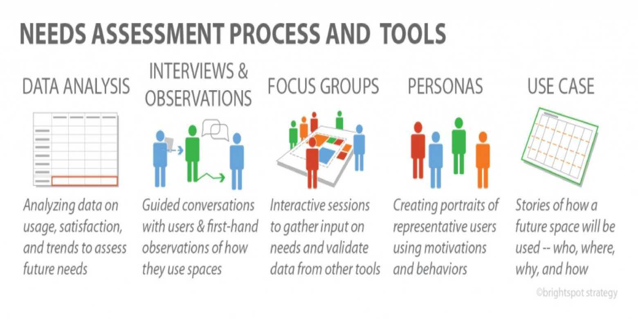

Slide 15
Projective Questionnaire
A group of health care providers might be asked questions like these:
What worries about the day ahead typically come into your mind during report/rounds?
When you read the patient’s chart/electronic medical record, what diagnoses/treatments do you wish you understood better?
What problems do your patients present that you have difficulty dealing with?

Slide 16
Card Sort
Type on 3x5 cards, one to a card, problem situations that health care providers typically confront in the course of a week’s work.
Ask each HCP to place the cards in three piles:
1. Feel secure and competent
2. Feel could perform only moderately well
3. Feel very insecure
Tabulate the frequency with which problems show up in pile #3.
Use the problems in this pile to plan educational sessions
Could also use a picture sort with photographs or diagrams

Slide 17
Sentence-completion Questionnaire
Ask the HCP to complete sentences with such beginnings as:
When I hear morning report/attend rounds I think about…
As a HCP(fill in the specific role/specialty), I wish I…
When I think about the future of health care, I…

Slide 18
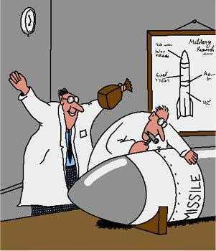
Readiness to learn

Slide 19
PEEK Model for Readiness to Learn
P=Physical readiness
Measures of ability (fine and/or gross motor movements, sensory acuity, adequate strength, flexibility, coordination, endurance)
Complexity of task (will affect the extent to which behavioral changes in the domains can be mastered by the learner; also comes into play when unlearning/new learning is required)
Environmental effects (distraction, including noise or frequent interruptions; value of self-pacing)
Health status (energy available, comfort level)
Gender (much of the difference is socially induced)

Slide 20
PEEK Model for Readiness to Learn
E=Emotional readiness
Anxiety level (impacts on learner’s ability to concentrate and retain information; fear is a major contributor)
Support system (important in buffering effects of stressful events; teacher can create reachable moment by supporting leaner; this sets the stage for the teachable moment)
Risk-taking behavior (need to help learner to develop strategies for minimizing risk)
Frame of mind (concern about the “here and now” versus the future)
Developmental stage (each developmental task produces a teachable moment)

Slide 21
PEEK Model for Readiness to Learn
E=Experiential readiness
Level of aspiration (extent to which the learner is driven to achieve; previous failures and past successes influence leaner goals)
Past coping mechanisms (teacher can help learner determine if they have been effective and whether they will work now)
Cultural background (behavioral differences, language)
Locus of control (internal versus external stimuli; see discussion of motivation)
Orientation (tendency to adhere to a parochial or cosmopolitan point of view)

Slide 22
PEEK Model for Readiness to Learn
K=Knowledge readiness
Present knowledge base (how much the learner already knows about a topic or how proficient he/she is at performing a task)
Cognitive ability (extent to which information can be processed by the learner)
Learning and reading disabilities (will require special or innovative approaches to instruction)
Learning styles (helps in selection of teaching methods and materials)

Slide 23

Questions??

Slide 24
Backup Slides

Slide 25
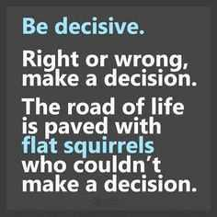
Assessing Your Own Learning Needs

Slide 26
WHY ASSESS YOUR OWN LEARNING NEEDS?
The most important reason for assessing your learning needs is that when you have assessed your learning needs it will be more likely to change your practice than if learning is imposed upon you
Assessing your learning needs can help your organization as well as you as an individual
Learning-needs assessment is a good way to discover the limits of your comfort zone and encourage you to move out of it

Slide 27
Ground Rules in Self-Assessment
Assessing your own learning needs is a vital first step on your learning journey
However, that it is all it is…the first step
You will not actually learn anything as a result—indeed discovering them is a waste of time if you do not do anything about them
Spending time learning is vital (seems common sense, huh?)

Slide 28
LNA and Other Factors in Learning
Learning-needs assessment is also just one factor that contributes to successful learning that will result in a change to practice
Other factors that will contribute include linking education to practice, ensuring that your learning is driven by personal motivation and reinforcing what you have learned
Do not let assessing your learning needs limit your learning
Learning can be a creative process and should be fun

Slide 29
HOW TO ASSESS YOUR LEARNING NEEDS
Some tools you can use to assess your own learning needs
360-degree appraisal
Critical incident reviews
Self-assessment
Practice review
Observation

Slide 30
360-Degree Appraisal
Those giving feedback should remember that it should be balanced, descriptive, objective and constructive
It is not helpful to say ‘you are useless and you always will be and you said horrible things about me’
It is helpful to say ‘you re good with patients but you don’t always keep good notes and you should work on this’

Slide 31
Critical incident reviews
The primary purpose of these reviews is to find out what went wrong, how and why it went wrong and how to prevent errors from being repeated
But they can also be used as an educational tool
The purpose of the review is not to blame individuals but to find out what the team can learn from what went wrong
Such reviews should be structured

Slide 32
Self-assessment
This involves keeping a diary of learning needs that crop up during your working day
You might jot down something in a consultation or write a note about an issue from a practice meeting
By looking back at your diary you can identify your knowledge gaps
People who keep a diary generate more specific learning objectives than those who do not

Slide 33
Practice review
This could involve using data that already exist or doing a formal patient satisfaction questionnaire
The latter requires you to have confidence in yourself and in your colleagues and to be robust enough to accept criticism

Slide 34
Observation
You could ask your colleagues to observe your performance and to give feedback on what you could do better
Observing how you practice by recording your consultations on video is a powerful tool that can help you identify your learning needs.
It is particularly good at looking at how you communicate and how patient-centered you are in your consultations

Slide 35

Useful Summary Points

Slide 36
Learning needs assessment is a crucial stage in the educational process that leads to changes in practice, and has become part of government policy for continuing professional development
Learning needs assessment can be undertaken for many reasons, so its purpose should be defined and should determine the method used and the use made of findings
Exclusive reliance on formal needs assessment could render education an instrumental and narrow process rather than a creative, professional one

Slide 37
Different learning methods tend to suit different doctors and different identified learning needs
Doctors already use a wide range of formal and informal ways of identifying their own learning needs as part of their ordinary practice
These should be the starting point in designing formalized educational systems for professional improvement

