Slide 1
Knowledge Dissemination
Bob Marshall, MD MPH MISM FAAFP
Program Director, DoD/MAMC Clinical Informatics Fellowship

Slide 2
Agenda
Gap between science and practice
Diffusion theory and dissemination
Models and definitions
Knowledge sharing versus knowledge transfer
What is really important

Slide 3
Gap Between Science and Practice 1 of 2
Much of the writing about translating research to practice employs a pipeline analogy in which evidence is produced by scientists, then vetted and disseminated to policy makers and practitioners.
This pipeline can be seen as a funnel (see Figure next slide) in which more research must be conducted than is usable in practice
Research that makes its way into practice has undergone a filtering process that works well in adjudicating biomedical research to evidence-based clinical interventions

Slide 4
Gap Between Science and Practice 2 of 2
Such one-way filtering, however, serves public health interventions less well
The need to consider social-psychological processes, cultural contexts, and socioeconomic conditions of public health practice suggests the need to work in both directions:
  from research to evidence-based practices, and
  from practice-based evidence to better-informed, more relevant and actionable practices and policies

Slide 5
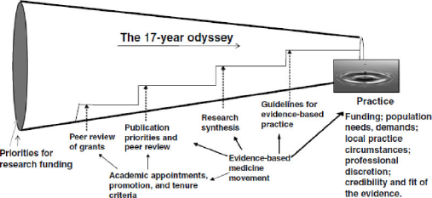
Conceptualization of the production and transfer of knowledge from research to practice & policy

Slide 6
Diffusion Theory 1 of 2
Diffusion theory represents a long history of attempts to understand the spread of ideas and actions within social systems.
Gabrielle Tarde outlined three phases:
  (1) repetition, in which there is an inventor and an imitator;
  (2) opposition, in which there are diverse interpretations to the mimicry, especially with diverse or changing circumstances; and
  (3) adaptation, in which a new balance is achieved by the imitators after reconciling these interpretations

Slide 7
Diffusion Theory 2 of 2
Gustav Le Bon, viewed diffusion as the result of a herd instinct or “collective behavior,” with little room for interpretive nuance, a perspective embraced by critics of the tyranny of the majority and crowd behavior
These early theories on diffusion may help unpack current tensions between the demand for fidelity of evidence-based practices and practitioners’ need for adaptability
The practitioners’ resistance and adaptation can be viewed not as infidelity to the evidence-based practices, but as a logical and natural adjustment of the intervention to fit varied and evolving situations

Slide 8
Diffusion to Dissemination
Whereas diffusion is the natural spread of ideas, dissemination is the conscious effort to spread new knowledge, policies, and practices to target audiences or the public at large
Twentieth century theories of diffusion evolved into more robust theories of knowledge utilization in waves, ending with a focus on how knowledge utilization could improve human services in health, education, and social support

Slide 9
Implementation and Knowledge Utilization 1 of 2
Despite numerous reviews and guidelines, a gap still exists in how knowledge is implemented and utilized
Understanding the underlying causes for this gap is central to knowledge utilization theory, making such theories critical components in translational research
The influences on the use of knowledge can be grouped according to source, content, medium, user, and context

Slide 10
Implementation and Knowledge Utilization 2 of 2
The following figure models a theoretical framework for disseminating policies and practices of surveillance, a core public health function involving research
It begins with a broad context of the subject matter, in this case surveillance, including multiple understandings of use and users
Facilitating use begins with a consideration of the end users and their circumstances and needs to emphasize shaping the product, not just disseminating or selling it

Slide 11
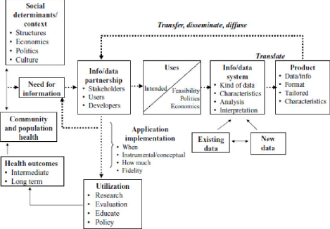
Utilization-Focused Surveillance Framework

Slide 12
Quick Definition Review
Diffusion ("just let it happen")
  passive, unplanned, uncontrolled dissemination; primarily horizontal or mediated by peers (e.g. publishing in peer reviewed journals, presenting research results to peers at academic conferences); potential user needs to seek out the information
Dissemination ("make it happen")
  active process to communicate results to potential users by targeting, tailoring and packaging the message for a particular target audience; strategies include: linkage and exchange events to share relevant research syntheses; developing a user driven dissemination strategy; media engagement; using a knowledge broker; developing researcher/knowledge user networks

Slide 13
Fundamentals of Dissemination
Dissemination processes and approaches should be informed by high-quality context specific evidence
Messages should be clear, simple, action-oriented and tailored for each audience (i.e. knowledge user driven)
Dissemination strategies should include a plan to evaluate the impact of the chosen approach, including ways to measure success
Consider – What is the message? Who is the audience? Who is the messenger? What is the best dissemination method? What is the expected outcome?

Slide 14
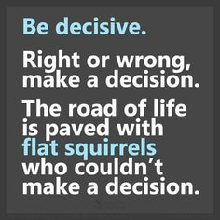

Slide 15
Definitions and Models

Slide 16
A Cacophony of Terminology
The literature is filled with differing definitions and uses of dissemination, knowledge utilization, diffusion, and technology transfer, among other related terms
These terms are sometimes used interchangeably, sometimes carefully distinguished from one another.
The different uses and definitions reflect varying assumptions and interests, ranging from a limited focus on “getting the word out” to an all-encompassing focus on seeing new knowledge or products from creation all the way through implementation by intended users

Slide 17
Including a Focus on the Use of Results
Does use of information—the process of transmission and reception of a research study—mean:
  (1) receiving it and thus getting a chance to read it;
  (2) receiving and actually reading it;
  (3) receiving, reading, and understanding it;
  (4) receiving, reading, understanding, and appreciating it;
  (5) receiving, reading, understanding, appreciating, and making it the basis of a decision; or
  (6) receiving, reading, understanding, and appreciating it, plus letting it help you in making a decision and taking an action (or refusing to act) in line with the decision reached with the help of the knowledge obtained

Slide 18
Question of Use Moves Dissemination to a Focus on Implementation
The Dissemination Analysis Group in 1977 identified four functions or types of dissemination:
  spread, which is defined as “the one-way diffusion or distribution of information,”
  choice, a process that “actively helps users seek and acquire alternative sources of information and learn about their options,”
  exchange, which “involves interactions between people and the multidirectional flow of information,” and
  implementation, which “includes technical assistance, training, or interpersonal activities designed to increase the use of knowledge or to change attitudes or behavior of organizations or individuals

Slide 19
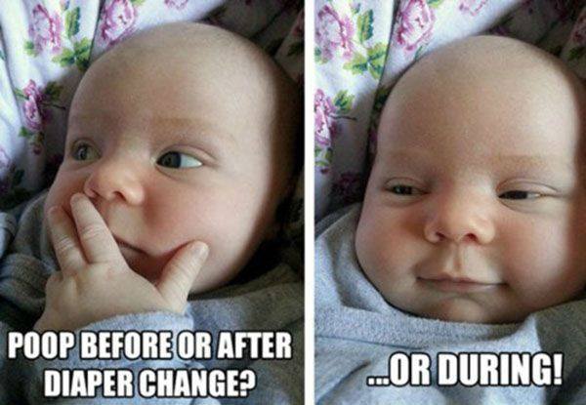

Slide 20
Knowledge Sharing versus Knowledge Transfer

Slide 21
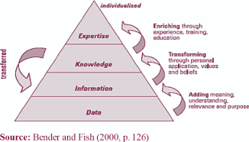
Knowledge Hierarchy

Slide 22
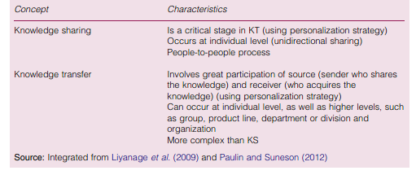
Acceptable Differences between KS and KT

Slide 23
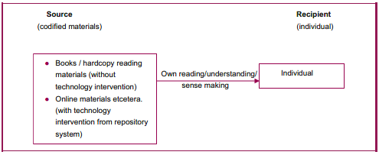
Simple KT Model Using Codification Strategy

Slide 24
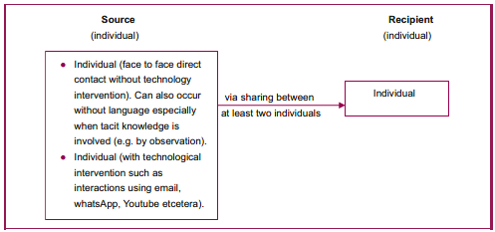
Simple KT Model Using Personalization Strategy

Slide 25
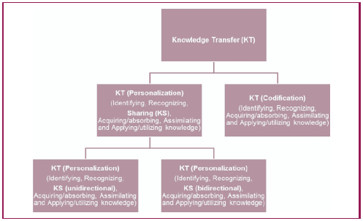
Interconnections of KS and KT

Slide 26
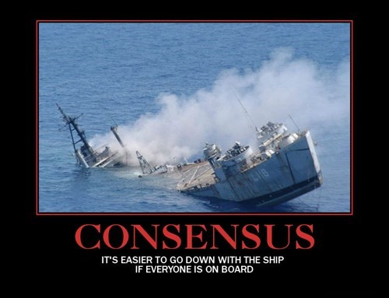

Slide 27
What is Really Important

Slide 28
Lots of Terms, Often Used Interchangeably
Knowledge Dissemination
Knowledge Sharing
Knowledge Transfer
Knowledge Translation
Pick one for the organization, define it well so everyone understands the use and intent, and then use it consistently

Slide 29
Have a Plan
If you go through all the trouble to collect tacit and explicit knowledge in a usable and retrievable format…whatever the method(s) used
  Organize the knowledge into an easily searched and used data warehouse
  Create a very strong search capability with the use of both wildcards and context-based searching with filters
  Determine the knowledge needs of the various components of the organization…people, departments, product lines, etc
  Have a deliberate methodology for archiving and retrieval of knowledge older than an agreed upon age (5, 10 or whatever years old)

Slide 30
Implement Your Plan
Formalize disseminating knowledge as part of the onboarding, training and every day work processes
As previously mentioned, incentivize knowledge capture and knowledge dissemination/sharing
  Individual incentives at the executive level
  Department-/Division-based incentives at the upper management level
  Team-based incentives at the middle management and below levels

Slide 31
Keeping It Going/Incremental Change
Inculcate knowledge capture and dissemination into the organizational culture
Refine the operational knowledge management capabilities and goals/objectives at regular intervals based on organizational goals and objectives as they support the vision and mission
Unless it is absolutely necessary for the survival of the organization, do not make “seismic shifts” in the overall knowledge management process or goals/objectives
  Incremental and agreed-upon change can work

Slide 32
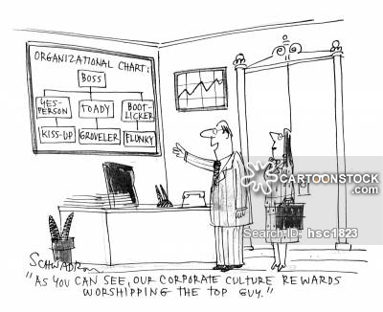
Questions

