Slide 1
Introduction to Machine Learning
Bob Marshall, MD MPH MISM FAAFP
DoD/MAMC Clinical Informatics Fellowship

Slide 2
Discussion Objectives
Differences/Relationships between AI, ML and DL (Deep Learning)
Why ML is important
Supervised ML
Regression in ML
Linear Regression
Gradient Descent
Overfitting in ML…and combating it

Slide 3
Artificial Intelligence, Machine Learning & Deep Learning - Definitions
Artificial Intelligence
Al is an ability of computer program to function like a human brain
Machine Learning
Machine Learning is a technique of parsing data, learn from that data and then apply what they have learned to make an informed decision
Deep Learning
Deep learning is actually a subset of machine learning
Deep learning is self-learning/self-adjusting machine learning
Autonomous driving is an example of deep learning

Slide 4
Relationship Between AI, ML and DL
Deep learning and machine learning both are the subsets of Al
Al means to actually replicate a human brain, the way a human brain thinks, works and functions
Machine learning and deep learning are ways of achieving AI
By using machine learning and deep learning, we may able to achieve Al in future, but they are not Al

Slide 5
Some Background on ML
Many machine learning algorithms have been around for a long time
The ability to automatically apply complex mathematical calculations to big data – over and over, faster and faster – is a recent development
Resurging interest in machine learning is due to the same factors that have made data mining and Bayesian analysis more popular than ever.
Growing volumes and varieties of available data, computational processing that is cheaper and more powerful, and affordable data storage

Slide 6
Requirements for Good ML Systems
Data preparation capabilities
Algorithms – basic and advanced
Automation and iterative processes
Scalability
Ensemble modeling

Slide 7
Who Uses ML
Financial Services
Government
Health Care
Retail
Oil and gas
Transportation

Slide 8
Why Machine Learning Matters 1 of 2
Machine learning is a subfield of artificial intelligence
Its goal is to enable computers to learn on their own
A machine’s learning algorithm enables it to identify patterns in observed data, build models that explain the world, and predict things without having explicit pre-programmed rules and models
ML is an example of artificial narrow intelligence (ANI), which can effectively perform a narrowly defined task
ML is also the foundation of human-level artificial general intelligence (AGI), also known as strong AI

Slide 9
Why Machine Learning Matters 2 of 2
The definition of an AGI is an artificial intelligence that can successfully perform any intellectual task that a human being can, including learning, planning and decision-making under uncertainty, communicating in natural language, making jokes, manipulating people, trading stocks, or… reprogramming itself
This last one is a big deal
Once we create an AI that can improve itself, it will unlock a cycle of recursive self-improvement that could lead to an intelligence explosion over some unknown time period, ranging from many decades to a single day

Slide 10
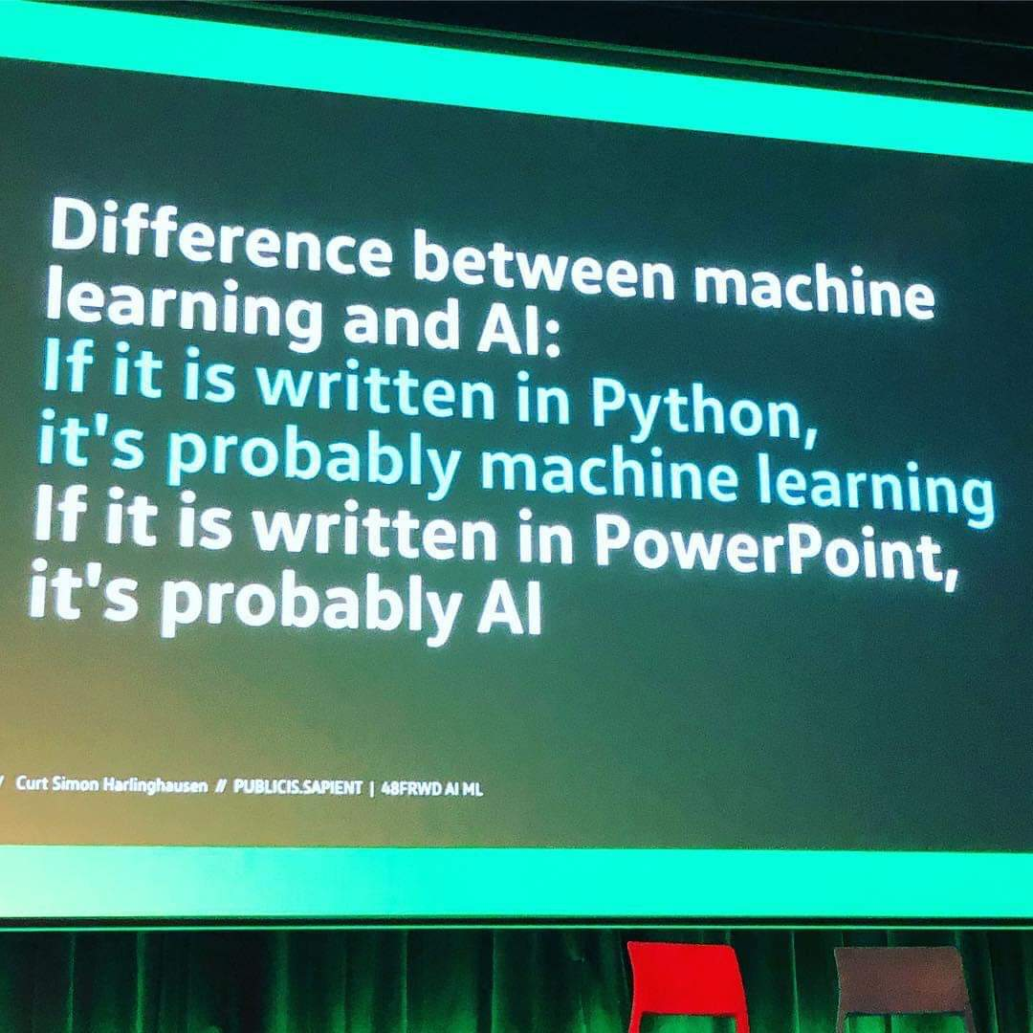

Slide 11
Supervised Machine Learning 1 of 4
In supervised learning problems, we start with a data set containing training examples with associated correct labels
When learning to classify handwritten digits, a supervised learning algorithm takes thousands of pictures of handwritten digits along with labels containing the correct number each image represents
Using many examples, a supervised learning algorithm will then learn the relationship between images and associated numbers, and apply that learned relationship to classify completely new images (without labels) that the machine hasn’t seen before

Slide 12
Supervised Machine Learning 2 of 4
Explicit rules-based programming doesn’t work well with complex data
Supervised machine learning solves this problem by getting the computer to do the work for you
By identifying patterns in the data, the machine can form heuristics
The primary difference between this and human learning is that machine learning runs on computer hardware and is best understood through the lens of computer science and statistics, whereas human pattern-matching happens in a biological brain

Slide 13
Supervised Machine Learning 3 of 4
In supervised learning, the machine attempts to learn the relationship between income and education from scratch, by running labeled training data through a learning algorithm
The goal of supervised learning is to predict Y as accurately as possible when given new examples where X is known, and Y is unknown

Slide 14
Supervised Machine Learning 4 of 4
The two tasks of supervised learning: regression and classification
Regression: predict a continuous numerical value. How much will that house sell for?
Classification: assign a label. Is this a picture of a cat or a dog?

Slide 15
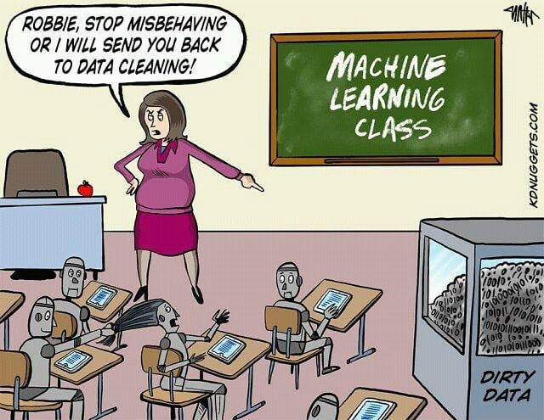

Slide 16
Unsupervised Learning 1 of 2
Unsupervised learning algorithms take a set of data that contains only inputs, and find structure in the data, like grouping or clustering of data points
The algorithms therefore learn from test data that has not been labeled, classified or categorized
Instead of responding to feedback, unsupervised learning algorithms identify commonalities in the data and react based on the presence or absence of such commonalities in each new piece of data

Slide 17
Unsupervised Learning 2 of 2
Unsupervised learning encompasses domains involving summarizing and explaining data features
Cluster analysis is the assignment of a set of observations into subsets (called clusters) so that observations within the same cluster are similar according to one or more predesignated criteria, while observations drawn from different clusters are dissimilar
Different clustering techniques make different assumptions on the structure of the data, often defined by some similarity metric and evaluated, for example, by internal compactness, or the similarity between members of the same cluster, and separation, the difference between clusters

Slide 18
Reinforcement Learning 1 of 2
Reinforcement learning is an area of machine learning concerned with how software agents ought to take actions in an environment so as to maximize some notion of cumulative reward.
Due to its generality, the field is studied in many other disciplines, such as game theory, control theory, operations research, information theory, simulation-based optimization, multiagent systems, swarm intelligence, statistics and genetic algorithms
In machine learning, the environment is typically represented as a Markov Decision Process (MDP)

Slide 19
Reinforcement Learning 2 of 2
Many reinforcement learning algorithms use dynamic programming techniques
Reinforcement learning algorithms do not assume knowledge of an exact mathematical model of the MDP, and are used when exact models are infeasible
Reinforcement learning algorithms are used in autonomous vehicles or in learning to play a game against a human opponent

Slide 20
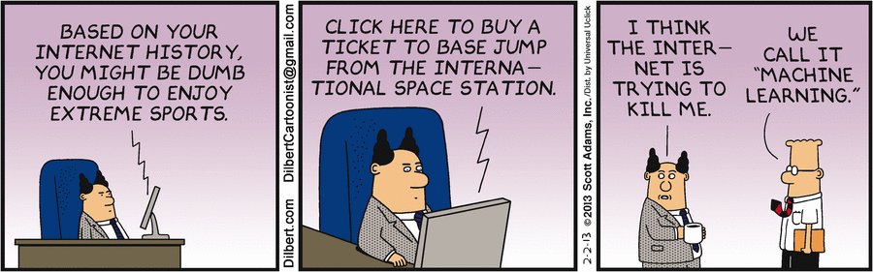

Slide 21
Feature Learning 1 of 4
Several learning algorithms aim at discovering better representations of the inputs provided during training
Classic examples include principal components analysis and cluster analysis
Feature learning algorithms, also called representation learning algorithms, often attempt to preserve the information in their input but also transform it in a way that makes it useful, often as a pre-processing step before performing classification or predictions

Slide 22
Feature Learning 2 of 4
This technique allows reconstruction of the inputs coming from the unknown data-generating distribution, while not being necessarily faithful to configurations that are implausible under that distribution
This replaces manual feature engineering, and allows a machine to both learn the features and use them to perform a specific task
Feature learning can be either supervised or unsupervised
In supervised feature learning, features are learned using labeled input data

Slide 23
Feature Learning 3 of 4
Examples include artificial neural networks, multilayer perceptrons, and supervised dictionary learning.
In unsupervised feature learning, features are learned with unlabeled input data
Examples include dictionary learning, independent component analysis, autoencoders, matrix factorization and various forms of clustering
Feature learning is motivated by the fact that machine learning tasks such as classification often require input that is mathematically and computationally convenient to process

Slide 24
Feature Learning 4 of 4
However, real-world data such as images, video, and sensory data has not yielded to attempts to algorithmically define specific features
An alternative is to discover such features or representations through examination, without relying on explicit algorithms

Slide 25
Regression in ML 1 of 3
Regression predicts a continuous target variable Y
It allows you to estimate a value, such as housing prices or human lifespan, based on input data X
Here, target variable means the unknown variable we care about predicting, and continuous means there aren’t gaps (discontinuities) in the value that Y can take on
Predicting income is a classic regression problem

Slide 26
Regression in ML 2 of 3
Your input data X includes all relevant information about individuals in the data set that can be used to predict income, such as years of education, years of work experience, job title, or zip code
These attributes are called features, which can be numerical (e.g. years of work experience) or categorical (e.g. job title or field of study)
You’ll want as many training observations as possible relating these features to the target output Y, so that your model can learn the relationship f between X and Y

Slide 27
Regression in ML 3 of 3
The data is split into a training data set and a test data set
The training set has labels, so your model can learn from these labeled examples
The test set does not have labels, i.e. you don’t yet know the value you’re trying to predict
It’s important that your model can generalize to situations it hasn’t encountered before so that it can perform well on the test data

Slide 28
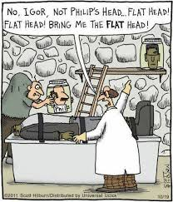
Discussion/Questions

Slide 29
Backup Slides on ML

Slide 30
Linear regression (ordinary least squares) 1 of 3
First, we’ll focus on solving the income prediction problem with linear regression, since linear models don’t work well with image recognition tasks
We have our data set X, and corresponding target values Y
The goal of ordinary least squares (OLS) regression is to learn a linear model that we can use to predict a new y given a previously unseen x with as little error as possible
We want to guess how much income someone earns based on how many years of education they received

Slide 31
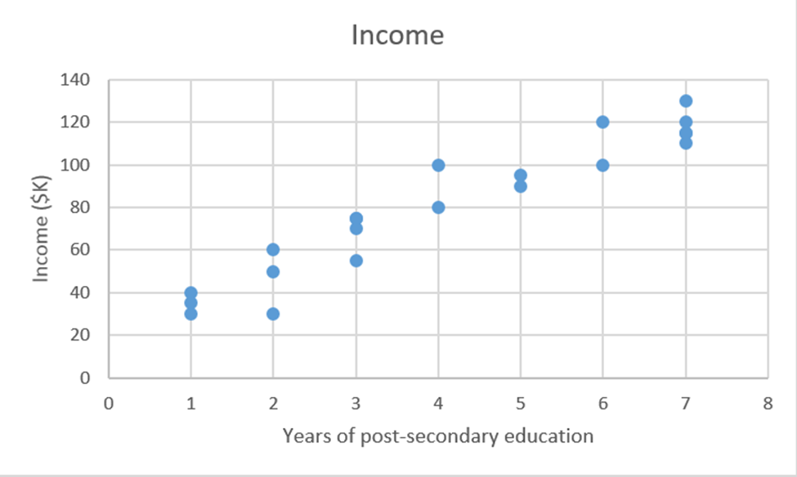

Slide 32

Linear regression (ordinary least squares) 2 of 3
Linear regression is a parametric method, which means it makes an assumption about the form of the function relating X and Y
β0 is the y-intercept and β1 is the slope of our line, i.e. how much income increases (or decreases) with one additional year of education.
Our goal is to learn the model parameters (in this case, β0 and β1) that minimize error in the model’s predictions

Slide 33
Linear regression (ordinary least squares) 3 of 3
To find the best parameters:
Define a cost function, or loss function, that measures how inaccurate our model’s predictions are
Find the parameters that minimize loss, i.e. make our model as accurate as possible
Graphically, in two dimensions, this results in a line of best fit
As a cost function grows in complexity, finding a closed form solution with calculus is no longer feasible.
This is the motivation for an iterative approach called gradient descent, which allows us to minimize a complex loss function

Slide 34

Gradient Descent 1 of 2
The goal of gradient descent is to find the minimum of our model’s loss function by iteratively getting a better and better approximation of it
Look at the loss function we saw in regression:
To begin gradient descent, you make some guess of the parameters β0 and β1 that minimize the function

Slide 35
Gradient Descent 2 of 2
Find the partial derivatives of the loss function with respect to each beta parameter: [dz/dβ0, dz/dβ1]
A partial derivative indicates how much total loss is increased or decreased if you increase β0 or β1 by a very small amount
If the partial derivative dz/β1 is a negative number, then increasing β1 is good because it will reduce total loss
If it’s a positive number, you want to decrease β1
If it’s zero, don’t change β1 because it means you’ve reached an optimum

Slide 36
Overfitting in ML 1 of 3
A common problem in machine learning is overfitting: learning a function that perfectly explains the training data that the model learned from but doesn’t generalize well to unseen test data
Overfitting happens when a model overlearns from the training data to the point that it starts picking up idiosyncrasies that aren’t representative of patterns in the real world
This becomes especially problematic as you make your model increasingly complex
Underfitting is a related issue where your model is not complex enough to capture the underlying trend in the data

Slide 37
Overfitting in ML 2 of 3
Bias is the amount of error introduced by approximating real-world phenomena with a simplified model
Variance is how much your model's test error changes based on variation in the training data. It reflects the model's sensitivity to the idiosyncrasies of the data set it was trained on
As a model increases in complexity and it becomes more wiggly (flexible), its bias decreases (it does a good job of explaining the training data), but variance increases (it doesn't generalize as well)
Ultimately, in order to have a good model, you need one with low bias and low variance

Slide 38
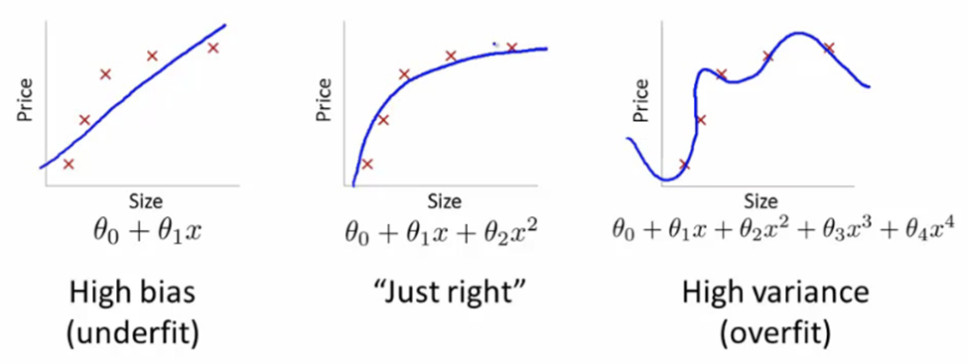

Slide 39
Overfitting in ML 3 of 3
Remember that the only thing we care about is how the model performs on test data
In the previous image set, the model on the right has zero loss for the training data because it perfectly fits every data point
However, the lesson doesn’t generalize
It would do a horrible job at explaining a new data point that isn’t yet on the line

Slide 40
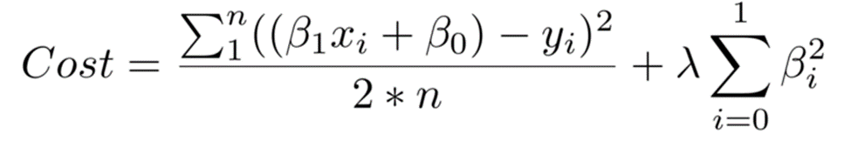
How to Combat Overfitting 1 of 3
Use more training data. The more you have, the harder it is to overfit the data by learning too much from any single training example.
Use regularization. Add in a penalty in the loss function for building a model that assigns too much explanatory power to any one feature or allows too many features to be taken into account

Slide 41
How to Combat Overfitting 2 of 3
The first piece of the sum above is our normal cost function
The second piece is a regularization term that adds a penalty for large beta coefficients that give too much explanatory power to any specific feature
With these two elements in place, the cost function now balances between two priorities: explaining the training data and preventing that explanation from becoming overly specific
The lambda coefficient of the regularization term in the cost function is a hyperparameter: a general setting of your model that can be increased or decreased (i.e. tuned) in order to improve performance

Slide 42
How to Combat Overfitting 3 of 3
A higher lambda value will more harshly penalize large beta coefficients that could lead to potential overfitting
To decide the best value of lambda, you’d use a method called cross-validation which involves holding out a portion of the training data during training, and then seeing how well your model explains the held-out portion

