Slide 1
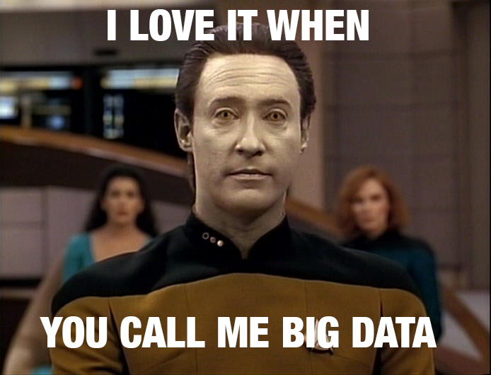
Introduction to Clinical Informatics
Bob Marshall, MD, MPH, MISM, FAAFP, FAMIA
Program Director, DoD/MAMC Clinical Informatics Fellowship

Slide 2
Clinical Informatics Outline
Definition
Major areas of informatics
What Informatics is and is not
Areas of Informatics
Clinical Informatics in depth
Professional Organizations
Examples of Informatics Expertise

Slide 3
Definition of Biomedical/Health Informatics (BM/HI) 1 of 2
According to the American Medical Informatics Association (AMIA), “Biomedical informatics (BMI) is the interdisciplinary field that studies and pursues the effective uses of biomedical data, information, and knowledge for scientific inquiry, problem solving, and decision making, motivated by efforts to improve human health.”¹
Health Informatics is “the science, the how and why, behind health IT” according to the Centers for Disease Control and Prevention (CDC)²
Practitioners of BMI are usually called Informaticians (sometimes Informaticists)
Often, the terms Biomedical Informatics (BMI) and Health Informatics (HI) are used Interchangeably or combined, as in BMHI or BM/HI.

Slide 4
Definition of Biomedical/Health Informatics (BM/HI) 2 of 2
"Clinical informaticians transform health care by analyzing, designing, implementing, and evaluating information and communication systems that enhance individual and population health outcomes, improve patient care, and strengthen the clinician-patient relationship." - Gardner RM et al. Core Content for the Subspecialty of Clinical Informatics (From HIMSS website)
“10% medicine, 10% technology, 80% sociology”
Homer Warner

Slide 5
Short History of BMHI
Informatics began to have an effect in the United States during the 1950’s
Homer R. Warner, one of the fathers of medical informatics, founded the Department of Medical Informatics at the University of Utah in 1968
The American Medical Informatics Association was founded in 1988 by the merger of three health informatics organizations
In 2002 and 2007, AMIA developed Core Competencies for BMHI … the final set was published in 2010
In September, 2011, Clinical Informatics was approved by the Amer. Board of Medical Specialties as a board-certified clinical subspecialty

Slide 6
What Clinical Informatics Is
We do…
Try to help folks use clinical systems more efficiently and effectively
Voice clinical opinions/perspective on software and hardware selection
Match workflow to software/hardware
Help improve quality care/patient safety in any setting (by applying bullets 1, 3 & 5)
Identify analytics (data/information) and how best to use it clinically (and for research)
Serve as a bridge between IT/security folks and clinical end users

Slide 7
What Clinical Informatics Is Not
We do not ….
Run the network
Run the EHR, PACS or other clinical systems
Configure computers (or ultimately decide what goes on them…but we do recommend)
Have anything to do with computer security decisions
Run the Help Desk

Slide 8
Terminology
Imaging Informatics
Legal Informatics
Biomedical and Health
Bioinformatics (molecular)
Medical Clinical Informatics (person)
Public Health Informatics (population)
Chemoinformatics
{Field} Informatics
Research Informatics
Informatics

Slide 9
Major areas of application¹:
Translational Bioinformatics
Clinical Research Informatics
Clinical Informatics
Consumer Health Informatics
Public Health Informatics
Population Health Informatics (often grouped under Public Health)
1: American Medical Informatics Association (AMIA)

Slide 10
Applied Clinical Informatics
Military Clinical Informaticists generally work in what is called “Applied Clinical Informatics”
This focuses on how the clinical informatics tools (EHR’s and such) are used to care for patients
In most cases, work in the background to continually improve the systems we all use in patient care

Slide 11
Focus Areas for Clinical Informatics 1 of 2
Clinical Decision Support
Computational Science and Analytics
Security and Privacy
Change Management
System Adoption and Implementation
IT Infrastructure

Slide 12
Focus Areas for Clinical Informatics 2 of 2
Terminology/Taxonomies
Interoperability and Standards
User Interface/User Experience (UI/UX) & Usability
Learning Healthcare Systems/Research
Patient Safety/Population Health
Knowledge Management
Transitions of Care/Disease Management

Slide 13
More Clinical Informatics Areas
Imaging informatics (PACS, now areas like pathology and dermatology)
Clinical Informatics
“X” Informatics (pharmacy, primary care, etc.)
or
Clinical decision support
Population health
User experience (development, human factors)
Patient engagement
mHealth
Interoperability and data standards/health information exchange
Data reporting/descriptive analytics
Data science/predictive/prescriptive analytics
Value-based care (comparative effectiveness research)

Slide 14
Clinical Informatics Areas
May overlap with:
Bioinformatics (genomics)
Population health, governance and policy (health informatics)
Health information management (HIM) -- historically focused on management of medical records.
Translational medicine (translational bioinformatics)

Slide 15


Slide 16
Translational Bioinformatics
Development of storage, analytic, and interpretive methods to optimize the transformation of increasingly voluminous biomedical data, and genomic data, into proactive, predictive, preventive, and participatory health
End product is newly found knowledge that can be disseminated to a variety of stakeholders, including biomedical scientists, clinicians, and patients

Slide 17
Clinical Research Informatics
The use of informatics in the discovery and management of new knowledge relating to health and disease
Includes management of information related to clinical trials and also involves informatics related to secondary research use of clinical data

Slide 18
Consumer Health Informatics
The field devoted to informatics from multiple consumer or patient views
These include patient-focused informatics, health literacy and consumer education
The focus is on information structures and processes that empower consumers to manage their own health – ex. health information literacy, consumer-friendly language, personal health records, and Internet-based strategies and resources

Slide 19
Public Health Informatics
The application of informatics in areas of public health, including surveillance, prevention, preparedness, and health promotion
Public health informatics and the related population informatics, work on information and technology issues from the perspective of groups of individuals

Slide 20
Organizations
Healthcare Information and Management Systems Society (HIMSS)
American Medical Informatics Association (AMIA)
Association of Medical Directors of Information Systems (AMDIS)
American Board of Preventive Medicine (ABPM)

Slide 21
Informatics Challenges and Goals
Demonstrate value
Clinical outcomes
Financial outcomes/Return on Investment
“Billable” service
Improve usability
Interoperability (standards and platforms)
Predictive/prescriptive integration into practice
DoD
Information assurance (Cybersecurity)
Change control (MHS Genesis as model)
Portfolio standardization
Test and deploy new capabilities
Workforce
MHS GENESIS Implementation/Optimization

Slide 22
Examples of Informatics Expertise
Data Analysis
Pretty much every research and/or QI/PI project at MAMC uses CI for data retrieval and analysis
Workflow Analysis
Health IT Training – GENESIS and other
Natural Language Processing
Machine Learning/Artificial Intelligence

Slide 23
More Examples
Clinical Documentation Improvement
AsUType and Dragon Macros
HERMES (Survey tool)
MHSG Optimization
MHSG Implementation (it could have been worse)

Slide 24
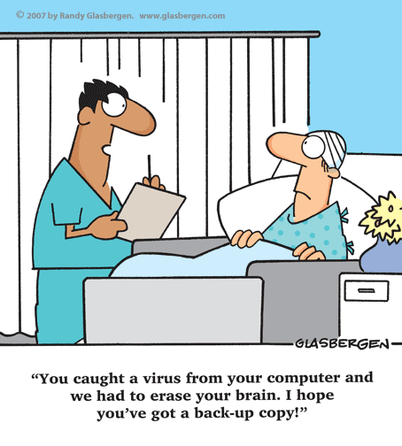
Questions

