Slide 1
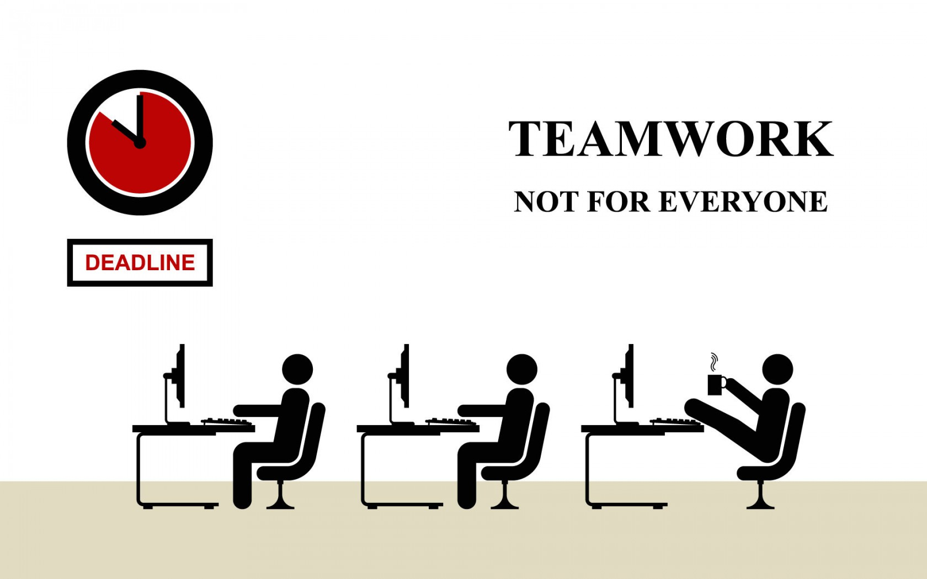
Intro to Teams
Bob Marshall, MD MPH MISM FAAFP Program Director, DoD/MAMC Clinical Informatics Fellowship

Slide 2
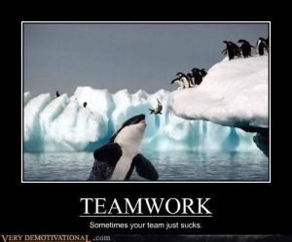
Learning Objectives
Basic Overview
Tuckman’s 5 Stages Model
Limitations of Tuckman’s Model
Another Model of Team Development

Slide 3
What are Work Teams?
Teams consist of a group of people who working as one unit, performing organizationally relevant work organized around one or more common goals
Teams vary in size and location
Regardless of team size, there should be an established set of goals that define why the team has been formed, what the team is expected to accomplish, who will be on the team and how the team’s work will be performed

Slide 4
Advantages of Teams
A major advantage of a team is that it can operate on greater scales, broader scope and longer time frames in a single person.
Interdisciplinary teams that bring together participants with diverse knowledge, experience and expertise have the potential to solve problems and be innovative in ways that are not feasible for a single individual
Interdisciplinary teams that bring together participants with diverse knowledge, experience and expertise have the potential to solve problems and be innovative in ways that are not feasible for a single individual

Slide 5
Types and Functions of Teams
Teams can be used as task forces, development teams, committees and working groups
Problem-solving teams composed of cross-trained workers are brought together to resolve issues within the organizational structure
Leadership teams include heads of specific departments to develop company goals and strategic marketing directions
Self-directed teams are issued a goal by the organization and are left to their own discretion to determine how to accomplish it
Virtual teams are formed by companies who rely on technology to conduct long-distance business, meetings and conferences in real time

Slide 6
Initiating/Forming a Team
Once it is determined that 18 is the most appropriate solution to accomplish and establish school informing/initiating the team is the next step.
Team members need to be identified.
The team leader needs to establish how the team will be organized and operate as it develops and performs the necessary tasks.
The best way to lay the groundwork for an effective team is to create the team charter.

Slide 7
Team Charter
A team charter is a document that establishes why the team is needed, what it will do, who will be part of the team and how it will function.
The charter needs to be explicit about the purpose the team, the team members, processes for working together in necessary recourses.
Once the charter is documented, stakeholders and teaming members need to give their buy-in
This support gives the team the green light to get started, bringing forward specific information about the teams will need to function so they can work effectively

Slide 8
Team Charter Components
A team charter may have many parts, but it is imperative to include the following:
Purpose - Why the team exists, and what it is expected to accomplish
Members - who is involved in and affected by the team.
Structures and process - how will the team be organized and operate
Resources - what is needed to support the team and from where does it come

Slide 9
Stages of Team Development
Models of Team Development

Slide 10
Introduction to Team Building
For teams to be effective, people in the team must be able to work together to contribute collectively to team outcomes
But this does not happen automatically: it develops as the team works together
When your team first gets together, you likely sit around and look at each other, not knowing how to begin
Initially you are not a team; you are just individuals assigned to work together
Over time you get to know each other, to know what to expect from each other, to know how to divide the labor and assign tasks, and to know how you will coordinate your work
Through this process, you begin to operate as a team instead of a collection of individuals

Slide 11
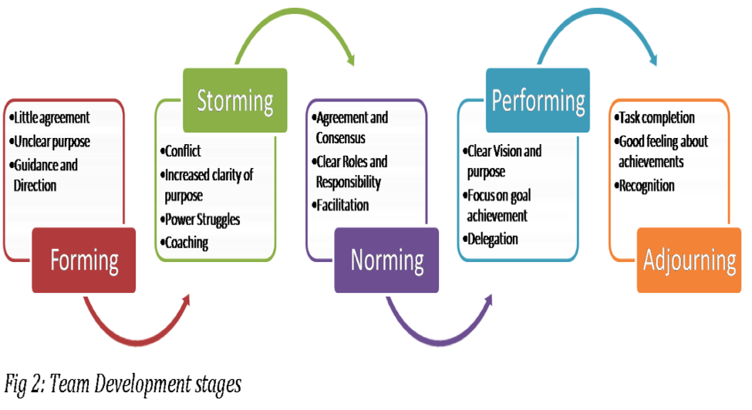
Tuckman’s Model of Team Development

Slide 12
Forming
The forming stage involves a period of orientation and getting acquainted
Uncertainty is high during this stage, and people are looking for leadership and authority
A member who asserts authority or is knowledgeable may be looked to take control
Team members are asking such questions as “What does the team offer me?” “What is expected of me?” “Will I fit in?”
Most interactions are social as members get to know each other

Slide 13
Storming
The storming stage is the most difficult and critical stage to pass through
It is a period marked by conflict and competition as individual personalities emerge
Team performance may decrease in this stage because energy is put into unproductive activities
Members may disagree on team goals, and subgroups and cliques may form around strong personalities or areas of agreement
To get through this stage, members must work to overcome obstacles, to accept individual differences, and to work through conflicting ideas on team tasks and goals
Teams can get bogged down in this stage
Failure to address conflicts may result in long-term problems

Slide 14
Norming
If teams get through the storming stage, conflict is resolved, and some degree of unity emerges
In the norming stage, consensus develops around who the leader or leaders are, and individual member’s roles
Interpersonal differences begin to be resolved, and a sense of cohesion and unity emerges
Team performance increases during this stage as members learn to cooperate and begin to focus on team goals
However, the harmony is precarious, and if disagreements re-emerge the team can slide back into storming

Slide 15
Performing
In the performing stage, consensus and cooperation have been well-established and the team is mature, organized, and well-functioning
There is a clear and stable structure, and members are committed to the team’s mission
Problems and conflicts still emerge, but they are dealt with constructively
The team is focused on problem solving and meeting team goals

Slide 16
Adjourning
In the adjourning stage, most of the team’s goals have been accomplished
The emphasis is on wrapping up final tasks and documenting the effort and results
As the work load is diminished, individual members may be reassigned to other teams, and the team disbands
There may be regret as the team ends, so a ceremonial acknowledgement of the work and success of the team can be helpful
If the team is a standing committee with ongoing responsibility, members may be replaced by new people and the team can go back to a forming or storming stage and repeat the development process

Slide 17
Teams Norms and Cohesiveness 1 of 3
Teams usually develop norms that guide the activities of team members
Team norms set a standard for behavior, attitude, and performance that all team members are expected to follow
Norms are like rules, but they are not written down
Instead, all the team members implicitly understand them
Norms are effective because team members want to support the team and preserve relationships in the team, and when norms are violated, there is peer pressure or sanctions to enforce compliance
Norms result from the interaction of team members during the development process

Slide 18
Teams Norms and Cohesiveness 2 of 3
Norms result from the interaction of team members during the development process
During the forming and storming stages, norms focus on expectations for attendance and commitment
During the norming and performing stages, norms focus on relationships and levels of performance
Performance norms are very important because they define the level of work effort and standards that determine the success of the team
Leaders play an important part in establishing productive norms by acting as role models and by rewarding desired behaviors
Norms are only effective in controlling behaviors when they are accepted by team members

Slide 19
Teams Norms and Cohesiveness 3 of 3
The level of cohesiveness on the team primarily determines whether team members accept and conform to norms
Team cohesiveness is the extent that members are attracted to the team and are motivated to remain in the team
Members of highly cohesive teams value their membership, are committed to team activities, and gain satisfaction from team success
They try to conform to norms because they want to maintain their relationships in the team, and they want to meet team expectations
Teams with strong performance norms and high cohesiveness are high performing

Slide 20
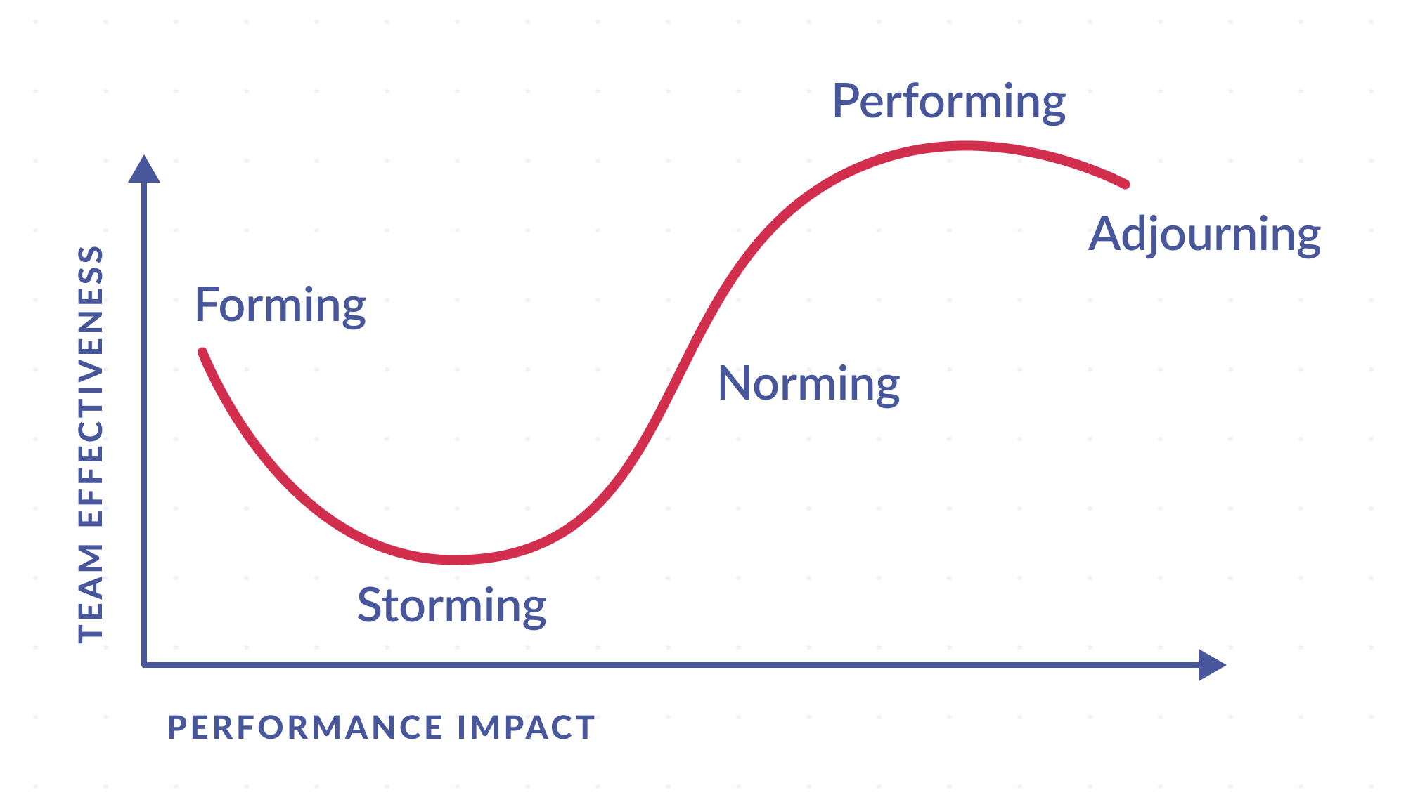

Slide 21
Tuckman Model Limitations 1 of 3
Tuckman’s model was created for (and based on) small groups, and at the time of its creation, virtual / distributed groups were nearly non-existent – or at least not able to work together as easily and frequently as they are today
Tuckman identified additional limitations pertaining to the literature review he based the model on
The literature overrepresented therapy-group environments
Later studies found that groups outside of therapy largely fit within the 5-Stages, although variations exist within the exact definition of “Storming” and that the “Storming” stage is typically not as clear-cut and defined outside of therapy group settings

Slide 22
Tuckman Model Limitations 2 of 3
The model lacks a complete explanation of how groups change over time
In addition, there are two significant concerns relating to task performance
The first is that the model fails to address the effects of team development on creativity in problem solving
The second concern is that the model does not discuss either failure to achieve success in task performance or the ability to show outstanding performance
Two significant questions exist:
first, what if the storm stage never ends, and
second, what is needed to exceed performance norms?

Slide 23
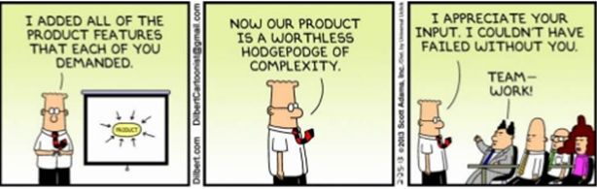
Tuckman Model Limitations 3 of 3
Movement between the stages is not a guaranteed linear progression
Actual work groups may move into the Storming stage and never make it into Performing before Adjourning

Slide 24
Drexler and Sibbet’s Team Performance Model
Just another model about team development stages

Slide 25
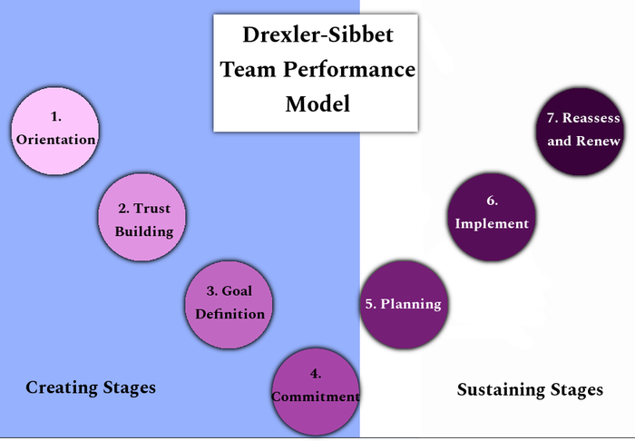

Slide 26
Introduction
Most people have some familiarity with Tuckman’s Model – 5 Stages of Team Development
It’s simple and easy to understand, but it may not show the whole story and sometimes it is nice to have a bit of a different perspective on things
This is where the Drexler-Sibbet Model comes in
The Drexler-Sibbet Model of Team Performance has 7 stages that are divided into two groups
This model was developed by Allan Drexler and David Sibbet in the 1980s

Slide 27
The 7 Stages Model
Orientation
Trust Building
Goal Definition
Commitment
Planning
Implementation
Reassess and Renew

Slide 28
Two Main Parts to the Model
Creating Stages: Encompasses the initial stages of group development as the group forms and works to become a single cohesive unit
The first four stages are contained within the “Creating Stages” group
Sustaining Stages: After the group adjusts and becomes established the Sustaining Stages begin
The final three stages are contained within this group

Slide 29
Creating Stages 1 of 2
Orientation - Why am I here?
This is where the group learns why they are being brought together
They may wonder why they are there and that question is one that should be answered early in the group’s formation
2. Trust Building - Who are you?
The members of the group may not know everyone and during the Trust Building stage, they should learn who their teammates are
They may not know the experience levels of the other members, the members’ area of expertise, or even their names
The team must get to know each other and learn who they will be working with and build trust among the members of the group

Slide 30
Creating Stages 2 of 2
3. Goal Definition - What are we doing?
Within the Goal Definition stage, the group figures out what they are doing and define or learn the roles of the team member
This definition of roles may or may not be formal (and generally shouldn’t be), the team should fall into a pattern of where their skills lie and only be guided by external leadership towards that pattern
Conflict naturally arises as the team figures out their place in the group
4. Commitment - How will we do it?
This defines how the team will work together as a group and how they proceed to where they can begin to be their most productive
Conflict among the team should be reduced

Slide 31
Sustaining Stages
Planning - Who is going to do what?
The team plans the activities and tasks are assigned or volunteered for
Planning begins the transition to completing the required work
Implementation - Is the team performing?
Implementation lines up with the Performing stage of the Tuckman Model
This is where the work gets done and ideally, the team is functioning as a cohesive unit
Reassess and Renew - Do we continue?
Has the group completed objectives or are the objectives still relevant?
The group identifies what it has done and if the team’s purpose is completed
It either plans to complete the remaining work or if no work needs to be done, the group disbands

Slide 32
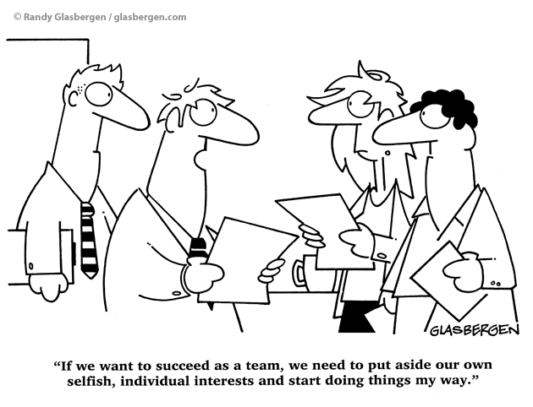
Questions???

