Slide 1
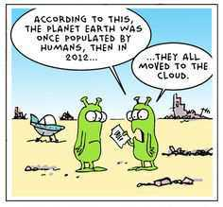
Networking –Part 3
Bob Marshall, MD MPH MISM
12/2018

Slide 2
Recap/Intro
Reviewed networking types
Reviewed network devices
Discuss the potpourri of topics to cover networks and network security
Introduce 802.11ax

Slide 3
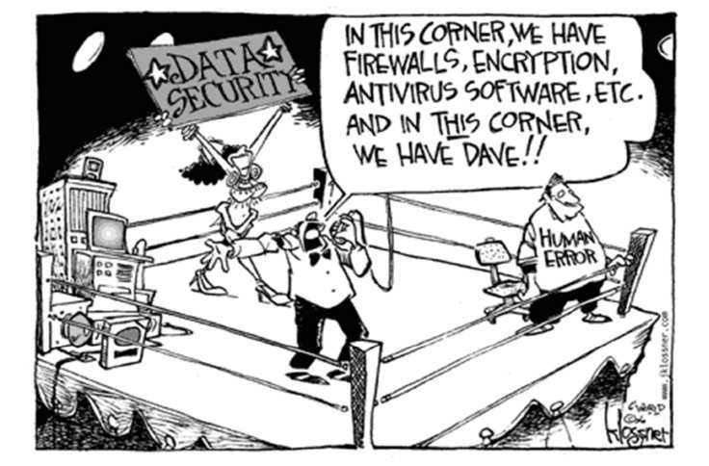

Slide 4
Definition
Network security refers to any activities designed to protect your network
Specifically, these activities protect the usability, reliability, integrity, and safety of your network and data
Effective network security targets a variety of threats and stops them from entering or spreading on your network

Slide 5
Network Threats
Viruses, worms, and Trojan horses
Spyware and adware
Zero-day attacks, also called zero-hour attacks
Hacker attacks
Denial of service attacks
Data interception and theft
Identity theft

Slide 6
Security Basics
No single solution completely protects you from the variety of possible threats
You need multiple layers of security
Network security is accomplished through hardware and software
The software must be constantly updated and managed to protect you from emerging threats

Slide 7
Security Components
Network security components often include:
Anti-virus and anti-spyware
Firewall, to block unauthorized access to your network
Intrusion prevention systems (IPS), to identify fast-spreading threats, such as zero-day or zero-hour attacks
Virtual Private Networks (VPNs), to provide secure remote access

Slide 8
Authentication & Firewalls
Once authenticated, a firewall enforces access policies such as what services are allowed to be accessed by the network users
Though effective to prevent unauthorized access, this component may fail to check potentially harmful content such as computer worms or Trojans being transmitted over the network.
Anti-virus software or an intrusion prevention system (IPS) help detect and inhibit the action of such malware
An anomaly-based intrusion detection system may also monitor the network like Wireshark traffic and may be logged for audit purposes and for later high-level analysis.

Slide 9
1, 2 & 3 Factor Authentication
Network security starts with authenticating, commonly with a username and a password
Since this requires just one detail authenticating the user name —i.e., the password— this is sometimes termed one-factor authentication
With two-factor authentication, something the user 'has’ is also used (e.g., a security token or 'dongle', an ATM card, or a mobile phone)
With three-factor authentication, something the user 'is’ also used (e.g., a fingerprint or retinal scan).

Slide 10
Public Key Infrastructure
A set of hardware, software, people, policies, and procedures needed to create, manage, distribute, use, store, and revoke digital certificates and manage public-key encryption
Purpose of a PKI: facilitate the secure electronic transfer of information for a range of network activities such as e-commerce, internet banking and confidential email
Required for activities where simple passwords are inadequate authentication method and more rigorous proof required to confirm identity of parties involved in the communication and to validate information being transferred

Slide 11
PKI continued
Binds public keys with respective user identities by means of a certificate authority (CA)
User identity must be unique within each CA domain.
The third-party validation authority (VA) can provide this information on behalf of the CA
Binding established through registration and issuance process
Depending on assurance level of binding, this may be carried out by software at a CA or under human supervision.
The PKI role that assures this binding is called registration authority (RA)
RA responsible for accepting requests for digital certificates and authenticating the person or organization making the request
In Microsoft PKI, a registration authority is usually called a subordinate CA

Slide 12
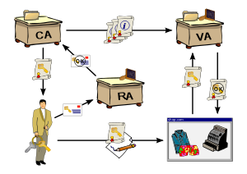
PKI Diagram

Slide 13
PKI consists of
A certificate authority (CA) that both issues and verifies the digital certificates
A registration authority which verifies the identity of users requesting information from the CA
A central directory—i.e., a secure location in which to store and index keys
A certificate management system[clarification needed]
A certificate policy

Slide 14
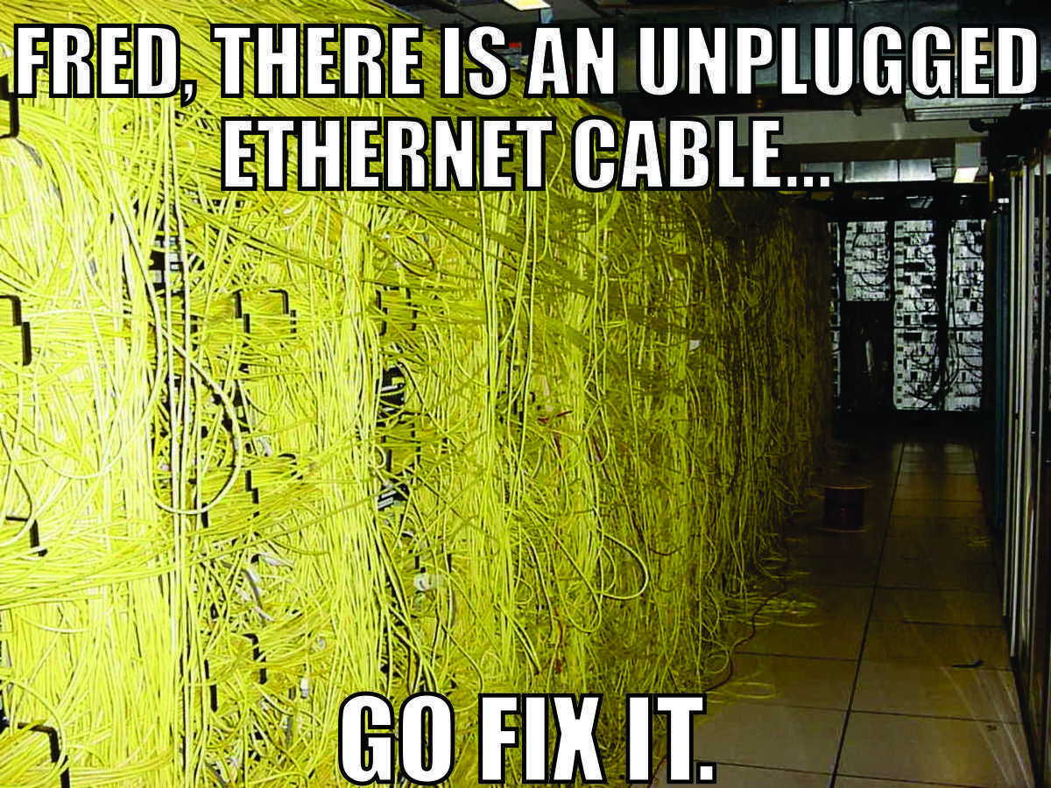

Slide 15
Network Security Controls

Slide 16
Link vs. End-to-End Encryption

Slide 17
Virtual Private Network
Virtual private network (VPN) technology uses IP-in-IP tunneling to encrypt and encapsulate the IP datagram that has the private IP addresses of the two end hosts with another IP header that has the source and destination IP addresses as the public IP address of the gateway routers for these two private networks.
Each organization is required to have one or more gateway routers with a public IP address in order to facilitate communication over the public Internet.
As the original IP datagram is encrypted, no intermediate forwarding host in the public Internet can look at the contents of the message.

Slide 18
VPN Diagram
R1 & R2 – Network Routers

Slide 19
Different Phases of IP-in-IP Tunneling

Slide 20
Secure Shell (SSH)
Network protocol that allows a user to securely interact with remote machines by establishing a secure channel for data exchange.
SSH replaced TELNET and other insecure remote shell programs that were used in the past to send information in plaintext, including passwords, to remote systems.
SSH encrypts the information sent over the insecure Internet and thus provides both confidentiality and integrity of data.

Slide 21
Steps to Establish a Secure Shell

Slide 22
Transport Layer Security (TLS)
successor of the Secure Sockets Layer (SSL) [18]
cryptographic protocol and it provides secure communication of the datagrams of the transport layer
protocols as part of an end-to-end connection across the network. TLS has been used for a wide-variety of
applications like web browsing, electronic mail, voice-over-IP, instant messaging and etc

Slide 23
TLS Connection Establishment Mechanism

Slide 24
IP Security
The IP Security Protocol suite (IPSec) is implemented at the IP layer; does not require any change to existing transport layer and application layer protocols
IPSec primarily designed to address fundamental shortcomings of IP layer such as IP address spoofing, wiretapping and session hijacking.
The following two protocols are used to provide packet-level security for both IPv4 and IPv6:
IP Authentication Header, AH (Next Header protocol ID: 51) provides integrity, authentication and non-repudiation
IP Encapsulating Security Payload, ESP (Next Header protocol ID: 50) provides confidentiality, along with authentication and integrity protection

Slide 25
Kerberos
Authentication protocol used by processes/hosts communicating over an insecure network to verify each other’s identity in a secure manner
Based on the idea that a central server provides authenticated tokens called “tickets” to requesting applications
A ticket is an unforgeable, non-replayable, authenticated object
Security of the protocol depends on the assumption that participating machines maintain loosely synchronized time

Slide 26
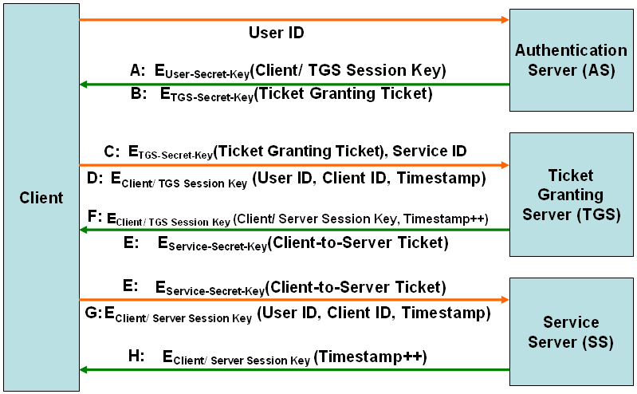
Kerberos Protocol Steps

Slide 27
Kerberos Weaknesses
Requires continuous availability of trusted ticket-granting server for all access control and authentication checks
Password guessing could still work to get the valid secret key for a user. The whole system is still dependent on the user password
Kerberos does not scale well as the number of service servers is increased
Network services cannot be accessed without obtaining Kerberos authentication. All applications run by users in the network need to go through Kerberos authentication

Slide 28
Firewalls
Device that filters traffic between a “less trustworthy” outside network and a “protected” inside network
Firewall often implemented in software; basically code running on dedicated computer located in the periphery of network to be protected
All traffic exiting and entering network should go through the firewall.
Hence, the firewall often a bottleneck for network performance
Design often makes use of either “default-deny” or “default-allow” approach

Slide 29
Firewall Types
Packet filtering firewall controls access to packets based on network address, IP address or port numbers (representing specific transport layer protocols).
Stateful firewalls examine each packet with regards to their overall placement in the packet series belonging to a specific connection
Application proxy firewall acts as intermediate gateway attempting to look not only at packet headers but also at the data inside the packets entering or leaving the network to be protected
Personal firewall is an application program running on a specific computer system
Can also be configured to function as a virus scanner

Slide 30
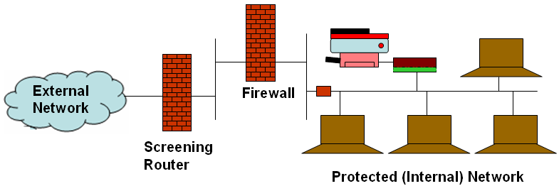
Layered Firewall Approach

Slide 31
Secure Email
The key requirements [6] for secure e-mail are as follows:
Confidentiality: E-mail contents should not be exposed on the path from the sender to the receiver
Integrity: The receiver should see in the e-mail, the same content which the sender sent
Authenticity: Receiver should be able to verify that the e-mail message indeed came from the sender
Non-repudiation: The sender of the e-mail cannot deny having sent the message

Slide 32
S/MIME (Secure/ Multi-purpose Internet Mail Extensions)
Secure e-mail standard commonly used in the Internet. Satisfies all four requirements for secure e-mail design
Four components of S/MIME:
Encrypted version of the original plaintext (e-mail message header and body)
Encrypted version of random session key used for symmetric encryption of original message header and body
Encrypted version of the hash of original e-mail message header and body
Encrypted version of the sender’s public-key certificate

Slide 33
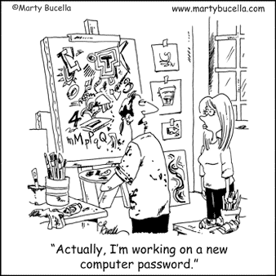

Slide 34
Network Attacks
Networks are subject to attacks from malicious sources
Attacks can be from two categories to disrupt the network’s normal operation:
“Passive” when a network intruder intercepts data traveling through the network,
“Active” in which an intruder initiates commands

Slide 35
Passive/Active Attacks
Passive
Network
Wiretapping
Port scanner
Idle scan
Active
Denial-of-service attack
DNS spoofing

Slide 36
Other Attacks
Man in the Middle
ARP poisoning
VLAN_hopping
Smurf attack
Buffer overflow
Heap overflow
Format string attack
SQL injection
Phishing
Cross-site scripting
CSRF
Cyber-attack

Slide 37
Wiretapping
Process of extracting information as it flows through a wire
The process of wiretapping differs depending on communication medium used
In cables, wiretapping can be done through the use of a packet sniffer or through inductance
Wireless signals are broadcast through open space and are more susceptible for tapping
Optical fibers are more secure than any other transmission media

Slide 38
TCP Session Hijacking
TCP session hijacking refers to the act of taking over an already established TCP session and injecting packets into the stream that are processed by the receiver as if the packets are coming from the authentic owner of the session
To successfully hijack an existing TCP session, an attacker has to first desynchronize the session and then inject the intended commands
Attacker injects unfamiliar packets into the data stream and creates an ACK storm and can quickly bring down performance of the network

Slide 39
Man in the Middle Attack
Attacker can read, modify and insert messages between two communicating parties, without either party knowing that the link between them has been compromised
Must be able to observe and intercept messages between the two victims

Slide 40
DDoS Attack
This involves breaking into hundreds or thousands of machines all over the Internet
Attacker installs malicious software on all compromised machines (called zombies) and controls them to launch coordinated attacks on victim sites
DDoS attacks normally aimed at exhausting the network bandwidth, overwhelming a router’s processing capacity and breaking network connectivity to the victims

Slide 41
Zero day/Zero hour attacks
A zero-day (also known as zero-hour or 0-day) vulnerability is an undisclosed computer application vulnerability that could be exploited to adversely affect the computer programs, data, additional computers or a network
It is known as a "zero-day" because, once the flaw becomes known, the application author has zero days in which to plan and advise any mitigation against its exploitation (by, for example, advising workarounds or issuing patches)

Slide 42
802.11ax Introduction

Slide 43
What is 802.11ax?
802.11ax (High Efficiency Wireless) is designed specifically for high-density public environments, like trains, stadiums and airports.
It also will be beneficial in Internet of Things (IoT) deployments, in heavy-usage homes, in apartment buildings and in offices that use bandwidth-hogging applications like videoconferencing
802.11ax is also designed for cellular data offloading
In this scenario, the cellular network offloads wireless traffic to a complementary Wi-Fi network in cases where local cell reception is poor or in situations where the cell network is being taxed

Slide 44
What is 802.11ax trying to solve?
The fundamental problems with Wi-Fi are that bandwidth is shared among endpoint devices, access points can have overlapping coverage areas, especially in dense deployments, and end users can be moving between access points
802.11ax promises improved performance, extended coverage and longer battery life
802.11ax can deliver a single stream at 3.5Gbps, and with new multiplexing technology borrowed from the world of LTE cellular, can deliver four simultaneous streams to a single endpoint for a total theoretical bandwidth of an astounding 14Gbps

Slide 45
How does 802.11ax work? 1 of 2
It takes a variety of well-understood wireless techniques and combines them in a way that achieves a significant advance over previous standards, yet it maintains backward compatibility with 802.11ac and 802.11n
It delivers a nearly 40 percent increase in pure throughput thanks to higher order QAM modulation, which allows for more data to be transmitted per packet
It also achieves more efficient spectrum utilization

Slide 46
How does 802.11ax work? 2 of 2
The Wave 2 version of 802.11ac began using Multi-User, Multi-Input, Multiple Output (MU-MIMO), which allowed access points to send up to four streams simultaneously
802.11ax allows for eight simultaneous streams and makes use of explicit beamforming technology to aim those streams more accurately at the receiver’s antenna
Even more importantly, 802.11ax piggybacks on MU-MIMO with an LTE cellular base station technology called Orthogonal Frequency Division Multiple Access (OFDMA)
This allows each MU-MIMO stream to be split in four additional streams, boosting the effective bandwidth per user by four times

Slide 47

Questions

Slide 48
802.11ax Back-up Slides

Slide 49
Radio
802.11ax uses the same spectrum allocations on 2.4GHz and 5GHz
Has sets of 20MHz-wide channels that can be grouped together in blocks up to 160MHz wide
Within the 20MHz channels, 802.11ax subdivides the frequency space into 256 subchannels -- four times more than the 64 subchannels previously used
This improves the resolution with which a link can cope with interference, frequency-dependent fading and so on

Slide 50
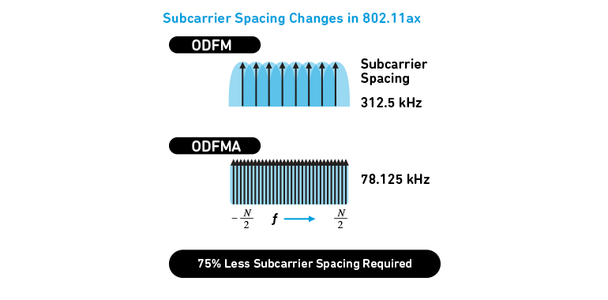
The greater density of narrower subcarriers gives 802.11ax more flexibility to control each channel

Slide 51
Subchannel Allocation
A bigger change is in the way 802.11ax uses the subchannels
Before, all subchannels were used in parallel to talk to an individual device, which monopolized the channel until it was handed over to another device
802.11ax allocates subchannels into resource units (RUs) that can be used to talk simultaneously with multiple 802.11ax clients -- up to nine on one 20MHz channel, or 74 on a 160MHz channel group
This means much lower latency and fairer distribution of bandwidth between 802.11ax clients

Slide 52
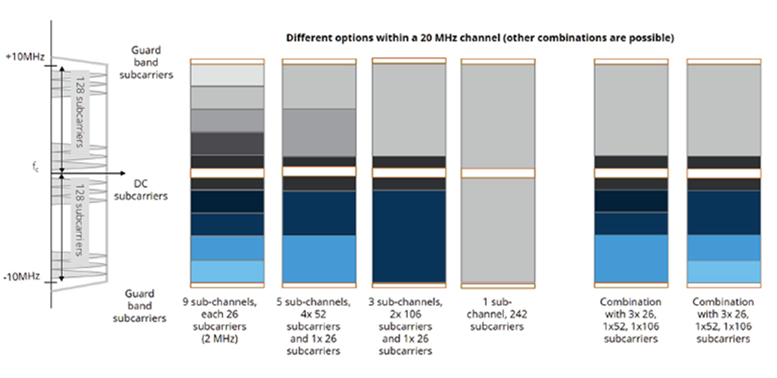
By combining different sets of subchannels, 802.11ax makes much better use of the spectrum with a high density of clients
However, one non-802.11ax client in the mix can severely downgrade this capability

Slide 53
ODFM → MU-ODFM
The old 64-subcarrier system was called Orthogonal Frequency Division Multiplex (OFDM) -- 'orthogonal' meaning the frequencies were related to each other to minimize interference between subcarriers
The new 802.11ax version is called Multi-User Orthogonal Frequency Division Multiple Access (MU-OFDMA)

Slide 54
Colors
Another major cause of slow working in dense wi-fi environments is mutual interference between access points that share the same channel, or whose channel groupings overlap
Wi-fi copes with this co-channel interference by Carrier Sense with Multiple Access Collision Avoidance (CSMA/CA): a radio wanting to transmit first listens on its frequency, and if it hears another transmission in process it waits a while before trying again
Even if two access points are too far apart from them to detect each other's transmissions directly, a client of either in between them can effectively trigger collision avoidance when one access point hears it talking to the other

Slide 55
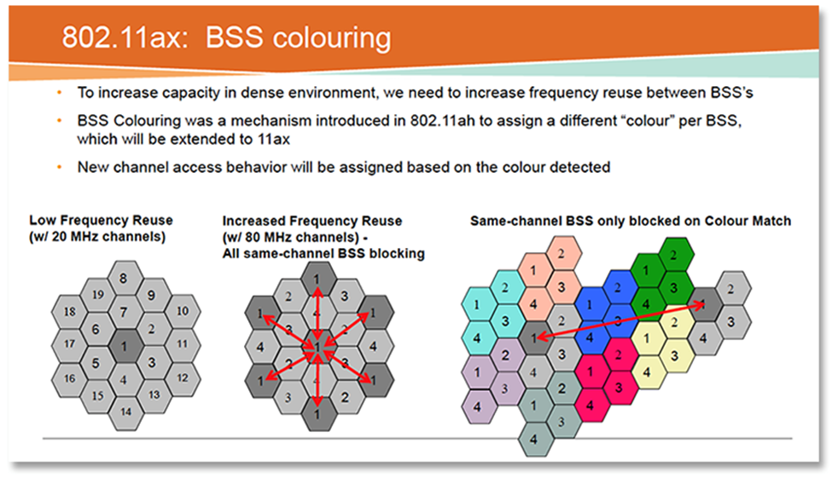
With BSS Color, different links on the same frequency can decide to ignore each other and continue if they decide the risk of interference is low, instead of backing off and potentially not using available spectrum

Slide 56
BSS Coloring
802.11ax has added a concept called BSS Color
BSS stands for Basic Service Set, which doesn't matter: it's the color that's important
This is a number between 0 and 7, and APs that are close together on the same channel should be configured to use different colors
When an AP or a client that wants to transmit picks up a signal on its channel, it can check the color code and if it's different and the signal strength is low enough to indicate a low chance of interference, go ahead with its transmission anyway
If the color is the same, or if there's no color value because the conversation is taking place between pre-802.11ax radios, then the old rules apply

