Slide 1
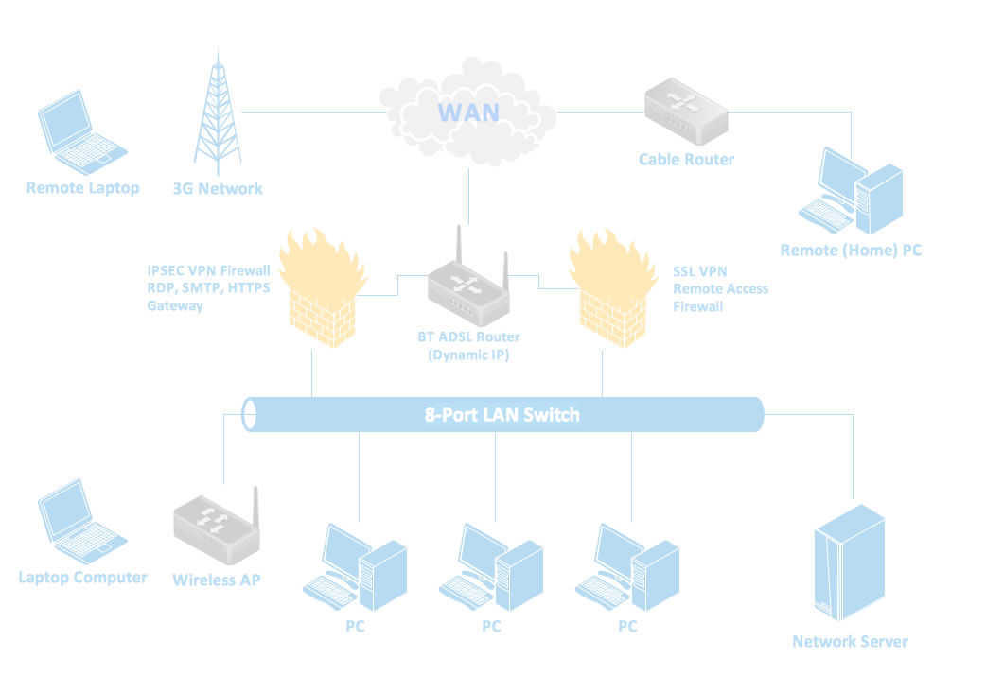
Computer Networks Part - 2
Bob Marshall, MD MPH MISM FAAFP
Program Director, DoD/MAMC CI Fellowship

Slide 2
IEEE 802
Complete IEEE 802 protocol suite provides diverse set of networking capabilities.
Protocols have flat addressing scheme.
Operate mostly at levels 1 and 2 of the OSI model

Slide 3
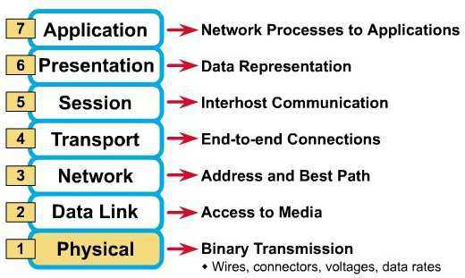
7-layer OSI Modle

Slide 4
Network Protocols
Ethernet
Often simply called LAN
Family of protocols used in wired LANs
Described by set of standards together called IEEE 802.3
Published by Institute of Electrical and Electronics Engineers (IEEE)

Slide 5
Network Protocols
Wireless Protocols/Wireless LAN
Widely known as WLAN or WiFi
Most well-known member of the IEEE 802 protocol family for home users today
Standardized by IEEE 802.11
Operate in the 2.4, 3.6, 5, and 60 GHz frequency bands.
Shares many properties with wired Ethernet

Slide 6
802.11 Protocols
The 802.11 family: series of half-duplex over-the-air modulation techniques that use the same basic protocol.
802.11b was the first widely accepted one, followed by 802.11a, 802.11g, 802.11n, and 802.11ac.
Other standards in the family (c–f, h, j) are service amendments used to extend scope of existing standard
May also include corrections to a previous specification

Slide 7
Spectrum and Speed
802.11a – 54Mb/s in 5 GHz band
802.11b – 11 Mb/s in 2.4 GHz band
Compatible with 802.11b and 802.11n protocols
802.11g – 54 Mb/s in 2.4 GHz band
802.11n – up to 1 Gb/s in 2.4 or 5 GHz bands
802.11ac – up to 1.3 Gb/s in 2.4/5 GHz bands
802.11ad – operates in 60 GHz band; up to 7 GB/s; called WiGig
802.11ax – successor to 802.11ac; operates at 4x throughput of 802.11ac (early stages)

Slide 8
Channels & Frequencies
802.11b, 802.11g, and 802.11n-2.4 utilize the 2.400–2.500 GHz spectrum, one of the ISM bands.
802.11a and 802.11n use the more heavily regulated 4.915–5.825 GHz band
2.4 GHz band divided into 14 channels spaced 5 MHz apart, beginning with channel 1, centered on 2.412 GHz.
Can result in overlap of channels/interference

Slide 9
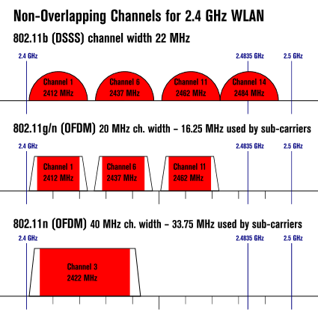
Non-Overlapping Channels

Slide 10
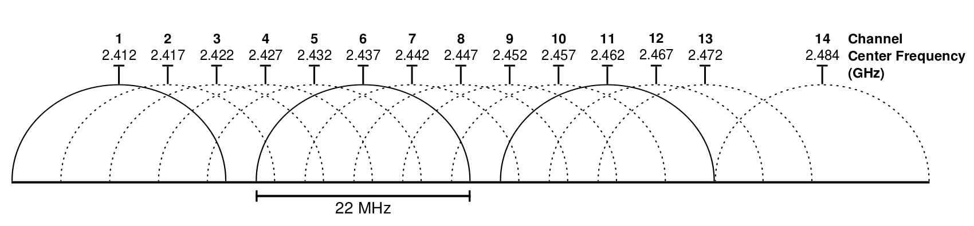
2.4 GHz Wi-Fi channels (802.11b,g WLAN)
"2.4 GHz Wi-Fi channels (802.11b,g WLAN)" by Michael Gauthier

Slide 11


Slide 12
Network Devices
Components used to connect computers or other electronic devices together so that they can share files or resources like printers or fax machines
Devices used to setup a Local Area Network (LAN) are the most common type of network devices used by the public
A LAN requires at least a hub, switch, router
Networking Devices also called Communicating Devices

Slide 13
NIC - Network Interface card
Provides the physical interface between computer and cabling
Prepares data, sends data, and controls data flow
Can also receive and translate data into bytes for the CPU to understand
Has specific MAC address (48 bit)
Ethernet is a physical and data link layer technology for local area networks (LANs)
Media Access Control (MAC) address

Slide 14
Network Device Properties
SSID: iPhone
Protocol: 802.11n
Security type: WPA2-Personal
Network band: 2.4 GHz
Network channel: 6
IPv6 address: 2600:100f:b019:5cb5:c9b4:ed3b:cd1b:f28e
IPv4 address: 172.20.10.3
Manufacturer: Marvell Semiconductor, Inc.
Description: Marvell AVASTAR Wireless-AC Network Controller
Driver version: 15.68.9040.67
Physical address (MAC): ‎4C-0B-BE-1C-FC-BE

Slide 16
Wi-Fi Signal Distance
802.11 protocol transmission ranges (indoors):
802.11b: 115 ft.
802.11a: 115 ft.
802.11g: 125 ft.
802.11n: 230 ft.
802.11ac: 230 ft.

Slide 17
Impact on Wi-Fi Signal
Solid items can greatly attenuate (weaken) communication signals..
For example….
A solid wood door will attenuate a wireless signal by 6 dB.
A concrete wall will attenuate a wireless signal by 18 dB.
Each 3 dB of attenuation represents a power loss of ½!
At 10 dB of attenuation, 90% of the signal is lost.

Slide 18
Other Wi-Fi Interference
Various home appliances like microwave ovens, cordless phones, and wireless baby monitors can all interfere with the Wi-Fi network
In addition, if there are too many Wi-Fi networks all using the same wireless channel in the same area, the “noise” can impact your signal.

Slide 19
Repeater
Network repeaters regenerate incoming electrical, wireless or optical signals
With physical media like Ethernet or Wi-Fi, data transmissions can only span a limited distance before the quality of the signal degrades
Repeaters preserve signal integrity and extend the distance over which data can safely travel
Repeaters remove unwanted noise in incoming signals
Cannot filter the signal traffic
Works in physical layer of OSI Model

Slide 21
Hubs – Active/Passive
Two types of hubs: active and passive
Passive hubs simply connect all ports together electrically; usually not powered
Active hubs use electronics to amplify and clean up signal before it is broadcast to other ports
Used to link several computers together
Repeat any signal that comes in on one port and copy it to other ports (also called broadcasting)
Works in physical Layer of OSI Model

Slide 23
Bridges
Join similar topologies; used to divide network segments
Can filter traffic on basis of MAC address
If aware of destination address, is able to forward packets; otherwise bridge will forward packets to all segments.
More intelligent than repeaters, but unable to move data across multiple networks simultaneously
Unlike repeaters, bridges can filter out noise

Slide 24
Bridges cont.
Works in Data link Layer (2) of OSI Model
Multiple collision Domain, but single Broadcast Domain
Main disadvantage: cannot connect dissimilar network types or perform intelligent path selection.
For that function, need a router
Local (LAN), remote (WAN) and wireless bridges
Remote bridges replaced by routers

Slide 26
Switches
Computer networking device that connects network segments
Populates MAC address table on the basis of source MAC address of a Frame
Network switches capable of inspecting data frames as received, determining source and destination device of frame, and forwarding it appropriately
Data Link Layer or Layer 2 Device

Slide 27
Switches cont.
Multiple collision Domain but single Broadcast Domain
Vital difference between hub and switch is that all the nodes connected to a hub share the bandwidth among themselves, while a device connected to a switch port has the full bandwidth all to itself
For example:
If 10 nodes communicating using a hub on 10- Mbps network, each node may only get a portion of 10 Mbps if other nodes on the hub want to communicate as well
With a switch, each node could possibly communicate at the full 10 Mbps
Like a multi-port bridge

Slide 29
Routers
Highly intelligent devices that connect multiple network types and determine best path for sending data (embedded software)
Normally used to connect one LAN to another
Examine incoming packets to determine data destination address
Then examines internal routing table to choose best packet pathway through network, and switches them to the proper outgoing port

Slide 30
Routers cont.
Slower than bridges because they are more intelligent devices
Analyze every packet, causing packet-forwarding delays.
Because of this intelligence, also more expensive
OSI network layer 3 devices (Internet protocol)
Typically, when WAN set up, there will be at least two routers used

Slide 31
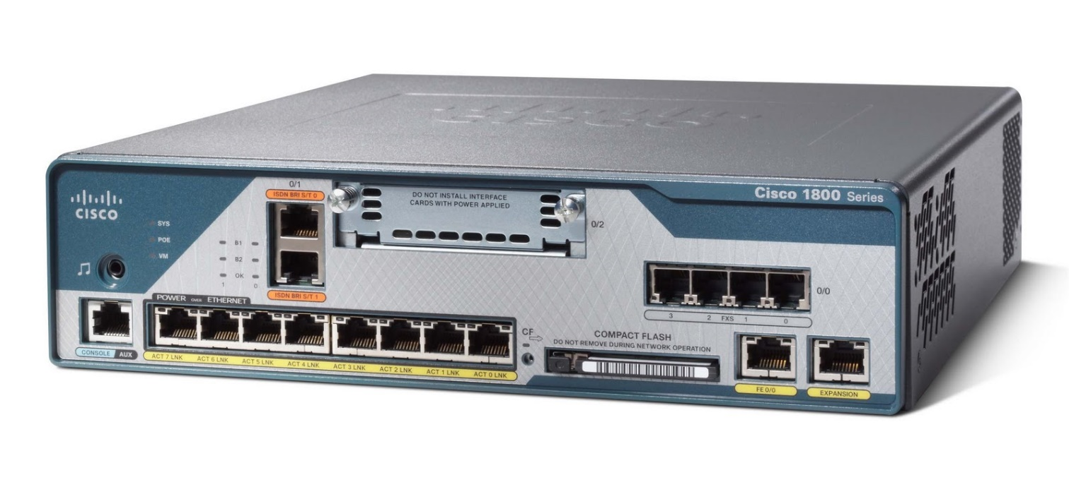

Slide 32
Modem
Modems (MOdulator-DEModulator): used to connect network nodes via wire not originally designed for digital network traffic, or for wireless
One or more carrier signals are modulated by digital signal to produce analog signal that can be tailored to give required properties for transmission
Commonly used for telephone lines, using Digital Subscriber Line technology.

Slide 34
Firewalls
Network device for controlling network security and access rules.
Typically configured to reject access requests from unrecognized sources while allowing actions from recognized ones
Vital role firewalls play in network security grows in parallel with constant increase in cyber attacks

Slide 35
Network Congestion
Network congestion occurs when a link or node is carrying so much data that quality of service deteriorates
Typical effects include queueing delay, packet loss or blocking new connections
Consequence of these latter two: incremental increases in load lead either to only small increase in network throughput, or to actual reduction in network throughput
Premise behind DDOS attacks

Slide 36
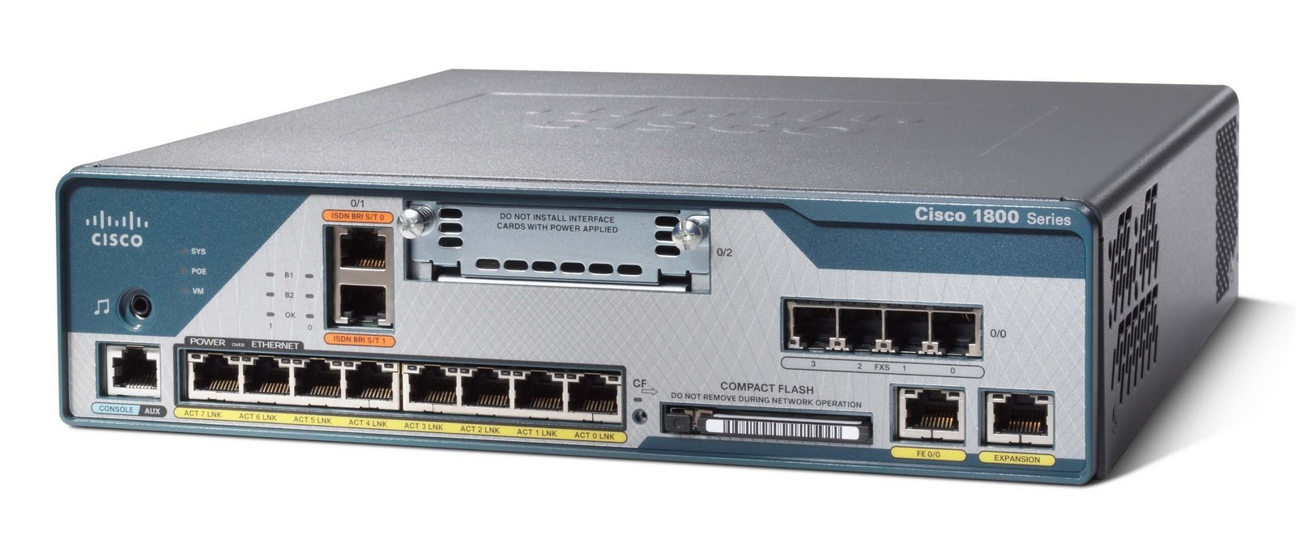
Questions

