Slide 1
Intro to Networks – Part 1
Bob Marshall, MD MPH MISM FAAFP
Program Director, DOD Clinical Informatics Fellowship

Slide 2
Computer Network
Computer or data network: telecommunications network which allows computers to exchange data
Networked computing devices exchange data with each other along network links (data connections)
Connections between nodes are established using either cable media or wireless media
The best-known computer network: the Internet
Computer networks differ in the transmission media used to carry signals, communications protocols to organize network traffic, size, topology and organizational intent

Slide 3
Every network includes:
At least two computers: Server or Client workstation (usually at least one server and one or more clients).
  For really small networks, any of today's desktops or laptops could act as a server
Networking Interface Card's (NIC): wired or wireless
A connection medium, wire/cable or wireless, between networked computers and peripherals
Network Operating system software, such as Microsoft network OS (including newer versions of Windows), Novell NetWare, Unix and Linux

Slide 4
OSI Model
The Open System Interconnection model defines a networking framework to implement protocols in seven layers
Control is passed from one layer to the next, starting at the application layer in one station, and proceeding to the bottom layer, over the channel to the next station and back up the hierarchy
It is a conceptual framework so we can better understand complex interactions that are happening in networks
The OSI model takes the task of internetworking and divides that up into what is referred to as a vertical stack that consists of the layers depicted in the following image

Slide 5
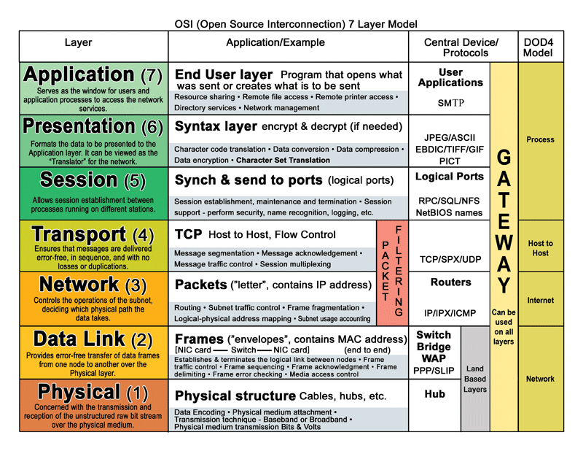

Slide 6
Network packets
Most information in computer networks is carried in packets.
  Network packet is a formatted unit of data (a list of bits or bytes, usually a few tens of bytes to a few kilobytes long) carried by a packet-switched network
  In packet networks, the data is formatted into packets that are sent through the network to their destination.
  Once the packets arrive they are reassembled into their original message.
  With packets, the bandwidth of the transmission medium can be better shared among users than if the network were circuit switched
  Packets consist of two kinds of data: control information and user data (also known as payload)

Slide 7
Network structure
Network topology is the layout or organizational hierarchy of interconnected nodes of a computer network
Different network topologies can affect throughput, but reliability is often more critical
With many technologies, such as bus networks, a single failure can cause the network to fail entirely.
In general the more interconnections there are, the more robust the network is; but the more expensive it is to install.

Slide 8
Physical versus Logical Topology
Physical topology is the placement of the various components of a network, including device location and cable installation
Logical topology illustrates how data flows within a network, regardless of its physical design
Distances between nodes, physical interconnections, transmission rates, or signal types may differ between two networks, yet their topologies may be identical

Slide 9
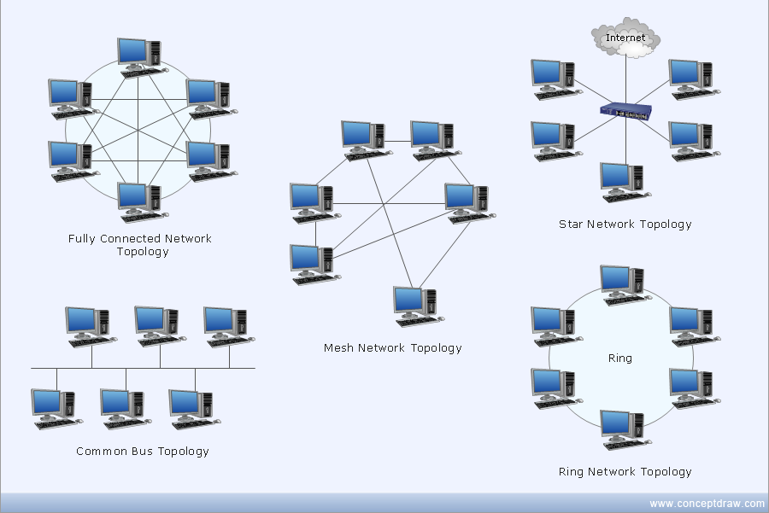
Common layouts

Slide 10
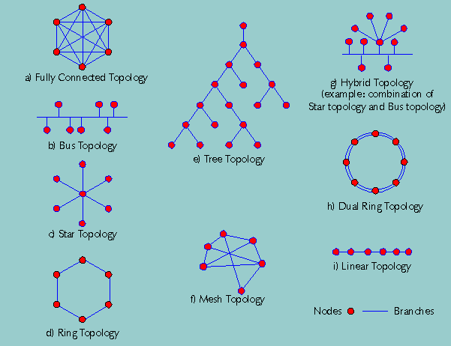
More Layouts

Slide 11
Layout explanations
Bus network: all nodes are connected to a common medium along this medium (the original Ethernet)
Star network: all nodes are connected to special central node (WLAN)
Ring network: each node connected to its left and right neighbor node; all nodes are connected and each node can reach each other node by traversing nodes left- or rightwards
Mesh network: each node is connected to an arbitrary number of neighbors so that there is at least one traversal from any node to any other
Fully connected network: each node is connected to every other node in the network.
Tree network: nodes are arranged hierarchically
Hybrid network: uses two or more topologies within its physical layout; does not represent any one topology

Slide 12
Different types of Networks (1 of 4)
Classified based on scale
LAN (Local Area Network)
  Connects computers and devices in a limited geographical area such as a home, school, office building, or closely positioned group of buildings
  Each computer or device on the network is a node.
  Wired LANs are most likely based on Ethernet technology, and wireless LAN’s are based on one of the 802.11X protocols
  The defining characteristics of a LAN include higher data transfer rates, limited geographic range, and lack of reliance on leased lines to provide connectivity.
  LAN’s can be connected to WAN’s using a router

Slide 13
Types of Networks (2 of 4)
WAN (Wide Area Network)
  Computer network that covers a large geographic area such as a city, country, or spans even intercontinental distances
  Uses a communications channel that combines many types of media such as telephone lines, cables, and air waves
  Often makes use of transmission facilities provided by common carriers, such as telephone companies
  Generally function at the lower three layers of the OSI reference model: the physical layer, the data link layer, and the network layer

Slide 14
Types of Networks (3 of 4)
SAN (Storage Area Network)
  A dedicated network that provides access to consolidated, block level data storage.
  SANs primarily used to make storage devices, such as disk arrays, tape libraries, and optical jukeboxes, accessible to servers so that the devices appear like locally attached devices to the operating system.
  Typically has its own network of storage devices not accessible through the local area network by other devices.
  Cost and complexity of SANs dropped in the early 2000s to levels allowing wider adoption across both enterprise and small to medium-sized business environments

Slide 15
Types of Networks (4 of 4)
Virtual Private Network (VPN)
  An overlay network in which some of the links between nodes are carried by open connections or virtual circuits in some larger network (e.g., the Internet) instead of by physical wires
  The data link layer protocols of the virtual network are said to be tunneled through the larger network when this is the case
  Common application - secure communications through the public Internet, but a VPN need not have explicit security features, such as authentication or content encryption
  VPNs, for example, can be used to separate traffic from different user communities over an underlying network with strong security features

Slide 16
Other network types
Personal area Network (PAN): computer network used for communication among computer and different information technological devices close to one person
Home area network (HAN): residential LAN used for communication between digital devices typically deployed in the home
Campus area network (CAN): interconnection of LANs within a limited geographical area (enterprise, university, government, etc.)
Backbone network: computer network infrastructure that provides a path for exchange of information between different LANs or sub-networks
Metropolitan area network (MAN): large computer network that usually spans a city or a large campus

Slide 17
Network protocols
The complete IEEE 802 protocol suite provides a diverse set of networking capabilities
  The protocols have a flat addressing scheme
  They operate mostly at levels 1 and 2 of the OSI model
Ethernet: family of protocols used in wired LANs, described by a set of standards together called IEEE 802.3; published by the Institute of Electrical and Electronics Engineers (IEEE)
Wireless LAN (also widely known as WLAN or WiFi): widely adopted member of the IEEE 802 protocol family for both home and business users
  Standardized by IEEE 802.11; shares many properties with wired Ethernet.

Slide 18
Internet Protocol Suite & SONET/SDH
Also called TCP/IP; the foundation of all modern networking.
  Offers connection-less as well as connection-oriented services over an inherently unreliable network traversed by datagram transmission at the Internet protocol (IP) level.
  At its core, the protocol suite defines the addressing, identification, and routing specifications for Internet Protocol Version 4 (IPv4) and for IPv6
Synchronous optical networking (SONET) and Synchronous Digital Hierarchy (SDH): standardized multiplexing protocols that transfer multiple digital bit streams over optical fiber using lasers
  Due to its protocol neutrality and transport-oriented features, was the obvious choice for transporting Asynchronous Transfer Mode (ATM) frames

Slide 19
Asynchronous Transfer Mode
ATM is a switching technique for telecommunication networks
  It uses asynchronous time-division multiplexing and encodes data into small, fixed-sized cells.
  Differs from other protocols, such as the Internet Protocol Suite or Ethernet, that use variable sized packets or frames
  Role of ATM is diminishing in favor of next generation networks; however, still plays a role in the last mile, which is the connection between an Internet service provider and the home user

Slide 20
Intranet
Set of networks under the control of a single administrative entity
The intranet uses the IP protocol and IP-based tools such as web browsers and file transfer applications
The administrative entity limits use of the intranet to its authorized users
Most commonly, an intranet is the internal LAN of an organization
A large intranet typically has at least one web server to provide users with organizational information
Also defined as anything behind the router on a local area network

Slide 21
Extranet
Network that is also under the administrative control of a single organization, but supports a limited connection to a specific external network
An organization may provide access to some aspects of its intranet to share data with its business partners or customers
These other entities are not necessarily trusted from a security standpoint
Network connection to an extranet is often, but not always, implemented via WAN technology

Slide 22
Darknet
An overlay network, typically running on the Internet, but only accessible through specialized software
An anonymizing network where connections are made only between trusted peers — sometimes called “friends” (F2F) — using non-standard protocols and ports
Distinct from other distributed peer-to-peer networks as sharing is anonymous (that is, IP addresses are not publicly shared)
Users can communicate with little fear of governmental or corporate interference or monitoring

Slide 23
Internet
Global system of interconnected governmental, academic, corporate, public and private computer networks
Based on networking technologies of the Internet Protocol Suite
Communications backbone underlying the World Wide Web
Participants use diverse array of several hundred documented, and often standardized, protocols compatible with the Internet Protocol Suite and an addressing system (IP addresses) administered by the Internet Assigned Numbers Authority and address registries
Service providers & large enterprises exchange information about the reachability of their address spaces through the Border Gateway Protocol (BGP), forming a redundant worldwide mesh of transmission paths

Slide 24

Questions

Slide 25
Back-up Slides
Advantages and Disadvantages of the Various Network Topologies

Slide 26
Bus Topology
Advantages of Bus Topology
  It is cost effective.
  Cable required is least compared to other network topologies.
  Used in small networks.
  It is easy to understand.
  Easy to expand joining two cables together.
Disadvantages of Bus Topology
  Cables fails then whole network fails.
  If network traffic is heavy or nodes are more the performance of the network decreases.
  Cable has a limited length.
  It is slower than the ring topology

Slide 27
Ring Topology
Advantages of Ring Topology
  Transmitting network is not affected by high traffic or by adding more nodes, as only the nodes having tokens can transmit data.
  Cheap to install and expand
Disadvantages of Ring Topology
  Troubleshooting is difficult in ring topology.
  Adding or deleting the computers disturbs the network activity.
  Failure of one computer disturbs the whole network

Slide 28
Star Topology
Advantages of Star Topology
  Fast performance with few nodes and low network traffic.
  Hub can be upgraded easily.
  Easy to troubleshoot.
  Easy to setup and modify.
  Only that node is affected which has failed, rest of the nodes can work smoothly.
Disadvantages of Star Topology
  Cost of installation is high.
  Expensive to use.
  If the hub fails, then the whole network is stopped because all the nodes depend on the hub.
  Performance is based on the hub that is it depends on its capacity

Slide 29
Mesh Topology
Advantages of Mesh Topology
  Each connection can carry its own data load.
  It is robust.
  Fault is diagnosed easily.
  Provides security and privacy.
Disadvantages of Mesh Topology
  Installation and configuration is difficult.
  Cabling cost is more.
  Bulk wiring is required

Slide 30
Tree Topology
Advantages of Tree Topology
  Extension of bus and star topologies.
  Expansion of nodes is possible and easy.
  Easily managed and maintained.
  Error detection is easily done.
Disadvantages of Tree Topology
  Heavily cabled.
  Costly.
  If more nodes are added maintenance is difficult.
  Central hub fails, network fails

Slide 31
Hybrid Topology
Advantages of Hybrid Topology
  Reliable as Error detecting and troubleshooting is easy.
  Effective.
  Scalable as size can be increased easily.
  Flexible.
Disadvantages of Hybrid Topology
  Complex in design.
  Costly

