Slide 1

Implementing ML in Healthcare
Go Live
Eric Shry, MD

Slide 2
Why Give This Talk?
People will want to sell you the next data “great thing”
I have advised companies who sell these things (disclosure: none now)
These products sound great
The data side is (relatively) easy, the human side (medical staff, patients) is not
I want to give you perspective on what ML is, why you might use it, and the pitfalls

Slide 3
What is Machine Learning (ML)?
ML
New (1959)
Subfield of computer science
Uses algorithms
Small to large data sets
Can have less human effort (can learn w/o programming)
Can improve predictive ability
Less understanding of inputs
More risk of over-fitting, bias
Statistical Modeling
Older (17th Century)
Subfield of mathematics
Uses equations
Small data sets
Human effort (variables, relationships)
Best estimate

Slide 5
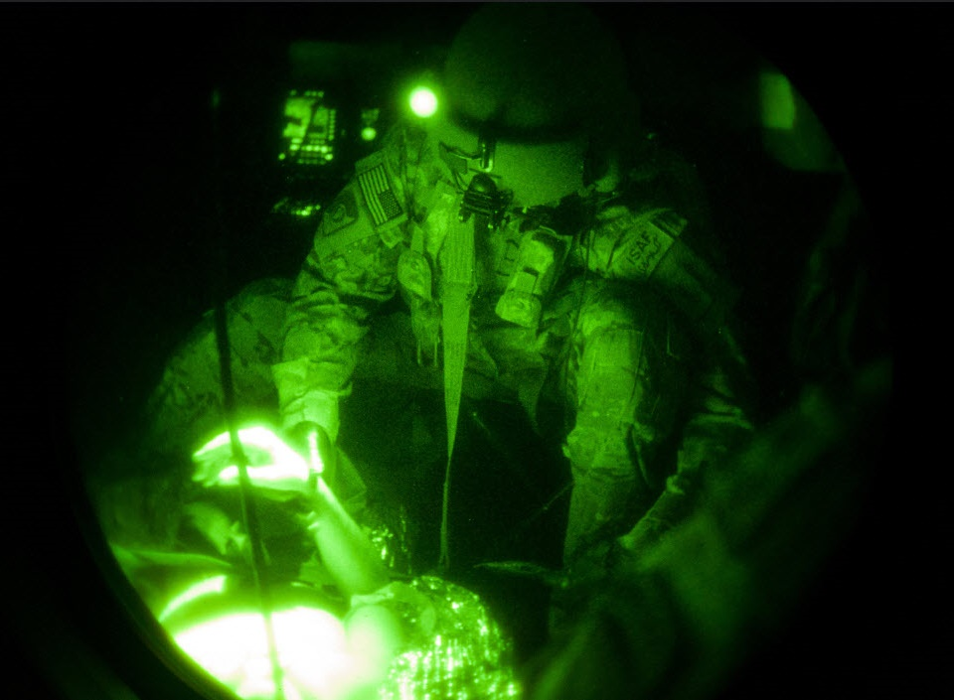
Army.mil

Slide 6
Terminology – Techniques
Supervised
Bayesian Statistics
Decision Trees
Forecasting
Neural Networks
Random Forests
Regression Analysis
Support Vector Machines
Examples: Fraud detection, image/speech/text recognition, risk assessment, customer segmentation
Semi-supervised
Same techniques, some of input data not tagged with the desired output
Examples: Speech, image recognition

Slide 7
Techniques
Unsupervised
Affinity Analysis
Clustering
Clustering: K-Means
Nearest-Neighbor Mapping
Self-Organizing Maps
Singular Value Decomposition
Examples: Anomaly/intrusion detection, identifying like things, market analysis
Reinforcement Learning
Artificial Neural Networks
Learning Automata
Markov Decision Process
Q-Learning
Examples: Gaming, robotics, navigation

Slide 8
Techniques in the News
Deep Learning – sophisticated neural networks
  Image, sound, video
Cognitive computing – understand and emulate human behavior, provide intuitive interface using many techniques
  Natural language processing and natural language generation, sentiment analysis
Ensemble Methods – combinations of models

Slide 9
Terminology Measuring Success
Test v. train datasets
  Able to use computational-intensive methods (cross validation/K-folds)
Classification Accuracy – # correct/total predictions
Confusion Matrix –TP, FP, FP, FN
Area under Curve (Receiver Operator Curve/Characteristics)
Logarithmic Loss – Penalizes false classifications
F1 Score – Harmonic Mean between precision and recall
Mean Absolute Error – Distance from prediction
Mean Squared Error – Distance from prediction, penalizing outliers
Lift – Numerical variation on ROC
Confidence Intervals/Scores

Slide 10

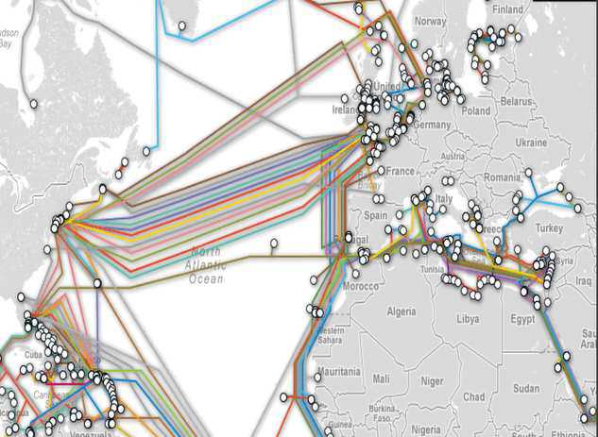
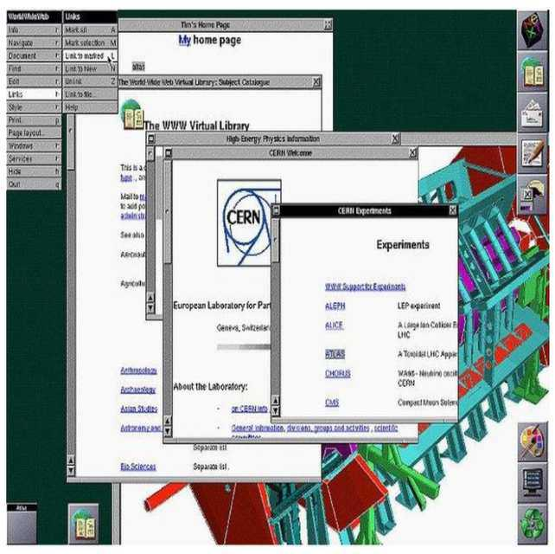
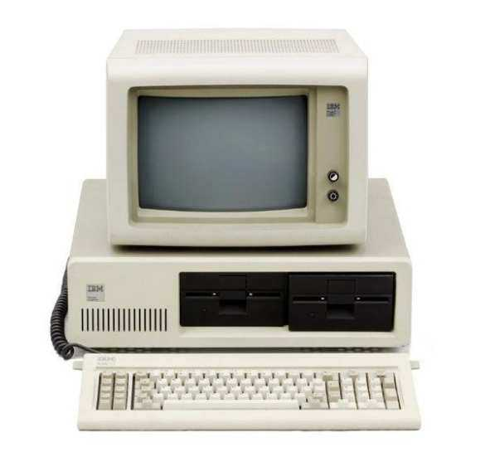
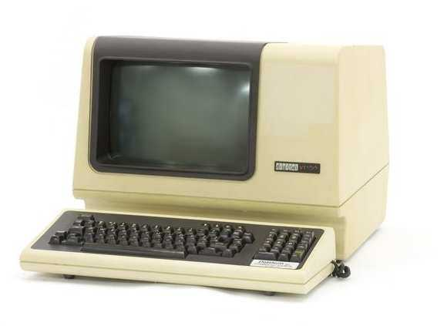
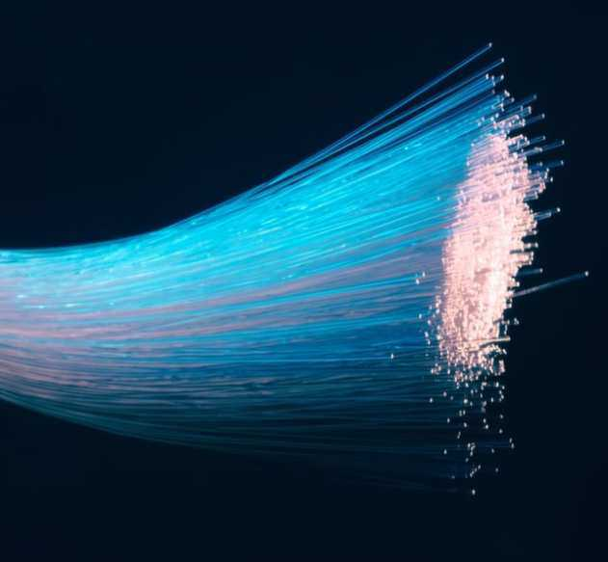
Why Now?
https://www.techspot.com/news/76900-wikileaks-dumps-amazon-data-center-locations-all-see.html
https://eos.org/research-spotlights/fiber-optic-networks-can-be-used-as-seismic-arrays
https://www.computerhistory.org/

Slide 11

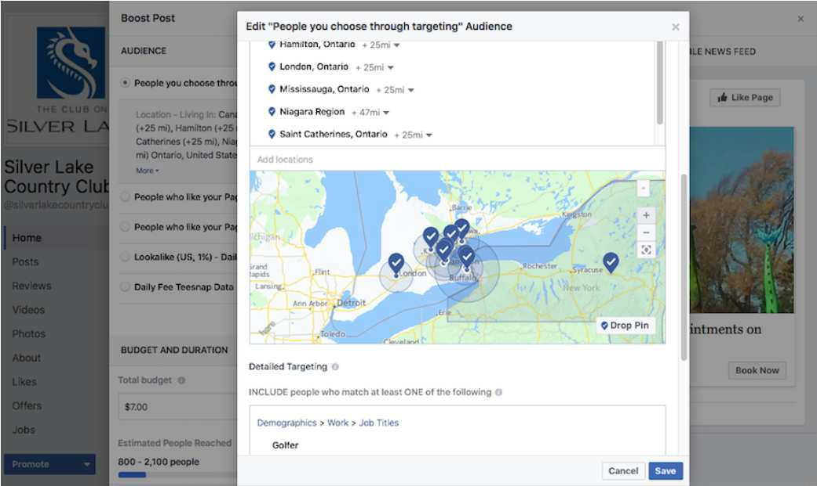
Where are we headed?
https://www.teesnap.com/

Slide 12
Your Role
If you are firing your weapon in war, something is very wrong
If you are building machine learning models, something is very wrong
You will be considered the expert on:
  Business processes targets
  Data sources
  How to implement
  How to sustain
  How to evaluate

Slide 13
When You Might Use Machine Learning
Current techniques not working
Significant data exists, high # with/without outcome variable
  Try to avoid Black Swan events
Associations not easily described by simple logical rules
Decision making changes frequently
Accuracy more important than interpretability
Data problematic for traditional techniques
  Large number of input variables (attributes)
  Highly correlated data

Slide 14
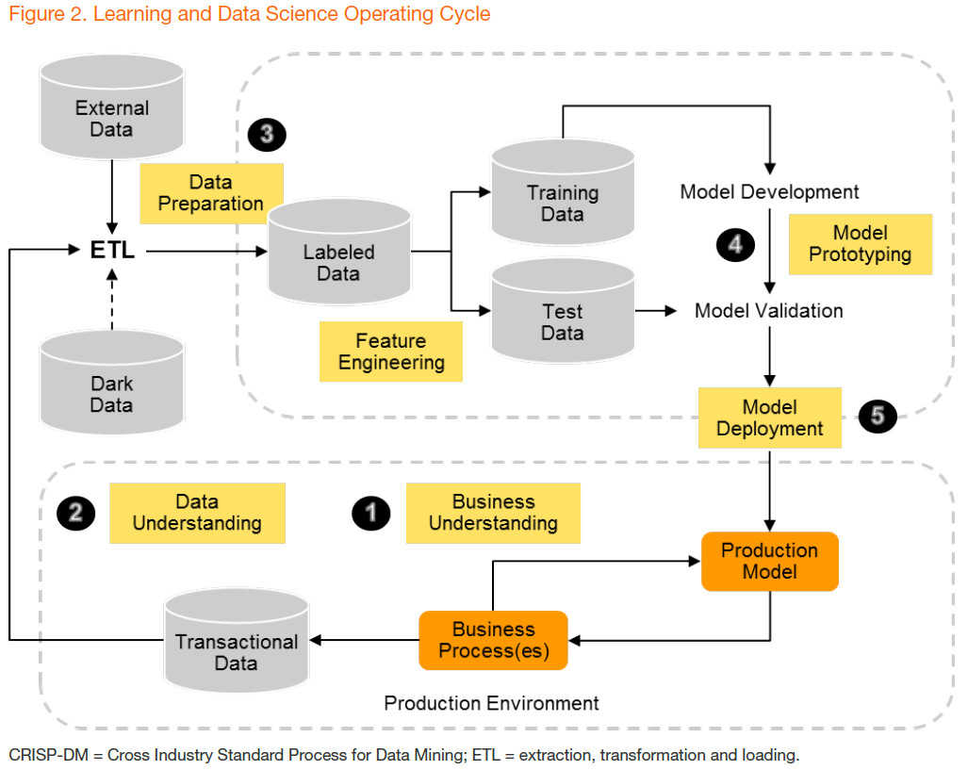
From Gartner, “Machine Learning Drives Digital Business”

Slide 15
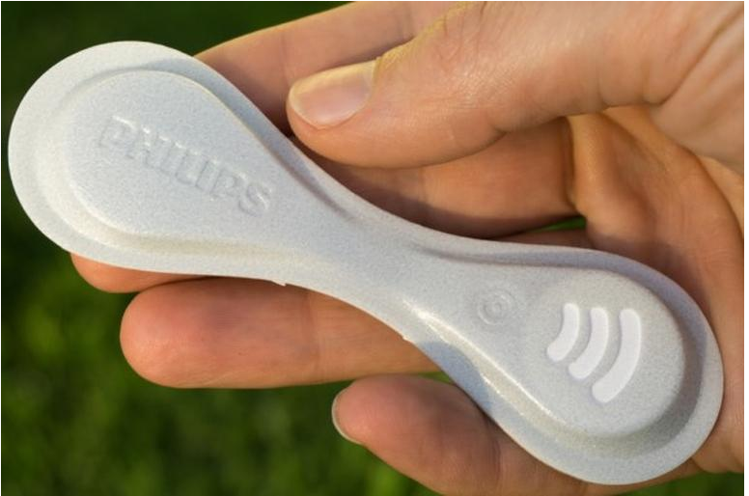
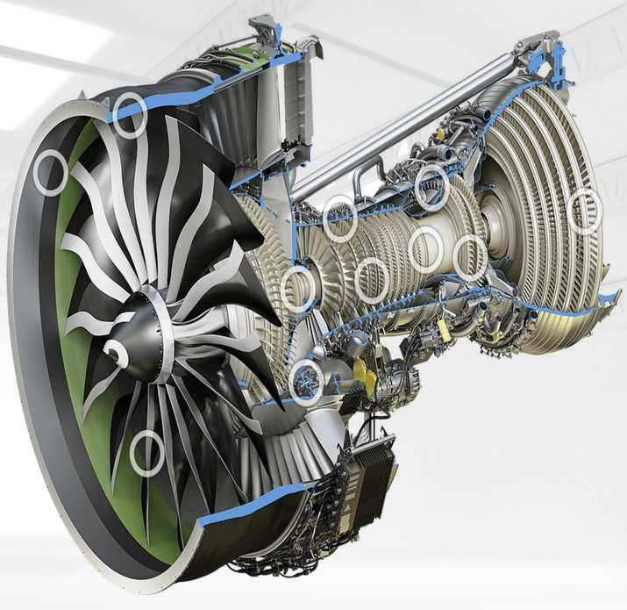
Chasing Black Swans
https://www.geaviation.com https://www.usa.philips.com/

Slide 16
Data Sources
EHR
  Structured
    Diagnoses
    Past Medical
    Past Surgical
    Allergies
    Medications
    Social
    Family
    ROS
    Exam
    Labs
    Radiology
    Billing
  Log
  Relationship
  Unstructured
    NLP
Genomics
Device
Imaging
Environmental
  Weather
  Pollution (air, water)
  Radiation
  Major stressors
    Natural disaster
    Shootings?
Personal
  Demographics
  Address
  Income
  Socioeconomic
  Compliance
  Browsing
  Social media
  Purchase
  Geospatial

Slide 17
Output Channels
Dashboard
EHR
Messaging (email, SMS)
App notification
Email
Phone
Mail
Advertising
$$$

Slide 18
Areas for Intervention
Service Providers Determine
  Staffing
  Location
  Hours of operation
  Base pay
  Covered services
  Formulary
  Case management
  Staff incentives
  Staff education
  Policies
  Initiatives
  Goals
  Patient education
Insurers Determine
  Cost
  Who to enroll
  Co-pay
  MD incentives (rate, bundled services)
  Minimum return intervals
Medical Staff Determine
  Time with patients
  Return interval
  Referral
  Prescribing
  Lab ordering
  Imaging ordering
  Patient education
  Case management

Slide 19
Areas for Intervention
Patients Determine
  Behavior
  Home
  Acquaintances and contacts
  Compliance (some)
  Engagement
  Access healthcare
  Support others/themselves
Public Policy Determines
  Coverage mandates
  Public transportation
  Health and safety limits
  Food, housing and income subsidies

Slide 20
Complexity of Action
Financial/Procurement decision
Coding/Billing/Fraud
Case Management
Care Coordination
Broad Point of Care
Low
Medium
High

Slide 21
Frequency/Dependability of Access
Financial/Procurement decision
Coding/Billing/Fraud
Point of care complex/infrequent
Care coordination
Point of care high-volume
Low
Medium
High

Slide 22
Need for Integration
Financial/Procurement decision
Coding/Billing/Fraud
Care coordination
Point of care
  Complex/infrequent
  High-volume
Clinical actions/orders
Low
Medium
High

Slide 23
Complex/Frequent/Integrated Solutions
Frequent interaction requires increasing integration with workflow
Minimize alerts (e.g. integrate, but only give info on high-risk)
Deliver to channels available at time of decision making
  Provider at point of care (e.g. EHR)
  Patient during decision making (e.g. mobile)
Make contextually aware (e.g. provider v. nurse view)
Ideally integrated with immediate action (click here to…cause action)
Not needed for infrequent, less complex/dynamic workflows (e.g. purchase decision, which charts to review or people to call that day)

Slide 24
How to Implement--Simple
Frame problem
Determine data sources
Get, clean data
Model
Prototype
Deploy
Maintain

Slide 25
How to Implement--Complex
Frame problem
Determine data sources
Get, clean data
Model
Prototype
Deploy
Maintain

Slide 26
How to Implement--Complex
Study business process/workflows
Study channels available
Anticipate business implications
Change management
Communications
Training
Project management
Contextually-aware technical plan
Systems integration
Governance
Frame problem
Determine data sources
Get, clean data
Model
Prototype
Deploy
Maintain

Slide 27
Change Management
Executive Sponsor
Champions
Benefit
  Communications
  Actual benefit
Training
Governance

Slide 28
Training
For large projects, may be substantial part of the project budget
Accurate simulation
Timing
Repetition

Slide 29
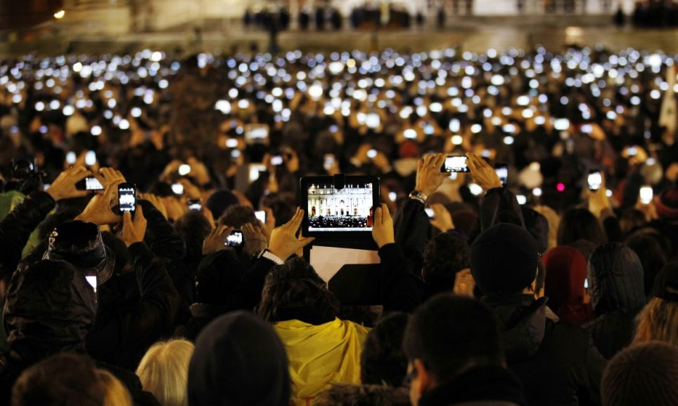
Systems Integration
Not sexy
Costly
Time-consuming
Users expect
Can start without integration
Have a roadmap

Slide 30
Governance, Sustainability, Regulatory
Data governance
  Who owns the data
  Who maintains the data
Model governance
  Transparency
  EU GDPR, FDA regulation
EHR governance (or other source/target system)
Health system governance
  Personnel needs
  Technical needs

Slide 31
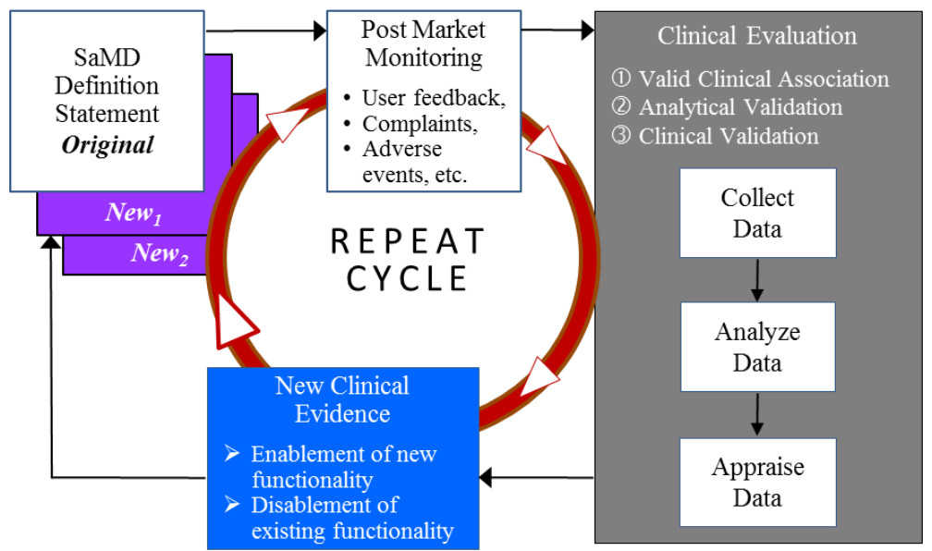
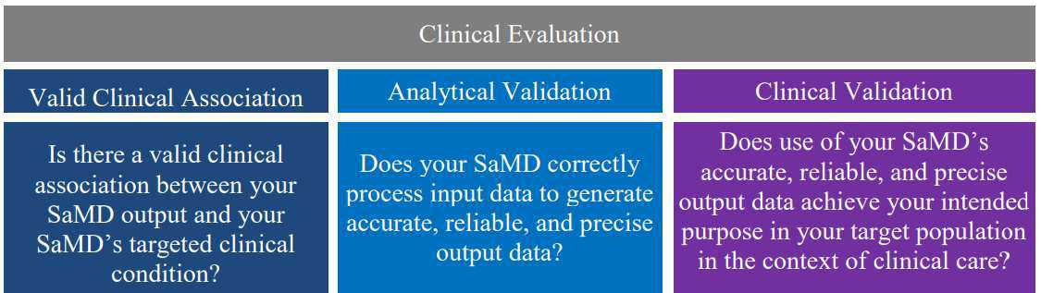
https://www.fda.gov/downloads/MedicalDevices/DeviceRegulationandGuidance/GuidanceDocuments/UCM524904.pdf

Slide 32
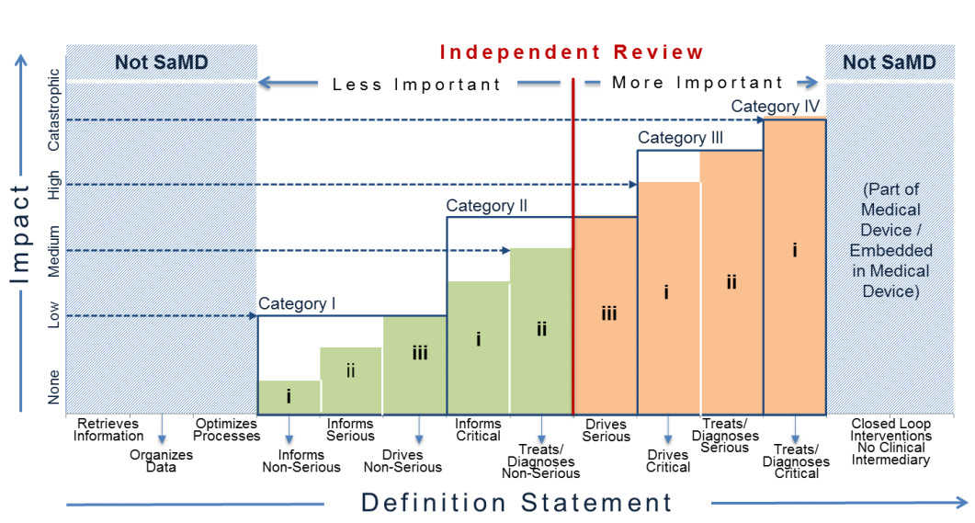
https://www.fda.gov/downloads/MedicalDevices/DeviceRegulationandGuidance/GuidanceDocuments/UCM524904.pdf

Slide 33
Summary
Machine learning is cool
There are many considerations other than the model
Spend some time learning about assessing the technology
Have a plan

