Slide 1
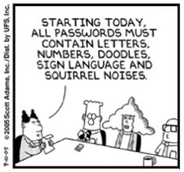
IT Security
Bob Marshall, MD MPH MISM FAAFP Program Director, DoD/MAMC Clinical Informatics Fellowship

Slide 2
Learning Objectives
Review Health IT Security Methods
HIPAA Review
Overview
Security Rule
Privacy Rule
VPN Review
Encryption Review
Discuss Security Best Practices

Slide 3
Health IT Security Methods
HIPAA
Regulations in Meaningful Use/MACRA/MIPS
Firewalls
Virtual Private Networks
Encryption
Security Best Practices

Slide 4
HIPAA
Health Insurance Portability and Accountability Act of 1996
Enacted by the United States Congress and signed by President Bill Clinton in 1996.
It was created primarily to modernize the flow of healthcare information, stipulate how Personally Identifiable Information maintained by the healthcare and healthcare insurance industries should be protected from fraud and theft, and address limitations on healthcare insurance coverage.
It has been known as the Kennedy–Kassebaum Act or Kassebaum–Kennedy Act after two of its leading sponsors.

Slide 5
The Act consists of five Titles.
Title I of HIPAA protects health insurance coverage for workers and their families when they change or lose their jobs
Title II of HIPAA, known as the Administrative Simplification (AS) provisions, requires the establishment of national standards for electronic health care transactions and national identifiers for providers, health insurance plans, and employers
Title III sets guidelines for pre-tax medical spending accounts
Title IV sets guidelines for group health plans
Title V governs company-owned life insurance policies

Slide 6
HIPAA Privacy Rule
The HIPAA Privacy Rule regulates the use and disclosure of protected health information (PHI) held by "covered entities" (generally, health care clearinghouses, employer-sponsored health plans, health insurers, and medical service providers that engage in certain transactions)
By regulation, the HHS extended the HIPAA privacy rule to independent contractors of covered entities who fit within the definition of "business associates"

Slide 7
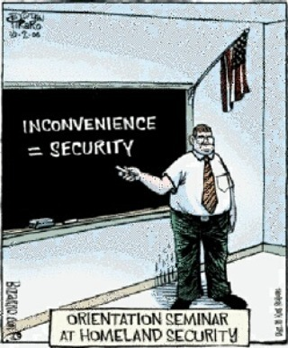

Slide 8
HIPAA Security Rule
The Security Rule complements the Privacy Rule
While the Privacy Rule pertains to all Protected Health Information (PHI) including paper and electronic, the Security Rule deals specifically with Electronic Protected Health Information (EPHI)
It lays out three types of security safeguards required for compliance: administrative, physical, and technical
For each of these types, the Rule identifies various security standards, and for each standard, it names both required and addressable implementation specifications
Required specifications must be adopted and administered as dictated by the Rule

Slide 9
Administrative Controls
Defined as policies and procedures designed to clearly show how the entity will comply with the act. Examples include:
Development of a written plan outlining privacy procedures.
Designating an individual as a privacy/HIPAA compliance officer.
Ensuring employees who only have a "need to know" have access to PHI
Developing a process for authorizing, establishing and modifying access for employees, as well as how to terminate access to information when required.

Slide 10
Administrative Controls
Examples continued:
Offering ongoing training
Ensuring third-party compliance
Developing a contingency plan
Performing internal audits
Developing a security breach response plan

Slide 11
Technical Controls
Defined as the technology and the policy and procedures that protect electronic protected health information and control access to it. These technical controls include requirements for:
Data encryption
Unauthorized change alerts
Data corroboration and methods to check data integrity.
Authenticating users

Slide 12
Technical Controls
Additional requirements:
Documented practices and procedures
Configuration setting tracking and management.
Risk analysis and management plans

Slide 13
Physical Controls
These are the physical measures, policies and procedures to protect the covered entities electronic information systems and related buildings and equipment, from natural and environmental hazards as well as unauthorized intrusion. Physical controls include:
Proper disposal of equipment
Proper scanning of equipment prior to addition to network
Limiting, controlling and monitoring of authorized users access to hardware and software

Slide 14
Physical Controls
Additional physical controls:
Signing in of all visitors
Development of a physical security plan
Ensuring devices and screens are placed out of you by a passerby

Slide 15
Risk Analysis
Risk analysis and management is a required component of the Security Rule
Performing a risk analysis helps an entity determine reasonable and appropriate security measures
RA can help the entity choose the direction to take when implementing safeguards
Risk analysis and management allows entities the ability to monitor, measure and manage the security measures put in place to protect e-PHI

Slide 16
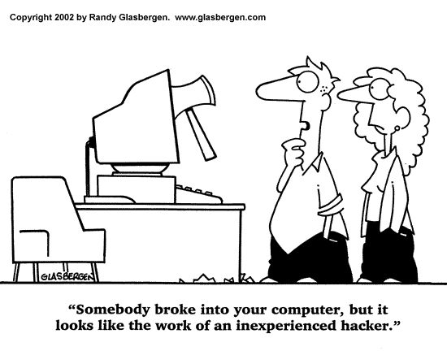

Slide 17
Risk Analysis Components
An evaluation of the likelihood and probability of a potential risk to e-PHI
The implementation of appropriate security measures to address identified risks
Documentation and explanation for adoption (when appropriate) of chosen security measures
Continuing to maintain reasonable and appropriate security considerations

Slide 18
Meaningful Use Security Controls
Under meaningful use, there are 2 core objectives that focus on privacy and security:
Core Objective 12: provide patients with an electronic copy of their health information (including diagnostic test results, problem list, medication list, medication allergies) upon request
Core Objective 15: protect electronic health information created or maintained by this certified EHR technology through the implementation of appropriate technical capabilities

Slide 19
Virtual Private Networks
VPNs extend the benefits of a private network across a public one (like the Internet)
Using a VPN ensures that your Internet connection is secured in all send and receive data is encrypted
VPNs offer the following security benefits:
Confidentiality: even if an attacker tries to "sniff" your data, they can't because even packet level data is encrypted.
Authentication: only authenticated users can access the VPN
Integrity: any attempt at tampering with messages can be detected

Slide 20
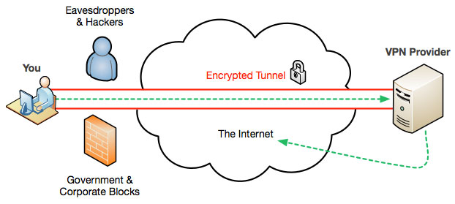
Image of VPN

Slide 21
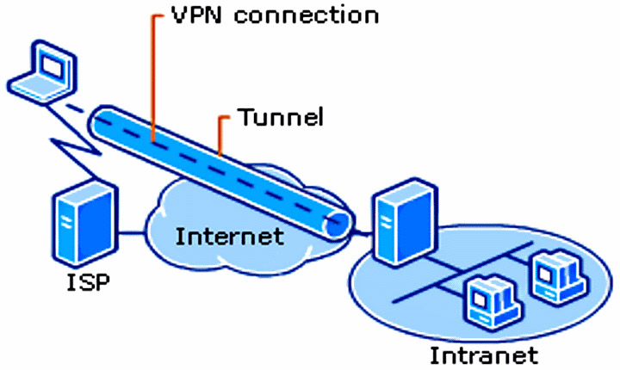
Another VPN Diagram

Slide 22
Encryption
Encryption encodes messages so that only those authorized to access information may do so
Encryption encodes plaintext into ciphertext using a pseudo-random encryption key
Encryption keys and decryption keys specify how the transformation between plaintext and ciphertext occurs
In symmetric encryption, both computers have the same encryption and decryption keys.

Slide 23
Encryption
In asymmetric encryption (commonly referred to as public-key encryption or public-key infrastructure), the keys used by each party are different.
In public-key encryption, only the receiving party may decrypt data using a decryption key.
In this encryption method, public keys, encrypt data while private keys decrypt data

Slide 24
Encryption
Encryption can be implemented with any of the 3 states of data: data arrests, data in use in data in motion
Data at rest is data that is stored in persistent storage, such as a hard drive or on tape.
Data in use refers to data being processed by a CPU or in RAM
Data in motion refers to data that is being transported such as data moving be a email, web or Internet protocol
Encryption is most commonly used to protect data in motion

Slide 25
Data at Rest Encryption
With the use of mobile devices that store data at rest, there is increasing need to encrypt data at rest in case of device loss, theft or unauthorized use.
To best protect data at rest, the following best practices should be followed:
Use IPSec, AES, RSA or SHA-256 encryption for data at rest.
Encrypted data should remain encrypted if authentication fails
Only store the minimum amount of sensitive data

Slide 26
Data at Rest Encryption
Store encryption keys away from the data
Schedule regular security audits.
Use cryptography on databases holding sensitive information in on the physical devices that hold the databases

Slide 27
Security Best Practices
Encrypt your data
Do not allow removable media on your network
Use SSL or TLS on your website and scan daily for threats
Use spam filters
Install and use a comprehensive security solution
Keep up-to-date on all security patches
Train your personnel on security and commonly used tactics like social engineering and phishing
Implement data loss prevention and system audits to watch inflow/outflow on your network

Slide 28
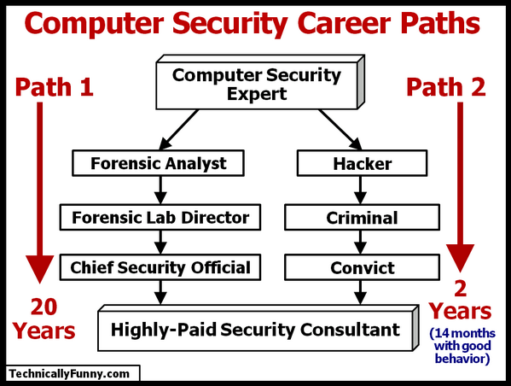
Questions

