Slide 1

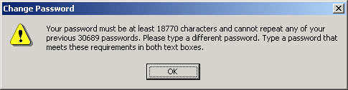
IT Risk Assessment
Bob Marshall, MD MPH MISM FAAFP Program Director, DoD/MAMC Clinical Informatics Fellowship

Slide 2
Learning Objectives
Provide overview of IT Risk Assessment
Discuss what Risk is
Run through the 9 steps of an IT Risk Assessment
Summarize and questions

Slide 3
Getting Started
To get started with IT security risk assessment, you need to answer three important questions:
What are your organization’s critical information technology assets — that is, the data whose exposure would have a major impact on your business operations?
What are the top five business processes that utilize or require this information?
What threats could affect the ability of those business functions to operate?

Slide 4
Developing Strategies
Once you know what you need to protect, you can begin developing strategies
Before spending a dollar of your budget or an hour of your time implementing a risk reduction solution, you need to answer the following questions:
What is the risk you are reducing?
Is it the highest priority security risk?
Are you reducing it in the most cost-effective way?
These questions get to the heart of the problem — it is all about risk

Slide 5
What is Risk?
Risk is a business concept — is the likelihood of “financial” loss for the organization high, medium, low or zero?
Three factors play into risk determination: what the threat is; how vulnerable the system is; and the importance of the asset that could be damaged or made unavailable.
Thus, risk can be defined as follows:
Risk = Threat x Vulnerability x Asset
Risk is a logical concept, not a math concept

Slide 6
Two Special Cases
Anything times zero is zero.
If any of the factors is zero, even if the other factors are high or critical, your risk is zero.
Risk implies uncertainty.
If something is guaranteed to happen, it is not a risk.

Slide 7
Common Ways to suffer Damage
Data Loss
System or Application Downtime
Legal Consequences
HIPAA and data breaches, for example

Slide 8
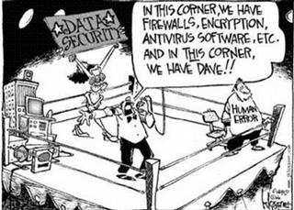
Risk Assessment Process

Slide 9
Step 1: Identify and Prioritize Assets 1 of 2
Assets include servers, contact information, sensitive partner documents, secrets and so on.
Remember, what you as an Informaticist think is valuable might not be what is actually most valuable for the organization.
Therefore, you need to work with end users and management to create a list of all valuable assets.
Because most organizations have a limited budget for risk assessment, you will likely have to limit the scope of the project to mission-critical assets.

Slide 10
Step 1: Identify and Prioritize Assets 2 of 2
Accordingly, you need to define a standard for determining the importance of each asset.
Common criteria include the asset’s monetary value, legal standing and importance to the organization and its mission.
Once the standard has been approved by management and formally incorporated into the risk assessment security policy, use it to classify each asset you identified as critical, major or minor

Slide 11
Step 2: Identify Threats
A threat is anything that could exploit a vulnerability to breach security and cause harm to your organization.
While hackers and malware probably leap to mind, there are many other types of threats:
Natural Disasters
System Failure
Accidental Human Interference (Dave)
Malicious Humans
Interference – DDoS; deleting data; physical theft
Interception – classic hacking
Impersonation – stealing and misusing someone’s credentials

Slide 12
Step 3: Identify Vulnerabilities
Vulnerabilities can be identified through vulnerability analysis, audit reports, the NIST vulnerability database, vendor data, computer incident response teams and system software security analysis
Testing the IT system is also an important tool in identifying vulnerabilities.
Testing can include the following:
Information Security test and evaluation (ST&E) procedures
Penetration testing techniques
Automated vulnerability scanning tools

Slide 13
Step 4: Analyze Controls
Analyze the controls that are in place, or in the planning stage, to minimize or eliminate the probability that a threat will exploit vulnerability in the system (now or in the near term).
Controls can be implemented through technical means, such as computer hardware or software, encryption, intrusion detection mechanisms, and identification and authentication subsystems.
Nontechnical controls include security policies, administrative actions, and physical and environmental mechanisms.
Both technical and nontechnical controls can further be classified as preventive or detective controls.

Slide 14
Step 5: Determine Likelihood of an Incident
Assess the probability that a vulnerability might actually be exploited, taking into account the type of vulnerability, the capability and motivation of the threat source, and the existence and effectiveness of your controls.
Rather than a numerical score, many organizations use the categories high, medium and low to assess the likelihood of an attack or other adverse event.

Slide 15
Step 6: Assess Potential Threat Impact 1 of 2
Impact analysis should include the following factors:
The mission of the system, including the processes implemented by the system
The criticality of the system, determined by its value and the value of the data to the organization
The sensitivity of the system and its data
The information required to conduct an impact analysis can be obtained from existing organizational documentation, including a business impact analysis (BIA) (or mission impact analysis report, as it is sometimes called)

Slide 16
Step 6: Assess Potential Threat Impact 2 of 2
An attack or adverse event can result in compromise or loss of information system confidentiality, integrity and availability.
As with the likelihood determination, the impact on the system can be qualitatively assessed as high, medium or low.
The following additional items should be included in the impact analysis:
The estimated frequency of the threat’s exploitation of a vulnerability on an annual basis
The approximate cost of each of these occurrences
A weight factor based on the relative impact of a specific threat exploiting a specific vulnerability

Slide 17
Step 7: Prioritize Information Security Risks 1 of 2
For each threat/vulnerability pair, determine the level of risk to the IT system, based on the following:
The likelihood that the threat will exploit the vulnerability
The impact of the threat successfully exploiting the vulnerability
The adequacy of the existing or planned information system security controls for eliminating or reducing the risk

Slide 18
Step 7: Prioritize Information Security Risks 2 of 2
A useful tool for estimating risk in this manner is the risk-level matrix.
A high likelihood that the threat will occur is given a value of 1.0; a medium likelihood is assigned a value of 0.5; and a low likelihood of occurrence is given a rating of 0.1.
Similarly, a high impact level is assigned a value of 100, a medium impact level 50, and a low impact level 10.
Risk is calculated by multiplying the threat likelihood value by the impact value, and the risks are categorized as high, medium or low based on the result.

Slide 19
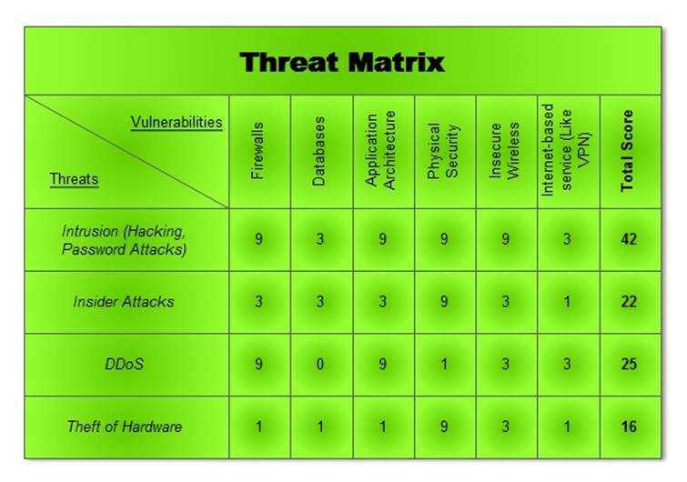

Slide 20
Step 8: Recommend Controls
Using the risk level as a basis, determine the actions that senior management and other responsible individuals must take to mitigate the risk.
Here are some general guidelines for each level of risk:
High— A plan for corrective measures should be developed as soon as possible.
Medium — A plan for corrective measures should be developed within a reasonable period of time.
Low — The team must decide whether to accept the risk or implement corrective actions

Slide 21
Step 9: Document Results
The final step in the risk assessment process is to develop a risk assessment report to support management in making appropriate decisions on budget, policies, procedures and so on.
For each threat, the report should describe the corresponding vulnerabilities, the assets at risk, the impact to your IT infrastructure, the likelihood of occurrence and the control recommendations
You can use your risk assessment report to identify key remediation steps that will reduce multiple risks.
Each of these steps should have the associated cost and should deliver real benefit in reducing the risks

Slide 22
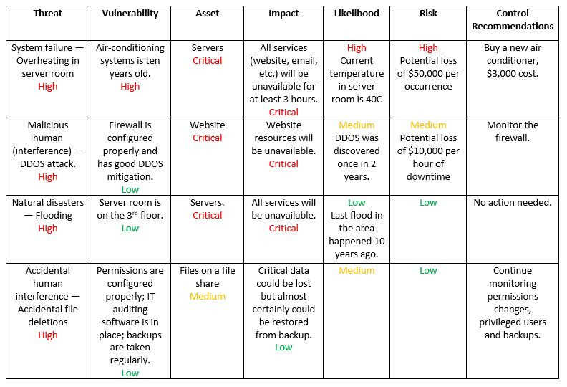

Slide 23
Summary
Always keep in mind that the information security risk assessment and enterprise risk management processes are the heart of the cybersecurity.
These are the processes that establish the rules and guidelines of the entire informational security management, providing answers to what threats and vulnerabilities can cause financial harm to our business and how they should be mitigated

Slide 24

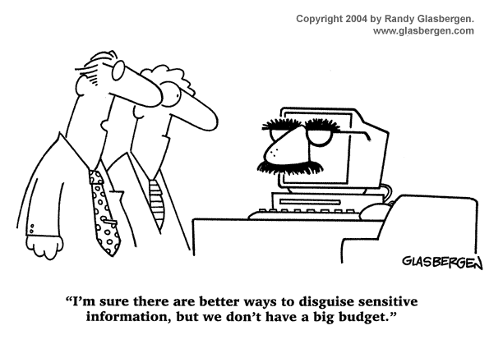
Questions

