Slide 1
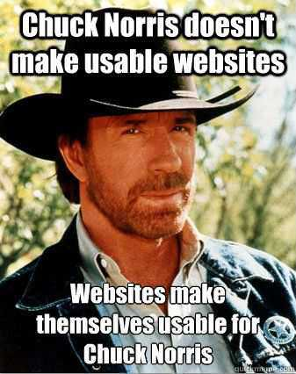
EHR Usability
Bob Marshall
Program Director, CI Fellowship

Slide 2
Learning Objectives
Review the definitions of usability
What constitutes good usability
Characteristics of good user interfaces/heuristics
Usability issues with EHR’s
Patient safety and EHR’s
Usability testing tools/methods
Usability questionnaires

Slide 3
Usability Defined
According to the HIMSS EHR Usability Task Force, usability is the “effectiveness, efficiency and satisfaction with which specific users can achieve a specific set of tasks in a particular environment.”
An EHR with high usability is easy to use, effective, intuitive, forgives mistakes and encourages users to perform important tasks efficiently and quickly.
If tasks like data retrieval, crosschecking, organization, summarizing or calculating can be done in the background, then accuracy is improved and the user’s mind is less cluttered.

Slide 4
What Constitutes Good Usability?
Since usability stems from understanding the needs of users, using established design elements and performing user testing further ensures usability.
In order to assess usability, focus on three basic criteria:
  Effectiveness (success/failure)
  Efficiency (time to completion)
  Error Prevention

Slide 5
Nielsen Usability Heuristics 1 of 4
Visibility of system status
  The system should always keep users informed about what is going on, through appropriate feedback within reasonable time
Match between system and the real world
  The system should speak the users' language, with words, phrases and concepts familiar to the user, rather than system-oriented terms
  Follow real-world conventions, making information appear in a natural and logical order
User control and freedom
  Users often choose system functions by mistake and will need a clearly marked "emergency exit" to leave the unwanted state without having to go through an extended dialogue; support undo and redo

Slide 6
Nielsen Usability Heuristics 2 of 4
Consistency and standards
  Users should not have to wonder whether different words, situations, or actions mean the same thing.
Error prevention
  Even better than good error messages is a careful design which prevents a problem from occurring in the first place.
  Either eliminate error-prone conditions or check for them and present users with a confirmation option before they commit to the action
Recognition rather than recall
  Minimize the user's memory load by making objects, actions, and options visible.
  The user should not have to remember information from one part of the dialogue to another.

Slide 7
Nielsen Usability Heuristics 3 of 4
Flexibility and efficiency of use
  Accelerators — unseen by the novice user — may often speed up the interaction for the expert user such that the system can cater to both inexperienced and experienced users
  Allow users to tailor frequent actions
Aesthetic and minimalist design
  Dialogues should not contain information which is irrelevant or rarely needed
  Every extra unit of information in a dialogue competes with the relevant units of information and diminishes their relative visibility

Slide 8
Nielsen Usability Heuristics 4 of 4
Help users recognize, diagnose, and recover from errors
  Error messages should be expressed in plain language (no codes), precisely indicate the problem, and constructively suggest a solution
Help and documentation
  Even though it is better if the system can be used without documentation, it may be necessary to provide help and documentation
  Any such information should be easy to search, focused on the user's task, list concrete steps to be carried out, and not be too large

Slide 9
NCCD and Usability
The National Center for Cognitive Informatics and Decision Making in Healthcare (NCCD) defines usability based on its TURF (Task, User, Representation, and Function) framework as “how useful, usable, and satisfying a system is for the intended users to accomplish goals in the work domain by performing certain sequences of tasks.”
Within the TURF framework there are three dimensions and measures of usability:
  Useful
  Usable
  Satisfying

Slide 10
NCCD and Useful
Useful refers to “how well the system supports the work domain where the users accomplish the goals for their work, independent of how the system is implemented.”
A system is useful if it contains the domain functions necessary and only those functions that are essential for the work
Useful is measured by the “percentage of domain functions in the EHR vs. all domain functions in the work domain and percentage of domain functions over all functions (domain and nondomain) in the EHR

Slide 11
NCCD and Usability 1 of 2
Usable refers to whether a system “is easy to learn, easy to use, and error-tolerant.”
Usable may be measured by learnability, efficiency, and error tolerance
  Learnability is how quickly a new or novice user learns or relearns the user interface to conduct basic tasks.
    it is dependent on the consistency of the interface and the ability of the interface to allow exploratory learning by including undo or cancel functions
  Efficiency is defined as the speed with which a user can complete a task or accomplish a goal
    It is typically measured by the length of time required to complete a task, task success, number of keystrokes, and number of screens visited

Slide 12
NCCD and Usability 2 of 2
  Error tolerance refers to the ability of the system to help users avoid and recover from error
    Examples of error measurement include frequency of errors and recovery rate of errors

Slide 13
NCCD and Satisfying
Satisfying consists of a set of subjective measures regarding a user’s perception of a system’s usefulness and impact and how likable a system is
The main measures include instruments and interviews that may measure the users’ perception of a system

Slide 14
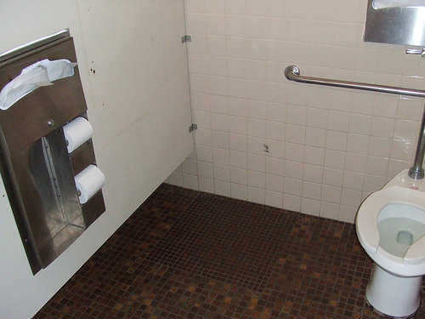

Slide 15
Usability Issues in EHR’s 1 of 2
Poor organization and display of information
  Limited screen space and poor interface design of some systems add to clinician’s cognitive workload and increase the risk of errors
Interference with practice workflow
  A chief complaint about EHR systems is that they do not integrate well with user workflows
Increases in cognitive burden
  When combined, time pressures, conflicting demands, and information burden can lead to cognitive overload
  The likelihood of errors increases when EHR systems do not adequately support the mental models of physicians
  A lack of standard clinical nomenclatures, or poor implementation of these nomenclatures within EHRs, makes information search and retrieval difficult across systems

Slide 16
Usability Issues in EHR’s 2 of 2
Poor design of system function
  The challenges EHRs pose to clinician’s workflow may stem from the design of EHR functions
  Poor documentation capability at the point of care affects the quality of information to support health care decisions as well as other key activities including compliance, external reporting (such as population health and surveillance activities), and billing
  Management of test results is another area of particular concern for health care providers
  Well-designed ordering capabilities are important to clinicians

Slide 17
Desired Features in EHR’s
Support team-based care
Promote care coordination
Offer product modularity and configurability
Reduce cognitive workload
Promote interoperability and data exchange
Facilitate digital patient engagement
Expedite user input into product design and post-implementation feedback
  From the AMA Professional Satisfaction and Practice Sustainability Initiative

Slide 18
EHR’s and Patient Safety 1 of 2
Problem 1: Inadequate testing requirements
  All EHR vendors should meet minimum standards for formative, summative, and post-implementation testing
  ONC should incorporate the standards for formative, summative, and post-implementation testing as requirements in EHR certification criteria
Problem 2: Insufficient measures of EHR safety and usability
  Vendors, hospitals, clinicians, and patient safety advocates should prioritize developing measures called for by NQF, and these measures should be funded by the federal government, foundations with an interest in patient safety, or private sector stakeholders

Slide 19
EHR’s and Patient Safety 2 of 2
Problem 3: Inability to learn from EHR usability and safety issues
  Create an organization that can facilitate the sharing of providers’ experiences—without fear of violating a gag clause—and can systematically examine EHR-related issues reported by providers and vendors at the national level
  Both the Institute of Medicine and ONC have called for the establishment of such a group
Results from a Pew Charitable Trusts meeting in July 2015

Slide 20
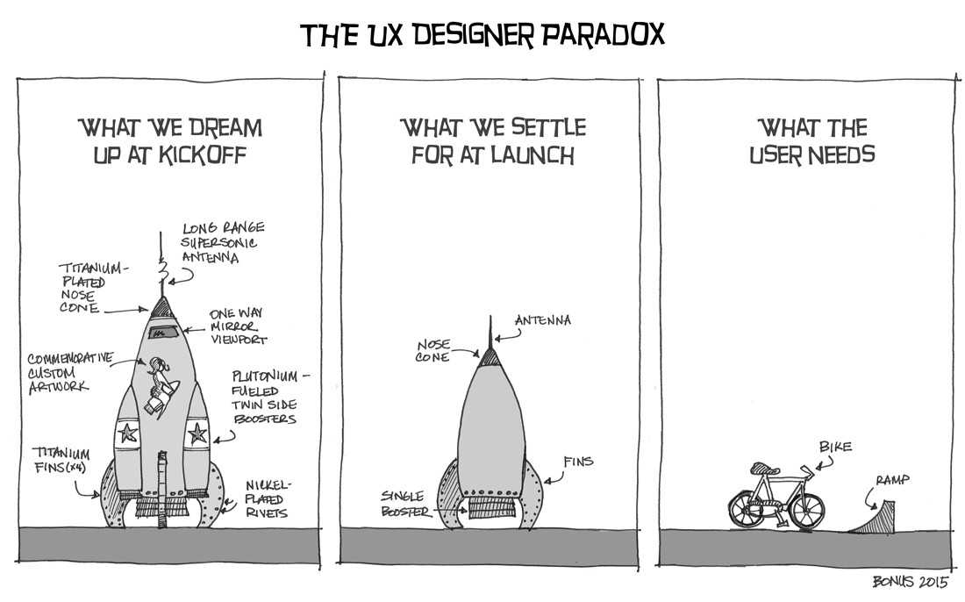

Slide 21
Usability Evaluation Methods 1 of 4
Heuristic Evaluation
  It is an inspection method that can prospectively uncover problems with a user interface, indicate the severity of the problems, and make suggestions for fixing the problems
Cognitive Walkthrough
  a usability inspection method that compares the users’ and designers’ conceptual model and can identify numerous problems within an interface
  It can be used to evaluate an interface for ease of learning and to disclose many problems that a first-time user would encounter with system functionality and ease of system use

Slide 22
Usability Evaluation Methods 2 of 4
Laboratory Testing
  It is considered the gold standard of usability engineering methods
  Lab-based usability testing includes both qualitative and quantitative studies since it collects both objective data such as performance metrics and subjective data such as the vocalizations of users thinking aloud as they work through representative tasks or scenarios
  Includes Think aloud and Eye-tracking methods
Remote Evaluation
  Remote evaluation provides ecologically valid data from remote locations and has several benefits such as eliminating the need for participants to travel to the laboratory, decreased costs associated with evaluation, and potential ability to engage a diverse group of participants

Slide 23
Usability Evaluation Methods 3 of 4
Usability Questionnaires
  Subjective usability questionnaires measure the users’ experience and perceptions with a particular system after using the system in question
  These questionnaires can identify areas within a system that need improvement and can provide a measurement of the overall usability of a system
  The questionnaires measure a diverse set of constructs such as satisfaction, efficiency, effectiveness, learnability, perceived usefulness, ease of use, information quality, and interface quality

Slide 24
Usability Evaluation Methods 4 of 4
Goals, Operators, Methods and Selection Rules (GOMS) and Keystroke-Level Models (KLM)
  GOMS is a cognitive modeling technique that analyzes human performance in interactive systems, such as the speed and the steps the user takes to complete a goal
  GOMS and keystroke-level models can be used in the design phase, during development, and after implementation with existing systems to determine human performance and interaction with a system
  Keystroke-Level Model shows differences in execution times of each performed task by summing up the time taken for keystrokes, pointing, clicking, thinking, waiting, and deciding

Slide 25
Risk Assessment
Risk assessment identifies the probability of human error occurrence within a system. These approaches include Failure Mode Effects Analysis (FMEA) and critical incident techniques
FMEA is generally conducted by a team of experts including end users, designers, developers, and human factors experts who brainstorm within scenarios to determine anticipated probabilities of harm associated with tasks
CIT is another method that examines the cause for human-computer interaction problems that occur in task performance
It is a way to collect information about features, functions, or events within an environment that result in critical incidents such as usability problems that can cause medical errors

Slide 26
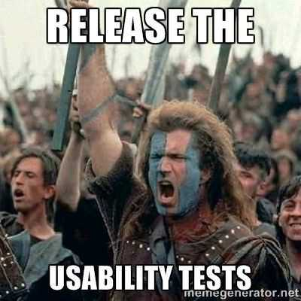

Slide 27
Usability Questionnaires 1 of 3
System Usability Scale (SUS) is a 10-item scale that is scored on a 5-point Likert scale on strength of agreement
  SUS assesses the general usability of a system
  Due to variable findings regarding the instrument’s reliability, the SUS should be used in combination with another method to determine the usability of a system
Questionnaire for User Interaction Satisfaction - developed by University of Maryland; designed to evaluate the users’ satisfaction with different aspects of an interface.
  Long form (71 questions) and short form (27 questions)
  The overall reliability of QUIS has a Cronbach’s alpha of 0.94 and 0.95

Slide 28
Usability Questionnaires 2 of 3
Computer System Usability Questionnaire (CSUQ) is a slightly modified version of the Post-Study System Usability Questionnaire (PSSUQ)
  CSUQ measures the same three factors as PSSUQ: system usefulness, informational quality, and interface quality
  Overall, the CSUQ’s coefficient alpha is 0.95, with coefficient alphas of 0.93 for system usefulness, 0.91 for informational quality, and 0.89 for interface quality
Software Usability Measurement Inventory (SUMI) is intended to be completed by users who have experience with the system being evaluated
  The coefficient alpha for SUMI is 0.89 and ranges from 0.71 to 0.92 for each of the questionnaire’s five subscales: efficiency, affect, helpfulness, control, and learnability

Slide 29
Usability Questionnaires 3 of 3
After Scenario Questionnaire (ASQ) is designed to be completed directly following scenario usability studies
  Items measure ease of task completion, time required to complete the tasks, and satisfaction with support information
  The coefficient alpha for ASQ is 0.93, but no evidence exists of its use for Health IT systems
End-User Computing Satisfaction Questionnaire (EUCS) is a multidimensional instrument and measures user satisfaction with all types of applications
  It is a reliable and valid instrument that can be used as a general measure of user satisfaction with an information system
  The reliability of each factor was 0.89 for content, 0.91 for accuracy, 0.78 for format, 0.85 for ease of use, and 0.82 for timeliness

Slide 30
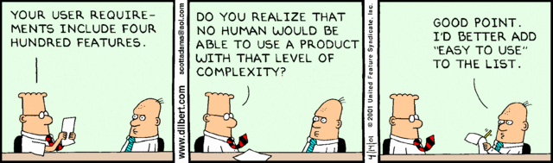
Questions

