Slide 1
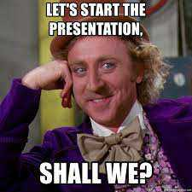
Dynamic Presentations – Part 2
Bob Marshall, MD MPH MISM FAAFP
Program Director, DoD/MAMC Clinical Informatics Fellowship

Slide 2
Learning Objectives
Passing the Glance Test
Applying Design Elements to Your Slides
Authentic Presentations Take Practice
Create a Conversation
Giving Data-Heavy Presentations
Giving Webinars

Slide 3
Passing the Glance Test
An audience can’t listen to your presentation and read detailed, text-heavy slides at the same time (not without missing key parts of your message, anyway).
So make sure your slides pass what I call the glance test:
  People should be able to comprehend each one in about three seconds
Your audience should focus intently on what you’re saying, looking only briefly at your slides when you display them

Slide 4
Keep It Simple
People learn more effectively from multimedia messages when they’re stripped of extraneous words, graphics, animation, and sounds
Lots of extras take away meaning because they become a distraction and overtax the audience’s cognitive resources
So when adding elements to your slides, have a good reason
Keep it short and easy to skim
Scale the type as large as possible so the people in the back of the room can see it

Slide 5
Stick to a consistent visual style in your slide deck
Select one typeface — two at most
Use the same color palette throughout (limit yourself to three complementary colors, plus a couple of neutral shades, like gray and pale blue)
Photos should be taken by the same photographer or look as if they are
Illustrations should be done in the same style

Slide 6
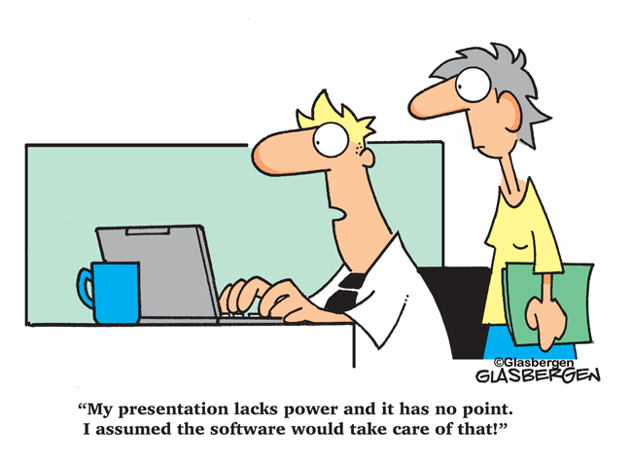
Applying Design Elements to Your Slides

Slide 7
Arrange Slide Elements with Care
Think like a designer when you arrange slide elements
The five design principles in the following slides will help you simplify your slides, so they’ll pass the glance test:

Slide 8

Flow
You can direct people’s eyes to certain areas of a slide to emphasize important points

Slide 9
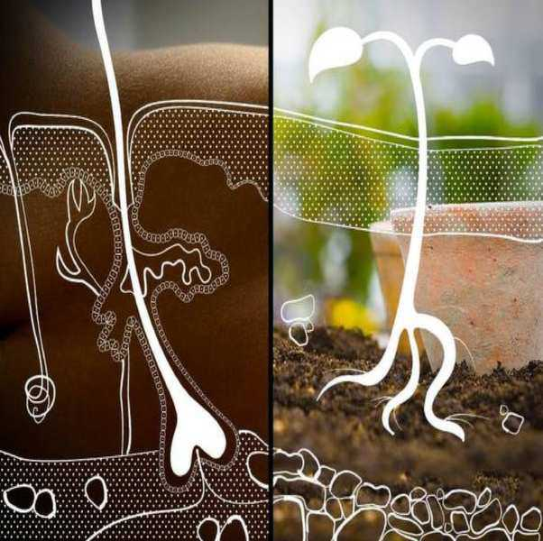
Contrast
Our eyes are drawn to things that stand out, so designers use contrast to focus attention
Create contrast through your elements’ size, shape, color, and proximity

Slide 10
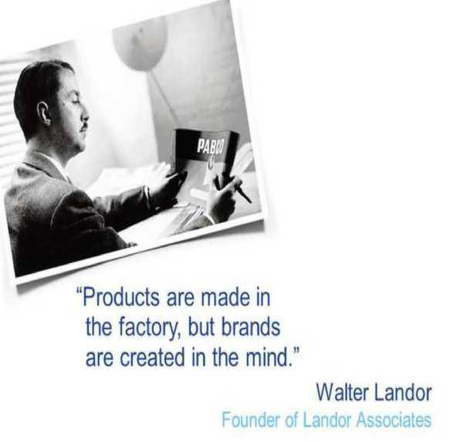
White space
White space is the open space surrounding items of interest
Including a healthy amount of white space sharpens viewers’ focus by isolating elements

Slide 11
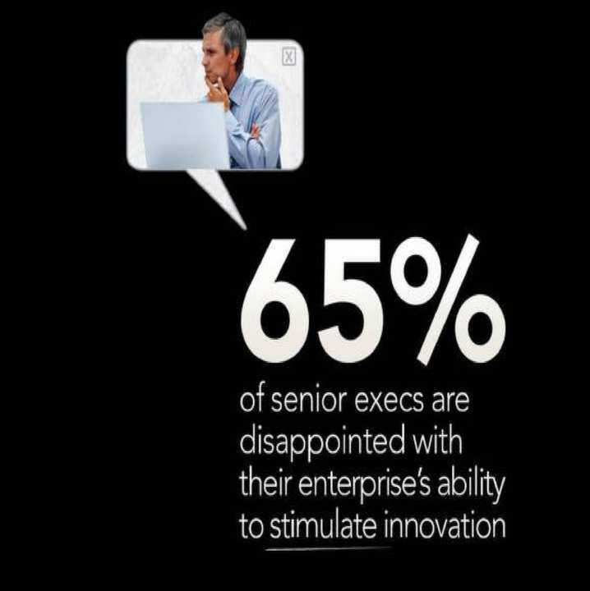
Hierarchy
A clear visual hierarchy allows viewers to quickly ascertain a slide’s most important elements

Slide 12

Unity
Slides with visual unity look as though the same person created them and make your message feel cohesive
You can achieve this through consistent type styles, color, image treatment, and element placement throughout the slide deck

Slide 13
Presentation Tools – Other Options
The best presenters tend to show rather than tell, creating opportunities to engage and persuade
They feature fresh, exciting information
By soliciting feedback and helping listeners feel ownership of the ideas under discussion, they inspire audiences and ultimately create a bond with them
Great presentation tools should:
  have the necessary elements to support questions and intellectual digression
  allow as little or as much data to be presented per idea to communicate effectively
  should discourage the user from accidentally or intentionally “suffocating key data and conclusions” with what Edward Tufte describes as “Chartjunk.”

Slide 14
Some Other Presentation Tools
Prezi
Zoho Show
SlideCaptain
Plotly (Interactive graphs)
Document Sharing Platforms
  Google Docs
  Dropbox
  OneDrive

Slide 15
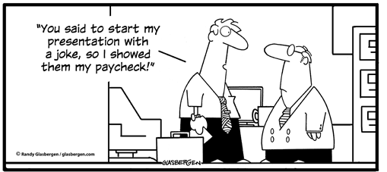
Authentic Presentations Take Practice

Slide 16
Being Authentic 1 of 3
Lots of us fall into the “smart” trap when presenting:
  we work so hard to be polished and articulate that we overcompensate and come across as flat, boring, and egg-headed
We’ve all certainly heard (and suffered through) talks like this
So how is it that great communicators manage to engage and entertain their audiences while sounding smart?
  They’re open and sincere

Slide 17
Being Authentic 2 of 3
We all have different personalities, of course
Whether you’re boisterous or quiet, be yourself
If you really love what you do, for example, let your enthusiasm show
It takes practice to be natural in front of a group
When you rehearse, think carefully about your stance and your gestures

Slide 18
Being Authentic 3 of 3
Use your physical expression to its fullest by:
  Peeling yourself away from your slides
  Opening up your posture
  Using gestures to amplify what you’re saying
It’s easy to get caught up in what the audience thinks about you
Audiences are more gracious than you’d think, especially if you’ve earned their trust by being yourself — and showing them that you’re comfortable in your own skin

Slide 19
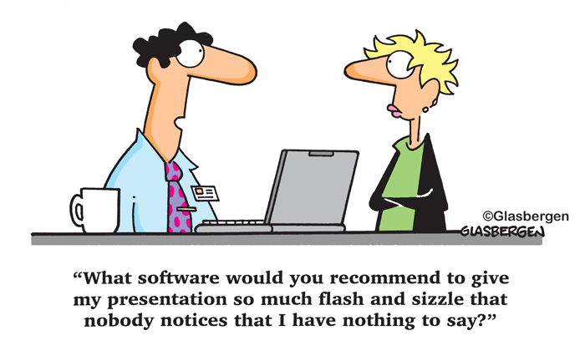
Create a Conversation – Applicable to both meetings and conferences

Slide 20
Background
Group intelligence typically trumps individual intelligence
Relying entirely on one-way presentation makes for boring meetings/conferences
No one wants to sit and listen to another person present for hours on end
People want to ask questions and to provide their own insights
They want to problem-solve and debate

Slide 21
First Step
Draft presentation materials in careful partnership with important members of the audience.
Often the best way to start problem-solving is simply to have an initial discussion with everyone involved and get their thoughts on the issues and potential outcomes in play
  In lieu of such a discussion, an LNA can suffice to identify important topics to cover
This helps surface the broadest array of topics and allows everyone to feel heard and included

Slide 22
Second Step
Design a presentation that invites insight and discussion.
For most meetings/conferences, you want presentations that have enough detail to be read and understood in advance
You want to include key insights on most pages, along with call-out questions for discussion to keep readers thinking critically about the issues in play
Finally, use “punchline first” (aka BLUF) communication

Slide 23
Third Step
Send the “final” materials well in advance of any group discussion and require a pre-read
If you show up to a meeting/conference with a warm deck that no one has seen, most thoughtful people will spend their time trying to read and absorb it, even if you’re describing the material in detail in person
This is particularly true of introverts and others who prefer time to absorb information before speaking about it and drawing their own conclusions

Slide 24
Fourth Step
Avoid marching through any document page-by-page or slide-by-slide
If everyone has prepared, they will be more informed—but they’ll also disengage if you then try to painstakingly read every word
The presentation or document you’ve routed then becomes a reference for points of conversation
You can focus on the concepts and lead the conversation rather than give a lecture

Slide 25
Fifth Step – for meetings or group table conferences
Appoint facilitators to draw out comments and questions from the whole group
Have senior people/leaders, or facilitators, ask questions of the group and assure that everyone’s voice is heard
This can be formulaic by surveying each person about key conclusions one-by-one, or with adept facilitators, it can be more free-flowing, drawing out opinions from various people as the conversation develops

Slide 26
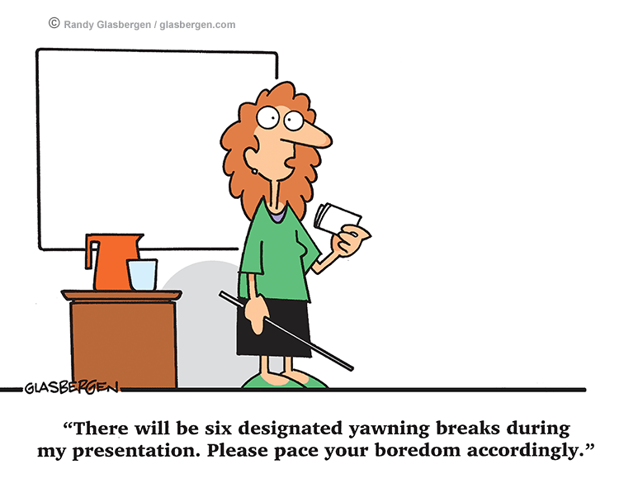
Giving Data-Heavy Presentations

Slide 27
Why It Is Important
The power of data storytelling isn’t limited to written communication:
  you can also use data to deliver presentations that are both more credible and more visually compelling.
Knowing how to develop and deliver a data-driven presentation is now a crucial skill for many professionals
Since we often must tell our colleagues about changes in strategy, workflow and/or content — they that are much more compelling when they’re backed by numbers showing benefit

Slide 28
Basic Approach
As with any communication, start by thinking about your audience.
  Who are you presenting to, and how much do they know about the topic?
A good rule of thumb is to look at the legend on your charts:
  if you can’t count on the audience knowing what each item in the legend refers to, you need to spend some time on setup before you get to the numbers

Slide 29
Specific Recommendations 1 of 6
It’s easy to let the data overtake your presentation, so be sure you know the overall story you’re trying to tell and use charts sparingly to support your story
You’re not trying to subdue your enemy through the sheer volume of data you can bring to bear on your argument
You are using data strategically, when it provides clear and concrete evidence for the story you are telling

Slide 30
Specific Recommendations 2 of 6
It’s rare that anyone will retain all the actual numbers in your presentation, so think about the words that capture the idea, insight, or conclusion you want them to retain
Instead of simply throwing up a bar chart that shows levels of employee engagement versus different working arrangements, build to that key chart with a story about the impact of working arrangements on employee satisfaction — illustrated by actual human examples, if possible

Slide 31
Specific Recommendations 3 of 6
As you present, remember that it takes people some time to digest a chart or data table
Take the time to spell out the story you see in the data so that it’s clear to everyone
Speak slower than you usually do, and consider pausing for a moment mid-chart, to allow people the time to absorb the data
Even if you prefer to wait until the end of your presentation for questions, ask if anyone needs you to clarify the chart

Slide 32
Specific Recommendations 4 of 6
While clarifying statements are helpful, that doesn’t mean you can neglect the visuals
You may still need to restructure or reformat your charts to make them work on screen, however.
Even if you’ve used shading to differentiate between categories in a printed document, it will be easier for people to distinguish between on-screen categories if they’re shown in different, contrasting colors.

Slide 33
Specific Recommendations 5 of 6
Make sure your legend and data labels are printed in a large, visible font
Get familiar with the very basic rules of good data visualization, like which types of charts to use for different purposes
Make sure that you don’t violate any data visualization principles when you squeeze your data onto a slide

Slide 34
Specific Recommendations 6 of 6
There is a lot of value in leaving people with a physical (or virtual) copy of your charts, so that they can look at the numbers more closely after your presentation
Since data-driven decks and reports tend to get circulated, make sure that any charts you include can stand on their own, without you speaking to them
Note the source of your data, make your legend clear, and annotate your charts with callouts that show people how to make sense of a specific data point

Slide 35
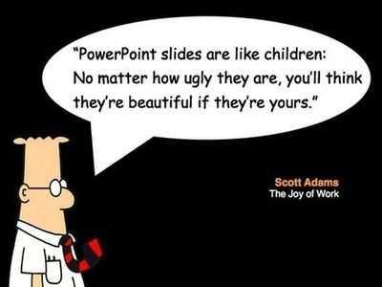
How to Give a Webinar Presentation

Slide 36
Background
For years, teleconferencing was the best option
In the past five years, internet speeds and web conferencing technologies have become sufficiently robust to support a shift to live video streaming.
Presenting in a webinar — when you often don’t have access to visual cues about how the audience is responding — can sometimes feel disconcerting or awkward

Slide 37
How to Present in a Webinar 1 of 5
Make use of the camera
Most of the time, the internet quality/speed should be just fine
Just as television flourished only when its creators stopped thinking of it as “radio with pictures,” it’s essential for professionals steeped in teleconferencing to realize that successful webinars must make use of the inherent strengths and possibilities of the medium — namely video

Slide 38
How to Present in a Webinar 2 of 5
It may feel uncomfortable to present in the absence of audience feedback
One popular trick is to simply imagine a good friend of yours “on the other end of the line” and pretend you’re presenting to that person
If you’re using the camera, you must be mindful of visual aesthetics
It is essential to plan your visuals carefully
Specifically, adjust your camera so that it’s giving a straight-on view of your face

Slide 39
How to Present in a Webinar 3 of 5
it’s a good idea to rehearse the mechanics of the webinar software you’re using
The fundamentals of each platform are similar, but are just different enough that it’s worth a brief run-through, including:
  How to toggle between slides and screen sharing
  How to mute or unmute participants (it’s a very good idea to mute everyone upon entry to avoid random blasts of noise)
  How to access questions or comments
  How to run instant polls

Slide 40
How to Present in a Webinar 4 of 5
One often-overlooked element is ensuring you’re able to maintain eye contact with the camera so that you appear to be looking viewers in the eye
Some platforms display video images in one corner by default
  If so, it’s likely that your eyes will drift over there, making you appear to be staring off to one side for no reason
Guard against this by familiarizing yourself with the platform and adjusting the default settings as needed

Slide 41
How to Present in a Webinar 5 of 5
One essential element that’s worth deciding on in advance is how you’ll handle audience participation
Depending on the number of attendees, you may ask them to “raise their hand” if they have a question, type their questions into the comment box, or use a separate Q&A feature
Whatever you decide, make sure you’re explicit at the beginning of the webinar and remind people periodically throughout, to avoid frustration or confusion

Slide 42
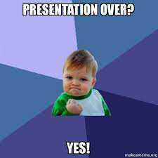
Discussion/Questions

Slide 43
A Couple of Backups

Slide 44
Retention Pyramid
Average 24-hr Retention Rate
Discussion Group 50%
Practice By Doing 75%
Teach Others / Immediate Use of Learning 90%
Lecture
5%
Demonstration 30%
Audiovisual 20%
Reading
10%
Active Learning
Source: Adapted from E. Dale, Audiovisual Methods in Teaching, 1969, NY: Dryden Press.
Notes:
Reflecting back on my initial quote that it doesn’t matter how you feel you present the information it is if your team understands it. Lets look at how we best learn by bringing up the cone the learning. I understand this pyramid is not without its critics, but the overall concept, I believe most can agree on.. If our goal is for actual learning or retention, then we should place more of our efforts toward the areas at the bottom of the pyramid that represent active learning as opposed to the top. However, the majority of our students and us have spent most of education receiving nothing but lectures and powerpoints. They are used to it and a lot of times they even state they prefer it. Probably because passive learning is easy, but it is not necessarily as effective.

Slide 45
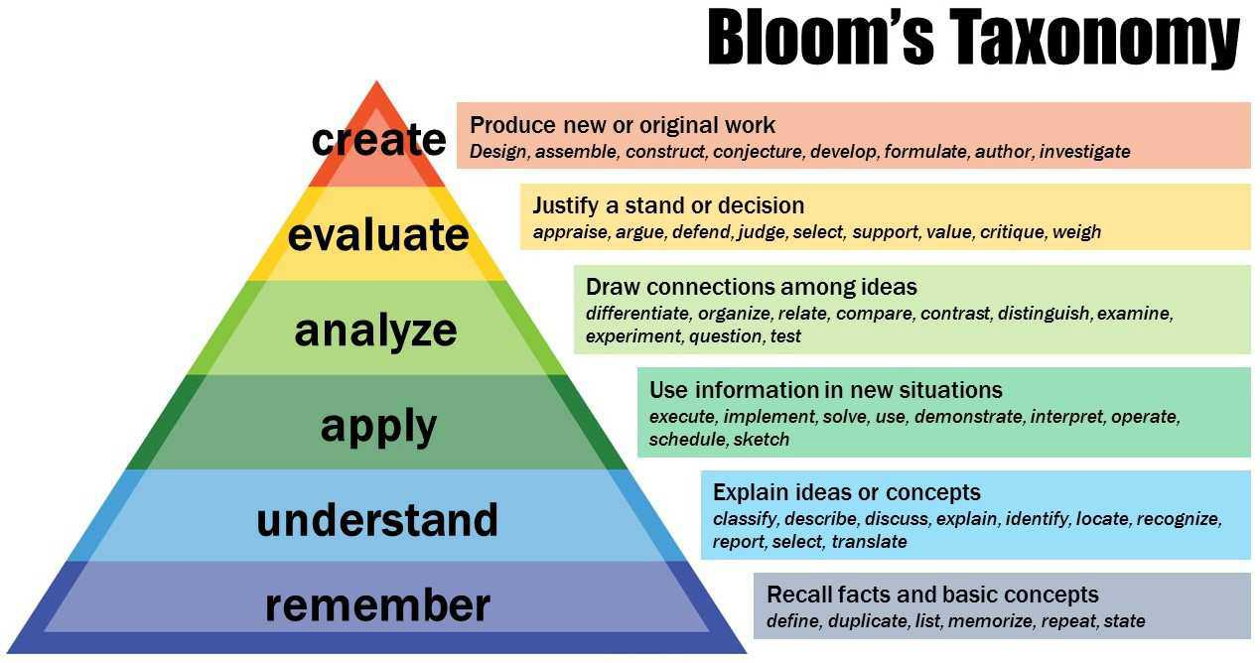
Notes:
Now lets take a look at Bloom’s Taxonomy to ensure we are really meeting the needs of the learner. When we were in our school, the expectation was simply to remember facts so that you can pass the next test. So, students are given a vast amount of information in lectures with the purpose of being able to recall the facts and basic concepts. Okay, so in that time of their life, lectures were ok. It met their need and expectation. But what is the current expectations for residents, physicians, or just providers in practice. Yes we need to recall information and sometimes that is all we need to do as providers to solve certain issues. We also need to understand information such as diseases so that we can explain it to our patients and each other. But do we really just want our providers to be simple robots of information? For a lot of what we do on a routine basis, is apply information to new situations because patients do not come with textbook presentation of diseases. They also need to connect new information against prior knowledge to prioritize best treatment plans, because a lot of times there are many ways to treat a disease and you need to compare the differences. From there you need to be able to justify your decision and argue your choice by weighing those options (OR ARGUE TO CHANGE THE WAY WE PREVIOUSLY PRACTICED). An ultimate goal which we need to attain in order to expand our medical fields is through creating new ways to solve the many problems in our medical field. These higher levels of cognition going up the pyramid will not as effectively be obtained if we are not facilitating learning events that promote that behavior. But we can as long as we create learning events geared toward hitting those desired levels of needs of your learner.

