Slide 1
Data Governance:
The Executive Data Council and
Data Management Board
COL John S. Scott
DHA Data Manager
DHA J5 – Strategy and Plans

Slide 2
BLUF
The Executive Data Council and Data Management Board are new since 2016
The DMB has responsibility for ongoing and enduring data governance activities
The DMB coordinates with several other MHS governance bodies

Slide 3
Overview
Purpose
  To inform Summiteers about data governance bodies, their roles and responsibilities, and their relationship to other governance bodies and organizational elements
  Background
  Data governance in the MHS has been patchy, with pockets of excellence but absence of an overall strategy. Clinical systems lag business systems. The Executive Data Council was chartered in March of 2016 and its subordinate Data Management Board established in October. The DMB is beginning to take responsibility for data governance activities as needs are recognized.

Slide 4
Data Governance & Enterprise Data Management
Central Data Governance
  The implementation and execution of centralized data controls and management through governing policies, regulations and standards to realize maximum value of information investments while achieving organizational goals related to transparency, accountability, interoperability and quality of MHS data. It does not address defining purpose or content of the data managed.
Enterprise Data Management
  The development and execution of data architectures, policies, practices, and procedures in order to manage the information lifecycle needs of the MHS in the most effective manner. The focus of enterprise data management in the MHS relates to activities developed and executed to improve the visibility, accessibility, understandability, usability, trustworthiness, and responsiveness of MHS data.
Source: EDC Charter

Slide 5
MHS Data Vision Statement
The Military Health System (MHS) seeks to establish a modern data ecosystem that maximizes readiness and value for beneficiaries.
As we transition to this modern data ecosystem, we will ensure that data is:
Interoperable: Data will conform to MHS approved data compliance standards for interoperability and be collected, stored, and communicated in accordance with privacy and security regulations.
Trustworthy: Data will be trustworthy, reliable, and complete, through consistent capture and minimal burden of data entry.
Visible: Data will be visible to appropriate functional users to support all aspects of care.
Accessible: Data will be accessible through critical reporting and decision support tools, to enhance productivity of functional users.
Understandable: Data will be integrated across all functional data sources in a standardized manner, providing all authorized stakeholders usable and understandable data assets.
Note: The scope of the MHS data management entities is to assure systems using the data follow the data management objectives. The scope of the MHS functional community is to identify and prioritize end user requirements for data content and purpose.

Slide 6
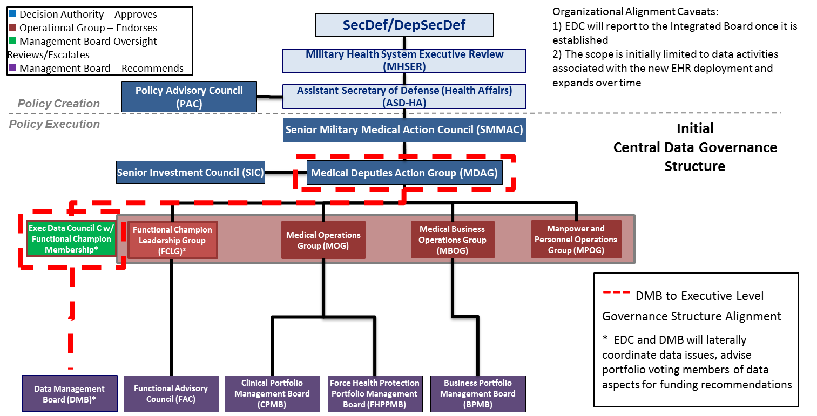
Data Governance Relationships

Slide 7
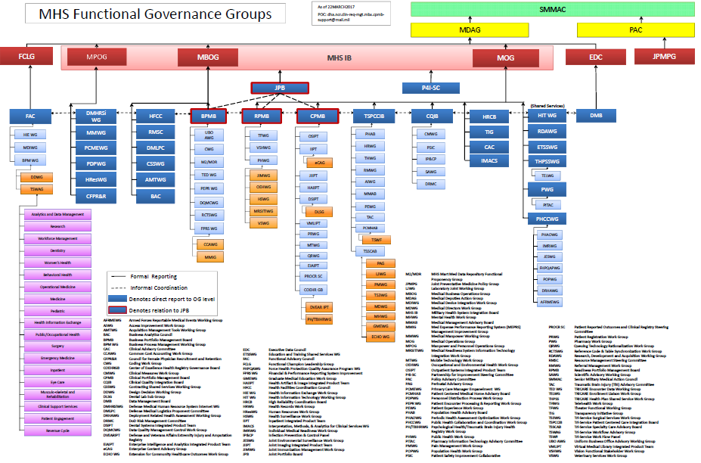
But that’s not all …

Slide 8
DMB Chairperson and the J5 Clinical Data Section
DHA J5 Strategy, Planning and Functional Integration Directorate
Functional
Clinical Data Management
Decision Support Division
Strategy Management Division
EHR Functional Champion (Temporary)
Information and Requirements Division
MHS Dashboard Management
Analytic Support (Health Services Operations, Financial)
Strategic Planning
Business Process Changes
Execution Support for Resourcing
System Design
Workflow Standardization
Support for DOTMLPF Analysis
Clinical Data Analytics Platform Management
Methods and Algorithms
Change Management
Measurement and Reporting (P4I)
Information Management/ Requirements
Clinical Enterprise Data Management
Enterprise Data Management
Clinical Content Standardization
Improvement Science
Data Governance support
Data Infrastructure Support

Slide 9
The “Three Legged Stool” for data management
Military Health System
Secretary of Defense
Sec Army
Sec Navy
Sec
Air Force
USD (AT&L)
USD(P&R)
PEO
ASD(HA)
CSA
CNO
CMC
CSAF
DHMSM
USUHS
Policy & Oversight
Execution
Senior Data Engineer
Defense Health Agency
Army SG
Navy SG
Air Force SG
J1/J8
J3
J4
J5
J6
J7
J9
J10
J11
Army
MEDCOM
Navy
BUMED
Air Force
MAJCOMs
DHA Data Manager
EIDS PM
MTFs
MTFs
Army
Operational
Units
Navy
Operational
Units
Marine
Operational
Units
Air Force
Operational
Units
MTFs
Defense Health Agency
Service Medical Organization
9
Distribution D: Distribution authorized to the DoD and U.S. DoD contractors only. Other requests for this document shall be referred to DHMSM PMO.

Slide 10
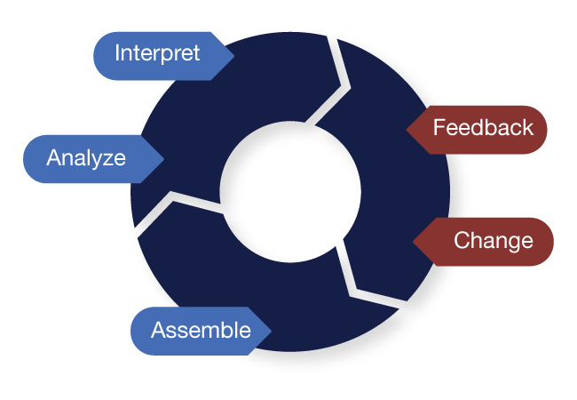
Learning Health System
http://www.learninghealthcareproject.org/
Distribution D: Distribution authorized to the DoD and U.S. DoD contractors only. Other requests for this document shall be referred to DHMSM PMO.

Slide 11
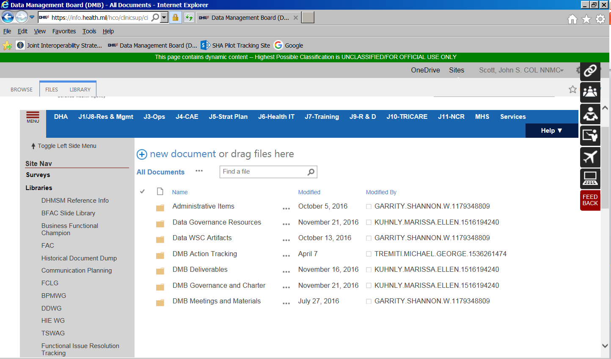
Visit our work space – and provide feedback!

Slide 12


