Slide 1
Analytics: Definition, Simple to Complex, Current To/Be
David Carnahan, MD, MSCE, Col
Deputy PM, Data Scientist
DHA | J6 HIT | SDD | EIDS

Slide 2
BLUF
Analytics strategy will drive data management strategy
Analytics is a broad term that encompasses operational analytics, data discovery, and research
The goal of analytics is to provide insight by using methods that looks to the past, predicts the future, and informs the present

Slide 3

Overview
Purpose
  Analytics is ultimately about providing insights & recommendations for clinicians at point of care to improve outcomes in healthcare.
  Background
  Analytics at Work (Tom Davenport)
  Data
  Enterprise Perspective
  Leadership
  Targets
  Analytic Talent

Slide 4
Analytics Big Picture
Why
Quadruple Aim
What
Operational
How
Data Science Lab
Learning Health System
Data Discovery
Research
Analytic Workbench
Information Portal

Slide 5
Learning Health System
Characterized by a number of core attributes. Particularly important is a consistent emphasis on a collaborative approach that shares data and insights across boundaries to drive better, more efficient medical practice and patient care.

Slide 6
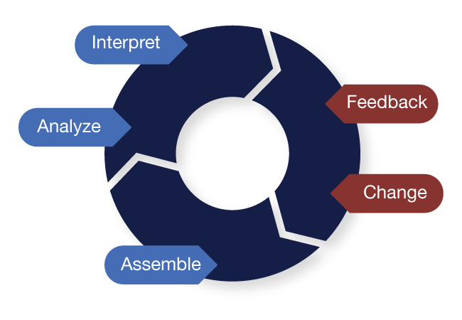
Learning Health System
http://www.learninghealthcareproject.org/
Distribution D: Distribution authorized to the DoD and U.S. DoD contractors only. Other requests for this document shall be referred to DHMSM PMO.

Slide 7
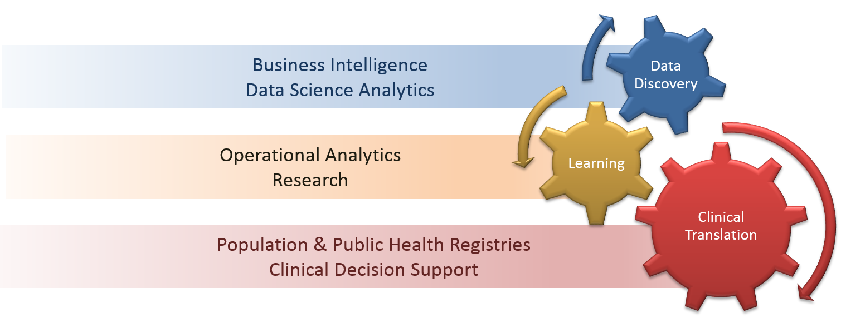
Learning Health System

Slide 8

Operational Analytics:
Going from Strategic Goal to Operational Target
Good Data
Segmentation
Differentiation
Prediction
Automation

Slide 9

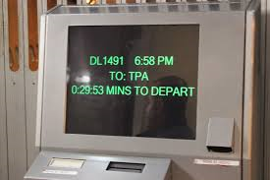
Operational Analytics:
Going from Strategic Goal to Operational Target
Strategic Measure(s)
On-Time Departure
Right Person on Right Plane
Operational Target

Slide 10
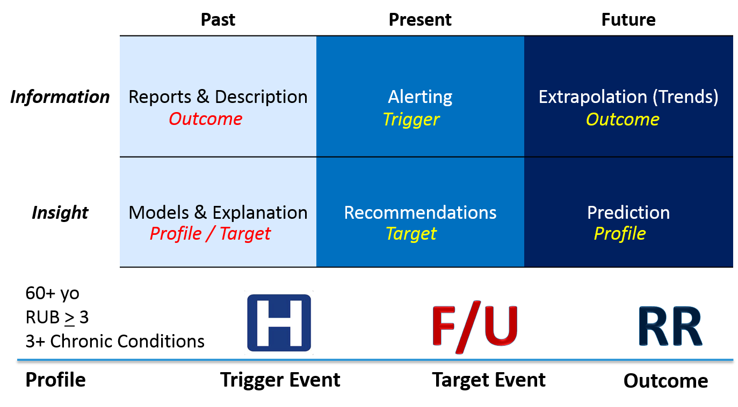
Readmissions Example

Slide 11
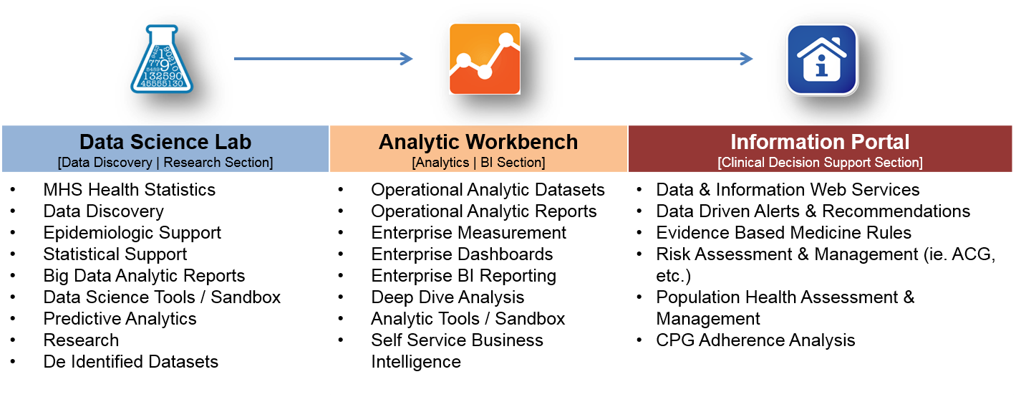
The Platform Framework

Slide 12
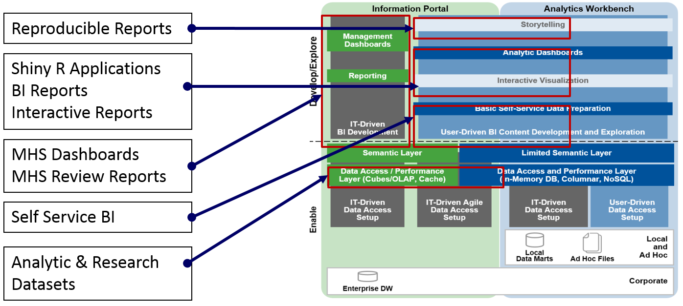
What is an Information Portal?

Slide 13
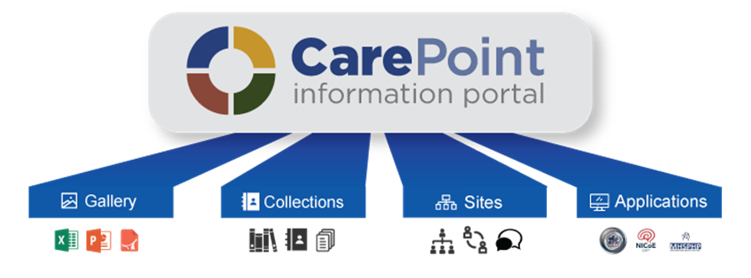
Information Portal
Create & share your data, research, & analytics
Group & share related
healthcare topics that
matter most to you
Collaborate with other
users on shared
healthcare interests
Use applications that
promote better readiness,
care, health, and lower cost

Slide 14
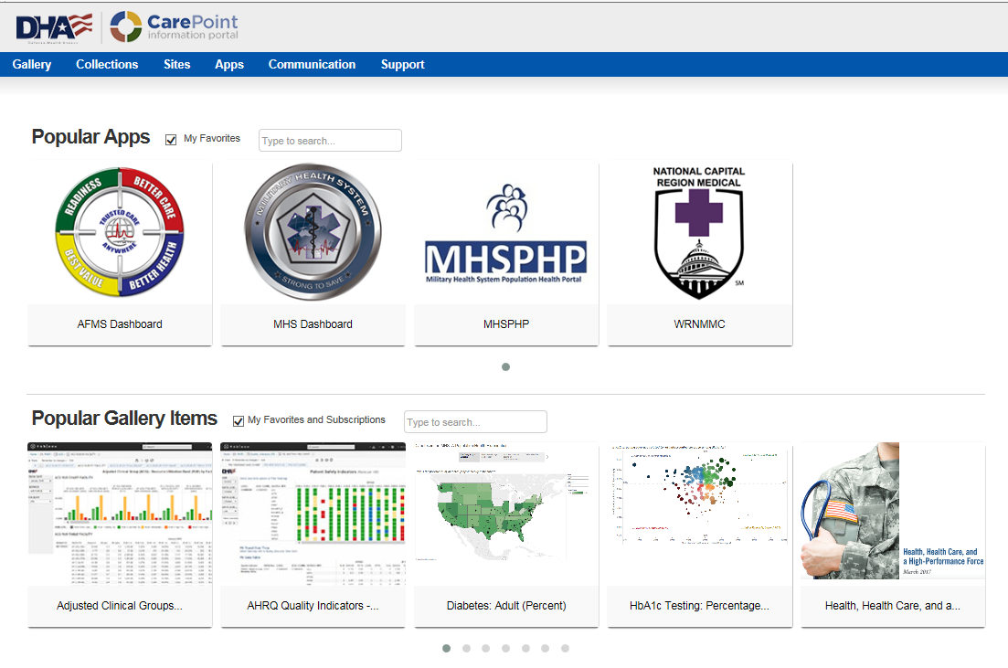
Gallery

Slide 15
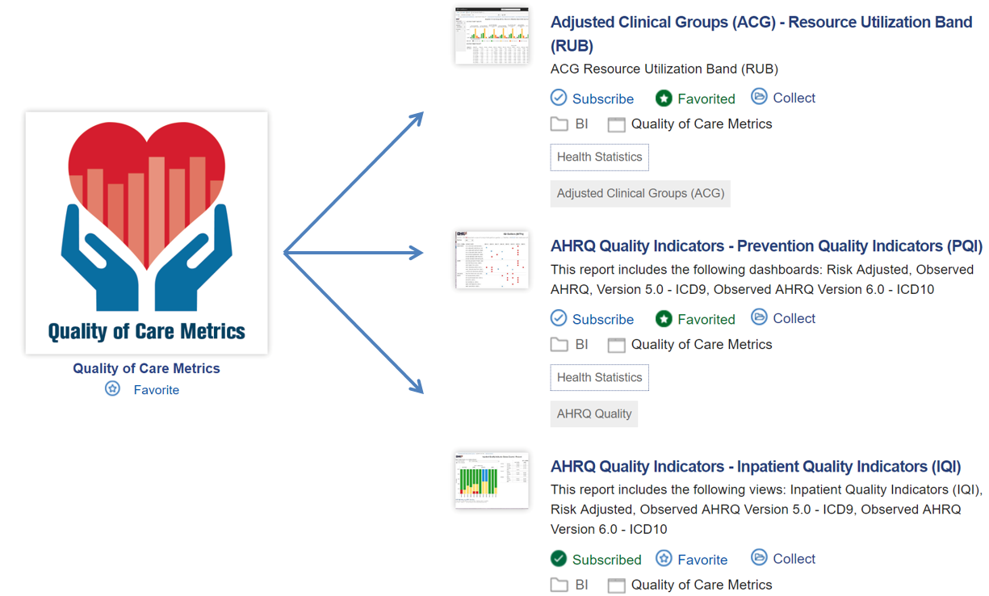
Collections

Slide 16


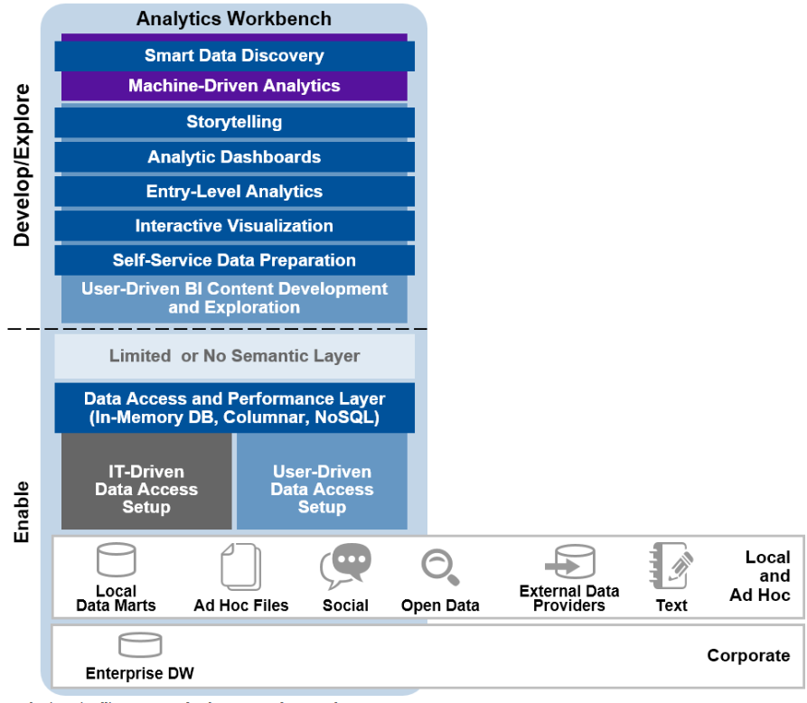



What is an Analytic Workbench?

Slide 17
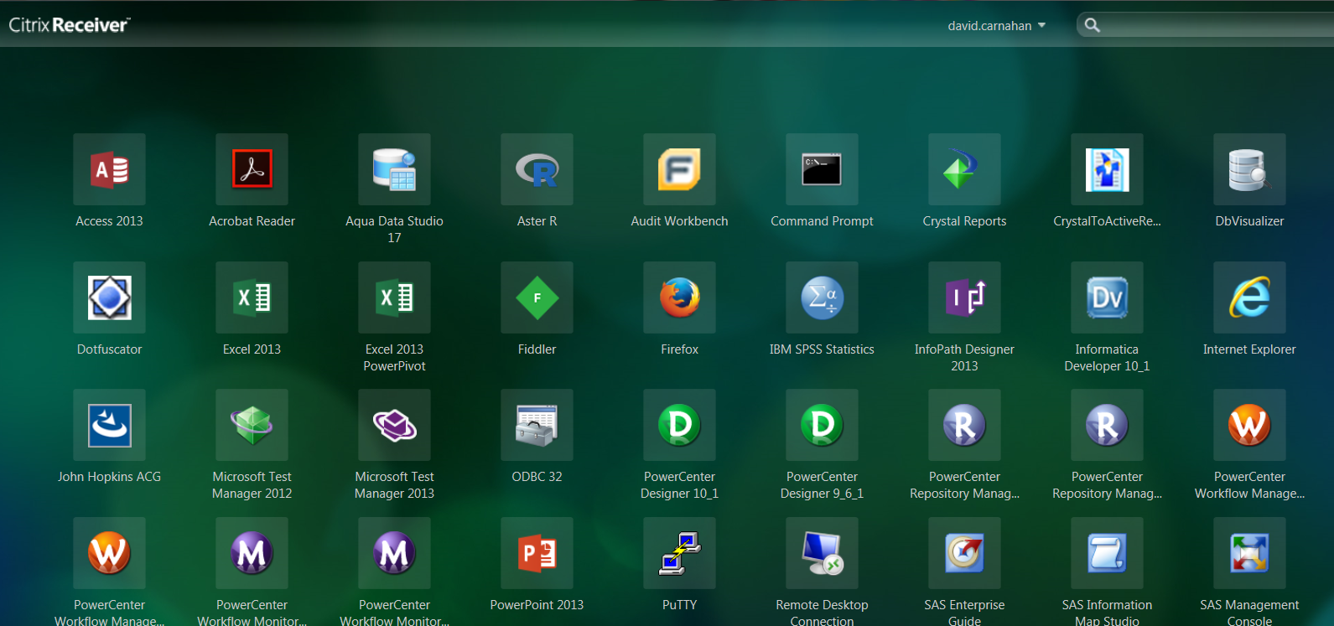
Current Analytic Workbench

Slide 18
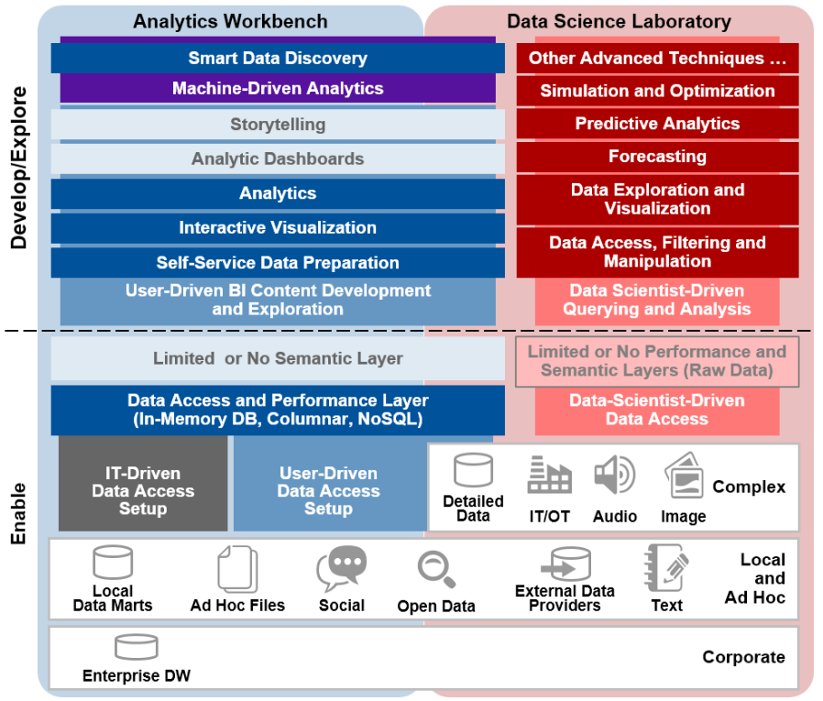


Data Science Laboratory

Slide 19
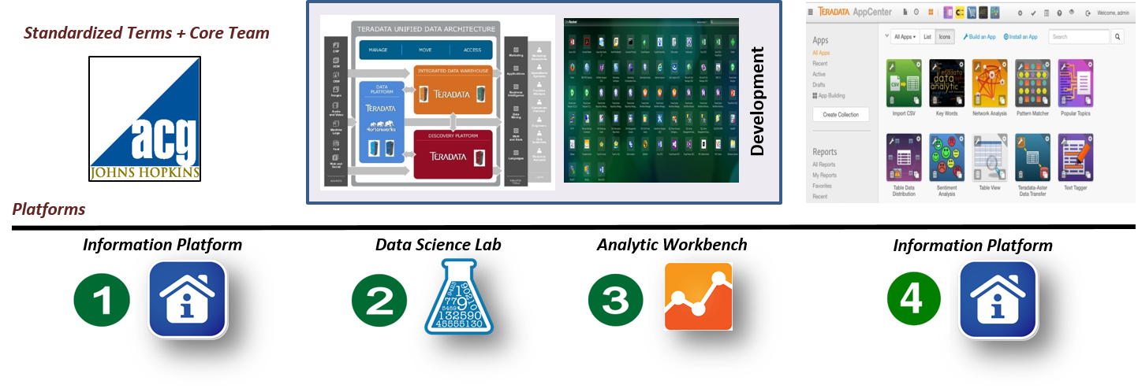
Data Science Laboratory

Slide 20
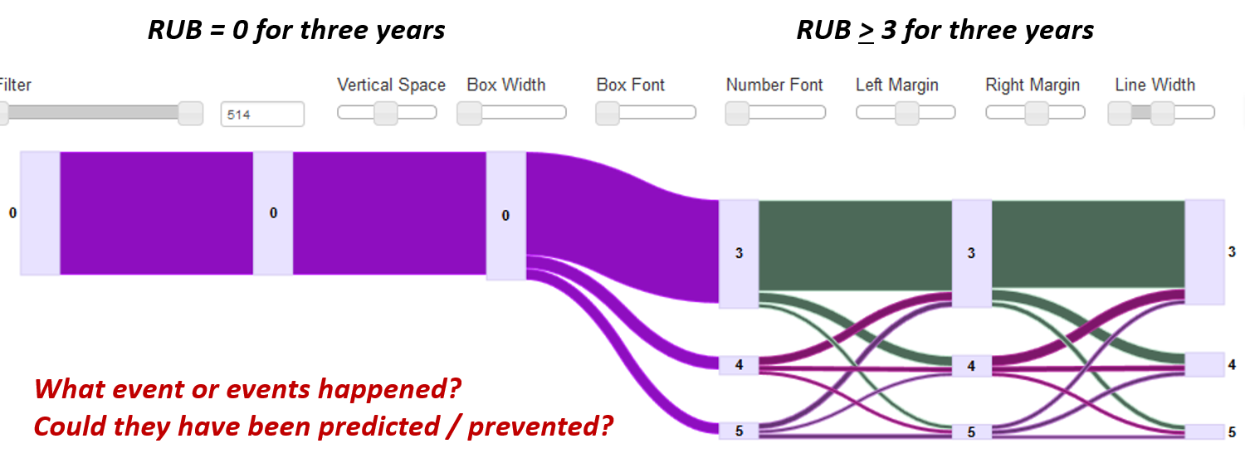
Data Science Laboratory

Slide 21
Next Steps
Data acquisition & consolidation based on requirements
Optimize analytic workbench & data science lab
Validate data warehouse for analytics & data science
Create web services (SOA) for registry management
Promote information governance in Information Portal

Slide 22


Slide 23
Data Quality and Reference Data Overview
Presented by
Nancy J. Orvis, M.H.A, CPHIMS
Defense Health Agency

Slide 24
Overview
BLUF - Background
Data Quality in the Data “Lifecycle”
MHS Data Quality Infrastructure/Resources
  Ex 1 Data Quality Management Control Program
  Ex 2 Reference Code and Synchronization Work Group
MHS GENESIS Data Issue Example
Data Quality Common Operating Picture
Challenges
Next Steps
Summary

Slide 25
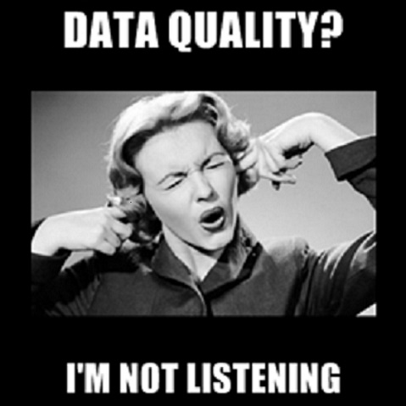
Has this happened to you?
Notes:
Sometimes it’s hard to get leaders and those peers outside the data community to hear the message.
Now I think the members of the choir are singing with me in the room today, so most will be willing to listen, but I promise you - and not only because my talk with you is standing in the way of lunch --- that you will take away some key ideas and actions useful to you!

Slide 26
BLUF
Patient Safety Depends on Data Quality
Data Quality Depends on “Gold Standard” Reference Data
The initial deployment of MHS GENESIS has identified data quality issues and risks that must be addressed in a timely manner
A plan for applying all lessons learned needs to be developed during IOC and managed as each subsequent phase/wave rolls out
  Identification of where human interaction and monitoring is needed based on data triggers [MHS GENESIS Example]
  Identification of requirements and the current capabilities to meet these requirements for monitoring and measuring data availability, accuracy and timeliness
  Identification of new sources, reports and processes to enable data quality
Patient safety depends on consistent and available enterprise reference data, tracked in production, and filtered to relevant local use at the point of care and patient management
Data Quality depends on partnership process between DHA and PEO DHMS/LPDH
Notes:
Data Triggers ---- data in movement
Give Example
***Legacy Military unique business processes in lines such as blood and pharmacy , have been/and need to be examined and modernized/ standardized against best of suite Industry Practices
Problem Statement
Recommendation
Justification

Slide 27
Data Quality? Approved Characteristics
Data Quality: A multi-dimensional measurement of the adequacy of a particular datum or data sets.
The Data WSC and the DQMC Program agree that for MHS data to be deemed reliable and able to serve its purpose in a given context, it must measure favorably in the following data dimensions/characteristics:
  Accuracy – free of error
  Completeness – the degree to which values are populated in the fields which require them
  Timeliness – synonym for currency; “up to date”
  Consistency - A measure of the degree to which a set of data satisfies a set of constraints or a set of business rules
Notes:
6040.4 Data quality is a multi-dimensional measurement of the adequacy of a particular datum or data sets *. The Data WSC data quality subgroup has agreed that for data to be deemed reliable and able to serve its purpose in a given context, it must measure favorably in the following data dimensions/characteristics:
Accuracy** - A quality of that which is free of error. A qualitative assessment of freedom from error, with a high assessment corresponding to a small error (FIPS Pub 11-3). E.g. Percent of values that are correct when compared to the actual value. M=Male when the subject is Male
Completeness** - The degree to which values are present in the attributes that require them. E.g. Percent of data fields having values entered into them.
Timeliness** - As a synonym for currency, timeliness represents the degree to which specified data values are up to date. E.g. Percent of data available within a specified threshold time frame (e.g., days, hours, minutes).
Consistency** – A measure of the degree to which a set of data satisfies a set of constraints or a set of business rules. E.g. Percent of matching values or matching set of data across tables/files/records.
Consistency refers to ensuring that data values in one data set are consistent with values in another data set. The concept of consistency is relatively broad; it can include an expectation that two data values drawn from separate data sets must not conflict with each other, or define consistency with a set of predefined constraints. Encapsulate more formal consistency constraints as a set of rules that specify consistency relationships between values of attributes, either across a record or message, or along all values of a single attribute. However, care must be taken not to confuse consistency with accuracy or correctness. Consistency may be defined between one set of attribute values and another attribute set within the same record (record- level consistency), between one set of attribute values and another attribute set in different records (cross- record consistency), or between one set of attribute values and the same attribute set within the same record at different points in time (temporal consistency). (DMBOK) BusinessIntelligence.com
Data quality is affected by the way data is entered, stored and managed.
Data quality is a perception or an assessment of data's fitness to serve its purpose in a given context.
Data quality is a multi-dimensional measurement of the adequacy of a particular datum or data sets. In business, data quality is measured to determine whether or not data can be used as a basis for reliable business intelligence and for making organizational decisions.
-data must measure favorably in a number of dimensions, including, but not limited to accuracy, completeness, consistency, and timeliness.

Slide 28
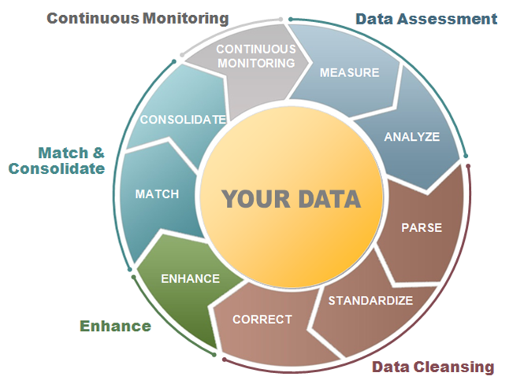
Data Quality in the Data “Lifecycle”
Patient Safety Depends on Data Quality
CONTINUOUS
MONITORING
Accuracy
Completeness
Timeliness
Consistency
Notes:
DoD Data Quality Instruction
From DoDI 6040.40: Each MTF will establish and operate its DQMC Program in accordance with this policy and its respective MILDEP or NCR MD supplemental policy to provide the internal structure to meet the DQMC performance metrics for data accuracy, completeness, and timeliness, and to assure uniformity and standardization [consistency] of information across the MHS.
IT and Data Quality
Typically, Data Quality is viewed as an IT problem ...
Some of our problems with data quality can be attributed to problems with IT
Examples:
Errors in transmission of data
Errors in processing data
Unsynchronized databases
But …
The most difficult problems we face with data quality are not directly attributable to IT, nor readily fixed by IT solutions
Business Practices and Data Quality
A few examples of Business practices affecting data quality:
Lack of standardized business rules and policies
Inconsistent choices of codes, weights and algorithms
Lack of adequate training and education
Lack of adequate local data quality assurance
Failure to set and enforce tough performance expectations about data quality
Reference Code, Files and Tables Work Group
Goal
Comply with industry best practices for health care records maintenance and billing. Industry best practices are achieved by ensuring the timely adoption and release of updated code sets throughout MHS
Ensure the direct input from and coordination with stakeholders of key systems and business departments
Scope
Coordinate annual International Classification of Diseases (ICD) updates
Coordinate annual CHCS CPT-HCPCS updates
Coordinate annual update to list of MHS CHCS sites using CPT-HCPCS
Maintain the code set-specific deployment process flows
Maintain the roadmap/timeline for deployment of updates to the code set within DHA
Maintain the plan/approach for addressing licensing fees for the code set (e.g., CPT-HCPCS, RBRVS Weights)
Coordinate releases of tables and codes that are pertinent to MHS GENESIS.
Review and distribute HIPAA Healthcare Provider Taxonomy Table and PSC changes
Review and distribute MHS PATCAT Table changes
Review and distribute the Modifier Mapping Table during CPT-HCPCS work
Oversee updates to MS-DRG Weights
Transition to MHS GENESIS
Integrate lessons learned from each IOC into a convergence path toward a uniform set of enterprise level Data Quality Policies and Practices
Terminology and Standards
Reconcile MHS and MHSG Mapping of process flows, data dictionaries, standards, and code sets
Ensure Currency of Code Sets
Implement an Enterprise approach
Process Flows
Coding and Compliance Inpatient and Outpatient Encounters
Intermountain Health Pilot for Use of the 3M 360 Encompass Platform
Billing
Enterprise Chargemasters
Interoperability
Data Exchanges
Governance
Data Quality Oversight
Configuration Management
Evaluate Transition Schedule Based on Lessons learned

Slide 29
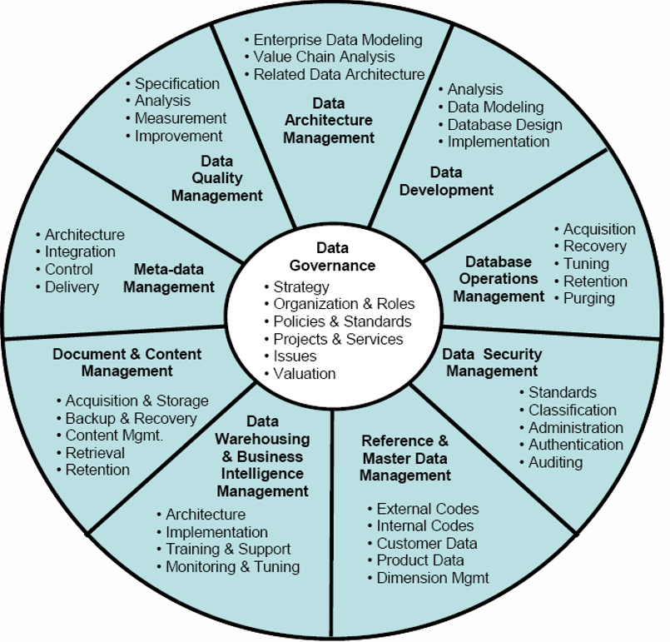
Data Quality & Reference Data Management
Data Quality Management: Defining, monitoring and improving data quality.
Reference and Master Data Management: Managing golden versions and replicas
* Ref: Data Management Association Int’l: Data Management Book of Knowledge
Notes:
DoD Data Quality Instruction
From DoDI 6040.40: Each MTF will establish and operate its DQMC Program in accordance with this policy and its respective MILDEP or NCR MD supplemental policy to provide the internal structure to meet the DQMC performance metrics for data accuracy, completeness, and timeliness, and to assure uniformity and standardization [consistency] of information across the MHS.
IT and Data Quality
Typically, Data Quality is viewed as an IT problem ...
Some of our problems with data quality can be attributed to problems with IT
Examples:
Errors in transmission of data
Errors in processing data
Unsynchronized databases
But …
The most difficult problems we face with data quality are not directly attributable to IT, nor readily fixed by IT solutions
Business Practices and Data Quality
A few examples of Business practices affecting data quality:
Lack of standardized business rules and policies
Inconsistent choices of codes, weights and algorithms
Lack of adequate training and education
Lack of adequate local data quality assurance
Failure to set and enforce tough performance expectations about data quality
Reference Code, Files and Tables Work Group
Goal
Comply with industry best practices for health care records maintenance and billing. Industry best practices are achieved by ensuring the timely adoption and release of updated code sets throughout MHS
Ensure the direct input from and coordination with stakeholders of key systems and business departments
Scope
Coordinate annual International Classification of Diseases (ICD) updates
Coordinate annual CHCS CPT-HCPCS updates
Coordinate annual update to list of MHS CHCS sites using CPT-HCPCS
Maintain the code set-specific deployment process flows
Maintain the roadmap/timeline for deployment of updates to the code set within DHA
Maintain the plan/approach for addressing licensing fees for the code set (e.g., CPT-HCPCS, RBRVS Weights)
Coordinate releases of tables and codes that are pertinent to MHS GENESIS.
Review and distribute HIPAA Healthcare Provider Taxonomy Table and PSC changes
Review and distribute MHS PATCAT Table changes
Review and distribute the Modifier Mapping Table during CPT-HCPCS work
Oversee updates to MS-DRG Weights
Transition to MHS GENESIS
Integrate lessons learned from each IOC into a convergence path toward a uniform set of enterprise level Data Quality Policies and Practices
Terminology and Standards
Reconcile MHS and MHSG Mapping of process flows, data dictionaries, standards, and code sets
Ensure Currency of Code Sets
Implement an Enterprise approach
Process Flows
Coding and Compliance Inpatient and Outpatient Encounters
Intermountain Health Pilot for Use of the 3M 360 Encompass Platform
Billing
Enterprise Chargemasters
Interoperability
Data Exchanges
Governance
Data Quality Oversight
Configuration Management
Evaluate Transition Schedule Based on Lessons learned

Slide 30
MHS Workgroups Addressing Data Quality
Direct Reference to Data Quality Oversight:
  Data Quality Management Control WG - Service and DHA-wide issues discussed and documented
  IT Data Quality IPT
  Clinical Measures Working Group (CMWG)
  Coding Workgroup (CWG)
  Data Management Board (DMB)
  Executive Data Council (EDC)
  Financial and Performance Reporting System Improvement Work Group (FPRS)
  Patient Registration Workgroup (PRWG)
  Reference Code and Table Synchronization Work Group (RCTSWG)
  Theater Functional Working Group
  Clinical Measures Working Group (CMWG)
Indirect Reference to Data Quality Oversight:
  Enterprise Content Advisory Group (eCAG)
  Inpatient Integrated Product Team (IIPT)
  Interpretation, Methods, & Analytics for Clinical Services Work Group (IMACS)
  Tri-Service Health Records Working Group (HRWG)
  Tri-Service Workflow Content Advisory Panel (TSWF)
Notes:
The Highlighted two are ones we will discuss in more depth in today’s briefing
THESE GROUPS ARE ALL CHARTERED; THERE ARE 16 of THEM

Slide 31
Example 1
Data Quality Management Control Program
DQMCP – Formal Program that monitors the following types of measures at the Source System Level:
  Coding Timeliness, Accuracy & Completeness
  Workload Capture, Submission, Migration through our information systems
  Cost accounting/cost allocation, End-of-Day Compliance
Notes:
Visual cues give us an overall sense of what needs attention.
DoD Data Quality Instruction
From DoDI 6040.40: Each MTF will establish and operate its DQMC Program in accordance with this policy and its respective MILDEP or NCR MD supplemental policy to provide the internal structure to meet the DQMC performance metrics for data accuracy, completeness, and timeliness, and to assure uniformity and standardization [consistency] of information across the MHS.
IT and Data Quality
Typically, Data Quality is viewed as an IT problem ...
Some of our problems with data quality can be attributed to problems with IT
Examples:
Errors in transmission of data
Errors in processing data
Unsynchronized databases
But …
The most difficult problems we face with data quality are not directly attributable to IT, nor readily fixed by IT solutions
Business Practices and Data Quality
A few examples of Business practices affecting data quality:
Lack of standardized business rules and policies
Inconsistent choices of codes, weights and algorithms
Lack of adequate training and education
Lack of adequate local data quality assurance
Failure to set and enforce tough performance expectations about data quality

Slide 32
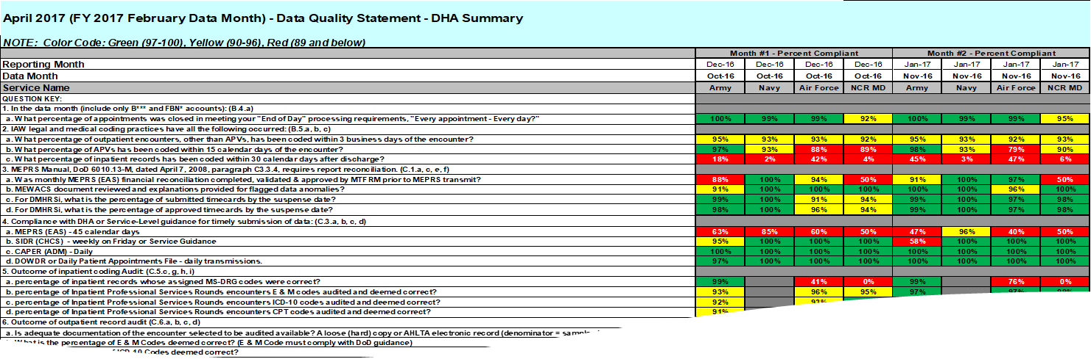
Data Quality Management Control Program – DHA Summary
Example 1 -Sample Dashboard
Metric Thresholds are as follows:
    Good – visual cue green FY16: 97-100%
    Caution – visual cue yellow FY16: 90-96%
    Needs Improvement – visual cue red FY16: 0-89%
    A number only question has no color cue
Metrics
  Generally move from “Needs Improvement” to “good” as the fiscal year progresses and issues are ironed out
  Sometimes “Needs Improvement” is good, revealing a system wide problem
Notes:
Not expected to read this barber pole chart. Refer to 11 x 17 handout.
Would someone help me pass these out?

Slide 33
FY16 DQ Metrics Observations – Current
Example 1 con’t
DHA has received metrics through Feb data month. What are we seeing?
For FY17 the following metrics are being tracked for issues:
2c: Inpatient Medical Record Coding
4a: MEPRS timeliness
11a: Results of DQ Coding Error Reports
NOTE: The DQMC Program is self reported by MTF and validated through Service Programs. Service Programs have flexibility to adjust and focus on Surgeon General Special Interest Items.
Notes:
This of course need to have other items measured because the event or transfer triggers will be different in the new system.

Slide 34
Ex 2 Reference Code and
Table Synchronization WG
Purpose
  Coordinate the release of enterprise files and tables in MHS Systems with the goal of meeting industry effective dates e.g.
    ICD-10s - released annually, effective Oct 1 with federal fiscal year
    CPT-4/HCPCs – released annually/quarterly, effective Jan 1 of each year
Goal
  Comply with industry best practices for health care records maintenance and billing. Industry best practices are achieved by ensuring the timely adoption and release of updated code sets throughout MHS
  Ensure the direct input from and coordination with stakeholders of key systems and business departments
Transition to MHS GENESIS ➔➔➔ Where’s the comparable function?
Notes:
Key Purpose
Goals:
So, As we transition to MHS GENESIS , where’s the comparable function

Slide 35
Reference Code and Table Synchronization Work Group
MHS PATCAT Table changes
For CPT and ICD-10:
Pre-Release Activities
Oversee validation of CPT-4 site list and ensure CPT licenses are ordered
Validate Modifier Mapping Table
Coordinate changes to/with DHA Relative Value Units (RVUs)
Coordinate resolution of CPT Modifier Table discrepancies
Release Synchronization Activities
Monitor downloads and installations until complete of:
CPT Table & Modifier Mapping Table for CHCS sites
updated CCE system for CHCS sites
updated ICD-10 and DoD Unique codes for CHCS, CCE and AHLTA
Out-of-Cycle CPT/HSPCS Update Process
Business Decision Point for approval of out-of-cycle CPT/HCPCS Codes and Narratives updates
MS-DRG Weights
Updates
Table and code Releases for MHS GENESIS.
HIPAA Provider Taxonomy Table and PSC changes
Current, Synchronized, Versioned, and Maintained Code Sets, Files, and Tables
Code set-specific deployment and update
CPT-HCPCS
MHS CHCS sites
Modifier Table Mapping
Code Set Licensing oversight CPT-HCPCS, RBRVS Weights
ICD-10 and CHCS CPT/HPCS Updates
Notes:
Key Purpose
Goals:
So, As we transition to MHS GENESIS , where’s the comparable function

Slide 36
RCTSWG – Expand to include MHS GENESIS
Synchronization
NOTIONAL RECOMMENDATION:
Integrate lessons learned from each IOC into a convergence path toward a uniform set of enterprise level Data Quality Policies and Practices
  Terminology and Standards
    Reconcile MHS and MHS GENESIS Mapping of process flows, data dictionaries, standards, and code sets
    Ensure Currency of Code Sets; Understand Deployment Synchronization & Delays
    Implement an Enterprise approach
  Process Flows
    Coding and Compliance Inpatient and Outpatient Encounters
      Intermountain Health Pilot for Use of the 3M 360 Encompass Platform
    Billing
      Enterprise Charge Description Master (CDM)
    Interoperability
    Data Exchanges
  Governance
    Data Quality Oversight; Develop Data Stewardship in new relevant areas
    Configuration Management
Evaluate Transition Schedule Based on Lessons learned
Notes:
Words from Dr Toney’s way forward??? Doug Felton to confirm

Slide 37
MHS GENESIS Data Issue Example
Distribution D: Distribution authorized to the DoD and U.S. DoD contractors only. Other requests for this document shall be referred to DHMSM PMO.

Slide 38
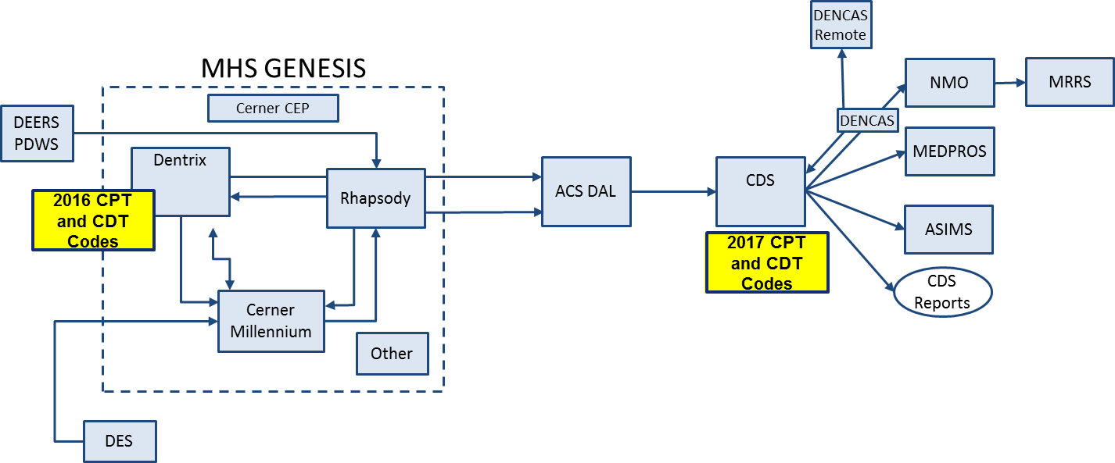
Reference Code and Data Synchronization
Co-existence
Source: PM DHMSM Engineering
Issue: Approximately 4% of messages rejected resulted from a treatment or procedure sent by DENTRIX that is not in CDS.
Root Cause: DENTRIX and CDS treatment and procedure code baselines are not aligned.
Corrective Action: Modify DENTRIX baseline from 2016 to 2017 and align to the DoD codes.
Notes:
Monica’s error? ---- These should be 2016 CDT codes and 2017 CDT codes I believe --- Monica needs to confirm.

Slide 39
Data WSC – Data Quality Common Operating Picture Item #188
COP item #188 updated Problem Statement:
Who will be responsible for MHS GENESIS data quality and for resolution of data quality issues?
Who on the MHS GENESIS team will be the POCs/SMEs for reporting and working with the identified MHS Management team data quality questions?
Findings and Analysis:
Analysis of Workgroups with data quality (DQ) oversight in their Charter: 2 primary, 9 with some direct DQ responsibilities, 5 with indirect DQ responsibilities.
The Data Quality Management Control (DQMC) Program Work Group is recommended as the best fit for overarching MHS GENESIS data quality oversight and governance. The DQMC Program Work Group is chartered to develop and recommend data quality strategy and processes for the complete, timely, and accurate submission of healthcare, labor, and resources data in support of the DQMC Program for the Military Health System and its associated Department of Defense Instruction (DoDI) 6040.40. The 14 Workgroups noted above will be utilized for issue resolution on particular issues relevant to their areas of responsibilities (e.g. Patient Registration WG)
Refined high-level Entrance Criteria:
Identification of MHS GENESIS data quality POCs/SMEs for the MHS Management data quality team.
A working list of data quality questions for the MHS GENESIS data quality SME.
Refined high-level Exit Criteria:
Data Quality Issue Resolution Process: A mature set of processes with active, ongoing MHS GENESIS participation in tasks & questions that will enable the DQMC to manage data quality oversight for MHS GENESIS during Wave One @ each MTF within the 60-90 day timeframe after go live.
Notes:
Message We’ve identified the problem
We’re on a journey to

Slide 40
Challenges
The opportunity to provide capabilities and improvements to care delivery within the MHS, including health informatics/analytics, big data and decision support desired by leaders throughout the organization.
Continuous evolution of Data Quality monitoring of 2 separate yet concurrently running EHR & Billing systems for the next 5-6 years
  AHLTA/CHCS/Essentris and MHS GENESIS
  ABACUS and Charge Description Master (CDM) / Cerner Patient Accounting Module (CPAM) Transition
Notes:
* 140 in AIR Force, 32 in Army, 2 in NCR, 26 in Navy x on average of 3-5 other people per site who are also involved in the MHS Data Quality Management Control Program

Slide 41
Next Steps
Recommended practices/actions for the next 12 months include:
  Access to LPDH (Cerner/Leidos) Experts to Map and Gap Legacy Data Quality Program Efforts to MHS GENESIS. The access to experts, will facilitate and ensure data quality tenets are addressed during MHS GENESIS deployment and sustainment
  Discovery of new Data Quality infrastructure supplied by MHS GENESIS in partnership with the LPDH Experts
  Continued use of and enhancement of current metrics tracked by the Data Quality Management Control infrastructure
  Continued use and enhancement of Reference File & Table Synchronization WG to register and monitor items necessary to MHS GENESIS interfaces and implementation
Notes:
* 140 in AIR Force, 32 in Army, 2 in NCR, 26 in Navy x on average of 3-5 other people per site who are also involved in the MHS Data Quality Management Control Program

Slide 42


MHS Data Quality Is A Partnership Process
Bottom Line: MHS GENESIS is expected to improve enterprise data quality
MHS Business Practices
DHA and PEO DHMS/LPDH
MHS GENESIS Technical
Information Management Functional
Access to the LPHD Experts is needed, so DQ personnel can understand how MHS GENESIS Works, the new vocabulary, and how to proactively translate that into a new/modern Data Quality Program that supports the enterprise.
Notes:
* 140 in AIR Force, 32 in Army, 2 in NCR, 26 in Navy x on average of 3-5 other people per site who are also involved in the MHS Data Quality Management Control Program

Slide 43
Summary
Background
Data Quality Lifecycle
MHS Data Quality Infrastructure/Resources
  Data Quality Management Control Program
  Reference Code and Synchronization Work Group
MHS GENESIS Data Quality Example
Data Quality Common Operating Picture
Challenges
Next Steps
Summary

Slide 44
Questions?
Nancy Orvis
Chief Business Architecture, Health Standards & Interoperability
Office of Information Management
Defense Health Agency DHHQ, Falls Church, VA
nancy.j.orvis.civ@mail.mil
Thanks to the MHS DQ Management Program, Mr. Bob Moss and DQ Team, Dr Steve Toney and the RCTSWG, and all those in the Data WSC

Slide 45
Backup Slides
45

Slide 46
Acronyms
  CAPER is Comprehensive Ambulatory/Professional Encounter Record
CCE is Coding and Compliance Editor
CDT is Code on Dental Procedures and Nomenclature
CPT is Clinical Procedural Terminology
FHIM is Federal Health Information Model
HIPAA PSCs – Health Insurance Portability and Accountability Act Provider Taxonomy Codes and Provider Specialty Codes
ICD-10 is International Classification of Diseases, 10th Edition
JLV is Joint Legacy Viewer
  MEPRS is Medical Expense & Performance Reporting System
MS-DRG is Medicare Severity-Diagnosis Related Group
PATCAT is Patient Category Codes
PAMPI is Problems, Allergies, Medications, Procedures and Immunizations
RBRVS – Resource Based Relative Value Scale weights
  SIDR is Standard Inpatient Data Record

Slide 47
MHS GENESIS Reporting
Mr. Drew Brown
Product Support Manager
DHMSM ILS

Slide 48
DHMSM Reporting Overview
Standard/Gap Reports
178 reports were approved by the FAC for Fairchild which included 173 standard reports and 5 gap reports
341 reports were approved by the FAC for Oak Harbor, Bremerton and Madigan which includes 323 standard reports and 18 gap reports
  Once the reports are published, all IOC sites will have 519 reports which can be viewed based on the user’s role
Following the Go-Live of Madigan, DHMSM PMO will review the Cerner catalog and determine what additional reports from the catalog will be published for the enterprise
  The Cerner catalog currently has 1100 standard reports

Slide 49
Reporting Capabilities
Carl Ohrberg (Cerner)
Distribution D: Distribution authorized to the DoD and U.S. DoD contractors only. Other requests for this document shall be referred to DHMSM PMO.
49

Slide 50
Objectives
Reporting Solutions
Operational Reporting
Distribution D: Distribution authorized to the DoD and U.S. DoD contractors only. Other requests for this document shall be referred to DHMSM PMO.
50

Slide 51
Reporting Solutions
Operational Reporting
  Real-time reporting
  Available from Reporting Portal
Enterprise Data Warehouse Reporting
  Copy/Extract of Cerner Millennium
  24 hour lag
  Available from Reporting Portal for viewing
  Report designed in Business Objects
Quality Reporting
  eMeasures 2017
  ORYX
  Available from Reporting Portal
Solution specific reporting
  Imbedded into the clinical workflow
  Available primarily in solution specific tools.
Healthe EDW (Future 2018)
Distribution D: Distribution authorized to the DoD and U.S. DoD contractors only. Other requests for this document shall be referred to DHMSM PMO.
51

Slide 52
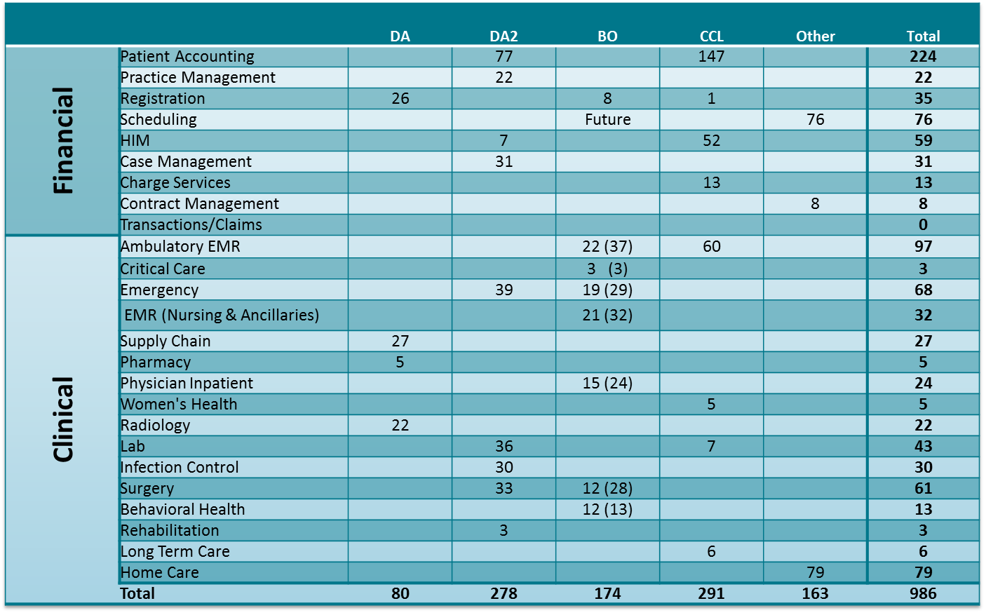
Solutions - Standard Reports

Slide 53
















REACT >
ANALYZE >
STRATEGIZE>
PREDICT>
PRESCRIBE>
UNIFIED DATA PLATFORM
Operational management
Business
intelligence
Predictive
analytics
Research
SCALABILITY
Department
Organization
Community
Cerner data
Operational Reporting / Solution Reports
Enterprise data
EDW
External data
Healthe EDW
Analytic tools
Embedded workflow capabilities
Self-service capabilities
Complementary services
Distribution D: Distribution authorized to the DoD and U.S. DoD contractors only. Other requests for this document shall be referred to DHMSM PMO.
53
Notes:
At Cerner, we believe analytics and reporting a multi-dimensional strategy that functions best when all data is hosted and accessible from a single unified data platform, scalable from a department to community level and capable of ingesting external data.
By having this unified data platform, solutions can leverage the same data and insights can be shared across all solutions– allowing you to have a single, unified analytics and reporting strategy instead of a siloed, fragmented approach.
When layered with….
Analytic tools that allow your organization to visualize the data
Embedded workflow capabilities that push vital information to users in the context of what they do every day
Self-service capabilities that empower your organization to answer their own analytic questions and control their data
And complementary services that offer your organization assistance in determining the best strategy and implementation assistance
… we feel organizations can be most successful.
Disclaimer: We have already started down the path of moving several of our solutions to the unified data platform (HealtheIntentSM) and plan to continue to do so.

Slide 54
Operational Reporting

Slide 55
Operational Reporting is…
Internally-focused
for the purpose of:
Operational improvement
Clinical improvement
Financial improvement
***Not externally-focused, not regulatory reporting***
Intended for MANAGERS
of clinical , financial and operational departments within a health care system
  Examples: OR manager, ED manager, clinic Manager
&
Distribution D: Distribution authorized to the DoD and U.S. DoD contractors only. Other requests for this document shall be referred to DHMSM PMO.
55

Slide 56








Meeting the needs of operational users
How long are my patients staying and what is their acuity?
What is my turnaround time (e.g., beds, ED…)
What’s the utilization of my beds and operating room?
Do I have the right staffing levels to meet demand?
Executive
Informatics leadership
Manager
Data
scientist
Clinician / Physician
Analyst
Abstractor
Utilization
Throughput
Cost of care
Outcomes
56
Notes:
Cerner can help meet the needs of operational users by helping answer key questions and address analytic focus areas that are top-of-mind for many in the industry.

Slide 57



Enhancing Operational Reporting
Operational reporting is key to the day-to-day basic functionality of a care venue or financial department. Cerner continually improving operational reporting in three key ways:
Operational dashboards
present departmental KPIs in dashboards that drill for analysis
Reporting portal
makes reports across tools easily found in a single location
Departmental reports
give each department relevant, modifiable standard reports
Distribution D: Distribution authorized to the DoD and U.S. DoD contractors only. Other requests for this document shall be referred to DHMSM PMO.
57
Notes:
Operational Reporting is key to the day-to-day basic functionality of a care venue or
financial department. Cerner is improving Operational Reporting in three key ways:
Cerner is working to enhance our operational reporting in three key ways:
Create manager dashboards that showcase departmental KPIs that have drill-down capabilities for analysis
Fill current gaps in reporting with new, modifiable standard reports that leverage the visualization tool, SAP BusinessObjects
Provide a reporting portal that allows managers to search for and run reports across any department in a single location

Slide 58

Clinical Operational Reporting
180+ reports available across reporting categories
Oncology
Appointments
Patient volumes
Documentation
Orders
Medication alerts
Powerplans
Lab
Orders
Blood utilization
Women’s & children’s
Immunizations
Outcomes
Patient volumes
Behavioral health
Documentation
Patient volumes
Orders
Patient safety
Outcomes
Acute care
Patient volumes
Patient safety
Orders
Documentation
Workflow & tasks
Care plans
Ambulatory
Patient volumes
Orders
Documentation
Charges
Problem list
Long-term care
Documentation
Patient volumes
Orders
Patient safety
Outcomes
Emergency
Throughput
Orders
Documentation
Charges
Perioperative
Case volumes
Surgery throughput
Scheduled procedures
Case details
Delays
Rehab
Patient Care
Orders
Documentation
Distribution D: Distribution authorized to the DoD and U.S. DoD contractors only. Other requests for this document shall be referred to DHMSM PMO.
58

Slide 60
MHS GENESIS Reporting
Backup Slides

Slide 61
IOC Reports by Type
Reports by Type | Total
Ambulatory - Physician Practice | 24
APACHE Outcomes | 11
Behavioral Health | 22
Care Management | 29
Cerner Bridge - System Reports | 7
Cerner Health Information Management | 19
Cerner Practice Management | 2
Charge Services | 7
Clairvia - Schedule | 8
Clairvia - Demand | 11
Clairvia – Acuity | 12
Clairvia – Patient Assign | 3
Clairvia – Administrative | 4
Clairvia – Management | 13
Critical Care | 3
Emergency | 19
Infection Control | 33
Lighthouse | 20
Nursing Care Delivery | 26
PathNet | 27
PathNet Specimen Management | 7
PathNet General Laboratory | 11
PathNet Microbiology Reports | 16
PathNet Microbiology Statistical Reports | 9
PharmNet Management | 8
Perioperative | 11
Pharmacy Clinical Interventions | 2
Pharmacy Outpatient | 13
Physician Inpatient | 17
Radiology | 1
RadNet- Operations | 2
RadNet- Imaging Applications | 3
RadNet - General Reports | 13
Registration Management | 26
RadNet- Mammography | 10
Scheduling Management | 15
Supply Chain | 23
Transfusion Administration Reports | 13
Total | 500

Slide 62


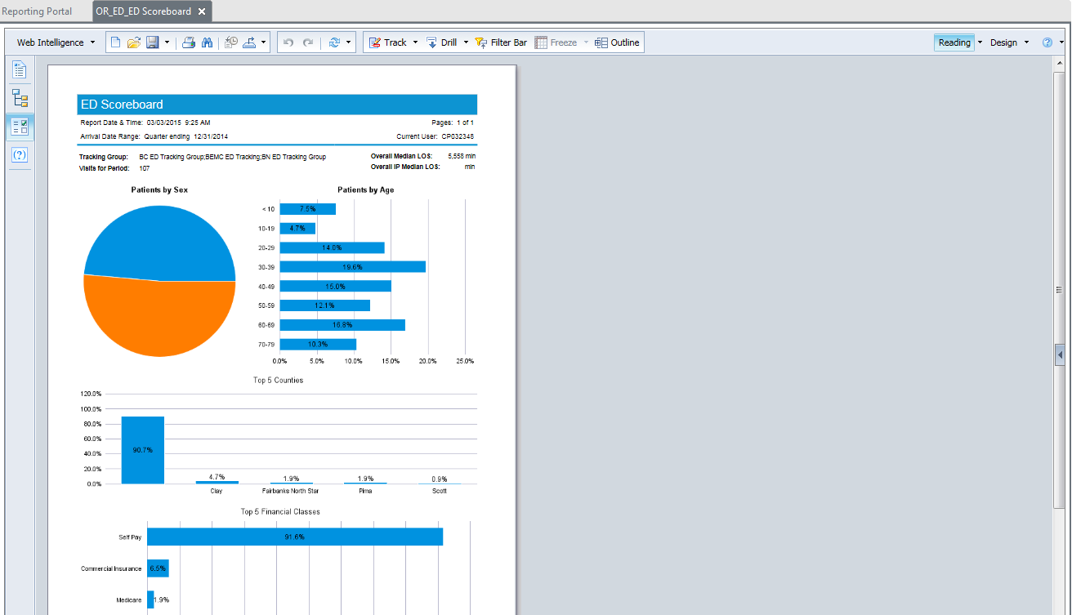
Reporting portal | run report
Distribution D: Distribution authorized to the DoD and U.S. DoD contractors only. Other requests for this document shall be referred to DHMSM PMO.
62
Notes:
Users can easily search for and run any report from one central location, the reporting portal.

Slide 63
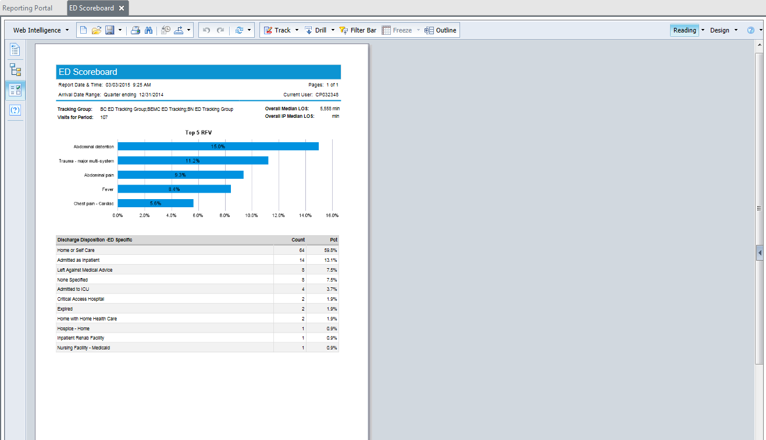
Reporting portal | run report
Distribution D: Distribution authorized to the DoD and U.S. DoD contractors only. Other requests for this document shall be referred to DHMSM PMO.
63
Notes:
Users can easily search for and run any report from one central location, the reporting portal.

Slide 64
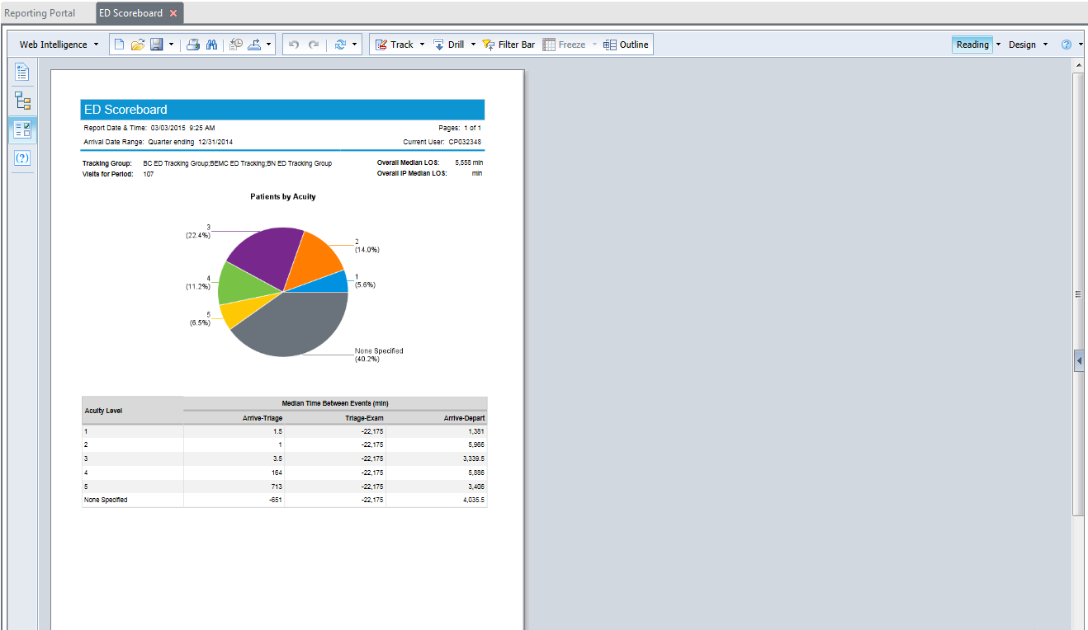
Reporting portal | run report
Distribution D: Distribution authorized to the DoD and U.S. DoD contractors only. Other requests for this document shall be referred to DHMSM PMO.
64
Notes:
Users can easily search for and run any report from one central location, the reporting portal.

Slide 65

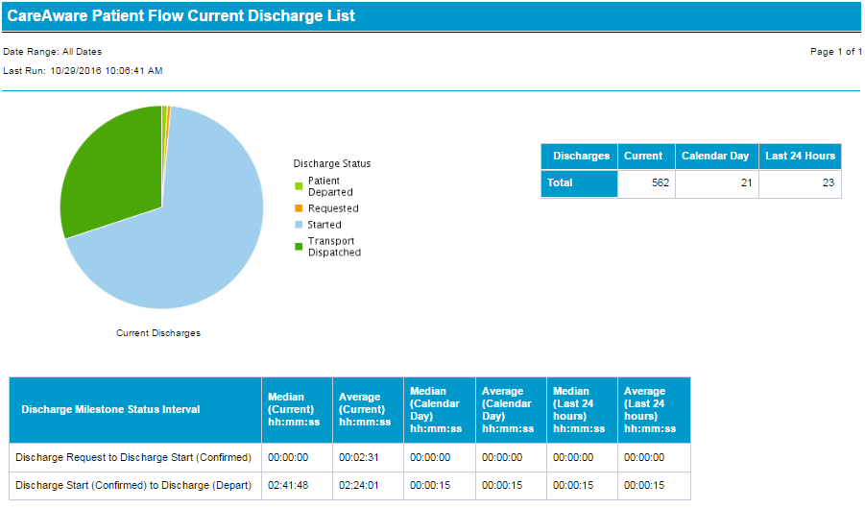
Current Discharge List
Distribution D: Distribution authorized to the DoD and U.S. DoD contractors only. Other requests for this document shall be referred to DHMSM PMO.
65
Notes:
Current Discharge List
-CareAware - Capacity Management – Patient Flow
CareAware Reporting
This report displays a list of all Discharge milestones that are in a pending (requested), confirmed (started), or departed (pending adt complete) status.

Slide 66
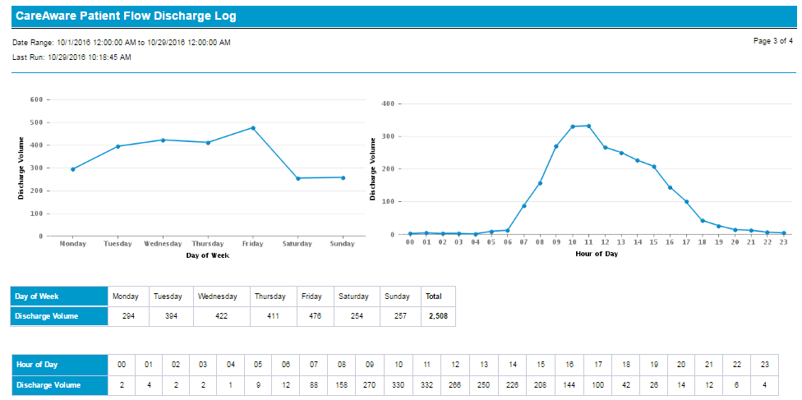
Discharge Log
Distribution D: Distribution authorized to the DoD and U.S. DoD contractors only. Other requests for this document shall be referred to DHMSM PMO.
66
Notes:
Discharge Log
- Capacity Management - Patient Flow
CareAware Reporting
This report provides a report to display a list of all Discharge milestones that posted a milestone action within the time range, Begin and End Date and Time, or entered in the report input parameters.

Slide 67
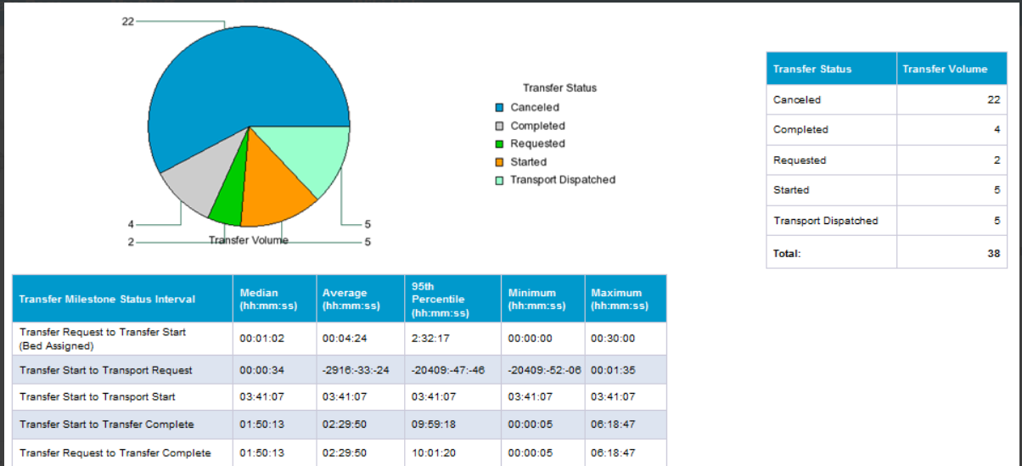
Transfer Log
Distribution D: Distribution authorized to the DoD and U.S. DoD contractors only. Other requests for this document shall be referred to DHMSM PMO.
67
Notes:
Transfer Log
-Capacity Management – Patient Flow
CareAware Reporting
This report provides a report to display a list of all Transfer milestones that posted a milestone action within the time range, Begin and End Date and Time, entered in the report input parameters.

Slide 68
Interoperability
Leanna Evans
Cerner | Interoperability Strategist

Slide 69
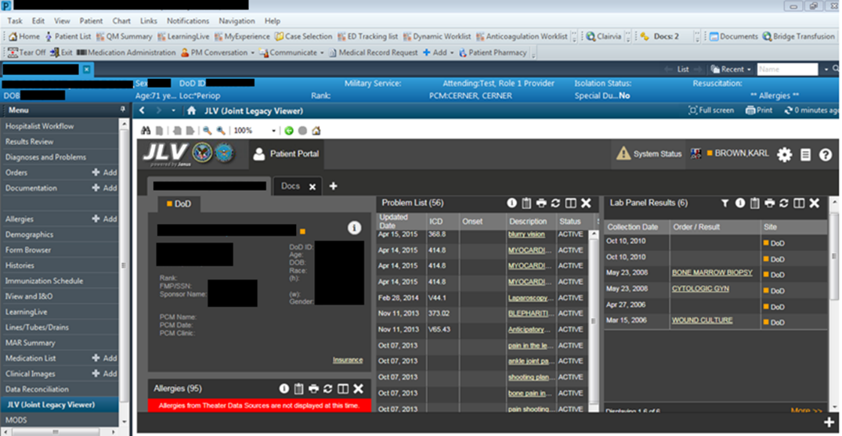
JLV (Joint Legacy Viewer) in PowerChart
Distribution D: Distribution authorized to the DoD and U.S. DoD contractors only. Other requests for this document shall be referred to DHMSM PMO.

Slide 70
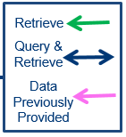
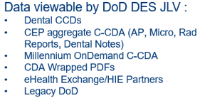
MHS GENESIS External Data Flow
MHS GENESIS
DES
CEP
(Cerner)
Data Stored in CEP :
-AP, Micro, Rad Results
-CDA Wrapped PDFs
-Dental CCDs/Notes
-OnDemand Doc IDs
eHealth Exchange
Partners
6
2
4
& 5
Commercial
Dental Notes/ CCDs
Government
3
Legacy
EMR
7
Retrieve
OnDemand
C-CDA
AP, Micro, Rad Results & PDFs
Dentrix
8
Govt. Sources, Consumers
Millennium
(Cerner)
1
JLV
JLV
JLV-mPage
1
Distribution D: Distribution authorized to the DoD and U.S. DoD contractors only. Other requests for this document shall be referred to DHMSM PMO.

Slide 71
Direct Messaging secure messaging for provider-to-provider email and document sharing
Distribution D: Distribution authorized to the DoD and U.S. DoD contractors only. Other requests for this document shall be referred to DHMSM PMO.
71

Slide 72
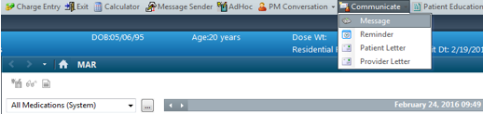
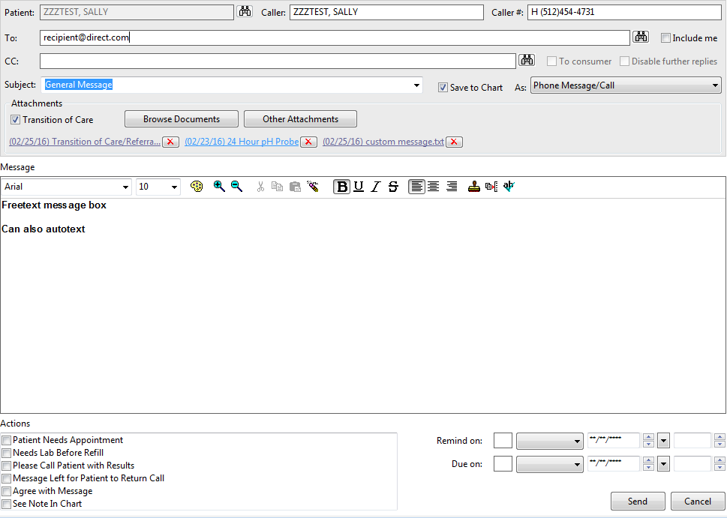
Direct Message - Manual
72

Slide 73
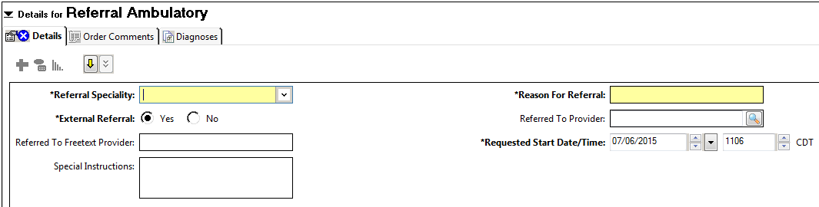
Direct Messaging - Automated
TOC OPS Job (Transition of Care Operations Job)

Slide 74
Clinical Data Reconciliation
Distribution D: Distribution authorized to the DoD and U.S. DoD contractors only. Other requests for this document shall be referred to DHMSM PMO.
74

Slide 75
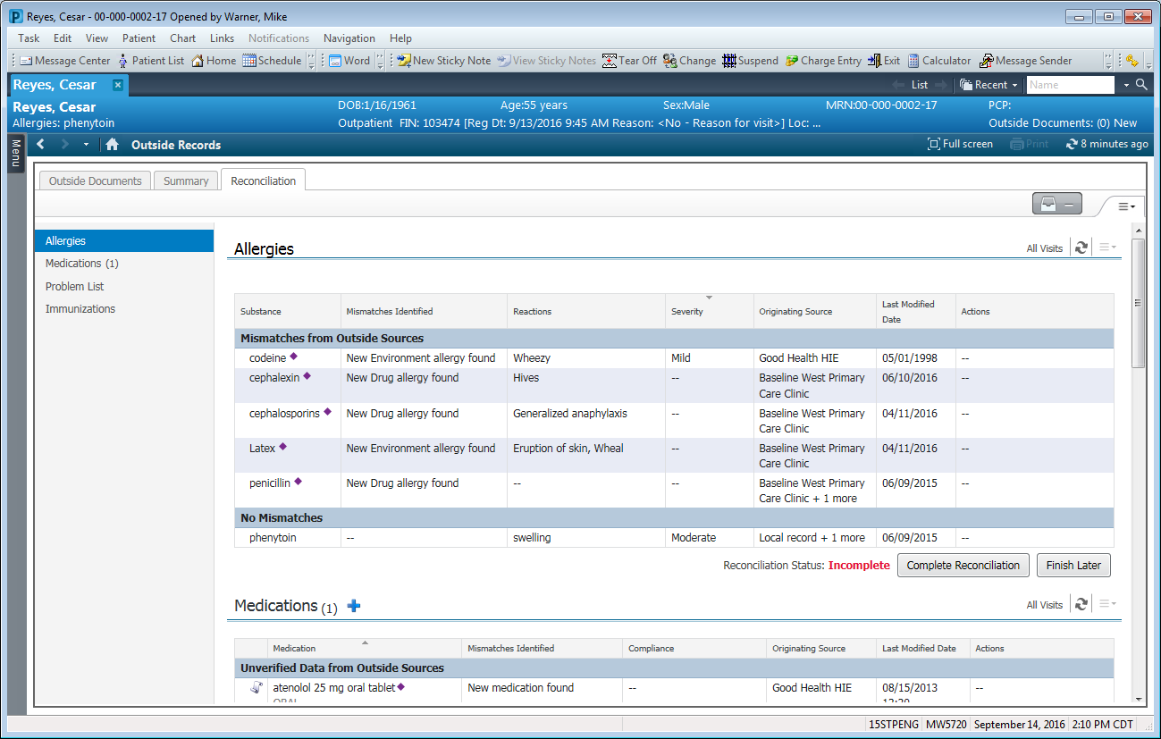
Clinical Data Reconciliation
MPage Workflow components
New “Reconcile” mode
Distribution D: Distribution authorized to the DoD and U.S. DoD contractors only. Other requests for this document shall be referred to DHMSM PMO.
75

Slide 76
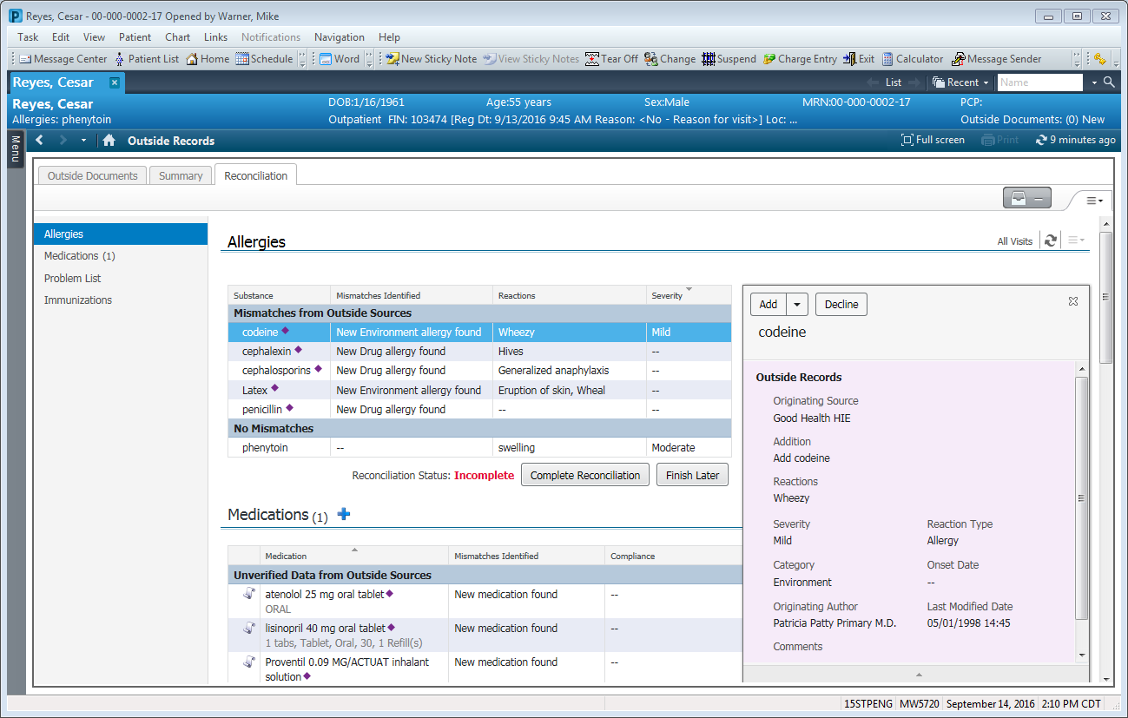
Clinical Data Reconciliation (cont’d)
Compare received data to local chart
Items not on local chart
  Add or Add with changes
  Decline
Distribution D: Distribution authorized to the DoD and U.S. DoD contractors only. Other requests for this document shall be referred to DHMSM PMO.
76

Slide 77
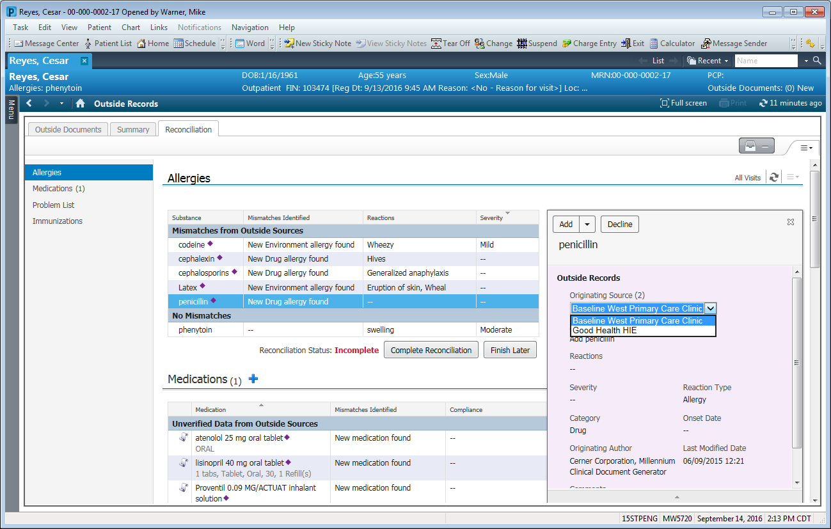
Clinical Data Reconciliation (cont’d)
Same items from multiple sources/CCDAs
Toggle between sources
Distribution D: Distribution authorized to the DoD and U.S. DoD contractors only. Other requests for this document shall be referred to DHMSM PMO.
77

Slide 78
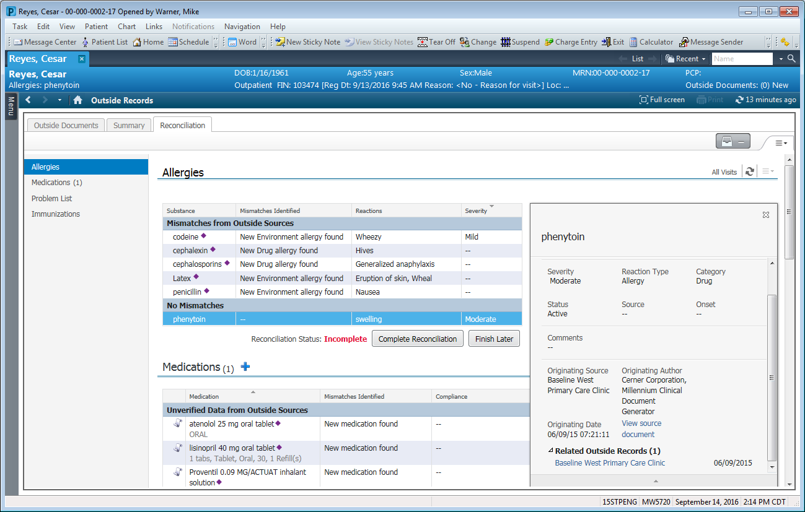
Clinical Data Reconciliation (cont’d)
Data Provenance
  Originating source
  Link to CCDA document
Distribution D: Distribution authorized to the DoD and U.S. DoD contractors only. Other requests for this document shall be referred to DHMSM PMO.
78

Slide 79
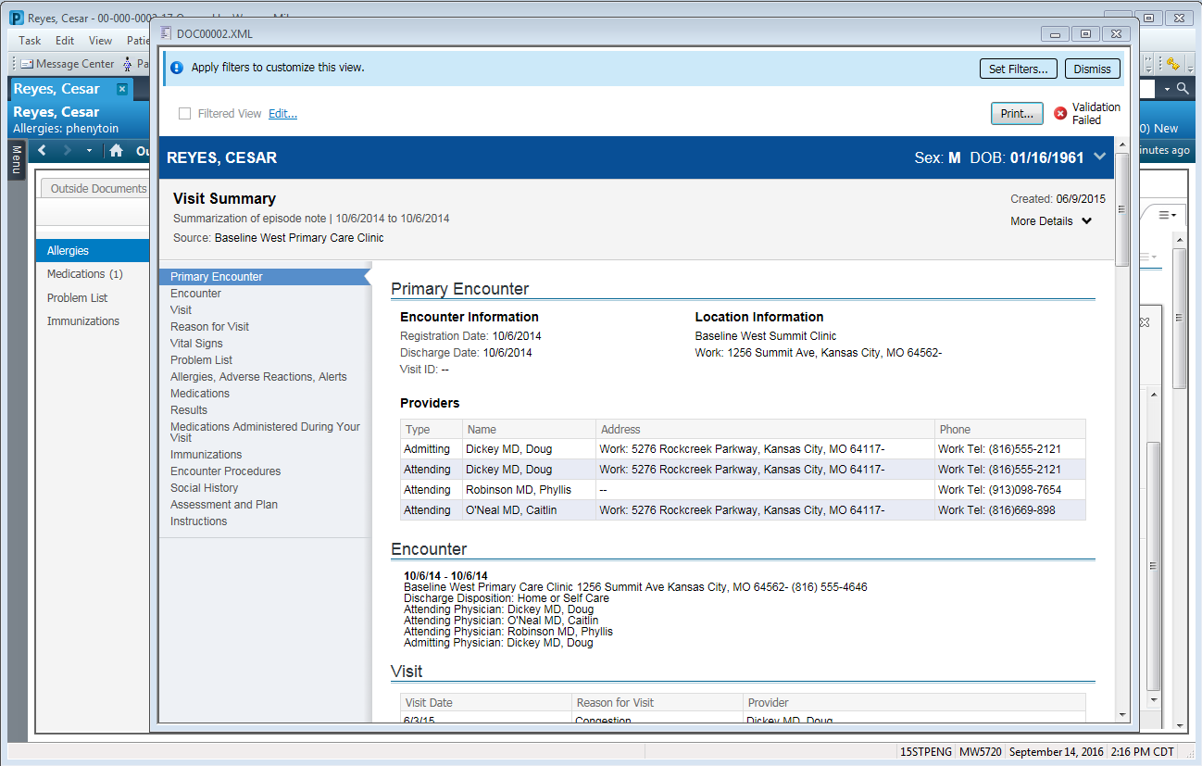
Clinical Data Reconciliation (cont’d)
Data Provenance
  Originating source
  Link to CCDA document
  Launch originating source or related record
Distribution D: Distribution authorized to the DoD and U.S. DoD contractors only. Other requests for this document shall be referred to DHMSM PMO.
79

Slide 80
Clinical Data Reconciliation (cont’d)
Complete Reconciliation for MU3
Finish Later to return to review mode
Distribution D: Distribution authorized to the DoD and U.S. DoD contractors only. Other requests for this document shall be referred to DHMSM PMO.
80

Slide 81
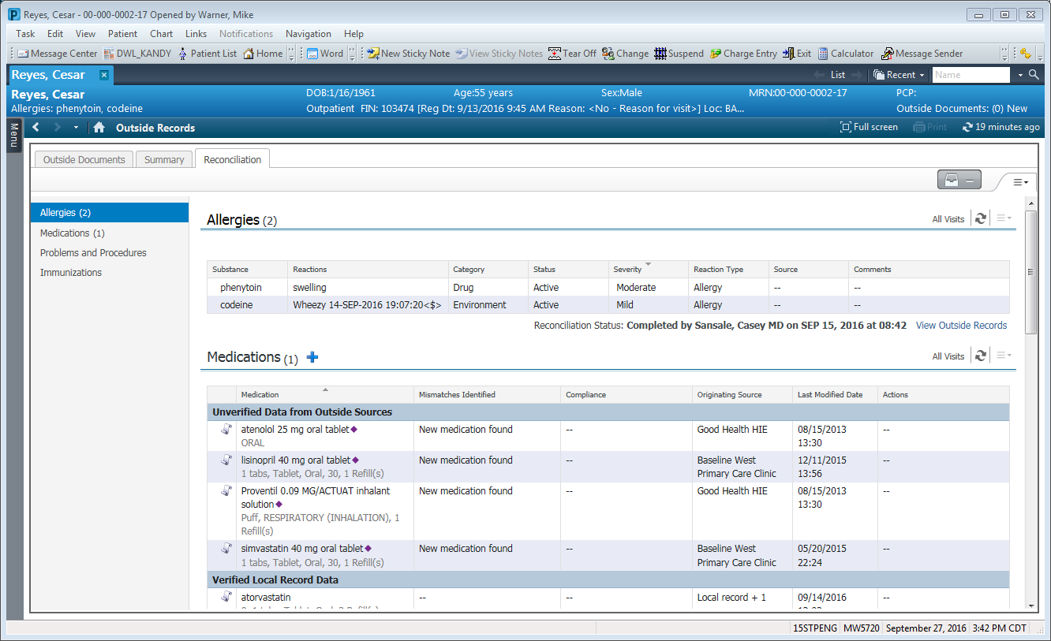
Clinical Data Reconciliation (cont’d)
Reconciliation Completed
Distribution D: Distribution authorized to the DoD and U.S. DoD contractors only. Other requests for this document shall be referred to DHMSM PMO.
81

Slide 82
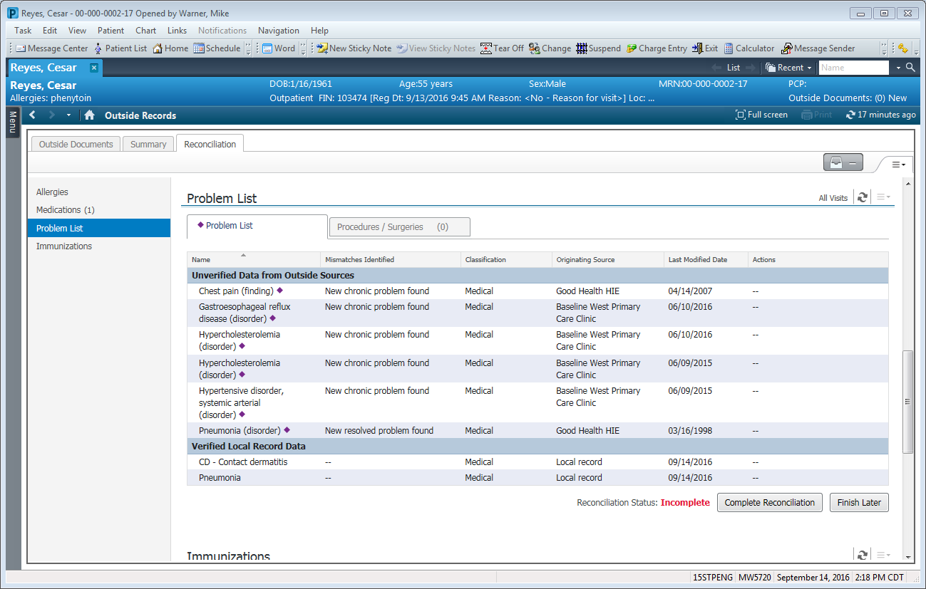
Problem List
Problem History
Distribution D: Distribution authorized to the DoD and U.S. DoD contractors only. Other requests for this document shall be referred to DHMSM PMO.
82

Slide 83
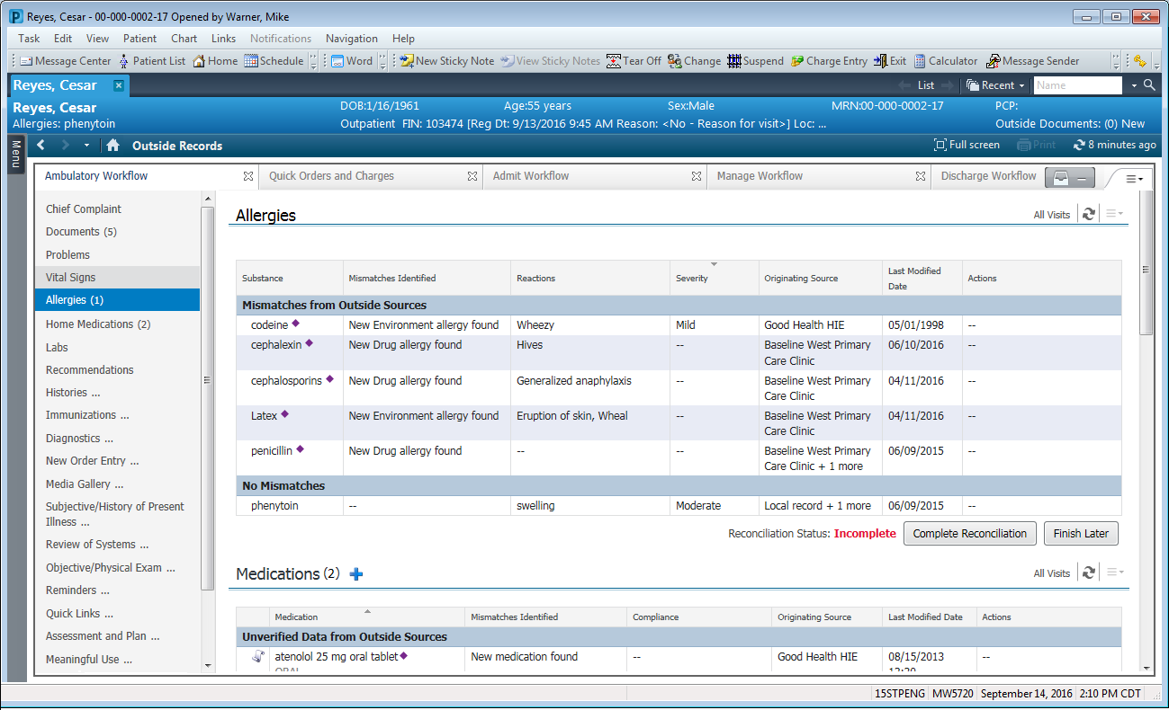
Reconcile in Workflows
Reconcile from any workflow
Distribution D: Distribution authorized to the DoD and U.S. DoD contractors only. Other requests for this document shall be referred to DHMSM PMO.
83

Slide 85
Business Data
Craig Mason
Matthew Shotton
Cerner

Slide 86
What is Business Data
Business Data is all of the necessary details to allow for timely billing and accurate coding.
  Clinically care will generate/capture Several data types
    Provider responsible for patient care
    Diagnosis of reason for patient care
    CPT & HCPCS codes for care provided
    Date & time of care provided
  Within MHS GENESIS Business Data is commonly interchangeable with Charges
  Coding will review & ensure the business data is supported by and generated from clinical documentation

Slide 87
How is Business Data Utilized in MHS GENESIS
In MHS GENESIS Business Data is primary utilized to provide
  CCE with the clinically driven charge codes
  ABACUS with all the necessary data to generate the appropriate claim
Reporting and Auditability of this data can be leveraged in several ways.

Slide 88
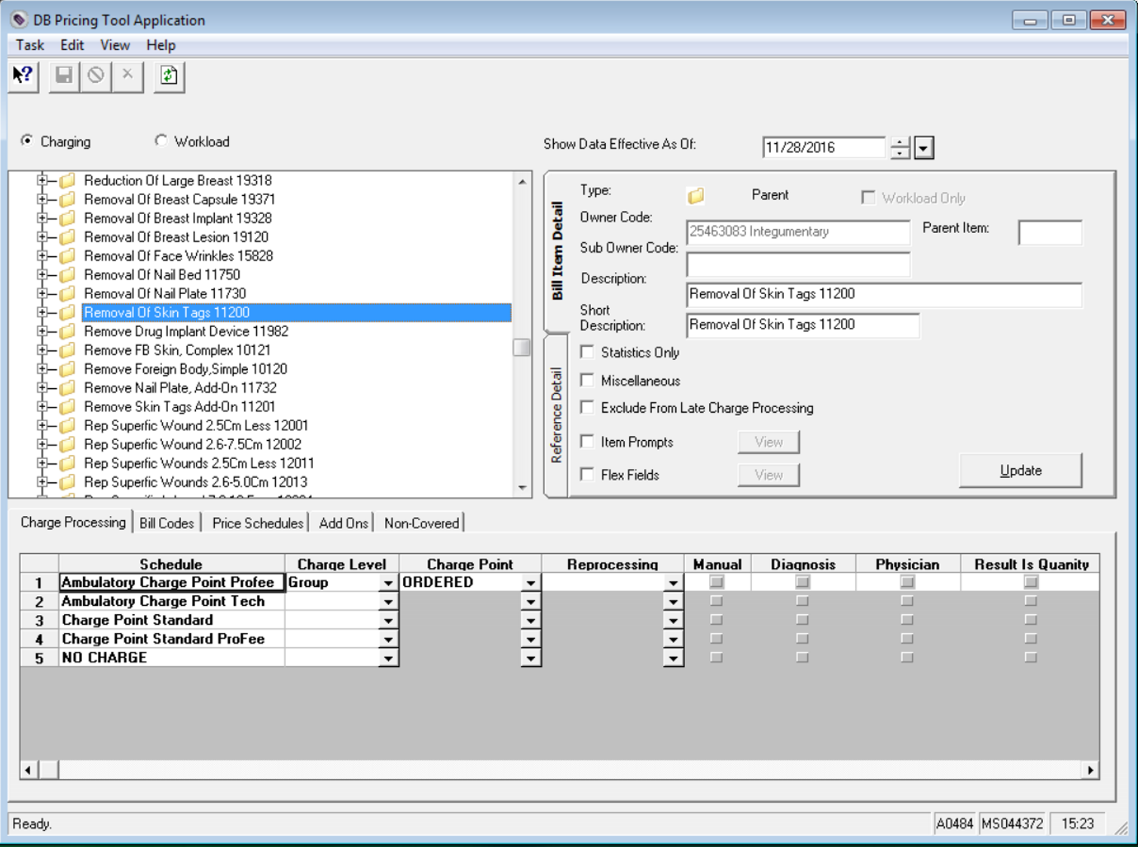
Build Data

Slide 89
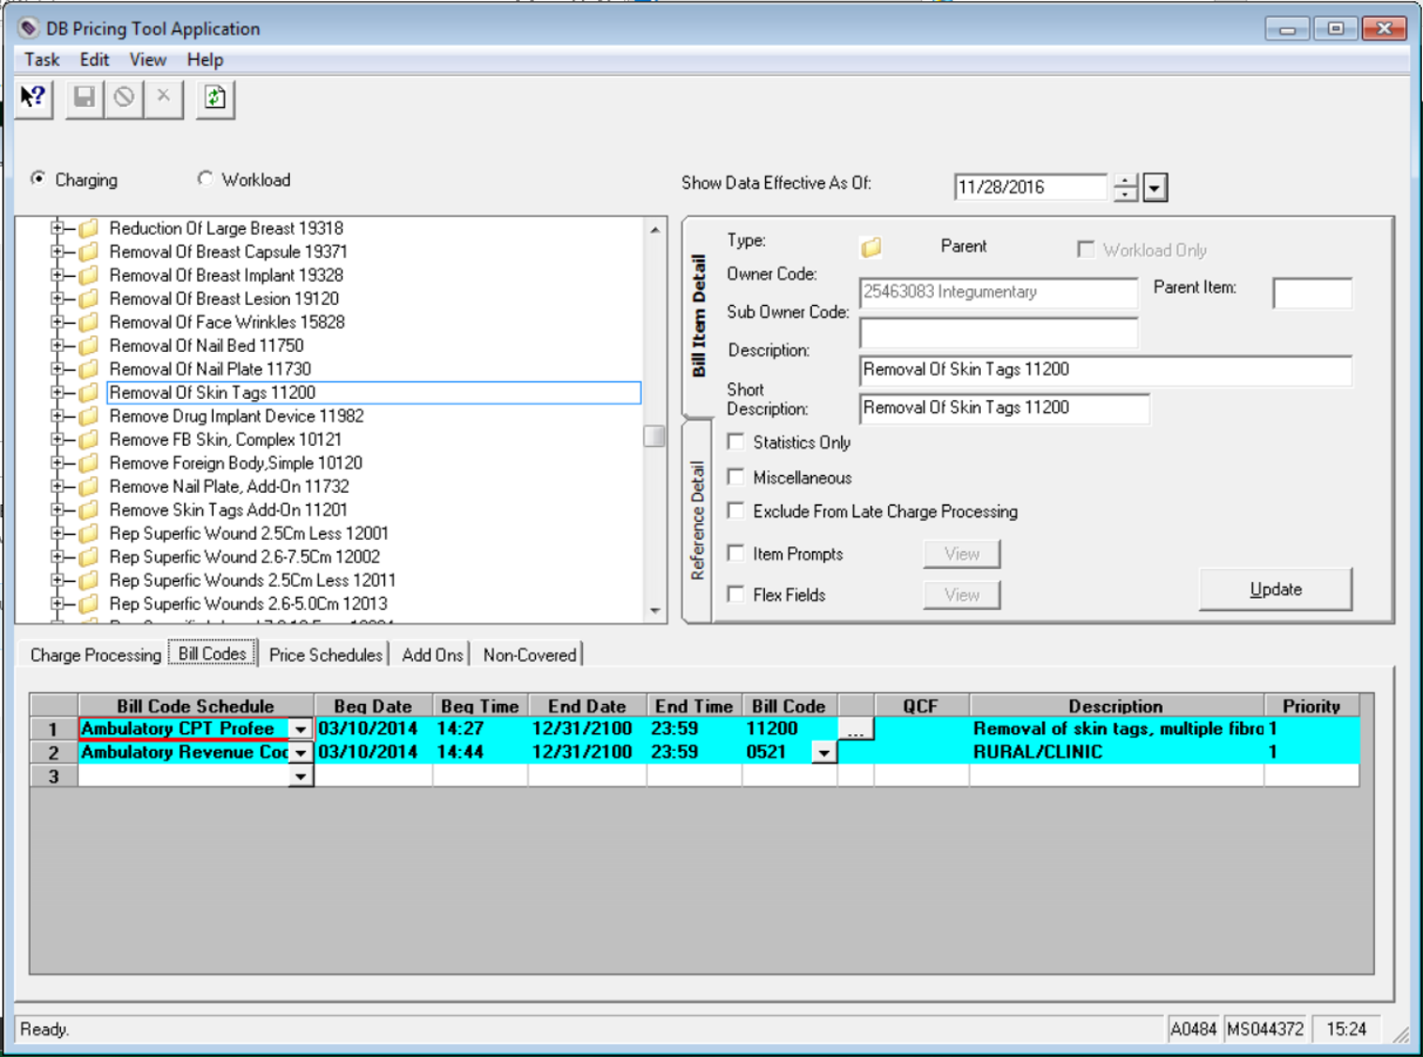
Build Data (cont’d)

Slide 90
Build Data – bill_item_mod
  Processing
    Charge Schedule
    Charge Level
    Charge Point
    Result is Quantity
  Business
    CPT codes
    HCPCS codes
    Modifiers

Slide 91

Charge Data – charge_mod
Reference Data:
Doctor
Order Name
Diagnosis

Slide 92

Charge Data – charge_mod (cont’d)
Activity Data:
CPT
CPT Modifier
Service Date & Time
Price
Quantity

Slide 93


Charge Data – charge_mod (cont’d)
Routing Data:
Tier Group
Charge Type
Status
Interfaced Date and Time

Slide 94
CCE Interface
  Outpatient Interface
    Outbound
      charge_mod
      diagnosis
      encntr_info
    Inbound
      procedure
      diagnosis
  Inpatient Interface
    Inbound
      DRG

Slide 95
ABACUS Extract
  Un-coded Extract files
    Script captures all person, encounter, and charge data for the day before
      Charge Header
      Charge Detail
      Person
      OHI
  Final coded Extract files
    Script captures all person, encounter, and charge data with coding complete flag

Slide 96
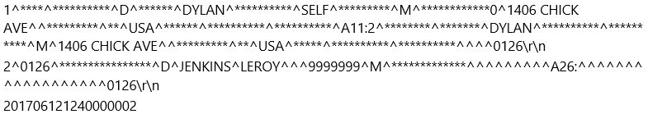
ABACUS Extract - Details
ABACUS Extract:
Has 23,202 lines of code
  9,026 lines just for Charge and Patient extraction
  6,240 lines specific to Other Health Insurance extraction
Leverages 13 clinical & system events to compile data
Touches over 108 different data tables

