Slide 1
Welcome

Slide 2
Meeting Rules of Engagement
PLEASE:
Remember HIPAA training – no PII or PHI in discussions, demos, slides, etc.
Refrain from side conversations in the room
One Topic at a time- stay on track with the current topic
One Speaker at a time – be considerate of colleagues
Be back on time from breaks
Cell Phone Reminder
  Turn to Silent
  If urgent, take the call outside
Contribute to meeting goals -- share your knowledge of the topic -- we are here to learn from each other
Have a good time
THANK YOU!

Slide 3
Agenda
Start Time | End Time | Topic | Speaker
8:00AM | 8:30AM | Networking
8:30AM | 8:45AM | Kickoff | Dr. Monica Farah-Stapleton
8:45AM | 9:15AM | Opening Remarks | Dr. Paul Cordts
9:15AM | 9:45AM | MHS Modernization | EIDS Program Manager Mr. Chris Nichols
9:45AM | 10:35AM | Day in the Life of an Encounter and Data Flow in MHS GENESIS Part I | Ms. Stephanie Hermreck - Cerner Mr. Kent Stevenson - ManTech Mr. Clinton Schasteen - LPDH
10:35AM | 10:50AM | BREAK
10:50AM | 11:45AM | Day in the Life of an Encounter and Data Flow in MHS GENESIS Part II | Ms. Stephanie Hermreck - Cerner Mr. Kent Stevenson - ManTech Mr. Clinton Schasteen - LPDH
11:45PM | 12:15PM | Analytics | COL David Carnahan
12:15PM | 12:45PM | Data Quality | Ms. Nancy Orvis
12:45PM | 1:45PM | Lunch
1:45PM | 2:15PM | MHS GENESIS Reporting | Mr. Drew Brown Mr. Carl Ohrberg - Cerner
2:15PM | 2:45PM | Interoperability | Ms. Leanna Evans - Cerner
2:45PM | 3:15PM | Business Data | Mr. Craig Mason - Cerner Mr. Matthew Shotton - Cerner
3:15PM | 3:30PM | BREAK
3:30PM | 4:00PM | Data Governance | COL John Scott
4:00PM | 4:30PM | Stump the Data WSC Co-Chairs | Data WSC Co-Chairs Dr. Monica Farah-Stapleton Mr. Alan (Bart) Bartholomew Mr. Walter (Andy) Anderson
4:30PM | 5:00PM | Parking Lot Review and Closing | Dr. Monica Farah-Stapleton

Slide 4
Complexities and Opportunities of MHS modernization to include data
Chris E. Nichols
Program Manager, Enterprise Intelligence & Data Solutions PMO
DHA | J6 HIT | SDD | EIDS

Slide 5
Data Consolidation
Opportunities
Background
Master Data Management
Service resources
Interface rationalization / SOA
Tool reduction (e.g. SAS, Tableau, Qlik)
Licensing
EHR Modernization
NDAA and Services
Data Management Board / Executive Data Council
J5 standup
Legacy Data/Medical Record Repository
Long history of data
  20+ years of syntactic data
  Secondary data in multiple places
  Little governance on requirements, data or analytics
Enterprise Intelligence and Data Solutions PMO
  Chris Nichols, Col David Carnahan
  Consolidates HSDW, MDR and other data initiatives under one PMO

Slide 6
Enterprise Intelligence and Data Solutions (EIDS) Mission and Delivery
Mission: To support MHS strategic goals and facilitate informed decision-making through the delivery of robust information services and data in a timely, relevant, and actionable manner.
EIDS Solution Layers
Presentation
Logic
Predictive, diagnostic, and descriptive tools for information delivery
Includes: CarePoint information Portal, dashboards and reporting services, and external apps
Data
Data transformation to deploy data virtualization and develop BI strategy and define analytics toolkit
Includes: Virtual Data/SOA/APIs, Business Rules Engine, Routes in the ESB
Single source for secondary data use to facilitate DHA Information and discover/define patterns in enterprise data
Includes: Infrastructure, data, and data marts
The Enterprise Intelligence and Data Solutions (EIDS) PMO was established within the Solution Delivery Division (SDD) of the Defense Health Agency (DHA) to help execute the DHA Data Vision of providing seamless data services and decision support for clinicians, patients, beneficiaries, analysts, researchers, and DoD leadership.

Slide 7
DHA HIT Data Vision
DHA Data Canons
Ensuring the right information is accessible to the right customers at the right time and in the right way
Efficiency
Streamlined information, clean of redundant data
Rationalized processes, tool utilization, and acquisition
Speed
Bimodal exploration to map current and future state
Tools
  Data lake, Hadoop, Teradata, etc
Trust
A single known source for up-to-date data
Centralized, master data management
Intelligence
Descriptive, prescriptive and predictive analytics in a one-stop-shop
Enabling User Experience
User tools (Super Users, Analysts, and Researchers)
User centered
Speed

Slide 8
EIDS PMO Structure and Components
EIDS is organized into five different sections that work in tandem to promote a
collaborative enterprise health information network:
Business Intelligence
Analytics
Data Platforms & Services
Registries
Data Discovery &
Research
Supports data-driven decisions and cost-effectiveness through data discovery, dashboards, and dynamic reports
Develops and manages enterprise measures and logic for dashboards, provides analytical support to MHS operational activities through deep dives and statistical support
Manages enterprise data, data architecture, and acquisitions, supporting data governance and operations (including legacy data management with roll-out of MHS GENESIS)
Leads the centralization and standardization of MHS registries (uniform data used to evaluate population health outcomes) through complete registry lifecycle management
Performs high-end exploratory and predictive analytics using big data techniques to gain insights on outcomes of interest and implementing them into patient care through clinical registries

Slide 9
EIDS PMO Sub-Programs
EIDS is oversees the Clinical Enterprise Intelligence Program (CEIP), SDD data systems, and other non-SDD systems and initiatives.
CEIP APPLICATIONS
SDD DATA SYSTEMS
NON-SDD SYSTEMS/INTIATIVES
  CarePoint Application Portal
  National Intrepid Center of Excellence (NICOE)
  eDQ – Electronic Data Quality
  AFMS Dashboard
  eMSM – enhance Multi Service Market
  MHS Dashboard (formerly P4I)
  DART – Direct Access Reporting Tool
  RMPMT – Referral Management Program Management Tool
  DoD/VA
  CAIB – Community Action Integration Board
  MHSPHP – Military Health Service Population Health Portal
  SDA – Service Delivery Assessment
  HSDW – Health Services Data Warehouse
  CareMart, CDR Mart, nMART, DaVINCI
  COHORT – Composite Occupational Health and Operational Risk Tracker
  ODS – Operational Data Storage
  RMS – Referral Management System
  NICoE – National Intrepid Center of Excellence
  AFCHIPS – Air Force Corporate Health Information Processing System
  ACS DAL – Enterprise Service Bus
  AFMS Kx – AFMS Knowledge Exchange
  MiCare
  CHAS – CarePoint Health Application Suite
  Army Regional Knowledge Exchange (RKC) – PCMH Dashboard
  M2/MDR (Effective 1Jul2017)
  AFHSB – Defense Medical Surveillance System
  Enterprise Services (ZBR) data warehouse effort
  Legacy Data/Record migration
  MHS GENESIS Integration (Interface efforts, data transition strategy)

Slide 10


Current State [Data Flow]
Graphic is simplified & representative
data flow for MHS performance systems
Service Specific (Army/AF/Navy) Data Environments
Access to Care Analytics Group
Business Analytics Group
M2/MDR
MHS Dashboard
Direct Care
Hospitalization
CHCS
CHAS
COHORT
AFCHIPS
HSDW
Referral Management
Transactional
Data System
MHSPHP & Registries

Slide 11
Data Modernization – External Factors
PRTT
ZBR-ES
EDC
ZBR Enterprise Services – functional & technical review of business intelligence, data & registries.
Executive Data Council provides recommendation to MDAG re: Data Management Strategy to improve effectiveness of EHR and data outputs for analytics & decision making.
Cost Reductions in FY19 POM
Portfolio Rationalization Tiger Team tasked to make recommendations to reduce & control cost of HIT investments
Data Strategy Draft Underway
Mandated $206M Cost Savings

Slide 12
Enterprise Services Effort
The current MHS architecture has grown increasingly complex and costly due to numerous siloed efforts, which duplicate portions of the Data Management process and require expensive integration efforts.
Data Source Layer
Data Integration Layer
Data Storage Layer
Data Analytics
Layer
4
Analytics Capabilities
ADDP
2
M2
*M2 BOXI (BCS)
Reports
CDR
CDS
MDR
Extracts
CHCS
1
*MDR SAS (SCE)
DED
DEERS
AFCHIPS
Data Mining
Delta Dental
Designated Provider
DMHRSi
BDQAS
CAP Apps
Modeling & Analytics
DSD
EAS-IV
COHORT
Exploration & Discovery
MCSC-TRO
MetLife
CHAS
CHAS
Apps
PDTS
Real Time Application
TED
HSDW
TMDS
WHS-DIOR
3
Cognitive Computing
ECAA
PASBA
PASBA Apps
MHS GENESIS
1
Source systems provide same data to multiple DW/BI systems
System functionality is horizontally siloed, no shared service
3
Multiple Data Marts exist, duplicating storage and maintenance costs
4
BI apps utilize outdated
and expensive technologies
2
  This architecture has resulted in an environment where data arrives at varying frequencies with various degrees of quality.
*All clarifications located in notes
DRAFT
12
Distribution D: Distribution authorized to the DoD and U.S. DoD contractors only. Other requests for this document shall be referred to DHMSM PMO.
Notes:
Mr. Ward talking points:
After analyzing 1000s of data points about interfaces, HW, SW and operational alignment and conducting over 25+ interviews to close gaps and clarify deviations from standard. We create the following view of the current state
Go through the five layers at the top saying that info flows left to right going through the various functions
The data source layer includes transactional systems like CHCS that feed data into the data management architecture
The data integration layer receives this data and is responsible for cleansing and transforming it
The data storage layer is the FTE HW and SW needed to store this data and make it available to end users
The analytics layer is the actual tools that are used to provide various analytics capabilities which are shown in the fifth and final layer
Important take-away – the architecture is complex and redundant. This is due to the haphazard way in which these systems have been built up over time
EMPHASIZE – the issue is not with any particular system but with the architecture
Go through the four bullets at the bottom
1.) multiple systems in integration layer that receive the same data, ex. CHCS sends the CAPER file to both MDR and CHAS, then the two systems expend duplicative energy manipulating the data
2.) some systems, because of when they were created, perform all layers for them selves and by themselves and fail to take advantage of shared service opportunities
3.) because of technical limitations and mission needs, some data siloes were created in the past that could now be consolidated to one source
4.) there are multiple apps which use custom code to perform simple operations that self-service tools like Tableau and Lumira could reproduce at a much cheaper price
Transition to next slide – so given this, we ran a classification in order to organize the architecture by the three layers
Asterisk Clarifications:
*(M2) The BOXI that supports M2 is part of a larger BOXI Shared Service which is operated by SDD. This shared services allows for cost effective access to the BOXI technology for multiple other Systems within the MHS portfolio
*(M2) The BOXI Shared Service is in the process of adding LUMIRA (a self-service BI tooI). This technology will be available as a shared service for M2 and other Systems within the MHS portfolio, supporting the cost effective transition to self-service BI.
*(MDR) The SAS that supports MDR is part of a larger SAS Shared Service which is operated by SDD. This shared services allows for cost effective access to the SAS technology for multiple other Systems within the MHS portfolio
*(MDR) The SAS Shared Service will be receiving a product called User Guide which provides a Graphical User Interface for the SAS environment which is currently console based.
*Blue Lines: The interfaces between MDR SAS/M2 BOXI and CAP are differentiated because they represent the manual sharing of processed metrics data. These metrics include reports such as the P4I reports and are created in the MDR SAS and M2 BOXI environments. They are then shared with the CEIP environment using Moveit-DMZ.
Note: The interface between AFCHIPS and CHAS was provided by Dr. Steve Toney.

Slide 13


Data Exchange Capabilities
Interim and Final Solutions
MHS GENESIS
M2/MDR
HealtheIntent (~ 2QFY18)
SFTP Staging site (*EPES*)
Dentrix
Millennium
Rhapsody
EASIV
Power Insight EDW (Current)
CEP
SFTP Staging site (**Move-It DMZ**)
HSDW/Carepoint
Issue: FAC/FCLG identified IOC Interface list did not identify MDR, HSDW, and EASIV as critical for IOC Go-Live.
Analysis: DHA HIT, PM DHMSM and LPDH teams evaluated multiple COAs to include different staging areas, utilization of a data broker (ACS DAL), and web services development.
Approach:
  NLT 15 Sep 2017 (1 month before Madigan go-live): Identified data set sent from PI EDW on a daily basis to Secure File Transfer Protocol (SFTP) staging site, and then retrieved by M2/MDR, EAS IV, HSDW, for consumption by downstream systems.
  NLT Mar 2018: Long term interfaces established, COAs still under review.
*EPES is a part of SDD Capacity Services and a flat file site for current data ingested into MDR*
**Move-It DMZ is a part CEIP toolset and a flat file site for current data ingested into Carepoint**
Distribution D: Distribution authorized to the DoD and U.S. DoD contractors only. Other requests for this document shall be referred to DHMSM PMO.
13
Notes:
Mr. Ward talking points:
After analyzing 1000s of data points about interfaces, HW, SW and operational alignment and conducting over 25+ interviews to close gaps and clarify deviations from standard. We create the following view of the current state
Go through the five layers at the top saying that info flows left to right going through the various functions
The data source layer includes transactional systems like CHCS that feed data into the data management architecture
The data integration layer receives this data and is responsible for cleansing and transforming it
The data storage layer is the FTE HW and SW needed to store this data and make it available to end users
The analytics layer is the actual tools that are used to provide various analytics capabilities which are shown in the fifth and final layer
Important take-away – the architecture is complex and redundant. This is due to the haphazard way in which these systems have been built up over time
EMPHASIZE – the issue is not with any particular system but with the architecture
Go through the four bullets at the bottom
1.) multiple systems in integration layer that receive the same data, ex. CHCS sends the CAPER file to both MDR and CHAS, then the two systems expend duplicative energy manipulating the data
2.) some systems, because of when they were created, perform all layers for them selves and by themselves and fail to take advantage of shared service opportunities
3.) because of technical limitations and mission needs, some data siloes were created in the past that could now be consolidated to one source
4.) there are multiple apps which use custom code to perform simple operations that self-service tools like Tableau and Lumira could reproduce at a much cheaper price
Transition to next slide – so given this, we ran a classification in order to organize the architecture by the three layers
Asterisk Clarifications:
*(M2) The BOXI that supports M2 is part of a larger BOXI Shared Service which is operated by SDD. This shared services allows for cost effective access to the BOXI technology for multiple other Systems within the MHS portfolio
*(M2) The BOXI Shared Service is in the process of adding LUMIRA (a self-service BI tooI). This technology will be available as a shared service for M2 and other Systems within the MHS portfolio, supporting the cost effective transition to self-service BI.
*(MDR) The SAS that supports MDR is part of a larger SAS Shared Service which is operated by SDD. This shared services allows for cost effective access to the SAS technology for multiple other Systems within the MHS portfolio
*(MDR) The SAS Shared Service will be receiving a product called User Guide which provides a Graphical User Interface for the SAS environment which is currently console based.
*Blue Lines: The interfaces between MDR SAS/M2 BOXI and CAP are differentiated because they represent the manual sharing of processed metrics data. These metrics include reports such as the P4I reports and are created in the MDR SAS and M2 BOXI environments. They are then shared with the CEIP environment using Moveit-DMZ.
Note: The interface between AFCHIPS and CHAS was provided by Dr. Steve Toney.

Slide 14
MHS GENESIS - HealtheIntent
HealtheIntent Platform – replaces the existing PowerInsight EDW and aggregates health data across the continuum of care from disparate systems while employing advanced decision support to analyze, predict & alert when patients are susceptible or probable of contracting a specific disease/illness (e.g., sepsis, diabetes).
  Big data platform with the capabilities and performance to aggregate and normalize data across multiple, disparate sources including non-Cerner data
  Plug-and-play analytics not available in PowerInsight EDW
  Enhanced data visualization leveraging Tableau
Distribution D: Distribution authorized to the DoD and U.S. DoD contractors only. Other requests for this document shall be referred to DHMSM PMO.
14
Notes:
Mr. Ward talking points:
After analyzing 1000s of data points about interfaces, HW, SW and operational alignment and conducting over 25+ interviews to close gaps and clarify deviations from standard. We create the following view of the current state
Go through the five layers at the top saying that info flows left to right going through the various functions
The data source layer includes transactional systems like CHCS that feed data into the data management architecture
The data integration layer receives this data and is responsible for cleansing and transforming it
The data storage layer is the FTE HW and SW needed to store this data and make it available to end users
The analytics layer is the actual tools that are used to provide various analytics capabilities which are shown in the fifth and final layer
Important take-away – the architecture is complex and redundant. This is due to the haphazard way in which these systems have been built up over time
EMPHASIZE – the issue is not with any particular system but with the architecture
Go through the four bullets at the bottom
1.) multiple systems in integration layer that receive the same data, ex. CHCS sends the CAPER file to both MDR and CHAS, then the two systems expend duplicative energy manipulating the data
2.) some systems, because of when they were created, perform all layers for them selves and by themselves and fail to take advantage of shared service opportunities
3.) because of technical limitations and mission needs, some data siloes were created in the past that could now be consolidated to one source
4.) there are multiple apps which use custom code to perform simple operations that self-service tools like Tableau and Lumira could reproduce at a much cheaper price
Transition to next slide – so given this, we ran a classification in order to organize the architecture by the three layers
Asterisk Clarifications:
*(M2) The BOXI that supports M2 is part of a larger BOXI Shared Service which is operated by SDD. This shared services allows for cost effective access to the BOXI technology for multiple other Systems within the MHS portfolio
*(M2) The BOXI Shared Service is in the process of adding LUMIRA (a self-service BI tooI). This technology will be available as a shared service for M2 and other Systems within the MHS portfolio, supporting the cost effective transition to self-service BI.
*(MDR) The SAS that supports MDR is part of a larger SAS Shared Service which is operated by SDD. This shared services allows for cost effective access to the SAS technology for multiple other Systems within the MHS portfolio
*(MDR) The SAS Shared Service will be receiving a product called User Guide which provides a Graphical User Interface for the SAS environment which is currently console based.
*Blue Lines: The interfaces between MDR SAS/M2 BOXI and CAP are differentiated because they represent the manual sharing of processed metrics data. These metrics include reports such as the P4I reports and are created in the MDR SAS and M2 BOXI environments. They are then shared with the CEIP environment using Moveit-DMZ.
Note: The interface between AFCHIPS and CHAS was provided by Dr. Steve Toney.

Slide 15
HealtheIntent Capabilities
3 Analytics packages are included on contract
  Practice Management
  Readmissions
  Pharmacy
  Many other packages available to build at a cost
  MHS can build data reports with Tableau, Business object
Not on contract are multiple HealtheIntent modules to include”
  HealtheRecord - longitudinal patient record for care coordination (Awaiting ROM)
  HealtheCare - care management services
  HealtheRegistries - enabling the measurement and reporting of outcomes, quality and efficiency, and providing clinical/business intelligence for those accountable for care (Awaiting ROM)
Distribution D: Distribution authorized to the DoD and U.S. DoD contractors only. Other requests for this document shall be referred to DHMSM PMO.
15
Notes:
Mr. Ward talking points:
After analyzing 1000s of data points about interfaces, HW, SW and operational alignment and conducting over 25+ interviews to close gaps and clarify deviations from standard. We create the following view of the current state
Go through the five layers at the top saying that info flows left to right going through the various functions
The data source layer includes transactional systems like CHCS that feed data into the data management architecture
The data integration layer receives this data and is responsible for cleansing and transforming it
The data storage layer is the FTE HW and SW needed to store this data and make it available to end users
The analytics layer is the actual tools that are used to provide various analytics capabilities which are shown in the fifth and final layer
Important take-away – the architecture is complex and redundant. This is due to the haphazard way in which these systems have been built up over time
EMPHASIZE – the issue is not with any particular system but with the architecture
Go through the four bullets at the bottom
1.) multiple systems in integration layer that receive the same data, ex. CHCS sends the CAPER file to both MDR and CHAS, then the two systems expend duplicative energy manipulating the data
2.) some systems, because of when they were created, perform all layers for them selves and by themselves and fail to take advantage of shared service opportunities
3.) because of technical limitations and mission needs, some data siloes were created in the past that could now be consolidated to one source
4.) there are multiple apps which use custom code to perform simple operations that self-service tools like Tableau and Lumira could reproduce at a much cheaper price
Transition to next slide – so given this, we ran a classification in order to organize the architecture by the three layers
Asterisk Clarifications:
*(M2) The BOXI that supports M2 is part of a larger BOXI Shared Service which is operated by SDD. This shared services allows for cost effective access to the BOXI technology for multiple other Systems within the MHS portfolio
*(M2) The BOXI Shared Service is in the process of adding LUMIRA (a self-service BI tooI). This technology will be available as a shared service for M2 and other Systems within the MHS portfolio, supporting the cost effective transition to self-service BI.
*(MDR) The SAS that supports MDR is part of a larger SAS Shared Service which is operated by SDD. This shared services allows for cost effective access to the SAS technology for multiple other Systems within the MHS portfolio
*(MDR) The SAS Shared Service will be receiving a product called User Guide which provides a Graphical User Interface for the SAS environment which is currently console based.
*Blue Lines: The interfaces between MDR SAS/M2 BOXI and CAP are differentiated because they represent the manual sharing of processed metrics data. These metrics include reports such as the P4I reports and are created in the MDR SAS and M2 BOXI environments. They are then shared with the CEIP environment using Moveit-DMZ.
Note: The interface between AFCHIPS and CHAS was provided by Dr. Steve Toney.

Slide 16
Data Transition IPT
Development of IPT to define business rules, use case design and organizational strategy to fully leverage HealtheIntent as it deploys:
  Service & DHA clinical and business functionals
  Data Scientists/Analysts & Data Architects
  Technical Integrators
  LPDH Domain Experts
Intent would be that this IPT will mature over time with focus on data transition/reporting/ registry migration etc.. between legacy efforts and future state
IPT will be task oriented with Executive Data Council/Data Management board for oversight and collaboration
Distribution D: Distribution authorized to the DoD and U.S. DoD contractors only. Other requests for this document shall be referred to DHMSM PMO.
16
Notes:
Mr. Ward talking points:
After analyzing 1000s of data points about interfaces, HW, SW and operational alignment and conducting over 25+ interviews to close gaps and clarify deviations from standard. We create the following view of the current state
Go through the five layers at the top saying that info flows left to right going through the various functions
The data source layer includes transactional systems like CHCS that feed data into the data management architecture
The data integration layer receives this data and is responsible for cleansing and transforming it
The data storage layer is the FTE HW and SW needed to store this data and make it available to end users
The analytics layer is the actual tools that are used to provide various analytics capabilities which are shown in the fifth and final layer
Important take-away – the architecture is complex and redundant. This is due to the haphazard way in which these systems have been built up over time
EMPHASIZE – the issue is not with any particular system but with the architecture
Go through the four bullets at the bottom
1.) multiple systems in integration layer that receive the same data, ex. CHCS sends the CAPER file to both MDR and CHAS, then the two systems expend duplicative energy manipulating the data
2.) some systems, because of when they were created, perform all layers for them selves and by themselves and fail to take advantage of shared service opportunities
3.) because of technical limitations and mission needs, some data siloes were created in the past that could now be consolidated to one source
4.) there are multiple apps which use custom code to perform simple operations that self-service tools like Tableau and Lumira could reproduce at a much cheaper price
Transition to next slide – so given this, we ran a classification in order to organize the architecture by the three layers
Asterisk Clarifications:
*(M2) The BOXI that supports M2 is part of a larger BOXI Shared Service which is operated by SDD. This shared services allows for cost effective access to the BOXI technology for multiple other Systems within the MHS portfolio
*(M2) The BOXI Shared Service is in the process of adding LUMIRA (a self-service BI tooI). This technology will be available as a shared service for M2 and other Systems within the MHS portfolio, supporting the cost effective transition to self-service BI.
*(MDR) The SAS that supports MDR is part of a larger SAS Shared Service which is operated by SDD. This shared services allows for cost effective access to the SAS technology for multiple other Systems within the MHS portfolio
*(MDR) The SAS Shared Service will be receiving a product called User Guide which provides a Graphical User Interface for the SAS environment which is currently console based.
*Blue Lines: The interfaces between MDR SAS/M2 BOXI and CAP are differentiated because they represent the manual sharing of processed metrics data. These metrics include reports such as the P4I reports and are created in the MDR SAS and M2 BOXI environments. They are then shared with the CEIP environment using Moveit-DMZ.
Note: The interface between AFCHIPS and CHAS was provided by Dr. Steve Toney.

Slide 17
Legacy Data Repository (LDR) Initiative
The LDR solution will assume data management and capability management for legacy Clinical and Business data for systems as they are decommissioned. As the LDR assumes Legacy data it must be retained within a flexible, scalable, and cost effective platform, but must also maintain the discipline of existing MHS data governance , management standards and regulatory requirements.
A legacy data transition solution is required to realize cost savings from decommissioning systems
Data must be maintained in a variety of formats and degrees of normalization and structuring. (i.e. discrete data, document)
Cost Savings
Data Formats
Data will be extracted from legacy vendors (involving extraction costs, risk assessments, and contracts) in coordination with system owners and decommissioning plans.
A platform is needed to maintain the legacy medical record for Service members and their dependents
Legacy Legal Medical Record
Data Sources
Distribution D: Distribution authorized to the DoD and U.S. DoD contractors only. Other requests for this document shall be referred to DHMSM PMO.
17
Notes:
Mr. Ward talking points:
After analyzing 1000s of data points about interfaces, HW, SW and operational alignment and conducting over 25+ interviews to close gaps and clarify deviations from standard. We create the following view of the current state
Go through the five layers at the top saying that info flows left to right going through the various functions
The data source layer includes transactional systems like CHCS that feed data into the data management architecture
The data integration layer receives this data and is responsible for cleansing and transforming it
The data storage layer is the FTE HW and SW needed to store this data and make it available to end users
The analytics layer is the actual tools that are used to provide various analytics capabilities which are shown in the fifth and final layer
Important take-away – the architecture is complex and redundant. This is due to the haphazard way in which these systems have been built up over time
EMPHASIZE – the issue is not with any particular system but with the architecture
Go through the four bullets at the bottom
1.) multiple systems in integration layer that receive the same data, ex. CHCS sends the CAPER file to both MDR and CHAS, then the two systems expend duplicative energy manipulating the data
2.) some systems, because of when they were created, perform all layers for them selves and by themselves and fail to take advantage of shared service opportunities
3.) because of technical limitations and mission needs, some data siloes were created in the past that could now be consolidated to one source
4.) there are multiple apps which use custom code to perform simple operations that self-service tools like Tableau and Lumira could reproduce at a much cheaper price
Transition to next slide – so given this, we ran a classification in order to organize the architecture by the three layers
Asterisk Clarifications:
*(M2) The BOXI that supports M2 is part of a larger BOXI Shared Service which is operated by SDD. This shared services allows for cost effective access to the BOXI technology for multiple other Systems within the MHS portfolio
*(M2) The BOXI Shared Service is in the process of adding LUMIRA (a self-service BI tooI). This technology will be available as a shared service for M2 and other Systems within the MHS portfolio, supporting the cost effective transition to self-service BI.
*(MDR) The SAS that supports MDR is part of a larger SAS Shared Service which is operated by SDD. This shared services allows for cost effective access to the SAS technology for multiple other Systems within the MHS portfolio
*(MDR) The SAS Shared Service will be receiving a product called User Guide which provides a Graphical User Interface for the SAS environment which is currently console based.
*Blue Lines: The interfaces between MDR SAS/M2 BOXI and CAP are differentiated because they represent the manual sharing of processed metrics data. These metrics include reports such as the P4I reports and are created in the MDR SAS and M2 BOXI environments. They are then shared with the CEIP environment using Moveit-DMZ.
Note: The interface between AFCHIPS and CHAS was provided by Dr. Steve Toney.

Slide 18
LDR - Source Systems and
Targeted Platforms
Core tenets of the LDR - Full utilization of MHS Genesis components, leverage existing Data Warehouses/Big Data Platforms, and analyze external vendor solutions to fill gaps
Legacy Data Sources
Potential Platforms for the LDR
Sunsetted applications will migrate data onto the LDR platform. Legacy data is currently unbounded, unformatted, and unsupervised throughout the heterogeneous data models of decommissioning systems.
Data Sources Under Review:
AHLTA
CHCS
CIS- Essentris
S3
ARMD
Potential Data Sources For Future Consideration:
CENSITRAC
COAGCLINIC
DENCAS-R
DOEHRS-HC
DQ-Navy (CBIS)
IMED
ITS
TOL
WMSNI
HSDW - The HSDW ecosystem comprises of three different platform components, a Hadoop distribution, a Teradata warehouse, and an Aster appliance. HSDW system owners can stage and archive semi or unstructured data within their Hadoop distribution, structure data into organized DataMarts within their Teradata warehouse, persists data for discovery (BI/Analytic functions) through their Aster platform while using Informatica for metadata management and platform administration. The tiered HSDW platform comes with integrated BI and Analytical tools through CarePoint and Aster to their data warehouse architecture.
Healtheintent/HealthEDW - Cerner’s Healtheintent platform provides a processing model that stores data within HDFS, either through batch or streaming data acquisition. Within their model data is de-normalized, normalized, mapped against industry standards and a patient matching algorithm to synthesize disparate patient information. The results of the Healtheintent model is data transformed into three different data stores, Hbase, Solr, and Vertica to make transformed data available for external applications and their EDW analytic platform.
External Vendor Offering - Through fact-finding market research into external vendors, EIDS has costed a full-stack solution that encompasses data extraction and transformation from RDMS. The offering also can ingest MUMPS DB data sources into a NoSQL document store with the ability to present clinical data along with its audit trail in an external viewer and making transformed data available to external systems through an API or ODBC SQL queries.
Distribution D: Distribution authorized to the DoD and U.S. DoD contractors only. Other requests for this document shall be referred to DHMSM PMO.
18
Notes:
Mr. Ward talking points:
After analyzing 1000s of data points about interfaces, HW, SW and operational alignment and conducting over 25+ interviews to close gaps and clarify deviations from standard. We create the following view of the current state
Go through the five layers at the top saying that info flows left to right going through the various functions
The data source layer includes transactional systems like CHCS that feed data into the data management architecture
The data integration layer receives this data and is responsible for cleansing and transforming it
The data storage layer is the FTE HW and SW needed to store this data and make it available to end users
The analytics layer is the actual tools that are used to provide various analytics capabilities which are shown in the fifth and final layer
Important take-away – the architecture is complex and redundant. This is due to the haphazard way in which these systems have been built up over time
EMPHASIZE – the issue is not with any particular system but with the architecture
Go through the four bullets at the bottom
1.) multiple systems in integration layer that receive the same data, ex. CHCS sends the CAPER file to both MDR and CHAS, then the two systems expend duplicative energy manipulating the data
2.) some systems, because of when they were created, perform all layers for them selves and by themselves and fail to take advantage of shared service opportunities
3.) because of technical limitations and mission needs, some data siloes were created in the past that could now be consolidated to one source
4.) there are multiple apps which use custom code to perform simple operations that self-service tools like Tableau and Lumira could reproduce at a much cheaper price
Transition to next slide – so given this, we ran a classification in order to organize the architecture by the three layers
Asterisk Clarifications:
*(M2) The BOXI that supports M2 is part of a larger BOXI Shared Service which is operated by SDD. This shared services allows for cost effective access to the BOXI technology for multiple other Systems within the MHS portfolio
*(M2) The BOXI Shared Service is in the process of adding LUMIRA (a self-service BI tooI). This technology will be available as a shared service for M2 and other Systems within the MHS portfolio, supporting the cost effective transition to self-service BI.
*(MDR) The SAS that supports MDR is part of a larger SAS Shared Service which is operated by SDD. This shared services allows for cost effective access to the SAS technology for multiple other Systems within the MHS portfolio
*(MDR) The SAS Shared Service will be receiving a product called User Guide which provides a Graphical User Interface for the SAS environment which is currently console based.
*Blue Lines: The interfaces between MDR SAS/M2 BOXI and CAP are differentiated because they represent the manual sharing of processed metrics data. These metrics include reports such as the P4I reports and are created in the MDR SAS and M2 BOXI environments. They are then shared with the CEIP environment using Moveit-DMZ.
Note: The interface between AFCHIPS and CHAS was provided by Dr. Steve Toney.

Slide 19
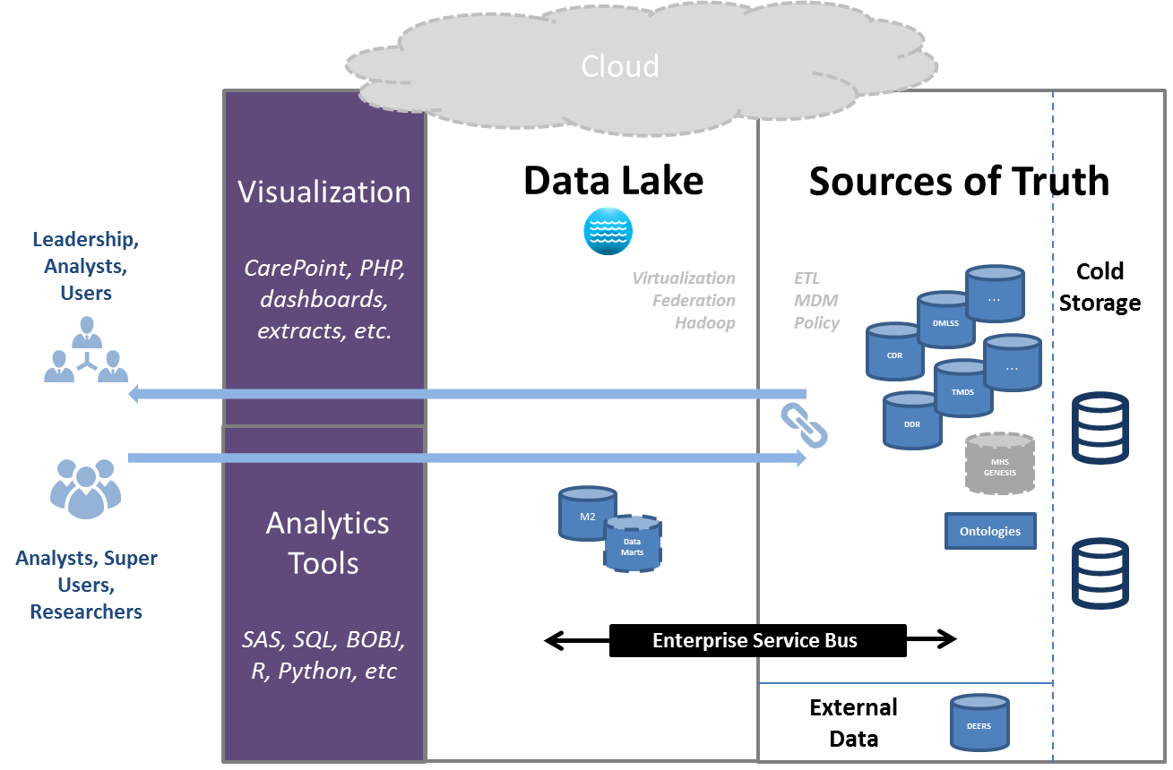
Architecture Vision
“Clinical Is Our Business”
Distribution D: Distribution authorized to the DoD and U.S. DoD contractors only. Other requests for this document shall be referred to DHMSM PMO.
19
Notes:
Mr. Ward talking points:
After analyzing 1000s of data points about interfaces, HW, SW and operational alignment and conducting over 25+ interviews to close gaps and clarify deviations from standard. We create the following view of the current state
Go through the five layers at the top saying that info flows left to right going through the various functions
The data source layer includes transactional systems like CHCS that feed data into the data management architecture
The data integration layer receives this data and is responsible for cleansing and transforming it
The data storage layer is the FTE HW and SW needed to store this data and make it available to end users
The analytics layer is the actual tools that are used to provide various analytics capabilities which are shown in the fifth and final layer
Important take-away – the architecture is complex and redundant. This is due to the haphazard way in which these systems have been built up over time
EMPHASIZE – the issue is not with any particular system but with the architecture
Go through the four bullets at the bottom
1.) multiple systems in integration layer that receive the same data, ex. CHCS sends the CAPER file to both MDR and CHAS, then the two systems expend duplicative energy manipulating the data
2.) some systems, because of when they were created, perform all layers for them selves and by themselves and fail to take advantage of shared service opportunities
3.) because of technical limitations and mission needs, some data siloes were created in the past that could now be consolidated to one source
4.) there are multiple apps which use custom code to perform simple operations that self-service tools like Tableau and Lumira could reproduce at a much cheaper price
Transition to next slide – so given this, we ran a classification in order to organize the architecture by the three layers
Asterisk Clarifications:
*(M2) The BOXI that supports M2 is part of a larger BOXI Shared Service which is operated by SDD. This shared services allows for cost effective access to the BOXI technology for multiple other Systems within the MHS portfolio
*(M2) The BOXI Shared Service is in the process of adding LUMIRA (a self-service BI tooI). This technology will be available as a shared service for M2 and other Systems within the MHS portfolio, supporting the cost effective transition to self-service BI.
*(MDR) The SAS that supports MDR is part of a larger SAS Shared Service which is operated by SDD. This shared services allows for cost effective access to the SAS technology for multiple other Systems within the MHS portfolio
*(MDR) The SAS Shared Service will be receiving a product called User Guide which provides a Graphical User Interface for the SAS environment which is currently console based.
*Blue Lines: The interfaces between MDR SAS/M2 BOXI and CAP are differentiated because they represent the manual sharing of processed metrics data. These metrics include reports such as the P4I reports and are created in the MDR SAS and M2 BOXI environments. They are then shared with the CEIP environment using Moveit-DMZ.
Note: The interface between AFCHIPS and CHAS was provided by Dr. Steve Toney.

Slide 20


Slide 21
Backup Slides

Slide 22
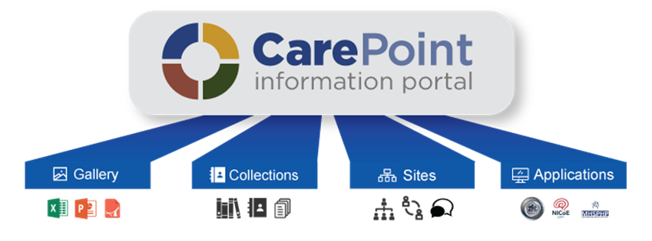
Information Portal
Create & share your data, research, & analytics
Group & share related
healthcare topics that
matter most to you
Collaborate with other
users on shared
healthcare interests
Use applications that
promote better readiness,
care, health, and lower cost

Slide 23
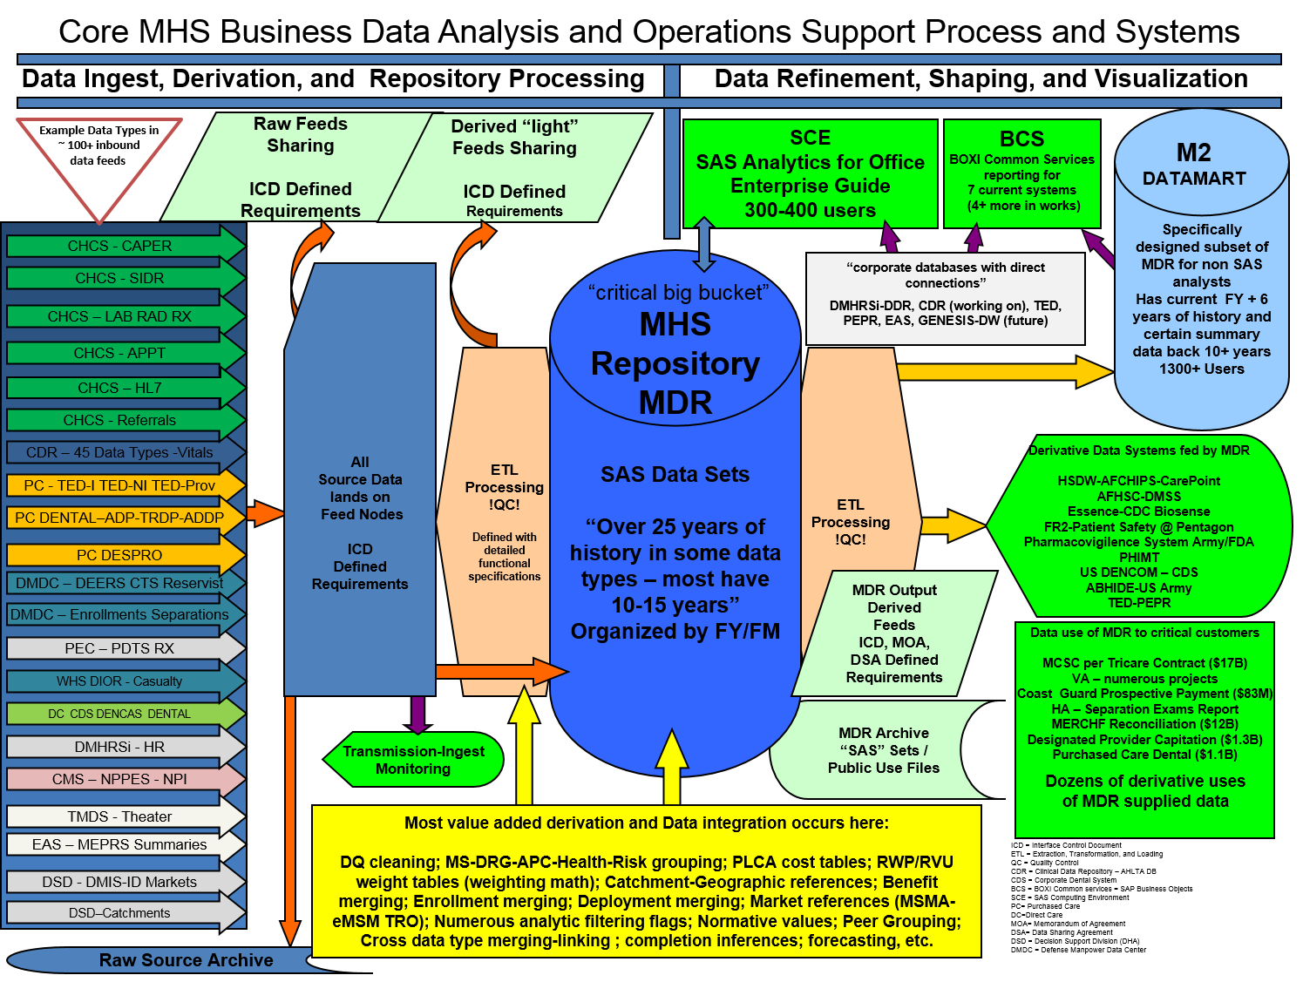
23

Slide 24
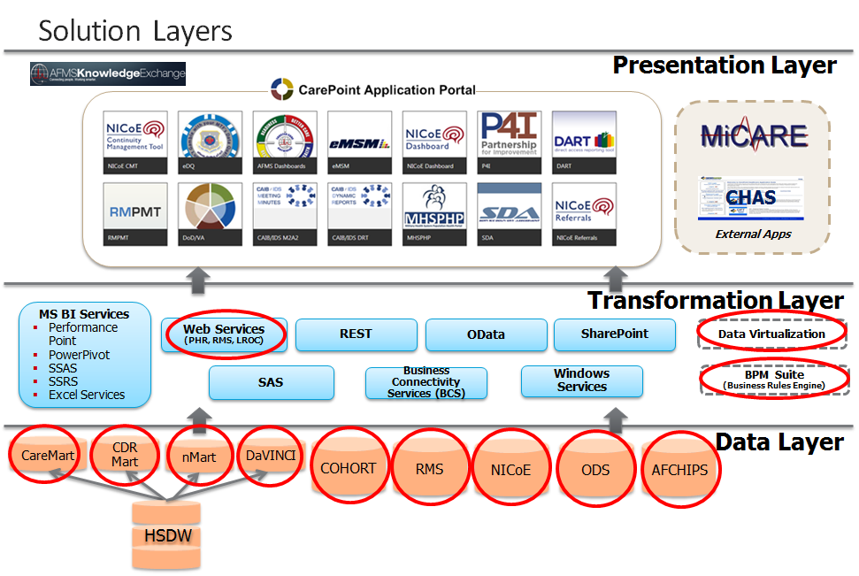
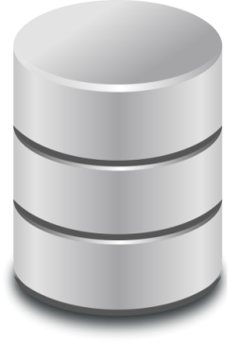
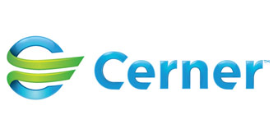
CAREPOINT Stack
This is not inclusive of
additional business intelligence, data warehouses, site/ service databases and registries that need evaluated for consolidation.
Rhapsody
Rhapsody
Rhapsody
Rhapsody

Slide 25
MHS GENESIS Encounter
Data Flows and Data Architecture
Kent Stevenson
Sr. Data Architect
LPDH Data Management Team

Slide 26
Agenda
  Demo of Outpatient Workflow
  Discuss high level data flows at key points in user interactions
  Review high level differences for Inpatient Workflow
  Review high level differences for Dental Encounters

Slide 27
Data Flow Conventions
  PAMPI means Problems, Allergies, Medications, Procedures, and Immunizations
  The numbers on the diagrams do NOT indicate sequence
    Beyond the scope and time limitations of this presentation
    The numbers simply tie the notes with the data flow arrows on the diagrams

Slide 28
Demo: CPM
  Schedule Appointment
  Check In Patient on Arrival

Slide 29
Register / Check-In Patient
Notes:
Rhapsody sends ADT Patient Discharge messages to ACS DAL. Includes Dental Readiness Code
Rhapsody sends ADT Patient Add/Update messages to NMIS.
Rhapsody sends ADT Patient Add/Update to NMIS. Food allergies and height/weight are included in message
Rhapsody sends ADT Patient Add/Update to CoPath Plus
Millennium sends Person Query to DEERS PDWS via Rhapsody to support searches from Millennium
DEERS PDWS returns Person Query Response (candidate patient list) to Millennium via Rhapsody
Millennium sends Person Retrieve by DoD ID to DEERS PDWS via Rhapsody
DEERS PDWS returns Person Retrieve Response (full demographics, and OHI information) to Millennium via Rhapsody
Millennium sends Person Add/Update messages to DEERS PAUS via Rhapsody whenever a patient is added or demographics are updated. Millennium limits update of patient demographics according to what DEERS allows.
Millennium sends Patient Add/Update/Admission/Discharge messages to Rhapsody for routing
Millennium sends OHI updates to DEERS OHI service via Rhapsody whenever OHI information is added or updated in Millennium
Rhapsody sends Notification Subscription request to DEERS Notification service whenever a patient Add/Update occurs that adds a DoD ID to a patient record (initial patient registration)
Millennium sends Patient Add/Update from Millennium to CEP to support HIE capabilities
Rhapsody sends ADT Patient Add/Update to Dentrix

Slide 30
Legacy Data Migration
Notes:
Rhapsody queries DES REST API for PAMPI data using the DoD ID
DES REST API returns PAMPI data to Rhapsody
Rhapsody queries DEERS Immunization repository for Immunization data
DEERS Immunization repository returns Immunization data to Rhapsody. Rhapsody combines and de-duplicates immunization data from DEERS Immunization repository and DES REST API
PAMPI data and demographics info from triggering HL7 v2 ADT message are sent to CCD Generator
CCD Generator returns CCD to Rhapsody. CCD contains the header (demographics) and sections for Problems, Allergies, Medications, Procedures, and Immunizations
Rhapsody sends CCD to Millennium for storage as a document from an external source
Rhapsody sends HL7 v2 messages to Millennium to automatically store coded Allergies, Medications, and Immunizations. Freetext allergies are also sent to Millennium These HL7 v2 messages are only sent for new patients
Provider subsequently uses reconciliation feature to review the most recent CCD and add data to the patient’s record if needed. After the initial migration of legacy data this is the only way additional data is migrated to MHS GENESIS. For the initial migration (new patient) Procedures and Problems are migrated using this mechanism and any freetext Medications and Immunizations can be migrated as appropriate. (Immunizations are store natively using CVX in source systems so no freetext Immunizations expected.)
When patient is added/updated in Millennium, ADT Msg is sent to Rhapsody (from Register / Check-in Patient dataflow)
Patient adds/updates are sent to CEP if the record has a DoD ID
Rhapsody sends CCD to Dentrix for storage as a document from an external source
Millennium FHIR Server is used to synchronize Problems, Allergies, and Medications between Millennium and Dentrix. Millennium is the “System of Record” within MHS GENESIS for this data. Data is synchronized to Dentrix during Dental Encounters and any additions or updates are immediately synchronized back to Millennium. Dentrix maintains a copy for internal purposes and generation of Dental Encounter Summary CCDs but data is only synchronized during Dental Encounters.
Provider subsequently uses reconciliation feature to review the most recent CCD and add data to the patient’s record if needed. After the initial migration of legacy data this is the only way additional data is migrated to MHS GENESIS. For the initial migration (new patient) Problems are migrated using this mechanism and any freetext Medications can be migrated as appropriate

Slide 31
Where Does the Data Go?
Upon DEERs Retrieval
  Person
  Person_plan_reltn
  Health_plan
  Encounter
  Encounter_plan_reltn
  Health_Plan
Person_Alias
  - DoD_ID
  - SSN
Encntr_alias
  - FIN
  - MRN
Notes:
Person – Each distinct human instance in millennium
- every patient, user, and patient contact alike
Encounter – Each distinct visit with the exception of recurring encoutners
Discuss lifetime Pharmacy encounter
Health plans can link back to a specific encounter. Think of instances where patient insurance isn’t billed (liability encounters)
Aliases link back to encntr and person as well.

Slide 32
Where Does the Data Go? (cont’d)
Code Values and Flags
  Code Values
  Listed within code sets
  Robust listing of Cerner Standard sets
  CDF Meanings
  Custom Code Sets
Data Flags
  Different flags for each table
  Discern Visual Developer
  Ex. Orig_ord_as_flag
Notes:
Many drop-down lists in Genesis are comprised of code values
These lists can be customized
Examples – encntr_type_cd, plan_type_cd, encntr_alias_type_cd, person_alias_type_cd
Data flags cannot be customized
Used by Cerner standard programs to identify specific data elements
Flags can be looked up

Slide 33
Where Does the Data Go? (cont’d)
CCD Import
  Orders
  Order_action
  Order_detail
  Allergy
  Clinical_event
  Problem*
  Procedure*
Notes:
Medications –
Orig_ord_as_flag = 2
Order_action writes out each distinct action taken on the singular parent order
Order_detail records all order details per action
Orders.last_action_sequence
Allergy – can be looked up by encounter or person, primary function is by person
Clinical_event – same as above.
Ties back to the event set hierarchy
When meds are administered in genesis, med_admin_event table is populated and tied back to clinical_event as well

Slide 34
Demo: Nurse/Medic
  Document Vital Signs/Labs/Chief Compliant

Slide 35
Demo: Physician
  Review schedule for the day
  Open patient’s chart and follow Outpatient Workflow
  CCD Reconciliation
  Place orders

Slide 36
Radiology Orders/Imaging/Reporting
Notes:
Radiologist interprets image and interacts with PowerScribe 360 to create report
Rhapsody sends radiology orders to PowerScribe 360
PowerScribe 360 sends finalized radiology reports to Rhapsody
PACS send image loc/ID to PowerScribe 360
PowerScribe 360 sends finalized radiology reports to PACS
Rhapsody sends radiology orders to PACS
PACS send image loc/ID to Rhapsody
Rhapsody sends finalized radiology reports to HAIMS
Rhapsody sends finalized radiology reports to CEP
Millennium sends finalized radiology reports to Rhapsody
Rhapsody sends finalized radiology reports to Millennium
Rhapsody sends image loc/ID to Millennium
Millennium sends radiology orders to Rhapsody

Slide 37
Lab Orders/Results – CHCS Sending Labs
21
Notes:
CHCS Sending Labs send order to Rhapsody
Rhapsody sends orders from CHCS Sending labs to Millennium
Millennium sends results from orders originating from CHCS Sending labs to Rhapsody
Rhapsody sends results back to CHCS Sending labs that the order originated from

Slide 38
Lab Orders/Results – CHCS Performing Labs
21
Notes:
Millennium sends orders to Rhapsody to route to a CHCS Performing Lab
Rhapsody sends orders to a CHCS Performing Lab
Specimen is sent to the CHCS Performing Lab
CHCS Performing Lab sends results to Rhapsody
Rhapsody sends results from a CHCS Performing Lab to Millennium

Slide 39
Lab Orders/Results – CoPathPlus (Lab AP)
21
Notes:
Millennium sends Lab AP orders to Rhapsody
Rhapsody sends Lab AP orders intended for the local (regional) CoPathPlus system to CoPathPlus
CoPathPlus sends Lab AP results to Rhapsody
Rhapsody sends results from CoPathPlus to Millennium

Slide 40
Lab Orders/Results – External Commercial Ref Labs
21
Notes:
Millennium sends Lab orders intended for a commercial lab to the Cerner Reference Lab Network
Cerner Reference Lab Network sends order to the appropriate Commercial Lab
Specimen is sent to the Commercial Lab
Commercial Lab sends results back to Cerner Reference Lab Network
Cerner Reference Lab Network sends results back to Millennium

Slide 41
Lab Orders/Results – Shared Data Flows
21
Notes:
All lab results stored in Millennium (including those originating from a CHCS Performing Lab, Commercial Lab, or CoPathPlus) are sent to Rhapsody by Millennium
Rhapsody sends microbiology and Lab AP results to CEP for inclusion in the OnDemand “Aggregate” CCD
Rhapsody sends readiness related labs to ACS DAL

Slide 42
Prescriptions
Notes:
CHDR sends retail and Mail Order claims based medications information to CDR (Legacy existing interface, no changes for MHS GENESIS)
PDTS sends retail and Mail Order claims based medications information to CHDR (Legacy existing interface, no changes for MHS GENESIS)
Tricare Mail Order Program (TMOP) sends medication claims information to ESI which stores information into the PDTS repository (Legacy existing interface, no changes for MHS GENESIS)
Retail pharmacies send medication claims information to ESI (PBM) which stores information into the PDTS repository (Legacy existing interface, no changes for MHS GENESIS)
ePrescribe sends new electronic prescription to TMOP and TMOP sends electronic renewal requests to ePrescribe (Legacy existing interface, no changes for MHS GENESIS)
CHC sends new electronic prescriptions to CHCS Pharmacy and CHCS Pharmacy sends electronic renewal requests to CHC (Legacy existing interface, no changes for MHS GENESIS)
ePrescribe sends new electronic prescription to Retail Pharmacies and Retail Pharmacies send electronic renewal requests to ePrescribe
CHC sends claims to ESI for prescriptions filled in MHS GENESIS and CHCS Pharmacies (Legacy existing interface for CHCS)
Millennium sends claims to CHCS for prescription filled in MHS GENESIS Pharmacies
ePrescribe sends new electronic prescriptions and electronic renewal requests to CHC for both MHS GENESIS pharmacies and CHCS pharmacies (Legacy existing interface for prescriptions intended for CHCS pharmacies)
CHC sends new electronic prescriptions and electronic renewal requests to Millennium
Millennium sends new electronic prescriptions to CHC
Commercial Provider EHRs send new electronic prescriptions to ePrescribe

Slide 43
Nurse and Physician Workflows
Nurse documented in PowerForm
PowerForm contains DTAs (Discrete Task Assays)
Each DTA can have different response types
DTAs are tied to Event Codes
Event Codes live within the Event Set Hierarchy
Documentation creates rows on clinical_event table
Notes:
Powerform ->DTA ->Responses (Alpha responses = nomenclature, numeric, Freetext)
DTAs live outside of powerforms as well. Iview shows a listing of DTAs and allows you to submit responses for grouped “bands”
DTAs can also drop charges in appropriate scenarios

Slide 44
Discern Rules Framework

Slide 45
Examples of Synchronous and Asynchronous
  Synchronous
  AddToScratchpad
  SignOrder
  OpenChart
  Evaluation is performed by discern before user’s activity is recorded to database
Asynchronous
  ClinicalEvent
  OrderEvent
  PatientEvent
  User’s activity is committed to database, then discern processing is called

Slide 46
Discern Rules Framework (Synchronous)
User Submits Order Request
Begin process
Discern Service is Called
Standard request structure fed to discern server
User Interacts With Alert
If Override or Accept is input
Orders Service Called
Processing Complete

Slide 47
Discern Rules Framework (Asynchronous)
User Submits Order Request
Begin process
Orders Service Called
Order is submitted to the database, no in line interaction with user
Discern Service Called
Discern can place new orders, create a notification window, create new clinical events, etc.
Processing Complete

Slide 48
Synchronous vs Asynchronous
  Synchronous
  Inherent discern capability to evaluate list of orders
  Can help prevention of Adverse Events
  Responses recorded in EKS_DLG_EVENT structure
Asynchronous
  Only evaluates one triggering event per execution
  Generates additional workflows
  All data accessible (not limited to Discern Request)
Notes:
Atypical to do “event” type checking synchronously. Main caveat is reverse allergy checking performed by the multum service (not the same as the discern service).

Slide 49
Discern Request
1 Req_type_cd = f8
1 Passthru_ind = i2
1 Trigger_app = i4
1 Person_id = f8
1 Encntr_id = f8
1 Position_cd = f8
1 Sex_cd = f8
1 Birth_dt_tm = dq8
1 Weight = f8
1 Weight_unit_cd = f8
1 Height = f8
1 Height_unit_cd = f8
1 OrderList [*]
2 synonym_code = f8
2 catalog_code = f8
2 catalogTypeCd = f8
2 orderId = f8
2 actionTypeCd = f8
2 activityTypeCd = f8
2 activitySubTypeCd = f8
2 dose = f8
2 dose_unit = f8
2 start_dt_tm = dq8
2 end_dt_tm = dq8
2 route = f8
2 frequency = f8
2 physician = f8
2 rate = f8
2 infuse_over = i4
2 infuse_over_unit_cd = f8
2 DetailList [*]
3 oeFieldId = f8
3 oeFieldValue = f8
3 oeFieldDisplayValue = vc
3 oeFieldDtTmValue = dq8
3 oeFieldMeaning = vc
2 DiagnosisList [*]
3 dx = vc
2 IngredientList [*]
3 catalogCd = f8
3 synonymId = f8
3 item_id = f8
3 strengthDose = f8
3 strengthUnit = f8
3 volumeDose = f8
3 volumeUnit = f8
3 bag_frequency_cd = f8
3 freetextDose = vc
3 doseQuantity = f8
3 doseQuantityUnit = f8
3 ivseq = i4
3 normalized_rate = f8
3 normalized_rate_unit = f8
2 protocol_order_ind = i2
2 DayOfTreatment_order_ind = i2
1 Alert_Titlebar = vc
1 commonreply_ind = i2
1 freetextParam = vc
1 expert_trigger = vc
Notes:
Do not read through this slide. Only used to demonstrate significance of request. Do not be afraid to use the synchronous pathway

Slide 50
Demo: Physician
  Create and Sign a Note

Slide 51
Clinical Notes
Notes:
Note created and signed by provider
Millennium transforms note to PDF, wraps in CDA, and issues “Provide and Register Transaction” to CEP. If an amendment is later made to the note in Millennium, when the amended note is signed it is again transformed to PDF, wrapped in CDA, and pushed to CEP to replace the previous version of the note. Only the most recent version is available.

Slide 52
Demo: Physician/Nurse/Medic
  Administer immunizations
  Perform procedures

Slide 53
Immunizations Documentation
Notes:
Rhapsody sends Immunizations to ACS DAL
ACS DAL sends Immunizations to Service specific Readiness Systems (interactions outside MHS GENESIS)
Service specific Readiness Systems pull immunizations from DEERS Immunization repository and push immunizations entered in the Readiness Systems (Legacy interface, no changes for MHS GENESIS)
Rhapsody sends Immunizations to DEERS Immunization repository
Millennium sends Immunizations to Rhapsody

Slide 54
Demo: Physician
  Complete encounter documentation

Slide 55
Visit Note Signed and Batch Auto-Discharge
Notes:
Millennium creates PDF, wraps in CDA, issues “Provide and Register Transaction” to CEP
NOTE: this is treated exactly like other notes in Millennium
Mentioned here only to underscore difference between the note and the encounter
Batch process sends “Register Document Set-b Transaction” to CEP for OnDemand Medical CCD for all patients with encounters discharged in the last 24 hours (if not already registered)
Visit note created and signed by provider
Batch Auto-Discharge process runs each night to close all outpatient encounters opened in previous 24 hours

Slide 56
DES Access to MHS GENESIS Data
Notes:
JLV Requests MHS GENESIS documents from DES
DES returns requested MHS GENESIS documents to JLV
DES sends XDS.b “Registry Stored Query” request to CEP
CEP returns list of matching documents in “Registry Stored Query” response which can include any or all of the following:
OnDemand Medical CCD registered by Millennium after first encounter is discharged/closed
OnDemand “Aggregate” CCD registered by CEP for each patient (automatically registered when patient is created in CEP)
Static Dental Encounter Summary CCDs submitted to CEP from Dentrix
Static CDA wrapped PDF documents from Notes from Millennium
DES sends XDS.b “Retrieve Document Set” request to CEP to retrieve specific documents. This includes the following types of documents:
CEP returns requested document
If retrieve of a static document is received, CEP retrieves it from its local repository
Static Dental Encounter Summary CCDs submitted to CEP from Dentrix
Static CDA wrapped PDF documents from Notes from Millennium
If retrieve of OnDemand Medical CCD is received, CEP forwards request to Millennium
Millennium generates OnDemand Medical CCD using current data in database
Doesn’t include encounter specific data for encounters that have not been discharged yet
CEP generates CCD using all HL7 v2 messages stored in CEP for patient
Microbiology results
Lab Anatomic Pathology results
Radiology results
Dental notes

Slide 57
Demo: Advance
  User Experience View

Slide 58
Power Insight EDW, LightsOn Network and Advance
PI EDW - Tables are broken down into a universe construct with pre-defined join paths which hit the most efficient table indexes
Healthe Intent EDW functions the same way, HOWEVER, data is stored within a Vertica platform and is very efficient.
LightsOn Network is an Oracle database that retrieves Cerner standard metrics
  Future functionality coming (No ETA for Generally Available service)
Advance uses function timers to measure how much time it takes to perform specific tasks. Timers are still being developed and embedded within applications. Currently only servicing Physician and Nursing workflows.

Slide 59
Additional Information for Inpatient Workflows
Dietary Orders sent to NMIS
  See following diagram
Discharge Summary created and signed (CDA wrapped PDF to CEP)
Encounter Discharged manually as part of check-out process
  No Auto-discharge
Batch process sends “Register Document Set-b Transaction” to CEP for OnDemand Medical CCD for all patients with encounters discharged in the last 24 hours (if not already registered)
  Occurs for both Outpatient and Inpatient encounters

Slide 60
Dietary Related Data
Notes:
Dietary Orders entered into Millennium
Millennium sends Dietary orders to Rhapsody and also triggers Patient Update messages that include Allergies, Height, and Weight information whenever that data is inserted/updated
Rhapsody sends Dietary orders to NMIS as well as Patient Update messages with Allergies, Height, and Weight information

Slide 61
Additional Information for Dental Workflows
Data flows very similar to Outpatient Workflows in Millennium except flows initiate from Dentrix rather than from Millennium
Millennium is treated as system of record for Problems, Allergies, and Medications using Millennium FHIR services
  Entering Problems, Allergies, and Medications in Dentrix is virtually the same as entering them directly in Millennium
    Same user attribution
  Immunizations not entered or viewed in Dentrix
  Dentrix is System of Record for Dental Procedures—they are not in Millennium
    Millennium is System of Record for medical procedures—they are not in Dentrix
Dentrix generates Encounter Summary CCD when encounter is closed
  Pushed to CEP via Rhapsody
Dentrix captures a dental note for each dental encounter
  Pushed to Rhapsody
  Rhapsody pushes to CEP and to Millennium
  Millennium makes dental notes available in Patient Portal

