Slide 1
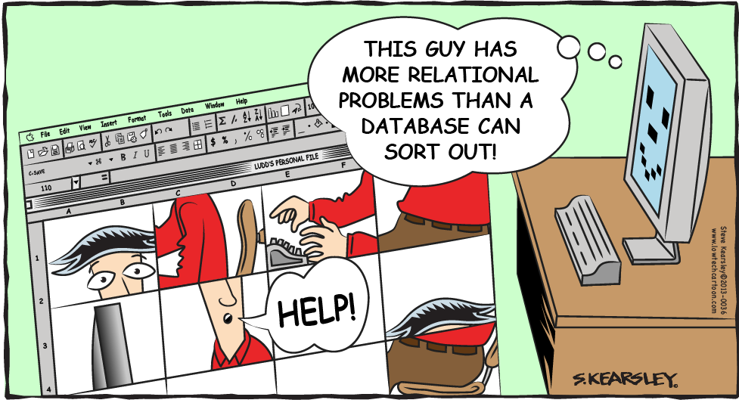
Database fundamentals: Data modeling
Victor Lin
Dod clinical informatics fellowship

Slide 2
Learning objectives
Review database basics including entities, attributes, keys, and schema.
Describe entity relationships.
Introduce the concept of data modeling as it relates to database design.
Discuss the conceptual, logical, and physical data models.

Slide 3
Review of Database basics
Database is an organized collection of data.
A “container” or “filing cabinet.”
Database table=“file” (structured list of data of specific type).
Database is used for a specific purpose.
Can be electronic/digital or paper.
Enables content search.

Slide 4
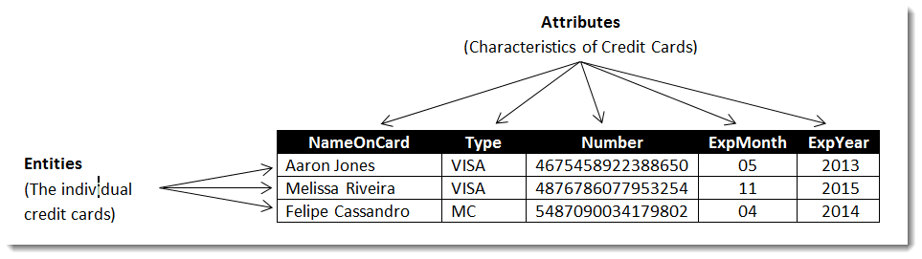
Database basics: entities and attributes
A database table contains information about entities (rows), which have specific characteristics called attributes (columns).

Slide 5
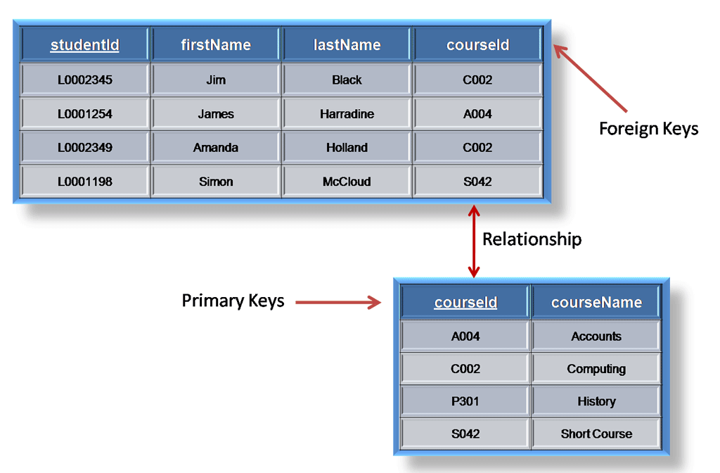
Database Basics: Keys and relationship
Each table has a primary key, and relationships between tables are established via the foreign keys. Keys are attributes.

Slide 6
Database schema
A database table contains characteristics and properties that define how data is stored. This set of information is called a schema (scheme), essentially the table’s metadata.
In the schema, the attributes are listed, and each attribute’s data type and characteristics (e.g. whether it is the primary key) are specified.
Schemas describe a table (layouts, properties), and can also delineate the relationship between tables in a database (entity relationships).

Slide 7
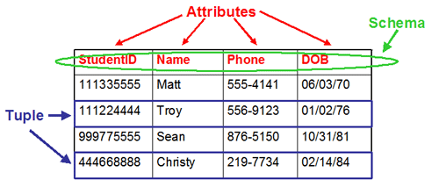
Database schema
Entities
StudentID
Data type: Number
Primary key: Yes

Slide 8
Entity relationships
One-to-one
A pair of tables have one-to-one relationship when a single record (entity, row) in table #1 is related to one record in table #2.
One-to-many
A single record in table #1 can be related to one or more records in table #2, but not vice versa.
Many-to-many
A single record in table #1 can be related to one or more records in table #2, and a single record in table #2 can be related to one or more records in table #1.

Slide 9
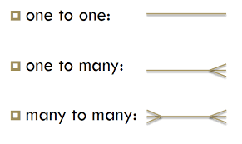
Entity relationships
One-to-one Ex: Each instructor has one office space.
One-to-many Ex: Each instructor can teach multiple courses, but each course has one instructor.
Many-to-many Ex: Each student can take multiple courses, and each course can have multiple students.

Slide 10
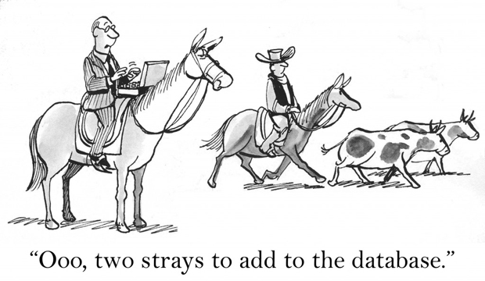

Slide 11
Database design
Three phases of database design (traditional methods):
Requirements analysis.
Assessment of the information requirements of the organization.
Data modeling.
Modeling of database structure. Define attributes (fields).
Normalization.
Decomposition of large tables into smaller ones. Elimination of redundant data.

Slide 12
Data modeling
In database design, the process of creating a database schema/structure is known as data modeling, which is when the entities, attributes, and entity relationships are worked out.
Typically based on the three-model (schema) approach.
The data model is eventually implemented within a database.

Slide 13
Why do we need data modeling?
Helps in the visual representation of data.
Helps to enforce business rules and compliance with government/regulatory policies.
Enhances consistency in naming conventions, semantics, data quality etc.
Helps to ensure that all required data objects are represented.

Slide 14
Why do we need data modeling
Helps to identify redundant and missing data.
Helps to define the relationships and the keys (primary, foreign).
Helps to manage data as a resource.
Over the long run, can facilitate the efficiency of IT infrastructure maintenance and upgrades.
Can help facilitate communication within and across organizations.

Slide 15
The data model
A model that organizes data and standardizes relationships implemented (eventually) in the database.
Similar to an architect’s plan/drawings.
Determines the structure of the data.
With the data model, the emphasis is on what data are needed and how they should be organized (versus on the operations to be performed on the data).

Slide 16
The data model
The three-model (schema) approach typically follows the path through the following three models :
Conceptual model.
Logical model.
Physical model.
The progression is from the most abstract to the most concrete as one moves from the conceptual model to the physical model. Sometimes the conceptual and logical models are viewed as one.

Slide 17
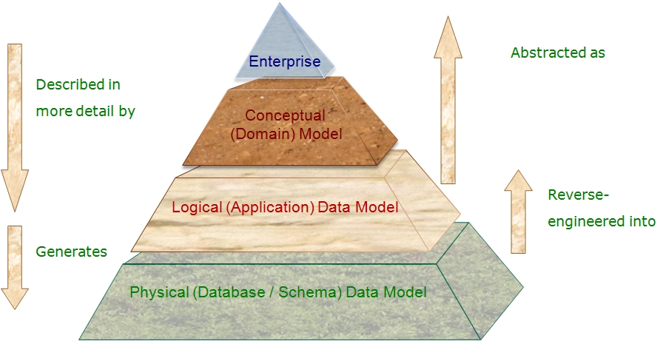
Data model pyramid

Slide 18
Conceptual model
Represents the “semantics” (scope of the model), and organizes and defines business concepts or rules.
Establishes the basic database relationships (entity relationships).
Typically involves business stakeholders and data architects.
Insufficient detail to construct the actual database.

Slide 19
Logical model
Based on structures identified in the conceptual model.
Focus is on logical data structures and relationships (e.g. keys).
The “database models” such as relational, hierarchical, and network models could fall under the logical model.
Data architects and business analysts would be involved.
DBMS/technology agnostic.

Slide 20
Physical model
Describes the specific database system that will be implemented for a particular DBMS system.
This data model is detailed enough to build the actual database, with all the characteristics and table/column names.
Database administrators/developers transform attributes into columns and assign data types.

Slide 21
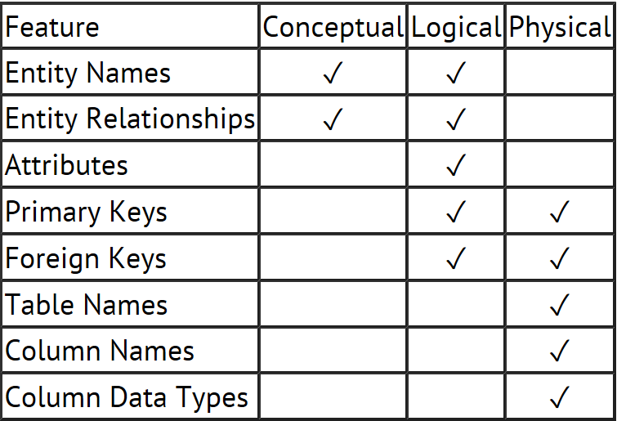
The 3 models and database design

Slide 22
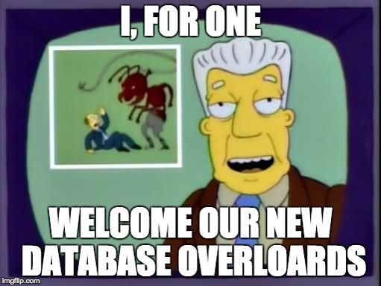
Questions?

