Slide 1
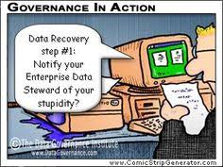
Data Governance
Bob Marshall, MD MPH MISM FAAFP Program Director, DoD/MAMC Clinical Informatics Fellowship

Slide 2
Goals and Objectives
Definition of Data Governance
Implementing Data Governance
Data Stewardship/Data Quality/Master Data Management
Data Governance Use Cases
10 Mistakes to Avoid with Data Governance

Slide 3
Definition
Data governance (DG) is the overall management of the availability, usability, integrity and security of data used in an enterprise
A sound data governance program includes a governing body or council, a defined set of procedures and a plan to execute those procedures
Businesses benefit from data governance because it ensures data is consistent and trustworthy

Slide 4
Implementing Data Governance 1 of 4
The initial step in implementing a data governance framework involves defining the owners or custodians of the data assets in the enterprise
This role is called data stewardship
Processes must then be defined to effectively cover how the data will be stored, archived, backed up and protected from mishaps, theft or attacks

Slide 5
Implementing Data Governance 2 of 4
A set of standards and procedures must be developed that defines how the data is to be used by authorized personnel.
Moreover, a set of controls and audit procedures must be put into place that ensures ongoing compliance with internal data policies and external government regulations, and that guarantees data is used in a consistent manner across multiple enterprise applications

Slide 6
Implementing Data Governance 3 of 4
Once an overarching strategy is defined and data owners and custodians are identified, data governance teams are often formed to implement policies and procedures for handling data. These teams can comprise business managers, data managers and staff, as well as end users familiar with relevant data domains within the organization. Associations dedicated to promoting best practices in such data governance processes include the Data Governance Institute, the Data Management Association (DAMA) and the Data Governance Professionals Organization

Slide 7
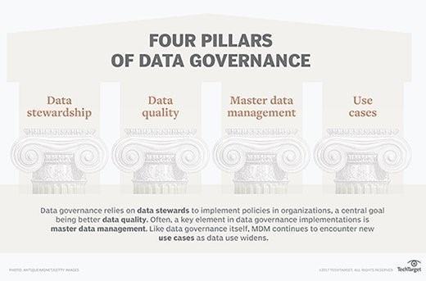

Slide 8
Implementing Data Governance 4 of 4
the early steps in data governance efforts can be the most difficult, as it is characteristic that different parts of an organization have diverging views of key enterprise data entities -- such as customer or product; these differences must effectively be resolved as part of the data governance process. To the extent that data governance may impose strictures on how data is handled, it can become controversial in organizations

Slide 9
Data Stewardship
An essential trait of the data steward is to be accountable for various portions of the data. The major objective of such data governance is to assure data quality in terms of accuracy, accessibility, consistency, completeness and updating
Data stewards work with individuals positioned in the overall data lifecycle to help ensure data use conforms to a company's data governance policies

Slide 10
Data Quality
Data quality is the driving force behind most data governance activities. Accuracy, completeness and consistency across data sources are the crucial hallmarks of successful initiatives.
Data scrubbing, also known as data cleansing, is a common element in the data quality initiative, as it identifies, correlates and removes duplicated instances of the same data points

Slide 11
Master Data Management 1 of 3
Data governance touches on nearly every aspect of data management, but one area of data management very closely associated with data governance processes is master data management (MDM)
This is a discipline that establishes a master reference to ensure consistent use of data across large organizations

Slide 12
Master Data Management 2 of 3
Metadata repositories, which hold data about data, are often used in establishing cross-group reference data in MDM programs.
Product and customer data is a major emphasis of MDM systems.
As with data governance generally, master data management projects can also encounter controversy within organizations, as different product groups or lines of business in the company promote different views on how to best present data

Slide 13
Master Data Management 3 of 3
The purview of master data management expanded as corporate computing came to include much more externally generated data, often collected via the web or the cloud
Much of this data is unstructured and different in nature from the structured relational data that was traditionally the focus of MDM
That is one of the reasons that some MDM tools have begun to utilize graph data stores that support descriptions of more complex data interrelationships

Slide 14
Use Cases for Data Governance 1 of 2
Data governance is a particularly important component of mergers and acquisitions, business process management, legacy modernization, financial and regulatory compliance, credit risk management, analytics, business intelligence applications, data warehouses, and data lakes
As data uses expand and new technologies emerge, data governance will gain wider application

Slide 15
Use Cases for Data Governance 2 of 2
Numerous high-profile data breaches have made data security a more central part of data governance efforts
Calls for data privacy have also led to the inclusion of data protection and data privacy audits as part of data governance programs
The European Union's (EU's) directive concerning General Data Protection Regulation (GDPR) is an example of a use case for data governance

Slide 16
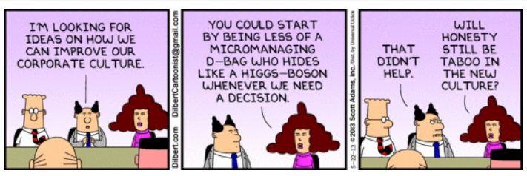
Avoiding Mistakes in Data Governance – Data Governance Best Practices

Slide 17
#1 – Failing to Define Data Governance
What is really important is how you define data governance and how your organization understands it
The most common definitional mistake companies make is using “data governance” synonymously with “data management”
Data governance is the decision-rights and policy-making for corporate data, while data management is the tactical execution of those policies
Both require executive commitment, and both require investment, but data governance is business-driven by definition, while data management is a diverse and skills-rich IT function that ideally reports to the CIO

Slide 18
#2 – Failing to Design Data Governance
As with any strategic initiative that enlists both business and IT and is process-centric and highly visible, data governance must be designed.
Designing data governance means tailoring it to your company’s/ organization’s specific culture, organizational structure, incumbent ownership environment, and current decision-making processes.
It means articulating the value proposition for cross-functional and formal decisions about corporate/organizational information

Slide 19
#2 – Failing to Design Data Governance cont
No two companies treat these issues in exactly the same way, and data governance is never exactly the same across companies
Deliberate data governance design ensures that governance supports the company’s/organization’s culture, organizational structure, implicit hierarchies, and way of doing business, while making sure its value is well understood and ultimately measurable

Slide 20
#3 – Prematurely Launching a Council
Well-meaning people who see the need for data governance will gravitate toward the “who” conversation (Who should be on the council? Who will sponsor it?) before understanding the “what” and the “how”
Until a core team of stakeholders deliberately designs a data governance framework (including guiding principles, decision rights, and the appropriate governing bodies), no sanctioned, cross-functional council will have either the clarity or the mission to affect change

Slide 21
#4 – Treating DG as a Project
When an initiative is deemed a project, it is, by definition, finite
The reality of data governance is that it should be continuous and systemic
As information needs change, data volumes increase, and new data enters the organization via new systems or third parties, decisions about how to treat, access, clean, and enforce rules about data will not only continue, but they’ll likely also proliferate
A structured, formal, and permanent process for making these policies and decisions should be retrofitted into the way a company/organization develops its data and conducts its business

Slide 22
#5 – Ignoring Existing Steering Committees
A key indicator of data governance success is an environment that encourages decision-making bodies
In instances in which the company/organization has already institutionalized steering committees, it would be foolish not to leverage their knowledge and clout
By inviting incumbent decision-making bodies to participate in the data governance process, you effectively institutionalize data governance as a component of corporate/organizational policy making
You also implicitly enlist the support of a variety of individuals, and change occurs one person at a time

Slide 23
#6 – Overlooking Cultural Considerations 1 of 3
Changing entrenched organizational paradigms and behaviors is perhaps the biggest obstacle for any governance effort
Examples include a corporate culture that stresses consensus over clear accountability, the absence of decision-making protocols, individuals unaccustomed to making decisions, or poor communication and planning
Common organizational constraints can derail governance before it begins

Slide 24
#6 – Overlooking Cultural Considerations 2 of 3
Regardless of your organization’s explicit structure and biases, establishing unambiguous decision rights is a requirement for governance to thrive.
Existing cultural norms should inform, but not necessarily dictate, how decision rights and accountability are assigned.
Effective governance often challenges intrinsic ideas about what decision making means.
Therefore, the governance program must also clearly articulate its mission and value, develop communication plans, and plan for, champion, and reward change—often one business constituent or person at a time

Slide 25
#6 – Overlooking Cultural Considerations 3 of 3
Remember: one size does not fit all
The governance design must address the unique challenges and biases in the specific organization
Although change is hard, companies with effective governance processes can generate up to 40 percent higher ROI on their IT investments than their competitors, according to researchers Peter Weill and Jeanne Ross
When it comes to governance, patience and perseverance really do pay off

Slide 26
#7 – Prematurely Pitching Data Governance
In today’s environment, executives and staff alike are wary of the sweeping reforms and lofty benefits typically promised by enterprise programs
Soliciting C-level executive sponsorship, broadly evangelizing expected outcomes, or establishing working teams without a clearly defined vision or framework to achieve the intended solution are all fraught with risk

Slide 27
#8 – Expecting Too Much from a Sponsor 1 of 2
Executive support and management sponsorship for data governance are critical.
A motivated sponsor, with a clear vision and the ability to communicate it to both senior executives and those he manages, is an important contributor to governance success.
That being said, there is a limit to what even a great sponsor can be expected to do

Slide 28
#8 – Expecting Too Much from a Sponsor 2 of 2
Sponsors, particularly those at the executive level, believe that value lies in their support, not their participation
They are, therefore, best leveraged to communicate the vision and objectives of data governance to their respective organizations
When it comes to sanctioning and evangelizing the program or rallying the troops, nothing beats an effective and engaged sponsor
Just don’t expect them to do the heavy lifting involved in data governance design

Slide 29
#9 – Relying on the Big Bang 1 of 2
The mantra think globally, act locally is particularly apt when embarking upon data governance
The issues addressed by data governance are far-flung and pervasive, ranging from arbitration of cross-functional data usage to information privacy, security, and access policies
As a result, governance initiatives attempting to address an array of enterprise needs in one big bang are quickly squelched by role confusion, prioritization debates, “emergency” development projects, and a general backlash of the incumbent culture

Slide 30
#9 – Relying on the Big Bang 2 of 2
To avoid these risks, successful programs begin with a series of tightly scoped initiatives with clearly articulated business value and sponsorship
While an incremental approach takes time, not to mention patience, it engenders business support by demonstrating the value of governance in a context relevant to each stakeholder or sponsor
Most important, a phased approach establishes data governance as a repeatable, core business practice rather than a standalone “once and done” project

Slide 31
#10 – Being Ill-Equipped to Execute 1 of 3
The need for ongoing maintenance and auditing is frequently overlooked or underestimated
Because data is constantly being generated, new applications are added, business processes change, and users come and go, data management becomes a full-time endeavor
Vigilance is required to monitor compliance with existing standards, enforce new behaviors, and ensure that old habits don’t creep back into common usage

Slide 32
#10 – Being Ill-Equipped to Execute 2 of 3
SAP defines data management as the tactical, day-to-day execution of data governance policies
For example, a typical data governance policy may mandate that sensitive customer data be stored in secure formats and available only to authorized users
Implementation of an appropriate storage algorithm and ongoing maintenance of user permissions are data management functions typically handled by resources in IT, security, or by a formally designated data management group
Such a group should be equipped to tackle these issues as the business continues to evolve

Slide 33
#10 – Being Ill-Equipped to Execute 3 of 3
Data governance and data management are symbiotic by nature
The most relevant or vital data governance policy is of little merit just sitting on a desk
To be perceived as valuable, data governance must be measured, ultimately demonstrating positive outcomes and hard payback
To do that, you must be able to manage data in a structured and tactical way

Slide 34
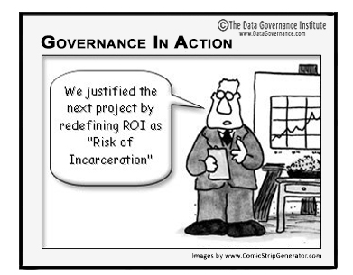
Discussion and Questions

