Slide 1
Creating a Data Driven UI Framework
February 28, 2014

Slide 2
Problems Faced
Specific Handling For Complex UI Components
Repetitive field’s code in a single view
Data Binding For UI Elements
Populate UI from received data
Multiple HTML Templates For Different Views
Even if the views have similar elements, we still had to write different html files.
Repetitive group’s code in application
Populate data from user inputs

Slide 3
Write Once, Run Everywhere

Slide 4




Write Once, Run Everywhere
Write Once, Run Once
Write Once, Run Everywhere
Let’s code
Let me plan and code
Requirement ABC
Requirement ABC
Again more code
Oh! I can reuse the previous code
Requirement PQR
Requirement PQR
Tired of writing it again
Ah! This is already taken care of
Requirement XYZ
Requirement XYZ

Slide 5
Write Once, Run Everywhere
JSON Dependent UI with no server side rendering (Avoid php, jsp etc. for HTML generation) and independent of the technology used at back-end.
Create Generic UI Components
Write UI code with a vision to use the same code for future usage. Assume that all the things that can change will change.
Independent UI Framework

Slide 6

`
How We Achieved

Slide 7
Solution: Specific Handling For Complex UI Components
Field type, validations, data model, specific properties are there in JSON
Custom Html Tags Using Angularjs Directives
For repetitive fields like data tables with custom needs and for repetitive groups like dependent dropdowns, angularjs directives were used.
JSON Based Field Population

Slide 8
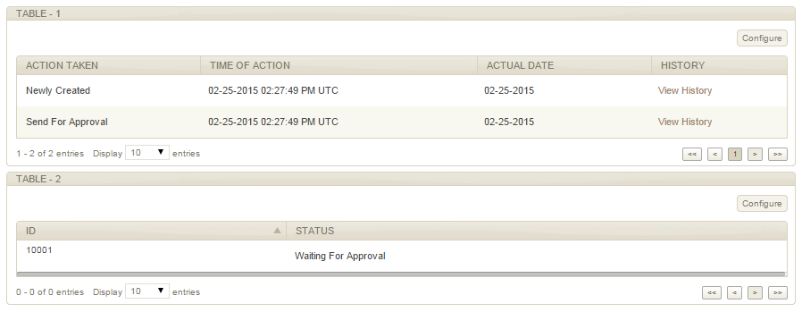

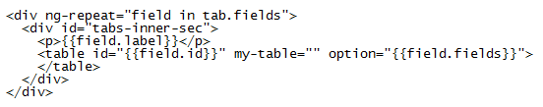
Demo Image: Specific Handling For Complex UI Components

Slide 9
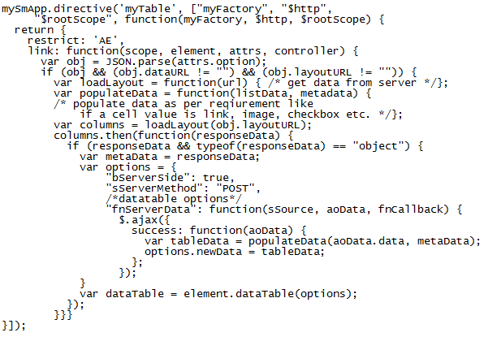
Demo Code: Specific Handling For Complex UI Components
Directive for Tables

Slide 10
Explanation :Specific Handling For Complex UI Components
How these tables are getting created
HTML is specifying the component we need to pick (this is also conditional, depending on the parent field)
myTable directive picks up the options, layout url and layout data url based on the JSON and draw the table accordingly.
Events are also handled inside the directive at element level (no global selectors)

Slide 11

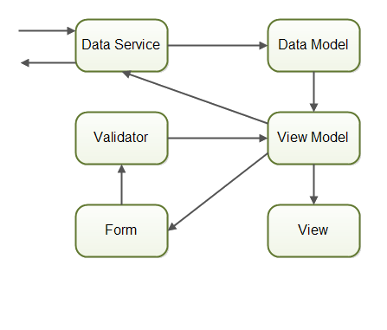
Solution: Data Binding For UI Element
Angularjs two-way Data Binding

Slide 12
Solution: Multiple Templates For Different Views
Dynamic Template Generation Based On Layout JSON
Every UI component is treated as a field. Each field’s information lies in JSON:
Components like tabs, tab-content, tables, buttons, popups, text input, text area, select etc. are all fields.
Field attributes like editable/non-editable, validations, data-source etc. are contained in JSON.

Slide 13
HTML Template free DOM Generation
JSON
Higher Order DOM Generator
DOM Generator
DOM
Angularjs Directive
Auto Update
Based on values
in DOM
Layout Info (from JSON)
Data Binding

Slide 14
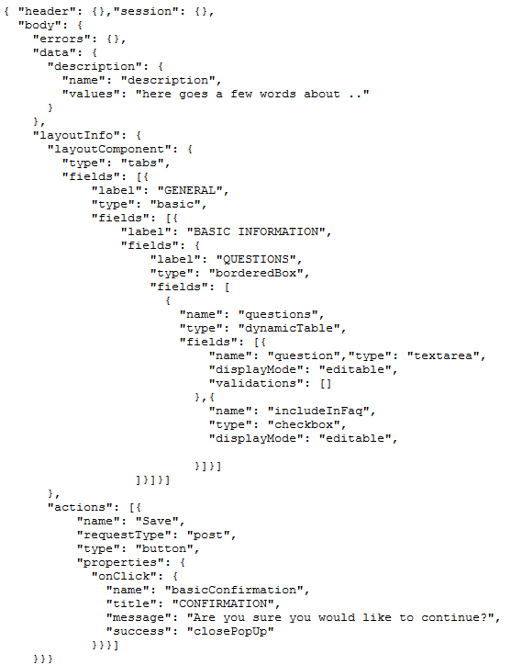
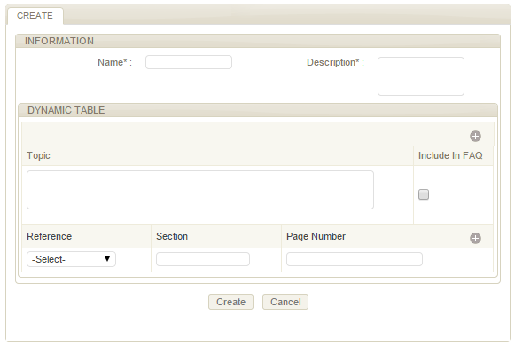
JSON Driven Template For Different Views

Slide 15
Demo Explained: JSON Driven Template For Different Views
How is JSON Creating the layout
Hierarchical structure of JSON is specifying the box structure of HTML
Type tabs specifies that a tab is needed
Next, type basic indicates the form type layout then type borderbox is asking to draw a box and at further level fields like input, dynamic table are inserted based on the type specified in JSON.
Each field has a name associated with it which binds that field to data.

