Slide 1
Augmenting Clinical Performance in Emergency or Critical Care:
Telemedicine to Automation
LTC Jeremy Pamplin, MD, FCCM, FACP
director, Virtual Critical Care
Madigan Army Medical Center
Joint Base Lewis-McChord, Washington

Slide 2
Why we fail and simple tools don’t work
Embracing technology to improve performance and patient care.

Slide 3
Disclosures
The opinions or assertions contained herein are the private views of the author and are not to be construed as official or as reflecting the views of the Department of the Army or the Department of Defense.
I have no financial disclosures.
Notes:
I have no disclosures other than to say my opinions are my own and that this work is support by a DoD grant.

Slide 4
Madigan Army Medical Center
Notes:
205 bed, tertiary care, regional referral medical center and level 2 trauma center. It was built in 1994 and it, along with NMSD, serves as the primary evacuation hospital for a war in the pacific theater.

Slide 5
A Case

Slide 6
37 yo E6 presents with shortness of breath, cough, sputum production, room air hypoxia, and bilateral infiltrates on Chest X-Ray.
Diagnosed with Community Acquired Pneumonia, admitted to the ward.
Developed respiratory distress within a few hours. RRT called, then code called to intubate the patient.
Patient intubated and brought to the ICU. Antibiotics broadened.

Slide 7
Diagnosed with ARDS given low P:F ratio.
  Placed on Low VT ventilation
  Paralyzed
Oxygenation improved (PaO2 > 200 on 60% FiO2, PEEP 10)
~36 hrs later, rapid decline requiring vasopressors. PaO2 still > 200 on 60% FiO2, PaCO2 rises and pH falls. TTE shows “RV failure” and severe pulmonary hypertension.
PA catheter placed & CT Surgery consulted for RVAD or ECMO.
  Declines RVAD, suggests VA EMCO not appropriate given unknown reason for RV failure.

Slide 8
12 hours later….
He dies of refractory shock.
What happened?
How????

Slide 9
Try this…
37 yo on ICU day 2 with ARDS secondary to pneumonia that he’s had for about five days, who had stable oxygenation when he suddenly develops hypotension, tachycardia, a respiratory acidosis, and increased dead space.
Emergent bedside TTE shows a huge RV and flattened septum or “D-shaped” LV.

Slide 10
PE!

Slide 11
Leading causes of death
Heart disease: 611,105
Cancer: 584,881
Preventable Adverse Events: 200,000-400,000
Chronic lower respiratory diseases: 149,205
Accidents (unintentional injuries): 130,557
Stroke (cerebrovascular diseases): 128,978
Alzheimer's disease: 84,767
Diabetes: 75,578
Influenza and Pneumonia: 56,979
Nephritis, nephrotic syndrome, and nephrosis: 47,112
Intentional self-harm (suicide): 41,149
James JT. J Patient Saf. 2013;9(3):122-128.
http://www.cdc.gov/nchs/fastats/deaths.htm

Slide 12
“The hardest thing about being a doctor is that you learn best from your mistakes, mistakes made on living people”
– Karen Delgado
“Technical errors are a small fraction of incorrect diagnoses & treatments. Most errors are mistakes in thinking” and communicating.
Groopman, Jerome E., and Michael Prichard.
How doctors think. Boston: Houghton Mifflin, 2007.
The Joint Commission 2016

Slide 13
Outline
Background
  Simple vs. Complex
CDSS
Telemedicine
Automation
Conclusions

Slide 14
Background
What do we need help with anyway?

Slide 15
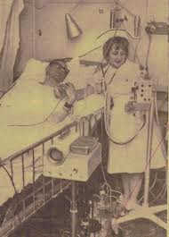
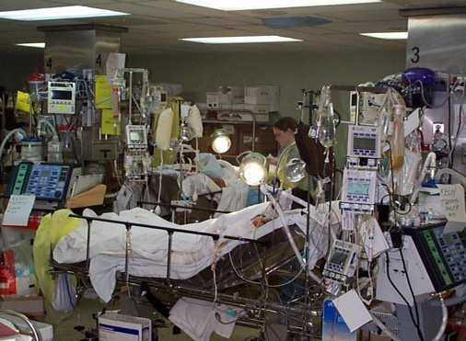
Evolution of ICU
Surgical Intensive Care Unit
USNS Comfort Hospital Ship,
Persian Gulf, 2003
Average of 178 activities/patient/day!
84% 1 RN,
3% RNs & MDs
2.7% 2 RNs
4.7% 1 MD
3% Other
2.2% 2 MDs
1950s
Present
Crit Care Med. 1995;23(2):294

Slide 16
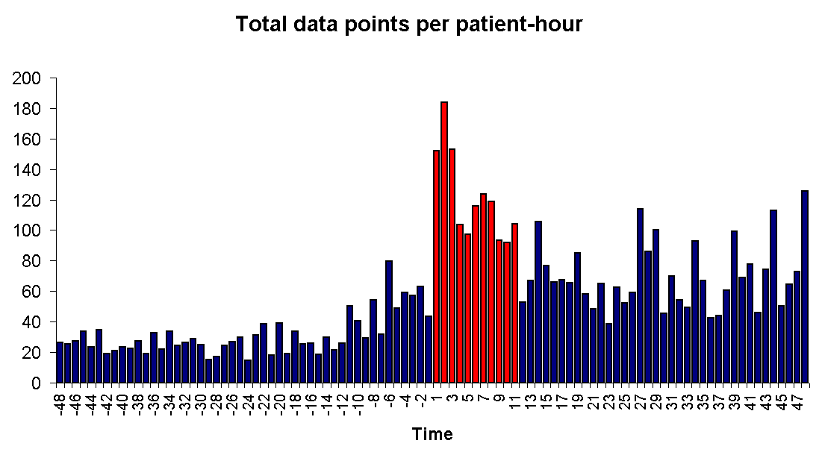
How about this?
Microbiology, labs, medications, chest X-ray, Nurses flowsheet, Clinical notes (history and impression/plan) – Vitals excluded
**Slide courtesy of Dr. Herasavich

Slide 17
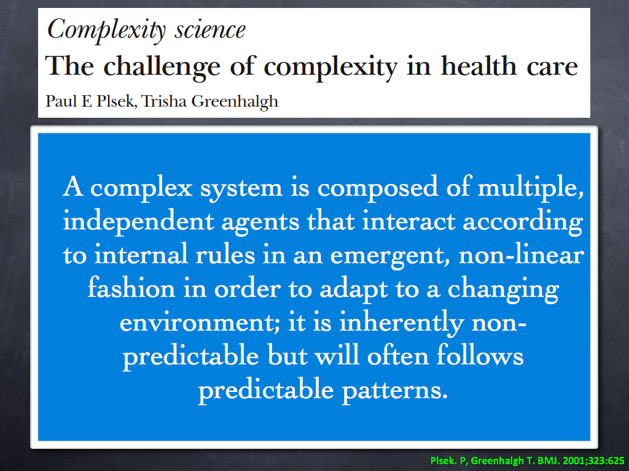

Slide 18
Example
Blunt Trauma Patient
Primary survey = suspected pneumothorax
Physician = EM Staff
Physician = Recent IM Grad
Patient gets Chest Tube
What if there is an ultrasound available?
Patient gets…..
  Differential diagnosis?
  A chest x-ray?
  Needle decompression?
What if there is an ultrasound available?
  What if it could automatically detect pneumothorax or not?
What if there were a step-by-step checklist? With pictures?
Notes:
Trauma
Pneumo
Inexperienced
Experienced
Introduce an ultrasound?
Introduce a checklist?

Slide 19
Complexity
The decisions that are made are not only related to the therapy for a pneumothorax.
They are related to:
  The diagnosis (pneumothorax)
  The provider type, knowledge, & experience (surgeon, intern, resident)
  The available equipment (chest tube, ultrasound, X-ray)
  The patient’s condition/preferences
  Time available
  Information available ( SpO₂, Prior Pneumonectomy)
  System resources (other physicians/consultants)
Notes:
Trauma
Pneumo
Inexperienced
Experienced
Introduce an ultrasound?
Introduce a checklist?

Slide 20
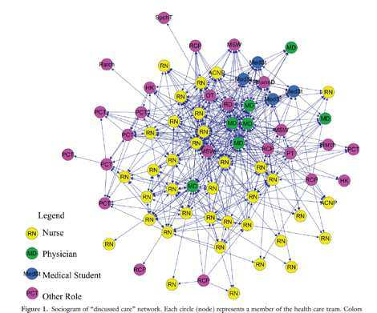
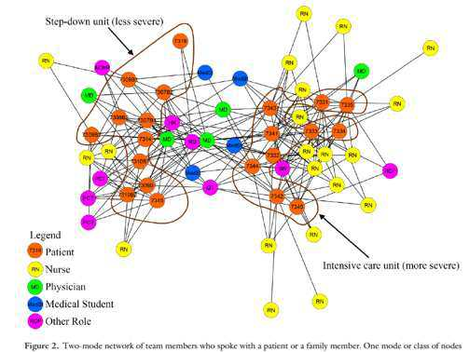
Care in context: the ICU Network
The patient “discussion network”
Who talks to the patient daily?
21 patients, 40 clinicians
The clinician “discussion network”
Who do we talk to daily?
72 actors!
Shoham. J Burn Care Res. 2015;36(5):551-557.
Notes:
Clinician “Discussed Care Network”
Spoke to patient network
72 actors in the discussed care network (25 other, 36 rn, 7 md, 4 ms)
21 pts 40 direct actors

Slide 21
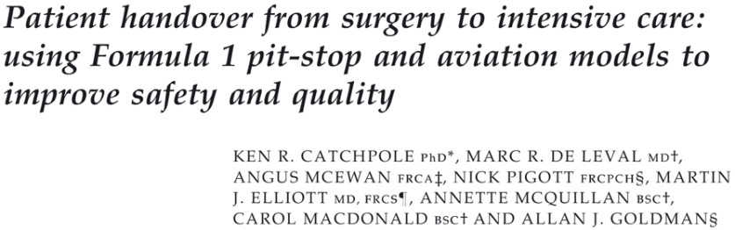
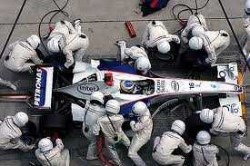
A team of experts is not an expert team!
Catchpole KR, et al. Pediatric Anesthesia 2007 17: 470

Slide 22
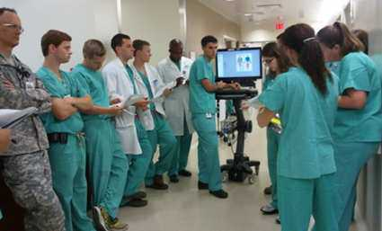
Consider this…
A time when your opinion was different than the rest of the team
We have witnessed this phenomena:
  Clinicians having the same information about a patient may have a VERY different opinions about appropriate treatment
This demonstrates a lack of shared understanding
This may impede effective collaboration and impact patient outcomes.
This patient needs to be intubated
Yep
Yep
He and his wife don’t want that….
Yep
Notes:
I want you to consider a time when, in the course of clinical care, you had a different opinion about a patient’s condition than the rest of the team.
Perhaps you had a, sense, a gut feeling that the patient was much sicker than other considered him to be and that he needed something different than what the team wanted to do. In this scenario, the team is prioritizing rehabilitation but bedside nurse thinks the patient is just getting worse and will not tolerate it.
We have witnessed this phenomena on many occasions and have observed its affect on daily care goal completion and we naturally assume that these discrepancies impact patient outcomes.
This problem prompted us to seek ways to better understand it and create tools to mitigate it.

Slide 23
Perception of Illness Severity
1 1.3 2.7 3 3.3 3.75 4 5.5 5.5 5.5 6.6 6.8 7 8.2 8.75 9 10
Average Illness Severity
1 1.3 2.7 3 3.3 3.75 4 5.5 5.5 5.5 6.6 6.8 7 8.2 8.75 9 10
Average Illness Severity
Notes:
These graphs represent the distribution of the severity of illness scores amongst clinicians about patients for whom we performed at least 5 sorts. The distribution suggests that there is more uncertainty about patient condition in patients with middle severity of illness.

Slide 24
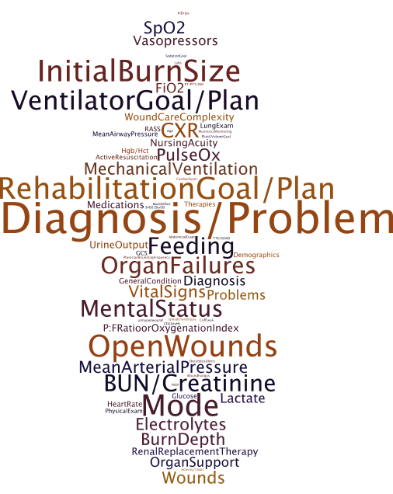
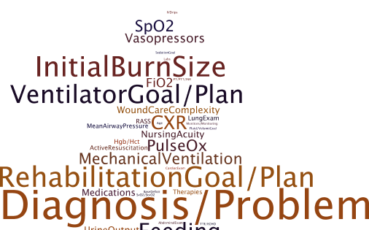
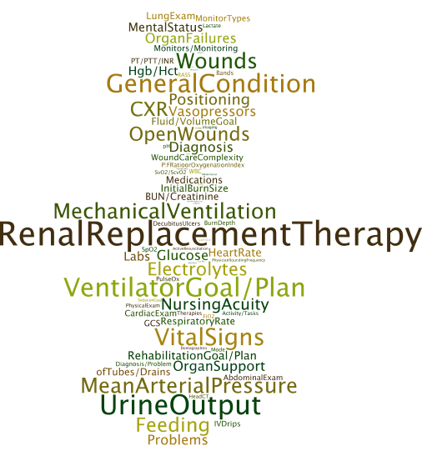
Word Clouds
Nurses
61Card Sorts, 56 Patients
Attending Physicians
25 Sorts, 23 Patients
Notes:
We have found that words clouds, are an effective method to visually demonstrate the remarkable differences between the mental models that different clinician types use to evaluate patient condition.
On your left side are all of the cards chosen by attending physicians that were important to their assessment of patient condition whereas on your right are the cards chosen by nurses.
The relative size of the words represents the frequency with which that card was chosen.

Slide 25
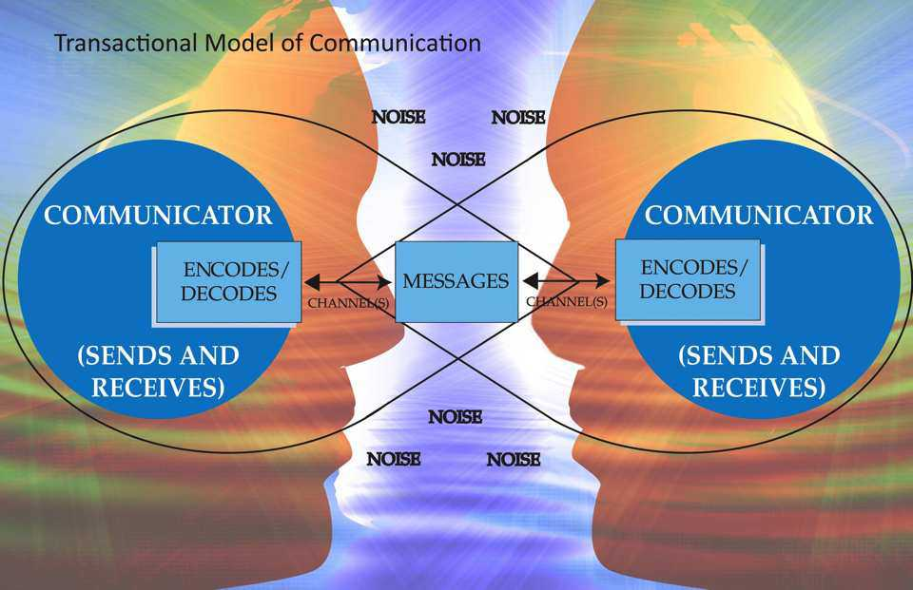
Medical Care in a Joint Cognitive System
Is nuanced and varies due to beliefs, personalities, experiences, biases resources, cultures, professional backgrounds
“In complex systems, relationships are key. Connections or relationships define how complex systems work; an organization is its relationships not its flow chart . . . Yet we long for simple solutions to our complex social problems and are drawn to mechanical solutions that prescribe one-size-fits-all remedies & measurable results.”
Scott CM, Hofmeyer AT. J Interferon Care. 2007;21:491

Slide 26
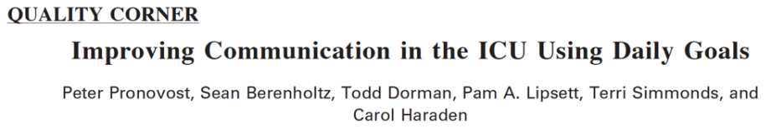
A prospective cohort study to evaluate and improve the effectiveness of communication during patient care rounds
16 bed surgical oncology ICU
Evaluated the Effectiveness of rounds using a 5 pt. Likert scale (nurses and residents)
  “How well do you understand the goals of care for this patient today?”
  “How well do you understand what work needs to be accomplished to get this patient to the next level of care?”
Intervention: Implementation of a daily goals form
Pronovost P, et al. J Crit Care. 2003;18:71
Notes:
8 weeks before intervention, then 2 months pilot, then one year evaluation.

Slide 27
Checklists in Medicine
Decreased ICU Length of Stay
  Pronovost P, et al. J Crit Care. 2003;18:71-75
  Dubose JJ, et al. J Trauma. 2008;64:22-27
Decreased Infectious Complications
  Wall RJ, et al. Qual Saf Health Care. 2005;14:295-302
  Pronovost P, et al. N Engl J Med. 2006;355:2725-2732
  Reilly L, et al. AACN Adv Crit Care. 2006;17:272-283
  Dubose JJ, et al. J Trauma. 2008;64:22-27
  Schulman J, et al. Pediatrics. 2011;127:436-444
Decreased Mortality Rates
  Haynes AB, et al. N Engl J Med. 2009;360:491-499
  Weiss CH, et al. Am J Respir Crit Care Med. 2011
Communication changes occur when checklist review is mandated in group settings
  Weiss CH, et al. Am J Respir Crit Care Med. 2011
  Newkirk M, Pamplin JC. J Trauma Acute Care Surg. 2012;73(2 Suppl 1):S75-S82

Slide 28

But lets face it
We hate checklists!
They don’t match the work we do.

Slide 29
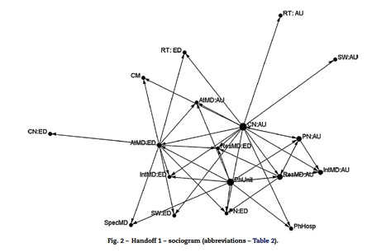
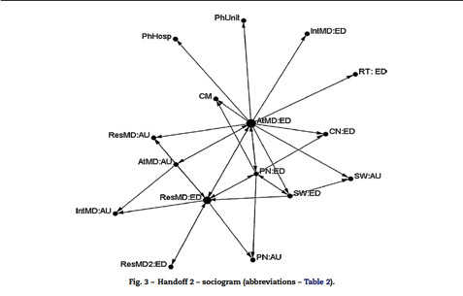
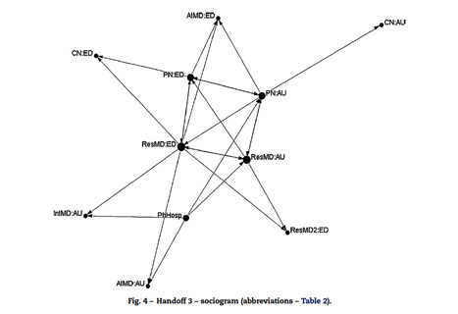
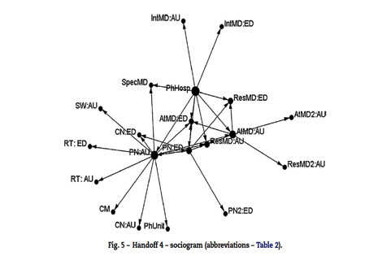
NO PATTERN!
Hutchins & Effken. Int J Med Informatics. 2010;79:252
Notes:
Flexibility, emergent vice traditional heirarchies.

Slide 30
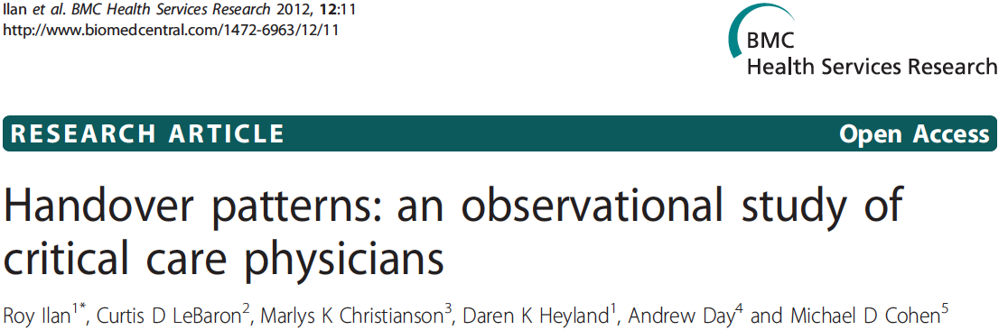
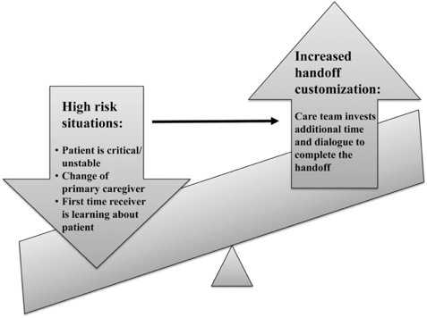
Ilan, et al. BMC Health Serv Res. 2012;12:11

Slide 31
Model of Cognitive Work in a BICU
Nemeth Support for ICU resilience using Cognitive Systems Engineering to build adaptive capacity. In: IEEE; 2014:654-658.

Slide 32
What do we do that needs help?

Slide 33
Medical Decision Making
Clinical Decision Making?
Clinical Reasoning?
Medical Decision Making

Slide 34
Decision Making by the Clinician
  Evaluate
  Diagnose
  Treat
  Discuss
  “Manage”
  Synchronize Care
Acad Emerg Med. 2002;9(11):1184-1204.
Notes:
Evaluation (labs, imaging, procedures)
Diagnosis
Therapy (medical, surgical/procedural)
Discussion (information gathering and information sharing with patient’s and colleagues)
“Management” (disposition, timing of, balancing, cross leveling)
Synchronization of care
Resource utilization

Slide 35
Proficiency | Situation: Action | Thought Paradigm: Information Source
Novice | Situation defined by objective, teachable attributes: task focused | Abstract Principles & Rules: data bits
Advanced Beginner | Recognizes aspects of situations (patterns identified by prior experience): acceptable performance based on stimulus-response.
Competent | Actions in terms of long-range goals: planned actions modify situation
Proficient | Perceives situation as whole: performance guided by maxims (nuances that mean on thing at one time and quite another at another time) | Relies on past experience: the complete whole
Expert | Not guided by analytical principle (gule, guideline, maxim): “I just know” what to do.
Benner P. From novice to expert. Am J Nurs. 1982;82(3):402-407

Slide 36
“The secret of the care of the patient is in caring for the patient.” – Dr. Francis Weld Peabody, 1925
Compared to didactic exercises of student and professor where a working diagnosis is developed over 20-30 minutes, expert clinicians form notion of a diagnosis within 20 seconds.
How?
  Diagnoses start from the first sighting of the patient…
Groopman, Jerome E., and Michael Prichard.
How doctors think. Boston: Houghton Mifflin, 2007.
Notes:
Representativeness error: thinking guided by a prototype so you fail to consider possibilities that contradict the prototype and attribute symptosm to the wrong cause.
Attribution effor: pattients fit a negative stereotype
Affective error: natural tendency to prefer what we hope will happen; value too highly information that fulfills our desires. A wish
Availability bias: tendancy to judge liklihood of an event by the ease with which relevant examples come to mind.
Confirmation bias: cherry picking information that confirms diagnosis and rationalizing others. An expectation.
Anchoring: quickly and firmly latches on to a single possibility
Diagnosis momentum: once a diagnosis is made, it stays.

Slide 37
BEWARE!
Heuristics, Biases, & Cognitive Dispositions to Respond (CDRs)
Croskerry P. Acad Med. 2003;78(8):775-780.
Croskerry P. Acad Emerg Med. 2002;9(11):1184-1204.
Notes:
Anchoring: he tendency to perceptually lock onto salient features in the patient’s initial presentation too early in the diagnostic process, and failing to adjust this initial impression in the light of later information. This CDR may be severely compounded by the confirmation bias.
Availability: the disposition to judge things as being more likely, or frequently occurring, if they readily come to mind. Thus, recent experience with a disease may inflate the likelihood of its being diagnosed. Conversely, if a disease has not been seen for a long time (is less available), it may be underdiagnosed.
Commission bias: results from the obligation toward beneficence, in that harm to the patient can only be prevented by active intervention. It is the tendency toward action rather than inaction. It is more likely in over-confident physicians. Commission bias is less common than omission bias.
Confirmation bias: the tendency to look for confirming evidence to support a diagnosis rather than look for disconfirming evidence to refute it, despite the latter often being more persuasive and definitive.
Overconfidence bias: a universal tendency to believe we know more than we do. Overconfidence reflects a tendency to act on incomplete information, intuitions, or hunches. Too much faith is placed in opinion instead of carefully gathered evidence. The bias may be augmented by both anchoring and availability, and catastrophic outcomes may result when there is a prevailing commission bias.
Diagnosis momentum: once diagnostic labels are attached to patients they tend to become stickier and stickier. Through intermediaries (patients, paramedics, nurses, physicians), what might have started as a possibility gathers increasing momentum until it becomes definite, and all other possibilities are excluded.
Fundamental attribution error: the tendency to be judgmental and blame patients for their illnesses (dispositional causes) rather than examine the circumstances (situational factors) that might have been responsible. In particular, psychiatric patients, minorities, and other marginalized groups tend to suffer from this CDR. Cultural differences exist in terms of the respective weights attributed to dispositional and situational causes.
Order effects: information transfer is a U-function: we tend to remember the beginning part (primacy effect) or the end (recency effect). Primacy effect may be augmented by anchoring. In transitions of care, in which information transferred from patients, nurses, or other physicians is being evaluated, care should be taken to give due consideration to all information, regardless of the order in which it was presented.
Outcome bias: the tendency to opt for diagnostic decisions that will lead to good outcomes, rather than those associated with bad outcomes, thereby avoiding chagrin associated with the latter. It is a form of value bias in that physicians may express a stronger likelihood in their decision-making for what they hope will happen rather than for what they really believe might happen. This may result in serious diagnoses being minimized.
Premature closure: a powerful CDR accounting for a high proportion of missed diagnoses. It is the tendency to apply premature closure to the decision- making process, accepting a diagnosis before it has been fully verified. The consequences of the bias are reflected in the maxim: ‘‘When the diagnosis is made, the thinking stops.’’
Sutton’s slip: takes its name from the apocryphal story of the Brooklyn bank-robber Willie Sutton who, when asked by the Judge why he robbed banks, is alleged to have replied: ‘‘Because that’s where the money is!’’ The diagnostic strategy of going for the obvious is referred to as Sutton’s law. The slip occurs when possibilities other than the obvious are not given sufficient consideration.
Triage cueing: the triage process occurs throughout the health care system, from the self-triage of patients to the selection of a specialist by the referring physician. In the emergency department, triage is a formal process that results in patients being sent in particular directions, which cues their subsequent management. Many CDRs are initiated at triage, leading to the maxim: ‘‘Geography is destiny.’’

Slide 38
Cognitive Debiasing Strategies to Reduce Diagnostic Error
Croskerry P. Acad Med. 2003;78(8):775-780.

Slide 39
How to defeat bias?
What doesn’t fit?
What else could it be?
Get a second opinion…
Groopman, Jerome E., and Michael Prichard.
How doctors think. Boston: Houghton Mifflin, 2007.
Notes:
Representativeness error: thinking guided by a prototype so you fail to consider possibilities that contradict the prototype and attribute symptosm to the wrong cause.
Attribution effor: pattients fit a negative stereotype
Affective error: natural tendency to prefer what we hope will happen; value too highly information that fulfills our desires. A wish
Availability bias: tendancy to judge liklihood of an event by the ease with which relevant examples come to mind.
Confirmation bias: cherry picking information that confirms diagnosis and rationalizing others. An expectation.
Anchoring: quickly and firmly latches on to a single possibility
Diagnosis momentum: once a diagnosis is made, it stays.

Slide 40
Promote novice to … more expert:
Clinical Decision Support Systems
Improving clinical decision making with technology

Slide 41
Intelligent Systems. 2014.

Slide 42
Levels of Automation
Level | Computer Action
1 | Offers no assistance
2 | Offers complete set of decision/action alternatives
3 | Narrows selection down to a few
4 | Suggests one option
5 | Executes suggestion if human approves
6 | Allows human a restricted time to veto before execution
7 | Executes automatically and informs human
8 | Executes; Informs human only if asked
9 | Executes; Informs human only if it (the computer) “decides to”
10 | Fully autonomous; ignores the human
Cognitive behavior/task | Degree of Automation
Skill-Based | Best candidate for automation, assuming reliable sensors for state and error feedback
Rule-Based | Possible candidate for automation, if rule set is well-established and tested
Knowledge-Based | Some automation can be used to help organize, filter, and synthesize data
Expertise | Human reasoning is superior, but can be aided by automation as a teammate
Intelligent Systems. 2014.

Slide 43
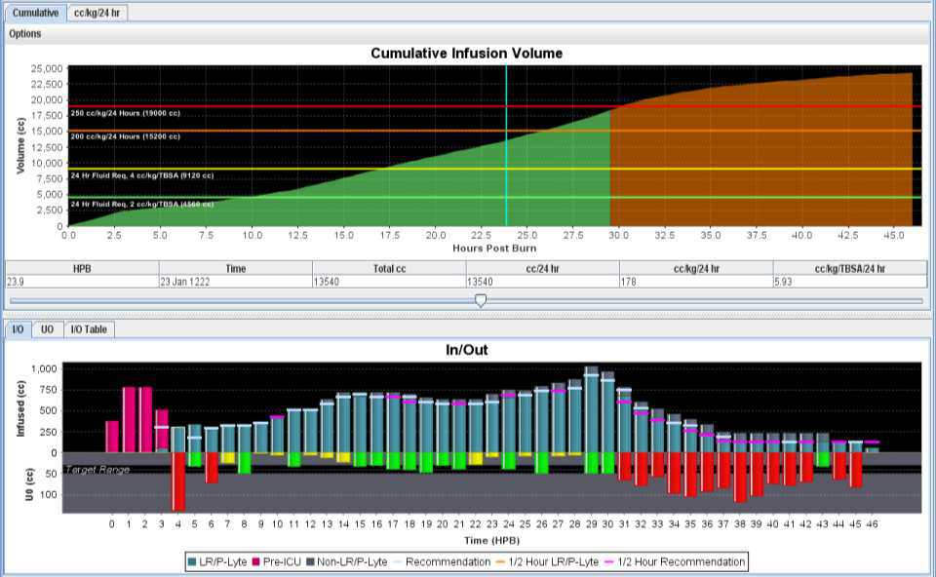
Burn Resuscitation Decision
Support System – Clinical (BRDSS-C)
Notes:
Ml/kg/24 hrs con = 258 +/- 152 dss = 151 +/-68 IVY et al 250 ml/kg threshold
Ml/kg/tbsa/24 hr = con 7.1 +/- 4.5 dss 4.7 +/- 2.2

Slide 44
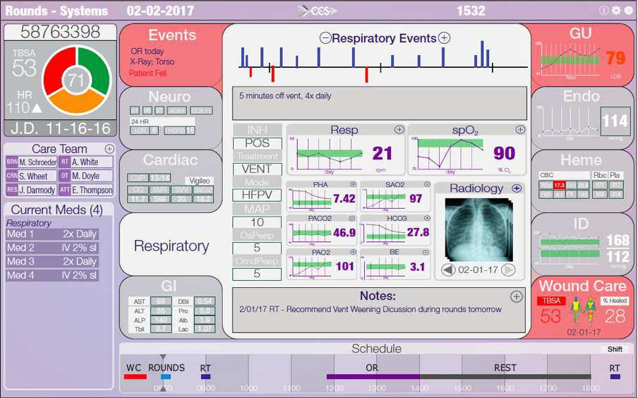
Salient, Learning Displays: The Cooperative Communication System

Slide 45
139⬆
WARNING! Sudden change in hemodynamics and dead space
Consider: PE
Alternatives:
Tension Pneumothorax
Mucus Plug
Sepsis
… (click for others)
Diagnostics
TTE
CXR
CT PA
PA Catheter
BNP
TI
… (click for others)
Therapeutics
TPA
Interventional Radiology
VA ECMO
Bronchoscopy
Antibiotics
62⬇
14⬆
30⬇

Slide 46
Automation in Medicine
The future is now

Slide 47
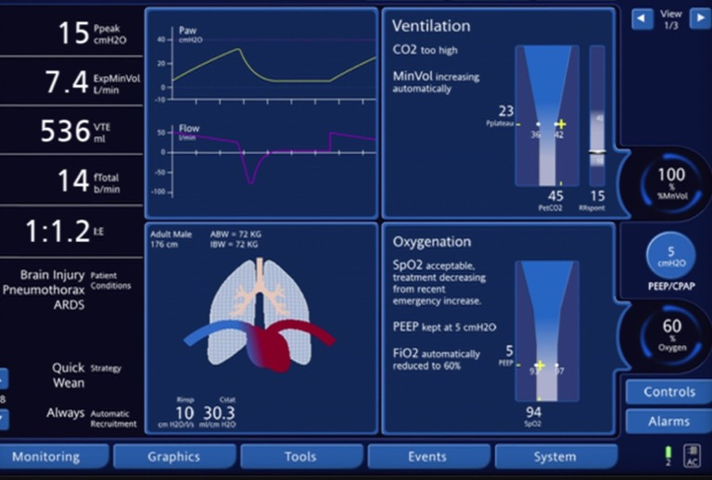
Intellivent-ASVTM
Adaptive Support Ventilation
Notes:
User selects target SpO₂ and ETCO₂
Ventilation controller adjusts P_{INSP} and RR
RR-VT combination is a function of the Otis least-work-of-breathing formula
Oxygenation controller adjusts FiO₂ and PEEP
Delivers a volume-targeted pressure-controlled breath

Slide 48
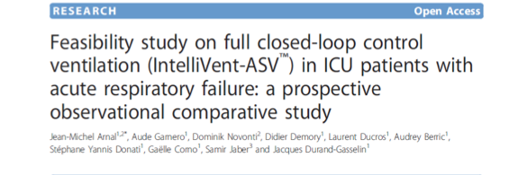
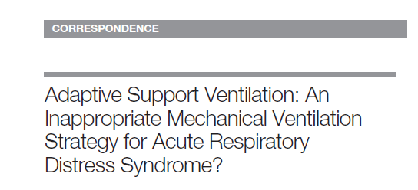
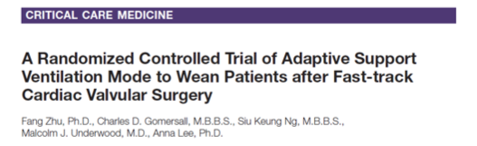
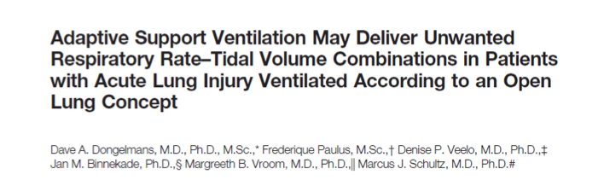
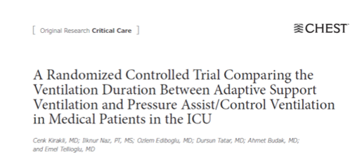
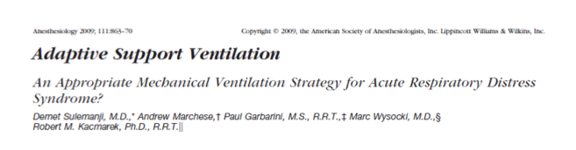
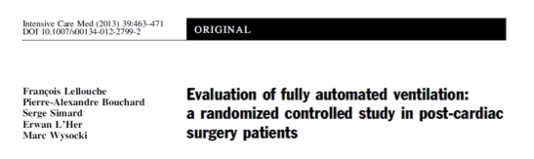

Slide 50
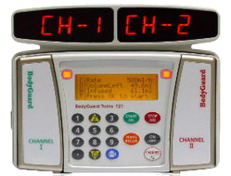
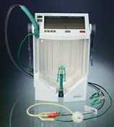
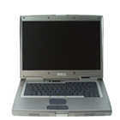

Burn Resuscitation Decision
Support System – Automated (BRDSS-A)
Patient + IV access & bladder catheter
IV Pump
IV Pump
Urine Monitor
BRDSS-A Software
with IDEA as interface to the devices
BodyGuard
Bard Criticore

Slide 51
Task Performance Based on Rules

Slide 52
“Big Data”
Moving toward Knowledge

Slide 53
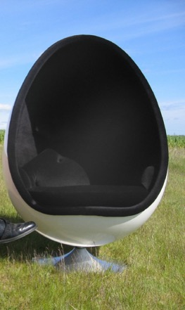
Various ways to train a computer

Slide 54
Sci Transl Med. 2015;7(299):299ra122-299ra122
Notes:
Using supervised learning, a machine learning methodology, and the MIMIC (Multiparameter Intelligent Monitoring in Intensive Care)–II Clinical Database (40), we trained a model that accounts for the censoring effects of clinical interventions on patient outcomes. Moreover, when learning predictive risk scores, current methods (34, 36, 37) often have not accounted for the censoring effects of clinical interventions on patient outcomes (38). For instance, a patient with severe sepsis who received fluids and never developed septic shock would be treated as a negative case, despite the possibility that he or she might have developed septic shock in the absence of such treatment and therefore could be considered a positive case up until the time of treatment (38). Methods that assume that these patients are negative and do not account for the uncertainty in the outcome due to censoring can yield scores that underestimate the probability of a positive outcome (38, 39).
We analyzed routinely available physiological and laboratory data from intensive care unit patients and developed “TREWScore,” a targeted real-time early warning score that predicts which patients will develop septic shock. TREWScore identified patients before the onset of septic shock with an area under the ROC (receiver operating characteristic) curve (AUC) of 0.83 [95% confidence interval (CI), 0.81 to 0.85]. At a specificity of 0.67, TREWScore achieved a sensitivity of 0.85 and identified patients a median of 28.2 [interquartile range (IQR), 10.6 to 94.2] hours before onset. Of those identified, two-thirds were identified before any sepsis-related organ dysfunction.

Slide 55
1. Crit Care Med. 2016;44(2):368-374.
JAMA. 2016;315(8):762–13.

Slide 56
Telemedicine
The Present

Slide 57
Case
House explosion
5 family members taken to a rural community emergency department
8 hours to transfer to two regional burn centers
Both parents and one child died.

Slide 58
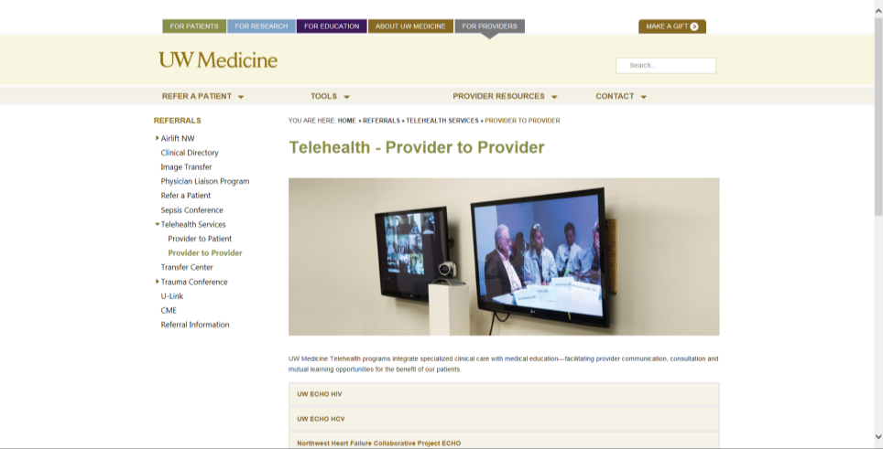
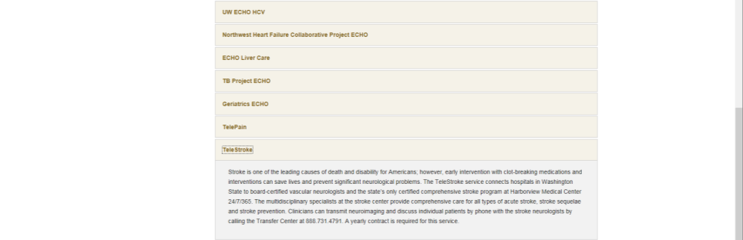

Slide 59
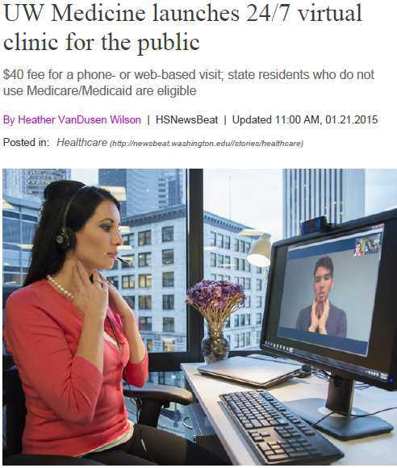

Slide 60
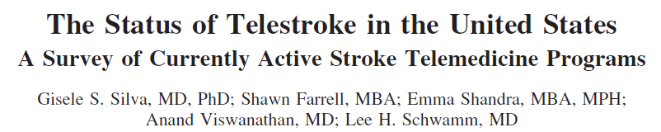
Stroke 43.8 (2012): 2078-2085.
“Telestroke is a widespread and growing practice model.”
>56 programs in > 27 states.
ED consultation, triage, inpatient teleconsultation
Increases use of TPA and decreases “door to needle time”
  Muthana, Jamal N., et al. "Abstract T P211: Continued Participation in a Telestroke Program Improves Time to Intravenous Thrombolysis." Stroke 46.Suppl 1 (2015): ATP211-ATP211.
  Hannah, Jessica A., et al. "Abstract TP308: Annual Trends in Door to Needle Time in a Statewide Telestroke Program." Stroke 47.Suppl 1 (2016): ATP308-ATP308.
Is cost effective
  Switzer, Jeffrey A., et al. "Cost-effectiveness of hub-and-spoke telestroke networks for the management of acute ischemic stroke from the hospitals’ perspectives." Circulation: Cardiovascular Quality and Outcomes 6.1 (2013): 18-26.
Improves clinical decision making (appropriate use of TPA) and outcomes in stroke networked hospitals compared to non-networked hospitals
  Bladin, Christopher F., and Dominique A. Cadilhac. "Effect of telestroke on emergent stroke care and stroke outcomes." Stroke 45.6 (2014): 1876-1880.
  Kepplinger, Jessica, et al. "Safety and Efficacy of Intravenous Thrombolysis in Telestroke Networks: a Systematic Review and Meta-analysis." Stroke 47.Suppl 1 (2016): A81-A81.

Slide 61
Goran SF. A Second Set of Eyes: An Introduction to Tele-ICU. Critical Care Nurse. 2010;30(4):46-55.

Slide 62
JAMA. 2011;305(21):2175-2183

Slide 64
JAMA. 2011;305(21):2175-2183

Slide 65
56 ICUs
13% Rural
30 Suburban
57% Urban
38% Non-Teaching
36% Unaffiliated Teaching
27% Academic or University Affiliated
Chest. 2014;145(3):500-507

Slide 66
Changes in Survey Responses pre/post teleICU impact on Survival
Domain | OR | P value
ICU Characteristics | 0.07 (0.56-0.87) | <0.01
MD Leadership | 0.8 (0.7-0.92) | <0.01
Best Practices & Performance Review | 0.71 (0.56-0.91) | <0.01
Higher % of intensivist care review in 1 hr of admit More frequent review of performance data Higher adherence to ”best practices” More rapid response to alerts and alarms More frequent interdisciplinary rounds More effective ICU committee as judged by leaders
Chest. 2014;145(3):500-507

Slide 67
TeleICU = Teleconsultation
Something we do every day
If you reach the limits of your knowledge or skills, you ask for help
Telemedicine offers the option to bring capability to patient vice patient to capability
Rapidly promotes “Novice” to “Expert” by bringing the expert into the care team

Slide 68
The Future

Slide 69
What is the most important “Monitor?”
      “My Eyes.”
      SGM Sims, Smart monitoring, 2010 (I think)
Notes:
But, it’s not really just the eyes that matter! I venture to guess that his eyes are better than some other people’s eye. Really, we’re after his instinct, his experience, his understanding, and, we want to improve upon them!

Slide 70
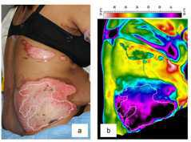
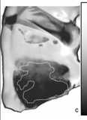
Implications for documentation? Decision support?
Could we automatically map wounds? Trauma?

Slide 71
AMIA Summits on Translational Science Proceedings. 2013;2013:136-140.

Slide 72
Conclusions

Slide 73
“Man is fallible, but maybe men are less so.”
- Atul Gawande, The Checklist Manifesto, 2010
“And, perhaps, men + machines are even less so.”
- Mary Cummings, Intelligent Systems, 2014

Slide 74
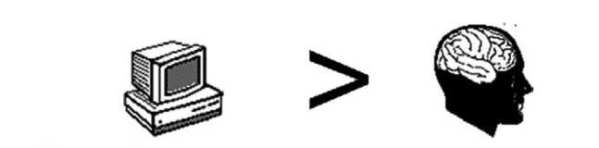
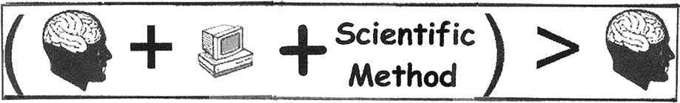
Conclusions
Hunter JS. Enhancing Friedman's “Fundamental Theorem of Biomedical Informatics”. J Am Med Inform Assoc 2010;17:112-113
Notes:
General conclusions from today presentation.

Slide 75
Conclusions
Clinicians are fallible, in many situations.
Technology reduces complexity
The goal is not to replace the clinician, but to improve performance
  Limiting performance of simple tasks during normal conditions in order to free the clinician(s) for other activities
    Automated support, not Closed Loop Autonomous
  Focus clinician attention on variance
Telemedicine is only a phone call (or a “skype”) away.

Slide 76
Any Questions?

Slide 77
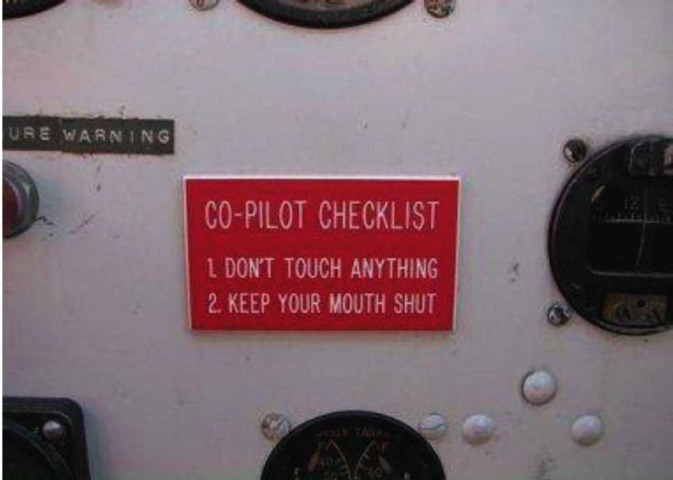

Slide 78
Peak Decision
Making
Easy
“Certainty is an illusion.”
- Andrew West
Ease & Accuracy
of Decision
Hard
None
Information Salience
Overload (too much)
Nemeth. "Support for Salience: IT to Assist Burn ICU Clinician Decision Making and Communication." Systems, Man, and Cybernetics (SMC), 2015 IEEE International Conference on. IEEE, 2015.
Postgraduate Medical Journal. 2002;78(920):319-321.
Notes:
Salinece = right information, right person, right time, to make the right decision

Slide 79
Incomplete or imperfect mastery of available knowledge.
Limitations in current medical knowledge.
The difficulty in distinguishing between personal ignorance or ineptitude and the limitations of present medical knowledge.
Postgraduate Medical Journal. 2002;78(920):319-321.
Groopman, Jerome E., and Michael Prichard.
How doctors think. Boston: Houghton Mifflin, 2007.

Slide 80
Integrated System with Clinician Input
One system…. To RULE them ALL!
Sensor
Output
Considerations
Sudden Drop SpO2
Normal Compliance
Sudden drop MAP
High SVV
High SVR
All sensors = “green”
Anything “I’m” missing (clinician as sensor)?
Increase FiO2
Decrease PEEP
Increase VT
Give Fluid Bolus
Increase NE
Increase sedation (alternative pathways)?
Is this right?
70% PE
20% Pneumothorax
5% Pneumonia
5% ARDS
50% PE
25%MI
10% Hypovolemia
10 %Hemorrhage
5% Sepsis
Consider
1st Ultrasound, 2nd CT
Notes:
Example: patient is dyssynchronous, in pain, anxious, pale, etc.

Slide 81
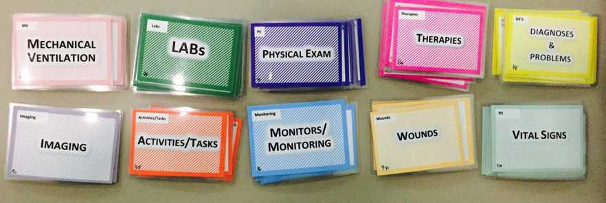
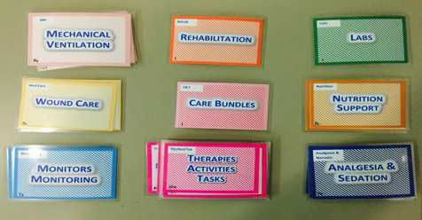
Methods
The final card set included 97 cards:
  67 cards in 10 categories of “features” used to determine patient condition
  30 cards in 9 categories of “treatments”
Feature Cards
Treatment Cards
Notes:
The final card set included 97 cards:
67 cards in 10 categories of “features” used to determine patient condition
30 cards in 9 categories of “treatments”

Slide 82
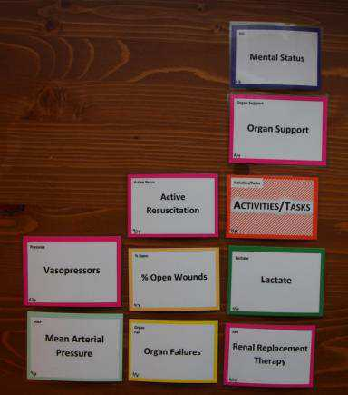
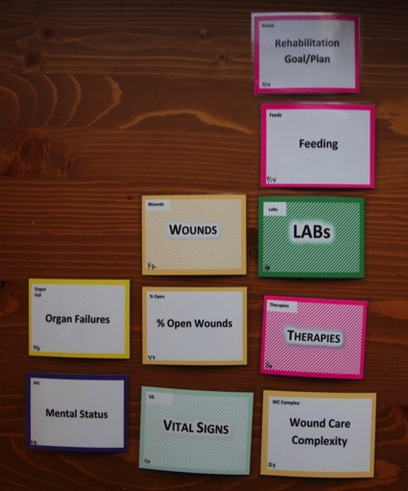
Example Feature Card Sorts
Least Sick Patient/Could Transfer
Sickest Patient/Could Die Today
Least Important Card
Most Important Card
Notes:
The final card sort looked like this where the card in the bottom left corner was most important and the on in the top right least important of the 10 most important cards. This image shows example sorts of a “most sick” patient on your left and a least sick patient on your right.

Slide 83
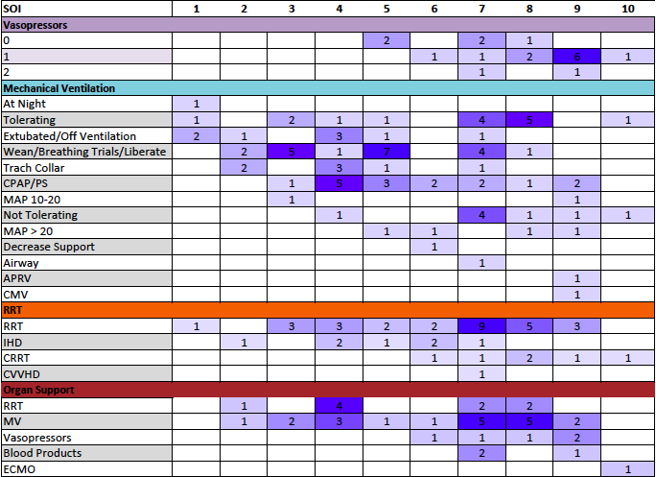

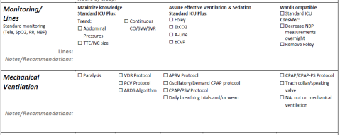
Pamplin. Critical Care Medicine 42 (12), A1579

Slide 84
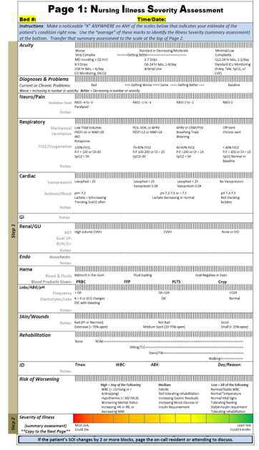

Pamplin. Critical Care Medicine 42 (12), A1579

Slide 85

Pamplin J, et al. ABA 2016

Slide 86
Goals
A clear and recognizable goal must serve as the focus for team success
This is ‘‘idea dominance’’
  Team members shift from a professional focus to one requiring understanding of another’s observations and interpretations.
  It requires problem solving and solution development utilizing professional perspective
    Must then comprehensibly share perspective with the team.
  Developments a common language and conceptual framework that transcends each professional
  Facilitates realistic expectations of the team’s work.
Hall P. Journal of Interfrofessional Care. 2005;S1:188

Slide 87


Notes:
Here you can see a version of our early tools used to improve team understanding of patient condition and care priorities.

