Slide 1
All About Training
Bob Marshall, MD MPH MISM FAAFP DoD Clinical Informatics Fellowship

Slide 2
Some Definitions of Training
Merriam-Webster
The act, process, or method of one that trains
The skill, knowledge, or experience acquired by one that trains
Business Dictionary
Organized activity aimed at imparting information and/or instructions to improve the recipient's performance or to help him or her attain a required level of knowledge or skill.

Slide 3
Learning Theory
Learning theories are conceptual frameworks describing how knowledge is absorbed, processed, and retained during learning
Cognitive, emotional, and environmental influences, as well as prior experience, all play a part in how understanding, or a world view, is acquired or changed and knowledge and skills retained
Behaviorists look at learning as an aspect of conditioning and will advocate a system of rewards and targets in education

Slide 4
Techniques and Benefits
There are many different conditions that influence transfer of learning in the classroom
These conditions include features of the task, features of the learner, features of the organization and social context of the activity
The features of the task include practicing through simulations, problem-based learning, and knowledge and skills for implementing new plans
The features of learners include their ability to reflect on past experiences, their ability to participate in group discussions, practice skills, and participate in written discussions

Slide 5
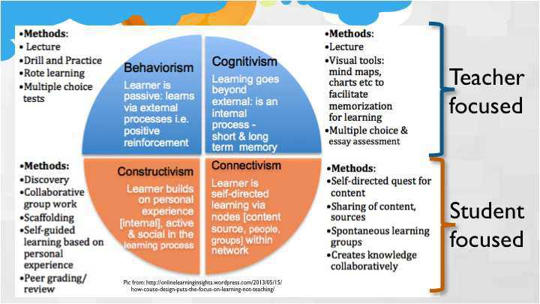
Major Learning Theories

Slide 6
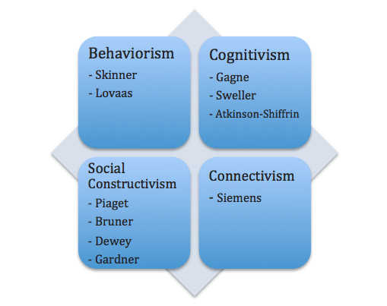

Slide 7
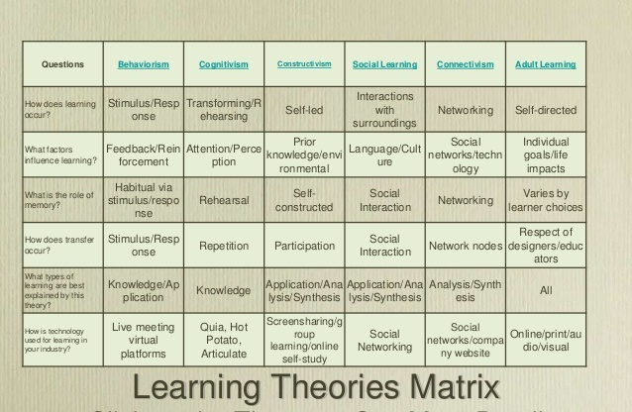

Slide 8
Formal and Mental Discipline
All individuals have the ability to develop mental discipline and the skill of mindfulness, the two go hand in hand
Mental discipline is critical in terms of the processing of information and involves the ability to recognize and respond appropriately to new things and information people come across, or have recently been taught
Mindfulness is important to the process of learning in many aspects
Being mindful means to be present with and engaged in whatever you are doing at a specific moment in time
Being mindful can aid in helping us to more critically think, feel and understand the new information we are in the process of absorbing

Slide 9
Multimedia Learning
Multimedia learning refers to the use of visual and auditory teaching materials that may include video, computer and other information technology
Multimedia learning theory focuses on the principles that determine the effective use of multimedia in learning, with emphasis on using both the visual and auditory channels for information processing
If both the visual and auditory channels are presented with information, more knowledge is retained
However, if too much information is delivered it is inadequately processed, and long term memory is not acquired

Slide 10
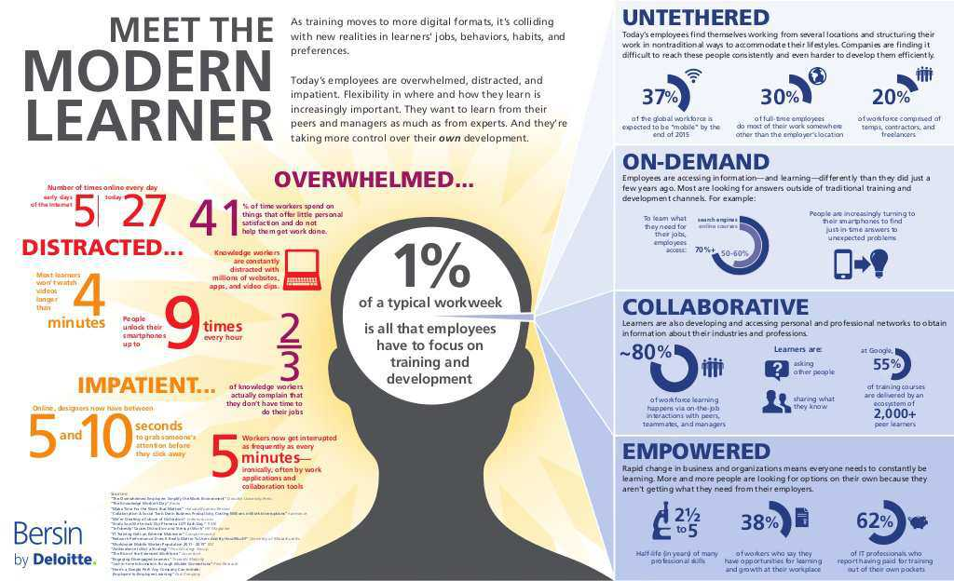

Slide 11
Learning Styles

Slide 12
Learning Styles - Overview
Learning styles refer to a range of competing and contested theories that aim to account for differences in individuals' learning
These theories propose that all people can be classified according to their 'style’ of learning, although the various theories present differing views on how the styles should be defined and categorized
Although there is ample evidence that individuals express preferences for how they prefer to receive information, few studies have found any validity in using learning styles in education

Slide 13
Learning Styles - Substance
There is evidence of empirical and pedagogical problems related to forcing learning tasks to "correspond to differences in a one-to-one fashion"
Well-designed studies contradict the widespread "meshing hypothesis" that a student will learn best if taught in a method deemed appropriate for the student’s learning style
There are substantial criticisms of learning-styles approaches from scientists who have reviewed extensive bodies of research
A 2015 peer reviewed article concluded: "Learning styles theories have not panned out, and it is our responsibility to ensure that students know that."

Slide 14
Memletic Learning Style
Memletics (memory + athletics) is an accelerated learning program that promises to help people improve their learning and memory abilities through the same method athletes use to build muscle tone and physical fitness
Learning styles associated with the program (visual, aural, logical, physical, verbal, solitary, and social) as well as the learning approaches it professes to teach practitioners (visualization, association, repetition, performance, and simulation techniques)
Based on two other learning style theories (neither objectively proven)

Slide 15
Learning Styles Assessment
Go to the following URL and determine your own learning style
https://www.learning-styles-online.com/inventory/questions.php
What is your learning style?

Slide 16
Memletic LSI
The Memletic LSI gives information about the extent to what each of seven learning styles is used by a particular learner.
Such indications are particularly important to e-learning as the learning content must be, for the most part, prepared in advance and is difficult to adapt “on the spot” according to learners’ needs
If the initial recognition of learning style, measured by applied learning styles inventory, was not precise (there can be many reasons for that) all learning throughout the course will be affected
An approach based on recognition of various learning styles helps to soften the consequences of such incorrect diagnosis

Slide 17
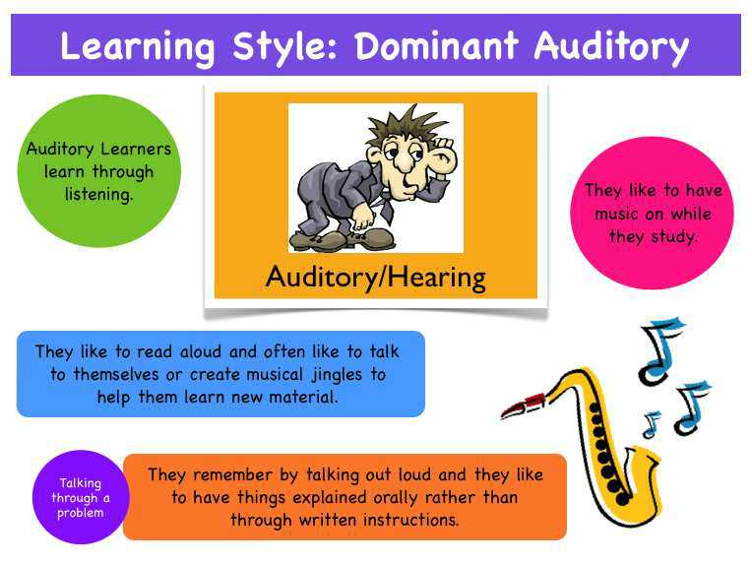

Slide 18
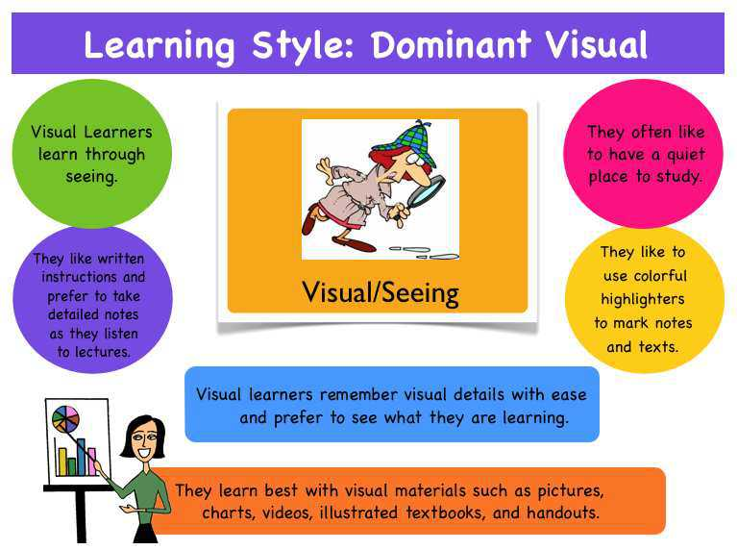

Slide 19
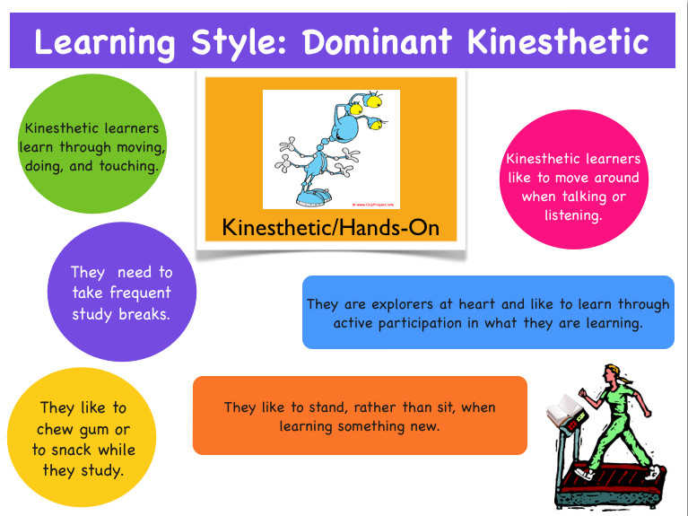

Slide 20
What does it all mean?
People have preferred learning styles
Most people are visual or visual-spatial learners
There is no objective evidence that focusing on a particular learning style while teaching enhances learning
Provide content in as many domains as possible, and do not overload the content
Using learning theory vice learning styles as the driver to create learning opportunities/support tools

Slide 21
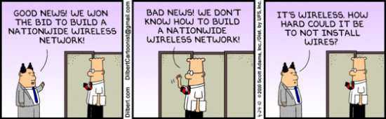
Questions
The Pointy-Haired guy now works for DHA – same level of functionality

