Slide 1
Code Re-Use: Libraries, APIs and Frameworks

Slide 2
Definitions
Libraries bundles code to allow re-use within a programming language
Examples: hashlib (crypto), sciKitLearn (ML) -- python
Frameworks sit on top of existing languages, create a new, “shorthand” version of language
Examples: jquery, node.js, js.react (javascript), Bootstrap (CSS)
Automated programming interface
Information exchange
Inputs
Expected outputs
Often language-agnostic
This is the “service” in the service oriented architecture (SOA)
Examples: Facebook API

Slide 3
Why Do You Care?
“Nobody codes anymore”
>90% of source code are libraries, shortcuts using frameworks, or APIs
Can take a multi-year programming effort down to hours
Can become independent of programming language and platform
If you are hand-coding, you are typically wasting time and money

Slide 4
Frameworks

Slide 5
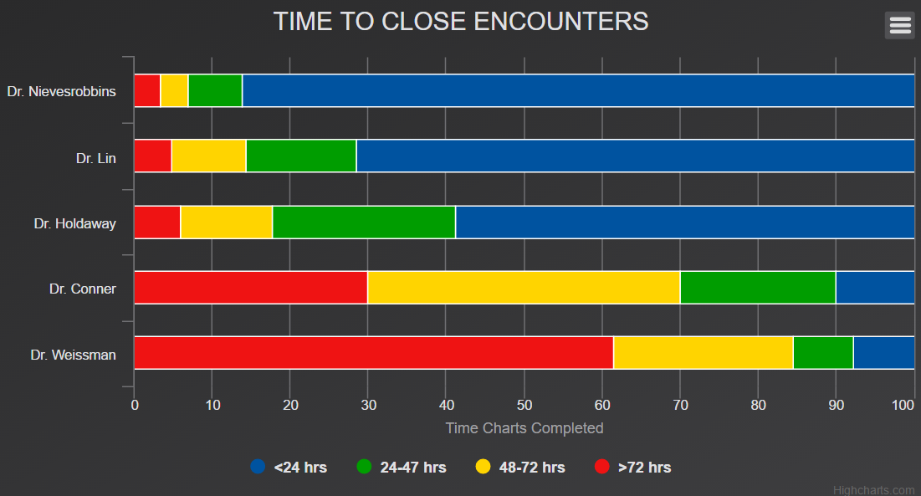
Highcharts open source charting (alternatives: Fusioncharts or D3.js)

Slide 6
APIs

Slide 7
Strategic Goals of APIs
Selective exposure of information/capabilities
E.g. may expose Google search results, but not programming
Function cross-platform/cross-programming language
Become a platform/Gain market share
Reduce repetition of tasks/be cost efficient
Use others to expand your reach
Monitor usage via webhits rather than database log files

Slide 8
Usage in Real (non-DoD) World
Web-accessible
Cloud-based
Many downloadable, but typically best if connected, require connectivity for storage
No or low cost for low volume, non-commercial use
JSON is ubiquitous data transfer standard

Slide 9
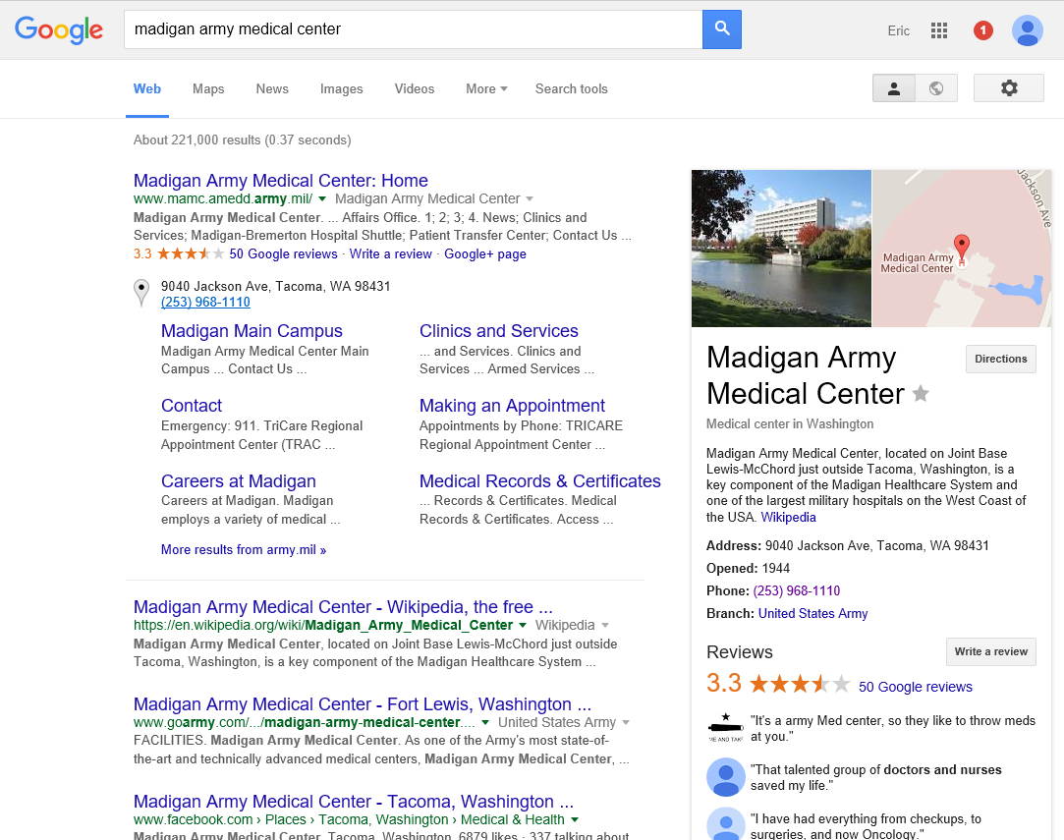
Notes:
Each red box represents different requests that were all brought together for this page. The revolution is the AGGREGATION of information in one place. This requires each one of these information streams to be accessible.

Slide 10

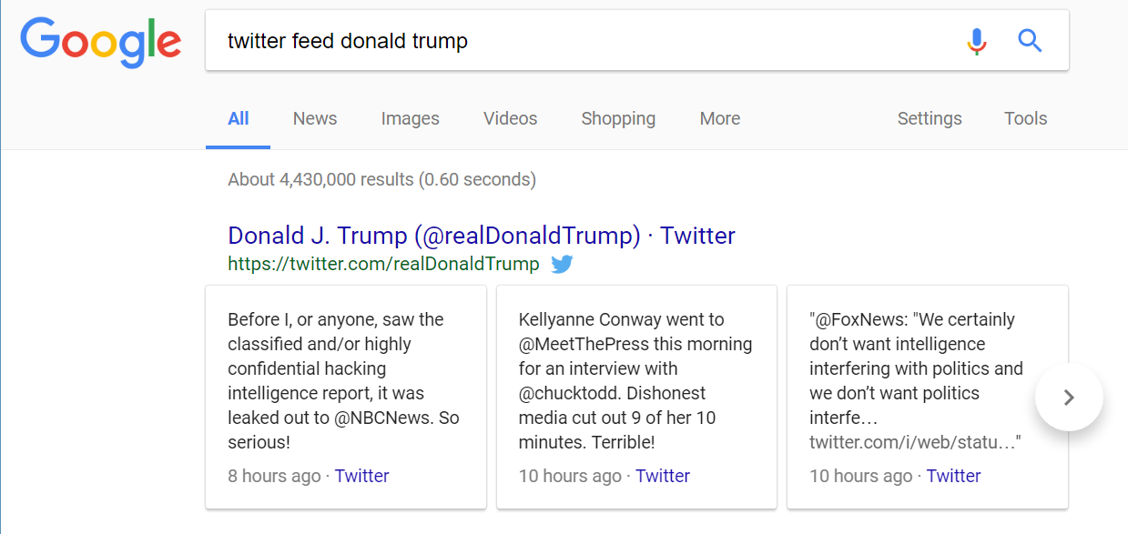
https://graph.facebook.com/10151443611110725/picture?width=9999
or
https://graph.facebook.com/donaldtrump/picture?type=large
How to embed a twitter feed in your website

Slide 11
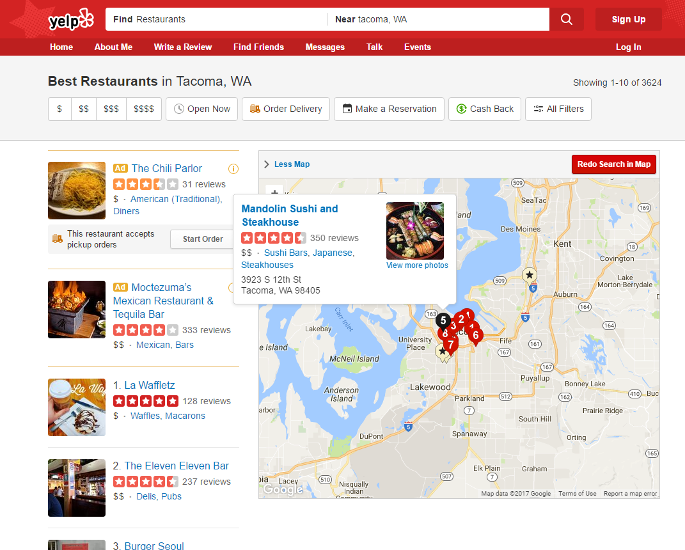

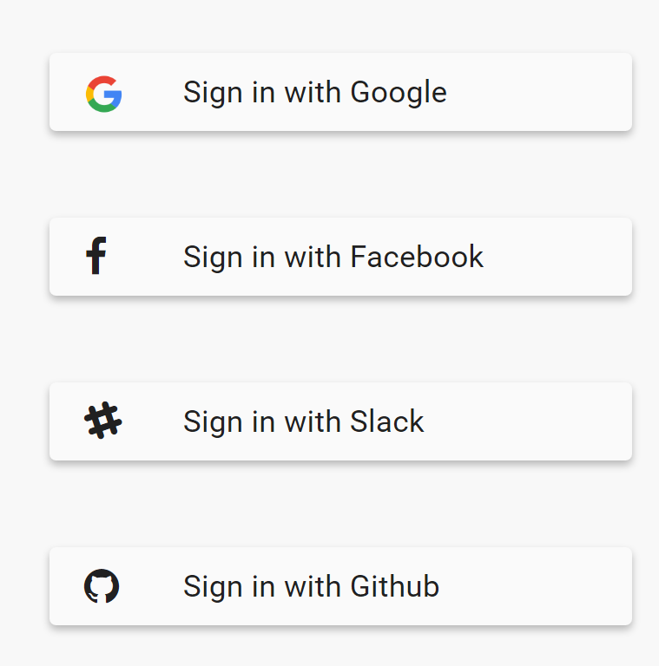

Slide 12

Healthcare Current State
DoD: Requirements-based contracting
Vendor/information provider functionally “owns” information
Q: How do you push information into/out of MHS GENESIS?
A: New contract.
Civilians must be better…
Hope:
SMART on FHIR or other open API standards

Slide 13
Current State Questionnaires
Requirements-based contracting for questionnaires
Contract for JOES
Contract for TRISS
Contract for research questionnaire
Contract for GAT
Contract for 360 eval
Contract for…
Does any web company do it this way?
Think about an API that could handle any questionnaire

Slide 14
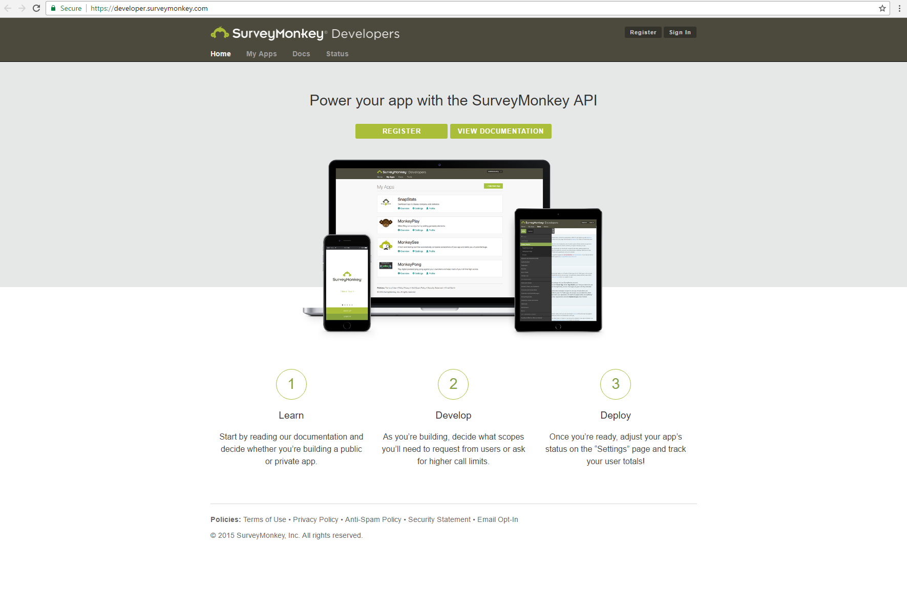
HIPAA-Compliant Alternative: surveygizmo

Slide 15
How Does It Work ? 1 of 2
Example:
https://www.google.com/maps/place/madigan+army+medical+center/
Converted to
https://www.google.com/maps/place/madigan+army+medical+center/@47.1097586,-122.5520699,15z/
Searches place database for: Madigan Army Medical Center (don’t need coordinates)
Plots this on map and adds the coordinates to URL (responding to API query)
If in a browser, displays place card and the Google Map plot
What if not in a browser, but in code?

Slide 16
How Does It Work? 2 of 2
http://en.wikipedia.org/w/api.php?action=query&list=backlinks&bltitle=Star%20Wars&bllimit=10
Go to wikipedia: http://en.wikipedia.org/w/api.php
Fetch information: action=query
Return a list: list=backlinks
About Star Wars: bltitle=Star%20Wars
Limit to first 10 results: bllimit=10
Returns machine-readable information that can be re-formatted or combined
Can be highly secure (typically Oauth, but could use any authentication method--CAC, etc.)

Slide 17
How Does It Work?
Information can be created, updated, added, or deleted (CRUD) using the same techniques
With permissions, could:
Change President Obama’s profile picture
Add entries to Wikipedia
Add reviews on Yelp, etc.

Slide 18
Healthcare (and DoD) Applications
Greater focus on security, HIPAA compliance, FDA regulation, zero error
Favors proprietary systems for core functions
Favors single vendor for assigning responsibility
Why use?
Common use cases (questionnaire)
Requirement for flexibility
Less complexity
Want to leverage many different developers

Slide 19
Healthcare (and DoD) Applications
Limited access to information (does not require full access)
HIEs
Simplified—does not require knowledge of database, just the API format
https://code.cerner.com/
Cerner’s pull implementation of SMART on FHIR
Need push implementations
Ingest data from external API into Cerner such as risk prediction tool
Change underlying data within EHR – C, U, D of CRUD
Most likely Create/add information such as blood pressure measurement rather than changing or deleting EHR

Slide 20
Why a Senior Leader Issue
Outside world changed
Depend on inter-operability, flexibility
Depend on machines moving information NOT users typing on webpages
Can’t view projects, requirements, in vacuum
What are underlying need of dozens/hundreds of contracts?
Must include ability to push and pull information in bulk
Contractually require API-type data exchange in addition to the cool-looking website that briefs well, but will be outdated before deployed

Slide 21
Healthcare Solution Example APIs
Prevention
Query to find all patients in the MHS without recent mammogram
Send all those patients a reminder in Relay Health
Questionnaires
Tend to be stand-alone
Readiness?
Data ingestion from home devices (mHealth integration)

Slide 22
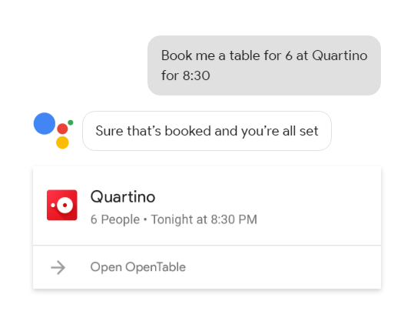
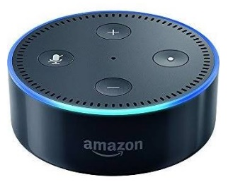
Future
“Conversation is the command line of tomorrow”
Language is how we communicate
WeChat had more mobile payment transactions for Chinese New Year than PayPal had for entire year
Users average 10 hours per day in Slack
Talk w/AI assistants more than spouses by 2020

Slide 23
Future in Healthcare
Predictive and prescriptives/CDS
EHR vendors not able to bring this to market quickly
Plug-ins with decision rules using SMART on FHIR
Patient behavior interventions outside hospital
Provider conversation with assistant that can include patient data in CDS from API
Audio interpretation (murmurs) as API
Video applications ??

Slide 24
Backup Slides

Slide 25
JSON
JSON (JavaScript Object Notation) is a lightweight data-interchange format.
It is easy for humans to read and write. It is easy for machines to parse and generate. It is based on a subset of the JavaScript Programming Language
JSON is a text format that is completely language independent but uses conventions that are familiar to programmers of the C-family of languages, including C, C++, C#, Java, JavaScript, Perl, Python, and many others.
These properties make JSON an ideal data-interchange language

Slide 26
JSON Cont.
JSON is built on two structures:
A collection of name/value pairs. In various languages, this is realized as an object, record, struct, dictionary, hash table, keyed list, or associative array.
An ordered list of values. In most languages, this is realized as an array, vector, list, or sequence

Slide 27

JSON example script representing a person

Slide 28

Node.js
Node.js is an open-source, cross-platform JavaScript run-time environment for executing JavaScript code server-side.
Node.js enables JavaScript to be used for server-side scripting, and runs scripts server-side to produce dynamic web page content before the page is sent to the user's web browser.
Consequently, Node.js has become one of the foundational elements of the "JavaScript everywhere" paradigm, allowing web application development to unify around a single programming language, rather than rely on a different language for writing server side scripts.

Slide 29
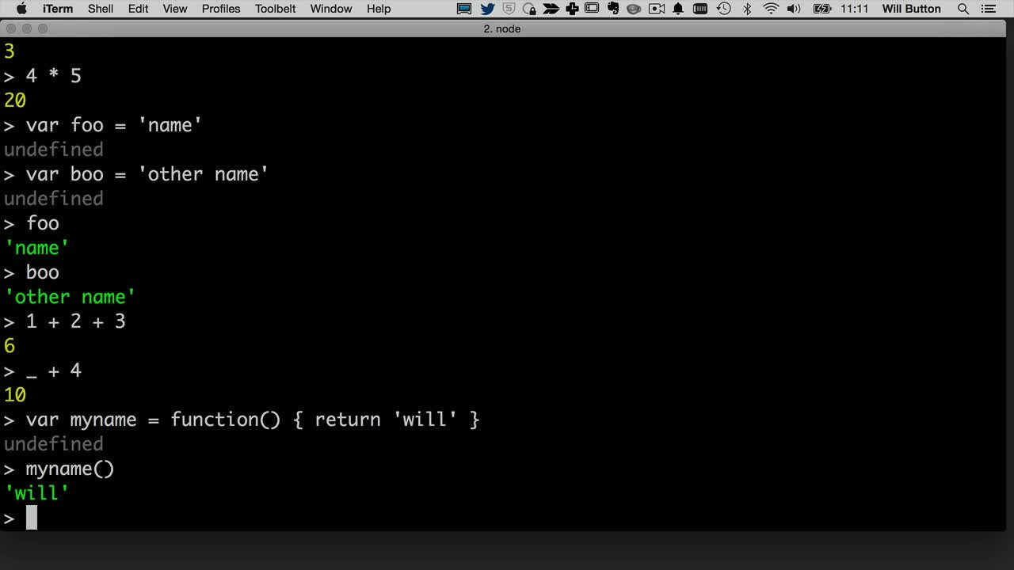

Slide 30
Lodash 1 of 2
Lodash is a JavaScript library that helps programmers write more concise and easier to maintain JavaScript.
It can be broken down into several main areas:
Utilities - for simplifying common programming tasks such as determining type as well as simplifying math operations.
Function - simplifying binding, decorating, constraining, throttling, debouncing, currying, and changing the pointer.
String - conversion functions for performing basic string operations, such as trimming, converting to uppercase, camel case, etc.

Slide 31
Lodash 2 of 2
Array - creating, splitting, combining, modifying, and compressing
Collection - iterating, sorting, filtering, splitting, and building
Object - accessing, extending, merging, defaults, and transforming
Seq - chaining, wrapping, filtering, and testing.

Slide 32
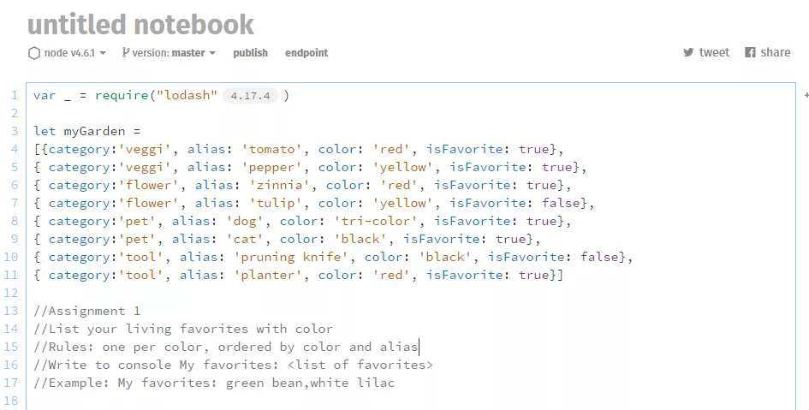

Slide 33
Alexa Skills
The Alexa Skills Kit (ASK) is a collection of self-service APIs, tools, documentation, and code samples that makes it fast and easy for you to add skills to Alexa.
ASK enables designers, developers, and brands to build engaging skills and reach customers through tens of millions of Alexa-enabled devices.
With ASK, you can leverage Amazon’s knowledge and pioneering work in the field of voice design

Slide 34
