Slide 1

Statistical Calculations for Research
Bob Marshall
DoD CI Fellowship

Slide 2
Learning Objectives
Cure insomnia
Learn a little bit about statistics
Have some fun

Slide 3
Risk Calculations
 | Condition Present | Condition Absent
Risk Factor Present | a | b
Risk Factor Absent | c | d

Slide 4
Formulas…1
RR – Relative Risk = [a/(a+b)] / [c/(c+d)]
Often used in cohort studies
OR – Odds Ratio = ad/bc
Often used in case-control studies
AR – Attributable Risk = a/(a+b) or c/(c+d)
Only used in cohort studies

Slide 5
Formulas…2
ARR – Absolute Risk Reduction = (a/a+b) or (c/c+d)
RRR – Relative Risk Reduction = 1-RR
NNT – Number Needed to Treat = 1/ARR
NNH – Number Needed to Harm =

Slide 6
Sensitivity & Specificity
Sensitivity measures the proportion of positives that are correctly identiﬁed as such (also called the true positive rate)
Speciﬁcity (also called the true negative rate) measures the proportion of negatives that are correctly identiﬁed as such
Sensitivity therefore quantiﬁes the avoiding of false negatives, and speciﬁcity does the same for false positives.

Slide 7
Sensitivity/Specificity Calculations
 | Condition Present | Condition Absent
Test Positive | a | b
Test Negative | c | d

Slide 8
Formulas
SN or Sn – Sensitivity = a/(a+c)
SP or Sp – Specificity = d/(b+d)
PPV – Positive Predictive Value = a/(a+b)
NPV – Negative Predictive Value = c/(c+d)

Slide 9
Sensitivity/Specificity vs NNT
Sensitivity and speciﬁcity are prevalence-independent test characteristics, as their values are intrinsic to the test and do not depend on the disease prevalence in the population of interest
Positive and negative predictive values, but not sensitivity or speciﬁcity, are values inﬂuenced by the prevalence of disease in the population that is being tested

Slide 10
Likelihood Ratios
The Likelihood Ratio (LR) is the likelihood that a given test result would be expected in a patient with the target disorder compared to the likelihood that that same result would be expected in a patient without the target disorder
LR is used to assess how good a diagnostic test is and to help in selecting an appropriate diagnostic test(s) or sequence of tests.
They have advantages over sensitivity and specificity as they are less likely to change with the prevalence of the disorder

Slide 11
Likelihood Ratios
LR+ - Positive Likelihood Ratio = [a/(a+c)] / [b/(b+d)]
LR- - Negative Likelihood Ratio = [c/(a+c)] / [d/(b+d)]
LR>10 or <0.1 – causes large changes in likelihood
LR 5-10 or 0.1-0.2 – causes moderate changes in likelihood
LR 2-5 or 0.2-0.5 – causes small changes in likelihood
LR<2 or >0.5 – causes tiny changes in likelihood
LR=1 – no change in likelihood

Slide 12
NNT/NNH
The Number Needed to Treat (NNT) is the number of patients you need to treat to prevent one additional bad outcome
To calculate the NNT, you need to know the Absolute Risk Reduction (ARR); the NNT is the inverse of the ARR
NNTs are always rounded up to the nearest whole number

Slide 13
NNT/NNH….cont
The ideal NNT is 1, where everyone improves with treatment and no one improves with control. The higher the NNT, the less eﬀective is the treatment
NNT is similar to number needed to harm (NNH), where NNT usually refers to a therapeutic intervention and NNH to a detrimental eﬀect or risk factor

Slide 14
Odds Ratios to NNT
The formula for converting ORs to NNTs is: NNT = (1­(PEER*(1­OR))) / ((1­PEER)*(PEER)*(1­OR))
The formula for converting ORs to NNHs (Numbers Needed to Harm) is: NNH = ((PEER*(OR­1))+1) / (PEER*(OR­1)*(1­PEER))

Slide 15
Positive/Negative Predictive Value
Positive predictive value is the probability that subjects with a positive screening test truly have the disease.
Negative predictive value is the probability that subjects with a negative screening test truly don't have the disease
Positive Predictive Value: A/(A+B) × 100
Negative Predictive Value: D/(D+C) × 100

Slide 16
PPV/NPV and Prevalence
Positive and negative predictive values are influenced by the prevalence of disease in the population that is being tested. If we test in a high prevalence setting, it is more likely that persons who test positive truly have disease than if the test is performed in a population with low prevalence

Slide 17
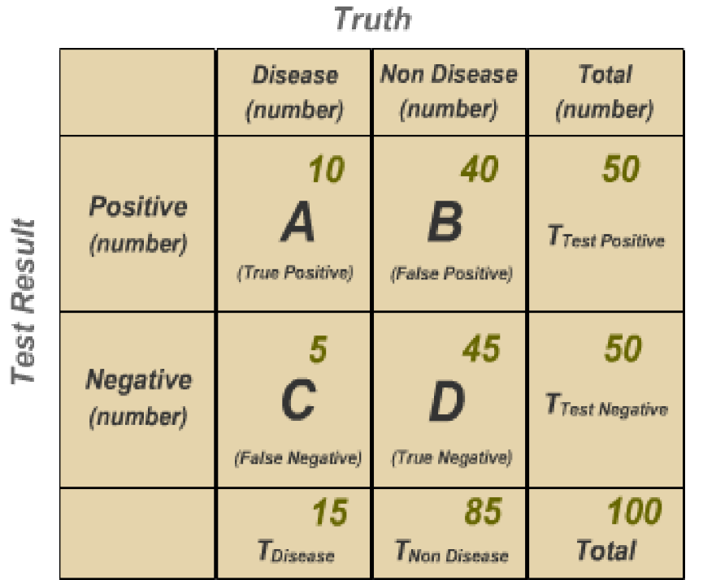

Slide 18
100 people are tested for disease. 15 people have the disease; 85 people are not diseased.
So, prevalence is 15%:
Prevalence of Disease: Tdisease/Total × 100, 15/100 × 100 = 15%
For a clinician, however, the important fact is among the people who test positive, only 20% actually have the disease
Positive Predictive Value: A/(A + B) × 100
10/50 × 100 = 20%
For those that test negative, 90% do not have the disease.
Negative Predictive Value: D/(D + C) × 100
45/50 × 100 = 90%

Slide 19
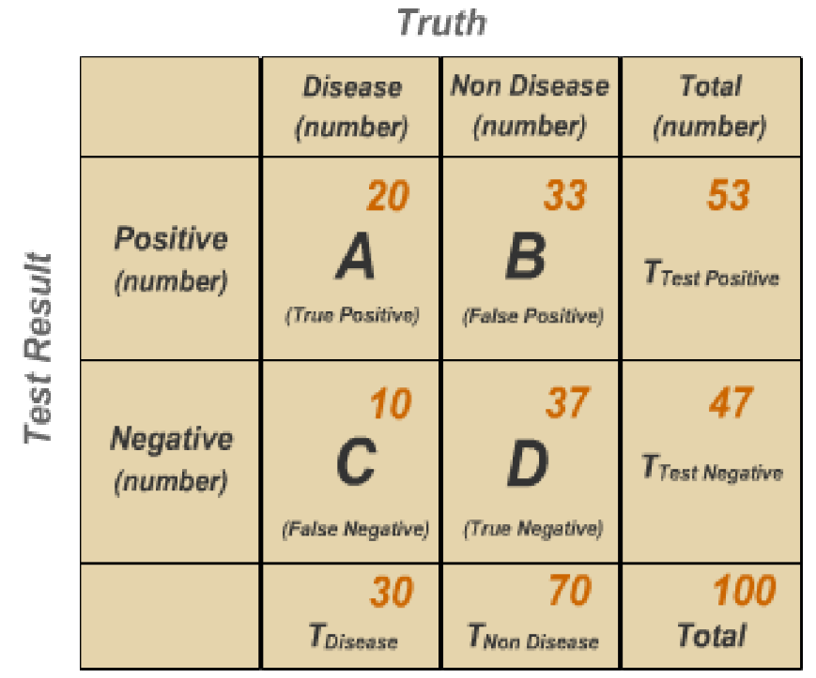

Slide 20
This time we use the same test, but in a different population, a disease prevalence of 30%.
Prevalence of Disease: Tdisease / Total × 10
30/100 × 100 = 30%
Now let's calculate the predictive values:
Positive Predictive Value: A/(A + B) × 100
20/53 × 100 = 38%
Negative Predictive Value: D/(D + C) × 100
37/47 × 100 = 79%

Slide 21
Rules Regarding PPV/NPV
Using the same test in a population with higher prevalence increases positive predictive value
Conversely, increased prevalence results in decreased negative predictive value.
When considering ppredictive values of diagnostic or screening tests, recognize the influence of the disease prevalence

Slide 22
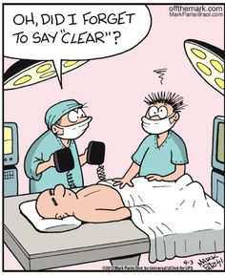
Questions

