Slide 1



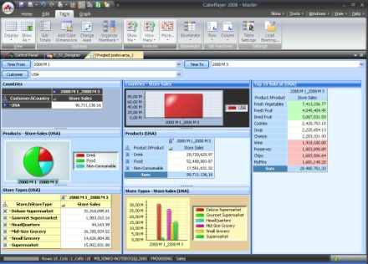
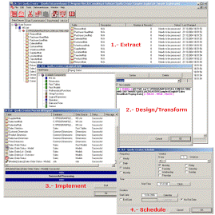

Clinical Data Use: Point of Care and Beyond
Clinical Decision Support
Intelligently Filtered Patient Information
Alarms & Alerts
Interventions
Point of Care Application Use
Non Point of Care Inquiry
Encounter Data
Clinical Business Intelligence
Pre-care
Health Summary
Post-Care
Retrospective
Predictive
Point of Care
Clinical Applications
Clinical
IDS
Clinical
DW
Clinical Transaction Data
Data
Marts
Controlled Medical Vocabularies
Enterprise
DW
Clinical Rules Engines
Operational Reporting
Vendor or Application
Specific Solutions
Other Enterprise
IDS
Other Enterprise
DW
Data Marts
Data Marts
Clinical Devices
Other Clinical Data
Vendor and Application
Neutral Data Environments
Integrated Clinical Reporting
NHSN
Joint Commission
VLER
PHR
Others
NHIN
ETL and Audit, Balance & Control (ABC)
Benchmarks
Data Security & Access Logging
Master Data Management
Other Clinical
Data Sources
Meta Data Management
Enterprise Data Management

Slide 2
Integrated Data Store vs Data Warehouse
An IDS Supplies Cleansed, Integrated Data To Applications and Data Warehouses
Integrated Data Store
(IDS)
Data Warehouse
(DW)
Fed from transactional and other source data systems.
Subject areas cleansed and integrated
No derivations, duplication or summaries
Limited time capture
Keys and Links (integrates) data
Relational and normalized
Insulation from source system changes
Can feed other applications directly that do not need history
Summary
Aggregated and Derived data
Redundancy
History (for analytics)
Linked data
Keyed data
Dimensional and de-normalized
Easy access for reports and statistical analysis
May be integrated with other enterprise data trusts

