Slide 1
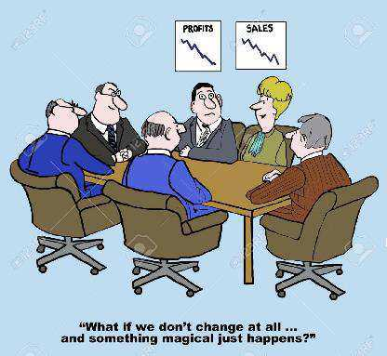
Managing Change
DoD Clinical Informatics Fellowship
COL Neris Nieves-Robbins
MAJ Chris Weissman
Bob Marshall, MD MPH MISM

Slide 2
Learning Objectives
Review the different models for Change Management
Recognize the 3 phases of the Change Management Process (Hiatt’s model)
List the steps needed to prepare for change implementation
Discuss the similarities between change management and process improvement
Identify organizational competencies for managing change
Provide exercise in planning for a new EHR

Slide 3
Definitions
Change Management versus Managing Change…what’s the difference?
BLUF: Not much
Change Management implies a prospective situation – i.e., you can plan for it in advance of the change occurring
Managing Change does not imply the ability to plan in advance for the change (though it can) – in this case, you may be managing a change that was implemented without advanced warning – this sets a whole new set of challenges in successfully making the change work for everyone
Managing change/change management increases the probability of successful change within the organization

Slide 4
Change Models
Lewin’s 3-step model (the original CM model)
Kotter’s 8-step model
Bullock and Batten’s 4-phase model
Lippitt’s 7-phase model
Lukas’ Healthcare Systems transformational change model
Hiatt’s “People Side” model and the Prosci Learning Institute

Slide 5
LeWin’s 3-Step Model 1 of 2
Lewin’s 3-step model provides a general explanation of how organizational change is actualized
Three step sequence of change: unfreezing, moving, and refreezing
Stage 1 - Unfreezing
destabilizing the status quo, creating buy-in for change and ensuring that organizational members appreciate the need for change

Slide 6
LeWin’s 3-Step Model 2 of 2
Stage 2 - Moving
identify what needs to be changed, then develop an implementation strategy that will resonate with the change targets
Stage 3 – Refreezing
must occur to stabilize the group at a new quasi-stationary equilibrium
change must be initiated as a group activity to ensure group norms and routines are accommodating to new individual behaviors

Slide 8
John Kotter’s 8-Step Model
Establish sense of urgency
Create guiding coalition
Develop vision and strategy
Communicate the change vision
Empower employees for broad-based action
Generate short-term wins
Consolidate gains and produce more change
Anchor new approaches in the culture

Slide 9
Lukas’ Model for Healthcare Systems
Impetus to transform
Leadership commitment to quality
Improvement initiatives that actively engage staff in meaningful problem solving
Alignment to achieve consistency of organization-wide goals with resource allocation and actions at all levels of the organization
Integration to bridge traditional intra-organizational boundaries between individual components

Slide 10
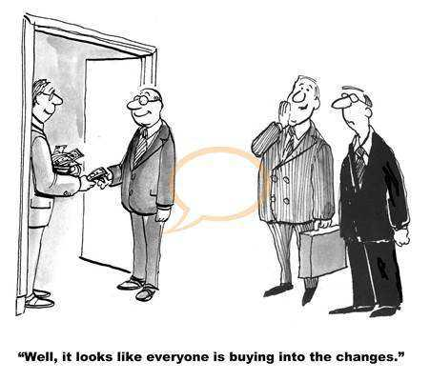

Slide 11
The People Side of Change
Jeffrey M. Hiatt and Timothy J. Creasy
ISBN number: 978-1930885615

Slide 12
Hiatt’s “People Side” Model - Intro
There are two ways to view change management: Organizational and Individual.
Organizational change is from the top-down
Individual change is driven from the bottom-up
The two most common mistakes made are:
Believing change management is someone else’s job
Ignoring the people side of change until major resistance stalls a project or causes the project to fail

Slide 13
3 Phases of Organizational Change Management
Phase 1 – Preparing for Change/Getting Ready
Phase 2 – Managing Change
Phase 3 – Reinforcing Change

Slide 14
Phase 1 – Preparing for Change
Includes activities to determine the best strategies for change
Change management team assesses the following:
The scope of the change
The readiness of the organization for change
Acquiring project resources and the strengths of the change management team
Who the sponsors will be, as well as how the sponsors will effectively begin to lead the change process

Slide 15
Phase 2 – Managing Change
Design the organizational change management plans and individual change management activities
These include:
Communication Plans
Coaching Plans
Training Plans
Sponsor Roadmaps
Resistance Management Plans
This phase includes executing the plans and implementing the change into the organization

Slide 16
Phase 3 – Reinforcing Change
After implementing changes using change management activities, this phase assesses the results, celebrates successes, and conducts “after-action” interviews
This includes transferring ownership of the change from the change management team to the organization, which helps the change be fully adopted throughout the organization

Slide 17
Connecting Change Management to Process Improvement Methodologies
All process/quality improvement methods and approaches use change management and integrate PI/QI strategies with change management activities
Blending the two processes can create a seamless integration to assist with the needs of the business
If change management is started late, the result will feel more like damage control or “firefighting”
It is in these situations where change management is more commonly used to fix current problems and prevent future difficulties
PI/QI efforts are more difficult to implement if change management is not utilized early on in the process

Slide 18
PI/QI and Change Management Alignment
Problem or Opportunity Identification
Project Planning and Team Formation
Data Gathering and Business Solution Design
Process and System Development
Implementation and Measurement
Organization and Change Assessments
Team Readiness and Sponsor Preparation
Awareness Building, Communications and Training
Coaching, Feedback and Employee Involvement
Resistance Management

Slide 19
Organizational Change Competencies
Change management planning and strategies
Change management team structures
Change management roles
Organizational change management methodologies
Executive sponsorship strategies
Communication planning and delivery
Training and educational programs
Incentive and recognition programs
Notes:
As an organization faces continual changes over time, sponsors and owners begin to adapt previously successful models, and managers develop skills to successfully and easily implement change management techniques throughout the organization.
When an organization develops the skills and knowledge to react to constant change, and can be ready
to embrace change, it has developed change competency. “It is the organization’s ability to
react to change over and over again,” not just one specific activity.
When change competency is incorporated into the everyday culture and lifestyle of the organization, it becomes
part of the day-to-day operations at every level. A major aspect in achieving change competency is front-line employees needing to understand “how they can succeed and perform in a constantly changing world”

Slide 20
Managers’ Roles During Times of Change
Communicate with your people about this change
Demonstrate your support for the change
Coach your people through the change process
Engage with and provide support to the Sponsor and the team who are developing this change
Actively identify and manage resistance (and leave the “hammer” at home)

Slide 21
Group Exercise

Slide 22
Scenario
You are going to be implementing a new EHR in 6 months
You are a Department Head
You want to ensure that your department can implement and utilize the new EHR to provide efficient, high quality care for your patients
In your group, discuss how you would approach the phase allocated to your group number – Phases 1-3
You have 10-15 minutes to discuss and lay out some planning points
There will be 2-minute summaries at the end

Slide 23
3 Phases of Organizational Change Management
Phase 1 – Preparing for Change/Getting Ready
Scope of change; organizational readiness; acquiring project resources; assessing team strength; who are the sponsors; how will the sponsors lead the change
Phase 2 – Managing Change
Communication Plans, Coaching Plans, Training Plans, Sponsor Roadmaps, and Resistance Management Plans
Phase 3 – Reinforcing Change
Assess results; celebrate successes; conduct after-action interviews; transferring ownership from the change management team to the organization

Slide 24
Group Activity Review

Slide 25

Questions/Wrap-up

