Slide 1
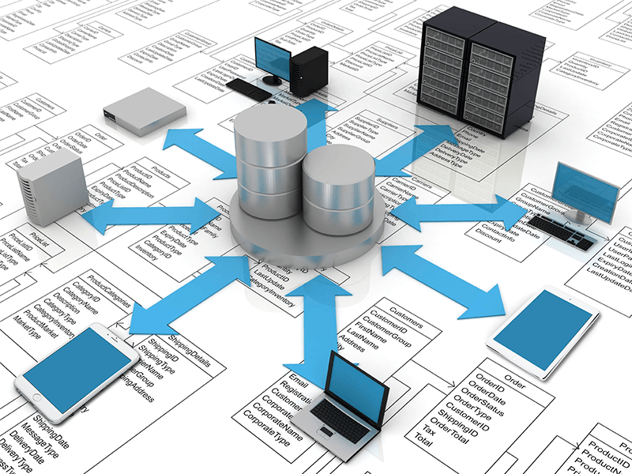
Database 101
Keith Solveson
Madigan Informatics

Slide 2
What is a Database?
A database is an organized set of information
It usually consists of schemas, tables, indexes, views, stored procedures, functions, jobs, and other objects.
It may support user applications, major production systems, business intelligence products (reports, dashboards and analytics), and ad-hoc query tools
There are many types of databases:
Relational vs. Non-relational
Normal vs. Flat vs. Other
Distributed vs. Self-Contained
Operational vs. Analytic
Other database types

Slide 3
Primary Database Objects
A database’s schema is the formal structure supported by the database management system (DBMS). Of primary interest are the database tables and the constraints within and between them.
A table is a collection of related data held in a structured format; usually with a specified number of columns and an unspecified number of rows. Each row should be identified with a primary key.
Constraints support the maintenance of entity and referential integrity. The most common constraint types are check and foreign key.
An index improves the speed of data retrieval at the cost of additional writes and storage space.
A view is the result of a stored query. Also known as a virtual table.
Stored procedures and user-defined functions are subroutines. A trigger is a subroutine that executes when a specific event occurs.
A job is a subroutine that executes on schedule, or when pre-defined conditions arise.

Slide 4
Relational Tables
Each table represents a single type of entity
Keys connect the tables
Primary keys
Foreign keys

Slide 5
Non-Relational databases
Most databases are relational
Recent growth in NoSQL databases that store data in non-relational models
Developed to support “Big-Data” tools. Often very fast, do not require fixed table schemas, avoid joins by storing de-normalized data, and can scale/distribute horizontally.
Popular NoSQL systems include MongoDB, Couchbase, Riak, Memcached, Redis, CouchDB, Hazelcast, Apache Cassandra, and HBase. All are open-sourced.
But, according to the CAP theorem, it is impossible for a distributed system to simultaneously provide consistency, availability, and partition tolerance guarantees.

Slide 6
Normal vs. Flat
Normalization
The process of organizing columns (fields) and tables in a relational database to reduce data redundancy and improve data integrity
Normal
Normal
Flat

Slide 7
Database Architectures
One tier, self-contained, may be a single file
Microsoft Access, SQLite
Two tier, vertically distributed
usually Server and either a client or web server/browser
Oracle, SQL Server, MySQL, DB2, PostgreSQL
N tier
Custom built, may involve multiple databases, or databases connected to middleware business logic
PCMH Huddle tool (RKC DB, then PCMH DB, then Microsoft ClickOnce as a thin client)

Slide 8
Our Major Systems
CHCS
Terminal Client
S3 Web Client
Cold Fusion
Essentris
CCI Client
Madigan Hosted Systems
CHCS Hosts
[Rest of DOD]
CHCS Hosts
[Rest of DOD]
CHCS Hosts
[Rest of DOD]
CHCS Host
Cache
S3
SQL Server
Essentris
LISP
GDR
Oracle
Local (42, 212)
SQL Servers
RKCs
SQL Server
RKCs
SQL Server
RKCs
SQL Server
SSRS (Reports)
SQL Server
PCMH Huddle
Click-Once Client
Rainbow Pages
Web Client, ASPX
CHART & NURSES
Web Client, ASPX

Slide 9
Operational vs. Analytic
Operational systems are designed to support online transaction processing (OLTP) whereas data warehouse systems are designed to support online analytical processing (OLAP)

Slide 10
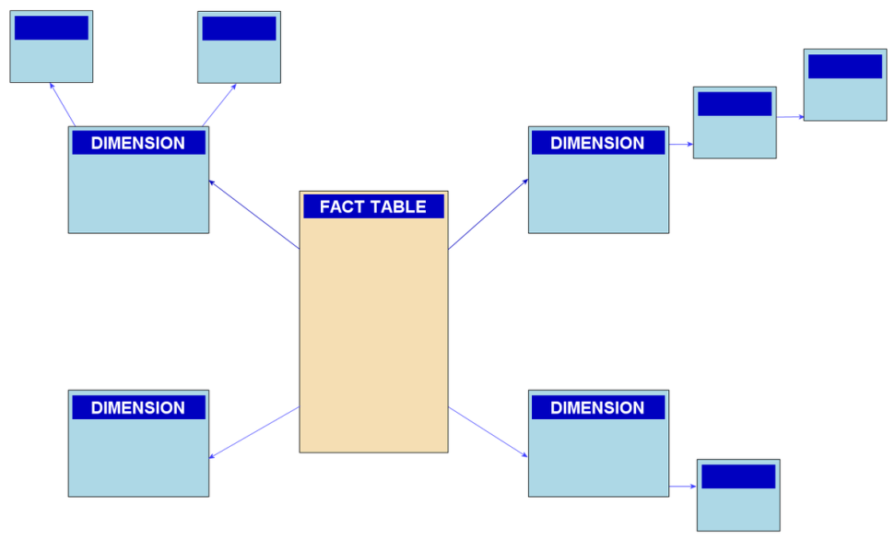
Facts and Dimensions
Data warehouses often use special “Facts and Dimensions” schemas
The fact table holds transaction data, sometimes aggregated.
Dimension tables are potential aggregating entities of interest, usually categorical except for dates
Snowflake schema:
dimensions are normalized into multiple related tables
Star schema:
dimensions are de-normalized with each dimension in a single table

Slide 11
Other Database Types
Operational Data Store
An operational data store (ODS) is a database designed to integrate data from multiple sources or schemas for subsequent processing. Unlike a master (primary) database, its data is rarely passed back to an operational system or client. It may be passed for further operations (ETL) and to the data warehouse.
Data Lakes
A data lake is a storage repository that holds vast amounts of raw data, possibly from many source systems, in its native format until needed. While a data warehouse stores data in pre-defined schemas, a data lake uses a flat architecture.
Data Marts
A data mart is a subset of a data warehouse, usually oriented to a specific business line. Whereas data warehouses have an enterprise-wide depth (EDW), data marts usually pertain to a single department.

Slide 12
Common Database products
Ad Hoc
A query that is produced as the need arises. Often created via command line or GUI interface (SSMS is our current query tool, Business Objects will be the Genesis GUI client.)
Report
A pre-defined query that is routinely processed. The data is usually exported to and presented via third-party SW. (SSRS currently, Business Objects for Genesis)
Dashboard
A multi-part data product, often with end-user selectable parameters and drill thru options. (Same tools as for reports)
Analytic Product
A data product that is created to answer non-trivial questions. Data is often gather from a database and then exported to and analyzed in a subsequent platform, e.g., Excel, SASS, Power BI, Tableau, etc.

Slide 13
SQL, the language of databases
SQL: the Structured Query Language
Pronounced either S-Q-L or Sequel.
Is largely a declarative language (vs. procedural)
Based on E. F. Codd’s 1970 relational model
Made an ANSI standard in 1986. Current ANSI model is 2011
Despite standards, most SQL code is not portable between platforms without adjustments. E.g., SQL Server code will not run natively on Oracle

Slide 14
SQL Statements
DDL: Data definition language. Define structure
CREATE, ALTER, RENAME, DROP, and TRUNCATE
DML: Data manipulation language. Maintain data
INSERT, UPDATE, DELETE, and sometimes SELECT
DCL: Data control language. Control access
GRANT, REVOKE
From this point on, we will study the Microsoft SQL Server language

Slide 15
Create Tables
CREATE TABLE [dbo].[Houses](
[ID] [float] Not NULL,
[Name] [nvarchar](255) Not NULL,
[Founder] [nvarchar](255) NULL,
[Head] [nvarchar](255) NULL,
CONSTRAINT house_pk PRIMARY KEY (ID)
)
CREATE TABLE [dbo].[Patients](
[ID] [float] Not NULL,
[PATIENT_IEN] [float] Not NULL,
[Status] [nvarchar](255) NULL,
[First_Name] [nvarchar](255) NULL,
[Last_Name] [nvarchar](255) NULL,
[Sex] [nvarchar](255) NULL,
[House_ID] [float] NULL,
[PCM_LOC] [nvarchar](255) NULL,
[pcm] [nvarchar](255) NULL,
CONSTRAINT patient_pk PRIMARY KEY (PATIENT_IEN),
CONSTRAINT pt_house_fk FOREIGN KEY (House_ID) REFERENCES dbo.Houses (ID)
)

Slide 16
Fill Tables
One can use Extract, Transform, and Load (ETL) tools to load data, or explicit SQL as follows:
INSERT INTO tablename (column1, column2, …) VALUES (value1, value2, …);
INSERT INTO houses (ID, Name, Founder, Head)
VALUES(1, 'Gryffindor', 'Godric Gryffindor', 'Minerva McGonagall')
INSERT INTO houses (ID, Name, Founder, Head)
VALUES(2, 'Hufflepuff', 'Helga Hufflepuff', 'Pomona Sprout')
INSERT INTO houses (ID, Name, Founder, Head)
VALUES(3, 'Ravenclaw', 'Rowena Ravenclaw', 'Filius Flitwick ')
INSERT INTO houses (ID, Name, Founder, Head)
VALUES(4, 'Slytherin', 'Salazar Slytherin', 'Severus Snape')

Slide 17
Query Data
Use the SELECT statement to query data
Most commonly used SQL statement (90%)
Has no persistent effect on the database
Describes the data set to be returned, leaving the DBMS to plan, optimize, and produce the data set

Slide 18
Simple Queries
-- Simple Query
select *
from dbo.Patients
-- With field list,
-- WHERE & ORDER BY clauses,
-- table alias
select
p.PATIENT_IEN,
p.First_Name,
p.Last_Name,
p.pcm
from Patients p
where p.Status = 'Student'
and p.Sex = 'M'
order by p.Last_Name

Slide 19
JOINS
A Join combines fields from one or more tables
Cross join: Returns the Cartesian product of both tables
Inner join: Returns rows present in both tables
Outer join, Left, Right, or Full
Left [or Right]: Returns all rows in the Left [or Right] table, plus matching rows from the other table
Full: Returns all rows from both tables, plus matching rows from the other table
Inner and Left Outer joins are used 99% of the time

Slide 20
Inner Join
-- Inner Join
-- Column Alias
select
p.First_Name,
p.Last_Name,
h.Name House_Name,
h.Head House_Head
from Patients p
inner join Houses h
on p.House_ID = h.ID
order by p.Last_Name

Slide 21
Outer Join
-- Outer Join
-- Alternate whitespace
select
p.First_Name,
p.Last_Name,
h.Name House_Name,
h.Head House_Head
from Patients p
left outer join Houses h
on p.House_ID = h.ID
order by
p.Last_Name,
p.First_Name

Slide 22
Grouping and Aggregation
One can collate rows into groups and summarize those groups in various ways, ultimately returning just one row per group.
This is done via the GROUP BY and HAVING clauses, and aggregate functions.
The most common aggregate functions are: avg(), count(), max(), min(), and sum().

Slide 23
Single Table Group
-- Simple Group
select
p.Sex,
p.Status,
count(*) n_pts
from Patients p
group by
p.Sex,
p.Status

Slide 24
Two Table Group
-- Multiple Table Group
select
h.Name House_Name,
p.Sex,
count(*) n_pts
from Patients p
inner join Houses h
on p.House_ID = h.ID
group by
h.Name,
p.Sex
order by
h.Name,
p.Sex

Slide 25
Three Table Group
-- Multiple Table Group
select
h.Name House_Name,
p.Sex,
count(*) n_appts
from Patients p
left outer join Houses h
on p.House_ID = h.ID
left outer join Appointments a
on p.PATIENT_IEN = a.PATIENT_IEN
group by
h.Name,
p.Sex
order by
h.Name,
p.Sex

Slide 26
Simple Analysis: T-Test (Status)
-- Appts by Status
select
p.Status,
p.First_Name,
count(a.CLINIC) nbr_appts
from Appointments a
join Patients p
on a.PATIENT_IEN = p.PATIENT_IEN
group by
p.Status,
p.First_Name
order by
p.Status

Slide 27
Simple Analysis: T-Test (Sex)
-- Appts by Sex
select
p.Sex,
p.First_Name,
count(a.CLINIC) nbr_appts
from Appointments a
join Patients p
on a.PATIENT_IEN = p.PATIENT_IEN
group by
p.Sex,
p.First_Name
order by
p.Sex

Slide 28
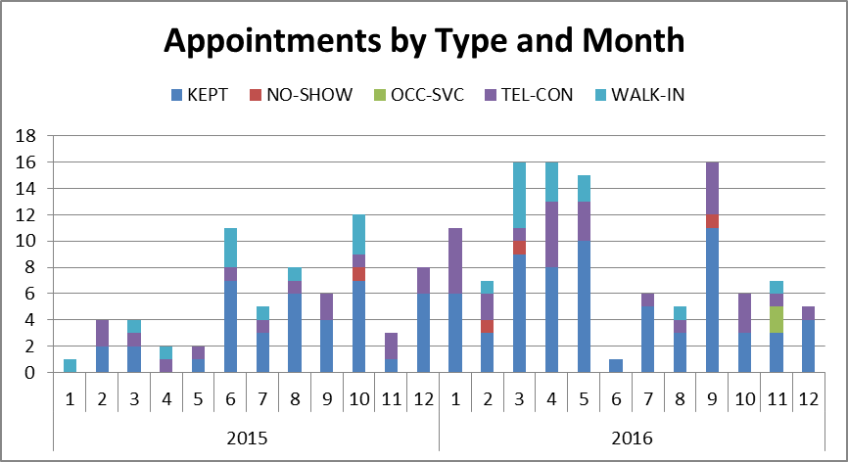
Simple Analysis: Temporal Trends
-- Temporal Query
---- Subqueries
WITH
aa as ( -- Transform Appts
select
year(a.APPT_DATE_TIME) yyyy,
month(a.APPT_DATE_TIME) mm,
a.APPT_STATUS
from Appointments a
where a.APPT_STATUS not in
('ADMIN', 'CANCEL')
)
-- Group by Query
select
yyyy,
mm,
APPT_STATUS,
count(*) n_appts
from aa
group by
yyyy,
mm,
APPT_STATUS

Slide 29
Summary
Databases are critical to any modern EHR
Most databases are relational and can be queried by SQL
SQL queries can extend the capability of existing database schemas
SQL itself can only perform basic analysis
SQL results (datasets) are often exported to other SW packages for presentation to end users as reports, dashboards, or analytic products
Questions???

