Slide 1
Evaluation
& Management
Coding
Presented by:
Hailey Trapier, CPC
Jessica Acosta, CMB
Outpatient Coding Team
Department of Pediatrics

Slide 2
Overview
Evaluation & Management
Problem Oriented E&M Visits
  Key Components for the correct E&M level
  New vs. Established
  Coding by time
Preventive Medicine Visits
  Physicals, Well checks
  Preventive Medicine visits with E&M
Prolonged Services
  Direct and Non-Direct
Modifier 25
Late Entries
GME Coding Guidance
Telephone Consults

Slide 3
Evaluation & Management
Objectives
Learn documentation and medical necessity requirements for E&M levels
Understand different types of E&M codes
Understand key component requirements for E&M leveling

Slide 4
General principals of documentation
Evaluation & Management
Complete and Legible
Reason for encounter and relevant history
Physical examination
Prior diagnostic test results
Assessment, clinical impression or diagnosis
Plan of care
Date and legible identity of observer
Ensures continuity of care

Slide 5
New vs. Established Patient
Evaluation & Management
  New Patient
    Patient has not seen a provider within same specialty within the last 3 years.
  Established Patient
Per MHS Guidelines:
  A new patient is one who has not received any professional services from the privileged provider or another privileged provider of the exact same specialty and subspecialty who belongs to the same group practice in the previous three years.

Slide 6
Principles of Documentation for
Problem Oriented E&M leveling
Problem Oriented E&M Visits
3 Key Components
  History
    Chief Complaint
    History of Present Illness (HPI)
    Review of Systems (ROS)
    Past Medical/Surgical, Family and Social History (PFSH)
  Physical Exam
  Medical Decision Making
    Number of Problems
    Amount and/or Complexity of Data
    Risk of Complications and/or Morbidity or Mortality Before Next Encounter
      *New Patient Visits require all 3 key components
      *Established Patient Visits require 2 of 3 key components
        (MDM) must be 1 of the key components

Slide 7
Problem Oriented Visits
Problem Oriented E&M Visits
Involves a chief complaint or present illness
  New or Established
New Patient: Requires 3 of the 3 Key Components
Code | History* | Exam* | Med. Dec. Making* | Presenting problem | Typical Time (mins) | Work RVU
99201 | Prob. Focused | Prob. Focused | Straight Fwd. | Self-limited/minor | 10 | 0.48
99202 | Exp. Prob. Focus | Exp. Prob. Focus | Straight fwd. | Low-mod. Sever. | 20 | 0.93
99203 | Detailed | Detailed | Low complexity | Mod. Severity | 30 | 1.42
99204 | Comprehensive | Comprehensive | Mod. Complexity | Mod-high sever. | 45 | 2.43
99205 | Comprehensive | Comprehensive | High complexity | High severity | 60 | 3.17
Established Patient: Requires 2 of the 3 Key Components
Code | History* | Exam* | Med. Dec. Making* | Presenting Problem | Typical Time (mins) | Work RVU
99212 | Prob. Focused | Prob. Focused | Straight Fwd. | Self-limiting/minor | 10 | 0.48
99213 | Exp. Prob. Focus | Exp. Prob. Focus | Low complexity | Low-mod. Sever. | 15 | 0.97
99214 | Detailed | Detailed | Mod. Complexity | Mod-high sever. | 25 | 1.50
99215 | Comprehensive | Comprehensive | High complexity | Mod-high sever. | 40 | 2.11

Slide 8
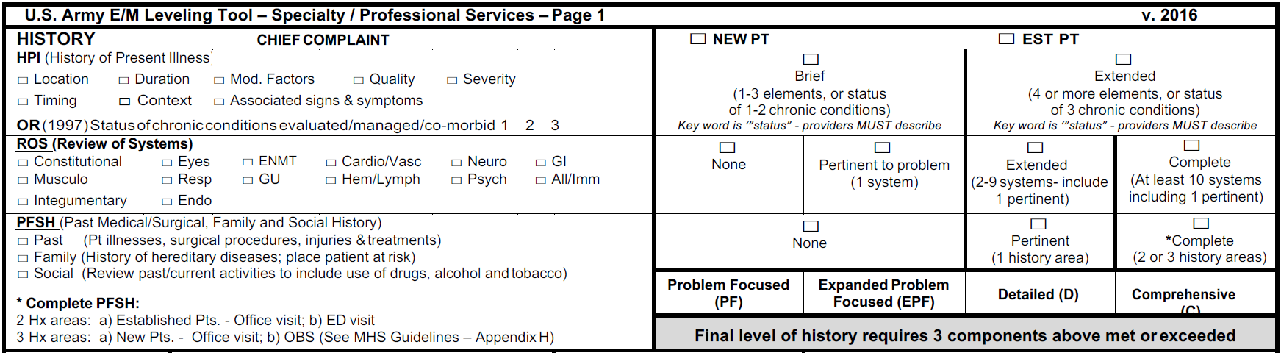
History
Problem Oriented E&M Visits

Slide 9
History
Problem Oriented E&M Visits
Chief Complaint
History of Present Illness (HPI)
Review of Systems (ROS)
Past Medical/Surgical, Family and Social History (PFSH)
History of Present Illness (HPI) | Brief | Brief | Extended | Extended
Review of Systems (ROS) | None | Problem Pertinent (1 system) | Extended (2-9 systems, including 1 pertinent) | Complete (At least 10 systems including 1 pertinent)
Past, Family, and/or Social History (PFSH) | None | None | Pertinent (1 history area) | Complete (2 or 3 history areas)
Level of History | Problem Focused | Expanded Problem Focused | Detailed | Comprehensive
*To qualify for a given type of history –
ALL THREE ELEMENTS IN THE TABLE MUST BE MET OR EXCEEDED*

Slide 10
HPI Elements
Problem Oriented E&M Visits
ELEMENT | DEFINITIONS | EXAMPLE
Location | Place or where on the body is patient experiencing sign/symptom | Pain in groin
Quality | Description identifying the type of sign/symptom | Burning pain in groin
Severity | Degree of sign/symptom, often by using a self-assessment scale to measure subjective level | History of mild burning pain in groin, becoming more intense
Duration | Length of time the patient has been experiencing the sign/symptom | History of mild burning pain in groin becoming more intense for last two weeks
Timing | Regulation of occurrence, when the patient experiences the sign/symptom | History of intermittent mild burning pain in groin becoming more intense and frequent for the last two weeks
Context | Circumstances of where the patient is or what the patient is doing when sign/symptom is experienced | History of intermittent mild burning pain in groin becoming more intense and frequent for the last two weeks since bent down to pick up child and continues to feel pain when bending
Modifying Factors | Altering elements, conditions that change or alter the sign/symptom | History of intermittent mild burning pain in groin becoming more intense and frequent for the last two weeks since bent down to pick up child and continues to feel pain when bending, currently taking Motrin without relief
Associated Signs and symptoms | What other signs/symptoms does the patient have | Nausea with vomiting; pain in arm, shoulder or leg
***Who can document HPI?
The nurses CAN document in the HPI if they do not sign their name/initials.
Provider MUST take over the S/O note.
Providers can NOT state, "I agree with above" in the HPI section or "I agree with nursing notes above." They must take over the nursing statements in the HPI and they can choose to leave it, add on, edit it, etc.

Slide 11
Review of Systems (ROS)
Problem Oriented E&M Visits
Constitutional
Eyes
ENMT
Cardiovascular
Respiratory
Gastrointestinal
Genitourinary
Musculoskeletal
Skin
Neurological
Psychiatric
Endocrine
Hematologic/Lymphatic
Allergic/Immunologic
*ROS TIPS*
ROS documentation doesn’t have to be located under a heading “ROS”. It can be pulled from the HPI dictation.
For example:
“Patient presents for nausea, and fever. Patient denies chest pain, shortness of breath, wheezing, and vomiting”
All ROS negative statement –
Must list at least one system, then include statement of remainder of a complete(or ALL )ROS negative.

Slide 12
Past, Family, Social, History (PFSH)
Problem Oriented E&M Visits
Past history
  illnesses, operations, injuries, allergies, and medications
Family history
  Family medical history. Including diseases which may be hereditary or place the patient at risk
Social history
  Student, work, siblings, who they live with, use of tobacco etc...
*PFSH TIP*
Allergies can be counted towards Past History or ROS
Per DOD Guideline:
Autocite information will not be considered when determining the appropriate ICD-CM, E&M, and/or Procedure code to be assigned to the encounter, unless pertinent findings are acknowledged within the body of the providers’ notes

Slide 13
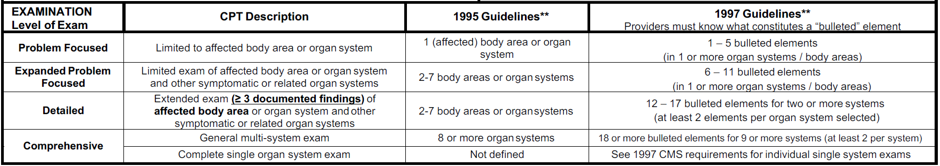
Physical Exam
Problem Oriented E&M Visits

Slide 14
1995 Exam Guidelines
Problem Oriented E&M Visits
Exam component is required for new patients
Problem Focused – limited exam of the affected body area / organ system
  1 System
Expanded Problem Focused – limited exam of affected body area / organ system and other symptomatic or related organ system(s)
  2-7 Systems
Detailed – extended exam of affected body area(s) and other symptomatic or related organ system(s)
  2-7 Systems
Comprehensive – a general multi-system exam
  8 or more Systems
Body areas:
  Head, including face
  Neck
  Chest, including breast & axillae
  Abdomen
  Genitalia, groin, buttocks
  Back, including spine
  Each extremity
  **Can’t double dip between body areas or organ systems. One or the other**
Organ systems
  Constitutional
  Eyes
  ENMT
  Cardiovascular
  GI
  GU
  Musculoskeletal
  Skin
  Neurologic
  Psychiatric
  Hematologic/ Lymphatic/ Immunologic

Slide 15
Medical Decision Making (MDM)
Problem Oriented E&M Visits
A common error in E&M leveling is to assign a self-limited or minor problem as a new problem, creating a tendency to overvalue the level of medical decision making and increasing the risk of over coding.
Problem Definitions:
Self-Limited/Minor problem: A problem that runs a definite and prescribed course, is transient in nature, and is not likely to permanently alter health status OR has a good prognosis with management/compliance.
  Upper Respiratory Infection, Conjunctivitis, Runny nose, Cough, Rash
Established Problem: A problem/condition previously evaluated and managed
(provider must describe status of problem-­ stable, worsening, uncontrolled, improved, resolving, failing, etc.)
New Problem: A problem/condition NOT previously evaluated and managed
(encourage providers to describe )
DOD Guidelines
DoD requires the utilization of medical decision making as a mandatory component of an established patient E&M assignment.
The provider may choose between History or Physical Exam for the second component to determine the E&M code assignment for the encounter for Established Patients.

Slide 16
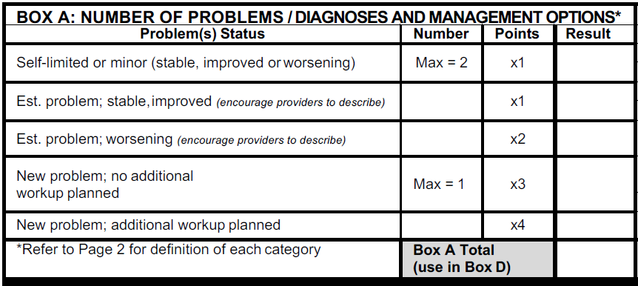
Medical Decision Making
Problem Oriented E&M Visits
Number of Problems –
  New vs. Established
  Stable vs. Worsening
  Additional workup vs. No Additional Workup

Slide 17
Medical Decision Making
Problem Oriented E&M Visits
Number of Problems
Amount and/or Complexity of Data
Risk of Complications and/or
Morbidity or Mortality Before Next Encounter
Number of problems or management options | Minimal | Limited | Multiple | Extensive
Amount and/or complexity of data to be reviewed | Minimal or None | Limited | Multiple | Extensive
Risk of complications and/or morbidity or mortality | Minimal | Low | Moderate | High
Level of Medical Decision Making | Straightforward | Low Complexity | Moderate Complexity | High Complexity
2 OF 3 REQUIRED

Slide 18
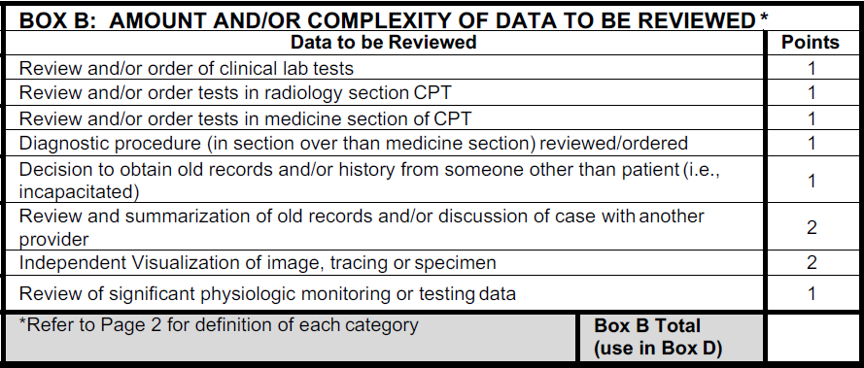
Medical Decision Making
Problem Oriented E&M Visits
Amount and/or Complexity of Data to be Reviewed
  Reviewed and/or ordered

Slide 19
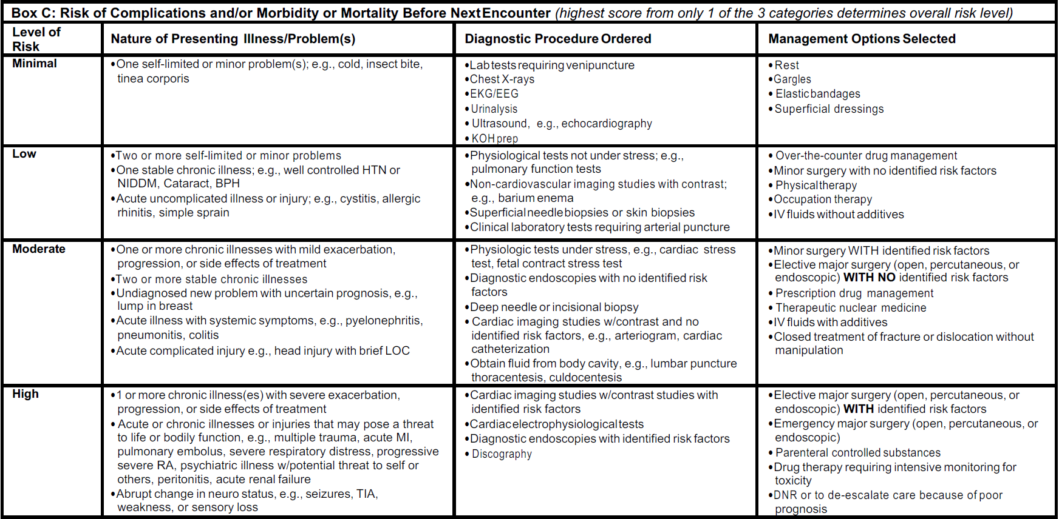
Medical Decision Making
Problem Oriented E&M Visits
Risk of Complications and/or Morbidity or Mortality BEFORE NEXT ENCOUNTER

Slide 20
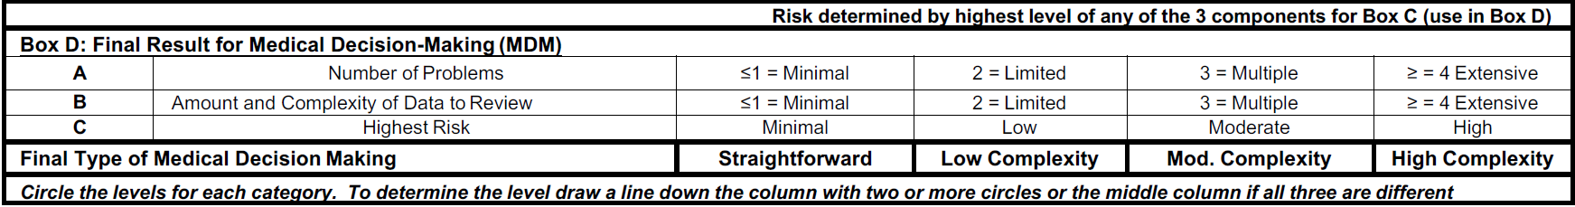
Medical Decision Making
Problem Oriented E&M Visits
2 OF 3 REQUIRED

Slide 21
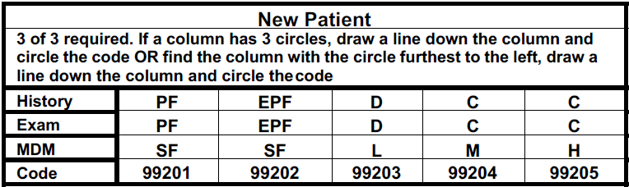
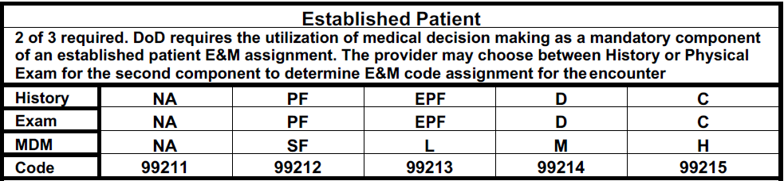
New Patient vs Established Patient
Problem Oriented E&M Visits

Slide 22
*MDM TIPS*
Problem Oriented E&M Visits
In the A/P section: Don’t make a limited/minor problem a bigger one!
  YOUR summarization of the patient’s problems and YOUR medical interpretation of these issues. You MUST comment on the status of the condition!! If a diagnosis is listed with no status, then no credit is given in MDM for that diagnosis.
The diagnoses MUST be supported by the HPI, ROS, and PE.
Data Order/Review
  1 point for labs and/or 1 point for radiology
  2 points for discussing case with another provider
  2 points for Independently viewing a image, tracing or specimen
Plan of Care
  Even if patient refused POC, credit for MDM is given if documented

Slide 23
Coding for time
Problem Oriented E&M Visits
Time frames in E&M code descriptions represent a general range of time that vary depending on actual clinical circumstances.
  Simply clicking the ‘box’ on the AHLTA disposition module does not do anything.
Time is the determining factor when counseling or coordination of care consumes more than 50% of the time a provider spends face-to-face with the patient, the family, or both.
MHS Rule 4.2.3.4-
Time is not a dominant factor for assigning the appropriate E&M code in most scenarios.
Documentation such as “counseled on condition, diagnosis, or treatment alternatives” is not acceptable documentation in and of itself.

Slide 24
Coding for time
Problem Oriented E&M Visits
Detailed documentation must indicate specifics on the counseling or coordination of care, discussion of why the additional time was necessary, what occurred during the additional time, and how much time was spent.
Coding for time requires documenting 3 critical pieces of information-
  1. The total face to face time spent with the patient**
  2. That more than 50% of the face to face time with the patient/family was spent in counseling and/or coordination of care.
  3. A detailed description or summary of the counseling/coordination of care provided. (Needs to be individualized per patient, per visit)
  Example: “45 mins spent with patient and father. Of this time, greater than 25 mins was spent counseling patients Father and coordinating care as it relates to asthma and in particular, the current and potential future medical regimen for managing asthma.”

Slide 25
Time Requirements
Problem Oriented E&M Visits
New Patient:
Code | Typical Time (minutes)
99201 | 10
99202 | 20
99203 | 30
99204 | 45
99205 | 60
Established Patient:
Code | Typical Time (minutes)
99212 | 10
99213 | 15
99214 | 25
99215 | 40
  If the time is in between two levels, it always goes to the lower level.

Slide 26
Prolonged Services
Coding for time
Example Verbiage:
*Established patient:
20 minutes have been spent with the patient more than 50% of the face to face time was spent in counseling on proper supportive treatment (fluids, cool-mist humidifier) and the difference between bacterial and viral illnesses.
Supports a 99213
*New patient:
40 min spent f-to-f of which greater than 20 min was spent counseling on back care, strengthening exercises, reasons to return to the clinic, showed patient exercises and asked for repeat demonstration, educated on medications and importance of compliance.
Supports a 99205

Slide 27
Preventive Medicine Visits
Preventive Medicine Visits
Routine physicals and well child checks
  Patient Age
  New or Established
Preventive Medicine Services; New Patient
Code | Age Range | Work RVU
99381 | Infant, younger than 1 year of age | 1.50
99382 | Early childhood, age 1-4 years | 1.60
99383 | Late childhood, age 5-11 years | 1.70
99384 | Adolescent, age 12-17 years | 2.0
99385 | 18-39 years | 1.92
99386 | 40-64 years | 2.33
99387 | 65 years of age and older | 2.50
Preventive Medicine Services; Established patient
Code | Age Range | Work RVU
99391 | Infant, younger than 1 year of age | 1.37
99392 | Early childhood, age 1-4 years | 1.50
99393 | Late childhood, age 5-11 years | 1.50
99394 | Adolescent, age 12-17 years | 1.70
99395 | 18-39 years | 1.75
99396 | 40-64 years | 1.90
99397 | 65 years of age and older | 2.0
**TIME BASED CODING DOESN’T APPLY**

Slide 28
Preventative Visits with E&M
Preventive Medicine
visits with E&M
If an abnormality or a preexisting problem is addressed in the process of the Preventive E&M, and if the problem or abnormality is significant enough to require additional work-up, then the appropriate problem-oriented E&M--99201-5, 99212-5 (with -25) should be reported.
  Documentation must support both services.
  Work performed for the Preventive service does not count toward the E&M service.
    A separate HPI describing the patient’s complaint supports additional work in the history. If a portion of the exam performed is not routine for a preventive service, identify that portion.
Sequencing:
1: Preventive E&M (99384–7, 99394–7)
2: Problem-oriented E&M (99201-5, 99212-5)
You must append modifier -25 to the problem-oriented E&M (e.g., 99212-25).

Slide 29
Preventative with E&M TIPS
Preventive Medicine
visits with E&M
Can’t use time based coding!
Must be for significant problem or issue that requires further work-up.
  Consults, labs, rads etc…
Prescribing a prescription or over the counter medicine isn’t always enough to justify further work-up.

Slide 30
Prolonged Services-Non Direct
Prolonged Services
99358 – Prolonged E&M service before and/or after direct patient care; first hour
+99359 – Prolonged E&M service before and/or after direct patient care; each additional 30 minutes (List separately in addition to code for prolonged service)
*Must document actual time spent in minutes*
*Specifically document why prolonged time was necessary*
Total Duration of Prolonged Services w/o direct patient contact | Code(s)
Less than 30 minutes | Not reported separately
30-74 minutes (30 minutes - 1 hr. 14 min.) | 99358 X 1
75-104 minutes (1 hr. 15 min. - 1 hr. 44 min.) | 99358 X 1 AND 99359 X 1
105 or more (1 hr. 45 min. or more) | 99358 X 1 AND 99359 X 2 (1 hr. 45 min. or more) or more for each additional 30 mins

Slide 31
Prolonged Services-Non Direct
Prolonged Services
Example Verbiage:
An additional 30 minutes of non-direct patient care time was spent reviewing the medical record from multiple hospital admissions and coordinating care with the Case Manager and subspecialists.

Slide 32
Prolonged Services-Direct
Prolonged Services
Typical time for a Level 5 Visit is generally maxed out,
when using a Direct Prolonged Service code.
99215-Established patient-40 minutes 99205-New patient-60 minutes
99354 - Prolonged E & M or psychotherapy service(s) (beyond the typical service time of the primary procedure) requiring direct patient contact beyond the usual service; first hour (List in addition to E & M or psychotherapy service)
+99355 - Prolonged E & M or psychotherapy service(s) (beyond the typical service time of the primary procedure) requiring direct patient contact beyond the usual service; each additional 30 minutes (List in addition to 99354)
*Must document total time spent face-to-face with patient*
Total Duration of Prolonged Services with direct patient contact | Code(s)
Less than 30 minutes | Not reported separately
30-74 minutes (30 minutes - 1 hr. 14 min.) | 99354 X 1
75-104 minutes (1 hr. 15 min. - 1 hr. 44 min.) | 99354 X 1 AND 99355 X 1
105 or more (1 hr. 45 min. or more) | 99354 X 1 AND 99355 X 2 (1 hr. 45 min. or more) or more for each additional 30 mins

Slide 33
Prolonged Services-Direct
Prolonged Services
Example Verbiage:
*Established patient:
70 mins spent with patient and father. Of this time, greater than 35 mins were spent counseling patients’ Father and coordinating care as it relates to asthma and in particular, the current and potential future medical regimen for managing asthma.
Supports a 99215 and 99354
*New patient:
Greater than 50% of 90 minute visit spent in counseling/discussing follow-up plan, parent being an advocate, stooling patterns, diet and behavior.
Supports a 99205 and 99354

Slide 34
Usage of Modifier 25
Modifier 25
Impacts reimbursement ◦ Use on an E/M code ONLY
No RVU difference ◦ Informational Modifier
Anytime a Problem Oriented E&M service and a procedure/service identified by a CPT code was performed at the same encounter, there should be a Modifier 25 attached to the Problem Oriented E&M code.
Signals to Insurance Companies that you should get paid for your office visit in addition to the procedure that was done at the same appointment.
Example: Patient presents with pharyngitis and a Rapid Strep test (87880) was done in addition to a Problem Oriented E&M service.
E&M service: 99212-25
Rapid Strep: 87880
*NOTE: This scenario is different from a walk-in Rapid Strep Test

Slide 35
Late Entries
Late Entries
Don’t confuse this with the 72 hour note completion policy-
A late entry is delayed Electronic Health Record documentation, recorded subsequent to the original date of encounter.
  Includes amendments to encounters.
  If the documentation is started on a date other than the original date of encounter, the provider needs to state when the patient was seen.
Examples:
“Late entry: Patient was seen on 25SEP2017.”
“Patient was seen on 25SEP2017”
Per MHS Rule 2.1.5.2

Slide 36
Graduate Medical Education (GME) Coding Guidance
GME Encounters
All care provided to patients by residents or fellows in approved graduate medical education programs will be supervised by a licensed Supervising Staff Provider with unrestricted privileges.
For coding purposes, mid-level provider may act in the role of a Supervising Provider over a resident in encounters involving non-Evaluation and Management (E&M) special procedures (i.e., anesthesia, OB procedures) when credentialed and within their scope of practice.

Slide 37
Three levels of Supervision
GME Encounters
Direct Supervision. Also known as personal supervision, the teaching physician is physically present for the key and critical portions of the service/encounter as determined by the teaching physician.
  Physically Present - The teaching physician is located in the same room (or partitioned or curtained area, if the room is subdivided to accommodate multiple patients) as the patient and/or performs a face-to-face service.
Indirect Supervision. The teaching physician is not physically present during the service/encounter, but is immediately available to provide assistance to the resident.
Oversight Supervision. The teaching physician is not physically present or immediately available during the service/encounter, and reviews the resident’s documentation and plan of care for the patient.

Slide 38
General Rules for E&M Services in GME Encounters
GME Encounters
Medical Students- All clinical students may perform and document during an encounter; however, the attending physician or the supervising senior resident appointed by the Program Director must re-perform and re-document all E&M components [except review of systems (ROS) and family history], and be the primary provider listed on the encounter. Student documentation of an HPI, exam, or assessment/plan may not be counted in determining the E&M level.
Fellows- For fellowship programs, Fellows with an unrestricted medical license may assign the full range of E&M codes for encounters without the presence of the teaching physician, so long as the Fellowship GME requirements are met, and the teaching physician reviews the care provided by the resident during or immediately after each visit. This review must include a review of the patient’s medical history, the resident’s findings on physical examination, the patient’s diagnosis, and treatment plan, documenting the extent of his/her own participation in the review and direction of the services furnished to the patient. The teaching physician is listed as the supervising provider in these encounters.
Time Based Codes- For any E&M codes determined on the basis of time, the teaching physician must be present for the period of time documented. For example, a code that specifically describes a service of from 20 to 30 minutes is acceptable only if the teaching physician is physically present for 20 to 30 minutes.

Slide 39
GME Encounters
Teaching Attestations
Teaching Physician Attestations- For E&M services, documentation of supervision by means of an attestation must be entered into the medical record by the teaching physician. The teaching physician will document an attestation in the encounter demonstrating their review of the patient’s medical history, the resident’s findings on physical examination, the patient’s diagnosis, and treatment plan, documenting the extent of his/her own participation in the review and direction of the services furnished to the patient.
  Documentation by the resident alone of the presence and participation of the teaching physician is not sufficient to establish the presence and participation of the teaching physician. The combined entries into the medical record by the teaching physician and the resident constitute the documentation for the service and together must support the coding of the service.
Minimum acceptable attestation for level of supervision:
  Direct Supervision: "I/Dr. 'X' saw the patient with the resident and agree with the resident's findings and plan.“
  Indirect Supervision: "I/Dr. 'X' was immediately available to assist the resident in the care of the patient, and have/has reviewed and agreed with the resident's findings and plan of care.”
  Oversight Supervision: "I/Dr.'X' reviewed the documentation of care provided by the resident and agreed with the resident's findings and plan of care.“
Unacceptable attestations for level of supervision:
  “Agree with above”, followed by legible countersignature or identity;
  “Rounded, Reviewed, Agree”, followed by legible countersignature or identity;
  “Discussed with resident. Agree”, followed by legible countersignature or identity;
  “Seen and agree”, followed by legible countersignature or identity;

Slide 40
GME Encounters
Teaching Physician Modifiers
For GME encounters, one of the following modifiers must be added to all of the CPT codes and E&M codes:
Modifier GC: For use where the teaching physician was physically present during the key and critical portions of the service.
Modifier GE: For use in outpatient clinics/emergency departments (EDs) where the teaching physician provided indirect or oversight supervision.

Slide 41
GME Encounters
E&M coding limitations for Residents
Licensed Residents:
  Can code 99201 – 99205 / 99211 – 99215 for outpatient clinic visits when supported by an attestation showing direct, indirect, or oversight supervision by a teaching physician.
Unlicensed Residents:
  Can code 99204-99205 / 99214-99215 for outpatient clinic visits when supported by an attestation showing direct teaching physician supervision.
  Can code 99201- 99203 / 99211 – 99213 for outpatient clinic visits when supported by an attestation showing indirect or oversight supervision.
Primary Care Exception (PCE) Rule

Slide 42
Telephone/Online Encounters
REQUIREMENTS
In order to code for a T-Con or Relay Health Encounter with any CPT code other than a 99499, there are specific requirements.
Most patient interactions are not able to be coded.
Interaction must be patient initiated
The patient must be an established patient
Can’t be related to a visit from the previous 7 days or lead up to an appointment in the next 24 hours
Minimum of 5 minutes of conversation documented (PHONE TIME)
Documentation must contain evidence of medical decision making

Slide 43
Telephone/Online Encounters
Credit is given to whom ever makes contact and gives advice. Encounter should be done under that provider.
Providers cannot simply sign off on the T-con encounter when the Nurse makes the contact with patient.
If a Nurse/Tech transfers to a Provider:
The Provider MUST review and change the E&M code and ensure that there is NO CPT code.
If a Provider transfers to a Nurse/Tech:
The Nurse/Tech MUST review and change the E&M code to 99499 and code the appropriate CPT code, if applicable.
TIME MUST BE DOCUMENTED

Slide 44
Telephone/Online Encounters
DIAGNOSIS CODES
Diagnosis codes:
      Providers can use full range of diagnosis codes
      Nurses can code diagnosis codes if the diagnosis was established by a provider.
        Most of the Z codes can be used, but should be used based off of the
        reason for the t-con:
        Most T-cons fit within these codes:
        Z76.0-Encounter for issue of repeat prescription
        Z71.2-Person consulting for explanation of examination or test findings (laboratory , radiology results etc..)
        Z02.7-Encounter for issue of medical certificate (paperwork)
        Z71.9-Counseling, unspecified
        Z02.89-Encounter for other administrative examination
          *TIP: Add them to your favorites

Slide 45
PROVIDER T-CON
PROVIDER T-CON
Patient Initiated:
  Provider responds to patient, contact made:
  T-Con under Providers name
  Telephone E&M service provided by a privileged provider to an established patient, parent, or guardian not originating from a related E&M service provided within the previous 7 days nor leading to an E&M service or procedure within the next 24 hours or next available appointment;
      99441- (Total RVU 0.38): 5-10 minutes of medical discussion
      99442- (Total RVU 0.73): 11-20 minutes of medical discussion
      99443- (Total RVU 1.08): 21-30 minutes of medical discussion
      Amount of time must be documented. Medical Decision Making must be done and documented.
      99444- (Total RVU 0.88): Online Evaluation & Management
        For Relay Health/E-mail copy & paste the patient message(s) and your response(s) into the T-CON.

Slide 46
NURSE T-CON
NURSE T-CON
Patient Initiated:
  Nurse/technician responds to patient, contact made:
  T-Con under Nurse/technician name with provider being the supervising provider.
    Nurse T-cons REQUIRE a SUPERVISING PROVIDER.
    Nurse T-cons E&M code should ALWAYS be 99499.
    Telephone assessment and management service provided by a qualified non-physician health care professional to an established patient, parent, or guardian not originating from a related assessment and management service provided within the previous 7 days nor leading to an assessment and management service or procedure within the next 24 hours or soonest available appointment;
      98966- (Total RVU 0.00): 5-10 minutes of medical discussion
      98967- (Total RVU 0.00): 11-20 minutes of medical discussion
      98968- (Total RVU 0.00): 21-30 minutes of medical discussion
      Amount of time must be documented, including details related to the medical discussion.
      98969- (Total RVU 0.00): Online assessment & Management
        For Relay Health copy & paste the patient message(s) and your response(s) to the T-CON.
CPT Codes

Slide 47
Telephone/Online Encounters
Provider/Non-privileged provider initiated calls:
      99499- (RVU 0.00): E&M code
          If returning a patients call, documentation must have:
          1: Date the patient called 2: Returning the patients call/message
        ……then follow coding example for a Patient Initiated T-con.
90 % of T-cons
should be 99499

Slide 48
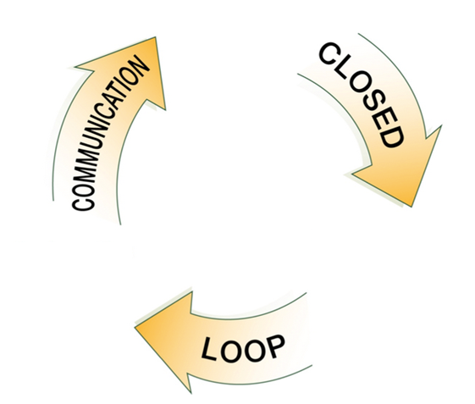
PROVIDER T-CON
PROVIDERS:
You will receive T-cons to acknowledge what is going on with the patient after the nurse has talked to the patient/parent.
Close the loop when you transfer the T-con back to the nurse.
Example statement: Transferring t-con back to nurse for closure.
***SELECT 99499***

Slide 49
NURSE T-CON
NURSES:
You will send T-cons to the providers for them to acknowledge what is going on with the patient after you have talked to the patient/parent.
Close the loop- Request for them to send the T-con back to you after they’ve acknowledged the T-con.
Example statement:
Please transfer back to me for T-con closure unless you call the patient as well.

Slide 50
References
Evaluation & Management
MHS Coding Guidelines , Version 5.0
CMS Evaluation and Management Services Guide
Evaluation and Management Official 1997 Guidelines
Centers for Medicare and Medicaid Services, http://www.cms.gov/

Slide 51
Questions?
Evaluation & Management
Dept. of Pediatrics Coding Team
Hailey Trapier, CPC 968-6285
Jessica Acosta, CMB 968-6458

