Slide 1
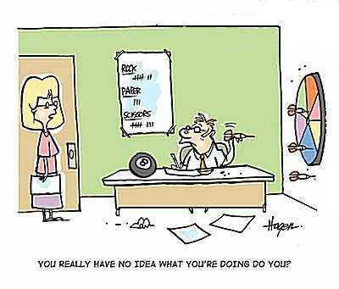
Decision Science – Part 1
Bob Marshall, MD MPH MISM FAAFP

Slide 2
Learning Objectives
Provide Background
Review Decision Analysis
Provide some definitions
Review Probability Theory
Discuss Utility & Preference
Review Preference Assessments

Slide 3
Some Background
Decision-making is one of the hard things in life
True decision-making occurs not when you already know exactly what to do, but when you do not know what to do
When you have to balance conflicting values, sort through complex situations, and deal with real uncertainty, you have reached the point of true decision-making
And to make things more difficult, the most important decisions in corporate or personal life are often those that put you in situations where you least know what to do
Decision science evolved to cope with this problem of what to do

Slide 4
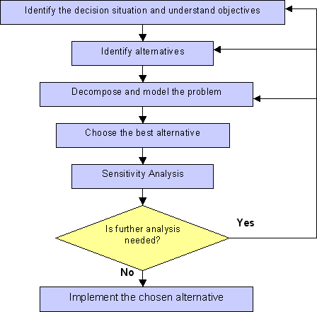
Decision theory is derived from economics by using the utility function of payoffs. It suggests that decisions be made by computing the utility and probability, the ranges of options, and also lays down strategies for good decisions

Slide 5
Decision Analysis
The discipline comprising the philosophy, theory, methodology and professional practice necessary to address important decisions in a formal manner
Decision analysis includes many procedures, methods and tools for:
Identifying, clearly representing and formally assessing important aspects of a decision,
For prescribing a recommended course of action by applying the maximum expected utility action axiom to a well-formed representation of the decision, and
For translating the formal representation of a decision and its corresponding recommendation into insight for the decision maker and other stakeholders.

Slide 6
Decision Analysis
Graphical representation of decision analysis problems commonly use influence diagrams and decision trees
Such tools are used to represent the alternatives available to the decision maker, the uncertainty they involve, and evaluation measures representing how well objectives would be achieved in the final outcome
Uncertainties are represented through probabilities
The decision maker's attitude to risk is represented by utility functions, and their attitude to trade-offs between conflicting objectives can be expressed using multi-attribute value functions or multi-attribute utility functions (if there is risk involved)

Slide 7
Decision Analysis….cont
In some cases, utility functions can be replaced by the probability of achieving uncertain aspiration levels
Decision analysis advocates choosing that decision whose consequences have the maximum expected utility (or which maximize the probability of achieving the uncertain aspiration level)

Slide 8
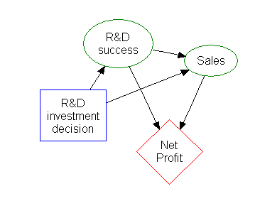
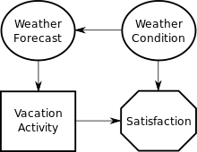
Influence Diagram

Slide 9
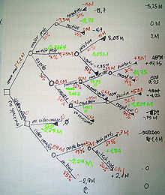
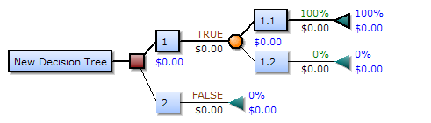
Decision Tree

Slide 10
Some Useful Definitions
Utility - measure of preferences over some set of goods (including services: something that satisfies human wants); it represents satisfaction experienced by the consumer of a good
Uncertainty - situation which involves imperfect and/or unknown information
Probability - measure of the likelihood that an event will occur
Goal/Objective - desired result or outcome that a person or a system envisions, plans and commits to achieve

Slide 11
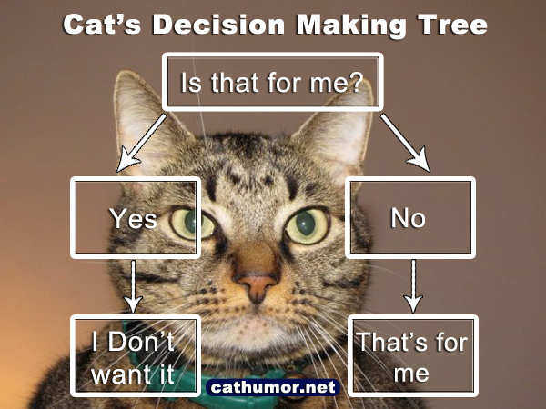

Slide 12
Probability Theory
A branch of mathematics concerned with the analysis of random phenomena
The outcome of a random event cannot be determined before it occurs, but it may be any one of several possible outcomes
The fundamental ingredient of probability theory is an experiment that can be repeated, at least hypothetically, under essentially identical conditions and that may lead to different outcomes on different trials
The set of all possible outcomes of an experiment is called a “sample space.”

Slide 13
Probability Theory…..cont
As a mathematical foundation for statistics, probability theory is essential to many human activities that involve quantitative analysis of large sets of data
The probability of an event is defined to be the ratio of the number of cases favorable to the event—i.e., the number of outcomes in the subset of the sample space defining the event—to the total number of cases
Discrete probability theory deals with events that occur in countable sample spaces
Continuous probability theory deals with events that occur in a continuous sample space

Slide 14
Probability Theory…..cont
The measure-theoretic treatment of probability unifies the discrete and the continuous cases, and makes the difference a question of which measure is used. It covers distributions that are neither discrete nor continuous nor mixtures of the two
Since it links theoretically derived probabilities to their actual frequency of occurrence in the real world, the law of large numbers is considered a pillar in statistical theory
The more often a fair coin is tossed, the more likely it should be that the ratio of the number of heads to the number of tails will approach unity
The central limit theorem states that the average of many independent and identically distributed random variables with finite variance tends towards a normal distribution irrespective of the distribution followed by the original random variables

Slide 15
Utility & Preference Assessment
In economics, utility is a measure of preferences over some set of goods (including services
An important underpinning of rational choice theory in economics and game theory
Since one cannot directly measure benefit, satisfaction or happiness from a good or service, economists instead have devised ways of representing and measuring utility in terms of measurable economic choices
Preference is the ordering of alternatives based on their relative utility, a process which results in an optimal "choice"

Slide 16
Utility
Utility is usually applied by economists in such constructs as the indifference curve, which plot the combination of commodities that an individual or a society would accept to maintain a given level of satisfaction
Individual utility and social utility can be construed as the value of a utility function and a social welfare function respectively
In finance, utility is applied to generate an individual's price for an asset called the indifference price
It was recognized that utility could not be measured or observed directly, so instead economists devised a way to infer underlying relative utilities from observed choice…called revealed preference

Slide 17
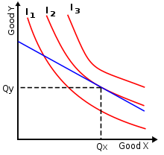

Indifference Curves
Three indifference curves where Goods X and Y are perfect substitutes. The gray line perpendicular to all curves indicates the curves are mutually parallel.
To maximize utility, a household should consume at (Qx, Qy). Assuming it does, a full demand schedule can be deduced as the price of one good fluctuates

Slide 18
Utility Functions
Utility functions express utility as a function of the amounts of the various goods consumed
They are treated as either cardinal or ordinal, depending on whether they are or are not interpreted as providing more information than simply the rank ordering of preferences over bundles of goods, such as information on the strength of preferences
When cardinal utility is used, the magnitude of utility differences is treated as an ethically or behaviorally significant quantity
When ordinal utilities are used, differences in utils (values taken on by the utility function) are treated as ethically or behaviorally meaningless

Slide 19
Preference Assessment
Preference assessments directly evaluate items that may serve as reinforcers
Designed to determine hierarchies under the specific set of circumstances in which they are conducted
Can be used to determine preference hierarchies from a limited group of items
The character of the individual preferences is determined purely by taste factors, independent of considerations of prices, income, or availability of goods

Slide 20
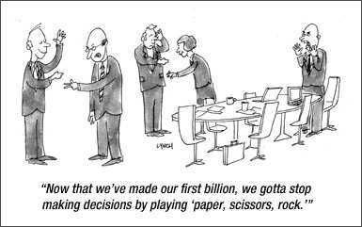
Questions

