Slide 1

Decision Analysis – Part 2
Bob Marshall, MD MPH MISM FAAFP
Program Director, DoD Clinical Informatics Fellowship

Slide 2
Learning Objectives
Cost Effectiveness Analysis - Define and Overview
Cost Utility Analysis
Some examples
CEA Criticisms
Comparative Effectiveness Research - Definition and Overview
CER steps
CER and PPACA
CER in the U.S.
CER Examples

Slide 3
Cost Effectiveness Analysis
Definitions
Examination of the cost and the outcomes of the alternative means of accomplishing an objective, in order to select the one with the highest effectiveness relative to its cost
Cost-effectiveness analysis (CEA) is an alternative to cost-benefit analysis (CBA). The technique compares the relative costs to the outcomes (effects) of two or more courses of action.
Most commonly used in health and defense policy/analysis

Slide 4
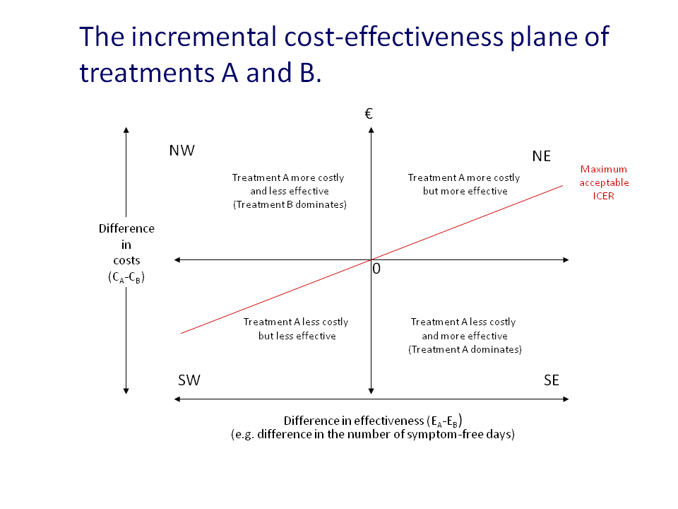

Slide 5
CEA Overview
CEA is most useful when analysts face constraints which prevent them from conducting cost-benefit analysis. The most common constraint is the inability of analysts to monetize benefits.
CEA is commonly used in healthcare, for example, where it is difficult to put a value on outcomes, but where outcomes themselves can be counted and compared, e.g. ‘the number of lives saved’.
CEA measures costs in a common monetary value and the effectiveness of an option in terms of physical units. These cannot be added or subtracted to obtain a single criterion measure. One can only compute the ratio of costs to effectiveness in the following ways:
CE ratio = C1/E1
EC ratio = E1/C1
where: C1 = the cost of option 1 (in $); and E1 = the effectiveness of option 1 (in physical units).
The first equation above represents the cost per unit of effectiveness (e.g. $s spent per life saved). The second equation is the effectiveness per unit of cost (e.g. lives saved per $ spent). Projects should be ranked from highest to lowest EC ratios.

Slide 6
CEA Overview…..cont
Typically the CEA is expressed in terms of a ratio where the denominator is a gain in health from a measure (years of life, premature births averted, sight-years gained) and the numerator is the cost associated with the health gain.
The most commonly used outcome measure is quality-adjusted life years (QALY).
Cost-utility analysis is similar to cost effectiveness analysis.
Cost-effectiveness analyses are often visualized on a plane consisting of four-quadrants, the cost represented on the x–axis and the effectiveness on the y– axis.
Cost-effectiveness analysis focuses on maximizing the average level of an outcome

Slide 7
CEA Overview…..cont
Unlike more standard forms of CBA, CEA bypasses three constraints:
It does not require all costs and benefits to be put into monetary terms.
It acknowledges that a measure may not represent all of the benefit that is accrued.
It may be analyzing intermediate goods (outcomes may not be clear)
Two forms of ratio can be expressed:
Cost-Effectiveness Ratio: dividing costs of an alternative by the measure of effectiveness.
Effectiveness-Cost Ratio: dividing effectiveness measured by costs of alternative

Slide 8
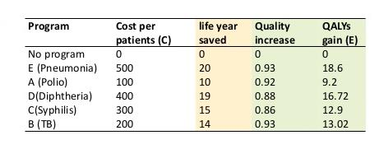
CEA - Example

Slide 9
CEA in Pharmacoeconomics
In the context of pharmacoeconomics, the cost-effectiveness of a therapeutic or preventive intervention is the ratio of the cost of the intervention to a relevant measure of its effect.
Cost refers to the resource expended for the intervention, usually measured in monetary terms such as dollars or pounds.
The measure of effects depends on the intervention being considered.
Examples include the number of people cured of a disease, the mm Hg reduction in diastolic blood pressure and the number of symptom-free days experienced by a patient.
The selection of the appropriate effect measure should be based on clinical judgment in the context of the intervention being considered.

Slide 10
Cost-Utility Analysis
A special case of CEA is cost–utility analysis, where the effects are measured in terms of years of full health lived, using a measure such as quality-adjusted life years or disability-adjusted life years.
Cost-effectiveness is typically expressed as an incremental cost-effectiveness ratio (ICER), the ratio of change in costs to the change in effects.

Slide 11
A Couple of Examples
A 1995 study of the cost-effectiveness of over 500 lifesaving medical interventions found that the median cost per intervention was $42,000 per life-year saved.
A 2006 systematic review found that industry-funded studies often concluded with cost effective ratios below $20,000 per QALY and low quality studies and those conducted outside the US and EU were less likely to be below this threshold.

Slide 12
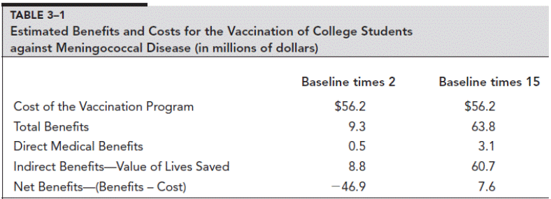

Slide 13
Another Example
Consider a project for which there are four alternatives. The project involves adding a safety barrier to the center reservation of a stretch of a major road. The cost per mile of the barrier differs depending on the quality of the material used. Scheme A uses a reinforced wooded barrier. Scheme B uses iron, C uses steel, and D uses concrete reinforced with steel. The costs and effectiveness in terms of lives saved are shown in the table below
Notes:
Incremental cost-effectiveness ratio can be calculated, as in the table. This calculates the cost effectiveness of each alternative relative to the change in costs and effectiveness compared with the previous, cheaper, alternative. In the above example, it can be seen that the lowest cost associated with an incremental change in effectiveness, that is an additional life saved, is associated with scheme C.
Scheme C costs $5,000 more than Scheme B (and $11,000 more than scheme A), but it results in a further three lives being saved each year compared with scheme B. This gives an incremental cost effectiveness ratio in comparison to scheme B of $1,667.
In this example, the choice of scheme would differ depending on whether a simple cost-effectiveness or incremental cost-effectiveness ratio was calculated.
In the prior case scheme A would be chosen, but this ignores the added effectives, in terms of lives saved, that is achieved by spending additional funds on scheme C

Slide 14
Criticisms of CEA
The key criticism associated with CEA is in the use of a ratio measure.
In CEA the prediction of costs and effectiveness, even more than in other forms of CBA, can result in incorrect outcomes due to the use of a ratio measure.
For this reason sensitivity analysis can be used by the researcher, as with other forms of CBA, to test the distribution of the cost effectiveness ratio relative to the normal distribution.
This is sometimes referred to as a Monte Carlo Analysis

Slide 15


Slide 16
Comparative Effectiveness Research

Slide 17
Definition
Comparative effectiveness research is designed to inform health-care decisions by providing evidence on the effectiveness, benefits, and harms of different treatment options. The evidence is generated from research studies that compare drugs, medical devices, tests, surgeries, or ways to deliver health care
The Institute of Medicine committee has defined CER as “the generation and synthesis of evidence that compares the benefits and harms of alternative methods to prevent, diagnose, treat, and monitor a clinical condition or to improve the delivery of care.”

Slide 18
Finding the Evidence
There are two ways that this evidence is found:
Researchers look at all of the available evidence about the benefits and harms of each choice for different groups of people from existing clinical trials, clinical studies, and other research. These are called research reviews, because they are systematic reviews of existing evidence.
Researchers conduct studies that generate new evidence of effectiveness or comparative effectiveness of a test, treatment, procedure, or health-care service

Slide 19
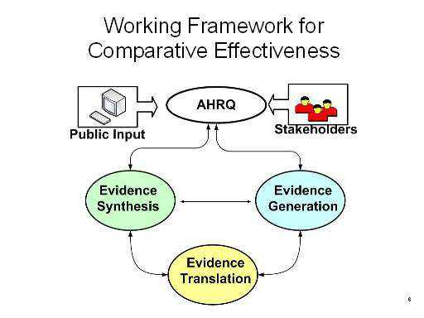

Slide 20
Additional Information
CER requires the development, expansion, and use of a variety of data sources and methods to conduct timely and relevant research and disseminate the results in a form that is quickly usable by clinicians, patients, policymakers, and health plans and other payers.
Comparative effectiveness research adopts many of the same approaches and methodologies as cost-effectiveness analysis, including the use of incremental cost-effectiveness ratios (ICERs) and quality-adjusted life years (QALYs).
An important component of CER is the concept of pragmatic randomized controlled trials.
These clinical research trials measure the benefit produced by the treatment in routine clinical practice.

Slide 21
The Seven Steps of CER
1. Identify new and emerging clinical interventions.
2. Review and synthesize current medical research.
3. Identify gaps between existing medical research and the needs of clinical practice.
4. Promote and generate new scientific evidence and analytic tools.
5. Train and develop clinical researchers.
6. Translate and disseminate research findings to diverse stakeholders.
7. Reach out to stakeholders via a citizens forum.

Slide 22
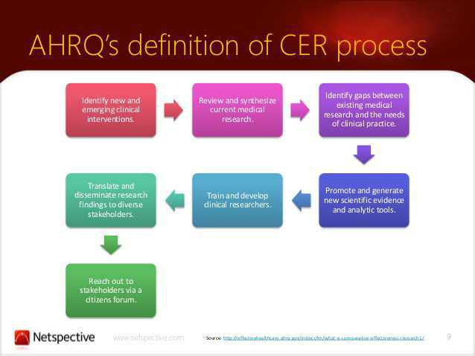

Slide 23
CER and PPACA
The Patient-Centered Outcomes Research Institute (PCORI) was established to conduct comparative effectiveness research, but the Patient Protection and Affordable Care Act (PPACA) prohibits it from using cost per QALY ICER thresholding:
“The Patient-Centered Outcomes Research Institute...shall not develop or employ a dollars per quality adjusted life year (or similar measure that discounts the value of a life because of an individual’s disability) as a threshold to establish what type of health care is cost effective or recommended.”

Slide 24
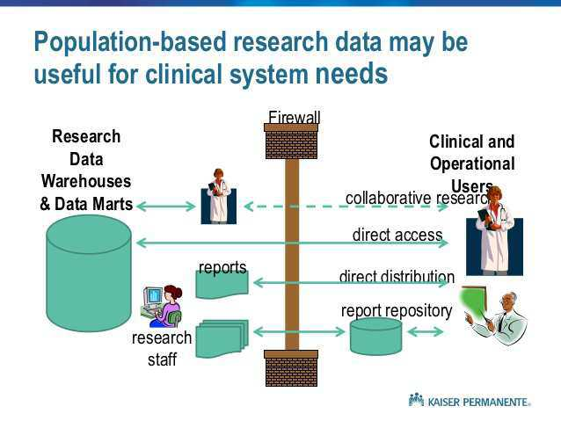

Slide 25
CER in the U.S.
The study of CER is composed of measures that are useful in determining the value of various treatment options.
While each of these measures provides a useful comparison of one treatment option versus another, they require different inputs into their respective calculations, thus the potential for producing conflicting results.
In part, due to these challenges, there remains a widespread lack of understanding on the potential impact of CER in the U.S., and a reluctance to fully adopt the concept as part of our healthcare system.[

Slide 26
Journal of CER
The Journal of Comparative Effectiveness Research provides stakeholders (including patients, clinicians, healthcare purchasers and health policy-makers) with the key data and opinions to make informed and specific decisions on clinical practice.
Coverage includes research and reviews on comparative effectiveness research (CER), patient-centered outcomes research and health economics.
Journal’s website: (http://www.futuremedicine.com/loi/cer

Slide 27
Examples – three abstracts
Comparative effectiveness of outpatient cardiovascular disease and diabetes care delivery between advanced practice providers and physician providers in primary care: Implications for care under the Affordable Care Act.
Comparative Effectiveness of Treatments for Chronic Low Back Pain: A Multiple Treatment Comparison Analysis
Systematic review with meta-analysis: the comparative effectiveness of aspirin vs. screening for colorectal cancer prevention

Slide 28

Questions

